Slide 1
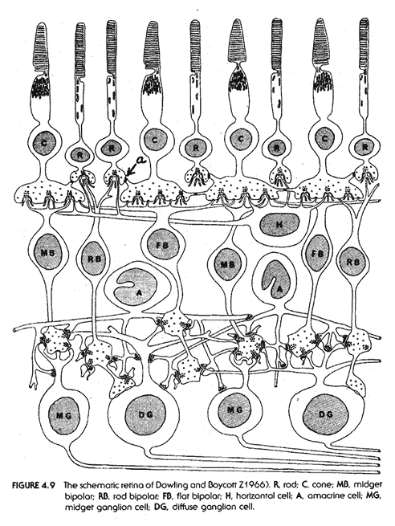
Visual System
https://www.cis.rit.edu

Slide 2
Note
Much of the text material is from, “Principles of Anatomy and Physiology” by Gerald J. Tortora and Bryan Derrickson (2009, 2011, and 2014). I don’t claim authorship. Other sources are noted when they are used.
The lecture slides are mapped to the three editions of the textbook based on the color-coded key below.
14th edition
13th edition
12th edition
Same figure or table reference in all three editions

Slide 3
Outline
Introduction
Nature of light
Basic structure of the eye
Light projection—retina
Visual processing and interpretation

Slide 4
Introduction

Slide 5
Importance of Vision
Vision, which is a critical important for human survival, makes use of many neural resources.
More than 50 percent of the sensory receptors of the human body are located in the eyes.
Large areas of the cerebral cortex process and interpret visual in-formation.
As many as 30 cortical areas are involved in visual processing and interpretation.
Neural = of or relating to a nerve or the nervous system.
Page 579
Page 642
Page 604

Slide 6
Nature of Light

Slide 7
Electromagnetic Radiation
Electromagnetic radiation is energy in the form of particles (photons) and waves that radiate from the sun and other light sources.
The vast range of possible wavelengths is called the electromagnetic spectrum.
The distance between two consecutive wave peaks is the wavelength.
Wavelength is used to calculate frequency that has a unit of measure-ment known as Hertz.
Hertz (Hz) = number of complete cycles per second.
Page 579
Page 642
Page 605
Figure 17.4

Slide 8
Electromagnetic Spectrum
Increasing energy
10⁻⁵ nm
10⁻³ nm
1 nm
10³ nm
10⁶ nm
1 m
10³ m
Wavelength
Electromagnetic
spectrum
Gamma
rays
X-rays
Ultra-
violet
Infrared
Microwaves
Radio waves
380 nm
750 nm
Visible light
Violet Indigo Blue Green Yellow Orange Red
The light we see is a small segment of the electromagnetic spectrum.
Sunlight is 45 percent visible light, 46 percent infrared radiation, and nine percent ultraviolet radiation.

Slide 9
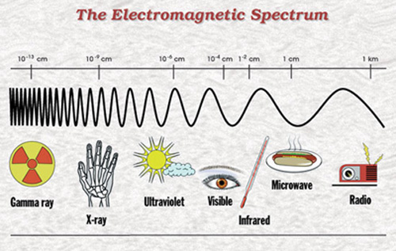
Wavelength
Wavelengths of electromagnetic radiation range from very short to very long:
  Gamma rays are shorter than a nanometer (nm), or billionth of a meter.
  Radio waves exceed one meter.
https://www.nasa.gov
Page 579
Page 642
Page 605
Figure 17.4

Slide 10
Visible Light
Visible light is the part of the electromagnetic spectrum that ranges from about 400 to 700 nm.
Color sensation depends on the wavelength of light and processing by the visual system.
For example, violet is associated with a wavelength of about 400 nm, and red is associated with a wavelength of about 700 nm.
Page 579
Page 642
Page 605
Figure 17.4

Slide 11

Mnemonic
From the longest to the shortest wavelengths of visible light, use the mnemonic ROY G BIV.
  R = red
  O= orange
  Y= yellow
  G = green
  B = blue
  I = indigo
  V = violet
https://www.missouriskies.org

Slide 12
Other Animals
Some animals have different sensitivities in the electromagnetic spec-trum.
Pit vipers, including rattlesnakes, are sensitive to infrared radiation to track warm-blooded animals as prey during the night.
Honeybees are sensitive to ultraviolet radiation to navigate to a nectar source—see the book, “The Dancing Bees” by the German ethologist, Karl von Frisch.
Humans cannot detect infrared and ultraviolet radiation without the use of special instruments.

Slide 13

Absorption and Reflection
Objects absorb some wavelengths and reflect others—an object will appear as the colors of the wavelengths that are reflected from it.
A new pair of blue jeans absorbs all wavelengths of the visible spec-trum except those associated with blue, which are reflected.
An object appears white because it reflects all lengths of visible light.
An object appears black because it absorbs all wavelengths of visible light.
https://www.featuresblogs.chicagotribune.com
Page 579
Page 642
Page 605

Slide 14
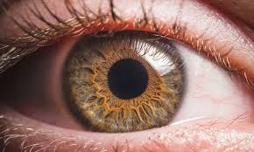
Basic Structure of the Eye

Slide 15
Extrinsic Eye Muscles
The extrinsic eye muscles extend from the walls of the bony orbit to the sclera (white) of the eye.
These muscles are controlled by the oculomotor (III), trochlear (IV), and abducens (VI) cranial nerves.
Page 582
Page 645
Page 606
Figure 17.6

Slide 16
Eye Movements
The six extrinsic eye muscles are capable of moving the eye in almost any direction.
They can move the eyeball laterally (to the side), medially (away from the side), superiorly (up), and inferiorly (down).
Another set, known as the oblique muscles, enable rotational stability of the eye.
Page 582
Page 645
Page 606
Figure 17.6

Slide 17
Motor Units
The motor units of the extrinsic muscle fibers of the eyes are small.
Some motor neurons serve only two or three extrinsic muscle fibers; fewer than in any other part of the body except the larynx (voice box).
The small motor units permit smooth, rapid, and precise movements of the eyes.
Neural circuits in the brainstem, including in the superior colliculi and the cerebellum, coordinate and synchronize eye movements such as when scanning a visual scene or reading a book.
Page 582
Page 645
Page 606

Slide 18
Eyeball
The adult eyeball measures about 2.5 cm (one inch) in diameter.
About one-sixth of the eyeball’s total surface area is exposed, and the rest is protected by the bony orbit.
The eyeball wall has three layers—fibrous tunic, vascular tunic, and retina.
Page 583
Page 646
Page 606
Figure 17.7

Slide 19
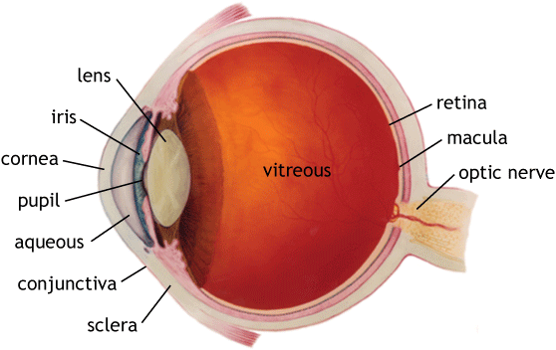
Eyeball (continued)
https://www.blundelloptometry.com

Slide 20
Fibrous Tunic
The fibrous tunic, the superficial layer, consists of the cornea and the sclera.
The cornea is a transparent tissue that covers the iris; it helps focus light on the retina.
The sclera, the white of the eye, is a dense layer of connective tissue consisting mostly of collagen fibers and fibroblasts.
Superficial = outer
Page 583
Page 646
Page 607
Figure 17.7

Slide 21
Fibrous Tunic (continued)
The sclera covers the entire eyeball except for the cornea.
It gives shape to the eyeball, makes it more rigid, protects its inner components, and serves as attachment points for the extrinsic eye muscles.
Page 583
Page 646
Page 607
Figure 17.7

Slide 22
Vascular Tunic
The vascular tunic, the middle layer, consists of the choroid, ciliary body, and iris.
Blood vessels of the choroid provide nutrients to the posterior surface of the retina.
The choroid has melanocytes that produce the pigment melanin, giv-ing it a dark brown color.
Melanin absorbs stray light rays to prevent reflection and scattering of light within the eye and help assure that light projected onto the retina remains sharp and clear.
Page 583
Page 646
Page 608
Figure 17.7

Slide 23
Vascular Tunic—Ciliary Body
The anterior portion of the vascular tunic becomes the ciliary body.
The protrusions and folds on the internal surface of the ciliary body, known as ciliary processes, secrete a fluid known as aqueous humor.
A circular band of smooth muscle fibers, known as the ciliary muscle, changes the lens shape for both near- and far-vision (more about this later in the lecture module).
Page 583
Page 646
Page 609

Slide 24
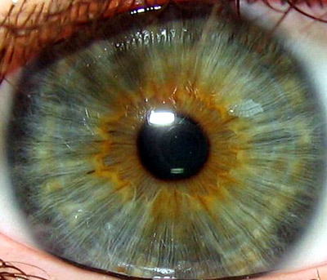
Vascular Tunic—Iris
The colored portion of the eye, the iris, is shaped like a flattened donut.
It is suspended between the cornea and the lens and is attached at its outer margin to the ciliary processes.
The iris contains melanocytes and smooth muscle fibers under control of the sympathetic and parasympathetic divisions.
https://www.army-technology.com
Page 583
Page 646
Page 609

Slide 25
Vascular Tunic—Iris (continued)
The amount of melanin in the melanocytes of the iris determines eye color:
  Brown-to-black color when the concentration of melanin is high.
  Green when the concentration is moderate.
  Blue when the concentration is low.
Page 583
Page 646
Page 609

Slide 26
Pupil
The pupil appears black due to the heavily-pigmented choroid and the retina.
If bright light is directed into the eye, such as with an ophthalmoscope, the reflected light is red due to the blood vessels found on the surface of the retina.
A person’s eyes will appear red in a photograph if the camera flash is directed into the pupil.
Ophthalmoscope = an instrument for examining the interior structures of the eye, especially the retina.
Page 583
Page 646
Page 609

Slide 27
Pupil (continued)
Autonomic reflexes regulate the diameter of the pupil in response to light levels, arousal, and emotional states.
The parasympathetic fibers of the oculomotor (III) cranial nerve stim-ulate the circular muscles to contract, producing pupillary constriction.
Sympathetic fibers stimulate the radial muscles to contract, producing dilation.
Page 583
Page 646
Page 609
Figure 17.8

Slide 28
Retina
The retina, the inner layer, lines the posterior three-quarters of the eyeball.
It serves as the first stage of visual processing by the nervous system.
An ophthalmoscope is used to view the retina, the only place where blood vessels can be viewed directly in the body to detect pathological changes.
Pathological changes of the retina can result from various conditions, most notably hypertension, diabetes mellitus, and age-related macular degeneration.
Pathological = relating to or caused by disease.
Macular degeneration = chronic eye disease marked by deterioration of the tissue responsible for central vision.
Page 584
Page 647
Page 609
Figure 17.9

Slide 29
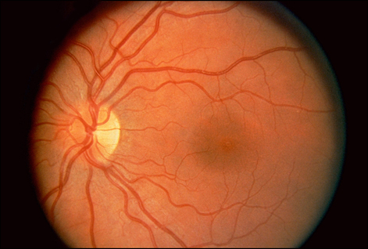
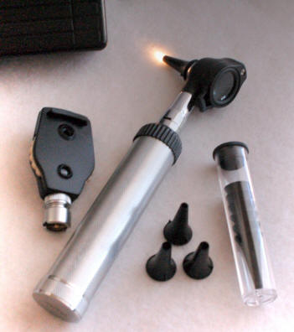
Retina—Visual Appearance
Ophthalmoscope
https://www.jbooy.files.wordpress.com
Retina
https://www.medrninja.files.wordpress.com

Slide 30
Retina—Prominent Features
Several features of the retina are visible through an ophthalmoscope:
  Optic disc, where the optic (II) cranial nerve exits the eye
  Central retinal artery and vein
  Macula lutea and fovea centralis
Branches of the central retinal artery fan-out to nourish the anterior surface of the retina.
The central vein drains blood from the retina through the optic disc.
Macula lutea = the part of the retina that is responsible for sharp, detailed central vision or visual acuity.
(https://www.medlineplus.gov)
Fovea centralis = a small depression where visual acuity is the highest. The fovea itself is the central portion of the macula, which is responsible for central vision.
(https://www.ncbi.nlm.nih.gov)
Page 584
Page 647
Page 609
Figure 17.9

Slide 31
Pigmented Layer
The retina consists of a pigmented layer and a neural layer of photo-receptors and other specialized nerve cells.
The pigmented layer, located between the choroid and neural layer, has epithelial cells that contain melanin.
Melanin in the pigmented layer, just as it does in the choroid, absorbs stray light.
Page 584
Page 647
Page 610
Figure 17.10

Slide 32
Neural Layer
The neural layer of the retina is a multi-layered outgrowth of the brain.
The photoreceptors and neurons in the neural layer begin processing visual information prior to being transmitted via the optic nerve to the thalamus and superior colliculi.
Retinal neurons are organized in sublayers, which are separated by sublayers of synaptic connections between the photoreceptors and neurons.
Page 584
Page 647
Page 610
Figure 17.10

Slide 33
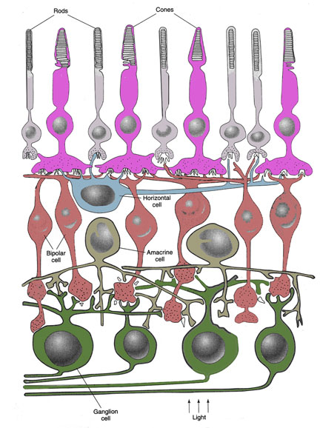
Cross Section of the Retina
Retina of the eye
Photoreceptors
(rods and cones)
Horizontal cell
Outer synaptic layer
Amacrine cells
Bipolar cells
Inner synaptic layer
Ganglion cells
https://www.skidmore.edu
Direction of light

Slide 34
Neural Layer (continued)
The neural layer contains sublayers of photoreceptors, bipolar cells, and ganglion cells.
Visible light passes through the bipolar and ganglion sublayers before it reaches the photoreceptors.
Page 584
Page 647
Page 610
Figure 17.10

Slide 35
Neural Layer (continued)
In addition to bipolar cells, the bipolar sublayer contains horizontal cells and amacrine cells.
These cells have lateral synaptic connections that modify the neural signals transmitted from the photoreceptors to the bipolar cell, and then to the ganglion cells.
This organization, as will be discussed, enables some low-level vis-ual processing to occur in the retina.
Lateral = toward the side (horizontal rather than vertical).
Page 584
Page 647
Page 610
Figure 17.10

Slide 36
Photoreceptors—Rods
Photoreceptors—the rods and cones—begin the process by which visible light is converted to electrical activity for transmission to the brain.
The human eye contains about 120 million rods and six million cones.
Rods enable vision in dim light—they provide sensations of shades of gray, but not of color.
Page 584
Page 647
Page 610
Figure 17.10

Slide 37
Photoreceptors—Cones
The cones, which enable color vision, are active at higher levels of illumination.
The three types of cones are sensitive to wavelengths that we inter-pret as red, green, and blue.
Color vision results from the stimulation of combinations of the three types of cones to produce the full palette of colors that we experience.
Page 584
Page 647
Page 610

Slide 38
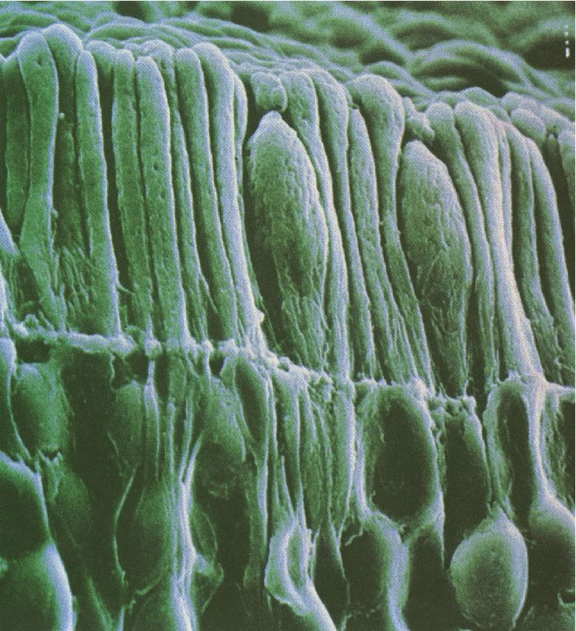
Rods and Cones
https://www.eyedesignbook.com
Electron micrograph of the photoreceptor sublayer of the retina.

Slide 39
Information Flow
From the photoreceptors, visual information in the form of electrical activity flows through an outer synaptic sublayer to the bipolar cells.
The information then flows through the inner synaptic sublayer to the ganglion cells.
The axons of the ganglion cells enter pass through the optic disc and exit as the optic (II) cranial nerve.
Page 584
Page 647
Page 610
Figure 17.10

Slide 40
Blind Spot
The optic disc has no rods or cones—it is slight off-axis so that it is not in the center of the visual field.
We rarely notice this blind spot because our brains generally fill in the information gap with what it expects to “see.”
The blind spot is located slightly off-center from the visual axis so that vision is not severely hindered when a person looks directly at an object.
The textbook has a simple demonstration for finding the blind spot of each eye.
Page 584
Page 647
Page 610
Figure 17.10

Slide 41
Macula Lutea and Fovea Centralis
The macula lutea is at the exact center of the retina and along the visual axis of the eye.
The fovea centralis, a small depression in the center of the macula lutea, has cones but no rods.
The sublayers of bipolar and ganglion cells, which would scatter the incoming light, are displaced to the side of the fovea centralis.
The fovea centralis is the area of highest visual acuity of the retina due to the high density of cones.
A primary reason for moving one’s head and eyes when looking at an object is to position the image on the fovea centralis with its high density of cones.
Page 584
Page 647
Page 610
Figure 17.9

Slide 42
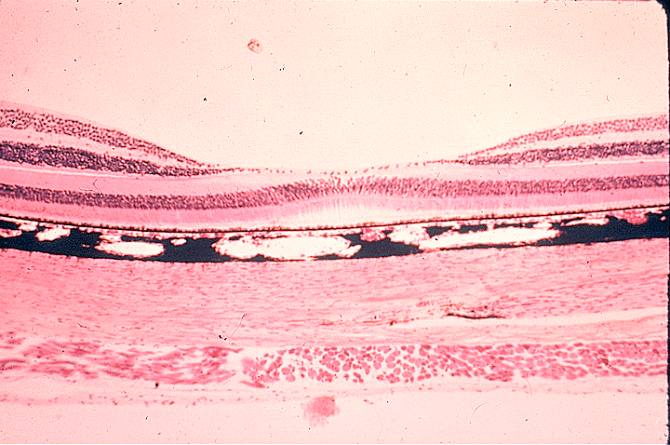
Fovea Centralis—Cross Section
https://www.dspace.udel.edu
Scanning electron micrograph.

Slide 43
Periphery of the Retina
While rods are absent from the fovea centralis, they are abundant toward the periphery of the retina.
Because rods are more sensitive to light than cones, a faint object, such as a dim star, is best viewed if a person shifts her or his gaze slightly to the side, away from the fovea centralis.
Page 579
Page 649
Page 610

Slide 44
Lens
The lens is located in the cavity of the eye behind the pupil and iris.
Its role, along with the cornea, is to help focus visual images on the retina.
Crystallins formed from protein molecules within cells of the lens are organized like layers of an onion to help form the refractive media to bend light.
Page 586
Page 649
Page 610
Figure 17.7

Slide 45
Lens (continued)
The lens does not have blood vessels and it is normally transparent—unless, for example, the person has a cataract involving the clouding of the outer layers of lens.
The lens is enclosed in a clear connective tissue capsule and is held in place by zonular fibers attached to the ciliary processes.
Page 586
Page 649
Page 610
Figure 17.7
45
Notes:
45

Slide 46
Interior of the Eye
The lens divides the eye’s interior into the anterior and vitreous cav-ities.
The anterior cavity consists of the anterior and posterior chambers.
The anterior chamber is located between the cornea and the iris.
The posterior chamber is located behind the iris and in front of the lens and its zonular fibers.
Page 586
Page 649
Page 612
Figure 17.11

Slide 47
Aqueous Humor
The two chambers of the anterior cavity are filled with aqueous humor, a transparent, watery fluid to nourish the lens and cornea.
Aqueous humor continually filters out of the blood capillaries in the ciliary processes of the ciliary body and into the posterior chamber.
The fluid circulates between the iris and lens, through the pupil, and into the anterior chamber.
The aqueous humor drains into the scleral venous sinus and then into the blood—this fluid is fully replaced about every 90 minutes.
Page 587
Page 649
Page 612

Slide 48
Vitreous Chamber and Vitreous Body
The vitreous body is located in the vitreous chamber—it is a trans-parent, jelly-like substance that holds the retina against the choroid.
The vitreous body is formed during the embryonic period, and consists mostly of water, hyaluronic acid, and collagen fibers.
It does not undergo constant replenishment, unlike the aqueous humor.
The vitreous body contains phagocytotic cells that remove debris to help maintain unobstructed vision.
Page 587
Page 649
Page 612

Slide 49
Vitreal Floaters
Debris in the vitreous body can cast shadows on the retina and create the appearance of specks that appear to dart into and out of the visual field.
These vitreal floaters are more common in older people.
They are usually no more than a nuisance, and typically do not require medical treatment.
In sufficient numbers, the floaters can scatter light and cause glare on a bright, sunny day.
Page 586
Page 649
Page 612

Slide 50
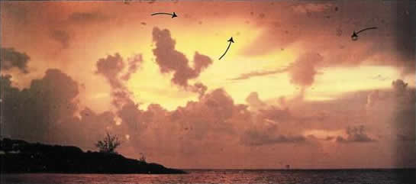
Vitreal Floaters (continued)
https://www.formulamedical.com
Vitreal floaters are mostly a nuisance although they can initially be disconcerting.

Slide 51
Intraocular Pressure
The hydrostatic pressure in the eye is called the intraocular pressure.
Intraocular pressure, which is normally about 16 mmHg, is produced by the aqueous humor and to a lesser extent by the vitreous body.
The intraocular pressure maintains the shape of the eye and prevents it from collapsing.
Hydrostatic pressure = the pressure exerted or transmitted by a fluid at rest.
Page 587
Page 649
Page 612

Slide 52
Intraocular Pressure (continued)
Puncture wounds of the eye can result in the loss of aqueous humor and vitreous body can substantially reduce the intraocular pressure.
A detached retina, which can lead to blindness, can result when intra-ocular pressure decreases.
Page 587
Page 649
Page 612
52
Notes:
52

Slide 53
Light Projection—Retina

Slide 54
The Visual System
The visual system is not analogous to a camera where an image is passively projected onto a light-sensitive, electronic or film medium.
Photoreceptors and other neurons of the visual pathway do not send a literal picture to the brain.
Neurons in the visual areas of the brain extract features from a visual scene and integrate them to form an image based on the visual stimuli and past experiences.
Page 587
Page 649
Page 613

Slide 55
The Visual System (continued)
Higher-level processing, including visual integration and interpretation, takes place in the visual projection and visual association areas of the cerebral cortex.
Up to 30 areas of the cerebral cortex are involved in visual processing, but often in ways that are not fully understood.
Page 587
Page 649
Page 613

Slide 56
Light Projection
The projection of light onto the retina involves three processes:
  Refraction involving the bending of light by the cornea and lens.
  Accommodation involving a change in the shape of the lens.
  Constriction or dilation involving a change in the diameter of the pupil.
Page 587
Page 649
Page 613

Slide 57
Refraction
Light bends at the junction between two substances with different densities, such as air and water, due to differences in transmission speeds.
This bending is known as refraction.
As light enters the eye, it is refracted at the anterior and posterior surfaces of the cornea and lens so that the visual stimulus can be focused on the retina.
Page 587
Page 650
Page 613
Figure 17.12

Slide 58
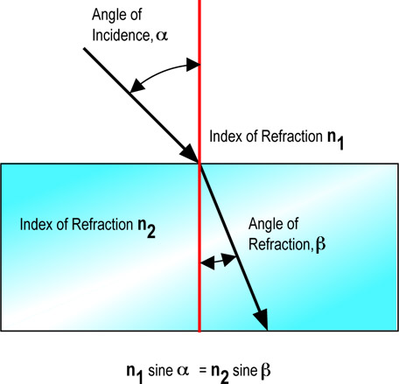
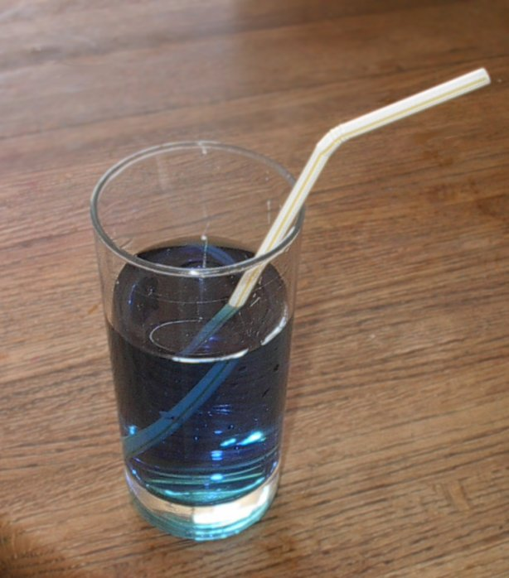
Refraction (continued)
https://www.datasync.com
https://www.wikivisual.com

Slide 59
Inversion
The light focused on the retina is upside down and reversed left to right.
Through experience, the brain learns to interpret the correct orienta-tion.
If one were to wear inverting goggles, all visual stimuli would appear upside down.
The visual areas would make adjustments and within a few weeks the visual stimuli would be seen as upright again.
Page 588
Page 650
Page 613
Figure 17.12

Slide 60
Contributors to Refraction
About 75 percent of light refraction of the eye occurs in the cornea.
The lens provides the remaining 25 percent of refraction to focus near and far objects.
When an object is at a distance of at least six meters, light rays are nearly parallel to one another.
In these circumstances, the lens need refract only slightly to enable an image to be focused on the fovea centralis.
Page 588
Page 650
Page 613

Slide 61
More on Refraction
Light from objects nearer than six meters become increasingly more divergent than parallel.
The light must be refracted to a greater extent to be focused on the fovea centralis.
This refraction is accomplished through accommodation by the lens, as will be discussed.
Page 588
Page 650
Page 613

Slide 62
Lens Curvature
A surface that curves outward is convex, and a surface that curves inward is concave.
When the surface is convex, the light rays will be refracted toward each other (convergence).
When the surface is concave, light rays will be refracted away from each other (divergence).
The lens is convex on both surfaces—its focusing ability increases as its curvature becomes greater by changes in its shape controlled by the ciliary muscles.
Page 588
Page 650
Page 613

Slide 63
Accommodation
When the eye focuses on a nearby object, where the light rays diverge, the lens takes on a more curved shape to increase light refraction and convergence.
The change in lens shape, as mentioned, is controlled by the ciliary muscles.
This increase in lens curvature for near vision is called accommoda-tion.
Page 588
Page 651
Page 614

Slide 64
Accommodation (continued)
The near point of vision is the minimum distance from the eye that an object can be focused with maximum accommodation by the lens.
The distance is about four cm (less than two inches) in a young adult.
With increasing age, the near point of vision generally increases due to decreased elasticity of the lens—that is, its ability to change shape and assume a greater curvature.
Page 588
Page 651
Page 614

Slide 65
Ciliary Muscle Control
With distant objects, the ciliary muscles attached to the lens relax, and the lens becomes flatter because due to the stretching of the zonular fibers.
With close objects, the ciliary muscles contract, to pull the ciliary process and choroid toward the lens—this action releases tension on the lens and zonular fibers.
The lens, due to its elasticity, becomes more convex, producing a greater convergence of light rays to focus the image on the retina.
Parasympathetic fibers of the oculomotor (III) cranial nerve control the ciliary muscles to mediate accommodation.
Page 589
Page 651
Page 614

Slide 66
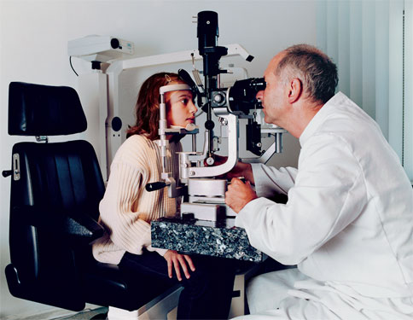
Refraction Abnormalities
A normal (emmetropic) eye can sufficiently refract light rays from a distance of six meters to enable a visual stimulus to be focused on the retina.
Many people, however, have refraction abnormalities that can often be corrected.
https://www.aurarosenberg.com
Page 589
Page 652
Page 614

Slide 67

Myopia
Myopia (nearsightedness) occurs when the eyeball is too long relative to the combined focusing power of the cornea and lens, or when the lens is thicker than normal.
The light converges in front of the retina.
Myopic individuals see close objects clearly, but more distant objects are out of focus.
https://www.psfk.com
Page 589
Page 652
Page 614
Figure 17.13

Slide 68

Hyperopia
Hyperopia (farsightedness) occurs when the eyeball is too short relative to the combined focusing power of the cornea and lens or when the lens is thinner than normal.
The light converges behind the retina.
Hyperopic individuals see distant objects clearly but not close objects.
https://www.bausch.co.uk
Page 589
Page 652
Page 614
Figure 17.13

Slide 69
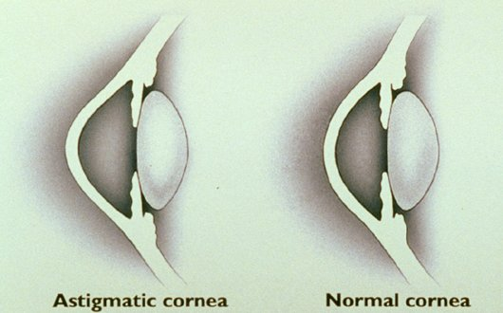
Astigmatism
Astigmatism results when the cornea or the lens has an irregular curvature.
Parts of the image are out of focus and vision is blurred or distorted.
https://www.carriehoffman.com
Page 589
Page 652
Page 614

Slide 70
Correction of Refraction Abnormalities
Refraction abnormalities can often be corrected with eyeglasses, contact lenses, or surgical procedures.
A contact lens floats over the cornea on a thin layer of synthetic tears.
The posterior surface of the contact lens matches the curvature of the cornea, and the curvature of its anterior surface corrects the visual defect.
Laser surgery involves precisely reshaping the cornea to correct for the refraction abnormality.
Page 589
Page 652
Page 614

Slide 71
Pupillary Constriction
Contraction of the circular smooth muscle fibers of the iris constrict (decrease) pupil size to help in projecting clearly-defined light on the retina.
Pupillary constriction also helps prevent light from entering through the edge of the lens.
If light were to enter along the edge (which can happen with dila-tion), it could not be brought fully into focus, which would result in blurred vision.
Pupillary constriction is under parasympathetic control by the auto-nomic nervous system.
Page 590
Page 653
Page 615

Slide 72
Binocular Vision
In some animals, such as cows and horses, two different visual scenes are projected on the retinas due to the opposing positions of the eyes.
Humans and many other animals, due to the forward-facing location of the eyes, have binocular vision in which both eyes focus on the same visual scene.
Binocular vision contributes substantially to depth perception, and to some extent to perception of the three-dimensional aspects of nearby objects.
Depth perception = ability to recognize three-dimensional objects and their relative position in space.
(https://www.jhu.edu)
Page 590
Page 653
Page 615

Slide 73
Binocular Vision (continued)
When viewing distant objects, incoming light is focused at comparable spots on the two retinas.
When an object moves closer (or as one moves closer to the object), the eyes rotate medially (toward the midline) to maintain image loca-tion.
Convergence refers to this medial movement of the eyes.
Convergence, among other visual cues, is used by the brain in judging the distance of an object.
Page 590
Page 653
Page 615

Slide 74
Visual Processing and Interpretation

Slide 75
Photoreceptors—Outer Segments
Photoreceptors are named for the shapes of their distal ends known as the outer segments—rods look somewhat like rods, and cones like cones.
The phototransduction of light energy into receptor potentials occurs in the outer segments.
The receptor potentials generated by the rods and cones initiate action potentials that propagate (travel) through the neural layer of the retina, along the optic nerve, and to the brain.
Phototransduction = the transformation of visual sensory energy into a cellular signal, especially a receptor (graded) potential.
Page 590
Page 653
Page 615
Figure 17.14

Slide 76
Photoreceptors—Plasma Membrane
The plasma membranes of the outer segments of the rods and cones contain photopigments of protein molecules—these pigments absorb photons of light.
For rods, pleats pinch-off from the plasma membrane of the outer seg-ment to form disks.
For cones, by comparison, the plasma membrane is folded in a pleated manner.
Photon = a quantum of electromagnetic radiation.
Quantum = the minimum unit of any physical entity involved in an interaction.
Page 590
Page 653
Page 615
Figure 17.14

Slide 77
Rods—Disks
The outer segment of each rod has about 1,000 disks in a stacked ar-rangement.
Every hour, one to three disks are added to the base of the outer seg-ment of a rod.
Older disks are sloughed-off the tip of the rod and phagocytized by epi-thelial cells in the photopigment.
Page 590
Page 653
Page 615
Figure 17.14

Slide 78
Inner Segments
The inner segment of rods and cones contains the cell nucleus, Golgi apparatus, and mitochondria.
The inner segments in both types of photoreceptors expand into bulb-like synaptic terminals, which have synaptic vesicles containing neuro-transmitters.
Page 590
Page 653
Page 615
Figure 17.14

Slide 79
Light Absorption
The first step in visual transduction is absorption of light by the photo-pigments.
The proteins in photopigments undergo structural changes when they absorb light—the changes produce graded receptor potentials.
The photopigment in rods is known as rhodopsin.
Each type of cone (red, blue, and green) has its own unique photopig-ment.
Page 590
Page 653
Page 616
Figure 17.15

Slide 80
Photopigments
The four photopigments (one for rods and three for cones) consist of a derivative of vitamin A called retinal and a glycoprotein known as opsin.
Retinal is the common, light-absorbing component of all photopigments in rods and cones.
Vitamin A derivatives are formed from carotene, the plant pigment that gives carrots their orange color.
An adequate dietary intake of liver or carotene-rich vegetables such as carrots, spinach, broccoli, and yellow squash is needed for good vision.
Page 590
Page 654
Page 616

Slide 81
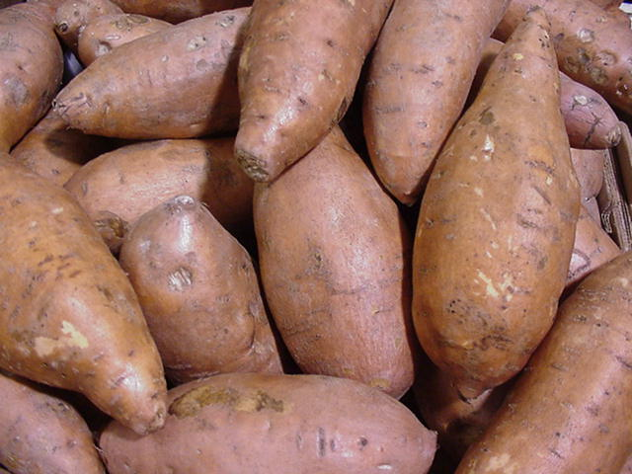
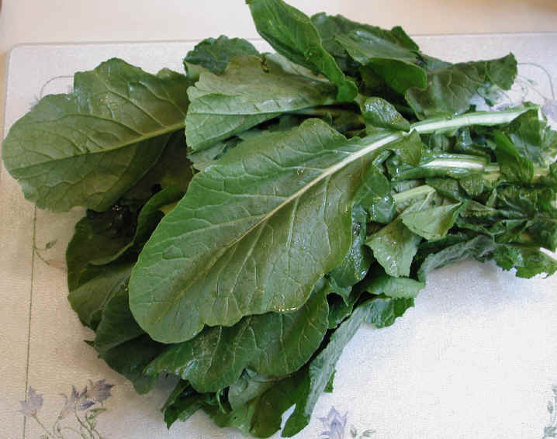


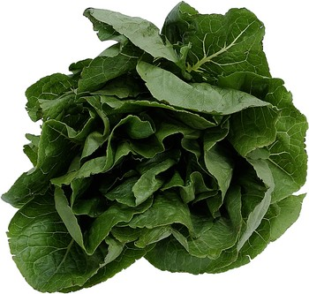
Some Sources of Beta Carotene
https://www.all-creatures.org
https://wwwcoolrain44.files.wordpress.com
https://www.westofpersia.files.wordpress.com
https://www.cdn.sheknows.com
Clockwise from the upper left—sweet potatoes, turnip greens, winter squash, carrots, and spinach. Other sources of beta carotene include kale, cilantro, and fresh thyme.
https://www.eating-in.com

Slide 82
Photopigments (continued)
Small variations in the amino acid sequence of opsins enable three types of cones (red, blue, and green) to absorb different wavelengths of light.
The responses of photopigments to light and the regeneration process are described in detail in the textbook.
Page 591
Page 654
Page 616

Slide 83
Other Details
The pigmented layer of the retina stores large quantities of vitamin A for the rhodopsin regeneration process in rods.
Rhodopsin regeneration decreases substantially if the neural layer is detached from the pigmented layer.
A detached retina can result in blindness, especially when it involves rods.
Page 591
Page 654
Page 616

Slide 84
Regeneration Times
The photopigments in cones regenerate more rapidly than rhodopsin in rods and are less dependent on the pigmented layer.
After complete bleaching by light, the regeneration of 50 percent of cones takes about 90 seconds
In comparison, the regeneration of 50 percent of rods takes about five minutes.
The full regeneration of the bleached rhodopsin in rods takes 30 to 40 minutes.
Page 591
Page 654
Page 617

Slide 85

Light and Dark Adaptation
Light adaptation occurs when leaving a darkened theater into the sunny outdoors—the visual system must adjust to higher illumina-tion by decreasing its sensitivity.
Dark adaptation occurs when entering the darkened theater—the visual system must adjust to the lower illumination by increasing its sensitivity.
Differences in the rates of
bleaching and regenera-tion of the photopigments account for much of these sensitivity changes during light and dark adaptation.
https://www.i674.photobucket.com
Page 591
Page 654
Page 617

Slide 86
Light Adaptation
Increasingly more molecules of photopigment are bleached as envi-ronmental illumination levels increase.
While light is bleaching some photopigment molecules, others are being regenerated.
In daylight, the regeneration of rhodopsin cannot keep up with the bleaching process—therefore, rods contribute very little to vision in daylight.
Page 591
Page 654
Page 617

Slide 87
Light Adaptation (continued)
In comparison, photopigments in cones regenerate rapidly so that sufficient amounts of retinal are present even in very bright light.
Cones contribute substantially to visual functioning in daylight and other high ambient illumination conditions.
Page 591
Page 654
Page 617

Slide 88
Dark Adaptation
When illumination decreases rapidly, visual sensitivity increases rapidly at first, but then more slowly.
In complete darkness, the full regeneration of the photopigments in cones takes about 8 minutes.
During this period of time, a barely-perceptible (threshold) flash of white light appears to have color since the cone photopigments re-generate before the rod photopigments.
Page 591
Page 654
Page 617

Slide 89
Dark Adaptation (continued)
Rhodopsin in rods regenerates slowly until a single photon of light can be detected.
A barely-perceptible (threshold) flash of light appears as gray-white regardless of the color of the flash since the rods are now active.
At very low light levels, such as under starlight, objects in a visual scene will appear only as shades of gray because only the rods are functioning.
Page 591
Page 654
Page 617

Slide 90
Receptor Potentials
The absorption of photons initiates changes in the outer segments of cones and rods that result in the generation of graded receptor potentials.
Details are contained in the textbook.
Page 592
Page 655
Page 617
Figure 17.16

Slide 91
Color Blindness
Color blindness involves an inherited (linked to the X chromosome) inability to distinguish between some colors—especially between red and green, and less often between blue and yellow.
Most forms of color blindness result from the absence or deficiency of one or more of the three types of cones.
Page 592
Page 655
Page 618

Slide 92
Color Blindness (continued)
Males are far more likely to have color blindness due to a recessive genetic defect on the one X chromosome (hemizygous).
Females would need copies of the defective gene on both X chromo-somes (one from each parent), a much rarer condition (homozygous).
Color blindness and related deficiencies are diagnosed using Ishihara plates and other vision tests.

Slide 93
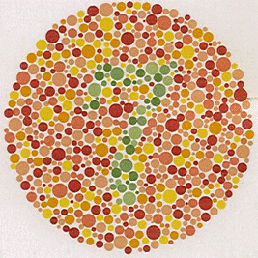
Ishihara Color Plate
https://www.mediacollege.com
Do you see an embedded figure?

Slide 94
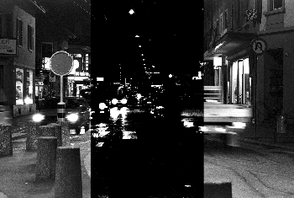
Night Blindness
Vitamin A deficiency can result in the synthesis of too little rhodopsin for the proper functioning of the rods.
It can cause night blindness, or nyctalopia, the inability to see well at low levels of illumination.
Compare the middle (nyctalopia) and outer panels.
https://www.retina-international.org
Page 592
Page 655
Page 618

Slide 95
Retinal Processing
The receptor potentials generated in rods and cones from visual stimuli undergo considerable processing by other neurons in the retina.
They include the horizontal cells, bipolar cells, amacrine cells, and ganglion cells.
The axons of the ganglion cells exit the eye as the optic (II) cranial nerve.
Page 592
Page 655
Page 618
Figure 17.10

Slide 96
Cross Section of the Retina
Retina of the eye
Photoreceptors
(rods and cones)
Horizontal cell
Outer synaptic layer
Amacrine cells
Bipolar cells
Inner synaptic layer
Ganglion cells
https://www.skidmore.edu
Direction of light

Slide 97
Convergence
Input from several neurons can converge on postsynaptic neurons or diverge to a larger number of postsynaptic neurons.
Convergence dominates in the retina—there are about 126 million photoreceptors, but only about one million ganglion cells to convey information along the optic nerve to the thalamus.
Page 593
Page 656
Page 618

Slide 98
Photopic and Scotopic Vision
Some features of a visual stimulus are enhanced within the retina, while others are not.
The convergence of many rods on a single bipolar cell increases the light sensitivity of rod (photopic) vision, but slightly degrades or blurs the image.
Cone (scotopic) vision is less sensitive at low light levels but provides higher resolution due to a one-to-one correspondence between cones and bipolar cells.
Up to 600 rods synapse with one bipolar cell, while a cone usually syn-apses with only one bipolar cell.
Page 593
Page 656
Page 618

Slide 99
Receptor and Local Potentials
Receptor potentials, once they are generated in the outer segments of rods and cones, propagate through the neural and synaptic sublayers of the retina.
Neurotransmitters released by rods and cones initiate graded poten-tials in bipolar cells and horizontal cells.
Stimulation of rods excites the bipolar cells, while stimulation of cones can either excite or inhibit them.
Page 593
Page 656
Page 618

Slide 100
Lateral Inhibition
The horizontal cells transmit inhibitory signals (graded potentials) to bipolar cells in areas adjacent (or lateral) to the stimulated rods and cones.
This lateral inhibition enhances contrast in the visual stimulus between the areas of the retina that are strongly stimulated, and areas that are weakly stimulated.
Horizontal cells also help differentiate among colors in the stimulation of the cones.
Page 593
Page 656
Page 618

Slide 101
Amacrine and Ganglion Cells
Amacrine cells, which receive input from bipolar cells, synapse with ganglion cells and transmit information about changes in brightness of a visual image.
When bipolar cells or amacrine cells transmit excitatory signals to ganglion cells (via neurotransmitters), the ganglion cells become depolarized.
The depolarization initiates action potentials that propagate along the axons of the optic (II) cranial nerve to the brain.
Page 593
Page 656
Page 618

Slide 102
Optic Nerve and Optic Tract
Axons in the optic nerve pass through the optic chiasm, where some crossover to the opposite contralateral (opposite) side.
Other axons remain on the same ipsilateral (same) side.
Once the axons pass through the optic chiasm, they are called the optic tract.
The optic tract enters the brain and terminates in the lateral genicu-late nucleus of the thalamus and the superior colliculi of the midbrain (the evolutionary older visual pathway).
Nucleus = a collection of neuronal cell bodies in the central nervous system.
Page 593
Page 656
Page 618
Figure 17.17

Slide 103
Visual Fields
Everything that can be seen by a stationary eye is said to be within its visual field.
The visual fields of the two eyes overlap in humans since the eyes are positioned anteriorly (looking forward).
Humans have binocular vision because of the large degree of overlap between the two visual fields.
The area of overlap is known as the binocular visual field—this area is ideal for depth perception.
Page 593
Page 656
Page 618
Figure 17.17

Slide 104
Visual Fields (continued)
The visual field of each eye has two regions: the nasal or central half, and the temporal or peripheral half.
Light from a stimulus in the nasal half of the visual field is projected on the temporal half of the retina.
Light from a stimulus in the temporal half is projected on the nasal half of the retina.
Nasal = pertaining to the nose.
Temporal = pertaining to the temples, the sides of the skull posterior to the orbits.
Page 594
Page 656
Page 618
Figure 17.17

Slide 105
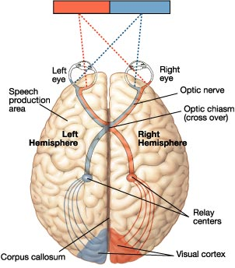
Visual Fields and Pathways
https://www.wps.prenhall.com

Slide 106
Visual Pathways
Visual information from the right half of each visual field (left nasal and right temporal) are conveyed to the left hemisphere of the brain.
Visual information from the left half of each visual field (left temporal and right nasal) are conveyed to the right hemisphere of the brain.
The projections are the result of the incomplete crossover of axons in the optic chiasm.
Page 594
Page 656
Page 618
Figure 17.17

Slide 107
Optic Radiations
In the lateral geniculate nucleus of the thalamus, the axons in the optic tract synapse with neurons whose axons form the optic radia-tions (diverging fiber tracts).
The optic radiations connect to the primary visual projection cortex (Brodmann’s area 17) of the occipital lobe.
Additional processing is performed in the adjacent areas 18 and 19, and many association areas (especially in the parietal and temporal lobes).
Page 594
Page 656
Page 618
Figure 17.17

Slide 108
Role of the Cerebral Cortex
The occipital lobe does not receive pictures from visual stimuli that activate the rods and cones—if they did, who is back there viewing them?
Visual information is processed by a number of areas primarily in the cerebral cortex.
These areas, working independently and together, are responsible for the perception of:
  Movement, location, and spatial arrangement
  Shape
  Brightness
  Contrast
  Color
  Context and meaning (which also involves learning and memory)
Page 594
Page 656
Page 620

Slide 109
Visual Perception
The primary visual projection area communicates with the visual association and other association areas through association fibers.
Visual perception would best be covered in a biopsychology course.
Page 594
Page 656
Page 620

Slide 110
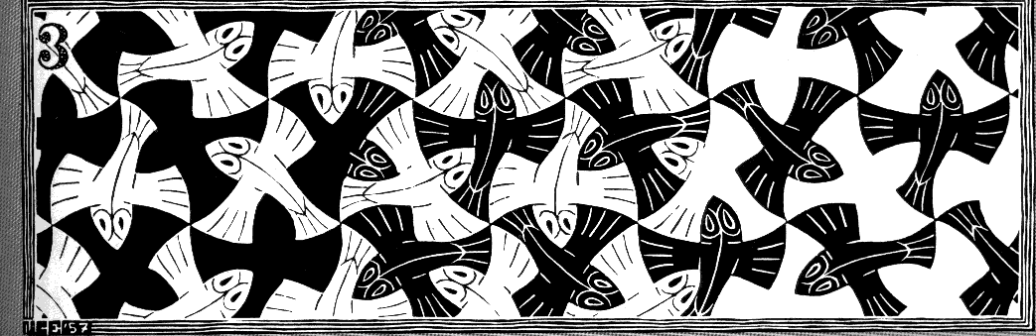
What Do You See?
M.C. Escher (1898-1972)
https://www.wiu.edu
“Maurits Cornelis Escher was a Dutch graphic artist who made mathematically inspired woodcuts, lithographs, and mezzotints. Despite wide popular interest, Escher was for long somewhat neglected in the art world, even in his native Netherlands. He was 70 before a retrospective exhibition was held.”
(https://www.wikipedia.org)
110
Notes:
110

