Slide 1
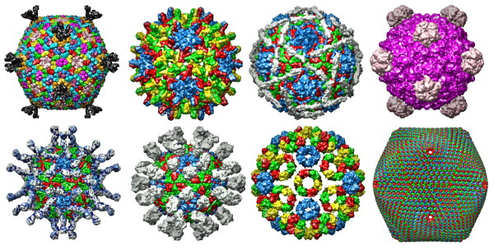
Viruses and Viral Diseases
https://www.virology.ws

Slide 2
Infectious Diseases
Infectious diseases are caused by bacteria, viruses, fungi, parasites, and prions.
The observation that each infectious disease is caused by a specific agent was established in the late-19th century.
2
Notes:
2

Slide 3
Infectious Diseases in History
Infectious diseases were the primary cause of human death through-out recorded history until the beginning of the 20th century.
The bubonic plague, or the Black Death, killed up to 75 percent of the European population in the 14th century.
Bubonic plague = an infectious disease that is caused by the bacterium Yersinia pestis and is transmitted to humans from infected rats by the oriental rat flea. It is named for the characteristic feature of buboes (painfully enlarged lymph nodes) in the groin, armpits, neck, and elsewhere. Symptoms of bubonic plague include headache, fever, chills, and weakness. Bubonic plague can lead to gangrene (tissue death) of the fingers, toes, and nose.
(https://www.medicinenet.com)
3
Notes:
3

Slide 4
Infectious Diseases in History (continued)
Tuberculosis, a bacterial disease, was the leading killer in Britain in the mid-19th century.
Epidemics of smallpox (a virus) and cholera (a bacterium) occurred in many cities every few years.
Death rates for tuberculosis, typhoid, and other respiratory and gas-trointestinal diseases in the mid-19th century were double the rates in 1930.
Smallpox = a highly-contagious viral disease caused by the variola virus. Initial symptoms include high fever, fatigue, headaches, and backaches. A rash starts with flat red lesions that evolve in 2 to 3 days. The lesions become pus-filled and begin to crust early in the second week. Death occurs in about 30 percent of cases. The smallpox virus is spread from one person to another via infected saliva droplets such as with face-to-face contact. Throughout human history, smallpox may have killed over a billion people.
(https://www.medicinenet.com)
4
Notes:
4

Slide 5
Control of Infectious Diseases
Many infectious diseases were subsequently controlled through extensive public health efforts including:
  Water purification
  Proper sewage disposal
  Milk pasteurization
  Vaccinations
  Improved nutrition and personal hygiene
The discovery of penicillin in the late-1920s, and its widespread use along with other antibiotics starting in the 1940s, led to the control of many bacterial diseases.
5
Notes:
5

Slide 6
Control of Infectious Diseases (continued)
The risks of many infectious diseases were greatly reduced by the 1960s.
With the control of infectious diseases that killed many millions of people, the role of public health tended to be viewed with compla-cency.
However, infectious diseases—some old and some new—are still with us.
This lecture module is about several viral diseases and especially COVID-19.
6
Notes:
6

Slide 7
Viruses
Viruses exist in a fuzzy zone between what is considered living and in-animate (non-living).
Unlike living organisms, viruses do not have a metabolism and cannot reproduce on their own.
A virus particle consists of a small amount of genetic material wrapped in a membrane and protective coat of protein.
A virus infects a cell with its genetic material (either RNA or DNA) and directs the cell’s machinery to produce more copies to spread the infec-tion.
Metabolism = the sum of all chemical processes that occur within a living organism to maintain life.
An individual virus particle is known as a virion.

Slide 8
What is Life?
Regenerate or produce offspring (asexually or sexually)
Self-sustainable (produce energy for metabolism)
Genetic instructions for development and growth ✅
Complex and well-ordered structure ✅
Carbon-based (which is not exclusive to life or viruses) ✅
✅ Viruses share these qualities with the cells of living organisms.
8
Notes:
8

Slide 9
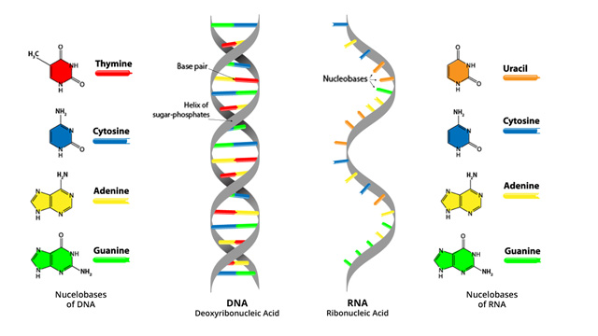
DNA and RNA
DNA = double helix strand of nucleotides
mRNA = single strand of nucleotides
https://www.technologynetworks.com/genomics
DNA contains the genetic code for life. DNA serves as the template for mRNA.
Messenger RNA (mRNA) contains the instructions for the synthesis of proteins by the ribosomes in cells.

Slide 10
DNA and RNA (continued)
The nucleotides in the two helical strands of DNA are paired adenine (A) with thymine (T) and guanine (G) with cytosine (C)—these are the base pairing rules.
If one DNA strand has a mutation, the other strand can apply the base pairing rule (either A with T or G with C) to insert the correct nucleotide.
This is a major reason that DNA viruses tend not to mutate when they replicate.
10

Slide 11
DNA and RNA (continued)
The single-strand RNA viruses lack the error checking mechanism of DNA viruses and therefore they can more readily mutate.
And so, it has been said, “the more a RNA virus replicates, the more it mutates.”
Mutations can lead to new variants as is the case for for the virus that causes COVID-19
11

Slide 12
Plant Viruses
The tobacco mosaic virus that infects tobacco plants was the first virus to be discovered (during the 1930s).
Viruses that infect plant cells can inhibit plant growth and diminish crop yields.
Most plant viruses contain RNA as their genetic material.
Many are rod-shaped with a spiral arrangement of proteins surrounding their RNA contents.
12

Slide 13
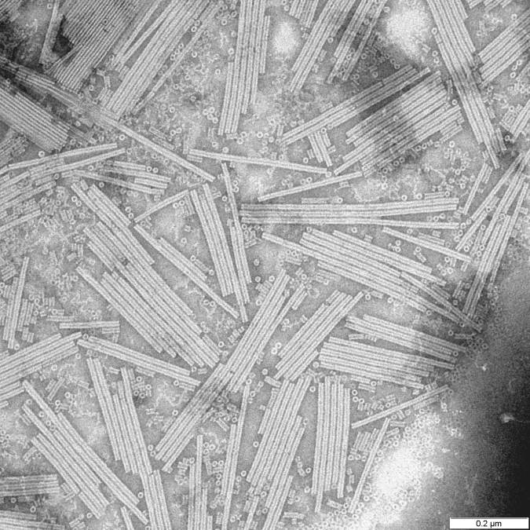
Tobacco Mosaic Virus
Scanning electron micrograph
https://www.wikimedia.org
13

Slide 14
Humans—RNA Viruses
The influenza (flu) virus, like many other viruses that infect humans, has RNA as its genetic material.
RNA viruses also cause the common cold, measles, mumps, rubella, West Nile fever, poliomyelitis (polio), among other infectious diseases.
The novel coronavirus (SARS-CoV-2) that causes COVID-19 is also a RNA virus.

Slide 15
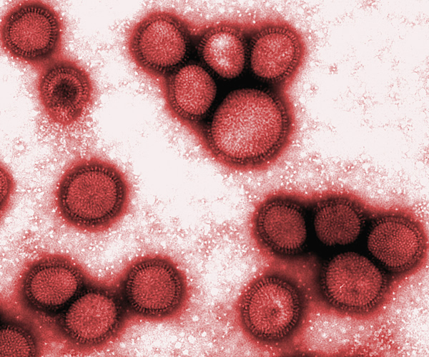
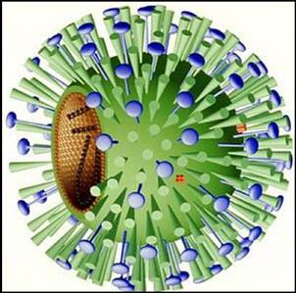
Influenza Virus
A drawing showing showing the spike proteins.
https://www.state.nj.us
False-color scanning electron micrograph
https://www.leeds.gov.uk

Slide 16
Biological Actions
A spike protein of the RNA virus binds to a receptor that has a match-ing configuration on a host cell.
A RNA virus fuses with the plasma membrane of a cell to release its genetic material into its interior (cytoplasm).
The viral RNA serves as a template for synthesizing new strands of viral RNA.

Slide 17
Biological Actions (continued)
The viral RNA also directs synthesis of viral proteins by the ribosomes in the host cell.
The viral proteins assemble around the new viral RNA to provide an envelope or protective coat.
New copies of the virus exit the cell through its plasma membrane to infect other cells.
Ribosomes = cell machinery for assembling polypeptides that form proteins from amino acid molecules. Healthy cells produce thousands of different proteins, each with a specific function.

Slide 18
Humans—DNA Viruses
DNA viruses cause chickenpox, cold sores, herpes simplex, and genital herpes.
Other DNA viruses cause smallpox, cowpox, and mpox (all are of the orthopox genus).
The viruses contain DNA that reproduce in the nucleus of the host cell.
Recall that DNA is a double helix strand of genetic material—the two strands serves as an error-checking, corrective mechanism.
RNA viruses lack this corrective mechanism since there is only one nucleotide strand.

Slide 19
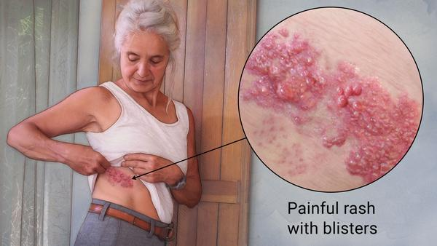
Shingles
For a person who had chickenpox, possibly as a child, the reemer-gence of the virus causes an infection of shingles on a dermatome usually on one side of the body.
As a person gets older and her or his immune system weakens, the varicella-zoster virus can re-emerge from the sensory nerve roots.
Treatment includes pain relief and antiviral drugs such as acyclovir.
A shingles vaccine is available
and is recommended for older people.

Slide 20
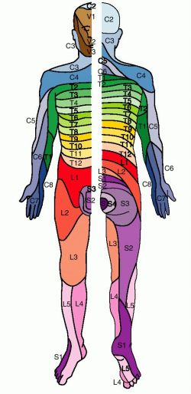
Dermatomes
Anterior
(front) view
Posterior
(rear) view
Sensory neurons for touch, vibration, temperature, and pain carry nerve impulses from the skin to the spinal cord and then to the brain for processing.
The area of the skin that provides input to the spinal cord or brain by one pair of spinal nerves or the trigeminal (V) cranial nerve is called a dermatome.
https://www.medical-dictionary.thefreedictionary.com

Slide 21
Herpes Virus
Copies of DNA in the herpes virus can remain in the nuclei of certain neurons.
They remain latent until a stress—such as cold, sunburn, or emotional stress—triggers the viral DNA to begin producing the virus once again.
A herpes viral infection can repeatedly flare-up during a person’s life-time.
Latent = dormant, hidden, or unrealized.

Slide 22
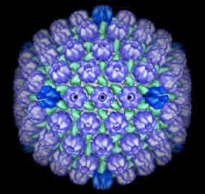
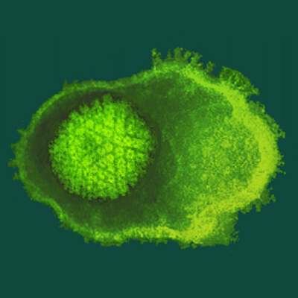
Herpes Virus (continued)
False-color electron micrograph
https://www.kimicontrol.com
Drawing
https://www.health-news-blog.com

Slide 23
Human Immunodeficiency Virus
Acquired Immunodeficiency Syndrome (AIDS) is caused by an RNA virus known as human immunodeficiency virus (HIV).
HIV is a retrovirus, meaning it reverses the normal DNA to RNA flow of genetic information.

Slide 24
HIV Production
HIV has an enzyme, called reverse transcriptase, that synthesizes DNA from its viral RNA template.
The viral RNA produces a DNA strand and adds a second comple-mentary strand.
The double-stranded viral DNA enters the cell nucleus through the pores in the membrane of the cell nucleus and inserts itself into the genome.

Slide 25
HIV Production (continued)
The “provirus” in the genome transcribes viral mRNA, which is trans-lated into viral proteins.
Copies of HIV, assembled from viral mRNA and proteins, exit the cell and spread the infection to other cells.

Slide 26
Primary and Secondary Effects
HIV infects and kills a type of white blood cell (CD4-T cells or T4 cells) involved in immune system responses.
Loss of T4 cells increases susceptibility to opportunistic infections that a person could normally overcome.
These secondary infections are known as Acquired Immunodeficiency Syndrome (AIDS).
Opportunistic infection = an infection that occurs more frequently or is more severe in people with weakened immune systems, such as people with HIV or people receiving chemotherapy, than in people with healthy immune systems.
(https://www.aidsinfo.nih.gov)

Slide 27
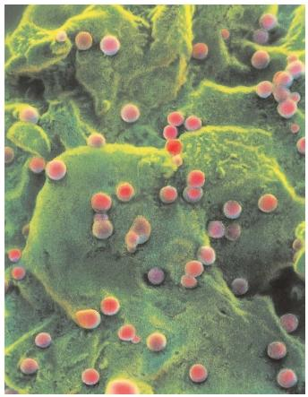
HIV Infecting White Blood Cells
https://www.faqs.org
False-color, scanning electron micrograph—the virus is shown in salmon color and T4 cells in green.

Slide 28
HIV Transmission
Modes of transmission include:
  Sexual activity—homosexual and heterosexual
  Needle sharing or non-sterile needle use
  Blood transfusion when donated blood has not been properly screened
  HIV-positive mother to fetus in utero or infant during delivery
  HIV-positive mother to infant via breast milk
In utero = in the uterus.
28
Notes:
28

Slide 29
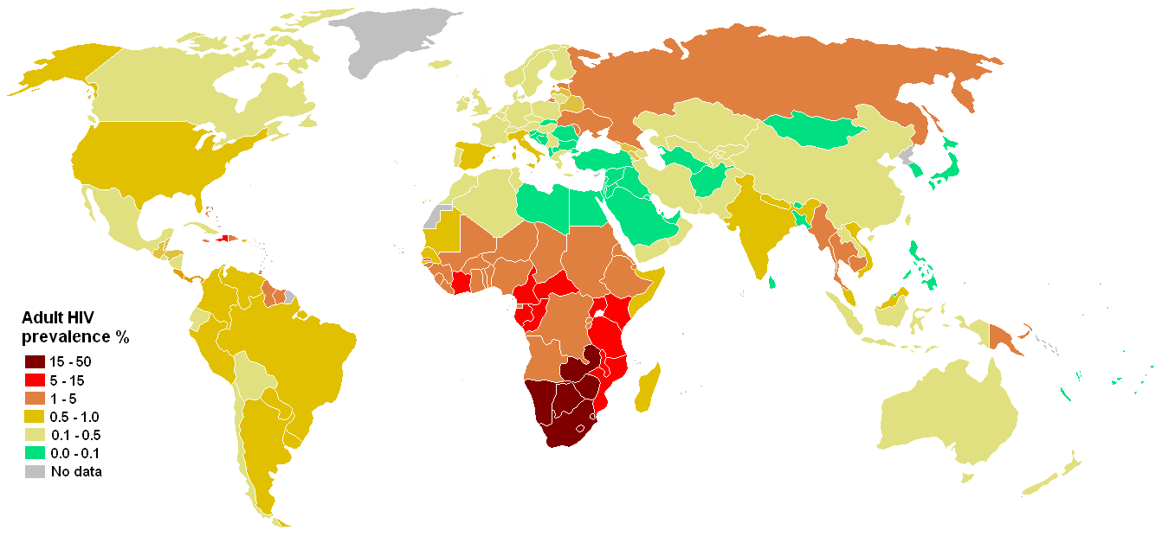
Adult HIV Prevalence
2005
https://www.wikimedia.org
Maroon and red = highest rates; green = lowest rates
According to U.S. intelligence agency reports, HIV and AIDS have the potential to trigger political instability in some parts of the world.

Slide 30
Drug Treatment
Anti-HIV drugs that are available interfere with the reproduction of the virus.
One class of drugs, especially AZT, inhibits the action of the enzyme, reverse transcriptase, in synthesizing viral DNA from the viral RNA template.
Another class, known as protease inhibitors, inhibits the action of proteases (enzymes) in the synthesis of viral proteins during the trans-lation process.
AZT = azidothymidine, also called zidovudine.

Slide 31
Drug Treatment (continued)
AZT and a protease inhibitor are often given in combination (“chem-ical cocktail”) to keep the virus in check and extend the patient’s life by many decades.
AIDS symptoms will return at some point if drug treatment is discon-tinued.
No treatment has yet been shown to completely rid the body of HIV.
Education and prevention are the most effective methods to control HIV infections and their spread.

Slide 32
Emerging Viruses
Other viruses have emerged into public awareness including the:
  West Nile virus
  Ebola virus
  Zika virus
  Hantavirus
  Mpox
  Avian and swine flu viruses
  Coronaviruses that are responsible for Severe Acute Respiratory Syndrome (SARS), Middle East Respiratory Syndrome (MERS), and COVID-19.

Slide 33
Emerging Viruses (continued)
How new viruses arise and why some emerge as global threats are of great concern and are being studied.
This is now true of the COVID-19 pandemic and the emergence of mpox.

Slide 34
Factors in Worldwide Spread
  Genetic mutation of existing viruses—such as avian flu and swine flu.
  New host species—rodents to humans for the hantavirus and bats to pangolins to humans for the novel coronavirus that causes COVID-19.
  Climate change and spread of some species of mosquitoes (known as biological vectors) to once-cooler areas that are now warming up.
  Human encroachment (farming, industry, housing) on wildlife habitat.
  Population growth and urbanization (growth of cities).
  Accessible, affordable, and rapid international travel.
  Behavioral and social factors.
Biological vector = an animal, usually an insect, that transfers a virus or other infective agent from one host to another.
(https://www.medical-dictionary.thefreedictionary.com)

Slide 35
West Nile Virus
In the early-2000s, West Nile virus (WNV) emerged as a health threat in North America.
A few species of mosquitoes of the Culex family can infect some birds with WNV, primarily those in the corvid family.
Corvids are called amplifying hosts that develop high levels of the virus that can be transmitted by mosquitoes (vectors) to birds, other animals, and humans.
WNV also kills the infected birds.

Slide 36
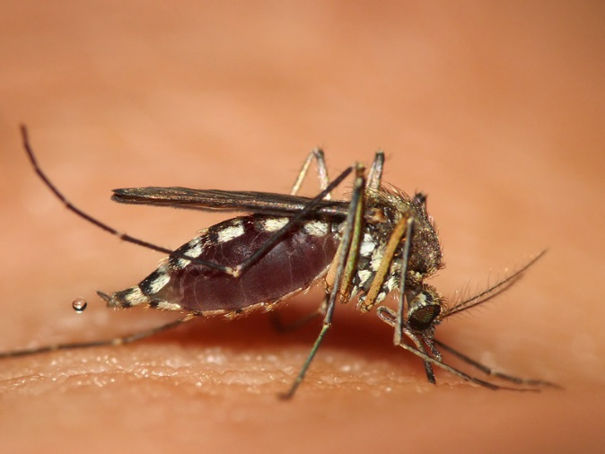
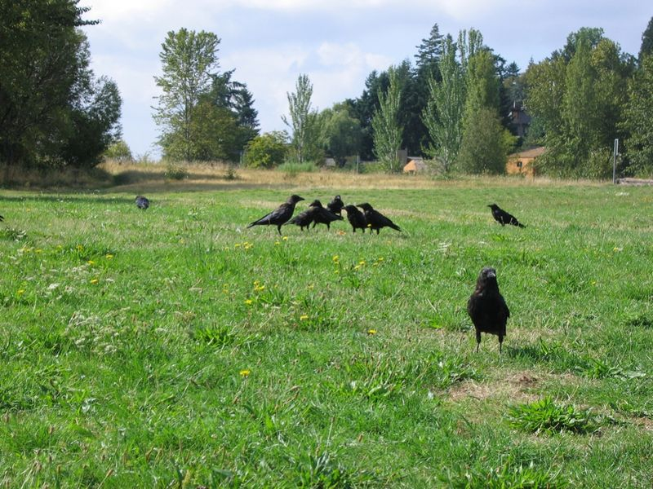
Transmission Cycle
Crows can serve as a WNV reservoir.
Other members of the corvid family that serve as reservoirs for WNV include ravens, jays, and magpies.
https://www.wikimedia.org
Culex mosquitoes are the biological vector for WNV between corvids and other animals including humans and horses.
https://www.wikimedia.org

Slide 37
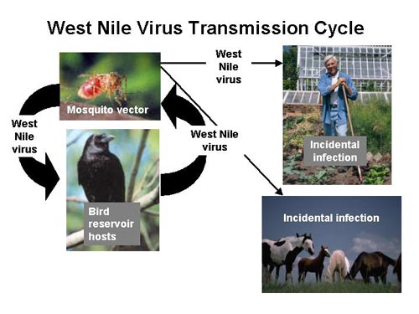
Transmission Cycle (continued)
https://www.wikimedia.org
37
Notes:
37

Slide 38
Symptoms
Infected individuals may have no symptoms (asymptomatic) or flu-like symptoms known as the West Nile fever.
Most people infected with WNV are asymptomatic.
In the most serious symptomatic cases, WNV can produce encephala-itis, a neurological disease.
Young children and seniors are at most risk for severe symptoms and debilitating effects.
A small percentage of symptomatic persons (less than three percent) die from West Nile fever.
Encephalitis = inflammation of the active tissues of the brain caused by an infection or an autoimmune response. The inflammation causes the brain to swell, which can lead to headache, stiff neck, sensitivity to light, mental confusion, and seizures.
(https://www.hopkinsmedicine.org)

Slide 39
Emergence
WNV emerged about 1,000 years ago in North Africa based on evi-dence from studies of its genetic lineage.
The virus was first isolated and identified in sub-Saharan Africa in the 1930s.
It made its first appearance in the United States, in New York City, in 1999.
WNV has now been reported in every state.
Locally, it has been most common in the San Gabriel Valley and City of Riverside, probably due to bodies of water that serve as mosquito breeding grounds.

Slide 40
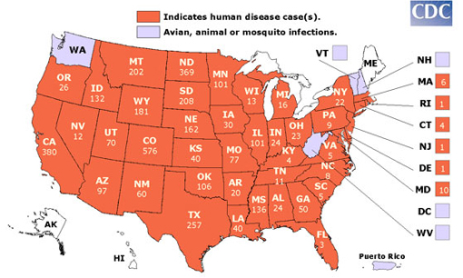
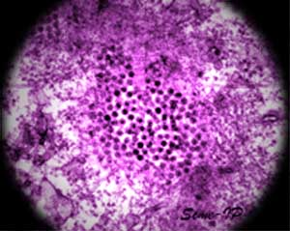
National Scope
WNV is a single strand of RNA of about 12,000 nucleotides in a capsid and contained in a membrane derived from the host cell.
https://www.dailyyonder.com
U. S. Centers for Disease Control, map for 2007—all states have now reported cases of WNV.
https://www.wikimedia.org

Slide 41
Prevention
WNV is not contagious—it cannot spread between persons except by blood transfusions.
There is no WNV vaccine—the only effective approaches are education and prevention.

Slide 42
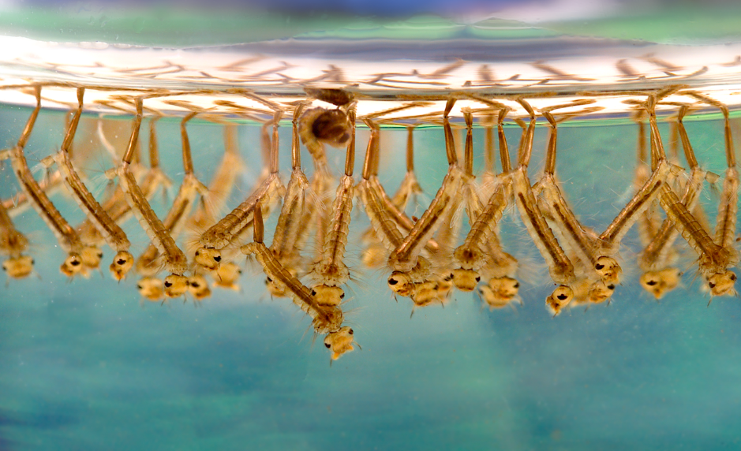
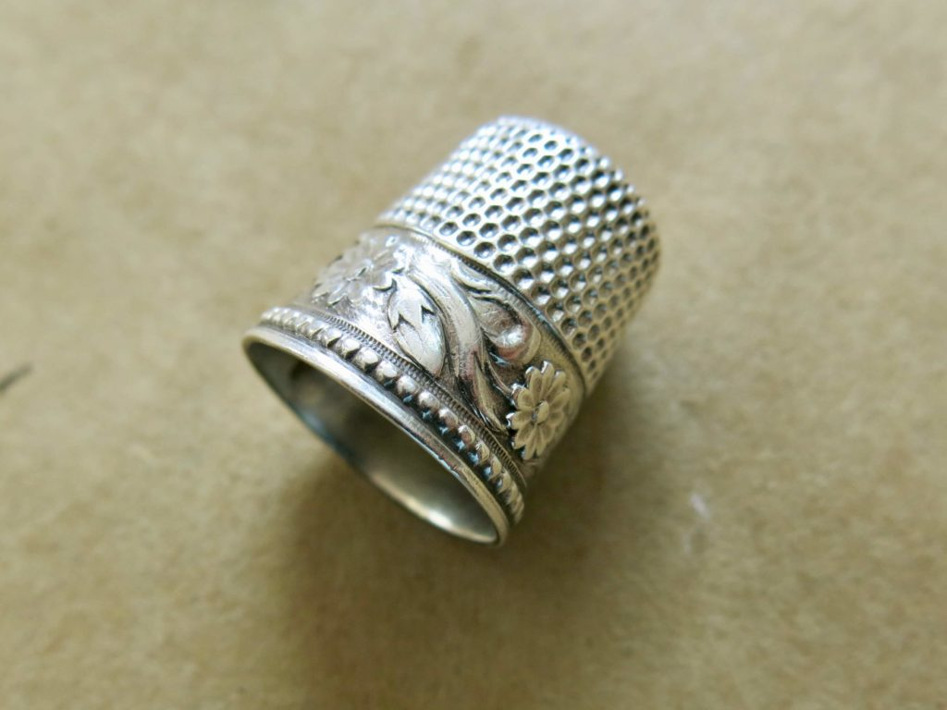
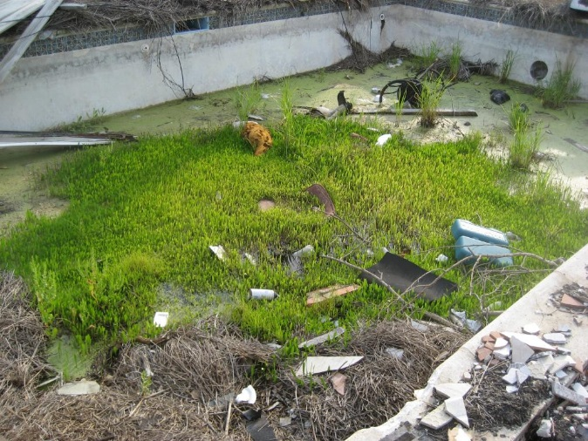
Breeding Grounds for Mosquito Larvae
Mosquito larvae
Sewing thimble
https://www.wikimedia.org
Standing pools of water, however small, are breeding grounds for mosquitoes. Even a sewing thimble can hold enough water for mosquitoes to breed.
https://www.onebrick.com

Slide 43
Recovery from a Virus
The amount of damage from a virus depends in part on how rapidly and forcefully the immune system responds to the threat.
The severity of damage also depends on the ability of the infected tissue to repair itself through cell division known as mitosis.
Tissues in the respiratory tract replace cells damaged in a common cold.

Slide 44
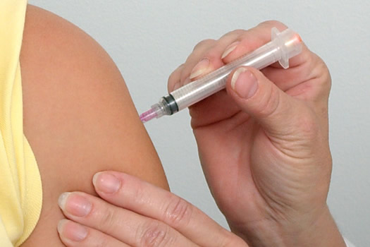
Vaccines and Antiviral Drugs
Vaccines, developed using attenuated or inactivated viruses, are used to build-up the body’s immune defenses.
Antibiotics, which are used for treating bacterial infections, are ineffec-tive against viruses.
Antibiotics can used to treat opportunistic bacterial infections that result from viral infections, but they have no effect on viruses.
The development of antiviral drugs has been challenging since destroy-ing the virus can also kill the host cells.
Attenuated = in this context, the word means weakened.
https://www.wac.450f.edgecastcdn.net

Slide 45
Immune System
The immune system includes red bone marrow (where white blood cells are produced), lymphatic vessels, lymphatic nodes and tissues, spleen, and thymus.
The immune system normally distinguishes self (our tissues) from non-self (foreign invaders).
Foreign invaders such as viruses, bacteria, and some environmental allergens are known as antigens that can trigger immune system re-sponses.
Allergen = a substance that causes an allergic reaction in some people, such as pollen or dog or cat hair.

Slide 46
Immune System (continued)
B cells release specialized protein molecules known as antibodies that tag an antigen (the invader) for destruction by T cells.
The response leaves behind small numbers of memory cells that can trigger a far more rapid immune system response if the antigen is ever encountered again.
B cells and T cells are types of lymphocytes that are one of the five types of white blood cells.

Slide 47
Transmission and Immunity
Unlike bacteria, viruses cannot exist in isolation from their biological hosts to produce more copies.
Some RNA and DNA viruses are transmitted from person-to-person.
However, transmission which can involve different routes depending on the virus.
Individual immunity depending on the virus can be achieved through infection or vaccination.

Slide 48
Herd Immunity
When a large percentage of a population is immune to an infec-tious disease, community protection may be conferred on people who are not immune.
The conferred protection is called herd immunity because it is was first studied in herds of cows for the cowpox virus (which is related to the smallpox virus in humans).
Some people cannot be vaccinated due to young or old age, being immunocompromised, or medical treatment for some types of can-cers.
Their protection to the infectious disease is achieved through herd immunity.
Conferred = granted or bestowed.
Immunocompromised = having an impaired immune system.

Slide 49
Vaccines
Vaccines for viral diseases have traditionally been produced from attenuated (weakened) or inactivated viruses.
Other approaches such as mRNA vaccines have been used for the novel coronavirus that causes COVID-19.
Vaccines for some bacterial diseases are produced from the exotoxins or endotoxins in pathogenic (disease-causing) bacteria.
Bacterial toxins are divided into exotoxins and endotoxins. While endotoxins are membrane compounds of gram-negative bacteria which elicit an inflammatory response in the host, exotoxins are secreted proteins which act locally and at distance of the bacterial colonization site.
(https://www.ncbi.nlm.nih.gov)

Slide 50
Vaccines (continued)
A vaccine is intended to fool the body’s immune system in generating a weak immune system response and memory cells if the virus is ever encountered again.
Some vaccines confer a lifetime of immunity—others may need to be repeated.
Vaccines, among others, are available for COVID-19, poliomyelitis; chickenpox; shingles (in older people); rotavirus; influenza; measles, mumps, and rubella (MMR); and bacterial tetanus, diphtheria, and per-tussis (Tdap).
Memory cells = long-lived immune system cells that have the ability to recognize a foreign invader that it previously encountered and consequently mount a faster and stronger immune response.
(Adapted from: https://www.biologyonline.com)

Slide 51
Vaccine Development
Vaccines have a long history extending back to the development of the smallpox vaccine by the physician Edward Jenner in England in 1796.
It was well known at the time that people who milked cows either did not get smallpox or had mild cases.
His discovery of the relationship between cowpox pus on the udders of cows and the smallpox virus led to the development of a vaccine.
Exposure to cowpox triggered an immune system response that gave immunity to smallpox.

Slide 52
Vaccine Development (continued)
A vaccine must pass an initial safety trial, then a small efficacy trial to prove that it actually works, and finally a large field trial before it is cer-tified for human use.
The introduction of a vaccine can take many years and cost billions of dollars.
Efficacy = the ability of a vaccine to produce a desired or intended result in controlled field trials.
Effectiveness = the ability of a vaccine to produce a desired or intended result in real-life conditions.

Slide 53
Poliomyelitis (Polio)
The three strains of the poliomyelitis RNA virus target neurons in the spinal cord (spinal motor neurons).
Spinal motor neurons control our skeletal muscles including those that regulate body movements and the inhalation phase of breath-ing.
Since neurons in humans cannot divide through mitosis to produce new neurons, the damage is permanent.
The transmission of the poliomyelitis virus is through feces or saliva (known as the fecal-oral route).

Slide 54
Poliomyelitis (continued)
The initial symptoms include fever, severe headache, stiff neck and back, muscle pain and weakness, and loss of some somatic reflexes.
An individual may not be able to breath unassisted if the polio virus destroys motor neurons that control the skeletal muscles for breath-ing (external intercostals and diaphragm).
Respiratory or heart failure can result if the virus invades centers in the brainstem.

Slide 55
Poliomyelitis (continued)
Some individuals, many years after being afflicted with the polio virus, develop a post-polio syndrome.
Slow degeneration of motor neurons in this syndrome can produce a progressive muscle weakness, extreme fatigue, loss of muscle func-tion, and chronic pain.

Slide 56
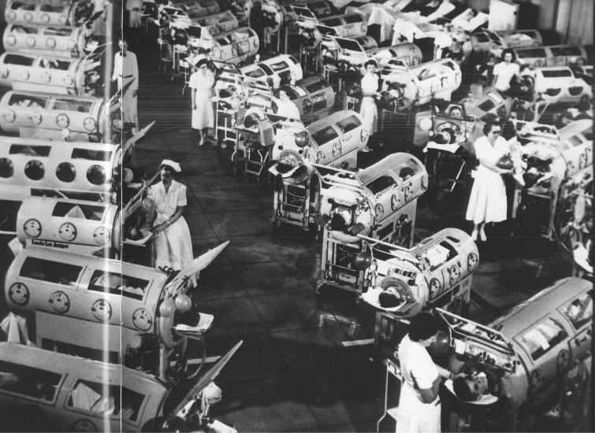
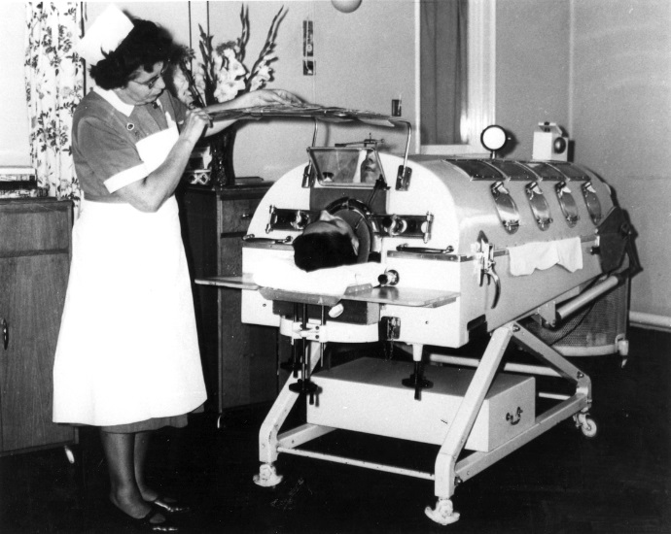
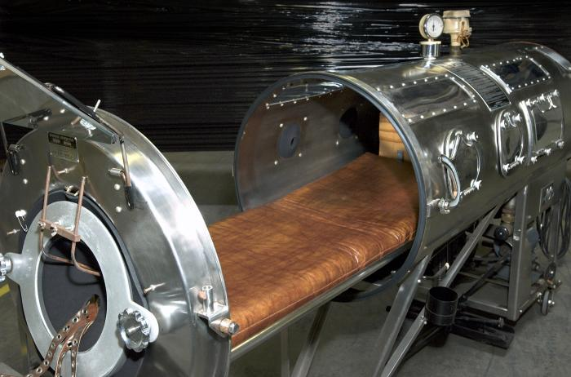
Iron Lung
Rancho Los Amigos
In Downey, California
during the 1950s.
https://www.ccat.sas.upenn.edu
https://www.nbt.nhs.uk
https://www.wikimedia.org
The iron lung is an assisted breathing device. Some patients with polio spent years in iron lungs.

Slide 57
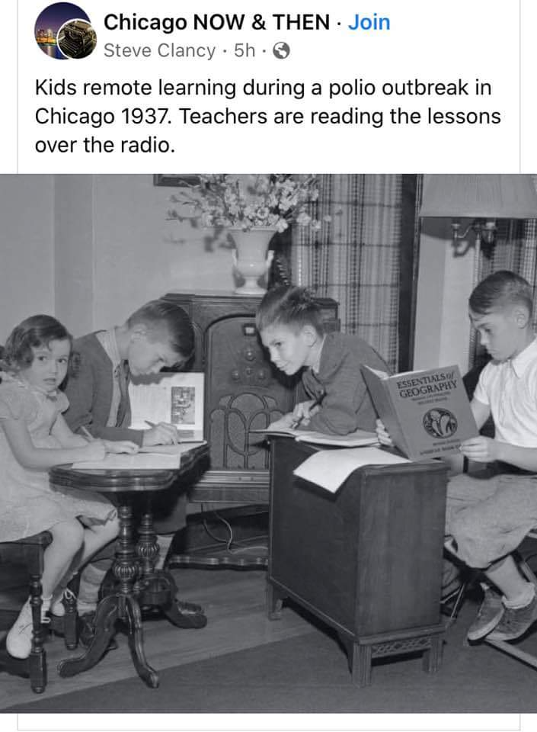
Remote Learning (1937)
Downloaded, October 2021

Slide 58
Polio Vaccine
An injectable poliomyelitis vaccine was developed from an inactiva-ted virus in the early-1950s and was introduced after much testing in 1955.
An oral vaccine was developed from an attenuated (weakened) virus and introduced in the early-1960s.
The oral vaccine can mutate in rare circumstances and cause addi-tional cases of poliomyelitis.
Today, although the injectable vaccine is more expensive to produce and administer, it is used almost exclusively in the United States and other countries due to its safety (it can’t mutate and become virulent).
Tap or click here to learn about the history of the Salk and Sabin polio vaccines.

Slide 59
Re-emergence of Polio
By the 1990s, due to vaccination programs, polio was considered to be eradicated worldwide except in some isolated mountain regions in the Middle East.
As of 2022 (right now), polio has remerged as a public health threat in Europe and the United States.
Re-emergence is mostly attributed to declining polio vaccination rates.

Slide 60
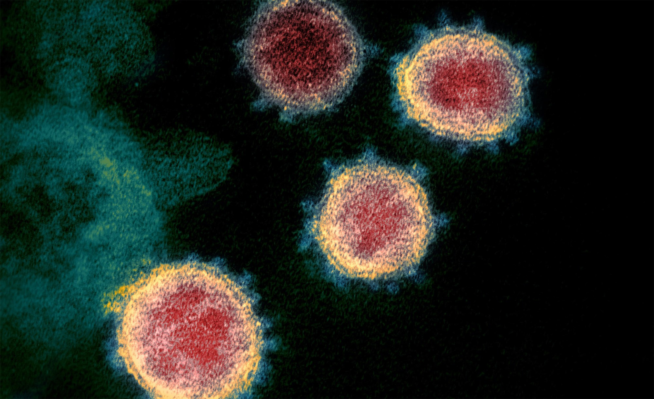
Coronaviruses
Coronaviruses are named because they look like crowns, or coronas, when viewed using a scanning electron microscope.
Coronaviruses originate, mutate, and multiply in some species of bats—the virus can be transmitted to other animals through their saliva, urine, or feces.
Bats are mammals but they have a partially-developed immune system to conserve energy for flight, which enables some viruses to flourish.
Coronaviruses transmitted to humans from animals include those that
cause Severe Acute Respiratory Syndrome (SARS), Middle East Respiratory Syndrome (MERS), and COVID-19.
False-color, scanning electron micrograph
https://www.nbcnews.com

Slide 61
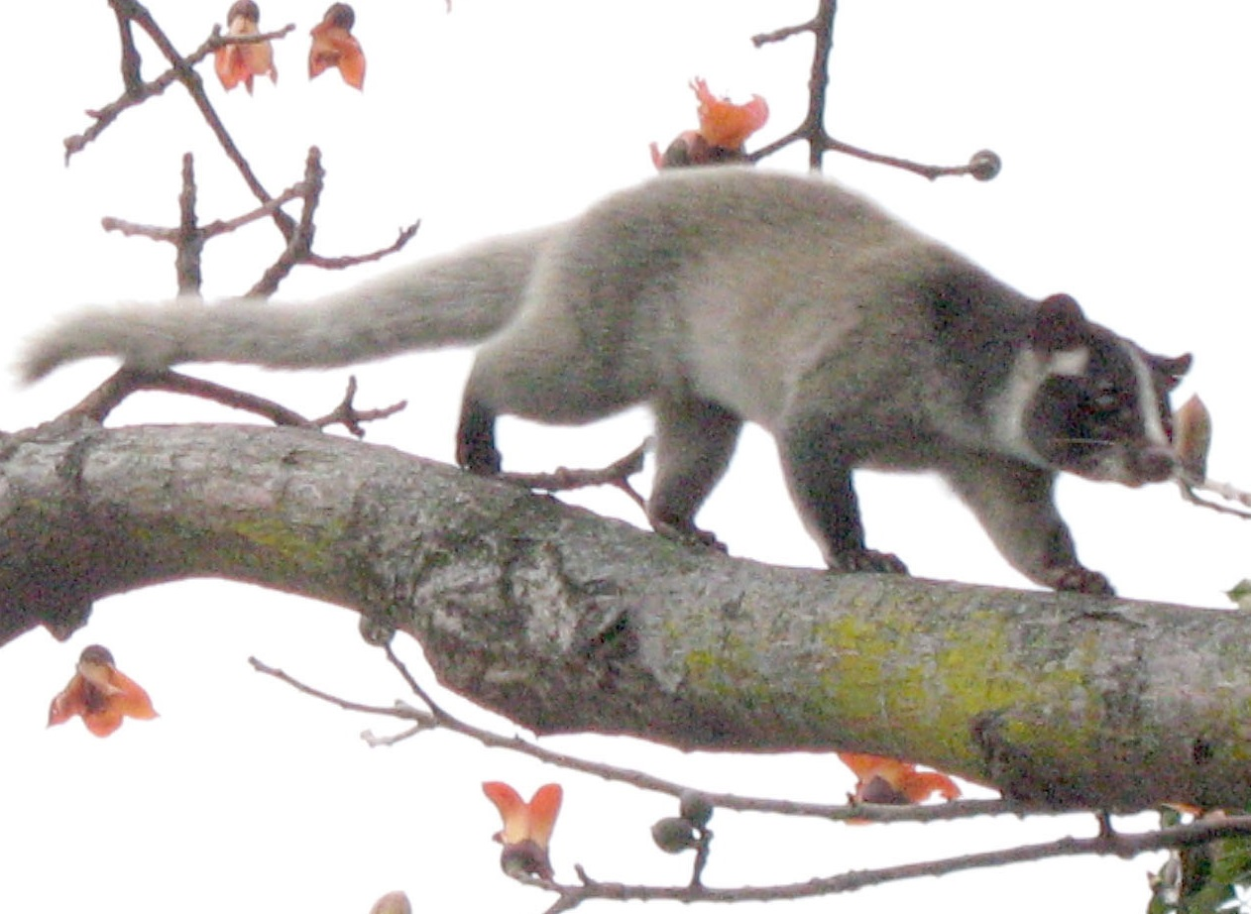
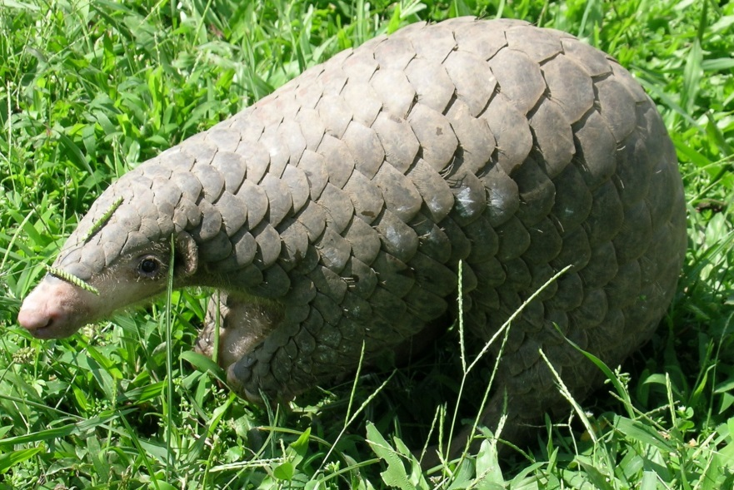
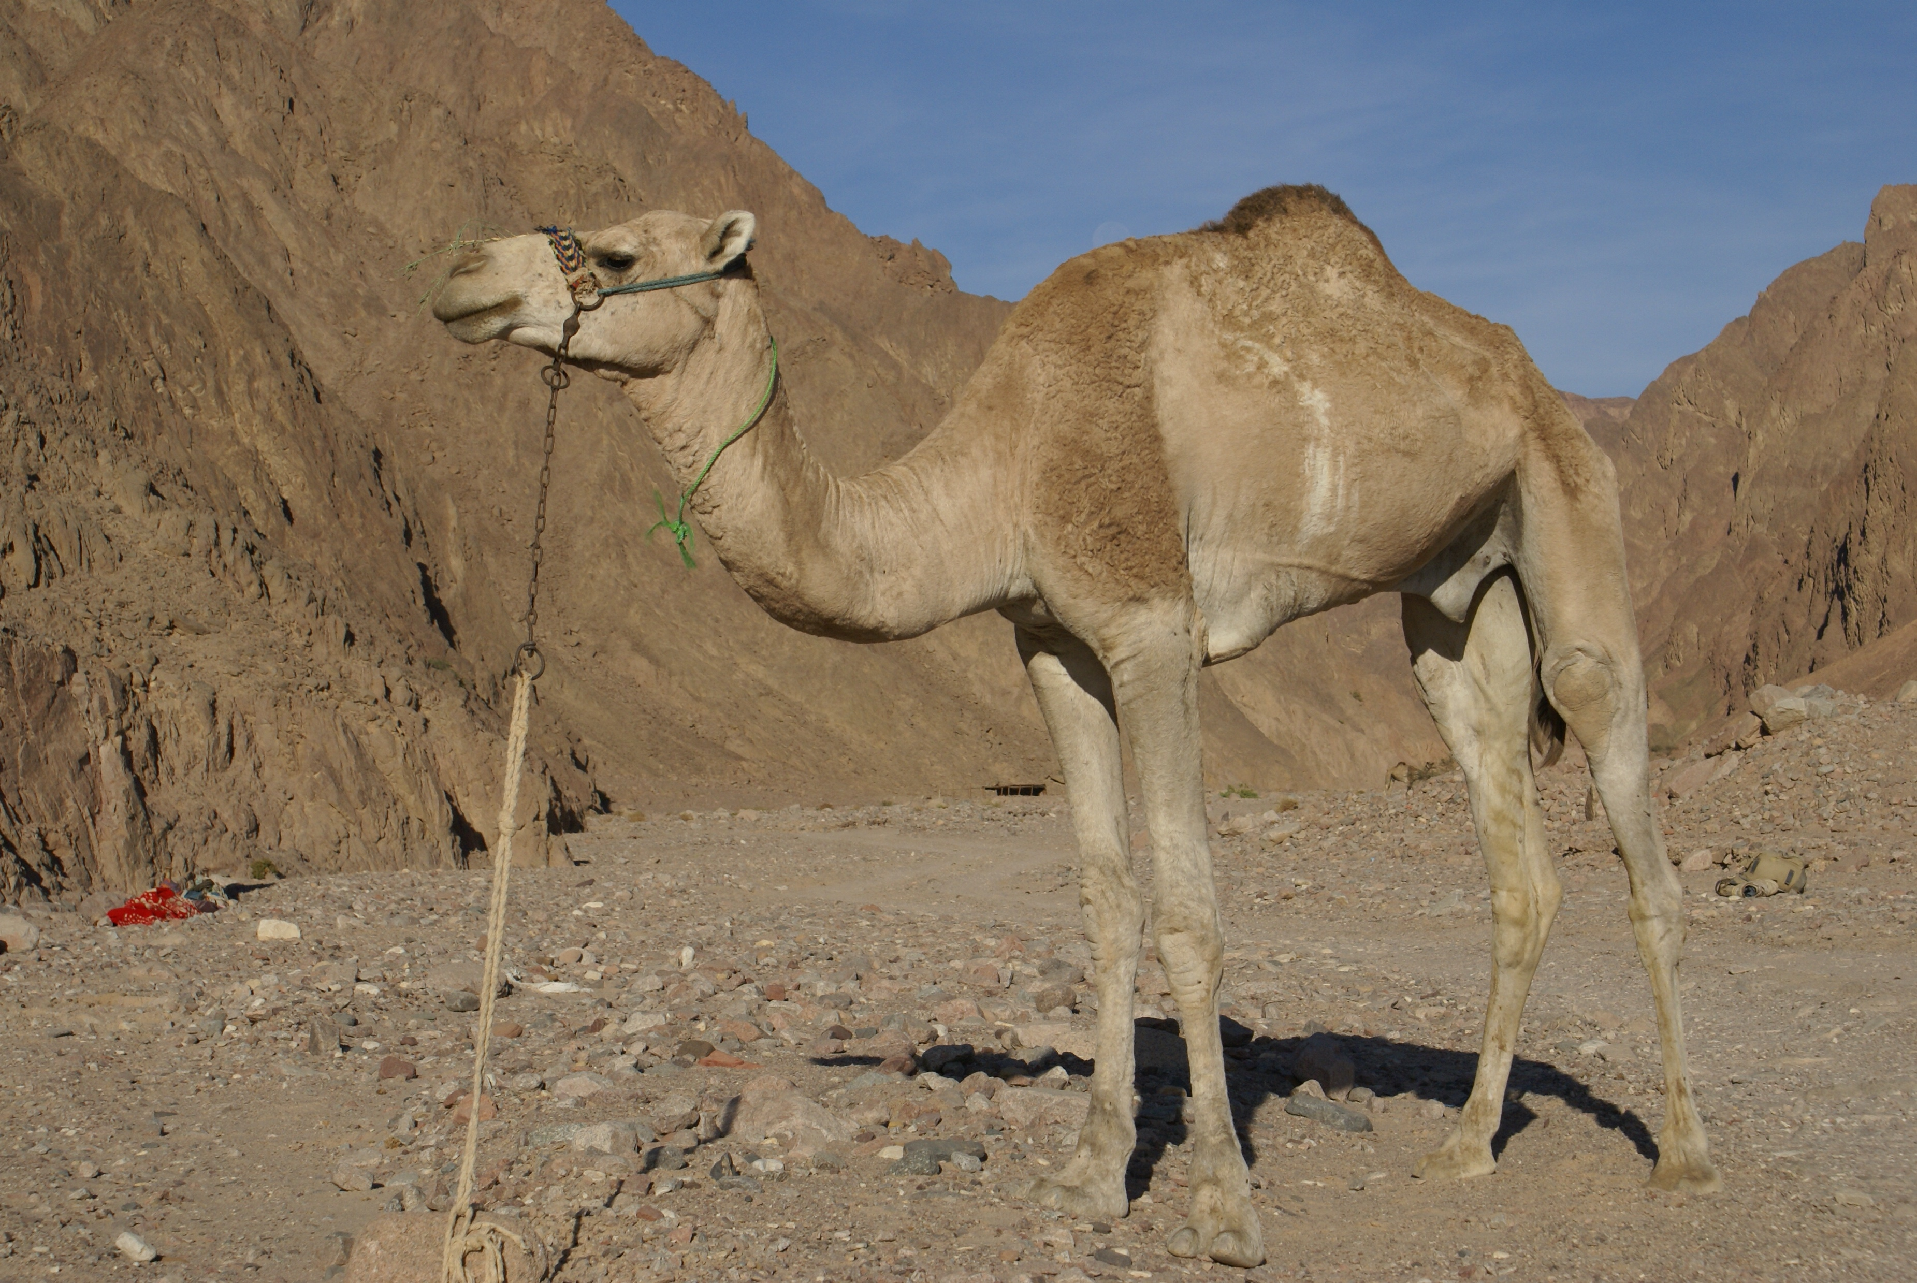
Zoonotic Transmission of Coronaviruses
Zoonotic = refers to transmission of a virus from animals to humans.
Middle East Respiratory Syndrome (MERS)—virus from bats to dromedary camels to humans.
Severe Acute Respiratory Syndrome (SARS)—virus from bats to civets to humans.
COVID-19—virus from bats to pangolins to humans.
All images are from
https://www.wikipedia.org

Slide 62
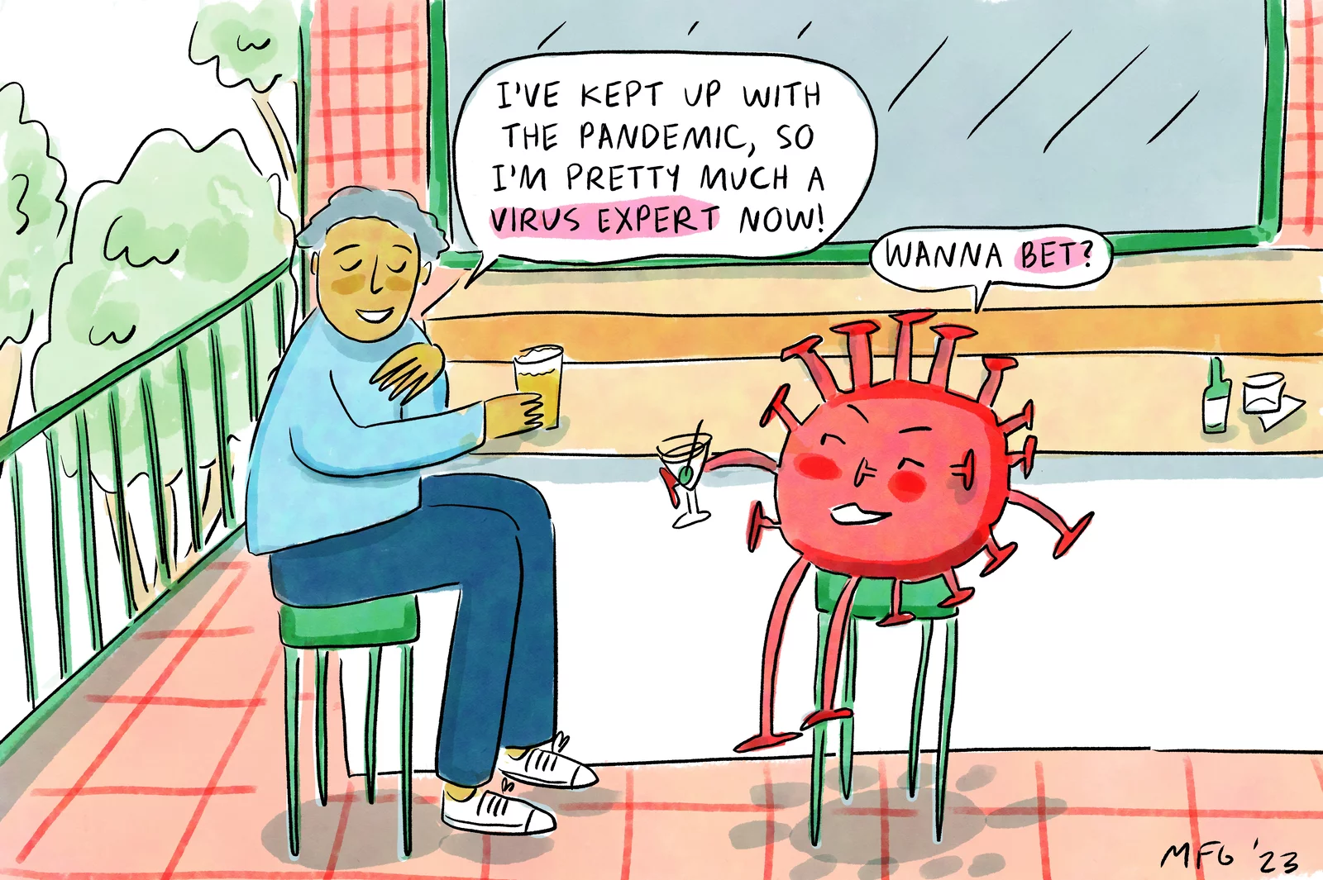
COVID-19
NPR, January 30, 2023

Slide 63
SARS-CoV-2
SARS-CoV-2 is the scientific name for the novel coronavirus that causes COVID-19—“novel” means new.
The virus was first detected in Wuhan, China in late-2019, after it (probably) made a jump from bats to pangolins, which then infected humans.
The virus, which is highly contagious, causes the disease known as COVID-19.
It began to spread rapidly worldwide in January 2020, by air travel.
Much of the original SARS-CoV-2 virus in the United States made its way through Europe from China based on genetic studies of he viral mutations of its RNA.
Tap or click here to learn about novel coronavirus terminology for everyday life.

Slide 64
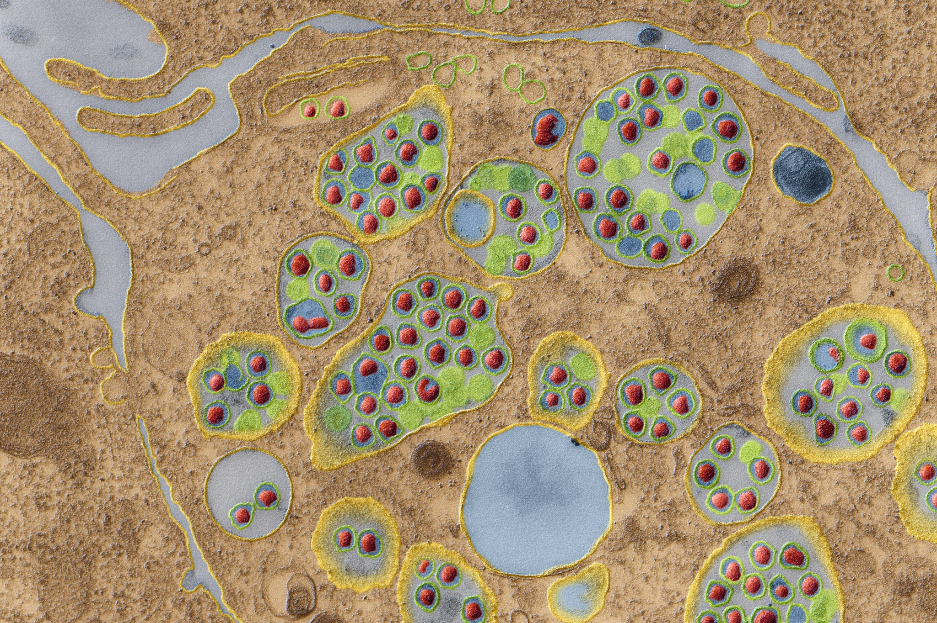
SARS-CoV-2 (continued)
https://www.nytimes.com
False-color, transmission electron micrograph of many copies of the SARS-CoV-2 virus (in red) inside a cell. The virus binds to ACE2 receptors of human cells.

Slide 65
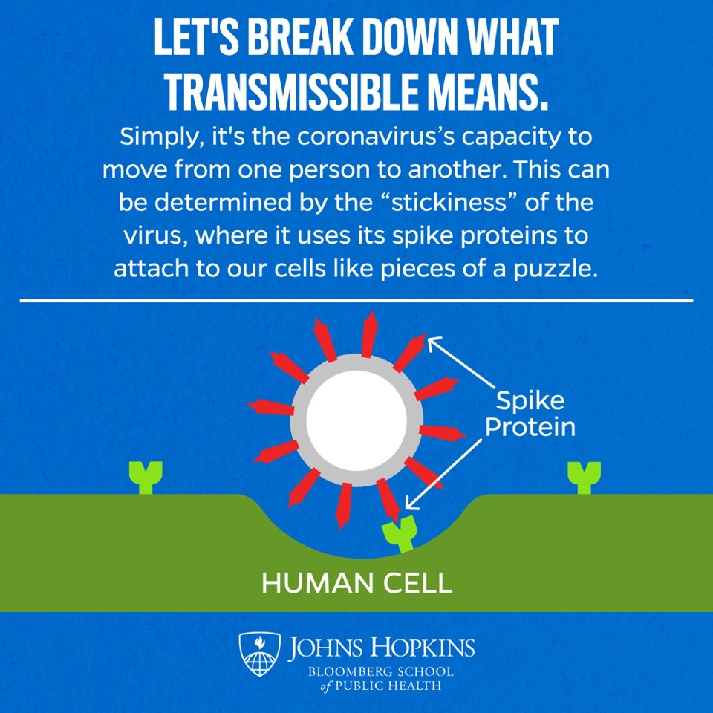
Spike Protein and Cell Receptors

Slide 66
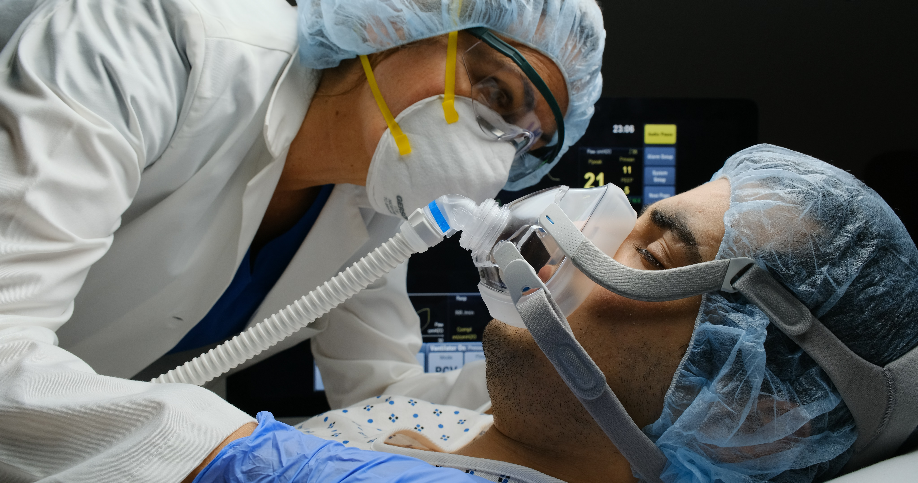
Immune System Responses
Immune system responses to SARS-CoV-2 leave viral and white blood cell debris and fluid that can fill all or part of the lungs which causes pneumonia.
A severely ill, COVID-19 patient may require supplemental oxygen including possibly the use of a ventilator or sometimes even ECMO.
Less commonly, the virus acts upon the heart, blood vessels, kid-neys, and nervous tissues—however, its effects can be devastating.
ECMO = extracorporeal membrane oxygenation (involves a heart-lung machine).
A ventilated patient
https://www.arlingtonmagazine.com
Tap or click here for more information.

Slide 67
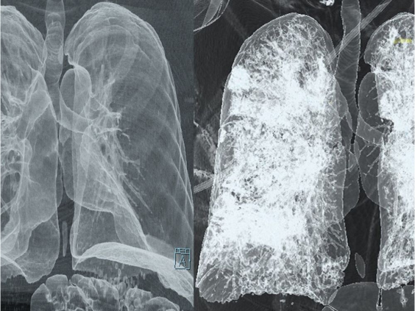
Comparison of X-Rays
https://www.vancouversun.com
Healthy lungs (left) and lung infection (right) in a severely-ill, COVID-19 patient (right). Note the “ground glass” appearance of the tissues in the infected lungs. The visual appearance is due to alveoli filled with viral and cellular debris and fluid.

Slide 68
Signs and Symptoms
A sign is what others can observe or measure—for example, a high fever.
A symptom is what an individual experiences—for example, pain.

Slide 69
Airborne Transmission
SARS-CoV-2 is spread through respiratory transmission of droplets (> 5 microns in diameter) and droplet nuclei (< 5 microns) of mucus when an infected person exhales.
Not every infected person shows signs and symptoms of COVID-19, but they can still unknowingly spread the virus to other people (of all ages) when they exhale.
Facemasks (N95 or KN95 classification) are very important in pre-venting the spread of the virus to ourselves and others.
Droplets fall to the ground fairly quickly due to gravity, while droplet nuclei stay suspended in air for longer periods of time.
N95 and KN95 masks meet the U.S. National Institute for Occupational Safety and Health (NIOSH) N95 classification of air filtration, meaning that it filters at least 95% of airborne particles.

Slide 70
Contaminated Surfaces
SARS-CoV-2 can also be spread by touching an object that has the virion (virus) on its surface.
The object is known as a fomite.
The virus can survive for a few hours to possibly a few days depend-ing on the type of surface.
Handwashing using a soap or sanitizer is important to prevent the virus coming in contact with a person’s mouth, nostrils, or eyes.
Learning not to touch out faces (a natural human behavior) can help prevent an infection.
Fomite = an object (such as a dish, door-knob, or article of clothing) that may be contaminated with infectious agents (such as bacteria or viruses) and serve in their transmission.
(https://www.merriam-webster.com)

Slide 71
Signs and Symptoms
According to the U.S. Centers Disease for Control and Prevention (CDC), “People with COVID-19 have had a wide range of symptoms ranging from mild (signs and) symptoms to severe illness. Symptoms may appear 2 to 14 days after exposure to the virus. People with these symptoms may have COVID-19.”
Fever or chills
Cough
Shortness of breath or difficulty breathing
Loss of taste and smell (once thought to be rare)
Fatigue
Muscle or body aches
Headache
Sore throat
Congestion or runny nose
Nausea or vomiting
Diarrhea

Slide 72
Self Care
According to the CDC, if you have possible or confirmed COVID-19:
  Stay home except to get medical care.
  Get rest and stay hydrated. Take over the counter medicines, such as acetaminophen, to help you feel better.
  Monitor your symptoms carefully. If your symptoms get worse, call your healthcare provider immediately.
  If you have a medical appointment, notify your healthcare provider ahead of time that you may have COVID-19.
  Stay in a specific room and away from other people in your home. If possible, use a separate bathroom. If you must be around others, wear a facemask.
Verbatim from the CDC website, https://www.cdc.gov.

Slide 73
Case-Fatality Rate
Case-fatality rate is the proportion of persons with a particular condition (such as COVID-19) who die from that condition. For COVID-19, the denominator is the number of people infected with SARS-CoV-2 virus and the numerator is the number of related deaths.
(Adapted from the CDC website, https://www.cdc.gov)
For COVID-19, determining the denominator has been difficult because some people who are infected are asymptomatic (showing no signs and symptoms).
Others who are infected don’t get counted in the denominator due to un-availability of sufficient testing.
Determining the actual numerator has also been difficult because some deaths related to the disease have been attributed by some healthcare providers and coroners to other causes—so these people also don’t get counted.

Slide 74
Case-Fatality Rate (continued)
The case-fatality rate for COVID-19 is thought to be about one per-cent.
The rate is higher for older people and those who have preexisting conditions such as diabetes and cardiovascular or respiratory prob-lems.
The rate is higher for lower-income communities for many reasons including people who cannot shelter at home since they have been designated as essential workers.

Slide 75
Case-Fatality Rate (continued)
The virus can infect and even disable or kill healthy, young people.
For other coronaviruses, the case-fatality rates were about 10 per-cent for SARS (2002-04) and 30 to 40 percent for MERS (2008 and still active).
Widespread catastrophes were averted because SARS and MERS were not nearly as infectious as COVID-19 due to lower transmissi-bility.
Tap or click here to learn about Multisystem Inflammatory Syndrome in Children (MIS-C).

Slide 76
Long COVID
The signs and symptoms of COVID-19 can persist for many months and possibly even years.
Long COVID can result not only from severe cases but sometimes milder cases of infection.
The effects of long COVID can be debilitating—there is uncertainty at this time over whether the effects are entirely reversible.

Slide 77
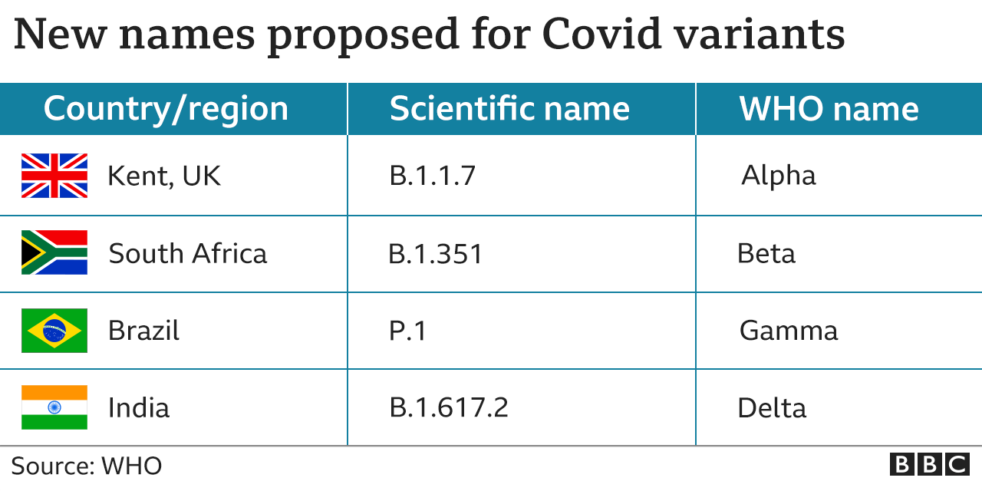
SARS-CoV-2 Variants
... And now, Omicron and its subvariants.

Slide 78
Omicron
Omicron (BA.5) is a subvariant of SARS CoV-2 (as of late 2022).
It is highly infectious, but it appears to have a lower case fatality rate, at least among younger people.
Still, about 300 to 400 people in the United States die every day from the virus.
A bivalent vaccine is available as of September 2022; however, federal funding for its distribution is in question.
Bivalent vaccine = targets two different variants of the SARS-COV-2 virus.
Tap or click here for “What sets BA.5 apart from other COVID-19 variants.”

Slide 79
Reproduction Number
R = 2 indicates that a person in the infectious stage of a disease will infect, on average, two people and those two people will each infect two people.
In actuality, it may not be a true geometric progression of 1, 2, 4, 8, 16, 32, 64, 128, 256, and so on.
For some infectious diseases, about 10 to 20 percent of those who are infected are responsible for about 80 percent of the total number of cases.
For COVID-19, this 10 to 20 percent could be either symptomatic or asymptomatic.

Slide 80
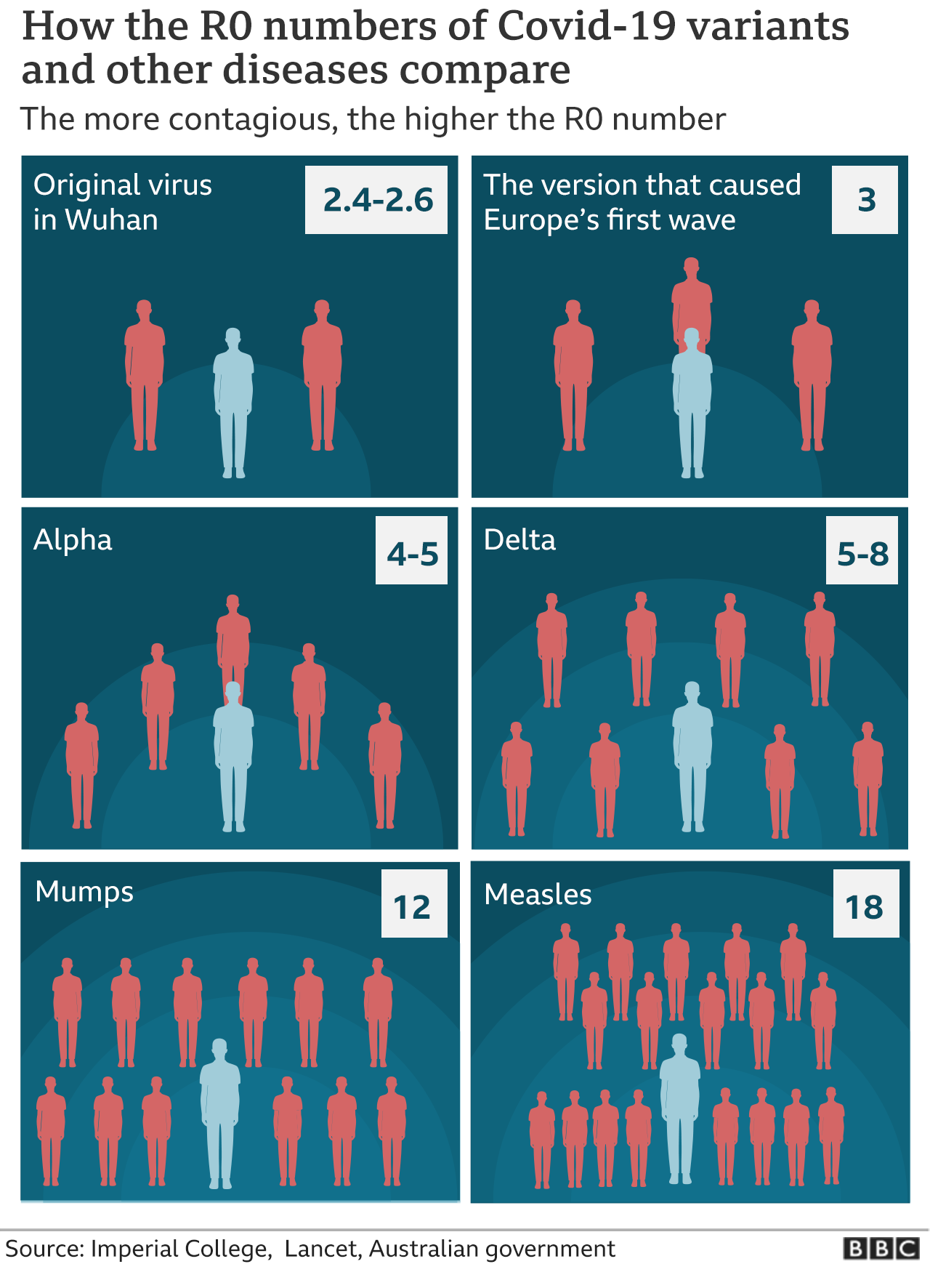
Reproduction Numbers Compared

Slide 81
Geometric Progressions Over Ten Generations
R = 3 (SARS-CoV-2 virus, early 2020)
1, 3, 9, 27, 81, 243, 729, 2,187, 6,561, 19,683
R = 5 (alpha variant, spring 2021)
1, 5, 25, 125, 625, 3,125, 15,625, 78,125, 390,625, 1,953,125
R = 8 (delta variant, fall 2021)
1, 8, 64, 512, 4,096, 32,768, 262,144, 2,097,152, 16,777,216, 134,217,728
R = > 8 (omicron subvariant BA.5, 2022)
Relatively small differences in the reproduction numbers result in big differences in infection outcomes.

Slide 82
Reproduction Number and Herd Immunity
Zero percent of the world’s population was presumed to have SARS-CoV-2 antibodies (Fall 2019).
20 percent of the New York City population had SARS-CoV-2 antibodies (late-May 2020).
Estimated herd immunity for SARS-CoV-2 for the alpha variant—70 percent of the population
(R = 3).
Herd immunity for measles, which is very contagious—
95 percent of the population
(R = 12 to 18).
R = reproduction number.

Slide 83
D.O.T.S.
Duration—length of time that a person is exposed to the contagion.
Opportunity—path of transmission (such as face-to-face conversa-tions).
Transmissibility—the probability (likelihood) that the opportunity will lead to transmission of the virus.
Susceptibility—the average probability that a population will become infected.
Each of the four factors contributes to the reproduction number. The factors can be studied individually (or in combination) to determine their relative contribution to the spread of an infectious disease such as COVID-19.

Slide 84
Vaccine Development
Governments, academic institutions, and commercial enterprises took various approaches to speed up the development of vaccines for SARS-CoV-2.
The vaccines used in the United States are produced by Moderna, Pfizer-BioNTech, and Johnson & Johnson—the first two are mes-senger RNA (mRNA) vaccines.
Booster vaccines have also been developed and are widely avail-able.
Tap or click here and here to learn about the approaches used by vaccine researchers to develop vaccines for COVID-19.

Slide 85
Preventive Measures for COVID-19
Get vaccinated (there is no financial cost to you)
Be tested—Los Angeles County offers COVID-19 testing options
Wear a facemask (especially N95 or KN95) to protect yourself and other people
Wash or sanitize our hands for 20 seconds
Avoid touching our faces
Maintain social (physical) distances in accordance with CDC guide-lines
Stay otherwise healthy (exercise, diet, rest, and stress management)
How to estimate 20 seconds = sing the “Happy Birthday” song twice.
Happy birthday to you,
Happy birthday to you,
Happy birthday dear (name),
Happy birthday to you.

Slide 86
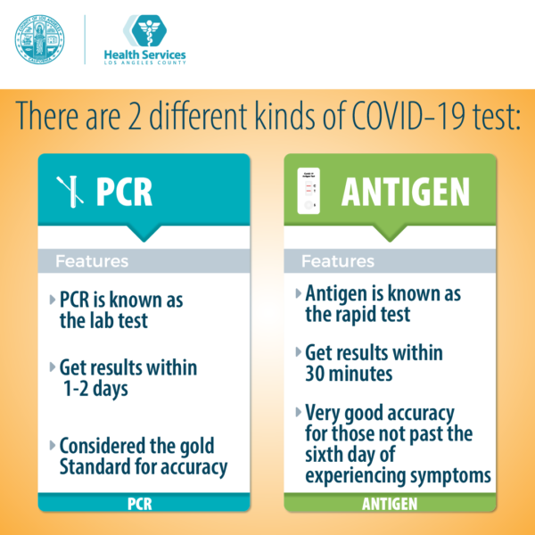
COVID-19 Testing
https://www.dhs.lacounty.gov/covid-19/testing
The COVID-19 rapid antigen (“home”) test tends to yield high false negative rates—especially for the first few days after infection when the viral load is low.

Slide 87
Monoclonal Antibodies
They are an experimental drug treatment involving harvesting anti-bodies from patients that have had COVID-19 to produce copies of the antibodies in laboratories.
The two companies that offer monoclonal antibodies for COVID-19 are Regeneron and Eli Lilly.
The drug cost is about $2,100, or about one hundred times the cost of the vaccine.
Monoclonal antibodies must be given with ten days of infection—they are usually not effective with patients that have already been hospitalized for COVID-19.
Monoclonal antibodies do not provide protection against COVID-19 reinfection.

Slide 88
Hydroxychloroquine and Ivermectin
Hydroxychloroquine is used to treat malaria, which is not a virus, and some autoimmune conditions including lupus and and rheu-matoid arthritis.
Ivermectin is intended to treat head lice in humans and deworm horses and cows.
Neither medication has U.S. Food and Drug Administration (FDA) approval for the treatment of COVID-19, which is a viral disease.
There are no data from randomized, case-controlled studies to support their use.

Slide 89
Hydroxychloroquine and Ivermectin (continued)
Most of the so-called evidence is anecdotal including from a small group of physicians who broadcast on social media.
People have been poisoned by self-medication—poison control hotlines have had a sharp uprise in the number of telephone calls during the pandemic.
Tap or click here to learn more about the spread of medical misinformation.

Slide 90
Paxlovid
Paxlovid, a prescription medicine, is an oral antiviral that must be given within five days of the first signs and symptoms of COVID-19.
In 2021 and 2022, the FDA gave emergency authorization for its use for moderate cases of COVID-19 in adults and in children 12 years of age and older.
Paxlovid reduces the risks of hospitalization; however, it does not prevent COVID-19.
Tap of click here to learn more about Paxlovid and here on why it is being underused.

Slide 91
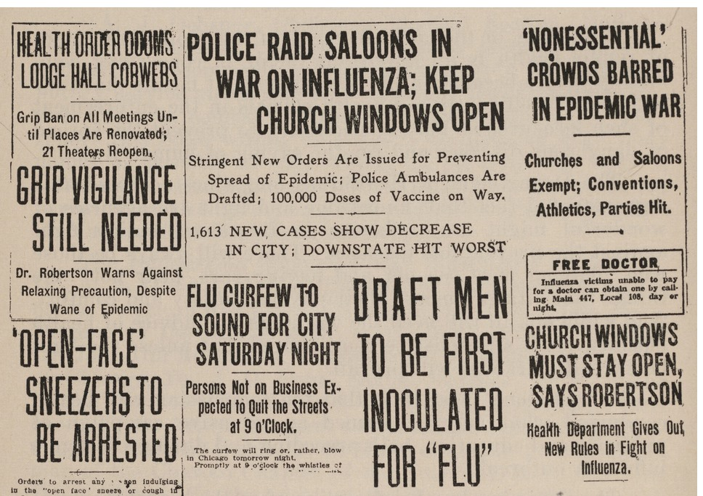
1918-19 Flu Pandemic
Hmm… sort of seems familiar.
Tap or click here to read about the “The Mask Slackers of 1918.”

Slide 92
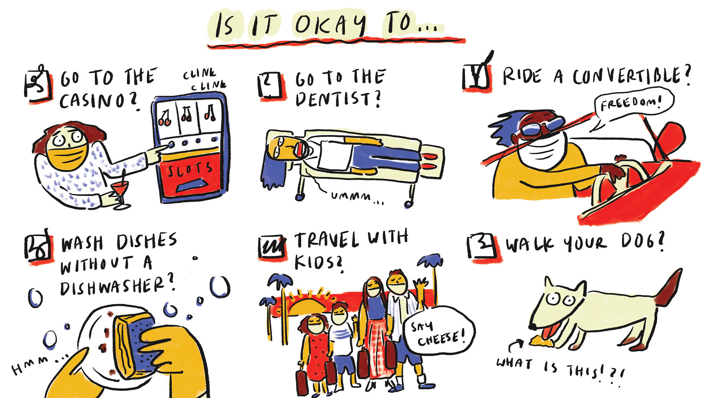
Moving Forward on Reopening
NPR website, June 12, 2020
92
Notes:
92

Slide 93
Existential Threats
Nuclear war
Asteroid impact
Global climate change
Global pandemic
Existential threat = a threat to civilization’s very existence—when the continued being of something is at stake or in danger. It is used to describe threats to actual living things.
(https://www.dictionary.com)
Osterholm, Michael T. and Olshaker Mark. Deadliest Enemy: Our War Against Killer Germs. New York: Little, Brown, 2017.

Slide 94
In Closing
“The more an RNA virus replicates, the more it mutates.”
“We might be done with the virus, but the virus may not be done with us.”
94
Notes:
94

