Slide 1
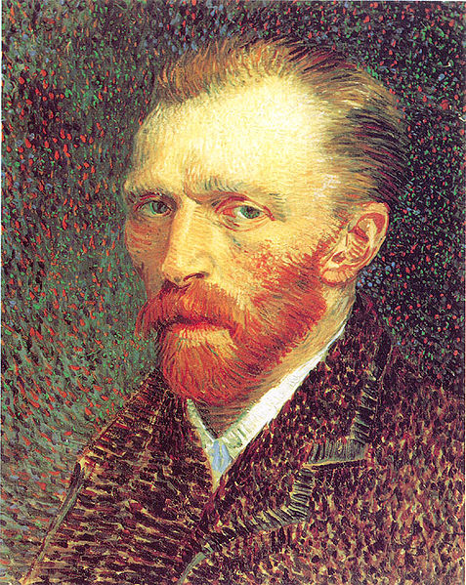
Vincent Van Gogh
Temporal Lobe Epilepsy?

Slide 2
Temporal Lobe Epilepsy
Temporal lobe seizures typically last from 30 seconds to about two minutes.
These seizures often involve structures in the limbic system due to fiber (axon) connections with the temporal lobes.
People who experience temporal lobe seizures may remain partial-ly conscious during the event.
They often lose awareness of their surroundings and later may not recall the episode.
Temporal lobe seizures are often followed by a period of confusion, emotionality, and difficulty in speaking.

Slide 3
Signs and Symptoms
Temporal lobe seizures are often accompanied by:
  Loss of awareness
  Staring
  Lip smacking
  Repeated swallowing or chewing
  Unusual finger movements, such as picking motions
Signs = objective evidence of a disease or disorder.
Symptoms = sensations of a disease or disorder reported by the patient.
The information is taken verbatim from the Mayo Clinic website:
https://www.mayoclinic.org

Slide 4
Preictal Aura
A temporal lobe seizure may be preceded by an unusual sensation or emotion known as a preictal aura.
The aura can include general feelings of fear and déjà vu experi-ences.
The aura is a localized seizure that has yet to spread to other parts of the temporal lobe.
Preictal = the state immediately before the actual seizure.
Déjà vu = a feeling that an experience is being repeated.

Slide 5
Possible Progression
Temporal lobe seizures can progress into grand mal, or tonic-clonic seizures.
Grand mal seizures are characterized by loss of consciousness and convulsions.
About 50 percent of persons with temporal lobe epilepsy are likely to experience grand mal seizures at some time in their lives.

Slide 6
If You Encounter a Grand Mal Seizure
If rhythmic muscle contractions or jerky movements occur in someone having a temporal lobe seizure, a grand mal seizure may be developing. Follow these tips:
Call for medical help immediately.
Gently roll the person onto one side and put something soft under his or her head.
Loosen tight neckwear.
Don't put anything in the mouth—the tongue cannot be swallowed but objects placed in the mouth can be bitten or inhaled.
Don't try to restrain the person—look for a medical alert bracelet that may identify an emergency contact person and medical information.
The information is taken largely verbatim from the Mayo Clinic website:
https://www.mayoclinic.org

Slide 7
Some Risk Factors for Epilepsy
Emotional stress
Illness, especially infection
Lack of sleep
Pregnancy
Use of alcohol or illicit drugs
Certain prescribed medications
Skipping doses of anti-seizure medications
The information is taken largely verbatim from the Google Health website:
https://www.health.google.com

Slide 8
Emotional Connections and the Arts
Temporal lobe seizures are often accompanied by sensory experiences including vibrant and intense colors.
Based on the research of medical historians, the mental and emotional states accompanying temporal lobe seizures may have contributed to significant works of art.
Some well-known writers and artists are thought to have had temporal lobe seizures, which in some instances may have been aggravated by alcoholism.
  Edgar Allen Poe (1809-1849)
  Fyodor Dostoevsky (1821-1881)
  Charles Lutwidge Dodgson—Lewis Carroll (1832-1898)
  Vincent Van Gogh (1853-1890)

Slide 9
Vincent Van Gogh
Vincent Van Gogh’s productive career as an artist lasted about eight years.
His adult life was increasing punctuated by intense emotional upsets, preictal experiences, and episodes that may have been temporal lobe seizures.
He was confined several times in what were then called mental asy-lums during his most productive years as a painter.
The visual intensity and abstract forms in Van Gogh’s paintings appear to coincide with an increasing severity of his emotional prob-lems.

Slide 10
Progression of a Life in Paintings

Slide 11
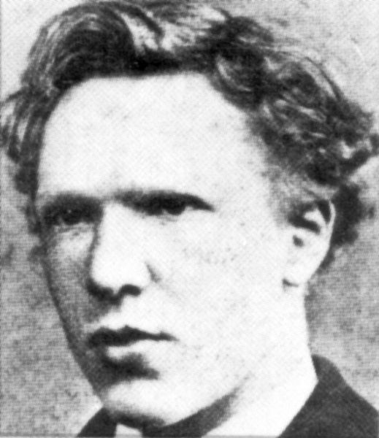
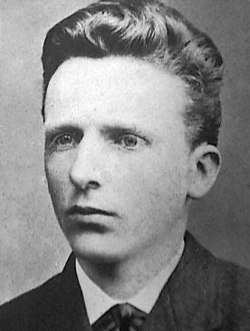
Vincent and His Brother Theo
Theo at 13
Vincent at 18
Both images from https://www.wikimedia.org
Theo Van Gogh financially supported his brother during his eight years as a painter (Vincent wasn’t able to sell more than a few paintings during his lifetime).

Slide 12
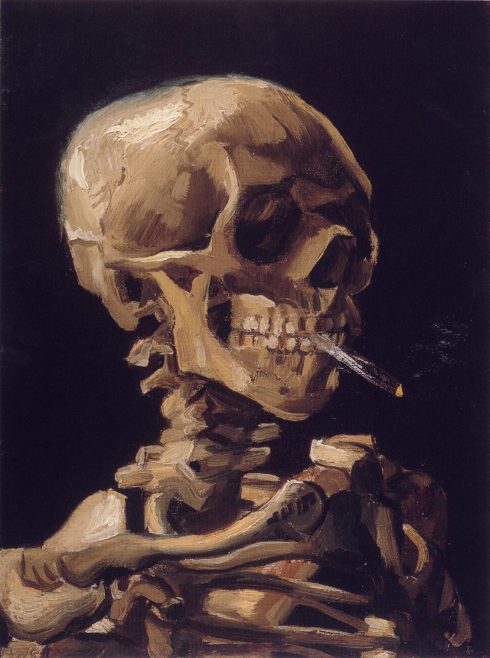
Skull of a Skeleton with Burning Cigarette (1885)

Slide 13
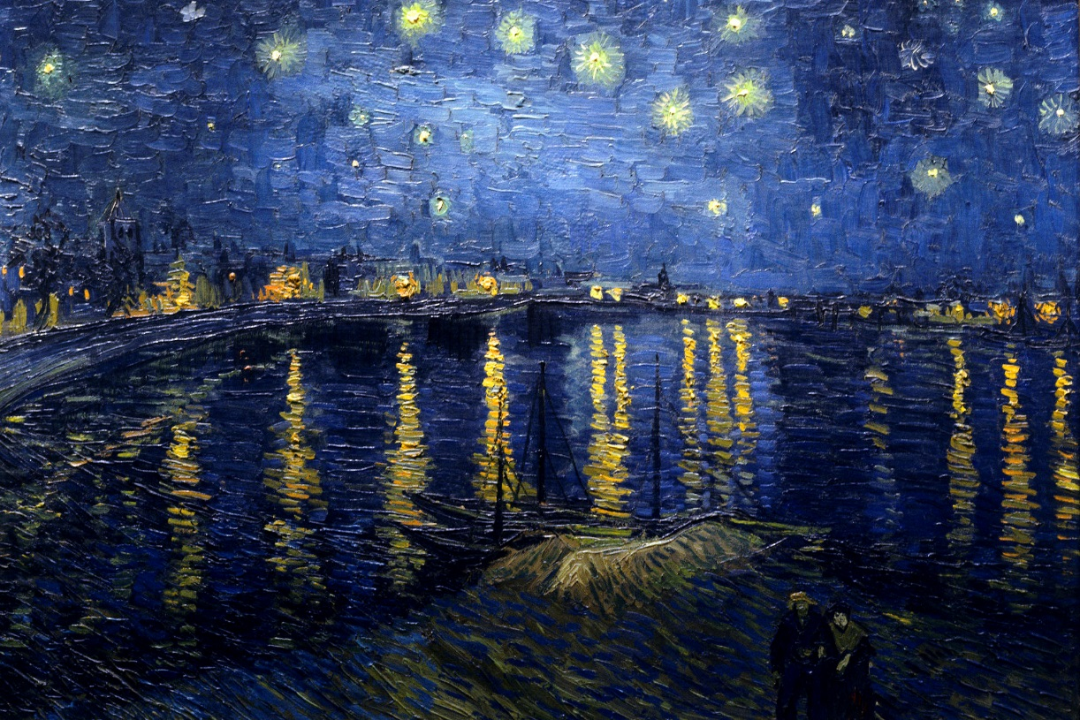
Starry Night Over the Rhone (1888)

Slide 14
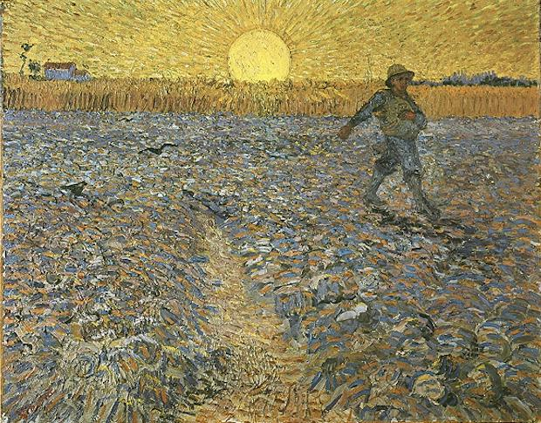
The Sower (1888)

Slide 15
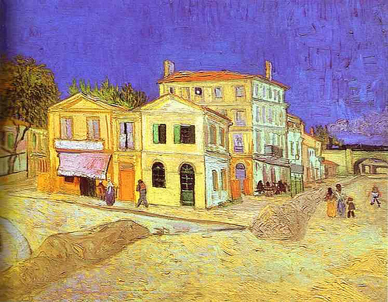
The Yellow House (1888)

Slide 16
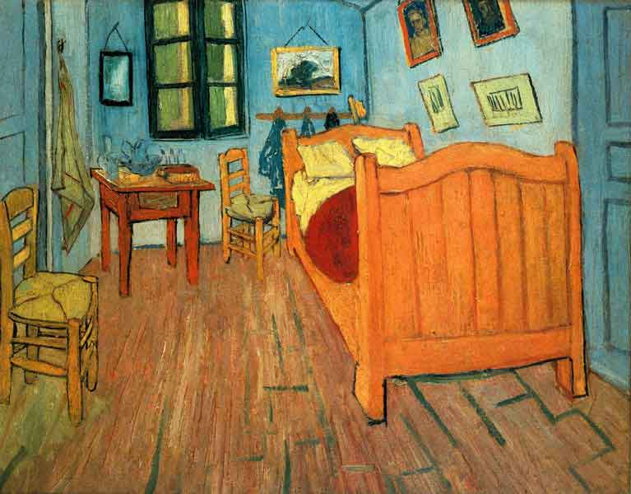
Bedroom in Arles (1888)

Slide 17
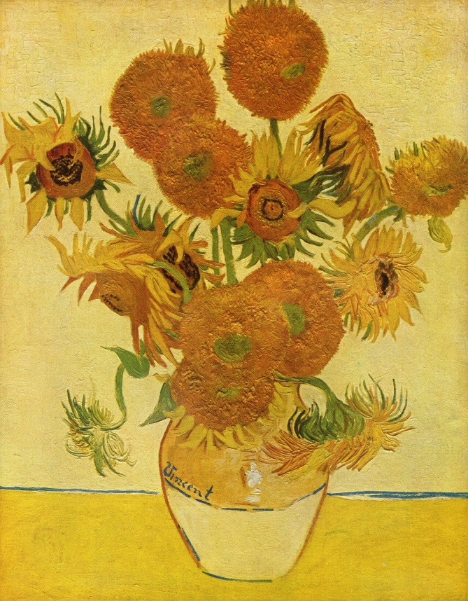
Still Life: Vase with Twelve Sunflowers (1888)

Slide 18
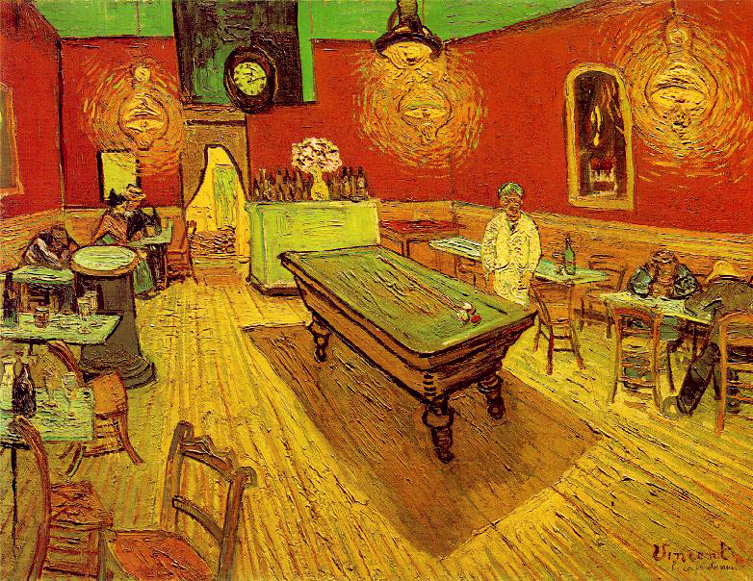
The Night Café (1888)

Slide 19
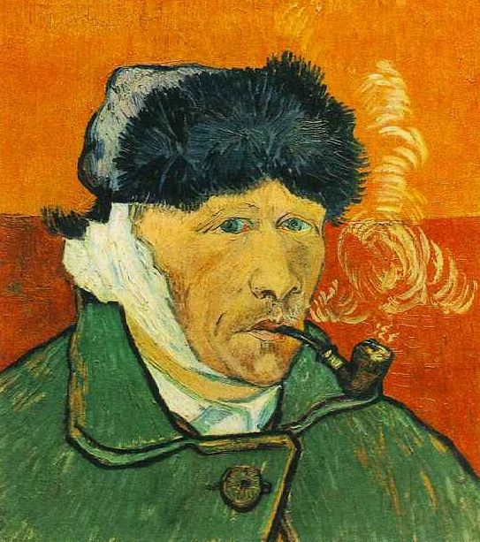
Self-portrait (1889)

Slide 20
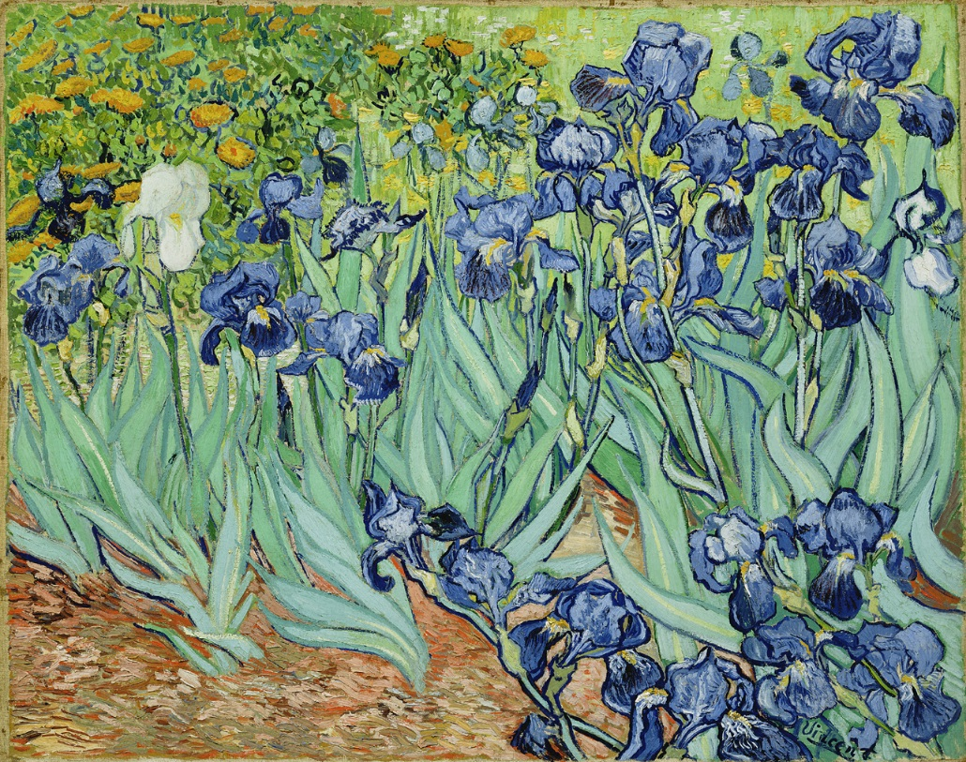
Irises (1889)

Slide 21
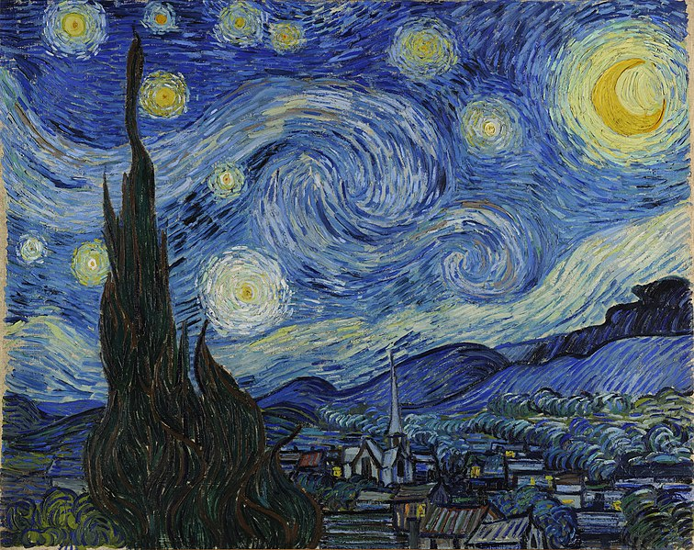
The Starry Night (1889)

Slide 22
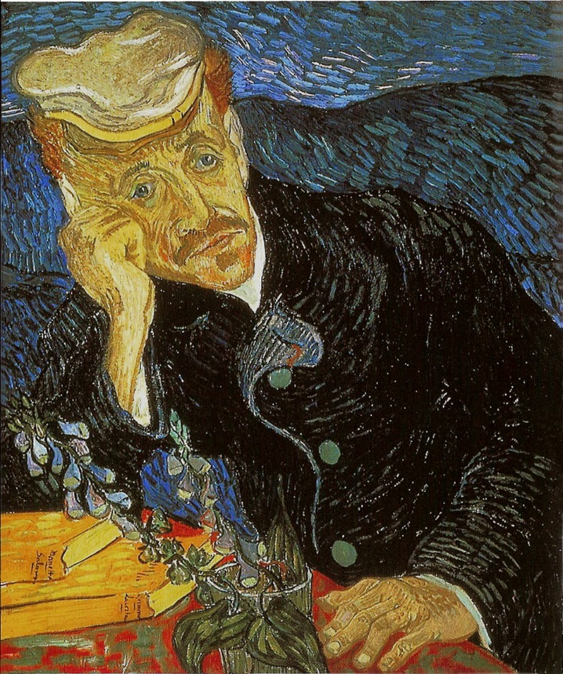
Portrait of Dr. Gachet (1890)

Slide 23
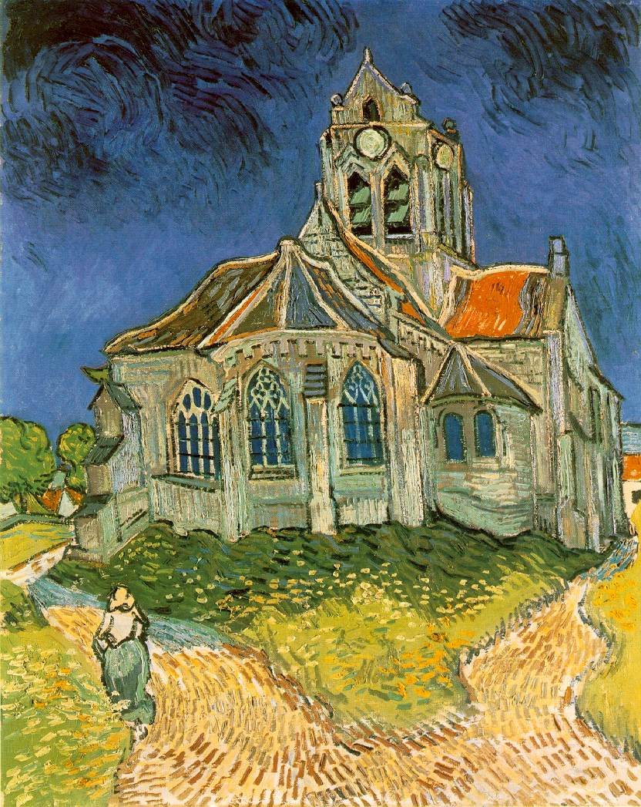
The Church at Auvers (1890)

Slide 24
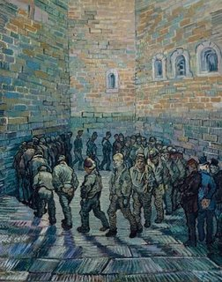
The Round of the Prisoners (1890)

Slide 25
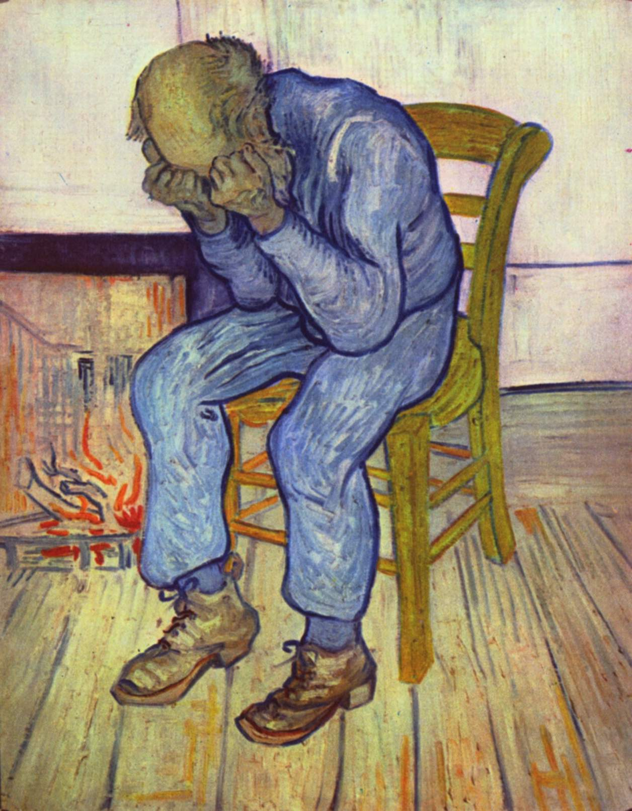
At Eternity's Gate (1890)

Slide 26
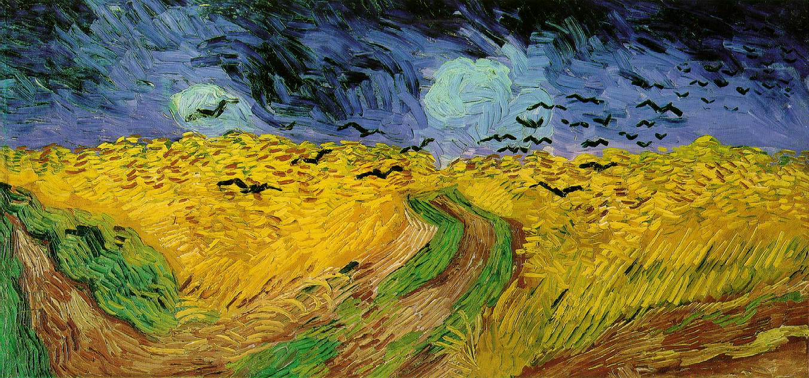
Wheatfield with Crows (1890)
Vincent Van Gogh’s final painting.

Slide 27
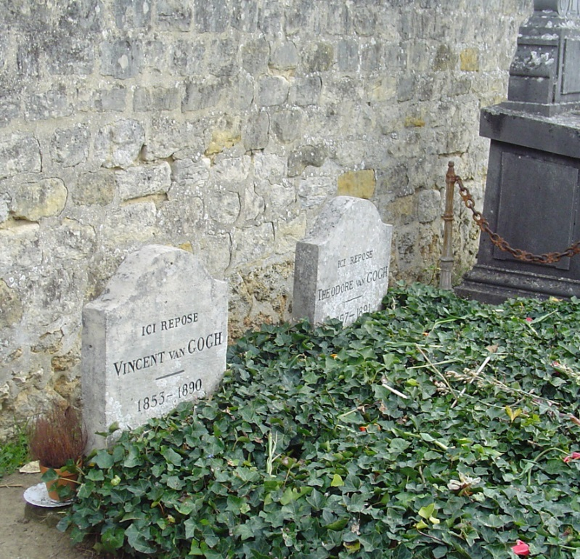
https://.www.wikimedia.org
Vincent and Theo van Gogh's graves at the cemetery in Auvers-sur-Oise in France.

Slide 28
Acknowledgements
The information on temporal epilepsy is mostly from the Mayo Clinic website:
https://www.mayoclinic.org/health/temporal-lobe-seizure
The images of Vincent Van Gogh’s paintings are from Wikipedia:
https://www.wikipedia.org/wiki/vincent_van_gogh

