Slide 1
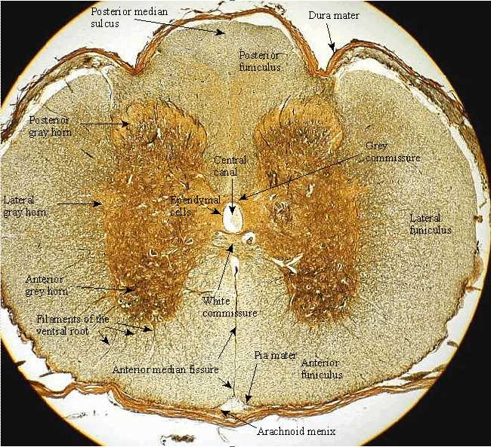
Spinal Nerves and Spinal Reflexes
https://www.biology.clc.uc.edu

Slide 2
Note
Much of the text material is from, “Principles of Anatomy and Physiology” by Gerald J. Tortora and Bryan Derrickson (2009, 2011, and 2014). I don’t claim authorship. Other sources are noted when they are used.
The lecture slides are mapped to the three editions of the textbook based on the color-coded key below.
14th edition
13th edition
12th edition
Same figure or table reference in all three editions

Slide 3
Outline
Structure and function
Spinal reflexes
Poliomyelitis

Slide 4
Structure and Function

Slide 5
Vertebral Column
The spinal cord is located within the vertebral canal of the vertebral column.
The foramina of the vertebrae stacked on top of each other form the vertebral canal.
The vertebrae provides structure and a protective enclosure for the spinal cord.
The vertebral ligaments, meninges, and cerebrospinal fluid provide additional protection.
Foramina (plural) = openings in bones.
Page 443
Page 493
Page 461
Figure 13.1

Slide 6
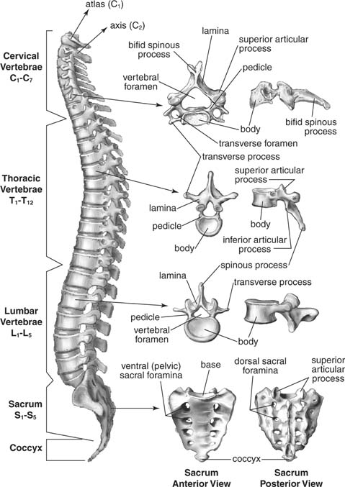
Vertebral Column (continued)
https://media.wiley.com

Slide 7
Spinal Nerves
The spinal nerves are part of the peripheral nervous system (PNS).
The nerves connect the CNS to sensory receptors, skeletal muscles, endocrine glands, and exocrine glands.
The 31 pairs of spinal nerves are named and numbered according to the segment of the vertebral column from which they emerge.
Endocrine gland = secretes a substance called a hormone into the bloodstream.
Exocrine gland = secretes a substance out through a duct and onto an epithelial surface.
(Both definitions are from https://www.medicinenet.com)
Page 446
Page 494
Page 464
Figure 13.2

Slide 8
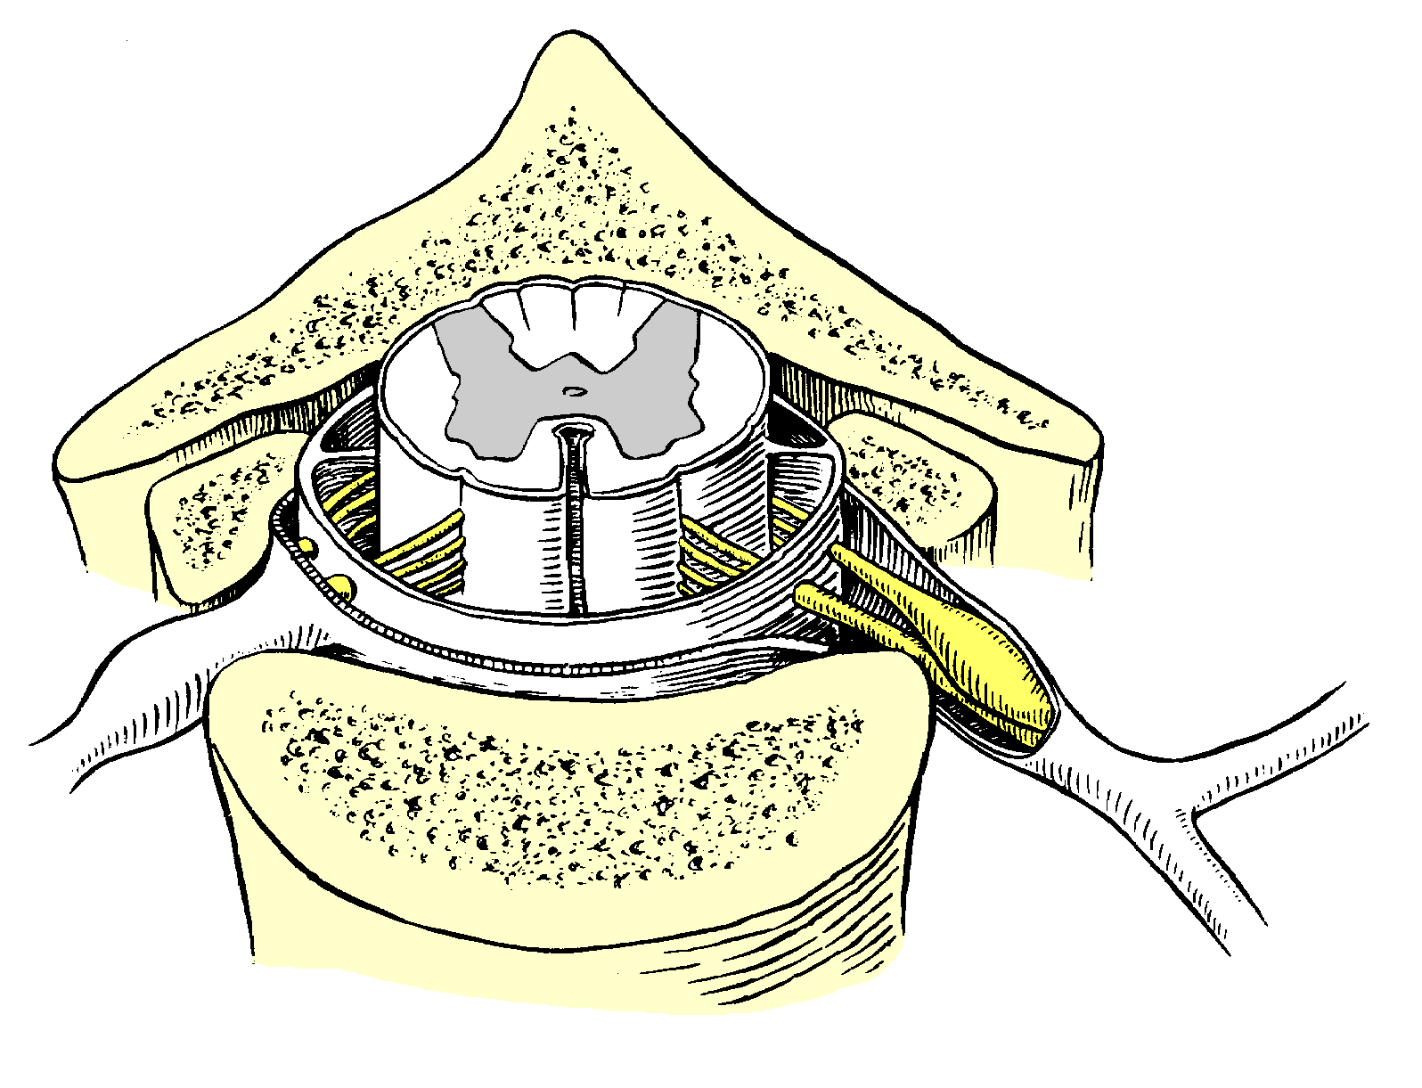
Spinal Nerves (continued)
Spinal
nerve
http://www.csus.edu

Slide 9
Segments
Eight pairs of cervical nerves, C1 through C8 (most superior location)
Twelve pairs of thoracic nerves, T1 through T12
Five pairs of lumbar nerves, L1 through L5
Five pairs of sacral nerves, S1 through S5
One pair of cocygeal nerves, Co1 (most inferior location)
Page 446
Page 497
Page 464
Figure 13.2

Slide 10
Posterior Roots
Two bundles of axons, called roots, connect each spinal nerve to a segment of the spinal cord by even smaller bundles of axons known as rootlets.
A posterior root and its rootlets contain sensory axons to conduct nerve impulses from the sensory receptors in the skin, muscles, and internal organs to the CNS.
Nerve impulse = action potential.
Page 446
Page 497
Page 464
Figure 13.3

Slide 11
Anterior Roots
A posterior root has a swelling, called a posterior root ganglion, that contains the cell bodies of sensory neurons.
The anterior root and its rootlets contain motor axons to conduct nerves impulses from the CNS to skeletal muscles and exocrine glands in the skin.
Page 446
Page 498
Page 464
Figure 13.3

Slide 12
Posterior Roots and Anterior Roots
Posterior root and its ganglion (sensory)
http://www.csus.edu
Anterior root (motor)

Slide 13
Spinal Cord Section
A freshly-dissected section of spinal cord shows white matter and an inner core of gray matter.
A transverse section of the spinal cord is shown on the next slide.
Page 447
Page 498
Page 464
Figure 13.3

Slide 14
Spinal Cord Section (continued)
Meninges
Central canal
Anterior median fissure
White matter
Gray matter
Posterior horn
Anterior horn
Lateral horn
Fiber tracts
Commissural fibers
https://www.biology.clc.uc.edu

Slide 15
Gray Matter
The posterior gray horns contain axons of sensory neurons, and cell bodies and axons of interneurons.
The anterior gray horns contain somatic motor nuclei—clusters of cell bodies of somatic motor neurons that control the contraction of skeletal muscles.
The lateral gray horns, found only in the thoracic and lumbar segments, contain motor nuclei for the autonomic nervous system.
These nuclei control the activity of smooth muscle, adrenal medulla, and exocrine glands.
Page 447
Page 498
Page 464
Figure 13.3

Slide 16
White Matter
White matter is organized in columns in the spinal cord.
The columns consist of bundles of myelinated axons that have either a common origin or destination and carry similar types of information.
The bundles, which can extend long distances in the spinal cord, are called fiber tracts in the CNS.
Page 447
Page 498
Page 464
Figure 13.3

Slide 17
White Matter (continued)
Ascending or afferent fiber tracts consist of axons that convey sensory information to the brain.
Descending or efferent fiber tracts consist of axons that convey motor information from the brain.
The ascending and descending tracts are continuous and uninter-rupted by synapses.
The arrangement helps increase the transmission speed of nerve impulses that must travel long distances between the brain and the spinal cord to eliminate synaptic time delays.
Page 447
Page 498
Page 464
Figure 13.3

Slide 18
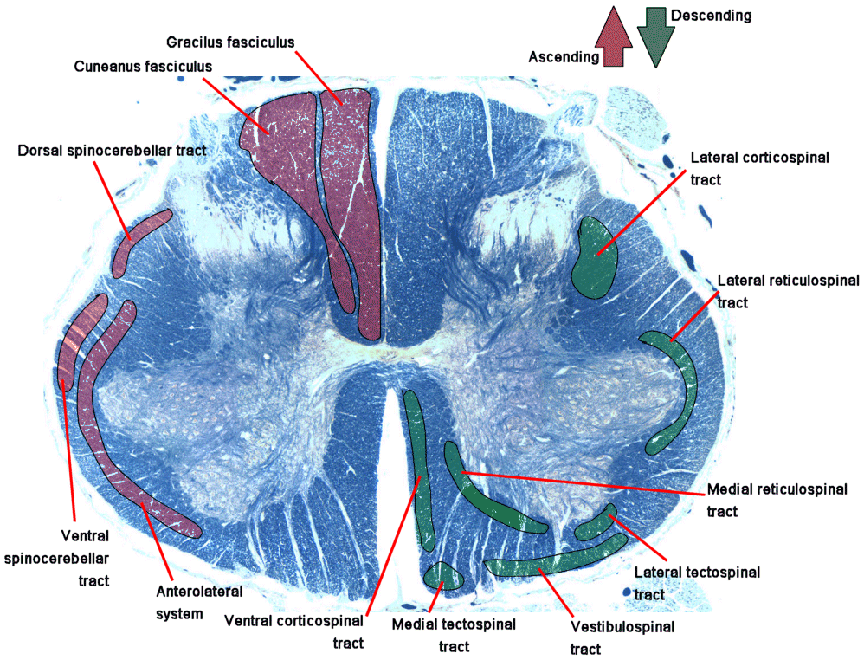
Fiber Tracts
https://www.hopkins-arthritis.org

Slide 19
Review—Input and Output
Sensory input is conveyed from sensory receptors to the posterior horns of the spinal cord.
Motor output is conveyed from the anterior and lateral horns to effectors (muscles and glands).
The sensory and motor pathways are shown in the textbook illustration.
Page 448
Page 498
Page 466
Figure 13.4

Slide 20
Dermatomes
Somatic sensory neurons for touch, vibration, temperature, and pain carry nerve impulses from the skin to the spinal cord and then to the brain.
Each spinal nerve consists of sensory neurons that serve a particular segment of the body.
The area of the skin that provides input to the CNS via one pair of spinal nerves or the trigeminal (V) cranial nerve is called a derma-tome.
The nerve distribution in adjacent dermatomes overlaps to a certain degree, so there is some redundancy.
Page 460
Page 512
Page 480
Figure 13.11
Figure 13.11
Figure 13.12

Slide 21
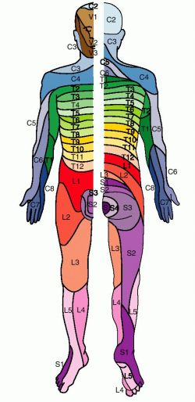
Dermatomes (continued)
Anterior
(front) view
Posterior
(rear) view
Sensory neurons for touch, vibration, temperature, and pain carry nerve impulses from the skin to the spinal cord and then to the brain for processing.
The area of the skin that provides input to the spinal cord or brain by one pair of spinal nerves or the trigeminal (V) cranial nerve is called a dermatome.
https://www.medical-dictionary.thefreedictionary.com

Slide 22
Injury Localization
Knowledge of which spinal cord segments supply each dermatome makes it possible to locate damaged regions of the spinal cord.
If the skin of a specific region is stimulated, but sensations are not perceived, the spinal cord segments supplying that dermatome may be damaged.
The same holds true for the three branches of the trigeminal nerve. (cranial nerve V).
Page 460
Page 512
Page 480

Slide 23
Injury Localization (continued)
In areas where the overlap in dermatomes is substantial, very little loss of sensation may occur if only one of the nerves supplying the dermatome is damaged.
Information about innervation patterns of the spinal nerves is also used in surgical procedures and anesthesia.
Page 460
Page 512
Page 482

Slide 24
Spinal Reflexes

Slide 25
Reflexes
A reflex is a rapid, automatic response involving a sequence of physio-logical actions in response to a stimulus.
Spinal reflexes are inborn, such as pulling one’s hand away from a hot stove.
Many inborn reflexes are adaptive in that they serve to protect the indi-vidual from injury.
Higher-level reflexes involving the brain involve learning, such as those in driving an automobile.
Page 462
Page 514
Page 482

Slide 26
Reflexes (continued)
A spinal reflex involves sensory-motor integration in the spinal cord.
An example is the patellar (knee jerk) reflex mediated by the spinal cord.
A cranial reflex is when the integration occurs in the brainstem or at a higher level.
An example is the saccadic movements of the eyes when reading a book.
Saccadic eye movements = an extremely fast voluntary movement of the eyes, allowing them to accurately reestablish focus on an object in the visual field.
(https://www.medical-dictionary.thefreedictionary.com)
Page 462
Page 514
Page 482

Slide 27
Types of Reflexes
Somatic reflexes involve the contraction of one or more skeletal mus-cles.
Autonomic reflexes involve smooth muscle, cardiac muscle, or glands.
These reflexes are controlled by the sympathetic and parasympathetic divisions of the autonomic nervous system, which we will discuss in an upcoming lecture module.
Page 462
Page 514
Page 482

Slide 28
Reflex Arc
The pathway of electrical activity in a reflex is known as a reflex arc.
The functional components of a reflex arc consist of:
  Sensory receptor—production of generator (graded) electrical potentials.
  Sensory neuron—propagation of action potentials to the spinal cord.
  Integrating center—monosynaptic (no interneuron) or polysyn-aptic (one or more interneurons).
  Motor neuron—propagation of action potentials from the spinal cord to an effector.
  Effector—response of the muscle or gland.
Page 462
Page 514
Page 482
Figure 13.13
Figure 13.13
Figure 13.14

Slide 29
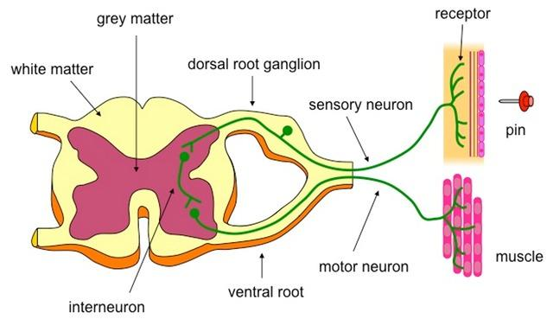
Example of a Reflex Arc
Posterior root
Anterior root

Slide 30
A Few Somatic Reflexes
Flexor reflex—causes contraction of skeletal muscle in response to, for example, a painful stimulus.
Stretch reflex—causes contraction of skeletal muscles in response to stretching of a skeletal muscle.
Tendon reflex—controls skeletal muscle tension by causing muscle relaxation before the muscle force becomes too great that tendons could be damaged.
Cross-extensor reflex—along with some flexor reflexes, causes con-traction of skeletal muscles on the opposite side of the body to main-tain balance.
Page 483
Page 515
Page 482
Page 462
Page 514
Figure 13.14
Figure 13.15
Figure 13.16
Page 462

Slide 31
Poliomyelitis

Slide 32
Poliomyelitis
Poliomyelitis (polio) is caused by the three strains of the poliovirus, a RNA virus of about 7,500 nucleotides.
The virus is spread through the fecal-oral route—contaminated food and water.
Its initial symptoms include fever, severe headache, stiff neck and back, muscle pain and weakness, and loss of some somatic reflexes.
Paralysis can result from destruction of cell bodies of motor neurons in the anterior horns of the spinal cord, or the nuclei of cranial nerves.
Page 470
Page 522
Page 490

Slide 33
Poliomyelitis (continued)
An individual may not be able to breath unassisted if the polio virus destroys motor neurons that control the skeletal muscles for breath-ing (external intercostals and diaphragm).
Respiratory or heart failure can result if the virus invades centers in the brainstem.
Some individuals, many years after being afflicted with virus, develop a post-polio syndrome.
Slow degeneration of motor neurons in this syndrome can produce a progressive muscle weakness, extreme fatigue, loss of muscle func-tion, and chronic pain.
Page 470
Page 522
Page 490

Slide 34
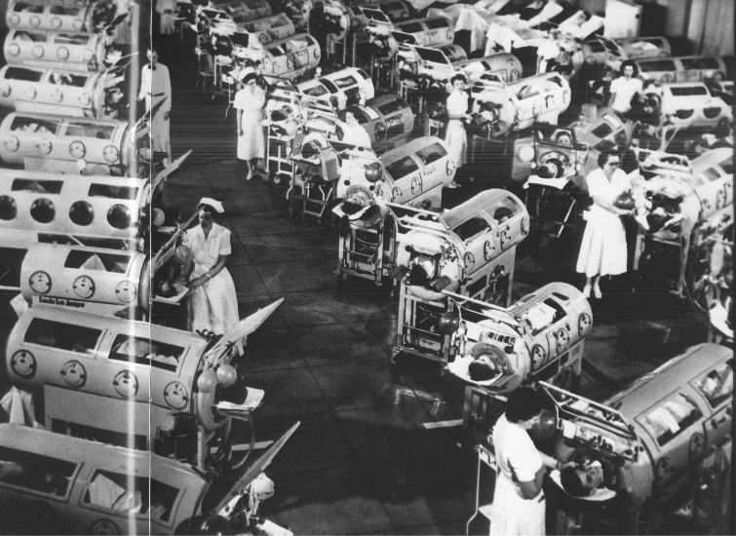
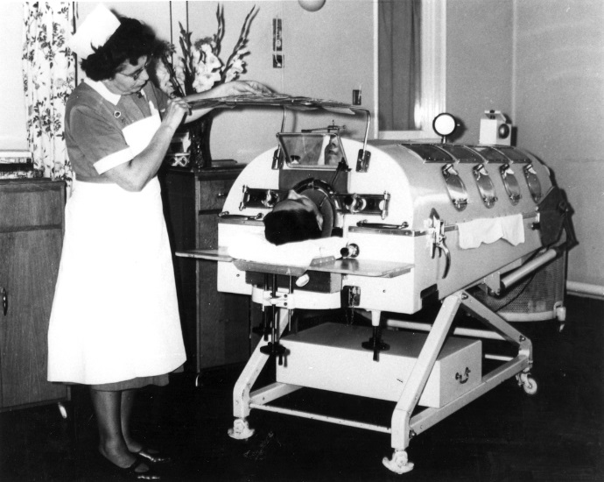
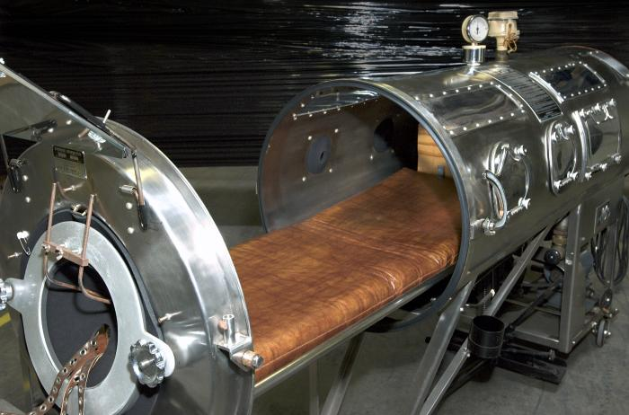
Iron Lung
Rancho Los Amigos
In Downey, California
during the 1950s.
https://www.ccat.sas.upenn.edu
https://www.nbt.nhs.uk
https://www.wikimedia.org
The iron lung is an assisted breathing device. Some patients with polio spent years in iron lungs.

Slide 35
Polio Eradication
Many cases of polio occurred in the United States in the early-1950s, which led to an accelerated emphasis on developing vaccines.
The vaccines consist of injecting a dose of the inactivated poliovirus (Salk method) or giving an oral dose of attenuated poliovirus (Sabin method).
Polio vaccines have almost completely eradicated polio in the United States and worldwide.
The Salk vaccine is now used exclusively in many countries because the inactivated virus cannot mutate into a virulent form to cause more cases of polio.
Outbreaks still occur in a few countries, and recently a small number of cases were reported in New York City.
Page 470
Page 522
Page 490

