Slide 1
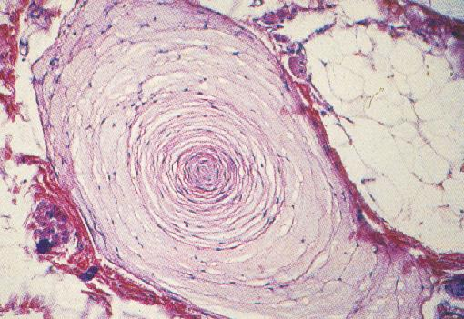
Somatic and Proprioceptive Senses
Pacinian corpuscle
https://www.science.mcmaster.ca

Slide 2
Note
Much of the text material is from, “Principles of Anatomy and Physiology” by Gerald J. Tortora and Bryan Derrickson (2009, 2011, and 2014). I don’t claim authorship. Other sources are noted when they are used.
The lecture slides are mapped to the three editions of the textbook based on the color-coded key below.
14th edition
13th edition
12th edition
Same figure or table reference in all three editions

Slide 3
Outline
Somatic sensations
Pain sensations
Proprioceptive sensations
Somatic sensory pathways

Slide 4
Somatic Sensations

Slide 5
Somatic Sensations
Somatic sensations result from the stimulation of sensory receptors in the:
  Epidermis, dermis, and subcutaneous layers of the skin—see the learning module on the integumentary system.
  Mucous membranes of cavities including the mouth, vagina, and anus.
  Skeletal muscles, tendons, and joints.
Page 550
Page 610
Page 573

Slide 6
Somatic Sensations (continued)
The four modalities of somatic sensations are tactile, thermal, pain, and proprioception.
Sensory receptors are unevenly distributed—some body areas are densely populated with receptors, while other areas have relatively few of them.
The highest densities of somatic sensory receptors are found in the fingertips, lips, and tip of the tongue that are most sensitive to touch.
Receptor densities are represented in the homunculus for the somat-osensory projection area, which was discussed in the lecture module on the brain.
Page 550
Page 610
Page 573

Slide 7
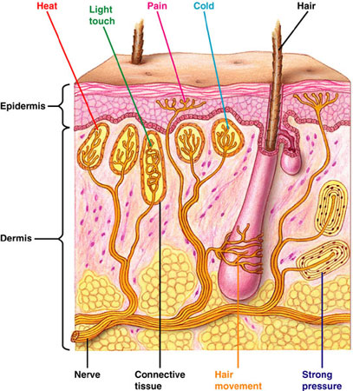
Sensory Receptors in the Skin
https://www.bio.miami.edu

Slide 8
Tactile Sensations
Tactile sensations include touch, pressure, vibration, itch, and tickle.
Encapsulated mechanoreceptors with large-diameter, myelinated (type A) fibers mediate the sensations of touch, pressure, and vibra-tion.
Free nerve endings with small-diameter, unmyelinated (type C) fibers mediate itch and tickle sensations.
Type A fibers conduct action potentials to the central nervous system more rapidly than the type C fibers because they are myelinated and larger in diameter.
Page 550
Page 610
Page 573
Figure 16.2

Slide 9
Touch Sensations
Touch sensations are produced by the stimulation of tactile receptors in the skin and its subcutaneous layers.
Meissner corpuscles are especially sensitive at the onset of a touch.
They are abundant in the fingertips, hands, eyelids, tip of the tongue, nipples, soles, clitoris, and penis.
Hair root plexuses, which detect movements that disturbs hairs, are found in normally-hairy skin.
Meissner corpuscles and hair root plexuses are rapidly-adapting tac-tile receptors.
Page 550
Page 610
Page 574

Slide 10
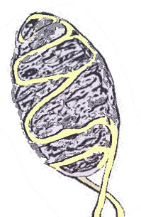
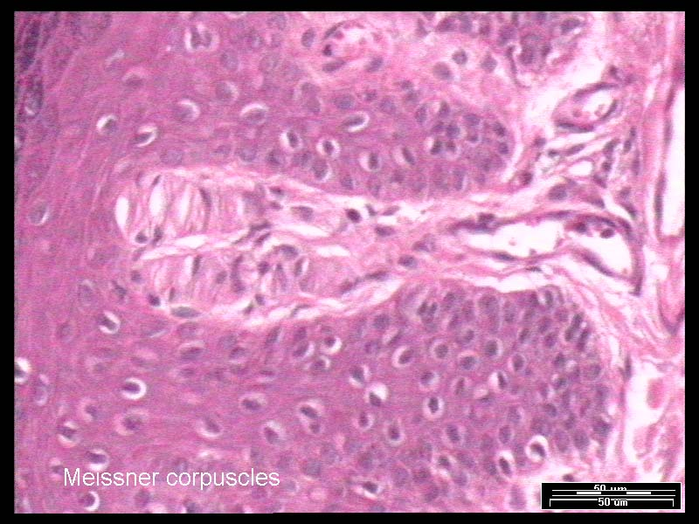
Meissner Corpuscle
Drawing and light micrograph
https://www.virtualworldlets.net
https://www.technion.ac.il

Slide 11
Touch Sensations (continued)
Merkel discs are sensitive to touch, and are densest in the fingertips, hands, lips, and external genitalia.
Ruffini corpuscles are sensitive to stretching from the movement of the digits and limbs and are most abundant in the hands and soles of the feet.
Merkel discs and Ruffini corpuscles are slowly-adapting tactile recep-tors.
Digits = fingers (including the thumb) and toes.
Page 550
Page 610
Page 574

Slide 12
Pressure Sensations
Pressure can be a sustained (prolonged) sensation usually felt over a larger surface area than touch.
Pressure sensations occurs in response to the mechanical deformation of deep tissues.
Pacinian corpuscles, Meissner corpuscles, and Merkel discs respond to mechanical pressure.
Deformation = a change from the normal size or shape of an anatomic structure due to mechanical forces that distort an otherwise normal structure.
(https://www.medterms.com)
Page 550
Page 610
Page 574

Slide 13
Pressure Sensations (continued)
Pacinian corpuscles are widely distributed in the:
  Dermis and subcutaneous layers of the skin
  Submucosal membranes
  Around joints, tendons, and muscles
  Mammary glands
  External genitalia
  Some visceral organs and structures including the pancreas and urinary bladder
These receptors adapt rapidly to mechanical pressure applied to a tissue.
Page 550
Page 610
Page 574

Slide 14
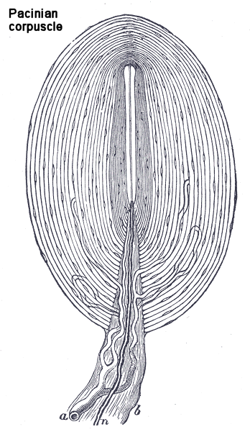
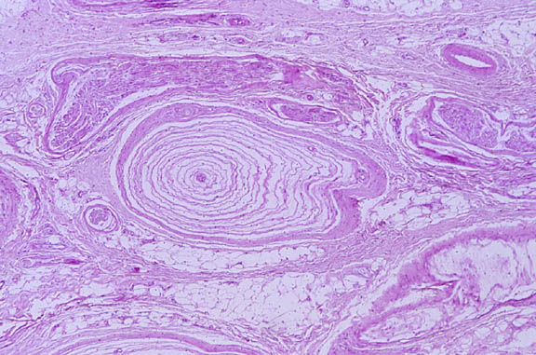
Pacinian Corpuscle
Drawing and light micrograph
https://www.cas.bellarmine.edu
https://www.pathology.mc.duke.edu

Slide 15
Vibration Sensations
Sensations of vibration result from fast, repetitive sensory signals in tactile receptors.
Meissner corpuscles respond to low-frequency vibrations and Pacin-ian corpuscles respond to higher-frequency vibrations.
Page 550
Page 610
Page 574

Slide 16
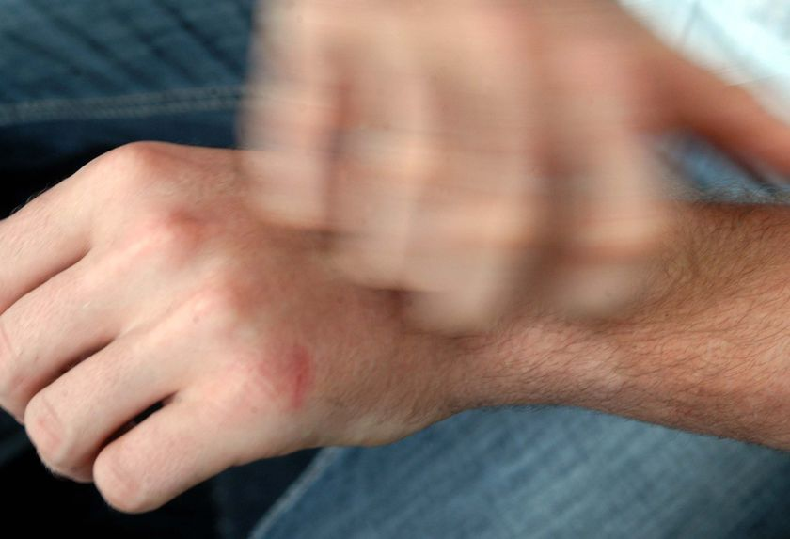
Itch Sensations
Itch sensations result from the stimulation of free nerve endings by chemicals including bradykinin.
The chemicals involved in itch sensations are also associated with the body’s inflammatory responses.
Bradykinin = a peptide molecule released by tissues that promotes inflammation.
http://www.abc.net.au
Page 550
Page 610
Page 574

Slide 17

Tickle Sensations
Free nerve endings in the skin are thought to mediate tickle sensa-tions.
The sensations don’t occur when we try to tickle ourselves, possibly because of the active role of the cerebellum and other motor areas in suppressing the sensation.
http://cm.iparenting.com
Page 550
Page 610
Page 574

Slide 18
Thermal Sensations
Thermoreceptors are free nerve endings that have receptive fields about 1mm in diameter.
Thermoreceptors are located near the skin surface; warm receptors are not as abundant as cold receptors.
Cold receptors (type A fibers) are activated between 10º C and 40º C (50º F and 105º F).
Warm receptors (type C fibers) are activated between 32º C and 48º C (90º F and 118º F).
Note the overlap between the temperature ranges for cold and warm receptors. At intermediate temperatures, both types of thermoreceptors can be stimulated but to different extents.
Page 551
Page 611
Page 574

Slide 19
Thermal Sensations (continued)
Cold and warm receptors rapidly adapt after the onset of a thermal stimulus—think about your experiences in a very hot shower or cold swimming pool.
With adaptation, the receptors continue to generate action potentials in response to prolonged thermal stimuli, but at a lower rate than ini-tially.
Temperatures below 10º C (50º F) and above 48º C (118º F) can also stimulate pain receptors.
Page 551
Page 611
Page 574

Slide 20
Pain Sensations

Slide 21
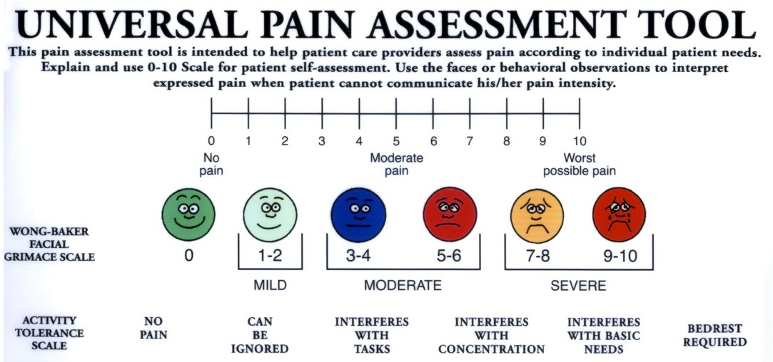
Survival Value
Pain is essential to survival because it serves as an important signal that tissue damage may be occurring.
An individual’s subjective description of pain can help in the medical diagnosis of a disease or injury.
Subjective reporting is on an 11-point Likert scale, where 0 is no pain and 10 is unbearable pain.
https://www.my.methodistcollege.edu
Page 551
Page 611
Page 574

Slide 22
Nocireceptors
Nocireceptors—receptors for pain—are free nerve endings in all tis-sues of the body except the brain.
They can be activated by intense thermal, mechanical, or chemical stimuli.
Tissue irritation or injury results in the release of chemicals including kinins, prostaglandins, and K⁺ ions that stimulate the nocireceptors.
Page 552
Page 612
Page 574
Figure 16.2

Slide 23
Nocireceptors (continued)
Pain may persist even after the stimulus is removed because: 1) pain-mediating chemicals linger, and 2) pain receptors have very little sensory adaptation.
Other conditions that can elicit pain include distension (stretching) of organs, prolonged muscular contractions, muscle spasms, and ischemia.
Ischemia = inadequate blood supply to an organ or part of the body.
Page 552
Page 612
Page 575

Slide 24
Fast Pain
Pain can be classified as fast or slow.
Sensation of fast pain can occur within 0.1 seconds of a stimulus since action potentials propagate along faster, type B fibers (mid-size diameter, myelinated axons).
Fast pain is associated with acute, sharp, or prickling sensations, such as from a needle puncture or skin cut.
Fast pain originates in superficial tissues, but not from deep tissues and organs.
Acute pain = of short duration but typically severe.
Page 552
Page 612
Page 575

Slide 25
Slow Pain
The sensation of slow pain has an onset of one second or longer after the stimulus is applied.
Slow pain sensations gradually increases in intensity over several seconds to minutes.
Action potentials propagate along the slower, type C fibers (small diameter, unmyelinated axons).
Page 552
Page 612
Page 575

Slide 26
Slow Pain (continued)
Slow pain often originates in deep tissues including all organs except the brain.
Slow pain can also originate in the skin.
The pain is associated with chronic, burning, aching, or throbbing sen-sations, which can be excruciating.
Chronic = persisting for a long time.
Page 552
Page 612
Page 575

Slide 27
Fast versus Slow Pain
Fast and slow pain can be experienced simultaneously, although they have different onset times.
When a person stubs a toe, the long conduction distance to the brain and the different fiber types separates the experience of pain (fast pain is experienced before slow pain).
Page 552
Page 612
Page 575

Slide 28
Pain Localization
Fast pain can be precisely localized to the stimulated area, such as that of a pin prick.
Since slow pain is generally spread over a large area, it cannot be as readily localized—often it is experienced as a diffuse, throbbing sensation in a part of the body.
Page 552
Page 612
Page 575

Slide 29
Referred Pain
Visceral slow pain, such as from the heart, can be experienced in or adjacent to an organ or in a body surface area some distance away.
The phenomenon is known as referred pain.
The organ and the area of referred pain are generally served by the same spinal nerves and segments of the spinal cord.
Pain associated with angina or heart attack is sometimes felt in the skin overlying the heart, along the inferior surface of the left arm, or jaw line.
Page 552
Page 612
Page 575
Figure 16.3

Slide 30
Pain-Relieving Drugs
For acute pain, analgesic drugs such as aspirin and ibuprofen block the formation of prostaglandins that stimulate the nocireceptors.
Local anesthetics such as Novacaine® may provide temporary pain relief by blocking the propagation of action potentials along the axons of nocireceptors.
Morphine and other opiates alter the quality of pain perception in the brain—the pain is still sensed, but it is no longer perceived as being so distressing.
Antidepressant drugs are sometimes used to help treat chronic pain by reducing the emotional component, which can exacerbate the pain-ful sensations.
Page 553
Page 613
Page 576

Slide 31
Phantom Limb Sensation
A person who has lost a limb may continue to experience itching, pressure, tingling, and pain sensations as if the limb still existed.
This well-documented medical condition is known as phantom limb sensation.
Page 551
Page 611
Page 574

Slide 32
Possible Causes
The cerebral cortex might continue to interpret the action potentials from the remnant parts of sensory neurons that had carried action potentials from the limb.
Another possible explanation is that the brain’s networks of neurons that generate sensations of body awareness may remain active and give false body sensations.
Yet another explanation involves dendritic reorganization in the pri-mary somatosensory cortex as covered in the video, “Secrets of the Mind.”
Page 551
Page 611
Page 574

Slide 33
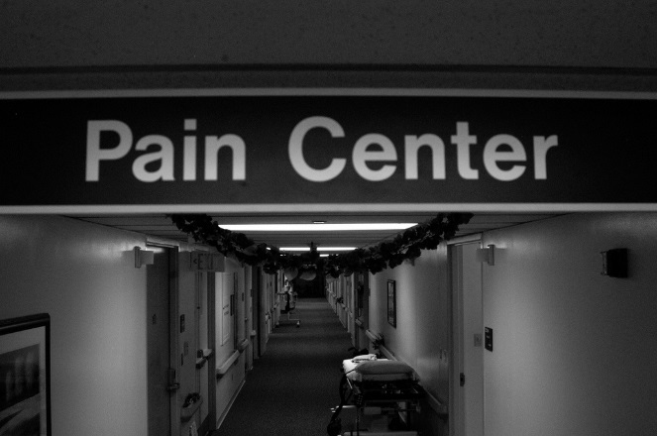
Treatment
Phantom limb sensations are often reported as intense and painfully-distressing.
This pain is often not resolved by traditional pain medication therapies.
Electrical nerve stimulation, acupuncture, and biofeedback sometimes can be helpful.
http://farm1.static.flickr.com
Page 551
Page 611
Page 574

Slide 34
Proprioception

Slide 35
Proprioceptors
Proprioceptors provide information to the brain about the location and movement (kinesthesia) of the head and limbs.
For skeletal muscles and tendons, they provide information about amount of contraction, tension on the tendons, and of the synovial joints.
Specialized hair cells in the inner ear sense the orientation and posi-tion of the head, as covered in the learning module on the auditory and vestibular system.
The brain continually receives nerves impulses from proprioceptors since they adapt slowly and only very slightly.
Page 553
Page 613
Page 576

Slide 36
Types of Proprioceptors
Muscle spindles in skeletal muscles
Tendon organs in tendons
Joint kinesthetic receptors in synovial joint capsules
Specialized hair cells in the vestibular system within the inner ear
Synovial joint = a joint surrounded by a thick, flexible membrane into which a viscous fluid is secreted to provide lubrication.
Page 553
Page 613
Page 576

Slide 37
Muscle Spindles
Muscle spindles monitor changes in skeletal muscles length to control stretch reflexes.
The brain establishes muscle tone by adjusting how vigorously muscle spindles respond to the stretching of skeletal muscles.
A muscle spindle has slowly-adapting sensory nerve endings wrapped around 4 to 10 intrafusal muscle fibers.
Muscle spindle = a stretch receptor found in vertebrate muscle.
Intrafusal muscle fibers = skeletal muscle fibers that make-up a muscle spindle and innervated by gamma motor neurons.
Page 553
Page 613
Page 576
Figure 16.4

Slide 38
Muscle Spindles (continued)
Muscle spindles are interspersed among skeletal muscle fibers and are aligned parallel with them.
They are densest in the skeletal muscles that control fine movements such as those of the hands.
Fewer muscle spindles are found in the skeletal muscles involved in coarse movements such as the major muscle groups of the arms and legs.
The tiny muscles of the inner ear are the only skeletal muscles that do not have muscle spindles.
Page 553
Page 613
Page 576
Figure 16.4

Slide 39
Muscle Spindles (continued)
A sudden and prolonged stretching of the intrafusal muscle fibers stimulates the sensory nerve endings of the muscle spindles.
Action potentials propagate to the primary somatosensory area of the cerebral cortex to enable the conscious awareness of limb posi-tions and movements.
Action potentials also propagate to the cerebellum that is involve-ed in the coordination of skeletal muscle contractions.
Page 553
Page 613
Page 576
Figure 16.4

Slide 40
Muscle Spindles (continued)
Muscle spindles have gamma motor neurons to adjust the tension of the muscle spindles based on variations in skeletal muscle length.
When a muscle shortens, gamma motor neurons stimulate the intra-fusal fibers to contract slightly.
Gamma motor neurons keep the intrafusal fibers taut to maintain the sensitivity of the muscle spindles to the stretching of the skeletal mus-cle.
Taut = pulled or drawn tight; under tension.
Page 553
Page 613
Page 576
Figure 16.4

Slide 41
Muscle Spindles (continued)
The intrafusal fibers are surrounded by extrafusal skeletal muscle fibers.
The extrafusal fibers, innervated by alpha motor neurons, are active during stretch reflexes.
Page 553
Page 613
Page 576
Figure 16.4

Slide 42
Tendon Organs
Tendon organs are found at the junctions of tendons between skeletal muscles.
They help mediate tendon reflexes to protect the tendons and muscles from excessive tension.
Tendon organs contain sensory nerve endings that are intertwined with the collagen fibers of a tendon.
Page 553
Page 613
Page 576
Figure 16.4

Slide 43
Tendon Organs (continued)
When external tension is applied to a skeletal muscle, tendon organs generate action potentials that propagate into the CNS.
The resulting tendon reflex decreases muscle tension through muscle relaxation.
Page 554
Page 614
Page 576
Figure 16.4

Slide 44
Joint Kinesthetic Receptors
Several types of kinesthetic receptors are found at the synovial joints.
They include free nerve endings and Ruffini capsules that respond to pressure.
Pacinian corpuscles in the connective tissue respond to acceleration and deceleration of joints during movement.
Ligaments have receptors similar to tendon organs to prevent exces-sive strain on a joint.
Page 554
Page 614
Page 577

Slide 45
Somatic Sensory Pathways

Slide 46
Sensory Pathways
Somatic sensory pathways relay information from somatic sensory receptors to the primary somatosensory area of the cerebral cortex via the thalamus.
The pathways consist of first-, second-, and third-order neurons that are connected by chemical synapses.
First-order neurons propagate action potentials from somatic sensory receptors into the spinal cord or brainstem.
Page 555
Page 615
Page 578

Slide 47
Sensory Pathways (continued)
Second-order neurons propagate action potentials from the spinal cord or brainstem to the thalamus.
The axons cross-over in the medulla oblongata before entering the thalamus.
Thus, higher brain centers receive somatosensory information from the contralateral (opposite) sides of the body.
Third-order neurons propagate action potentials from the thalamus to the primary somatosensory area on the ipsilateral (same) side of the brain.
Page 556
Page 616
Page 578

Slide 48
Sensory Pathways (continued)
Action potentials from somatic sensors reach the cerebral cortex via three pathways.
  Posterior column-medial lemniscus pathway (spinal cord)
  Anterolateral or spinothalamic pathway (spinal cord)
  Trigeminothalamic pathway (cranial nerve V)
Sensory information reaches the cerebellum via the spinocerebellar tracts.
Page 556
Page 616
Page 578
Figure 16.5
Figure 16.6
Figure 16.7

Slide 49
Thalamus
Relay stations are collections of nuclei within the CNS where neurons synapse with other neurons as part of a sensory or motor pathway.
The thalamus is the major relay station for somatic sensory pathways, as it is for most of the sensory systems except for olfaction.
Page 556
Page 617
Page 579

Slide 50
Primary Somatosensory Area
Input from somatic senses reaches the primary somatosensory areas of the cerebral cortex.
These areas (areas 1, 2, 3) are located in the parietal lobes pos-terior to the central fissure.
Page 558
Page 618
Page 581
Figure 16.8

Slide 51
Primary Somatosensory Area (continued)
A somatic sensory map, called the sensory homunculus, represents the somatic sensations from the opposite side of the body.
The external surfaces of the body that have the greatest densities of somatic sensory receptors, (such as the hands and lips) are most well-represented in the sensory homunculus.
Parts of the body that have relatively sparse densities of somatic sensory receptors are least represented in the sensory homunculus.
Page 559
Page 618
Page 581
Figure 16.8

Slide 52
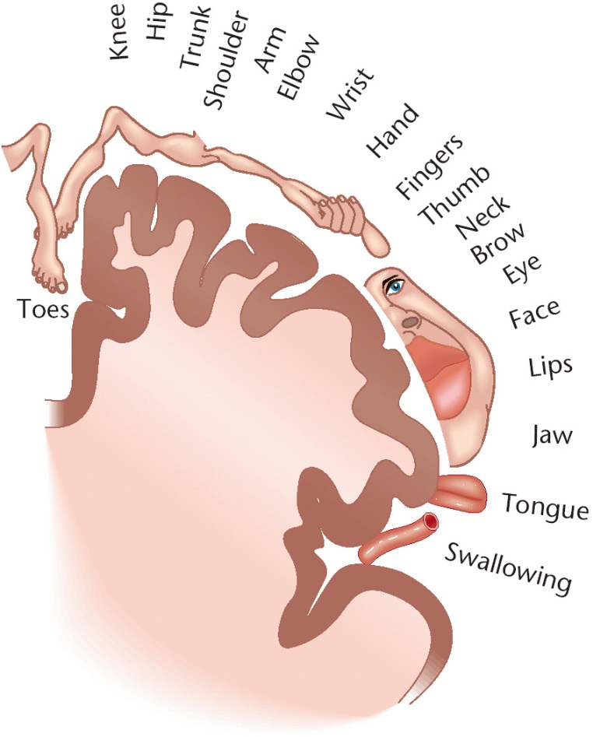
Homunculus—Somatosensory Map
Homunculus (early times and into the 19th century) = a supposed microscopic but fully-formed human being in a sperm cell from which a fetus was believed to develop.
Homunculus (today in neuroscience) = a representation of the human body based on a neurological map of the areas and proportions of the human brain dedicated to processing motor or sensory functions for different parts of the body.
https://www.spinacare.files.wordpress.com

Slide 53
Primary Motor Area
A somatic motor map, another homunculus, can be depicted for the primary motor area (area 4) of the motor cortex located anterior to the central fissure.
The sensory and motor homunculi have similarities and differences, as shown on the next slide, which was discussed during the lecture on the brain.
Page 561
Page 618
Page 581
Figure 16.8

Slide 54
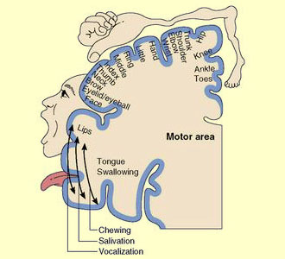
Homunculus—Motor Map
https://www.thebrain.mcgill.ca

Slide 55
Cerebellum
The anterior and posterior spinocerebellar tracts provide propriocep-tive information to the cerebellum.
These tracts and the cerebellum are involved in posture, balance, and coordination of skilled movements of skeletal muscles.
Sensory input to the cerebellum is not consciously perceived if it does not reach the cerebral cortex.
Page 565
Page 618
Page 584

