Slide 1
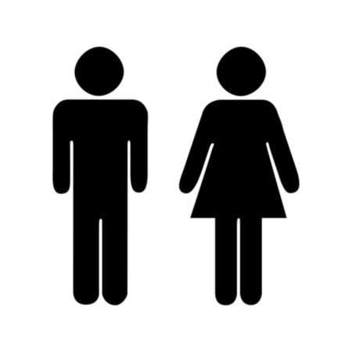
Sexual Differentiation
https://www.lifequake.files.wordpress.com

Slide 2
Note
Much of the text material through slide 26 is from, “Principles of Anatomy and Physiology” by Gerald J. Tortora and Bryan Derrickson (2009, 2011, and 2014). I don’t claim authorship. Other sources are noted when they are used.
The lecture slides are mapped to the three editions of the textbook based on the color-coded key below.
14th edition
13th edition
12th edition
Same figure or table reference in all three editions

Slide 3
Outline
Sex chromosomes
Embryonic development
Chromosomal anomalies
Androgen insensitivity syndrome
Adrenocortical syndrome
Sex determinants

Slide 4
Sex Chromosomes

Slide 5
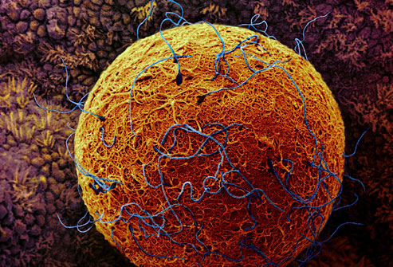
Sexual Reproduction
False-color, scanning electron micrograph
https://www.webmd.com
Sexual reproduction involves the fusion of the genetic material of one egg and one sperm. Usually, each gamete supplies 23 single strands of chromosomes to form 23 pairs in the zygote.
Gamete = egg or sperm; zygote = fertilized egg.

Slide 6
Homologous Chromosomes
All chromosomes, except X and Y on the 23rd pair in males, have two strands that are matched in size, shape, and bands.
These pairs are said to be homologous since the chromosomes have the same genes and in the same sequences for inherited characteris-tics.
For example, the multiple genes for eye color are found at the same locations on homologous pairs of chromosomes.
The alleles for each pair can be dominant or recessive, with one inher-ited from each parent.
Alleles = alternate gene forms on a homologous pair of chromosomes.

Slide 7
Karyotype
A typical body cell in humans, known as a somatic cell, usually (but not always) has 46 chromosomes in 23 pairs.
A light micrograph of the chromosomes can be made if the cell nucleus is opened.
The individual chromosomes can be arranged in an ordered array known as a karyotype.
Light micrograph = a photographic image made using a digital or film camera and a light microscope.

Slide 8
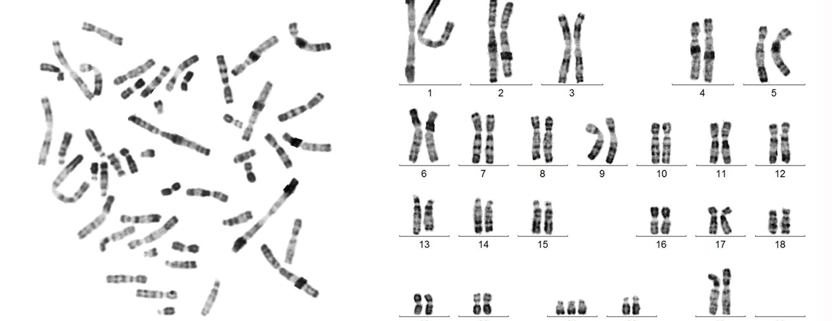
Karyotype (continued)
https://www.ucsfhealth.org
The karyotype represents trisomy-21, also known as Down Syndrome.
Tap or click here to learn more about karyotyping.

Slide 9
Sex Chromosomes
The 23rd set in a karyotype are the sex chromosomes (usually XX or XY).
The other 22 sets, in both females and males, are called the auto-somes.
An egg has a X chromosome, but not a Y chromosome.
A sperm has a X or Y chromosome, which determine the chromo-somal sex of the embryo.
Embryo = an early stage in the development of a multi-cellular organism. In humans, it covers about the first trimester after fertilization.

Slide 10
Sex Chromosomes (continued)
Females usually have two X chromosomes—but it can be XO or XXX (“O” indicates the absence of a second X chromosome).
Males usually have one X chromosome and one Y chromosome—but it can be XXY, XYY, or some higher multiple of these patterns.

Slide 11
X Chromosome
The X chromosome has between 900 and 1,200 genes—many of these genes are involved in the human development of both sexes.
One of these genes (DAX1) is involved in female sexual differentia-tion.
A few other genes involved in determining the female phenotype are found on the autosomes (the other 22 pairs).
Phenotype = a person’s observable traits.
Genotype = a person’s genetic makeup.

Slide 12
Genes on the Y Chromosome
Due to its much smaller size, the Y chromosome has far fewer genes (about 50) than the X chromosome.
The SRY gene on the Y chromosome is involved in male sexual dif-ferentiation.
A few genes on the Y chromosome are involved in male sexual func-tion and fertility.
SRY gene = sex determining region on the Y chromosome.

Slide 13
X-Linked Disorders
Some human genetic disorders are the result of defective recessive alleles on the X chromosome.
A male (XY pattern) needs to inherit one of these X-linked alleles from his mother, while a female (XX pattern) would need one from each par-ent, which is a much rarer situation.
Thus, males are far more often afflicted by X-linked disorders, including red-green color blindness, hemophilia (a blood disorder), and Duchenne muscular dystrophy (a muscle disorder).
Alleles = alternate gene forms, which can be dominant or recessive.

Slide 14
Embryonic Development

Slide 15
Bipotentiality
An embryo has the bipotentiality to follow the female or male pattern of development.
It has primitive gonads that can develop as ovaries or testes and two sets of ducts that develop into the supporting reproductive structures.
Bipotentiality = the capacity to develop in either of two different ways, in particular to become either female or male.

Slide 16
Gonads and Ducts
The gonadal tissues begin to develop during the fifth week after con-ception, first appearing as bulges in the embryo.
Wolffian ducts, located adjacent to the gonads, develop into male reproductive structures.
Müllerian ducts, which are lateral to the Wolffian ducts, develop into female reproductive structures.
Page 1077
Page 1167
Page 1119
Figure 28.27

Slide 17
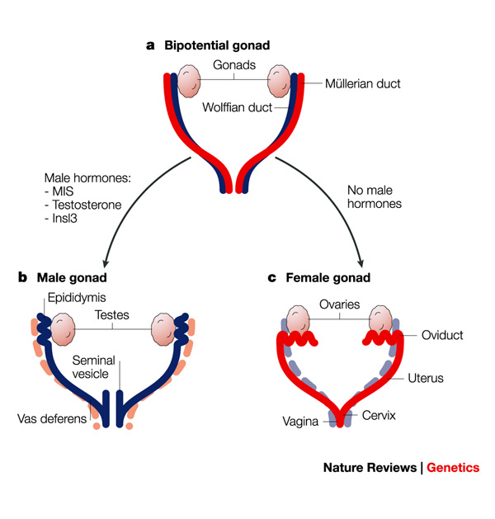
Wolffian and Müllerian Ducts
https://www.nature.com

Slide 18
Male Differentiation—SRY Gene
Males typically have one X and one Y chromosome on the 23rd set.
The SRY gene on the Y chromosome will initiate the male pattern of development.
The SRY gene is expressed (genotype to phenotype) in the seventh week of the embryonic period.
Its protein product stimulates primitive Sertoli cells to differentiate in the gonadal tissues that become testes.
Differentiation = the process of develop-ment of the differences between males and females from an undifferentiated zygote (fertilized egg).
Page 1077
Page 1169
Page 1121
Figure 28.27

Slide 19
Male Differentiation—MIH
The Sertoli cells synthesize and secrete Müllerian-inhibiting hormone (MIH).
MIH triggers apoptosis of cells in the Müllerian ducts so that female reproductive structures do not develop.
MIH is also referred to as Müllerian inhibiting substance (MIS).
Apoptosis = a form of cell death in which a programmed sequence of events leads to the elimination of cells without releasing harmful substances into the surrounding area.
(https://www.medterms.com)
Page 1077
Page 1169
Page 1121
Figure 28.27

Slide 20
Male Differentiation—Testosterone
Primitive Leydig cells in the developing testes are stimulated by human chorionic gonadotropin (hCG) from the placenta.
The Leydig cells begin secreting testosterone during the eighth week.
Testosterone stimulates Wolffian ducts to develop as the epididymis, vas deferens, ejaculatory duct, and seminal vesicles of the male reproductive system.
hCG = a hormone made by chorionic cells in the fetal part of the placenta. Human chorionic gonadotropin stimulates the gonads—hence, the name gonadotropin.
(https://www.medterms.com)
Page 1077
Page 1169
Page 1121
Figure 28.27

Slide 21
Male Differentiation—Testosterone (continued)
The primitive testes connect to the Wolffian ducts through a series of tubes that will form the seminiferous tubules.
The prostate and bulbourethral gland develop from outgrowths of the urethra in response to testosterone.
Page 1077
Page 1169
Page 1121
Figure 28.27

Slide 22
Female Differentiation
A female typically has two X chromosomes on the 23rd set.
The primitive gonadal tissues differentiate into ovaries since there is no SRY gene.
The Müllerian ducts develop to form the female reproductive structures in the absence of MIH.
Page 1077
Page 1169
Page 1121
Figure 28.27

Slide 23
Female Differentiation (continued)
The distal ends of Müllerian ducts fuse to form the uterus and vagina— the proximal ends become the fallopian tubes.
The Wolffian ducts degenerate through apoptosis due to the absence of testosterone.
Page 1077
Page 1169
Page 1121
Figure 28.27

Slide 24
Development of the External Genitalia
The external genitalia of females and males remain undifferentiated until about the eighth week of the embryonic period.
Prior to sexual differentiation, female and male embryos both have an elevated midline swelling known as the genital tubercule.
The genital tubercule consists of the urethral groove, paired urethral folds, and paired labioscrotal swellings.
Page 1077
Page 1169
Page 1121
Figure 28.28

Slide 25
Male External Genitalia
Testosterone released by the developing testes is converted to another androgen known as dihydrotestosterone (DHT) by an enzyme known as, 5-alpha reductase.
DHT stimulates development of the urethra, prostate gland, and external genitalia (scrotum and penis).
After birth, testosterone secretion steeply declines since hCG is no longer present because there is no longer a placenta.
Page 1077
Page 1170
Page 1121
Figure 28.28

Slide 26
Female External Genitalia
In the absence of testosterone and DHT, the female external genitalia are formed during embryonic development.
The female external genitalia consist of clitoris, labia majora, and labia minora.
The female and male genitalia are said to be homologous because they develop from the same embryonic tissues.
Page 1077
Page 1170
Page 1122
Figure 28.28

Slide 27
Chromosomal Anomalies

Slide 28
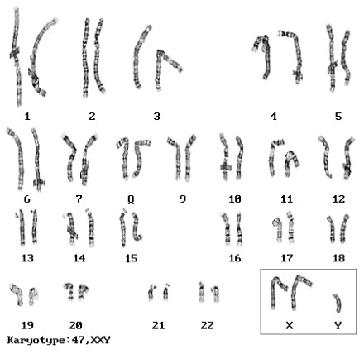
Klinefelter’s Syndrome—Karyotype
XXY
https://www.biology.iupui.edu
XXY karyotype—the 23rd set has two X chromosomes and one Y chromosome.

Slide 29
Klinefelter’s Syndrome
The embryo differentiates as a male in Klinefelter’s and related syn-dromes.
The male reproductive organs are present, but the testes are often small and sterile.
External physical characteristics include light beard growth, breast enlargement (gynecomastia), and narrow shoulders and wide hips.
Syndrome = a set of signs and symptoms occurring together.

Slide 30
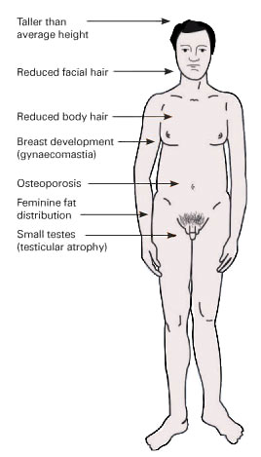
Klinefelter’s Syndrome (continued)
https://www.health-res.com

Slide 31
Klinefelter’s Syndrome (continued)
Men who have the syndrome are usually of normal intelligence and can lead normal lives.
The XXY karyotype results from a nondisjunction—an unequal distri-bution of the sex chromosome—during meiosis I.
Related chromosomal anomalies include XXYY, XXXY, and XXXXY karyotypes.
The karyotypes result from multiple nondisjunctions during meiosis I.

Slide 32
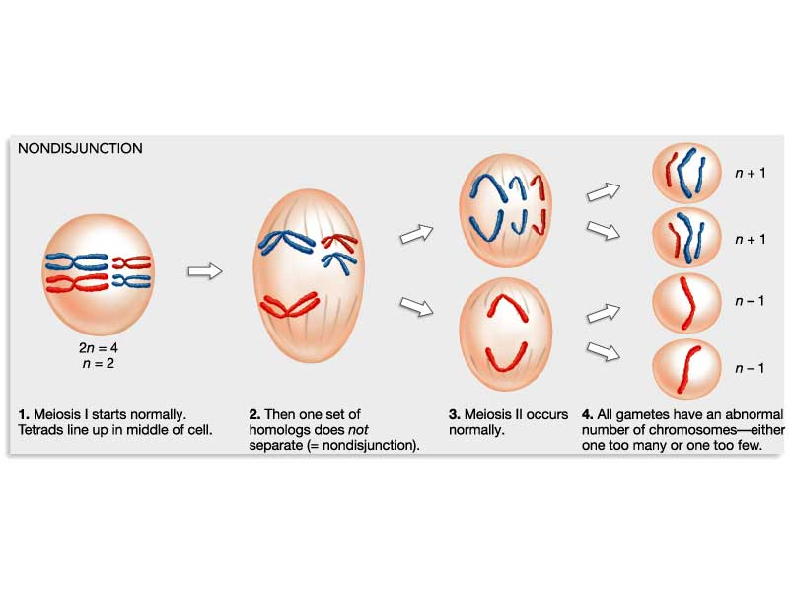
Nondisjunctions
https://www.uic.edu

Slide 33
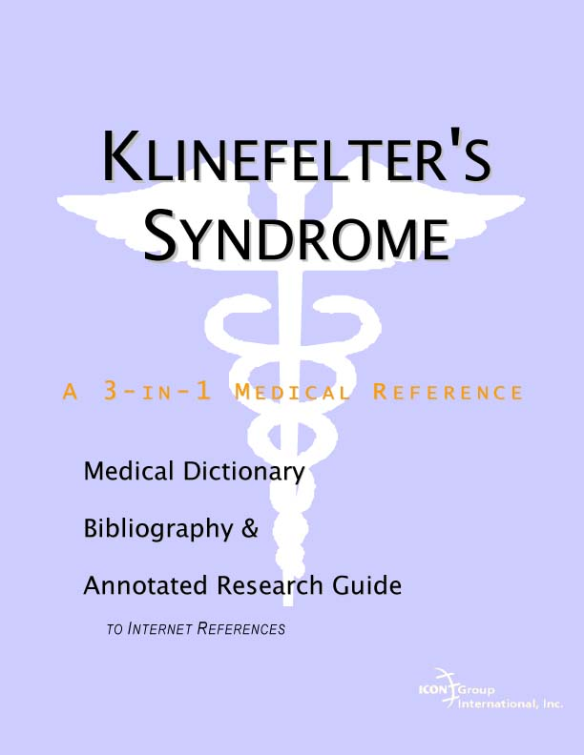
Resources and Support
https://www.icongrouponline.com

Slide 34
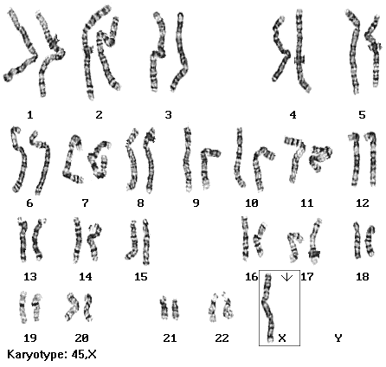
Turner Syndrome—Karyotype
XO
https://www.biology.iupui.edu
XO karyotype—the 23rd set has one X chromosome and no other as indicated by the “O.”

Slide 35
Turner Syndrome
The embryo differentiates as a female in Turner syndrome.
Women with the syndrome are usually of short stature and lack the full development of their breasts and other secondary sexual characteristics.
They are sterile because the female sexual reproductive system does not mature at adolescence.
Women with Turner syndrome are usually of normal intelligence and can lead normal lives.
The XO karyotype results from a nondisjunction during meiosis I.

Slide 36

Resources and Support
University of Texas publication
https://www.healthleader.uhouston.edu

Slide 37
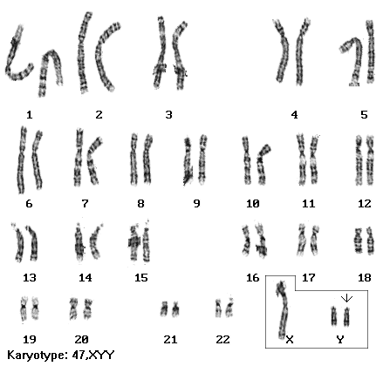
XYY Pattern—Karyotype
XYY
https://www.biology.iupui.edu
XYY karyotype—the 23rd set has one X chromosome and two Y chromosomes.

Slide 38
XYY Karyotype
The embryo differentiates as a male in individuals in XYY and related karyotypes.
Most males who have this karyotype (about one in 1,000 births) are usually not aware of any physical differences, other than possibly their height.
The XYY karyotype at one time was mistakenly associated with anti-social and criminal behaviors because prison populations were mostly studied.
Therefore, it may not be accurate or fair to refer to the XYY karyotype as a disorder as it once was known.

Slide 39
XYY Karyotype (continued)
Men who have an XYY karyotype are often tall—sometimes much taller than their parents and siblings.
They can experience learning difficulties more often than expected in their peers.
Men with this karyotype generally lead normal and productive lives.
The XYY karyotype results from a nondisjunction during meiosis I.

Slide 40
Androgen Insensitivity Syndrome

Slide 41
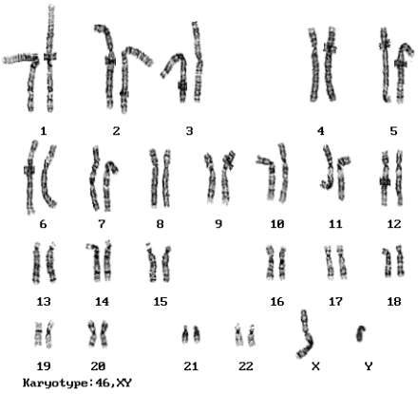
Androgen Insensitivity Syndrome—Karyotype
XY
https://www.biology.iupui.edu
The 23rd set has one X chromosome and one Y chromosome.

Slide 42


Complete Androgen Insensitivity—Two Lives
Melody
https://www.indiana.edu
Both women have Complete Androgen Insensitivity Syndrome and a XY karyotype.
https://www.tomamusica.com

Slide 43
Androgen Insensitivity Syndrome
As an embryo, a genetic male with androgen insensitivity syndrome (AIS) begins to differentiate with female features.
In complete androgen insensitivity syndrome, sexual differentiation is as a female.
The women do not have ovaries and uterus, but in all other respects their bodies are female.

Slide 44
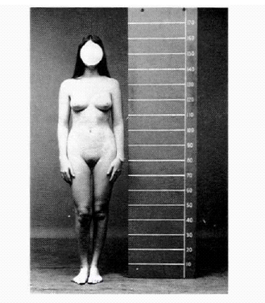
Female Physique
https://www.dls.ym.edu

Slide 45
Biological Mechanisms
The presence of testosterone and other androgens normally stimulates formation of the Wolffian duct, male external genitalia, and secondary sexual characteristics.
In complete AIS, androgen receptors are absent from all cells in the body.
Cells still have estrogen receptors regardless of whether the person is a genetic female or male.
During the embryonic period, the small amount of estrogen produced by genetic males is sufficient for the differentiation of the female exter-nal genitalia if androgen receptors are absent.

Slide 46
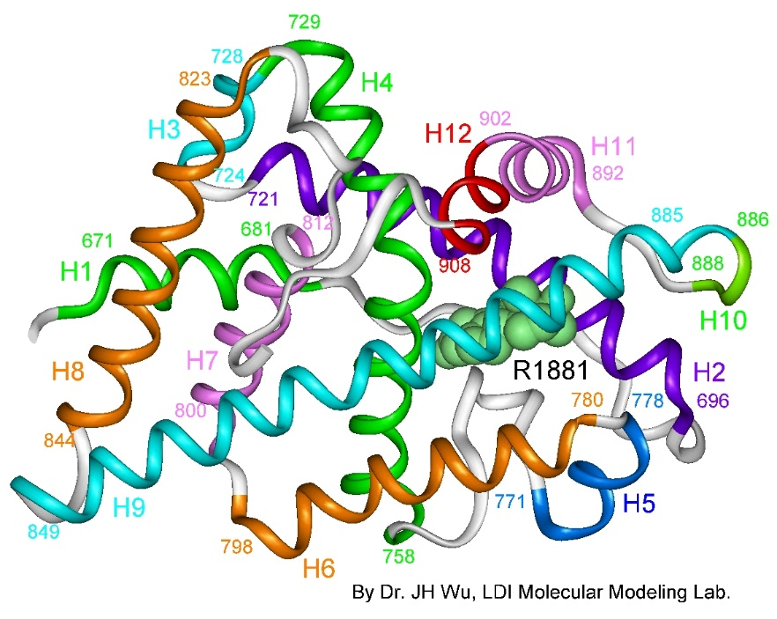
Androgen Receptor
Computer-generated graphic
https://www.androgendb.mcgill.ca
Androgen receptors in the cytoplasm of cells are complex structures of protein molecules.

Slide 47
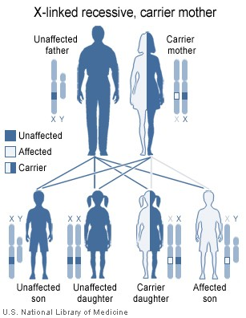
Genetic Basis
https://www.wikimedia.org

Slide 48
Implications
Women with complete androgen insensitivity typically lead normal and productive lives.
No amount of testosterone could change their female physical appearance to be consistent with their chromosomal status (XY karyotype).
Although complete androgen insensitivity is very rare, the cases have increased the understanding of how embryos differentiate as female or male.
The condition has also helped in the understanding the development of gender identity; that is, one’s personal sense of being female or male.

Slide 49

AIS Portrait
“Women with androgen insensitivity syndrome who want AIS to be represented by real people instead of pictures where the face has been removed.”
(Credit: Kasviano
https://www.wikimedia.org)

Slide 50
Adrenogenital Syndrome

Slide 51
Adrenocortical Hypersecretion
Adrenocortical hypersecretion is characterized by excessive secre-tion of androgens from the adrenal cortex.
The condition may be due to a tumor—an adenoma or carcinoma—of the adrenal cortex.
It can occur in genetic females and genetic males.
Adenoma = a benign tumor that develops from epithelial tissue.
Carcinoma = a malignant tumor that develops from epithelial tissue; one of the four major types of cancers.

Slide 52
Adrenogenital Syndrome
Adrenal androgens have a masculinizing effect at any age, and on the developing reproductive structures from seven to eight weeks after conception.
If androgen hypersecretion begins during the embryonic period, it can result in ambiguous genitalia in a genetic female.
This condition is known as adrenogenital syndrome.
If hypersecretion begins in infancy, precocious sexual development and masculinization of the body can occur in both females and males.
Ambiguous genitalia = genitalia that are neither typically female nor typically male; also known as intersexual genitalia.
(https://www.medterms.com)

Slide 53
Sex Determinants

Slide 54
Sex Determination
Sex determination as female or male in humans involves at least six aspects:
Genetic/chromosomal status (23rd set)
Hormonal (steroids—androgens or estrogens)
Reproductive organs (gonads, accessory glands, and ducts)
Secondary sexual characteristics (physical appearance)
Gender identity (one’s personal sense of being male or female)
Gender role (societal norms based on one’s actual or perceived sex)
Genetics is one aspect of sexual differentiation—usually, but not always, all six aspects are congruent.
Congruent = in agreement.

Slide 55
XY Karyotype
XY
https://www.biology.iupui.edu

Slide 56
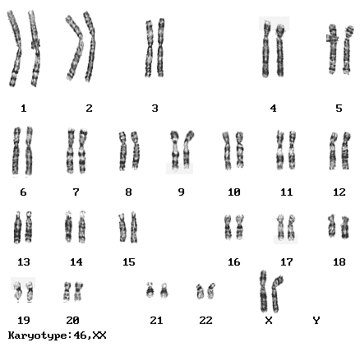
XX Karyotype
XX
https://www.biology.iupui.edu

Slide 57


Transgendered Individuals
Both individuals have websites to promote personal, family, and public awareness.
Lynn Conway
https://www.wikimedia.org
Loren Cameron
https://www.channel.nationalgeographic.com

Slide 58
Comparisons
Determinant | Complete Androgen Insensitivity Syndrome | Adrenogenital Syndrome (embryonic onset) | Transgender Male-to-Female (pre-transition) | Transgender Female-to-Male (pre-transition)
Genetic/chromo-somal status | XY | XX | XY | XX
Hormonal (functioning steroid levels) | Female | Male | Male | Female
Reproductive organs | Underdeveloped male | Underdeveloped female | Male | Female
Secondary sexual characteristics | Female | Male | Male | Female
Gender identity | Female | Female or Male | Female | Male
Characteristic gender role | Female | Female or Male | Female or Male | Female or Male

