Slide 1
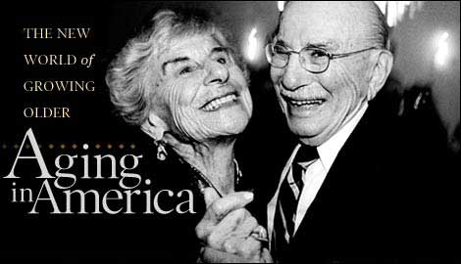
Reproductive Systems
Age-Related Changes
https://www.edkashi.com

Slide 2
Note
Much of the text material is from, “Principles of Anatomy and Physiology” by Gerald J. Tortora and Bryan Derrickson (2009, 2011, and 2014). I don’t claim authorship. Other sources are noted when they are used.
The lecture slides are mapped to the three editions of the textbook based on the color-coded key below.
14th edition
13th edition
12th edition
Same figure or table reference in all three editions

Slide 3
Hormonal Changes
The female and male reproductive systems remain in a juvenile state during the first decade of life.
Hormonal changes initiated by the hypothalamus and anterior pituitary begin to occur at about age ten.
Puberty is the period when secondary sexual characteristics begin to develop and the potential for sexual reproduction is reached in males and females.
The age of puberty onset and its duration varies considerably among children.
Juvenile state = not fully grown or developed.
Page 1079
Page 1171
Page 1122

Slide 4
Hormonal Control
FSH and LH secretions from the anterior pituitary are regulated by gonadotropin releasing hormone (GnRH) from the hypothalamus.
Although the release of GnRH at puberty is not yet fully understood, the hormone, leptin may have a role in this process.
Prior to onset of puberty, the blood level of leptin rises as the amount of adipose tissue increases.
Leptin = a protein hormone synthesized in adipose tissue that has a role in regulating metabolism and appetite.
Adipose tissue = composed of adipoctyes specialized for the storage of triglycerides. The tissue forms soft pads between organs for support, protection, and insulation.
Page 1079
Page 1171
Page 1122

Slide 5
Hormonal Control (continued)
The hypothalamus and anterior pituitary both have leptin receptors.
Leptin may signal the hypothalamus that long-term energy stores in the adipose tissue (triglycerides) are sufficient so that reproductive structures can mature at puberty.
GnRH is secreted by the hypothalamus, and FSH and LH from the anterior pituitary, which stimulate the gonads in females and males.
The ovaries secrete estrogens (estradiol and estriol), and the testes secrete androgens (testosterone) along with small amounts of estro-gens.
Page 1079
Page 1171
Page 1122

Slide 6
Hormonal Control (continued)
The onset of puberty coincides with pulses of FSH and LH secretions from the anterior pituitary.
Most of these pulses initially occur during sleep—they may also occur more frequently during the day as puberty progresses.
The pulse frequency increases over a period of three to four years until an adult pattern of hormonal release is established.
Page 1079
Page 1171
Page 1122

Slide 7
Female Reproductive Cycle—Early Years
The reproductive cycle typically occurs once each month from men-arche to menopause—this period defines the time span of fertility.
Ovulation occurs in only about ten percent of the initial cycles—the post-ovulatory phase is short for the first one to two years after men-arche.
The percentage of ovulations gradually increases, and the postovu-latory phase eventually reaches a typical duration of 14 days based on a 28-day reproductive cycle.
Menarche = first menses or menstruation.
Menstruation = the monthly discharge of blood, secretions, and tissue from the uterus of non-pregnant women from puberty to menopause.
Page 1079
Page 1171
Page 1122

Slide 8
Female Reproductive Cycle—Later Years
Fertility declines with age—the remaining ovarian follicles are usually depleted between the ages of 40 and 50.
The ovaries become less responsive to stimulation by FSH and LH, and the production and secretion of estrogens by the ovaries begin to decline substantially.
Menopause ensues over time.
Menopause = permanent cessation of menstruation.
Page 1079
Page 1171
Page 1122

Slide 9
Menopausal Signs and Symptoms
Women may experience hot flashes and sweating that coincide with bursts of GnRH secreted by the hypothalamus.
Other physiological and behavioral signs and symptoms of menopause can include:
  Headache
  Hair loss
  Muscular pains
  Vaginal dryness
  Weight gain
  Insomnia
  Depression
  Mood swings
Page 1079
Page 1171
Page 1122

Slide 10
Post-Menopausal Changes
Some atrophy of the ovaries, fallopian tubes, uterus, vagina, external genitalia, and breast occurs in post-menopausal women.
Women may experience a reduction in bone mineral density after men-opause due to the loss of estrogens.
An increased risk of osteoporosis accompanies bone density reduction.
Libido (sex drive) may not decline since it can be maintained by andro-gens secreted by the adrenal cortex.
Osteoporosis = a health condition that weakens bones, making them fragile and more likely to break. It develops slowly over several years and is often only diagnosed when a fall or sudden impact causes a bone to fracture.
(https://www.nhs.uk)
Page 1079
Page 1171
Page 1122

Slide 11
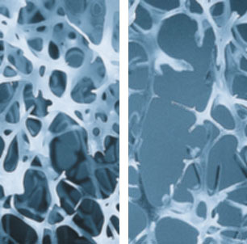
Osteoporosis
https://www.karger.com
Microscopic views of normal bone (left) and osteoporotic bone.
“Osteoporosis is a systemic disease characterized by low bone mass and microarchitectural deterioration of bone tissue, leading to enhanced bone fragility and a consequent increase in fracture risk.”
(World Health Organization,1994)

Slide 12
Male Reproductive Cycle
Declines in reproductive functions are often more subtle in males than in females.
A reduction in testosterone level leads to reduced skeletal muscle strength, fewer viable sperm, and decreased libido, usually starting at about age 55.
Although sperm production can decline by 50 to 70 percent, it can still be sufficient to maintain male fertility.
Men who are healthy can retain their reproductive capacity at age 80 and beyond.
Page 1080
Page 1171
Page 1122

Slide 13
Prostatic Changes
The prostate enlarges up to two to four times in many males over 60 years old.
The condition, called benign prostatic hyperplasia (BPH), compresses the prostatic urethra and reduces its diameter.
Signs and symptoms of BPH can include:
  Incomplete voiding of the bladder
  More frequent urination
  Hesitancy in urination
  Decreased force of the urinary stream
  Dribbling after urination
  Bed-wetting (nocturia)
Page 1080
Page 1171
Page 1122

Slide 14
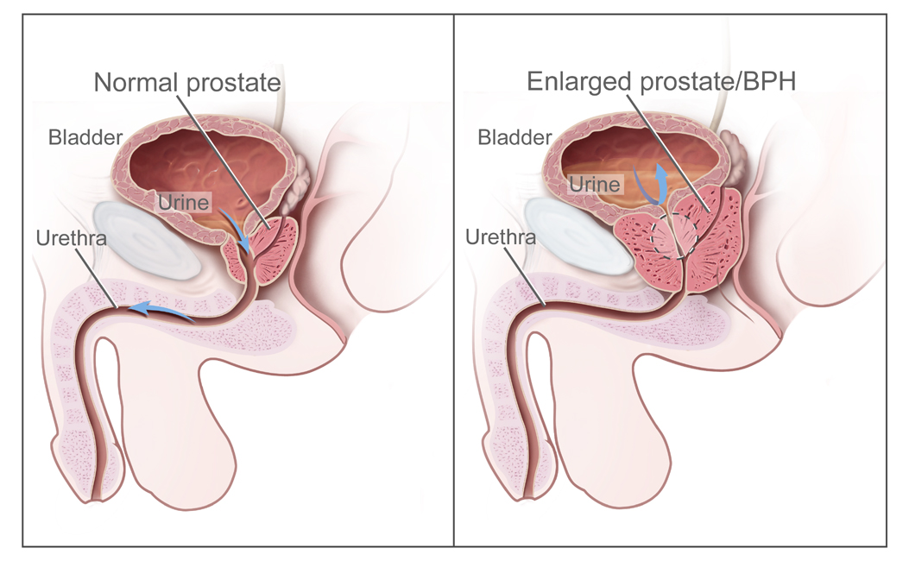
Benign Prostatic Hyperplasia
https://www.health-res.com
“BPH is a benign (not cancer) condition in which an overgrowth of prostate tissue pushes against the urethra and the bladder, blocking the flow of urine.”
(https://www.cancer.gov)

Slide 15
Prostate Testing
Men should have periodic prostate exams as they get older so that prostate cancer can be detected and distinguished from benign pros-tatic hyperplasia.
Prostate cancer can be best treated if it is detected at an early stage.
Tap or click here to learn about prostate cancer (video presentation).
Page 1080
Page 1171
Page 1122

