Slide 1
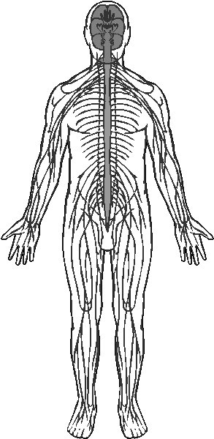
Nervous System Organization

Slide 2
Note
Much of the text material is from, “Principles of Anatomy and Physiology” by Gerald J. Tortora and Bryan Derrickson (2009, 2011, and 2014). I don’t claim authorship. Other sources are noted when they are used.
The lecture slides are mapped to the three editions of the textbook based on the color-coded key below.
14th edition
13th edition
12th edition
Same figure or table reference in all three editions

Slide 3
Nervous System Organization
Although the nervous system is only three percent of total body weight, it is our most complex organ system.
The brain is a highly-organized network of neurons supported by neuro-glia (glial cells).
The nervous system consists of the:
  Brain
  Spinal cord
  Somatic nervous system
  Enteric nervous system
  Autonomic nervous system
Page 400
Page 448
Page 416

Slide 4
Central and Peripheral Nervous Systems
The central nervous system (CNS) includes the brain and spinal cord.
The peripheral nervous system (PNS) includes all nervous tissue out-side of the CNS.
The optic nerve (cranial nerve II) is part of the CNS—all other cranial nerves are part of the PNS.
The optic nerve is considered to be an extension of brain tissue unlike the other cranial nerves.
Page 400
Page 448
Page 417
Figure 12.1

Slide 5
Peripheral Nervous System
The peripheral nervous system has three components:
  Somatic nervous system (SNS)
  Enteric nervous system (ENS)
  Autonomic nervous system (ANS)
Page 400
Page 448
Page 425
Figure 12.1
Figure 12.1
Figure 12.10

Slide 6
Somatic Nervous System
The somatic nervous system (SNS) has many sensory receptors that convey information from the body and special senses.
The special senses are vision, hearing, equilibrium and balance, taste (gustation), and smell (olfaction).
The SNS also has motor neurons to enable action potentials to propa-gate (travel) from the central nervous system (CNS) to skeletal muscle fibers.
Page 400
Page 448
Page 425
Figure 12.1
Figure 12.1
Figure 12.10

Slide 7
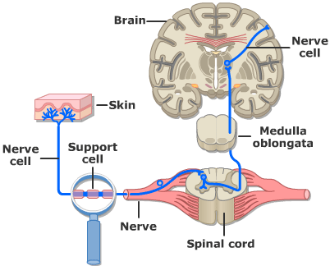
Somatosensory Input
https://www.getbodysmart.com

Slide 8
Enteric Nervous System
The enteric nervous system (ENS) has about 100 million neurons in plexuses that extend along almost the length of the digestive tract.
Sensory neurons monitor chemical changes and stretch of the walls of the hollow organs including the stomach and intestines.
Motor neurons control the contractions of smooth muscles, secretions from accessory organs, and activity of endocrine cells in the digestive tract.
Plexus = a complex, interconnected arrangement of parts; in this context, a network of neurons outside of the CNS.
Page 400
Page 448
Page 426
Figure 12.1
Figure 12.1
Figure 12.10

Slide 9
Autonomic Nervous System
The autonomic nervous system (ANS) conveys information from sensory receptors in the blood vessels and visceral organs to the CNS.
The ANS has motor neurons that conduct action potentials from the CNS to smooth muscle fibers, cardiac muscle fibers, and endocrine and exocrine glands.
The ANS consists of the sympathetic and parasympathetic divisions.
Visceral organs = the internal organs of the body, specifically those within the chest—heart and lungs—and the abdomen—liver, pancreas, and intestines.
(https://www.medterms.com)
Page 400
Page 448
Page 426
Figure 12.1
Figure 12.1
Figure 12.10

Slide 10
Autonomic Nervous System (continued)
With some exceptions, the two divisions of the ANS have opposing actions.
For example, the sympathetic division increases heart rate, while the parasympathetic division slows it down.
The two divisions, however, work in concert to control penile erection and ejaculation in the male sexual response.
Motor responses of the ANS are usually not under conscious control.
Page 400
Page 448
Page 426
Figure 12.1
Figure 12.1
Figure 12.10

