Slide 1
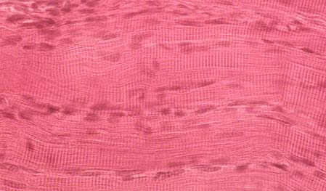
Muscle Tissue and How It Contracts
https://www.histol.chuvashia.com

Slide 2
Note
Much of the text material is from, “Principles of Anatomy and Physiology” by Gerald J. Tortora and Bryan Derrickson (2009, 2011, and 2014). I don’t claim authorship. Other sources are noted when they are used.
The lecture slides are mapped to the three editions of the textbook based on the color-coded key below.
14th edition
13th edition
12th edition
Same figure or table reference in all three editions

Slide 3
Outline
Overview
Skeletal muscle
Muscle contraction and relaxation
Muscle metabolism

Slide 4
Overview

Slide 5
Muscle Tissue
Muscle tissue consists of elongated cells called muscle fibers (or myocytes) that use ATP to generate mechanical force.
The mechanical force is muscle tension.
Muscle tension produces movements, maintains body posture, and generates heat.
The three types of muscle tissue are skeletal, cardiac, and smooth.
Page 134
Page 142
Page 137

Slide 6
Skeletal Muscle
Skeletal muscle tissue is usually attached to the bones of the skeleton.
The tissue has striations (stripes) of alternating light and dark bands that are visible using a light microscope.
Thus, skeletal muscle is sometimes referred to as striated muscle.
Skeletal muscle movement is considered voluntary because it can con-tract through conscious, willful control.
Movement involves the primary motor cortex (Brodmann’s area 4) and other neural systems and pathways including the cerebellum and basal ganglia.
Page 134
Page 142
Page 137
Table 4.9
Table 4.9
Table 4.5

Slide 7
Skeletal Muscle (continued)
Depending on the skeletal muscle, muscle fibers range in length from a few centimeters to 30 to 40 cm (12 to 16 inches).
The fibers are approximately cylindrical in shape, and each has many nuclei in its periphery (for a reason we will discuss later in this lecture module).
The fibers are usually arranged parallel to one another within a whole skeletal muscle.
Page 134
Page 142
Page 137
Table 4.9
Table 4.9
Table 4.5

Slide 8
Cardiac Muscle
Cardiac muscle tissue, which is also striated, forms most of the wall of the heart.
Cardiac muscle fibers are branched and usually have one centrally-located cell nucleus.
Cardiac muscle is considered to be involuntary because its contrac-tions are not consciously controlled.
Page 134
Page 143
Page 139
Table 4.9
Table 45
Table 4.5

Slide 9
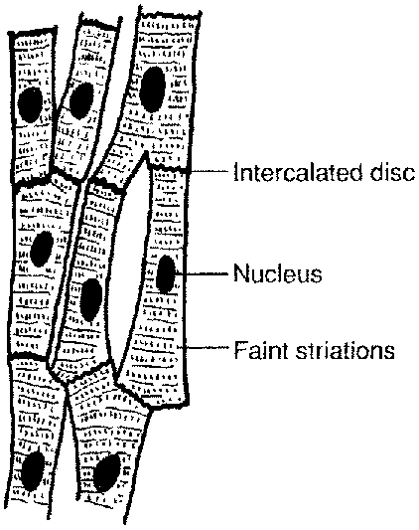
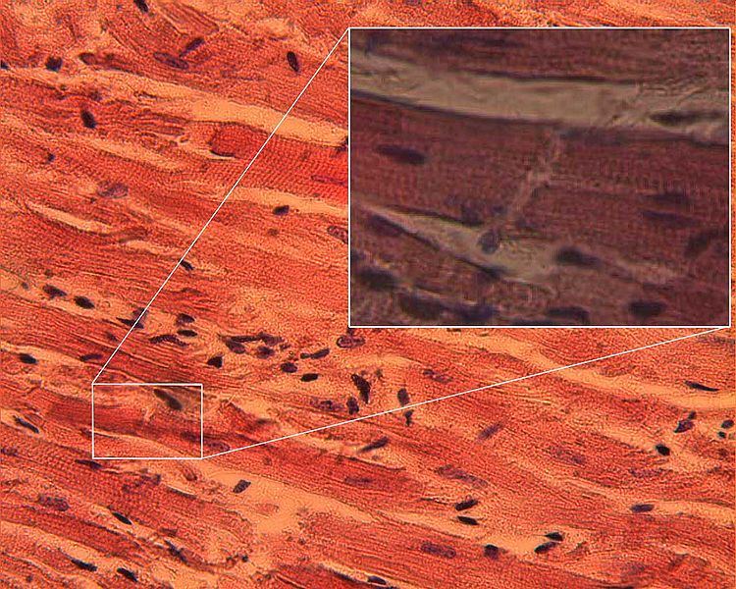
Cardiac Muscle (continued)
https://www.answers.com
https://www.wikimedia.org

Slide 10
Cardiac Muscle (continued)
Gap junctions enable the rapid conduction of muscle action potentials so that the cardiac muscle fibers in the atria and then in the ventricles contract in unison.
Intercalated discs, found only in cardiac muscle fibers, hold the heart muscle tissues together through the billions of contractions during a lifetime.
These discs are thickenings of the sarcolemma that connect the ends of cardiac muscle fibers to each another.
Page 134
Page 143
Page 139
Table 4.9
Table 4.5
Table 4.5

Slide 11
Smooth Muscle
Smooth muscle tissue is found in the walls of hollow internal structures and the iris of the eye.
Internal structures include the blood vessels, airways, lower two-thirds of the esophagus, stomach, intestines, gall bladder, and urinary bladder.
The tissue is not striated; therefore, the term, “smooth” is used for this type of muscle.
Smooth muscle activity is usually involuntary, although there are some exceptions, as discussed during the learning module on the autonomic nervous system.
Page 134
Page 143
Page 139
Table 4.9
Table 4.5
Table 4.5

Slide 12
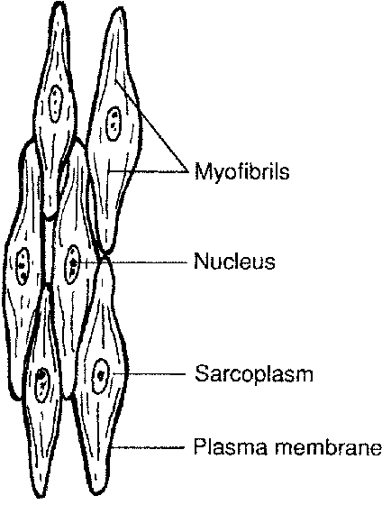
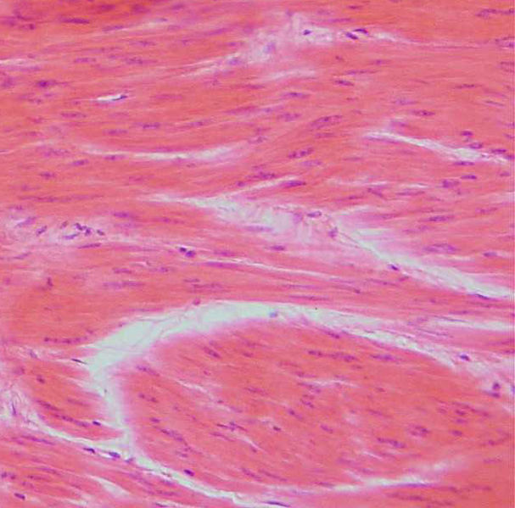
Smooth Muscle (continued)
https://www.answers.com
https://www.wikimedia.org

Slide 13
Smooth Muscle (continued)
Smooth muscle fibers are short, thickest in the middle, and tapered at their ends.
Gap junctions connect the individual fibers, enabling the muscle fibers to contract in unison when muscle action potentials rapidly jump from fiber to fiber.
Page 134
Page 144
Page 139
Table 4.9
Table 4.5
Table 4.5

Slide 14
Functions of Muscle Tissue
Produce body movements
Stabilize body positions
Move and store substances
Generate heat
Page 292
Page 328
Page 302

Slide 15
Produce Body Movements
Whole and localized body movements require the combined functions of skeletal muscles, bones, and joints.
The movements are controlled by systems and pathways in the brain and spinal cord (some of which we already covered in the lecture mod-ules on the nervous system).
Whole body movements are activities such as walking, running, bicycl-ing, and swimming.
Localized body movements are activities such as writing with a pen or pencil, typing on a keyboard, playing a musical instrument, and nodding one’s head.
Page 292
Page 328
Page 302

Slide 16
Stabilize Body Positions
Skeletal muscle contractions stabilize joints and help to maintain body posture.
Postural muscles will contract continuously in an awake person— they include, for example, neck muscles to hold the head upright.
Page 292
Page 328
Page 302

Slide 17
Move and Store Substances
Smooth muscle contractions, known as peristalsis, propel food through the digestive tract.
The contractions of ring-like bands of smooth muscle called sphincters control the outflow of the contents of a hollow organ, such as from the stomach to the small intestine.
The temporary storage of food in the stomach and fluid in the urinary bladder is possible since sphincters can partially or fully close the out-lets to these structures.
Page 292
Page 328
Page 302

Slide 18
Move and Store Substances (continued)
Smooth muscle in the walls of blood vessels adjust their diameters to regulate blood flow (which is primarily under the control of the medulla oblongata).
Cardiac muscle contractions enable blood to be pumped through the arterial blood vessels in the systemic and pulmonary circulatory sys-tems.
Systemic circulation is the general circulation of the blood through the body, as opposed to the pulmonary circulation of the blood from the heart to the lungs for oxygenation and elimination of carbon dioxide.
Page 292
Page 328
Page 302

Slide 19
Generate Heat
Muscle contractions generate heat by a process called thermogenesis.
Much of the heat generated from skeletal muscle contractions is used for maintaining core body temperature of about 98.6ºF (37ºC).
Shivering, an involuntary contraction of skeletal muscles, increases the rate of heat production to help maintain core body temperature in cold environments.
Page 292
Page 328
Page 302

Slide 20
Properties of Muscle Tissue
Electrical excitability
Contractility
Extensibility
Elasticity
Page 292
Page 328
Page 302

Slide 21
Electrical Excitability
Muscle fibers and neurons possess the biophysical property of electrical excitability.
Both respond to certain types of stimuli by generating electrical activity known as action potentials (neurons also generate graded potentials).
Action potentials are propagated along the plasma membrane of mus-cle fibers (and the axons of neurons) due to voltage-gated ion channels.
Biophysics = an interdisciplinary science that uses the methods of physics and physical chemistry to study biological systems.
(https://www.wikipedia.org)
Propagate = travel or spread.
Page 292
Page 328
Page 302

Slide 22
Electrical Excitability (continued)
Two classes of stimuli that trigger action potentials in muscle fibers are:
  Chemical stimuli such as neurotransmitters released by neurons, hormones in the blood, and local changes in acid-base balance (pH).
  Autorhythmic electrical signals from the pacemaker cells of the heart.
Auto- = the prefix for self.
Page 292
Page 328
Page 302

Slide 23
Contractility
Contractility is the ability of muscle fibers to shorten in response to an action potential.
A contracting skeletal muscle generates tension when it pulls on its attachment points of the skeleton.
If the tension is sufficient to overcome the resistance of an object to be moved, the entire skeletal muscle shortens and movement occurs.
Page 293
Page 329
Page 302

Slide 24
Extensibility
Extensibility is the ability of muscle to stretch to a certain extent with-out being damaged.
Muscle fibers can contract even when stretched, although the muscle tension they generate will be lessened.
This is due to the length-tension relationship, which will be discussed later in this lecture module.
Smooth muscle is usually subject to the greatest amount of stretching; for example, a stomach full of food after a large dinner.
Page 293
Page 329
Page 303

Slide 25
Elasticity
Elasticity is the ability of a muscle fiber to return to its original length after contraction or extension.
Muscle fibers, as we will discuss, have properties to maintain elasticity.
Page 293
Page 329
Page 303

Slide 26
Structural Hierarchy of Muscle
Whole muscle
Muscle fibers
Myofibrils—thread-like structures that can be observed using a light microscope
Sarcomeres—basic functional unit of contraction
Myofilaments—thin and thick filaments that can be observed using an electron microscope
Keep this top-to-bottom hierarchy in mind as we cover the upcoming slides.

Slide 27
Skeletal Muscle
The remainder of this lecture module and the next module focus mostly on skeletal muscle. Much of what is discussed also applies to cardiac muscle and smooth muscle.

Slide 28
Structure
A whole muscle has many skeletal muscle fibers positioned parallel to each other.
The diameter of mature skeletal muscle fibers ranges from 10 to 100 μm (microns).
A typical length is about 10 cm (four inches), although some fibers can be as long as 30 to 40 cm (12 to 16 inches).
1.0 μm (micron) = 1.0 x 10⁻⁶ meters (m) = one millionth of a meter.
Page 295
Page 331
Page 305
Figure 10.2

Slide 29
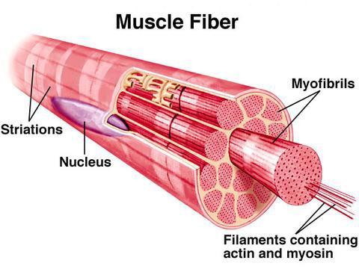
Muscle Fiber
https://www.crossfitoakland.com

Slide 30
Embryonic Development
During embryonic development, a skeletal muscle fiber fuses from 100 or more mesodermal cells called myoblasts.
Thus, a skeletal muscle fiber can have as 100 or more individual nuclei (unlike the other muscle fiber types that have one nucleus).
Muscle fibers lose almost all ability to undergo further cell division once fusion has occurred.
The number of skeletal muscle fibers are established before birth, and most last a lifetime.
Mesoderm = one of the three primary germ cell layers—the other two are the ectoderm and endoderm—in the very early embryo. The mesoderm is the middle layer. It differentiates to gives rise to a number of tissues and structures including bone, muscle, connective tissue, and the middle layer of the skin.
(https://www.medterms.com)
Page 295
Page 331
Page 305

Slide 31
Skeletal Muscle Repair
A few myoblasts persist in mature skeletal muscle—they are known as satellite cells.
These cells retain a capacity to fuse with one another in damaged muscle fibers to regenerate a very limited number of muscle fibers.
The number of muscle fibers that can be regenerated from satellite cells cannot compensate for a substantial amount of muscle damage.
Damaged muscle tissue usually undergoes fibrosis, the replacement of muscle fibers by scar tissue.
Scar tissue has no capability to contract and produce muscle tension.
Page 295
Page 331
Page 305

Slide 32
Muscle Growth
Skeletal muscle growth after birth is due to hypertrophy, an enlarge-ment of existing muscle fibers.
Human growth hormone (hGH) and other hormones stimulate an increase in the size of the skeletal muscle fibers in childhood and especially at puberty.
Androgens, a class of hormones that includes testosterone, promote enlargement of the skeletal muscle fibers through protein synthesis.
This process accelerates at puberty, and it increases muscle mass and strength.
Contrast hypertrophy with:
Hyperplasia = increase in the number of muscle fibers.
Human growth hormone (hGH) and androgens will be covered in the lecture modules on endocrinology.
Page 295
Page 331
Page 305

Slide 33
Nuclei, Sarcolemma, and T Tubules
The nuclei of a skeletal muscle fiber are located just beneath the sar-colemma, the name for the plasma membrane of a muscle fiber cell.
Thousands of invaginations known as transverse (T) tubules tunnel from the surface of the sarcolemma toward the center of the muscle fiber.
The tubules, which open to the outside of the muscle fiber, are filled with the same interstitial fluid that surrounds cells.
Invagination = folded inward.
Interstitial fluid = extracellular fluid found in the microscopic spaces between cells.
Page 295
Page 331
Page 305
Figure 10.2

Slide 34
Nuclei, Sarcolemma, and T Tubules (continued)
Muscle action potentials that trigger muscle contractions propagate along the sarcolemma, and deep into the interior of muscle fibers via the T tubules.
The arrangement assures that a muscle action potential excites all parts of a muscle fiber simultaneously for smooth, precise contrac-tions.
Propagate = in this context, travel.
Page 295
Page 331
Page 305
Figure 10.2

Slide 35
Sarcoplasm
Within the interior of the sarcolemma is the sarcoplasm, the cytoplasm of a muscle fiber.
The sarcoplasm contains a large amount of glycogen, a macromolecule formed from glucose molecules, for use in the regeneration of ATP in the muscle fiber.
The sarcoplasm also contains myoglobin, a protein molecule found only in muscle fibers.
Myoglobin has similarities to hemoglobin, which binds to and transports oxygen in red blood cells.
Page 295
Page 331
Page 305
Figure 10.2

Slide 36
Myoglobin and Mitochondria
Myoglobin binds oxygen (O₂) that passively diffuse into the muscle fibers from the interstitial fluid and the oxygenated blood in the cap-illaries.
Myoglobin releases O₂ when needed by the mitochondria for ATP production.
The mitochondria, arranged in rows in a muscle fiber, are adjacent to motor proteins to provide a continuous source of ATP for muscle fiber contraction.
Motor proteins = the protein molecules actin and myosin that make up the thin and thick filaments and are responsible for the muscle contraction process—more about the motor proteins in this lecture module.
Page 295
Page 331
Page 305

Slide 37
Myofibrils
When viewed using a light microscope, the sarcoplasm appears to contain very thin threads.
The threads, known as myofibrils, are the contractile organelles of a muscle fiber.
They are about 2 μm in diameter and extend the length of the muscle fiber.
Their striations, or bands, make an entire skeletal muscle fiber appear striated (more about this shortly).
Organelle = specialized structures within a cell that have specific functions.
Page 295
Page 331
Page 305
Figure 10.2

Slide 38
Sarcoplasmic Reticulum
The sarcoplasmic reticulum (SR) is a fluid-filled system of tubes and sacs that surround the myofibrils.
The SR is similar in structure to the smooth endoplasmic reticulum in non-muscle cells.
The SR stores calcium ions (Ca²⁺) that trigger the muscle contraction process.
Page 295
Page 331
Page 305
Figure 10.2

Slide 39
Myofilaments
Smaller protein structures, known as thin filaments and thick fila-ments (collectively known as myofilaments), are found within the myofibrils.
The filaments can be observed using a transmission electron mi-croscope.
The thin filaments are about 8 nm and the thick filaments are about 16 nm in diameter.
Both types of myofilaments are 1 to 2 um long.
1.0 nm (nanometer) = 1.0 x 10⁻⁹ meters = one billionth of a meter
Page 298
Page 334
Page 305
Figure 10.2

Slide 40
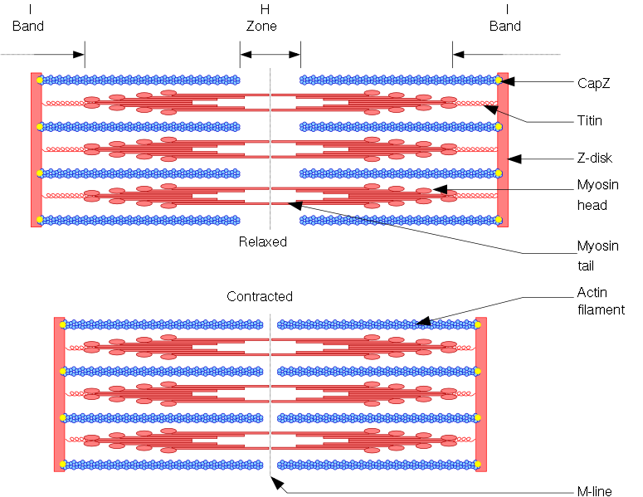
Myofilaments (continued)
A single, simplified sarcomere is shown.
https://www.wikimedia.org
The sarcomere is the basic functional unit of muscle contraction.
The horizontal thick filaments are shown in red, and the thin filaments in blue.

Slide 41
Arrangement of Myofilaments
One thick filament is arranged with four thin filaments—each filament is a motor protein.
The thin and thick filaments overlap one another to a certain extent, depending on whether the muscle is relaxed, contracted, or stretched.
The myofilaments do not extend the length of a myofibril but are in a short compartment known as a sarcomere, which is the functional unit of contraction.
Page 298
Page 334
Page 307
Figure 10.3

Slide 42
Arrangement of Myofilaments (continued)
Narrow regions of proteins called Z discs separate one sarcomere from the next.
The Z discs, bands, zones, and lines within a sarcomere are shown in the electron micrograph in Figure 10.3.
Page 298
Page 334
Page 308
Table 10.1

Slide 43
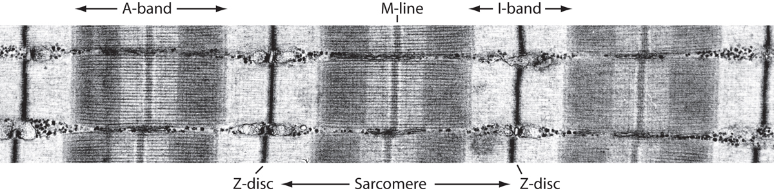
Discs, Bands, Zones, and Lines
https://www.ks.uiuc.edu
Transmission electron micrograph—note that each sarcomere within a muscle fiber (and there are many) contains thin and thick filaments.
The lines and bands are what give skeletal muscle and cardiac muscle their striated (striped) appearances.

Slide 44
Z Disc, A Band, and I Band
Z disc—narrow plates of dense protein that separate the two ends of adjacent sarcomeres.
A band—dark, middle portion of sarcomeres where the thin filaments overlap the thick elements.
I band—lighter portion of sarcomeres that contain thin filaments but no thick filaments.
Page 298
Page 334
Page 308
Table 10.1

Slide 45
H Zone and M Line
H zone—light, narrow region at the midline of the sarcomeres that contains thick filaments but no thin filaments.
M line—dark, narrow region in the center of the H zone that contains proteins to maintain the position of the thick filaments at the center of the sarcomeres.
Page 298
Page 334
Page 308
Table 10.1

Slide 46
Types of Muscle Proteins
Sarcomeres contain three types of proteins—motor, regulatory, and structural.
  Motor (or contractile) proteins generate mechanical force for muscle contractions.
  Regulatory proteins switch the muscle contraction process on and off.
  Structural proteins keep the thin and thick filaments in proper alignment.
Page 299
Page 335
Page 310
Table 10.2

Slide 47
Types of Muscle Proteins (continued)
Motor or contractile proteins—myosin and actin.
Regulatory proteins—tropomyosin and troponin.
Structural proteins—titin, α-actin, myomesin, nebulin, dystrophin, and others.
Page 299
Page 335
Page 310
Table 10.2

Slide 48
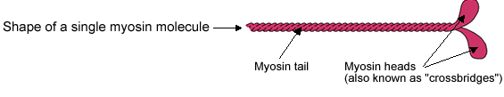
Motor Proteins
Motor proteins produce movement by using ATP to generate mech-anical force.
Myosin is the motor or contractile protein of the thick filaments.
A myosin molecule looks (sort of) like two golf clubs twisted together, with two individual heads and a combined tail.
About 300 myosin molecules form one thick filament.
Page 299
Page 335
Page 310
Figure 10.4
Figure 10.4
Figure 10.5

Slide 49
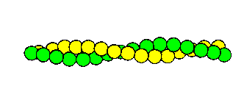
Motor Proteins (continued)
Actin is the motor protein in the thin filaments.
Individual actin molecules are joined to form two filaments a helical shape.
The actin molecules have myosin binding sites where myosin heads of the thick filaments can attach themselves to form crossbridges.
Page 299
Page 335
Page 310
Figure 10.4
Figure 10.4
Figure 10.5

Slide 50
Regulatory Proteins
Thin filaments also contain the regulatory proteins, tropomyosin and troponin.
In relaxed muscle fibers, the myosin heads of the thick filaments are blocked from binding to actin because strands of tropomyosin cover up the myosin binding sites on the thin filaments.
The tropomyosin strands are held in place on the thin filaments by the troponin molecules.
Page 300
Page 335
Page 310
Figure 10.4
Figure 10.4
Figure 10.5

Slide 51
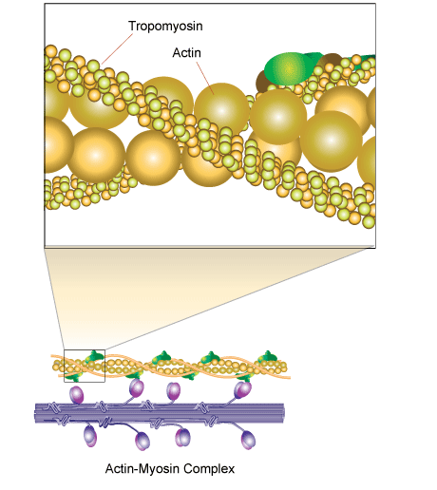
Myosin Binding Sites
https://www.sigmaaldrich.com

Slide 52
Structural Proteins
Muscle fibers contain about a dozen different structural proteins that contribute to the alignment, stability, elasticity, and extensibility of the myofibrils.
Titin, a structural protein, is the third most abundant protein in skeletal muscle fibers (after myosin and actin).
Titin aligns the Z disc to the M line to align and stabilize the exact position of the thick filament in relationship to the four thin filaments.
Titin can be stretched about four times its resting length and still recoil without damage.
This stretch accounts for much of the extensibility and elasticity of the myofibrils within a muscle fiber.
Page 300
Page 335
Page 310

Slide 53
Structural Proteins—Dystrophin
Dystrophin serves as an anchor for the myofilaments—the DMD gene codes for the protein.
A defective DMD gene results in Duchenne muscular dystrophy, an X-linked disorder.
The condition is characterized by a progressive weakening of skeletal muscle especially in boys, who need the defective gene on the one X chromosome.
In comparison, girls would need the defective gene on each of the two X chromosomes, which is much less likely to occur.
Page 300
Page 336
Page 310

Slide 54
Muscle Contraction and Relaxation

Slide 55
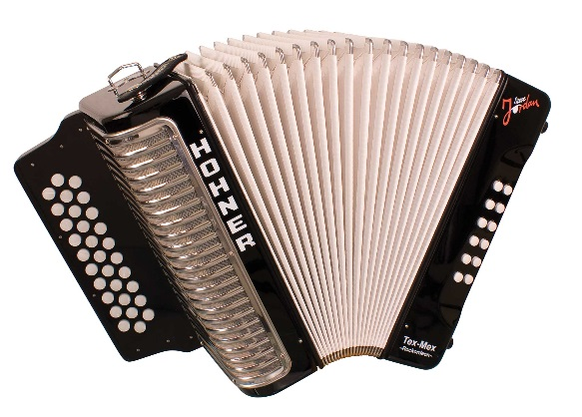
Contraction Mechanism
Muscle contractions were once thought to be the result the folding of contractile organelles in a manner similar to squeezing an accordion.
With the invention of electron microscopy, we now know the thin and thick filaments slide past each other in the muscle contraction process.
This process is called the sliding filament mechanism.
The mechanism is the same in skeletal, cardiac, and smooth muscle fibers.
Accordion
Page 302
Page 338
Page 310
Figure 10.5
Figure 10.5
Figure 10.6

Slide 56
Myofilaments (continued)
A single, simplified sarcomere is shown.
https://www.wikimedia.org
The horizontal thick filaments are shown in red, and the thin filaments in blue.

Slide 57
Sliding Filament Mechanism (continued)
A muscle contraction occurs when the myosin heads in the thick filaments attach to and “walk” along the molecular chains of actin in thin filaments.
The attachments that are formed are called crossbridges.
The thin filaments slide inward and meet at the M line of the sarco-mere.
The simultaneous shortening of many sarcomeres within a muscle fiber shortens the entire muscle fiber to produce mechanical force for muscle tension.
Page 302
Page 338
Page 310
Figure 10.5
Figure 10.5
Figure 10.6

Slide 58
Initiation of the Muscle Contraction Process
In response to a muscle action potential, the sarcoplasmic reticulum releases calcium ions (Ca²⁺) into the sarcoplasm to initiate a muscle contraction.
Ca²⁺ binds to troponin, which displaces tropomyosin from the myosin-binding sites on actin.
The contraction cycle begins when the binding sites on the actin mole-cules are exposed to the myosin heads.
This event leads to the sequence of events, known as the contraction cycle.
Page 302
Page 338
Page 312

Slide 59
Steps in the Muscle Contraction Cycle
The muscle contraction cycle has four steps:
ATP hydrolysis
Attachment of myosin heads to actin to form crossbridges
Power stroke
Detachment of the myosin heads from actin
Page 302
Page 339
Page 312
Figure 10.6
Figure 10.6
Figure 10.7

Slide 60
ATP Hydrolysis
Each myosin head has an ATP binding site and ATPase—an enzyme that hydrolyzes ATP to ADP.
The hydrolysis of ATP to ADP plus an energy-rich phosphate group en-ergizes the myosin head.
At this stage, the ADP molecule and phosphate group remain attached to the myosin head.
ATP hydrolysis:
ATP --> ADP + phosphate group
ATP = adenosine triphosphate (three phosphate groups)
ADP = adenosine diphosphate (two phosphate groups)
Hydrolysis = chemical breakdown of a compound due to its reaction with water.
Page 302
Page 339
Page 312
Figure 10.6
Figure 10.6
Figure 10.7

Slide 61
Crossbridge Formation
The energized myosin head attaches to the myosin-binding site on actin to form a crossbridge.
The phosphate group is released, but ADP remains attached to the myosin molecule in the crossbridge.
Page 303
Page 339
Page 312
Figure 10.6
Figure 10.6
Figure 10.7

Slide 62
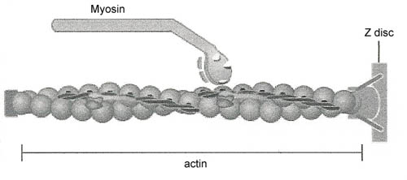
A Single Crossbridge (Among Many)
https://www.arn.org
The energized myosin head binds to a myosin binding site on an actin molecule.

Slide 63
Power Stroke
The crossbridge rotates and releases its ADP molecule in the power stroke.
Mechanical force is generated for muscle tension.
The force generated by many crossbridges enables the thin filaments to slide past the thick filament toward the M line.
Page 303
Page 339
Page 312
Figure 10.6
Figure 10.6
Figure 10.7

Slide 64
Detachment
The crossbridge between the myosin head and the myosin binding site on actin is still in place at the end of the power stroke.
The myosin head then detaches from actin so it can bind to another ATP molecule for continuing the contraction cycle.
Page 303
Page 339
Page 312
Figure 10.6
Figure 10.6
Figure 10.7

Slide 65
Muscle Contraction Cycle—Repetition
The contraction cycle can continue as long as sufficient amounts of Ca²⁺ and ATP are available.
The crossbridges rotate during each power stroke, much like a ratchet wrench, to pull the thin filaments closer and closer toward the M line.
The result is the progressive shortening of the entire sarcomere to produce contraction.
Page 303
Page 339
Page 312

Slide 66
Muscle Contraction Cycle—Repetition (continued)
Within a sarcomere, about 600 crossbridges attach and detach five times per second.
At any given instant, some myosin heads are attached to the myosin binding sites on actin to form crossbridges.
Other myosin heads detach from the myosin binding sites and are ready to bind again to form new crossbridges.
Page 303
Page 339
Page 312

Slide 67
Repetition (continued)
The continued movement of crossbridges produces the mechanical force that draws the Z discs toward each other to shorten the sarco-mere.
In a maximum contraction, the distance between the two Z discs can shorten by about 50 percent of the sarcomere’s resting length.
Page 303
Page 339
Page 312

Slide 68
Muscle Shortening
As the many sarcomeres in skeletal muscle fibers simultaneously shorten, the muscle pulls on their connective tissue coverings and the tendons.
The tension on the tendons pulls on the bones, resulting in skeletal movement.
Page 303
Page 339
Page 312

Slide 69
More Detail on Calcium Ions
Relaxed muscle fibers typically have a low concentration of calcium ions (Ca²⁺) in the sarcoplasm (~ 0.1 μm/l).
Ca²⁺ stored in the sarcoplasmic reticulum is released in response to muscle action potentials.
The increased Ca²⁺ concentration in the sarcoplasm initiates the con-traction cycle.
Ca²⁺ concentration in the sarcoplasm rises about ten-fold so that it can bind with troponin.
μm/l = micromoles per liter.
Page 304
Page 340
Page 313
Figure 10.7
Figure 10.7
Figure 10.8

Slide 70
Calcium Transport Pump
The calcium transport pump in the membrane of the sarcoplasmic reticulum (SR) return Ca²⁺ from the sarcoplasm to the sarcoplasmic reticulum.
As long as muscle action potentials continue, Ca²⁺ flows into the sarco-plasm more rapidly than it can be transported back to the sarcoplasmic reticulum.
Ca²⁺ release from the SR will end after the last muscle action potential is generated.
Eventually the calcium transport pump restores the resting concentration of Ca²⁺.
Page 304
Page 340
Page 313
Figure 10.7
Figure 10.7
Figure 10.8

Slide 71
Length-Tension Relationship
The tension or mechanical force generated by a muscle contraction depends on length of the sarcomeres before the contraction cycle begins.
At their resting length (2.0 to 2.4 μm), the zone of overlap between thin and thick elements is optimal for a maximum number of cross-bridges to be formed.
This optimal overlap enables a muscle fiber to generate maximum tension since the maximum number of crossbridges can be formed.
Resting muscle is normally close to its optimum length for generat-ing maximum tension.
Page 305
Page 341
Page 314
Figure 10.8
Figure 10.8
Figure 10.9

Slide 72
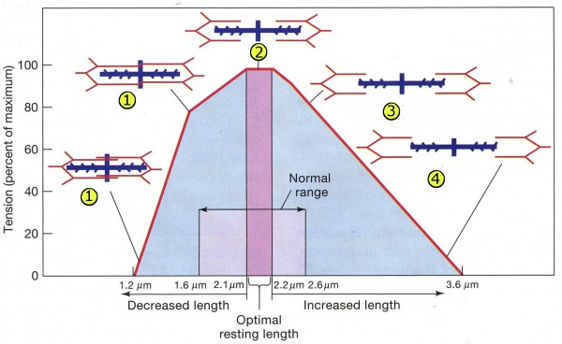
Length-Tension Relationship (continued)
https://www.files.slidingfilament.webnode.com

Slide 73
Length-Tension Relationship (continued)
At less than the optimal length, relatively few myosin heads can attach to the myosin binding sites on actin to form crossbridges.
The amount of tension that is generated decreases compared to the optimal length.
Page 305
Page 341
Page 314
Figure 10.8
Figure 10.8
Figure 10.9

Slide 74
Length-Tension Relationship (continued)
The zone of overlap decreases when the sarcomeres are stretched beyond their optimal length.
At 170 percent of optimal length, no overlap exists between the thin and thick filaments.
The myosin heads cannot bind to actin to form crossbridges, and the muscle fiber cannot contract.
Muscle tension is not generated.
Page 305
Page 341
Page 314
Figure 10.8
Figure 10.8
Figure 10.9

Slide 75
Muscle Metabolism

Slide 76
ATP Production
Skeletal muscle requires small amounts of ATP when relaxed to main-tain its resting metabolism.
However, skeletal muscle must use large amounts of ATP for the con-traction cycle.
The ATP stored in muscle fibers provides a sufficient reserve for only a few seconds.
Muscle fibers generate more ATP from three processes: 1) aerobic respiration (Krebs cycle), 2) anaerobic respiration (glycolysis), and 3) creatine phosphate.
Aerobic and anaerobic respiration are discussed in the module on cell metabolism.
Page 309
Page 345
Page 319
Figure 10.11
Figure 10.11
Figure 10.12

Slide 77
Creatine Phosphate
The excess ATP that muscle fibers produce during relaxation is used to synthesize creatine phosphate, an energy-rich molecule in muscle fibers.
Creatine is a small molecule synthesized in the liver, kidneys, and pancreas.
The enzyme, creatine kinase (CK) catalyzes the transfer of a high-energy phosphate group from ATP to creatine, to produce creatine phosphate plus a molecule of ADP.
Creatine phosphate is about three to six times more plentiful than ATP in the sarcoplasm of a relaxed muscle fiber to store chemical energy.
Page 309
Page 345
Page 319
Figure 10.11
Figure 10.11
Figure 10.12

Slide 78
Creatine Phosphate (continued)
When a muscle contraction begins, CK catalyzes the transfer of a phosphate group from creatine phosphate to ADP to form an ATP molecule.
This “phosphorylation reaction” quickly regenerates new ATP mole-cules.
The reaction provides sufficient energy for muscles to contract max-imally for about 15 seconds—more than enough time for a 100-meter dash.
Page 309
Page 345
Page 319
Figure 10.11
Figure 10.11
Figure 10.12

Slide 79
Dietary Needs
Humans need about two grams of dietary creatine each day to com-pensate for the urinary loss of creatinine, its metabolic by-product.
Good sources of creatine are animal proteins including those found in beef, salmon, and tuna.
Vegan and vegetarian diets when properly planned can provide ade-quate amounts of creatine.
Page 310
Page 345
Page 320

Slide 80
Skeletal Muscle Fatigue
The inability of skeletal muscle to maintain its normal force of contraction with prolonged and intense physical activity is called muscle fatigue.
Muscle fatigue mostly results from physiological changes in muscle fibers.
However, a person may feel tired even before muscle fatigue occurs.
This tired feeling is the result of changes in the brain and spinal cord that are not fully understood.
Page 310
Page 347
Page 320

Slide 81
Skeletal Muscle Fatigue (continued)
Physiological factors that contribute to muscle fatigue include:
  Depletion of creatine phosphate even if ATP is at near-normal levels.
  Inadequate release of Ca²⁺ from the sarcoplasmic reticulum, resulting in a low concentration of Ca²⁺ in the sarcoplasm.
  Insufficient O₂, depletion of glycogen and other nutrients, build-up of ADP and lactic acid, and insufficient release of ACh from motor neurons.
Page 310
Page 347
Page 320

Slide 82
Oxygen Consumption after Physical Exercise
Increases in respiratory rate and blood flow enhance the delivery of O₂ to muscle tissues during intense periods of muscle contrac-tions.
Once the physical effort ends, heavy breathing will continue since oxygen consumption by skeletal muscle remains above the resting level.
This recovery period may last from a few minutes to several hours, depending on the duration and intensity of the physical activity and the person’s physical condition.
Page 311
Page 347
Page 320

Slide 83
Oxygen Debt
Oxygen debt refers to the additional oxygen, beyond what is required at rest, that the body must take-in after physical exercise.
The additional oxygen is used to restore resting metabolic conditions through the:
  Conversion of lactic acid (a byproduct of anaerobic respiration) into glycogen that can be stored in the liver.
  Re-synthesis of creatine phosphate and ATP in muscle fibers.
  Replacement of the oxygen that was depleted from myoglobin in muscle fibers.
Page 311
Page 347
Page 320

