Slide 1
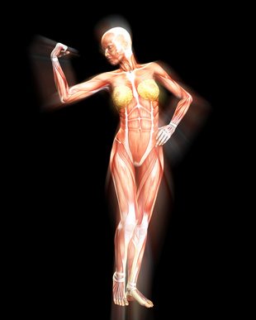
More About Muscle Physiology
https://www.photos.demandstudios.com

Slide 2
Note
Much of the text material is from, “Principles of Anatomy and Physiology” by Gerald J. Tortora and Bryan Derrickson (2009, 2011, and 2014). I don’t claim authorship. Other sources are noted when they are used.
The lecture slides are mapped to the three editions of the textbook based on the color-coded key below.
14th edition
13th edition
12th edition
Same figure or table reference in all three editions

Slide 3
Outline
Neuromuscular junction
Control of muscle tension
Types of skeletal muscle fibers
Physical exercise
Regeneration?
Aging

Slide 4
Neuromuscular Junction

Slide 5
Neuromuscular Junctions
Neurons in the primary motor cortex (Brodmann’s area 4) that control skeletal muscles are known as pyramidal motor neurons due to the pyramid shape of their cell bodies.
A pyramidal (or cortical) motor neuron has a synapse with a spinal motor neuron in the spinal cord.
The axon of the spinal motor neuron (peripheral nerve) extends from the spinal cord to a group of skeletal muscle fibers in a whole muscle.
Action potentials were discussed when we focused on neuronal activity. The biophysical processes for the generation of action poten-tials in muscle fibers and neurons are very similar.
Page 305
Page 341
Page 315
Figure 10.9
Figure 10.9
Figure 10.10

Slide 6
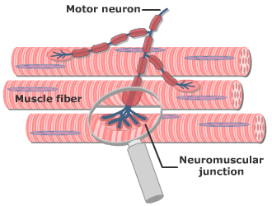
Neuromuscular Junctions (continued)
https://www.getbodysmart.com
The end branches and axon terminals of the axon of a spinal motor neuron are shown.

Slide 7
Neuromuscular Junctions (continued)
The axon of a spinal motor neuron branches and forms axon termi-nals at the neuromuscular junction.
Vesicles that contain the neurotransmitter acetylcholine (ACh), are located in the cytoplasm of the axon terminals.
ACh is released into the synaptic cleft via exocytosis when triggered by the action potentials of the spinal motor neuron.
Page 305
Page 341
Page 315
Figure 10.9
Figure 10.9
Figure 10.10

Slide 8
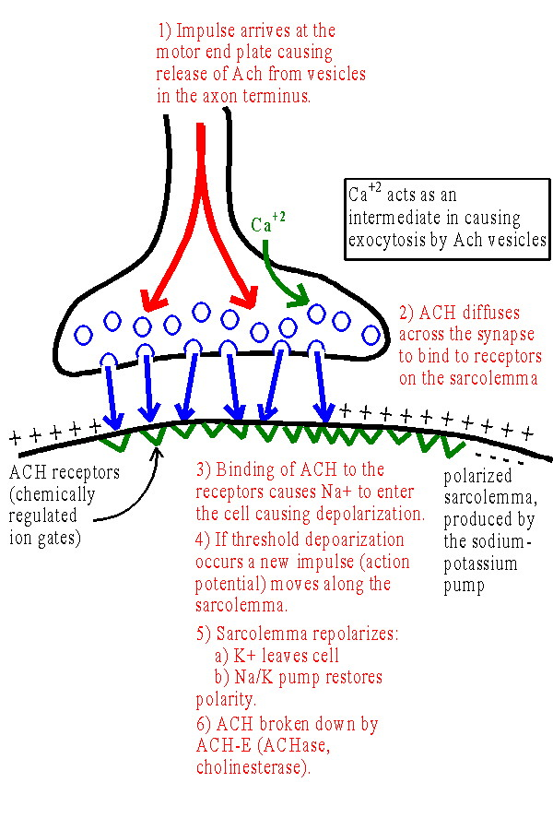
Synaptic Region
https://www.webanatomy.net

Slide 9
Neuromuscular Junctions (continued)
The sarcolemma on the postsynaptic side of the synaptic cleft is called the motor end plate.
The motor end plate has about 30 to 40 million receptors that can bind to ACh.
As few as two molecules of ACh binding to these receptors can trigger a muscle action potential.
The effect lasts only briefly because the enzyme, acetylcholinesterase (AChE) rapidly breaks down ACh into its inactive products, acetyl and choline.
Page 305
Page 342
Page 315
Figure 10.9
Figure 10.9
Figure 10.10

Slide 10
Motor Units
A motor unit consists of one spinal motor neuron and all of the muscle fibers it innervates.
A single muscle fiber is controlled by only one motor neuron.
One spinal motor neuron controls many muscle fibers so that all of the muscle fibers in the motor unit will contract in unison.
Page 311
Page 347
Page 321
Figure 10.12
Figure 10.12
Figure 10.13

Slide 11
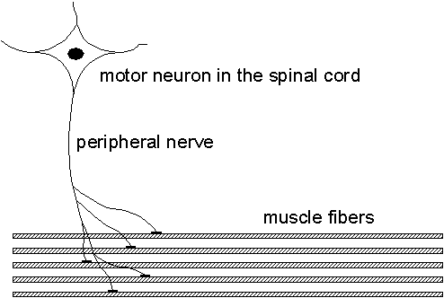
Motor Unit
https://www.signal.uu.se
In this instance, one spinal motor neuron synapses with and controls five skeletal muscle fibers.

Slide 12
Motor Unit Sizes
Skeletal muscles that control precise movements have small motor units.
  Muscles of the larynx (voice box) have as few as two to three muscle fibers in a motor unit.
  Muscles that control eye movements have ten to 20 muscle fibers in a motor unit.
Skeletal muscles that control gross movements, such as walking and running, have as many as 2,000 to 3,000 muscle fibers in a motor unit.
The vastly different ratios are related to the motor homunculus we discussed in the lecture module on the brain.
Page 311
Page 347
Page 321

Slide 13
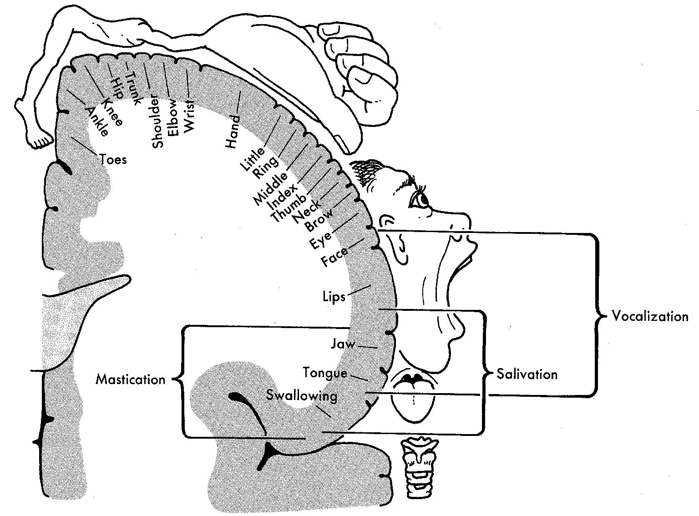
Motor Homunculus—Brodmann’s Area 4
Brodmann’s area 4 = primary motor cortex
https://www.acbrown.com
Smaller motor units for precision movements have the greatest amount of representation in the primary motor area of the cerebral cortex. The grossly distorted body is meant to show the relative differences in cortical representation.

Slide 14
Control of Muscle Tension

Slide 15
Control of Muscle Tension
Action potentials are always of the same amplitude in a muscle fiber, just as in the axon of a neuron.
This feature is known as the all-or-none principle, as discussed in the lecture module on nervous tissue.
However, tension generated by the contraction of muscle fibers varies as a graded response—it is not all or none.
How is this accomplished?
Page 311
Page 347
Page 321

Slide 16
Control of Muscle Tension (continued)
The tension that a single muscle fiber produces depends on the rate at which neuronal action potentials arrive at the neuromuscular junc-tion.
The higher the rate, the greater the amount of tension generated (up to a limit).
Page 311
Page 347
Page 321

Slide 17
Control of Muscle Tension (continued)
The tension that a whole muscle produces depends on the number of motor units that contract in unison.
The amount of tension that can be generated by a whole muscle is also determined by the length-tension relationship in the sarcomeres and the availability of oxygen and nutrients.
Page 311
Page 347
Page 321

Slide 18
Myograms
The physical record of the tension generated in a muscle contraction is known as a myogram.
A myogram has three distinct phases: 1) latent period, 2) contraction, and 3) relaxation.
The three phases correspond to the physiological events in the mus-cle contraction and relaxation process.
Page 312
Page 348
Page 321
Figure 10.13
Figure 10.13
Figure 10.14

Slide 19
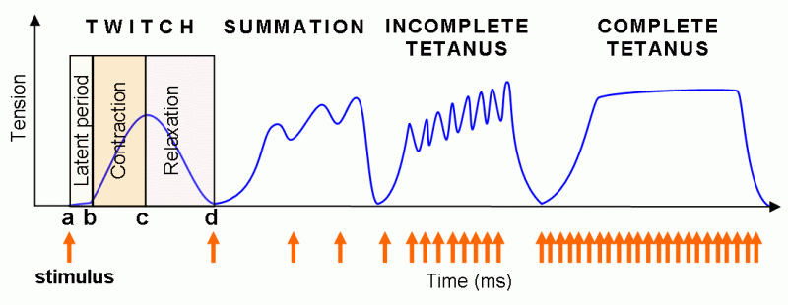
Latent Period, Contraction, and Relaxation
https://www.pef.uni-lj.si

Slide 20
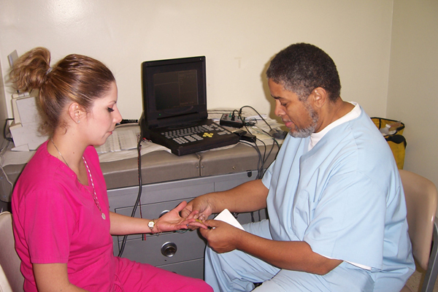
Electromyography
https://www.naderneuro.com
Electromyography is the recording of the electrical activity of muscle tissue using electrodes attached to the skin or inserted into the muscle.

Slide 21
Twitch Contraction
https://www.pef.uni-lj.si

Slide 22
Twitch Contraction (continued)
A muscle twitch is the brief contraction of all of the muscle fibers in a motor unit.
A twitch can be initiated by a spinal motor neuron or direct electrical stimulation of the muscle fiber.
A twitch lasts 20 to 200 msec, longer than the muscle action potential that elicited the muscle contraction.
msec = millisecond
Page 312
Page 348
Page 321
Figure 10.13
Figure 10.13
Figure 10.14

Slide 23
Refractory Period
If two stimuli are applied one immediately after the other, the muscle will respond to the first stimulus, but not to the second since contrac-tion is already underway.
This period of lost excitability is the refractory period, a characteristic of muscle fibers and neurons.
Skeletal muscle has a refractory period of ~ 5 msec (0.005 seconds).
In comparison, cardiac muscle has a refractory period of ~ 300 msec (0.3 seconds) that serves as an upper limit to heart rate as will be dis-cussed in the lecture module on the heart.
Page 312
Page 348
Page 322

Slide 24
Wave Summation
https://www.pef.uni-lj.si

Slide 25
Wave Summation (continued)
When a second stimulus occurs after the refractory period, but before the muscle fiber is completely relaxed, the second muscle contraction will be stronger than the first contraction.
This event is known as wave summation.
Page 312
Page 349
Page 322
Figure 10.14
Figure 10.14
Figure 10.15

Slide 26
Incomplete and Complete Tetanus
https://www.pef.uni-lj.si

Slide 27
Incomplete and Complete Tetanus (continued)
A skeletal muscle fiber that is stimulated 20 to 30 times per second will show a sustained but wavering contraction known as unfused or incom-plete tetanus.
At a rate of 80 to 100 stimuli per second, the result is fused or complete tetanus—a sustained contraction in which individual twitches cannot be detected.
The events are related to a high Ca²⁺ concentration in the sarcoplasm.
The release of calcium triggers the muscle contraction process by bind-ing to the regulatory molecule, troponin.
Page 312
Page 349
Page 322
Figure 10.14
Figure 10.14
Figure 10.15

Slide 28
Tetanus—The Disease
“Tetanus is caused by a bacterial toxin that affects your nervous system, leading to painful muscle contractions, particularly of your jaw and neck muscles. Tetanus can interfere with your ability to breathe and can threaten your life. Tetanus is commonly known as "lockjaw."
Because of the tetanus vaccine, cases of tetanus are rare in the United States and other parts of the developed world. But the disease remains a threat to those who aren't up to date on their vaccinations. It's more common in developing countries.”
(https://www.mayoclinic.org)

Slide 29
Motor Unit Recruitment
Not all motor units in a whole muscle are stimulated to act in unison (at the same time).
A progressive increase in the number of motor units involved in muscle contraction is known as motor unit recruitment.
Recruitment enables the contraction of a whole muscle to be sustained for a period of time.
The weaker motor units are recruited first, with the stronger motor units added as more muscle tension is needed.
Page 313
Page 349
Page 323

Slide 30
Motor Unit Recruitment (continued)
Recruitment delays the onset of muscle fatigue since unfatigued muscle fibers can be added as skeletal muscle continues to con-tract.
Fatigued muscle fibers relax and recover before they are recruited again.
Recruitment also helps produce smooth movements since not all muscle fibers are immediately activated—the weaker motor units are activated first.
Page 313
Page 349
Page 323

Slide 31
Muscle Tone
Muscle tone is the result of a slight amount of muscle tension from weak, involuntary contractions of motor units.
Skeletal muscle exhibits tone even when it at rest and not at work.
To sustain muscle tone over a long period of time—such as in the neck muscles—small numbers of motor units are alternatively active and inactive to prevent fatigue.
Page 313
Page 350
Page 323

Slide 32
Muscle Tone (continued)
Skeletal muscle tone is established by the motor areas of the brain.
If the axons of cortical motor neurons are cut, the skeletal muscle become flaccid, a condition of limpness characterized by a complete loss of muscle tone.
This is what happens in quadriplegia (higher spinal cord break) and paraplegia (lower spinal cord break).
Page 314
Page 350
Page 323

Slide 33
Quadriplegia and Paraplegia
Quadriplegia is paralysis from the neck down, including the trunk, legs and arms. The condition is typically caused by an injury to the spinal cord that contains the nerves that transmit messages of movement and sensation from the brain to parts of the body. Quadriplegia is most likely to occur from a spinal cord injury to the neck at C5 (cervical 5) to C7 (cervical 7). The spinal cord cannot transmit messages below the damaged area, resulting in the loss of mobility in the arms and legs and the loss of function in breathing, bowel, and bladder control.
(https://www.spine-health.com)
Paraplegia is paralysis that affects the legs, but not the arms. This symptom is most likely to happen with (lower) spinal cord injuries but can also happen because of diseases or medical conditions.
(https://my.clevelandclinic.org)
Page 314
Page 350
Page 323

Slide 34
Muscle Tone (continued)
Muscle tone is also important in smooth muscle, such as in main-taining steady pressure on the food contents of the digestive tract, including the small intestine.
Smooth muscle tone in the walls of arteries and arterioles helps in the regulation of blood pressure.
Page 314
Page 350
Page 323

Slide 35
Isotonic Contractions
Skeletal muscle contractions can be isotonic or isometric.
In an isotonic contraction, muscle tension remains almost constant while the muscle changes its length.
Isotonic contractions are involved in body movements and moving objects.
Page 314
Page 350
Page 323
Figure 10.15
Figure 10.15
Figure 10.16

Slide 36
Isometric Contractions
In isometric contractions, the muscle tension is insufficient to exceed the resistance of the object.
Therefore, the muscle does not change its length.
Isometric contractions maintain body posture and supporting objects in a fixed position—for example, holding a heavy book steady with an outstretched arm.
Page 314
Page 350
Page 323
Figure 10.15
Figure 10.15
Figure 10.16

Slide 37
Types of Skeletal Muscle Fibers

Slide 38
Red Muscle Fibers and White Muscle Fibers
Skeletal muscle fibers are not all alike in their composition and func-tions.
Muscle fibers vary in myoglobin content, the red-colored protein mol-ecule that binds oxygen molecules.
Red muscle fibers have high myoglobin content, while white muscle fibers have a lower content.
The high myoglobin content gives the red muscle fibers their reddish appearance.
Red muscle fibers have more mitochondria than white muscle fibers and are supplied by more capillaries.
Page 315
Page 351
Page 324

Slide 39
Muscle Fiber Types (Current View)
Skeletal muscles fibers are now classified as three types building upon what was known about red and white fibers:
  Slow oxidative (SO) fibers—what were called red muscle fibers
  Fast oxidative-glycolytic (FOG) fibers—hybrid fibers
  Fast glycolytic (FG) fibers—what were called white muscle fibers
The different fiber types contract and relax at different rates, differ in their metabolic pathways for generating ATP, and vary in how quickly they can fatigue.
A muscle fiber is considered slow or fast depending on how quickly the enzyme, ATPase in the myosin heads hydrolyzes ATP to ADP to liberate energy.
Page 315
Page 351
Page 324
Table 10.4
Table 10.4
Table 10.3

Slide 40
Distribution of Muscle Fiber Types
Most skeletal muscles contain all three fiber types (SO, FOG, and FG).
About 50 percent of the muscle fibers in a skeletal muscle are usually slow oxidative fibers.
The percentages of other fiber types varies in a whole muscle depend-ing on the role of the muscle, type and amount of physical training, and genetics.
Page 315
Page 352
Page 325

Slide 41
Distribution of Muscle Fiber Types (continued)
SO—postural muscles of the neck, back, and legs.
SO and FOG—muscles of the legs used for walking and running.
FG—muscles not constantly active such as those of the shoulders and arms.
Page 316
Page 352
Page 325

Slide 42
Recruitment of Muscle Fiber Types
All skeletal muscle fibers are of the same type within a single motor unit.
Motor units in a whole muscle are recruited in a specific order—SO, FOG, and then FG fibers—based on the amount of tension required for contraction.
This progressive activation of motor units is controlled by the brain and spinal cord.
Page 316
Page 352
Page 325

Slide 43

Physical Exercise
https://www.4.bp.blogspot.com

Slide 44
Individual Differences
The percentages of fast glycolytic (FG) fibers and slow oxidative (SO) fibers in the whole muscles of an individual are partially determined by genetics.
Variations among people help account for the individual differences in physical performance.
People with a higher percentage of FG fibers are more likely to excel in sports that require brief, intense activity such as weightlifting and sprint-ing.
People with a higher percentage of SO fibers are more likely to excel in sports that require endurance, such as long-distance running and long-distance bicycling.
Page 317
Page 352
Page 325

Slide 45
Exercise-Induced Changes
Physical exercise can, to a degree, change the percentages of skel-etal muscle fiber types.
Endurance type (aerobic) exercises, such as running and swimming, produce a gradual transformation of some FG fibers into FOG fibers.
FOG fibers have increased mitochondria and blood supply needed for aerobic respiration.
Endurance exercise can also produce cardiovascular and respiratory adaptations that improve the flow of oxygen and nutrients to skeletal muscles.
Page 317
Page 352
Page 325

Slide 46
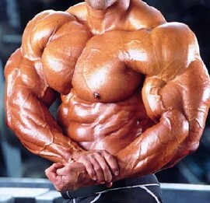
Exercise-Induced Changes (continued)
Physical exercise that requires great strength for short periods of time can to a degree increase the diameter and strength of the FG fibers.
The increase in fiber diameter is due to the increased synthesis of thin and thick filaments and other organelles in muscle fibers.
This muscle enlargement
(hypertrophy) is most evident in bodybuilders.
https://www.armwrestling.biz
Page 317
Page 352
Page 326

Slide 47
Regeneration?

Slide 48
Hypertrophy versus Hyperplasia
After birth, the growth of skeletal muscles is due to hypertrophy, the enlargement of existing muscle fibers through increased muscle pro-tein synthesis.
Compare this to hyperplasia—an increase in the number of fibers— which is rare.
Skeletal muscle fibers have limited capacity to regenerate when they are damaged.
The small number of satellite cells divide slowly and fuse with existing skeletal muscle fibers to allow for a slight amount of muscle growth and repair.
Page 320
Page 356
Page 329

Slide 49
Regeneration (continued)
The smooth muscle of the uterus maintains the capacity for growth though hyperplasia.
Other smooth muscle tissues have a limited capacity for regenera-tion.
Cardiac muscle fibers have no capability to regenerate after a heart attack when the myocardium has been deprived of oxygen due to a blood clot in a coronary artery.
Page 320
Page 356
Page 329

Slide 50
Aging

Slide 51
Aging Effects
With aging, humans undergo a slow but progressive loss of skeletal muscle mass.
The lost skeletal muscle is replaced with adipose and fibrous connec-tive tissues.
The loss of muscle mass with aging is accompanied by a decrease in maximum strength, slowing of muscle reflexes, and loss of flexibility.
Maximum muscle strength at age 85 is about 50 percent of what it was at age 25.
Page 322
Page 358
Page 331

Slide 52
Aging Effects (continued)
The number of slow oxidative fibers increases with age, which could be due to the aging process or to less physical activity in some older people.
Aerobic and anaerobic exercise can help slow age-related declines in muscular performance.
Page 322
Page 358
Page 331

