Slide 1
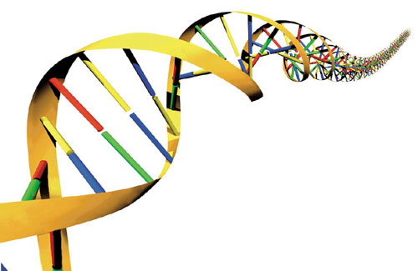
Molecular Biology
https://www.puesoccurrences.files.wordpress.com

Slide 2
Note
Much of the text material is from, “Essential Biology with Physiology” by Neil A. Campbell, Jane B. Reece, and Eric J. Simon (2004 and 2008). I don’t claim authorship. Other sources are noted when they are used.
2
Notes:
2

Slide 3
Outline
DNA and RNA
Gene regulation

Slide 4
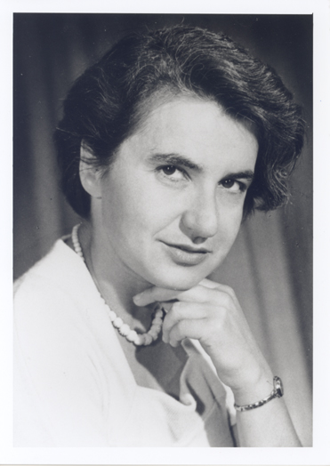
DNA and RNA
Rosalind Franklin
https://www.profiles.nlm.nih.gov

Slide 5
Brief History of DNA
DNA (deoxyribonucleic acid) was identified in cells by the end of the 19th century (1800s) although biologists did not recognize its role in heredity.
Scientific attention focused on chromosomes in the 1930s, that were now known to carry genes.
Scientists discovered in the 1940s that chromosomes consisted of DNA and protein molecules.

Slide 6
Brief History of DNA (continued)
DNA was known to be hereditary material by the early-1950s, but the details were not known.
In 1953, the structure of DNA and its mechanism of replication were deduced from scientific observations.

Slide 7
DNA and RNA
DNA has two strands in an anti-parallel helical arrangement, while RNA (ribonucleic acid) consists of a single strand.
The strands in DNA and RNA are long chains of monomers known as nucleotides.
The nucleotides are joined with covalent bonds by dehydration synthesis.

Slide 8
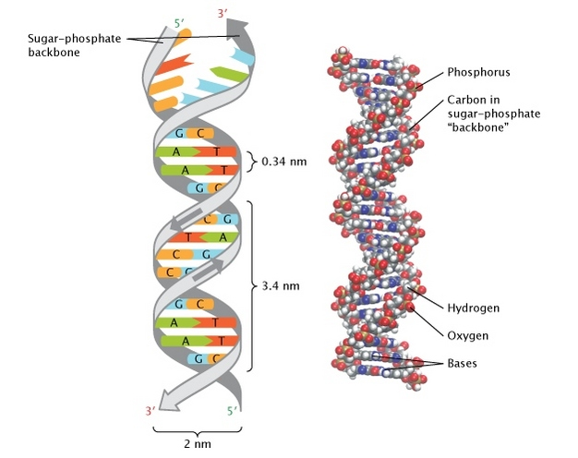
DNA
https://www.nature.com

Slide 9
Nucleotide Structure
Nitrogenous bases:
Thymine (T) and cytosine (C) have single-ring structures (known as pyrimidines).
Adenine (A) and guanine (G)
have double-ring structures (known as purines).
CH₂
Phosphate
group
Sugar
(deoxyribose)
Deoxyribose + phosphate group = sugar-phosphate backbone.
DNA base pairing rules = A with T and G with C in a double helix arrangement.

Slide 10
Nitrogenous Bases
DNA and RNA have a molecular backbone of a repeating pattern of sugar-phosphate-sugar-phosphate.
The nitrogenous bases are molecular appendages on the sugar-phosphate backbone.
RNA contains the nitrogenous base uracil (U) instead of thymine (T).
Appendage = a part that is added or attached to something larger.

Slide 11
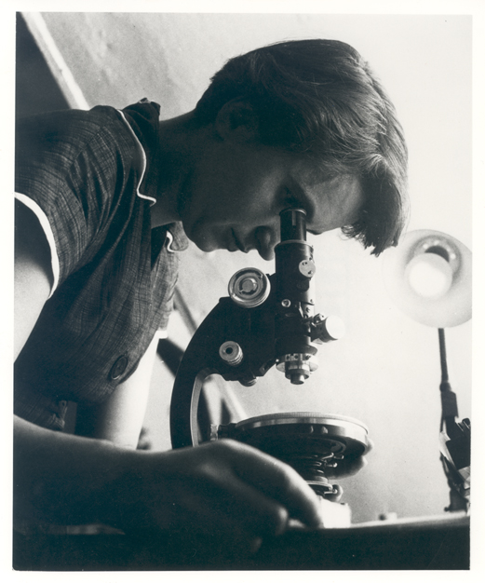
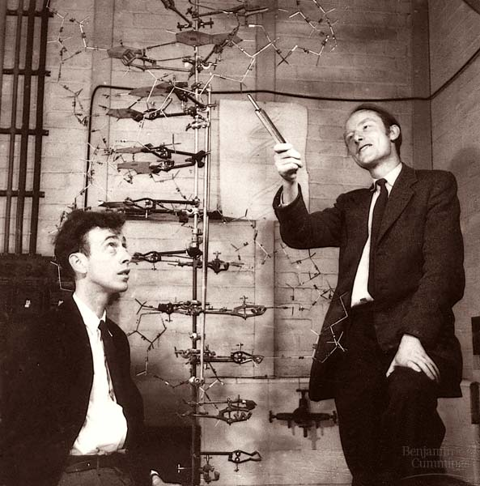
Co-Discoverers of the DNA Double Helix
James Watson and Francis Crick (Maurice Wilkins is not shown).
https://www.profiles.nlm.nih.gov
Rosalind Franklin
Tap or click here to learn more about her life.
https://www.chem.ucsb.edu

Slide 12
X-Ray Crystallography
James Watson, an American, was a visiting scholar at Cambridge Uni-versity in the U.K. in the early-1950s.
At Cambridge, Francis Crick was studying protein structures using X-ray crystallography.
They viewed an X-ray crystallography image produced by Rosalind Franklin of King’s College that suggested the configuration of DNA was a double helix.

Slide 13
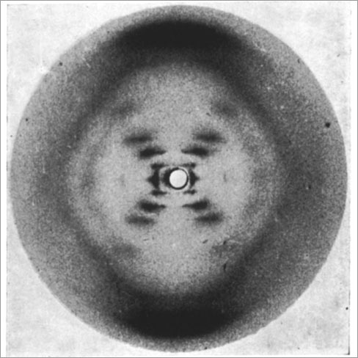
Photo 51
https://www.pbs.org
Rosalind Franklin’s X-ray crystallography image of DNA.

Slide 14
DNA Discovery
An analysis of Photo 51 suggested two strands of nucleotides in a double helix arrangement.
Watson and Crick puzzled over the consistent spacing between the DNA strands.
With help from others, they concluded the four nitrogenous bases can only be arranged in specific ways: A pairs with T, and G pairs with C.
In chemical terms, a purine (two-ring molecule) pairs with a pyrimidine (one-ring molecule) to maintain the consistent spacing between the two strands of DNA.
Watson and Crick created a three-dimensional model of a double helix based on their inductions with much help from Franklin, unbeknown to her.
Inductive reasoning = reasoning from detailed facts to general principles.

Slide 15
DNA Discovery (continued)
While the base-pairing rules are specific (A with T and G with C), they do not restrict the sequence of nucleotides in a strand of DNA.
Once the structure of DNA was determined, scientists focused on how the molecule stores genetic information and passes it on to the next generation.

Slide 16
Nobel Prize
Watson and Crick along with Maurice Wilkins were awarded the Nobel Prize for Physiology or Medicine in 1962 for the discovery of the double helix structure of DNA.
Rosalind Franklin’s role in the discovery went mostly unrecognized until about 20 years ago—she had died of ovarian cancer at age 37 in 1958.
The Nobel Committee does not offer posthumous awards even for the most significant discoveries.
Posthumous = awarded after a person’s death.

Slide 17
Complementary Strands
Each DNA strand serves as a template to guide the reproduction of the second (complementary) strand.
The sequence of bases in a strand determines the sequence of bases in the complementary strand with the application of the base-pairing rules (A with T and G with C).
If one DNA strand has the sequence, ACTGA, the complementary strand has the sequence, TGACT.
Complementary = in this context, relating to the specific pairing of nucleotides between strands of a DNA or an RNA molecule.
Compare with complimentary = encouraging, approving, or pleasing.

Slide 18
Replication Process
The breakage of the hydrogen bonds between the paired nitrogenous bases enables the two strands of DNA to unwind in what are known as replication bubbles.
Each strand serves as a template to produce a complementary strand.
The process is semi-conservative—that is, each new DNA strand con-serves half of the original DNA molecule.

Slide 19
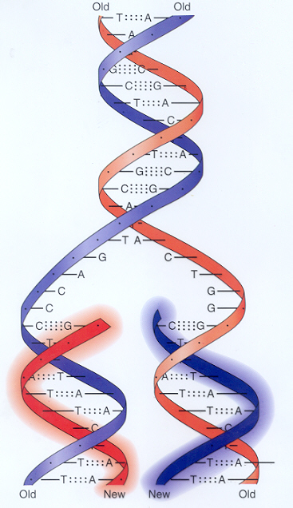
Replication Process (continued)
Replication bubble
https://www.library.tedankara.k12.tr

Slide 20
Replication Process (continued)
Within the cell nucleus, nucleotides are lined-up along each template in accordance with the DNA base-pairing rules (A with T and G with C).
Enzymes enable the the nucleotides to be linked through dehydration synthesis to form new complementary strands.
The daughter DNA strands wind to form a double helix, which will be identical to the parent strands that rewind.

Slide 21
Replication Bubbles
DNA replication occurs at many points along the separated strands of DNA.
Multiple replication bubbles shorten the replication time since the DNA in humans has about three billion nucleotides in each comple-mentary strand.

Slide 22
DNA Polymerases
Although the mechanism for DNA replication is simple in concept, the process is complex and involves more than a dozen enzymes and other proteins.
The enzymes that enable the formation of the covalent bonds between nucleotides in each complementary strand are known as DNA polymer-ases.
Replication at each of many replication bubbles occurs at about 50 nucleotides per second—despite the high speed, the process is usually very accurate.

Slide 23
Damage to DNA
Damage can be caused by environmental sources including toxic chem-icals and high-energy electromagnetic radiation in X-rays and ultraviolet (UVB).
UVB radiation in sunlight, especially in large doses, can damage DNA in skin cells.
Polymerases and other proteins are involved in repairing damaged DNA.
UVB radiation = invisible rays that are part of the energy that comes from the sun. UVB radiation causes sunburn, darkening and thickening of the outer layer of the skin, and melanoma and other types of skin cancer. It may also cause problems with the eyes and the immune system. Skin specialists recommend that people use sunscreens that protect the skin from ultraviolet radiation.
(https://www.cancer.gov)

Slide 24
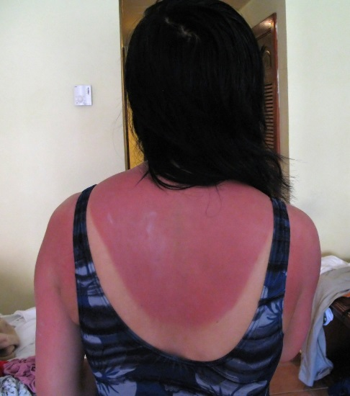
Ultraviolet Radiation
Higher frequency and increasing energy
10⁻⁵ nm
10⁻³ nm
1 nm
10³ nm
10⁶ nm
1 m
10³ m
Wavelength
Electromagnetic
radiation
Gamma
rays
Ultra-
violet
X-rays
Infrared
Microwaves
Radio waves
Visible light (380 to 750 nm)
Sunlight is about 45 percent visible light,
46 percent infrared, and 9 percent ultraviolet (UVA, UVB, and UVC).
Beyond limiting excessive exposure to sunlight, the best protection from UVB radiation is wearing sunglasses and protective clothing, and using a proven, high-SPF sunscreen.
https://www.content.answers.com

Slide 25
Do you use protective clothing and sunscreen when you spend a substantial amount of time outdoors during the daytime?

Slide 26
Genotype and Phenotype
As discussed in the lecture module on genetics, the genotype of an organism is its genetic make up and the phenotype is its physical traits.
The molecular basis of the phenotype is due to proteins, each with a specific function to perform.
The genes in DNA do not directly synthesize proteins, but dispatch instructions from the cell nucleus in the form of mRNA.
The mRNA directs polypeptide synthesis process in the ribosomes in the cytoplasm of cells.
Polypeptide = amino acids together in a chain, forming part of (or the whole of) a protein molecule.

Slide 27
Base Sequences
DNA and RNA are polymers synthesized from long strings of monomers known as nucleotides.
In DNA, the alphabet is A, T, G, and C—in RNA, the alphabet is A, U, G, and C.
The genetic instructions in DNA and RNA are written in a sequence of four bases (nucleotides).
The sequence of bases, along with beginning and ending instructions, form the two strands of DNA and the one strand of RNA.
A = Adenine
C = Cytosine
G = Guanine
T = Thymine (DNA)
U = Uracil (RNA)

Slide 28
Transcription and Translation
From DNA to mRNA is called transcription, and from mRNA to poly-peptide synthesis is called translation.
In the transcription process, the nitrogenous bases of DNA determine the nitrogenous bases of mRNA.
In translation, the nitrogenous bases of mRNA specify the sequences of amino acids to synthesize polypeptides that form complex protein molecules.
The four bases of mRNA specify the sequences of the 20 amino acids in strands of DNA and RNA.

Slide 29
Proteins
Proteins are formed from one or more polypeptide chains that are synthesized from monomers called amino acids.
The human body has tens of thousands of different proteins—each has a unique molecular shape and a specific function.
The functions of proteins include:
  Structural
  Storage
  Contractile
  Enzymes
  Signal
  Transport
  Defensive

Slide 30
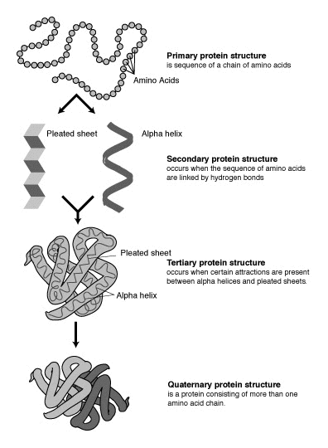
Levels of Protein Structure
Primary = amino acid sequence
Secondary = alpha helix or pleated sheet
Tertiary = polypeptide, three-dimensional shape
Quaternary = protein, three-dimensional shape
A protein molecule consists of one or more polypeptide chains.
https://www.wikimedia.org

Slide 31
Amino Acid Structure
H
Amino
Group
(NH₂)
Carboxyl
Group
(COOH)
C
Side
Group
Side
Group
Side
Group
Side
Group
or…
A schematic diagram of a carbon atom and its four covalent partners in an amino acid.

Slide 32
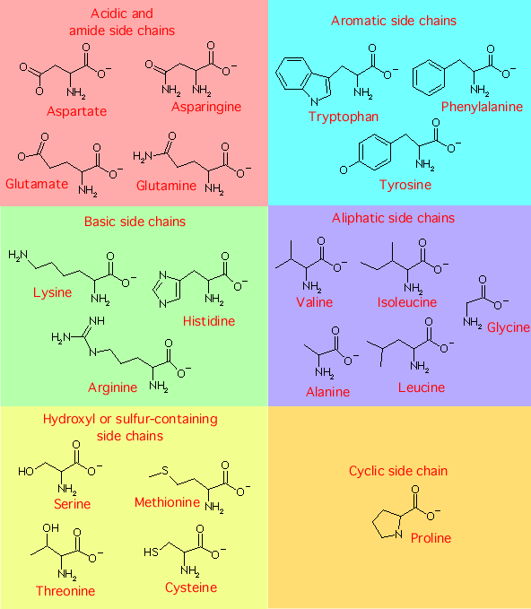
Side Groups of Amino Acids
Acidic or
amide
(n = 4)
Aromatic
(3)
Basic
(3)
Aliphatic
(5)
Hydroxyl or
sulfur-containing
(4)
Cyclic
(1)
https://www.bact.wisc.edu
Total = 20

Slide 33
Codons
How can four nitrogenous bases specify the 20 amino acids found in living organisms?
If each of the four bases uniquely coded for one amino acid, only four amino acids would be possible.
Instead, bases are read during the translation process as three-letter “words” called base triplets or codons
Codons allow for 4³ or 64 amino acids, many more than the actual number required.
Experiments have verified the flow of information from DNA to RNA and to polypeptide synthesis based on codons of three nitrogenous bases.

Slide 34
Codons (continued)
Sixty-one of 64 codons specify the genetic code for 20 amino acids— some amino acids are specified by more than one codon.
Although redundancy exists, there is no ambiguity since each codon specifies only one amino acid.
AUG has the dual role of coding for the amino acid, methionine, and serving as the start signal for translating the RNA instructions to form proteins from amino acids.
UAA, UAG, and UGA serve as stop signals in the translation process.

Slide 35

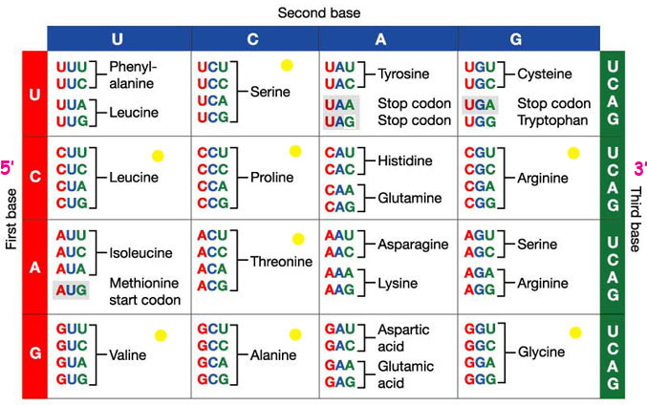
Codon Dictionary
Second base
First base
Third base
http://www.fig.cox.miami.edu

Slide 36
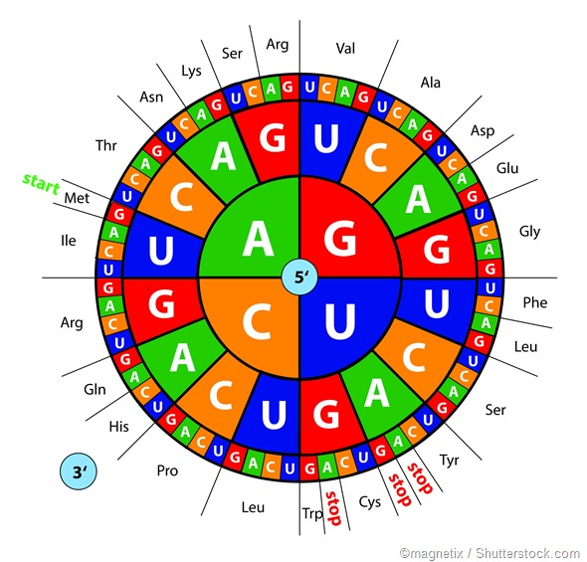
Codon Wheel
Same type of tool, but a different configuration.
36
Notes:
36

Slide 37
Transcription Process
Transcription from DNA to RNA occurs in the nucleus of eukaryotic cells.
The strands of DNA separate at many nodes where the transcription process occurs.
One of the two DNA strands serves as the template for the synthesis of RNA.
Nucleotides are paired one at a time using the RNA base pairing rules to form RNA.

Slide 38
Transcription Process (continued)
The nucleotides in the new RNA chain are linked by the transcription enzyme, RNA polymerase.
The transcription process ends when the RNA polymerase reaches the stop codon in the DNA template.
The single-strand RNA is a complementary copy of the DNA strand.
The transcription process, like DNA replication, is fast and accurate.

Slide 39
Messenger RNA
The RNA is spliced to remove non-coding regions (introns) while in the cell nucleus
A cap and tail of nucleotides are also added.
The molecule is now known as messenger RNA (mRNA) and con-tains exons of genetic instructions.
The mRNA passes through the pores in the nuclear membrane for the translation process involving polypeptide synthesis on the ribo-somes.
Exon = a segment of a DNA or RNA molecule containing information coding for a protein or peptide sequence.

Slide 40
Translation Process
Transfer RNA (tRNA) is the interpreter for translating the codons of the exons in mRNA into the synthesis of polypeptides from amino acids.
tRNA is found in the vicinity of ribosomes where polypeptide chains are synthesized.
The tRNA molecule is about 80 nucleotides—in comparison, mRNA can be very long since it contains a full set of instruction for polypep-tide synthesis.

Slide 41
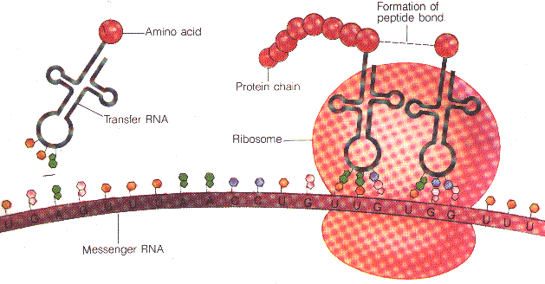
Translation Process (continued)
Formation of covalent bond
through dehydration synthesis
Amino acid
Polypeptide
Transfer RNA
(tRNA)
tRNA and amino acid
Ribosome
Reading frame—
Three nucleotides at a time.
Messenger RNA
https://www.virtualsciencefair.com

Slide 42
Translation Process (continued)
tRNA selects amino acids by reading the three-letter sequences of the mRNA codons.
Ribosomes in the cytoplasm coordinate the functions of mRNA and tRNA in synthesizing polypeptides to form complex protein structures.

Slide 43
Can you describe the basic aspects of the replication, transcription, and translation processes?

Slide 44
Mutations
Any change in a normal nucleotide sequence of a nucleic acid in DNA or RNA is called a mutation.
Mutations can involve large regions of a chromosome, or just a single nucleotide as in sickle-cell disease.
Mutations include: 1) base substitutions, 2) base insertions, and 3) base deletions.

Slide 45
Base Substitutions
In base substitutions, a nucleotide is replaced by another, creating a different RNA codon—GGC for the amino acid glycine would become AGC for serine.
If a codon is changed from GAA to GAG, no change would result since both code for glutamine—this change is known as a silent mutation.
A base substitution can occasionally lead to an improved protein—one with new capabilities that improves the adaptation of the organism and its descendants.
However, sometimes a genetic mutation can be harmful to the organism.
In sickle cell disease, the amino acid, valine replaces the amino acid, glutamic acid due to a single base substitution.

Slide 46
Base Deletions and Insertions
Mutations involving insertion or deletion of one or more nucleotides in a gene can have disastrous effects.
Adding or deleting one nucleotide alters all of the subsequent codons in the three-letter reading frame of tRNA.

Slide 47
Base Deletions and Insertions (continued)
The mRNA molecule with the sequence AAG-UUU-GGC-GCA codes for the polypeptide sequence, lysine-phenylalanine-glycine-alanine.
If a U is deleted from the second codon (UUU), the mRNA sequence from that point on shifts by one nucleotide to the left.
The sequence becomes AAG-UUG-GCG-CAU (assuming that the next nucleotide in the sequence is a U).

Slide 48
Base Deletions and Insertions (continued)
The sequence AAG-UUG-GCG-CAU erroneously codes for the poly-peptide, lysine-leucine-alanine-histidine instead of lysine-phenylala-nine-glycine-alanine.
The polypeptide will probably not be functional since it does not have the correct sequence of amino acids.
Base insertions shift the reading frame one nucleotide to the right, with similar results to those of base deletions.

Slide 49
More on Mutations
The replication, transcription, and translation processes are usually very accurate.
Mutations occasionally have beneficial effects that can help produce the diversity of genes—however, they usually have undesired conse-quences.
Mutations that occur without known causes are called spontaneous events.
Other sources of mutations are physical and chemical agents known as mutagens.

Slide 50
Sources of Mutagens
Some chemicals serve as mutagens that produce incorrect base pairings in DNA.
Mutagens that can cause some cancers are known as carcino-gens.
Carcinogens include tars (chemicals) in tobacco smoke, dietary factors, and excessive exposure to UVB radiation, among others including some industrial chemicals.

Slide 51
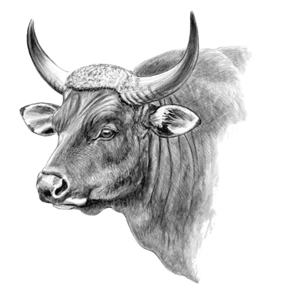
Gene Regulation
Banteng
https://www.rowlandward.com

Slide 52
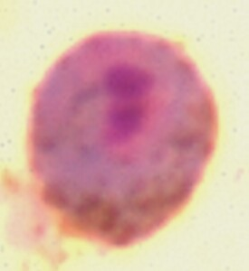
Cellular Differentiation
Every cell in an organism originates from a zygote (fertilized egg) that had gone through many rounds of mitosis.
Each body cell has an identical DNA set because mitosis duplicates the entire genome.
During embryonic development, genes regulate how the earliest cells develop into different body structures and functions.
These cells are known as stem cells, and the process is known as cell-ular differentiation.
An ovum one to three hours after sperm penetration, just prior to the fusion of genetic material from the mother and father.
https://www.lumc.nl

Slide 53
Gene Expression
In transcription, the genes in DNA determine the nucleotide sequences of mRNA molecules.
In translation, mRNA determines the amino acid sequences to synthe-size the polypeptide chains that form proteins.
The flow of genetic information from genes to proteins (that is from geno-type to phenotype) is known as genetic expression.

Slide 54
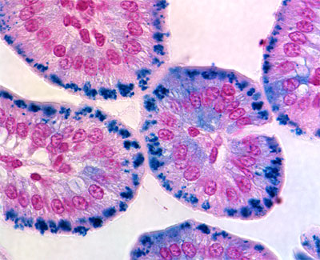
Different Pathways
Cells follow different pathways to develop as different tissues during early embryonic development.
Cells include neurons, muscle cells, blood cells, and skin cells, among many others.
Intestinal cells
https://www/focus.hms.harvard.edu

Slide 55
Genetic Potential of Cells
Although different cells have different functions, they have identical DNA.
Body cells have the potential to act like any other body cell if the pat-tern of gene expression could somehow be modified (which is far more eayily said than done).

Slide 56
Genetic Potential of Plant Cells
Many types of plant cuttings can develop into mature plants because of the genetic potential of their cells.
A single cell removed from a carrot root and placed in a growth medium starts dividing through mitosis.
It can eventually grow into a mature plant.
The technique is used to produce genetically-identical plants, known as vegetative cloning.

Slide 57
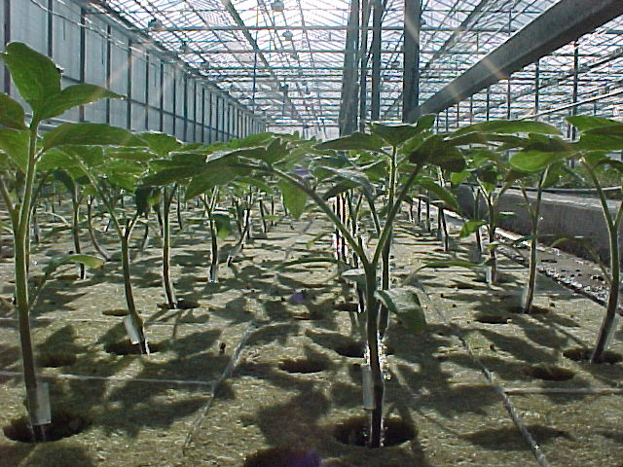
Vegetative Cloning
Commercial growers use vegetative cloning to propagate large numbers of plants or establish resistance to viral diseases.
Vegetative cloning illustrates that cellular differentiation does not lead to irreversible changes in the DNA.
Tomato plants growing
in a hothouse
https://www.houwelings.com

Slide 58
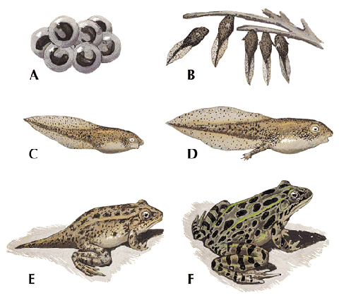
Animal Cloning
Animal cells that do not normally regenerate body parts also retain their full genetic potential.
In the 1950s, the nuclei of frog eggs were replaced with nuclei from the intestinal cells of tadpoles.
Under strict methodological control, the embryos developed into tadpoles and then into frogs.
https://www.cache.eb.com

Slide 59
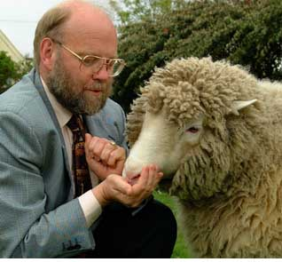
Dolly
https://www.hawaii.edu
Dolly, the first cloned sheep, was born in 1996.

Slide 60
Nuclear Transplantation
Dolly was cloned using the nucleus from a somatic cell from an adult inserted into an egg cell that had its nucleus removed.
The cell was grown in a culture medium.
The embryo was then implanted into the uterus of a surrogate mother.
Dolly resembled her genetic parent—but not the egg donor mother or the surrogate mother.
Nuclear transplantation has been used in cloning of mice, cows, goats, pigs, cats, and other animals.

Slide 61
Why Clone?
Farm animals, such as dairy cows, with desirable phenotypes have been cloned to produce complete herds with the same physical traits.
Researchers have used cloned animals (such as mice) to assure genetically-identical populations to control for extraneous variables in scientific experiments.
Pharmaceutical companies have explored the use of cloned animals for potential medical uses.
Biologists have examined how cloning could help restock populations of endangered species.
Extraneous variables = variables that influence the outcome of an experiment that are not the variables of interest.

Slide 62
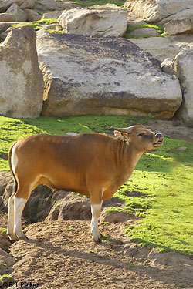
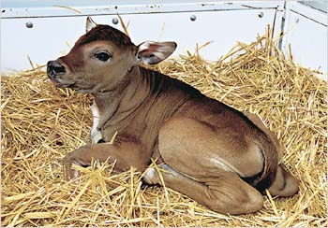
Banteng
In 2003, a baby banteng was produced by the cloning of frozen skin cells from an adult male that died in 1990. The nuclei from the banteng cells were inserted into cow eggs, and one was brought to term by the cow.
https://www.rowlandward.com
https://www.smh.com.au

Slide 63
Therapeutic Cloning
The goal of therapeutic cloning is to generate stem cells for producing new body tissues.
Stem cells during the early embryonic period produce all of the differ-entiated cells in the body—these stem cells are said to be pluripotent.
Embryonic stem cells can divide seemingly indefinitely when grown in a laboratory environment.

Slide 64
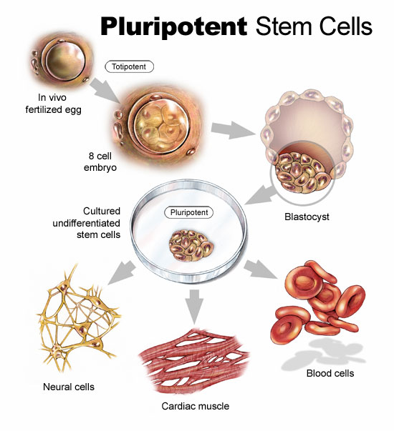
Pluripotent Stem Cells
Zygote
Eight-cell embryo
Blastocyst
Pluripotent stem cells
Red blood cells
Neurons
Cardiac muscle
https://www.csa.com

Slide 65
Possible Uses
Differentiated cells in a laboratory culture might be used for repair of injured or diseased organs in humans.
Embryos might be produced using cell nuclei from a human patient.
Stem cells from these embryos could be harvested and induced to develop entire organs that could be transplanted (right now, it’s still mostly science fiction).
The harvesting of stem cells, and other aspects of reproductive and therapeutic cloning, are part of an ongoing debate about ethics and morality.
Because we are able to achieve something technologically, is it okay to do so?

Slide 66
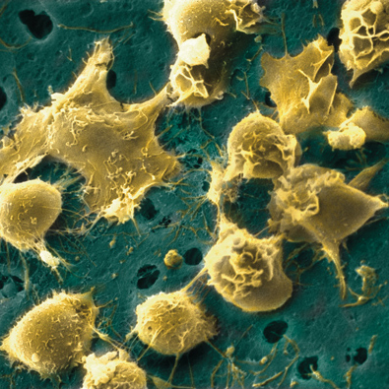
Adult Stem Cells
Adult stem cells are partially differentiated, and therefore can only give rise to some types of cells.
For example, stem cells in bone marrow can produce many different types of blood cells.
Although adult stem cells are more difficult to grow in a lab culture, their medical use (if feasible) could result in less debate than with the use of embryonic tissues.
Bone marrow stem cells,
false-color electron micrograph
https://www.epigenome.edu

Slide 67
Can you think of other potential uses for therapeutic cloning?

Slide 68
From Genes to Proteins
The process from genes to the synthesis of functioning proteins is complex.
The process can be regulated to turn-on, turn-off, speed-up, or slow-down gene expression.

Slide 69
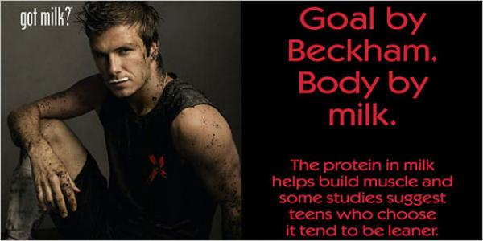
Lactose and Lactase
Lactose is a disaccharide (glucose + galactose) found in dairy products.
Lactase is an enzyme produced by the bacteria, Escherichia coli (E. coli), in the small intestine.
For people who are lactose tolerant, a surge of lactose occurs when milk or other dairy products are ingested.
The E. coli express three genes to produce lactase and other enzymes for the digestion and absorption of lactose.
https://www.coloribus.com

Slide 70
Repressor Proteins
Once the lactose is digested, E. coli stop producing the enzymes by turning-off the expression of the three genes.
The on-off mechanism is controlled by a repressor protein that blocks the activation sites on the genes.

Slide 71
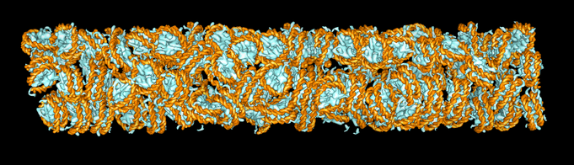
DNA Packing
DNA is densely packed along with proteins in chromatin within the cell nucleus.
Packing can prevent gene expression since the enzymes for transcrip-tion cannot physically come in contact with the DNA molecules.
DNA packing is a biological process that enables the long-term inactiva-tion of some genes.
Computer-generated image
https://www.cgl.ucsf.edu
DNA shown in orange and proteins in blue.

Slide 72
Cell Signaling
Gene regulation extends across cell boundaries in multicellular organ-isms.
Cells produce and secrete chemicals (hormones) that regulate target cells.
Genes are transcribed from DNA to RNA in the target cell in response to the chemical signal.
Cell signaling is a key mechanism in the differentiation and development of a zygote (fertilized egg) into a complex organism.

Slide 73
Cell Signaling (continued)
Cell signaling is important in the coordination of intercellular activities in a mature organism.
A signal molecule binds to a receptor molecule in the cytoplasm or plasma membrane, which activates a signal transduction pathway in the cell.
Signal molecules include human growth hormone, thyroid stimulating hormone, estrogens, testosterone, and other hormones in blood circu-lation.

