Slide 1
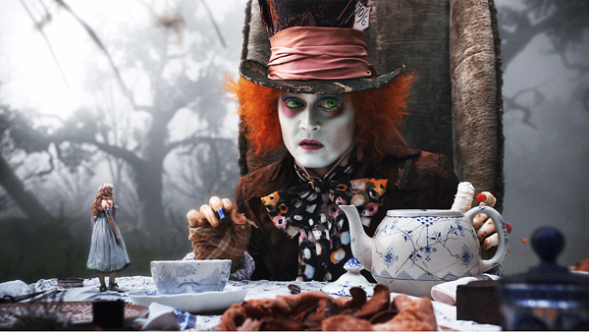
Mercury Poisoning and the Mad Hatter

Slide 2
Mad Hatter Disease
The manufacture of felt hats in the 18th and 19th centuries involved the use of mercury compounds.
Constant exposure to mercury resulted in tremors and other neuro-logical disturbances in people who made the hats (they were known known as hatters).
The signs and symptoms of mercury poisoning were known as mad hatter disease.
“As mad as a hatter” meant someone who had gone completely mad.
Lewis Carroll may have been inspired by mad hatter disease in creat-ing the Mad Hatter character in Alice in Wonderland.

Slide 3
Mercury Poisoning
Mercury is a heavy element found in several forms, all of which can be toxic.
Mercury can be very damaging to the kidneys, lungs, endocrine system, and nervous system.
Prolonged exposure can result in tremors, cognitive deficits, emotional effects, and sleep disturbances.
Extreme sympathetic responses can occur with high exposure levels because mercury blocks the breakdown of norepinephrine and other catecholamines at adrenergic synapses.
Mercury exposure can inhibit the formation of the myelin sheath of neu-rons in young children.

Slide 4
Mercury Exposure
Handling mercury, which some school children were allowed to do at one time.
Improper disposal of used electrical and electronic products that contain mercury.
Breathing atmospheric mercury as a residue of coal-fired power plants and volcanic action.
Use of mercury in gold mining and other mineral extraction operations.
Eating predator fish high in the marine food chain that accumulated mer-cury in their tissues.

Slide 5
Prognosis
Many of mercury’s toxic effects are reversible, especially in adults, if the source of the mercury is promptly removed.
Heavy and prolonged exposure during the fetal period and early child-hood can lead to long-term damage.
Environmental decontamination may be needed, which can be costly but necessary.
Prognosis = a prediction of the probable course and outcome of a disease.
(http://www.thefreedictionary.com)

Slide 6
Prevention
Effective prevention involves reducing or eliminating exposure to mer-cury and its compounds.
Governments issue regulations and communicate advisories to health practitioners and the general public.
The U.S. Environmental Protection Agency (EPA) issued an advisory in 2004 for moderate consumption of fish and shellfish.
The EPA also developed a program known as Fish Kids that focuses on families of young children.

Slide 7
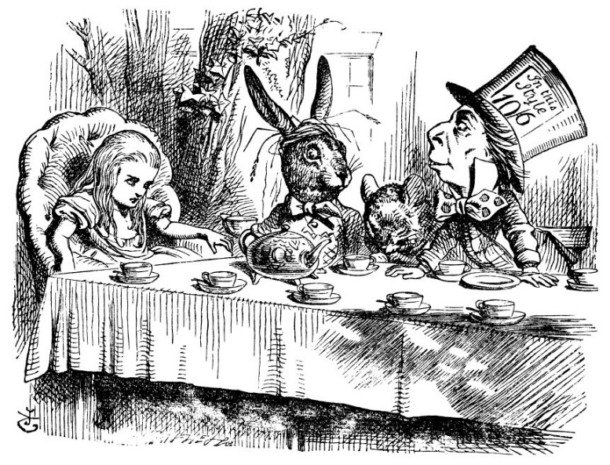
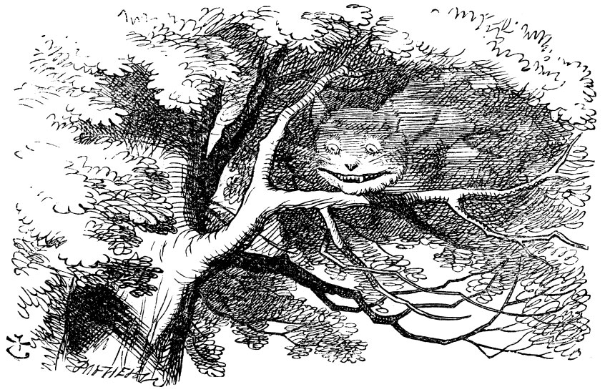
The Red Queen
“There’s no use in trying since one can’t believe impossible things,” said Alice, to which the Queen replies, “I dare say you haven’t had much practice. When I was younger, I always did it for half an hour each day. Why, sometimes I’ve believed as many as six impossible things before breakfast.”
— Lewis Carroll, Alice in Wonderland

