Slide 1
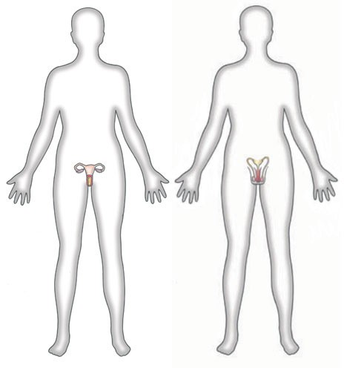
Male Reproductive System
https://www.dorlingkindersley-uk.co.uk

Slide 2
Note
Much of the text material is from, “Principles of Anatomy and Physiology” by Gerald J. Tortora and Bryan Derrickson (2009, 2011, and 2014). I don’t claim authorship. Other sources are noted when they are used.
The lecture slides are mapped to the three editions of the textbook based on the color-coded key below.
14th edition
13th edition
12th edition
Same figure or table reference in all three editions

Slide 3
Outline
Reproductive organs
Spermatogenesis
Hormonal control
Supporting reproductive structures
Erection and ejaculation

Slide 4
Definitions
Gynecology is the branch of medicine for the diagnosis and treat-ment of disorders and diseases of the female reproductive system.
Urology is the study of the urinary system—it also includes the diag-nosis and treatment of disorders and diseases of the male reproduc-tive system.
Page 1041
Page 1129
Page 1081

Slide 5
Definitions (continued)
Andrology is the branch of medicine involved in the diagnosis and treatment of male disorders, especially infertility and sexual dys-function.
Sexology is the study of the physiological, psychological, and socio-logical aspects of sexual behavior in females and males including attitudes, mental imagery, emotional arousal, and sexual responses.
Page 1041
Page 1129
Page 1081
5
Notes:
5

Slide 6
Reproductive Organs

Slide 7
Male Reproductive System
The organs and tissues of the male reproductive system include the:
  Testes
  Duct system—epididymis, ductus deferens, ejaculatory ducts, and urethra.
  Accessory glands—seminal vesicles, prostate, and bulboureth-ral glands.
  Supporting reproductive structures include the penis and scro-tum.
Page 1042
Page 1130
Page 1082
Figure 28.1

Slide 8
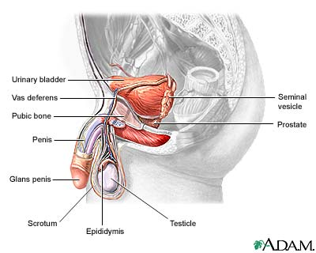
Reproductive and Other Structures
https://www.health-res.com

Slide 9
Male Reproductive System (continued)
The testes produce sperm and secrete hormones (testosterone and inhibin).
The duct system transports and stores sperm, assists in their maturation, and conveys them through the urethra of the penis.
Accessory glands secrete fluid to transport, nourish, and protect sperm.
The scrotum encloses the testes, and the penis delivers sperm in ejaculation.
Page 1042
Page 1131
Page 1082

Slide 10
Testes
The testes are a pair of glands in the scrotum—their oval shape measures about 5 cm by 2.5 cm.
The testes descend into the scrotum through the inguinal canal during the second half of month 7 of fetal development.
Undescended testes cannot function properly and can result in infertility—sometimes surgery is required to assure their descent.
Page 1043
Page 1131
Page 1082
Figure 28.3

Slide 11
Testes (continued)
Each testis is divided into 200 to 300 compartments, called lobules, where sperm are produced.
The production of sperm is called spermatogenesis.
Seminiferous tubules in each lobule have spermatogenic cells that produce sperm.
The tubules also contain Sertoli cells that support spermatogenesis.
Testis = singular form of testes.
Page 1045
Page 1131
Page 1082
Figure 28.3

Slide 12
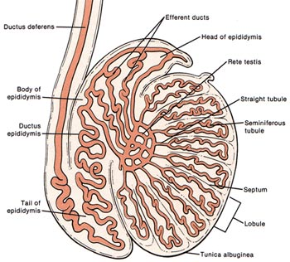
Testes (continued)
https://www.mcatzone.com

Slide 13
Testes (continued)
Layers of increasingly more developed sperm cells are found in the seminiferous tubules.
Once a sperm cell (spermatozoon) is fully formed, it is released into the lumen of the tubule for further maturation.
Lumen = the hollow inner space or cavity of a tubular organ.
Page 1045
Page 1131
Page 1084
Figure 28.4

Slide 14
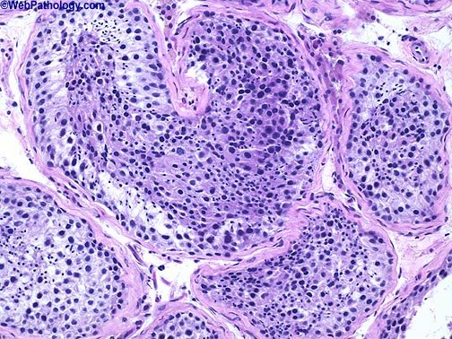
Spermatogenesis
https://www.webpathology.com
Micrograph showing sperm in a testicular biopsy.

Slide 15
Blood-Testis Barrier
Sertoli cells, found on the interior of the basement membrane of the seminiferous tubules, have tight junctions that join with each other.
The tight junctions form the blood-testis barrier so that substances must pass through the Sertoli cells before reaching the developing sperm.
The barrier prevents an immune response to the surface antigens on spermatogenic cells, which would otherwise be recognized as foreign intruders by the immune system.
Page 1045
Page 1132
Page 1084

Slide 16
Sertoli Cells
Sertoli cells support spermatogenic cells in several other ways by:
  Nourishing the developing sperm.
  Removing the excess cytoplasm of developing sperm through phagocytosis.
  Controlling the movements of spermatogenic cells and release of sperm into the lumen of the seminiferous tubule.
Phagocytosis = the process by which phagocytes ingest and destroy cell debris, microbes, and other foreign matter.
Page 1045
Page 1132
Page 1086
Figure 28.4

Slide 17
Sertoli Cells (continued)
Sertoli cells also:
  Produce fluid for sperm transport.
  Secrete a hormone known as inhibin.
  Regulate the physiological effects of testosterone and follicle stimulating hormone (FSH).
Page 1045
Page 1132
Page 1086

Slide 18
Leydig Cells
Clusters of Leydig cells, also known as interstitial cells, are found in the interstitial space between seminiferous tubules.
The cells secrete testosterone, the most prevalent and potent andro-gen in males.
The hormone promotes the development of masculine physical char-acteristics and sex drive (libido).
Page 1045
Page 1132
Page 1087
Figure 28.4

Slide 19
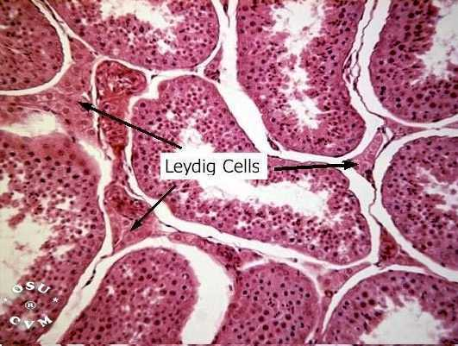
Leydig Cells (continued)
https://www.instruction.cvhs.okstate.edu

Slide 20
Scrotum
The scrotum, which consists of loose skin and subcutaneous layer, hangs from the base (or root) of the penis.
The scrotal septum divides the scrotum into two sacs, each contain-ing a single testis.
The scrotum has skeletal and smooth muscles called the cremaster and dartos muscles.
Page 1042
Page 1130
Page 1082
Figure 28.1
Figure 28.2

Slide 21
Temperature Regulation
Sperm production requires a temperature 2 to 3º C below a normal body core temperature of 37º C.
The lowered temperature is maintained since the scrotum and testes are outside the pelvic cavity and are not exposed to body tempera-ture.
In a cold environment, the cremaster muscles position the scrotum and testes close to the body to absorb heat.
The dartos muscles tightens-up the scrotal tissue to minimize its sur-face area and reduce heat loss.
Page 1042
Page 1130
Page 1083

Slide 22
Spermatogenesis

Slide 23
Sperm Development
Primordial germ cells arise from the embryonic yolk sac and enter the testes during the fifth week of embryonic development.
These cells in the embryonic testes then differentiate into sperma-togonia.
The spermatagonia remain dormant during childhood and produce sperm starting at puberty under the influence of pituitary hormones and androgens.
Dormant = a condition of biological rest.
Page 1045
Page 1135
Page 1087
Figure 28.5

Slide 24
Spermatogonia
Spermatogenesis, the production of sperm, requires 65 to 75 days in humans.
The process begins with the spermatogonia, a type of stem cell, that have a diploid number (2n) of chromosomes.
As they undergo mitosis, some of the spermatogonia remain near the basement membrane of the seminiferous tubule.
These spermatogonia serve as the reservoir for future cell division and sperm production.
The suffix, -genesis = the beginning of a process.
Page 1045
Page 1135
Page 1087
Figure 28.5

Slide 25
Primary Spermatocytes
Spermatogonia squeeze through the tight junctions of the blood-testis barrier and differentiate into primary spermatocytes.
Primary spermatocytes are also diploid (2n)—like spermatogonia, they have 46 chromosomes.
Page 1045
Page 1135
Page 1087
Figure 28.5

Slide 26
Secondary Spermatocytes
The primary spermatocytes replicate their DNA before meiosis I begins.
Crossing-over occurs in meiosis I to enable exchange of genetic material.
The two cells formed through meiosis I are known as secondary spermatocytes—each is a haploid (n) cell containing 23 chromo-somes.
Each chromosome within a secondary spermatocyte has two chromatids (two copies of the DNA) attached by a centromere.
No further replication of DNA occurs in secondary spermatocytes.
Page 1045
Page 1135
Page 1087
Figure 28.5

Slide 27
Spermatids
In meiosis II, which is similar to mitosis, four haploid (n) cells known as spermatids are formed.
One primary spermatocyte, therefore, produces four spermatids in the processes of meiosis I and meiosis II.
Page 1046
Page 1135
Page 1087
Figure 28.5

Slide 28
Spermiogenesis
In spermiogenesis, the final stage of spermatogenesis, the spher-ically-shaped spermatids are transformed into slender, elongated, sperm.
An acrosome forms atop the nucleus, a flagellum (tail) develops, and the mitochondria form in what is known as the middle piece.
Sertoli cells dispose of excess cytoplasm in the spermatids by the process of phagocytosis.
Acrosome = the cap-like, membrane-bound structure covering the anterior portion of the head of a sper-matozoon (sperm); it contains enzymes involved in penetration of a secondary oocyte.
(https://www.medical-dictionary.thefreedictionary.com)
Page 1046
Page 1135
Page 1087
Figure 28.5

Slide 29
Spermiation
The sperm are released from their connections with the Sertoli cells, in a process called spermiation.
The sperm enter the lumen of the seminiferous tubules.
The fluid secreted by the Sertoli cells forces the sperm toward the ducts of the testes.
The sperm are not yet able to propel themselves since they require further maturation.
Page 1046
Page 1135
Page 1088

Slide 30
Sperm
About 300 million sperm complete spermatogenesis each day.
Mature sperm, which are about 60 μm long, have structures that enable them to reach and penetrate a secondary oocyte in a fal-lopian tubes.
The head of the sperm, about 4 to 5 μm long, has a nucleus that has 23 chromosomes.
The anterior two-thirds of the head is covered by an acrosome, a cap-like vesicle containing enzymes that enable a sperm to pene-trate a secondary oocyte.
Page 1047
Page 1136
Page 1088
Figure 28.6

Slide 31
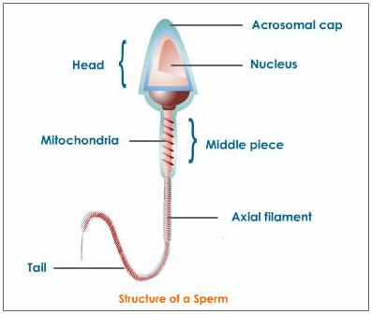
Sperm Structure
https://www.image.wistatutor.com

Slide 32
Sperm (continued)
The posterior part of the sperm is divided into the neck, middle piece, principal piece, and end piece.
The neck is a narrow region just posterior to the head that contains centrioles—they consist of microtubules that form the remainder of the tail.
The middle piece has mitochondria in a spiral arrangement to provide ATP for propulsion of the sperm.
Page 1047
Page 1136
Page 1088
Figure 28.6

Slide 33
Sperm (continued)
The principal piece is the longest segment of the tail, and the end piece is its final, tapering segment.
The tail, or flagellum, produces whip-like actions to propel the sperm.
Page 1047
Page 1136
Page 1088
Figure 28.6

Slide 34
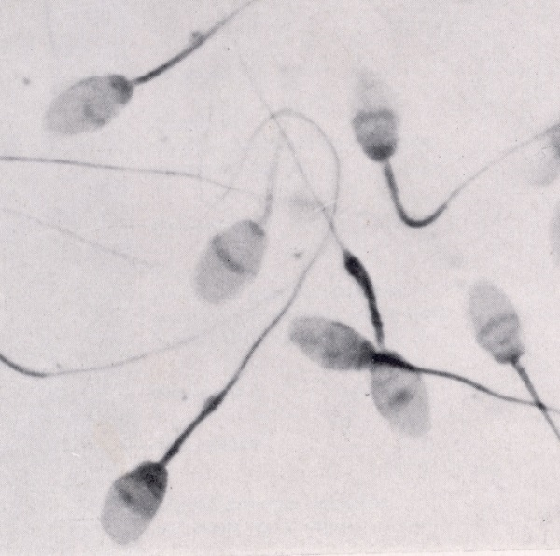
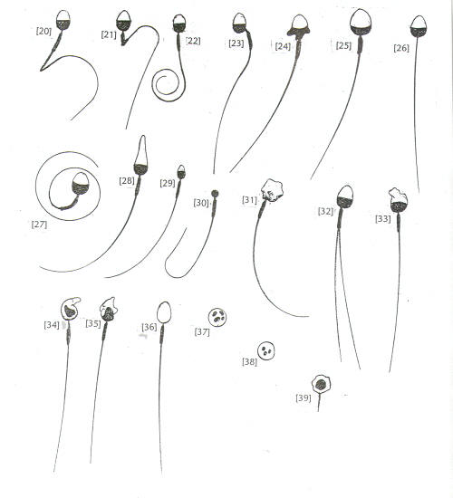
Sperm
Abnormal shapes of non-viable sperm.
https://www.spermomax.net
Apparently healthy sperm—
the whip-like actions of their tails propels them using ATP produced by the mitochondria their midpiece. The head of a sperm usually has 23 individual chromosomes.
https://www.cit.astate.edu
34
Notes:
34

Slide 35
Hormonal Control

Slide 36
Hormonal Control
Gonadotropin-releasing hormone (GnRH) is secreted by the hypothal-amus starting at puberty.
GnRH stimulates gonadotrophs located in the anterior pituitary through the hypophyseal portal system to secrete LH and FSH.
LH and FSH control the testosterone secretion and spermatogenesis in the testes.
Page 1047
Page 1136
Page 1088
Figure 28.7

Slide 37
Hormonal Control (continued)
Testosterone secreted by the Leydig cells stimulates spermatogen-esis in the tissue layers of the seminiferous tubules.
When the rate of spermatogenesis is sufficient, Sertoli cells release inhibin to inhibit FSH secretion by the anterior pituitary in a negative feedback pathway.
Otherwise, less inhibin is released to maintain a constant rate of sper-matogenesis.
Page 1047
Page 1136
Page 1088
Figure 28.7

Slide 38
Gene Expression
Testosterone and a metabolic by-product, dihydrotestosterone (DHT), bind to androgen receptors in target cells.
The hormone-receptor complex regulates gene expression by turning some genes on and turning other genes off.
Androgens have widespread physiological effects on the human body.
Both males and females have androgen receptors, just as males and females have estrogen receptors.
Page 1047
Page 1136
Page 1088

Slide 39
Androgenic Effects
Prenatal development—testosterone stimulates the male pattern of development of the reproductive system and descent of the testes; DHT stimulates development of the external genitalia.
Physical characteristics—at puberty, testosterone and DHT stimulate the maturation of the male reproductive organs and secondary sexual characteristics.
Male secondary sexual characteristics = muscular and skeletal growth including wide shoulders and narrow hips, facial and chest hair, increased hair on other parts of the body, thickening of the skin, increased sebaceous gland secretion, and enlargement of the larynx (voice box) and deepening of the voice.
Page 1047
Page 1136
Page 1088

Slide 40
Androgenic Effects (continued)
Sexual function—testosterone contributes to spermatogenesis and sex drive (libido).
Anabolic effects—testosterone stimulates protein synthesis to increase skeletal muscle mass, especially starting at puberty with a surge in the secretion of the hormone.
Page 1048
Page 1136
Page 1089

Slide 41
Testosterone Regulation
An increased blood testosterone level inhibits the release of GnRH from the hypothalamus via a negative feedback pathway.
With decreased GnRH, less LH is secreted by the anterior pituitary.
With less stimulation by LH, Leydig cells in the testes secrete less testosterone.
Page 1048
Page 1137
Page 1089
Figure 28.8

Slide 42
Supporting Reproductive Structures

Slide 43
Ducts
The male reproductive system has a series of ducts to convey sperm from the testes to the urethra.
The reproductive system ducts include the:
  Ducts of the testes
  Epididymis
  Vas deferens
  Ejaculatory ducts
Page 1048
Page 1138
Page 1090
Figure 28.9

Slide 44
Ducts of the Testes
The hydrostatic pressure generated by the fluid secreted from the Sertoli cells pushes fluid and sperm along the lumen of the semi-niferous tubules.
The sperm enter a series of short ducts called the straight tubules.
These tubules lead to a network of ducts in the testis known as the rete testis.
The sperm then enter a series of coiled ducts that empty into a tube known as the ductus epididymis (or epididymis).
Hydrostatic pressure = the force exerted by a fluid at rest.
Page 1048
Page 1138
Page 1090
Figure 28.3

Slide 45
Epididymis
The epididymis is located along the posterior border of each testis.
The epididymis would have a length of about six meters if it were uncoiled.
Sperm mature in the epididymis for about 14 days—they acquire motility and much of the capability to fertilize a secondary oocyte expelled by an ovary.
Motility = capacity for self-propelled movement.
Page 1048
Page 1138
Page 1090
Figure 28.3

Slide 46
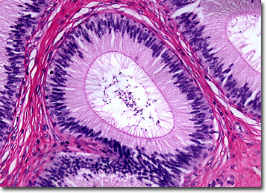
Epididymis (continued)
https://www.mcatzone.com
Light micrograph
http://www.microscopy.fsu.edu

Slide 47
Epididymis (continued)
The epididymis stores sperm, which can remain viable for several months.
Unused sperm are eventually reabsorbed by the tissue of the epi-didymis.
The epididymis propels sperm into the vas deferens by peristaltic contractions of its smooth muscle.
Viable = capable of living.
Peristalsis = successive smooth muscle contractions along the wall of a hollow muscular structure that perform a propulsive function.
Page 1049
Page 1138
Page 1090
Figure 28.3

Slide 48
Vas Deferens
The vas deferens, also known as the ductus deferens, conveys sperm during sexual arousal from the epididymis toward the urethra.
Their transport is is the result of peristaltic contractions of the smooth muscle in its walls.
The vas deferens is about 45 cm in length.
It can also store sperm for several months—unused sperm are even-tually reabsorbed.
Page 1049
Page 1138
Page 1092
Figure 28.3

Slide 49
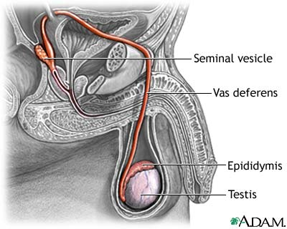
Vas Deferens (continued)
https://www.shands.org

Slide 50
Ejaculatory Ducts
The ejaculatory ducts eject sperm and secretions from the seminal vesicles into the urethra at the start of an ejaculation.
The ducts are about 2 cm long and terminate in the prostatic urethra.
Page 1051
Page 1138
Page 1092
Figure 28.9

Slide 51
Urethra
The urethra is the shared terminal or end duct of the reproductive and urinary systems.
It measures about 20 cm long.
The urethra passes through the prostate (prostatic urethra), deep skeletal muscles of the perineum, and penis.
It is known as the spongy or penile urethra where it travels through the corpus spongiosum of the penis.
Corpus spongiosum = erectile tissue of the penis.
Page 1051
Page 1139
Page 1092
Figure 28.10

Slide 52
Accessory Sex Glands
The accessory sex glands secrete most of the fluid in semen.
The accessory sex glands include the:
  Seminal vesicles
  Prostate
  Bulbourethral glands
Page 1051
Page 1140
Page 1093

Slide 53
Seminal Vesicles
Each of the bilateral seminal vesicles is pouch-shaped and meas-ures about 5 cm in length.
They are located posterior to the urinary bladder and anterior to the rectum.
The seminal vesicles secrete an alkaline, viscous fluid containing fructose, prostaglandins, and clotting proteins (that are different from those in the blood).
The alkalinity of the fluid helps to neutralize the acidic environments of the male’s urethra and female reproductive tract that could other-wise kill the sperm.
Page 1051
Page 1140
Page 1093
Figure 28.9

Slide 54
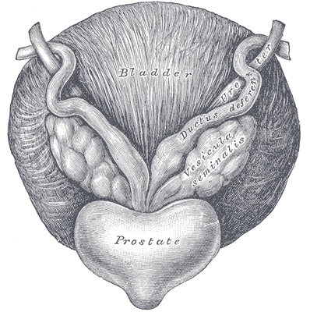
Seminal Vesicles (continued)
https://www.embryology.med.unsw.edu.au

Slide 55
Seminal Vesicles (continued)
Fructose, a monosaccharide, is used for ATP production for sperm motility.
Prostaglandins also contribute to sperm motility and viability and stimulate smooth muscle contractions in the female reproductive tract.
Clotting proteins help sperm to coagulate after ejaculation.
About 60 percent of semen volume is fluid secreted by the seminal vesicles.
Motility = movement.
Coagulate = in this context, to become viscous.
Page 1051
Page 1140
Page 1093

Slide 56
Prostate
The prostate is a donut-shaped gland measuring about the size of a golf ball in young, adult males.
It is located inferior to the urinary bladder, and surrounds the prostatic segment of the urethra (prostatic urethra).
The prostate slowly increases in size from birth to puberty, and then expands rapidly until about age 30.
A substantial enlargement of the prostate often occurs after ages 45 to 55—this normal condition is known as benign prostatic hyperplasia (BPH).
Page 1052
Page 1140
Page 1093
Figure 28.9

Slide 57
Prostate (continued)
The prostate secretes a milky, slightly acidic fluid (pH 6.5) of several substances:
  Citric acid is used by mitochondria in sperm for ATP production via the Krebs cycle.
  Proteolytic enzymes break-down the clotting proteins from the seminal vesicles.
  Seminal plasmin is an antibiotic that destroys naturally-occurring bacteria.
Secretions from the prostate enter the urethra through prostatic ducts and make-up about 25 percent of semen volume (the second largest contributor after the seminal vesicles).
Page 1052
Page 1140
Page 1093

Slide 58
Bulbourethral Glands
The two, bilateral bulbourethral glands, about the size of garden peas, have ducts that open into the spongy urethra.
During sexual arousal, they secrete an alkaline fluid into the urethra to neutralize the acids in urine.
The glands also secrete mucus to lubricate the lining of the urethra and tip of the penis.
This mucus helps reduce the number of sperm damaged during ejacu-lation.
Page 1052
Page 1141
Page 1093
Figure 28.9

Slide 59
Semen
Semen is composed of seminal fluid and sperm.
The seminal fluid consists of a mixture of secretions from the semini-ferous tubules, seminal vesicles, prostate, and bulbourethral glands.
The volume of fluid in a typical ejaculate ranges between 2.5 to 5.0 mL, with 50 to 150 million sperm per mL of semen.
A large number of sperm is needed to assure fertilization since only a tiny fraction reach the secondary oocyte after expulsion from the ovary.
Infertility can result if the sperm count falls below about 20 million per mL.
Page 1052
Page 1141
Page 1093

Slide 60
Semen (continued)
Semen is slightly alkaline (pH 7.2 to 7.5), which is due primarily to the fluid from the seminal vesicles.
Secretions from the prostate give semen its milky appearance, and the fluids from the seminal vesicles and bulbourethral glands give it a sticky consistency.
Semen provides sperm with:
  A transport medium.
  A source of chemical energy.
  Protection from the acidic environments of the male’s urethra and the female’s vagina.
Page 1052
Page 1141
Page 1093

Slide 61
Penis
The penis contains the spongy urethra, the common passageway for the ejaculation of semen and the eliminate of urine.
The spongy, erectile tissue that surrounds the spongy urethra contain vascular spaces lined with endothelial cells.
These cells are surrounded by smooth muscle and elastic connective tissue.
The two chambers of tissue are called the corpora cavernosa, which engorge (fill) with blood during sexual arousal for penile erection.
The anatomical details of the penis are described in the textbook.
Page 1052
Page 1141
Page 1093
Figure 28.10

Slide 62
Erection and Ejaculation

Slide 63
Erection
Parasympathetic nerve fibers from the sacral portion of the spinal cord initiate and maintain an erection in response to sexual stimu-lation.
Sexual stimuli include:
  Mechanical stimulation of somatic sensory receptors in the penis.
  Visual, auditory, olfactory (smell), and gustatory (taste) sen-sations.
  Mental imagery including fantasies.
Page 1054
Page 1143
Page 1095

Slide 64
Erection (continued)
Parasympathetic activation stimulates the local release of nitric oxide (a local hormone) that causes the smooth muscle in the arteriole walls of erectile tissue of the penis to relax.
The blood vessels of the erectile tissue dilate and engorge with blood.
Engorgement compresses the veins in the penis to slow the outflow of blood and maintain the erection.
Page 1054
Page 1143
Page 1095

Slide 65
Priapism
Priapism is a persistent and often painful penile erection that does not typically involve sexual arousal.
The condition, which may be accompanied by pain and tenderness of the penis, can last for several hours or longer.
It results from abnormalities of blood vessels and nerves in the penis.
In can also occur in response to medications that help produce erec-tions.
Prompt medical attention is essential if an erection lasts for more than a few hours.
Page 1054
Page 1143
Page 1095

Slide 66
Emissions
Prior to ejaculation, the peristaltic contractions in the epididymis, vas deferens, seminal vesicles, ejaculatory ducts, and prostate propel a small amount of semen into the spongy urethra.
The action can result in the emission of a small amount of semen just before ejaculation—this is a reason why the withdrawal method is not an effective method of birth control.
Semen emissions can occur during sleep (what are known as noctur-nal emissions).
Page 1054
Page 1143
Page 1095

Slide 67
Ejaculation
Ejaculation is the release of semen from the urethra.
Ejaculation is controlled by a sympathetic reflex of the lumbar region of the spinal cord.
During ejaculation, the smooth muscle in the penis contract to expel the semen forcefully.
The internal smooth muscle sphincter at the base of the urinary blad-der closes during ejaculation to prevent urine from being expelled with semen.
Page 1054
Page 1143
Page 1095

Slide 68
Afterwards
Once sexual arousal has ended, the arterioles supplying the erectile tissue of the penis constrict due to a decrease in the release of nitric oxide.
Constriction of the arterioles reduces the size of the vascular spaces.
The pressure on the veins of the penis is relieved to enable blood to drain from the erectile tissue.
The penis returns to its relaxed (flaccid) state.
Page 1054
Page 1143
Page 1095

Slide 69
Further Detail
The female and male sexual responses are described in scientific publications, including William Masters’ and Virginia Johnson’s, “The Human Sexual Response” (1966).

