Slide 1
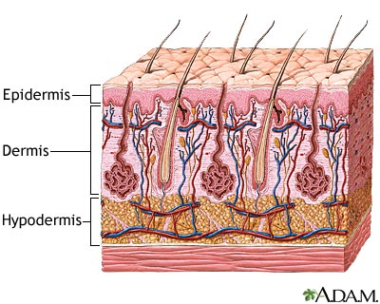
Integumentary System
https://www.clarian.org

Slide 2
Note
Much of the text material is from, “Principles of Anatomy and Physiology” by Gerald J. Tortora and Bryan Derrickson (2009, 2011, and 2014). I don’t claim authorship. Other sources are noted when they are used.
The lecture slides are mapped to the three editions of the textbook based on the color-coded key below.
14th edition
13th edition
12th edition
Same figure or table reference in all three editions

Slide 3
Outline
Introduction
Basic structure of the skin
Accessory structures
Functions
Healing of skin wounds
Aging

Slide 4
Introduction

Slide 5
Overview
The integumentary system consists of the skin, hair, oil glands, sweat glands, nails, and somatic sensory receptors.
The system helps maintain constant body temperature, provides a barrier to microbes, and provides sensory input about the external environment.
It also can mitigate, to an extent, some sources of trauma including sunlight and pollutants in the environment.
The skin can be indicative of some emotions, such as in frowning and blushing.
Somatic = of the body.
Page 142
Page 153
Page 147

Slide 6
Overview (continued)
Changes in skin color can indicate some types of homeostatic imbal-ances of the body.
Bluish color can suggest hypoxia, which can be associated with heart failure and other disorders.
Skin eruptions—such as chicken pox, cold sores, and measles—can reveal systemic infections and diseases involving the internal organs.
Some conditions—including pimples, moles, warts, and age spots— involve only the skin.
Hypoxia = a below-normal supply of oxygen to a body tissue.
Systemic = pertaining to or affecting the body as a whole.
Page 142
Page 153
Page 147

Slide 7
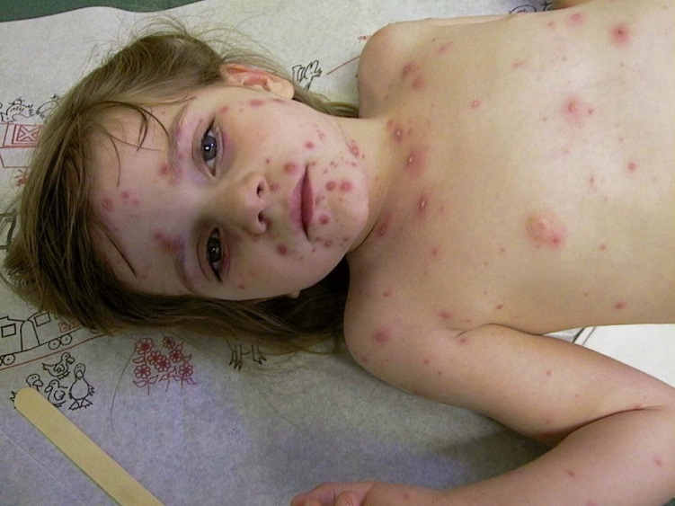
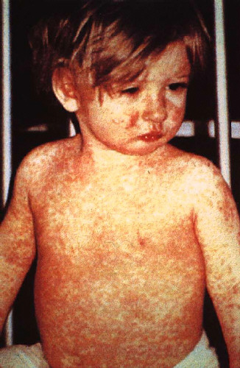
Chicken Pox and Measles
Measles
https://www.123shadow.files.wordpress.com
Chickenpox
https://www.phil.cdc.gov

Slide 8
Overview (continued)
Healthy-appearing skin can be important to a person’s positive self-image.
In the United States, much time and money is spent on attempting to restore skin to a youthful appearance.
Dermatology is a medical specialty involving diagnosis and treatment of disorders and conditions of the integumentary system.
Page 142
Page 153
Page 147

Slide 9
Basic Structure of the Skin

Slide 10
Skin
The skin, also known as the integument or cutaneous membrane, covers the external surfaces of the body.
Skin is the largest organ of the human body as measured by total weight and surface area.
Page 142
Page 154
Page 148
Figure 5.1

Slide 11
Skin (continued)
In adults, the skin covers an area of about 2 m², and weighs about 4.5 to 5 kg.
It ranges in thickness from 0.5 mm on the eyelids to 4 mm on the heels of the feet.
The skin is about 1 to 2 mm thick on most of the external surfaces.
Two square meters = about 3,100 square inches.
Page 142
Page 154
Page 148
Figure 5.1

Slide 12
Skin Layers
The skin consists of the:
  Epidermis, the superficial, thinner layer of epithelial cells.
  Dermis, a deeper and thicker layer of connective tissue.
The subcutaneous layer, deeper to the dermis, consists of areolar and adipose tissues.
Th subcutaneous layer is not considered part of the skin although it supports its functions.
Page 144
Page 155
Page 148
Figure 5.1

Slide 13
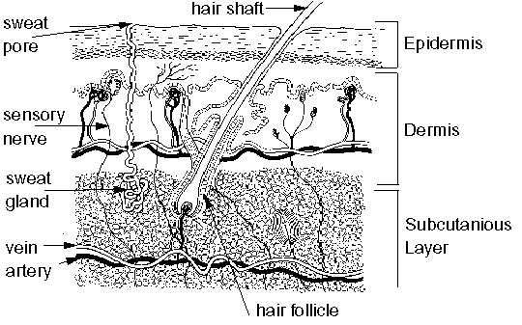
Skin Layers (continued)
https://www.cancerindex.org

Slide 14
Subcutaneous Layer
Fibers in the dermis anchor the skin to the subcutaneous layer.
The subcutaneous layer is attached to fascia, the connective tissue of muscles and bones.
The layer has substantial amounts of adipose tissue that give skin its form.
Page 144
Page 155
Page 148
Figure 5.1

Slide 15
Subcutaneous Layer (continued)
The subcutaneous layer has large blood vessels that supply oxygen and nutrition to the dermis.
The layer, and to a lesser extent the dermis, have free nerve endings and Pacinian corpuscles that are sensitive to the mechanical pressure of touch.
Page 144
Page 155
Page 148
Figure 5.1

Slide 16
Epidermis—Keratinocytes
The epidermis has four cell types—keratinocytes, melanocytes, Langer-hans cells, and Merkel cells.
Keratinocytes, which are about 90 percent of epidermal cells, are organ-ized into four or five layers, and produce the fibrous protein, keratin.
Keratin helps protect the skin and underlying tissues from heat, microbes, and chemicals.
Page 144
Page 156
Page 149
Figure 5.2

Slide 17
Epidermis—Keratinocytes (continued)
Keratinocytes produce lamellar granules that release a water repel-lant compound to minimize water entry and loss through the skin.
These cells also inhibit entry of foreign materials into the body such as microbes and some chemicals.
Page 145
Page 156
Page 150
Figure 5.2

Slide 18
Epidermis—Melanocytes
Melanocytes, about eight percent of all epidermal cells, produce the pigment, melanin.
The long, slender processes of the melanocytes extend between the keratinocytes and transfer melanin to them.
Melanin is a yellow-red or brown-black pigment that helps determine skin color and functions to absorb ultraviolet (UV) radiation from sun-light.
Page 145
Page 156
Page 150
Figure 5.2

Slide 19
Epidermis—Melanocytes (continued)
Once inside a keratinocyte, the melanin granules cluster to form a protective layer covering the cell nucleus on the side facing the skin surface.
Although melanin granules protect keratinocytes from UV radiation in sunlight, the melanocytes themselves are susceptible to damage from excessive UV.
Page 145
Page 156
Page 150
Figure 5.2

Slide 20
Epidermis—Langerhans Cells
Langerhans cells, which make-up a small fraction of the epidermal cells, are formed in red bone marrow and migrate to the epidermis.
The cells are involved in immune responses to microbes; however, they can be readily damaged by the high-frequency UV radiation in sunlight.
Page 145
Page 156
Page 150
Figure 5.2

Slide 21
Epidermis—Merkel Cells
Merkel cells are the least numerous of the epidermal cell types.
They are located in the deepest layer of the epidermis where they contact the flattened processes of Merkel disks, a type of sensory neuron.
Merkel cells and Merkel disks mediate touch sensations, especially involving mechanical pressure to the skin.
Page 145
Page 156
Page 150
Figure 5.2

Slide 22
Thin Skin
Layers of keratinocytes in different stages of development form the epidermis.
Keratinocytes make up its four layers—stratum basale (deepest), stratum spinosum, stratum granulosum, and a thin stratum corneum (shallowest).
The arrangement is called thin skin, which covers much of the human body.
Page 145
Page 156
Page 150
Figure 5.3

Slide 23
Thick Skin
Where exposure to friction is the greatest—such as in the fingertips, palms, and soles—the epidermis has an additional layer of keratino-cytes.
The five layers of keratinocytes are stratum basale (deepest), stratum spinosum, stratum granulosum, stratum lucidum, and a thick stratum corneum (shallowest).
This arrangement is known as thick skin.
Anatomical details of each stratum of epidermis are given in the text-book.
Page 146
Page 156
Page 150
Figure 5.3

Slide 24
Stratum Basale and Epidermal Growth
Newly-formed cells in the stratum basale, the deepest layer of the epidermis, are slowly pushed to the surface of the skin.
As this movement progresses, the cells accumulate keratin in a process known as keratinization.
The cells at the surface of the skin then undergo apoptosis and replacement.
Keratinization = the process by which keratin is deposited in cells to become horny, as in the outer layer of the epidermis, and in nails and hair.
Horny = composed of or resembling tough fibrous material consisting chiefly of keratin.
Apoptosis = pre-programmed cell death in which a cell uses specialized cellular machinery to kill itself.
Page 147
Page 156
Page 152

Slide 25
Epidermal Growth (continued)
The keratinized cells eventually slough-off from the outer layer of the epidermis, to be replaced by younger underlying cells.
The entire process takes about four weeks in an epidermis averaging 0.1 mm in thickness.
Slough-off = separate from the surrounding living tissue.
Page 147
Page 156
Page 152
Figure 5.3

Slide 26
Life and Death in the Epidermis
Epidermal cells in the stratum basale are supplied oxygen and nutri-ents due to their close proximity to the capillaries in the dermis.
These cells are metabolically active and undergo continuous mitotic cell division to produce new keratinocytes.
The layers of the epidermis overlying the stratum basale receive less oxygen and nutrients due to their diminished blood supply, and these cells eventually die.
Page 147
Page 158
Page 152

Slide 27
Rate of Cell Division
The rate of cell division in the stratum basale increases when the outermost layers of the epidermis are damaged such as in abra-sions or burns.
The mechanisms controlling the rate of mitotic cell division in the skin are not well-understood.
Hormone-like proteins including epidermal growth factor have roles in this process.
Page 147
Page 158
Page 152

Slide 28
Epidermal Tidbits
Constant exposure to skin friction results in the formation of a callus, an abnormal thickening of the outermost layer of epidermis (stratum corneum).
Excessive numbers of keratinized cells shed from the scalp is known as dandruff.
Page 147
Page 158
Page 152

Slide 29
Dermis
After the epidermis, the next deeper part of the skin is the dermis—it consists of connective tissue composed of collagen and elastic fibers.
The network of fibers has substantial tensile strength, and the ability to stretch and recoil.
The dermis has a small number of fibroblasts, macrophages, and adipocytes near its boundary with the underlying subcutaneous layer.
Tensile strength = the amount of longi-tudinal mechanical force a tissue can withstand without tearing apart.
Page 147
Page 159
Page 152

Slide 30
Dermis (continued)
Blood vessels, nerves, exocrine glands, and hair follicles are embedded in the dermis.
The dermis is essential to the epidermis, and the two layers have close structural and functional relationships.
The dermis consists of a superficial papillary region and a deeper reticu-lar region.
Page 147
Page 159
Page 152

Slide 31
Dermis—Papillary Region
The papillary region, which makes up about one-fifth the thickness of the dermis, consists of areolar tissue of collagen and elastic fibers.
Dermal papillae are finger-like projections into the undersurface of the epidermis.
Some of these papillae have capillary loops that serve as a source of blood supply—and therefore oxygen and nutrients—for the epidermis.
Page 147
Page 159
Page 152
Figure 5.1

Slide 32
Dermis—Papillary Region (continued)
Other dermal papillae contain sensory receptors including Meissner corpuscles and free nerve endings.
Meissner corpuscles are sensitive to the mechanical pressure from touch.
Free nerve endings are responsible for hot, cold, pain, tickling, and itching sensations.
Page 147
Page 159
Page 153
Figure 5.1

Slide 33
Dermis—Reticular Region
The reticular region, attached to the underlying subcutaneous layer, consists of connective tissue of fibroblasts, collagen, and elastic fibers.
The collagen fibers form a net-like arrangement.
Some adipose cells, hair follicles, nerves, sebaceous glands, and sudoriferous glands are found in the space between the collagen fibers.
Sebaceous gland = produces an oily secretion.
Sudoriferous gland = produces perspiration and secretes it at the surface of the skin.
Page 148
Page 159
Page 153
Figure 5.1

Slide 34
Dermis—Reticular Region (continued)
Collagen and elastic fibers in the reticular region give skin its strength, elasticity, and extensibility.
Signs of extensibility can be seen around the joints, and in pregnancy and obesity.
Extreme stretching of the skin can produce small tears in the dermis, producing striae (stretch marks).
Striae are visible as red or silvery-white streaks on the surface of the skin.
Extensibility = the capability of being stretched.
Elasticity = the property of returning to an initial form or state following deformation.
Page 148
Page 159
Page 153
Figure 5.1

Slide 35
Epidermal Ridges
The surfaces of the palms, fingers, soles, and toes have patterns that form from epidermal ridges.
They appear as straight lines or as a pattern of loops and whorls such on the fingertips.
The ridges are produced during the third month of fetal development from downward projections of the epidermis into the dermis between the dermal papillary.
Page 148
Page 159
Page 153
Figure 5.1

Slide 36
Epidermal Ridges (continued)
Epidermal ridges increase the surface area of the epidermis, and there-fore enhance the grip of the hands and feet by an increased friction with objects and surfaces.
Imagine having entirely smooth hands and trying to hold a smooth-sided glass filled with water.
Page 148
Page 159
Page 153
Figure 5.1

Slide 37
Fingerprints and Footprints
Ducts of sweat glands open as sweat pores onto the epidermal ridges.
The epidermal ridges and sweat form fingerprints (and footprints) upon contact with a smooth surface.
Page 148
Page 159
Page 153
Figure 5.1

Slide 38
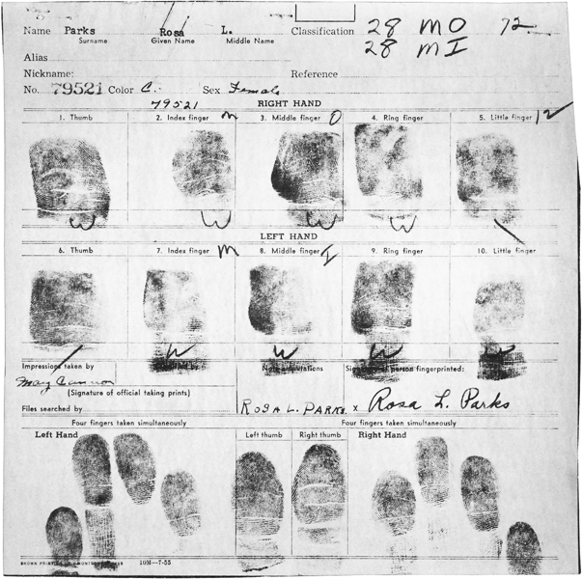
Fingerprint Card
https://www.library.kentlaw.edu
A digital (electronic) method known as LiveScan is now used.

Slide 39
Genetic Uniqueness
The epidermal ridge pattern is genetically-determined and unique to each individual.
Identical (monozygotic) twins have similar but not identical ridge pat-terns due to minute differences in mechanical forces encountered in the uterus.
The ridge pattern usually does not change during a lifespan (except to enlarge) which makes it useful for identification purposes.
The scientific study of epidermal ridge patterns is known as derma-toglyphics.
Page 148
Page 159
Page 153

Slide 40
Nourishment
The dermal papillae greatly increase the contact area between the dermis and epidermis.
An extensive network of blood vessels in the dermis serves as the source of oxygen and nutrition for the overlying epidermis.
Oxygen and nutrients diffuse from capillaries in the dermal papillae to the cells of the basal stratum in the epidermis.
The nourishment enables epithelial stem cells to divide via mitosis, and keratinocytes to grow and develop.
Page 148
Page 159
Page 153

Slide 41
Cell Migration
Keratinocytes migrate toward the skin surface and away from their blood source.
They are eventually no longer able to obtain nutrition, which leads to the breakdown of their organelles.
Keratinocytes continue their migration to form the outer layer of dead cells in the epidermis.
Page 148
Page 159
Page 153

Slide 42
Epidermal Junctions
The dermal papillae closely fit with the epidermal ridges to form epi-dermal junctions between the dermis and epidermis.
This structure enables skin to resist mechanical shearing forces that could otherwise separate the epidermis from the dermis.
Shearing force = a mechanical force applied perpendicular or tangential to the face of a tissue.
Page 148
Page 159
Page 153

Slide 43
Skin Color
Three pigments that produce the full range of skin colors are melanin, hemoglobin, and carotene.
The concentration of melanin produces skin colors ranging from pale yellow to reddish-brown and to black.
Melanin-producing cells, called melanocytes, are most plentiful in the epidermis of the penis, nipples, areolae (the area surrounding the nip-ples), face, and limbs.
Melanocytes are also found in high concentrations in the mucous mem-branes.
Mucous membrane = mucus-secreting membrane lining all body cavities or passages that communicate with the exterior.
Page 149
Page 160
Page 153
Figure 5.1

Slide 44
Skin Color Variations
The number of melanocytes is about the same in all people of all her-itages.
The differences in skin color are primarily due to the amount of mela-nin that the melanocytes produce and transfer to keratinocytes in the epidermis.
Darker skinned individuals have high concentrations of melanin in the epidermis.
Page 149
Page 160
Page 154

Slide 45
Skin Color Variations (continued)
Lighter skinned individuals have lower epidermal concentrations of melanin.
Skin color has genetic and environmental components, as covered in the lecture module on genetics.
Page 149
Page 160
Page 154
45
Notes:
45

Slide 46
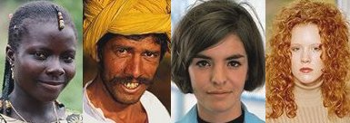
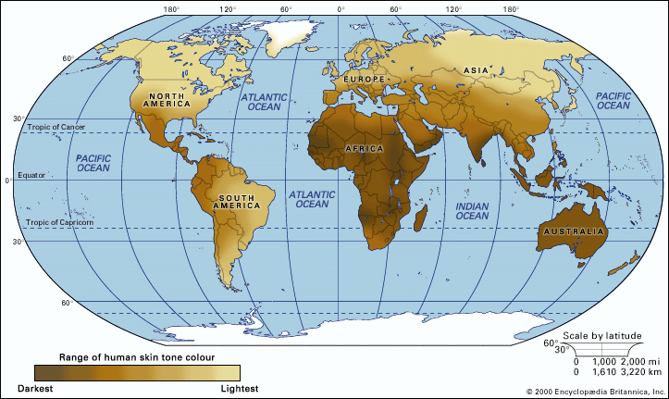
Skin Color
https://www.anthro.palomar.edu
https:/www.cache.eb.com

Slide 47
Visual Appearance of Light Skin
The epidermis can appear translucent in individuals who have light-colored skin.
The skin color can range from pink to red depending on the oxygen content of the blood in the capillaries of the dermis.
This color is due to hemoglobin, the oxygen-carrying pigment in red blood cells.
Translucent = semi-transparent; features on the other side can be seen but are not distinguishable.
Page 149
Page 160
Page 154

Slide 48
Melanin Accumulation
Melanin accumulates in patches known as freckles in some people.
Age spots, which range in color from light brown to black, are accumula-tions of melanin.
A round, flat, or raised area of localized growth of melanocytes is known as a nevus (or mole).
Page 149
Page 160
Page 154

Slide 49
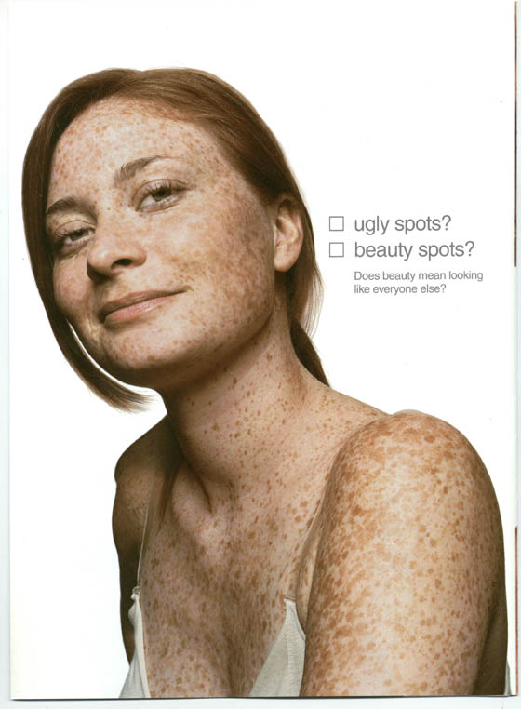
Freckles
https://www.blogs.cornell.edu

Slide 50
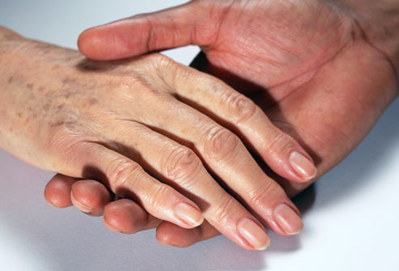
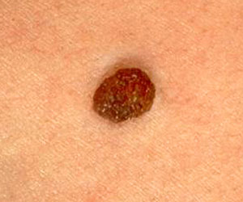
Age Spots and Moles
Mole
https://www.img.webmd.com
Age spots
https://www.images.meredith.com

Slide 51
Normal Moles and Melanomas
http://www.healthcare.utah.edu
Melanomas, a type of carcinoma, are often treatable if detected early. It is good to know the warning signs and have your skin examined periodically by a health care professional.

Slide 52
Melanin Synthesis and Tanning
Melanocytes synthesize melanin from the amino acid tyrosine in the presence of the enzyme, tyrosinase—the synthesis occurs in an organ-elle known as a melanosome.
Exposure to UV radiation in sunlight increases enzymatic activity within melanosomes to increase melanin production.
The amount of melanin increases with exposure to UV radiation to give skin a tanned appearance and help protect the skin from further UV ex-posure.
The tan is lost when the melanin-containing keratinocytes are shed from the stratum corneum.
Page 149
Page 160
Page 154

Slide 53
Protective Functions
Melanin helps prevent damage to DNA in cell nuclei by absorbing UV radiation in sunlight.
Melanin also neutralizes the free radicals in skin damaged by UV radiation.
Repeated exposure to intense UV radiation, however, may cause melanoma, among other skin cancers.
Many physicians recommend limiting exposure to intense sunlight by covering-up with clothing or using a sunscreen with an effective UV blocker.
Free radical = an atom or group of atoms that has at least one unpaired electron and is therefore unstable and highly reactive. Free radicals can cause cellular damage.
Page 149
Page 160
Page 154

Slide 54
Carotene
Carotene is a yellow-orange pigment that gives egg yolk and carrots their characteristic colors.
The pigment is the precursor of Vitamin A for synthesizing photosen-sitive pigments for rods and cones.
Beta carotene is an isomer that is found in dark green and dark yellow fruits and vegetables.
Dietary carotene is stored in the stratum corneum and adipose tissue of the dermis and subcutaneous layer.
Isomer = compounds with the same chemical formula but different structures.
Dietary = pertaining to the food and drink of a person or animal.
Page 149
Page 160
Page 154

Slide 55
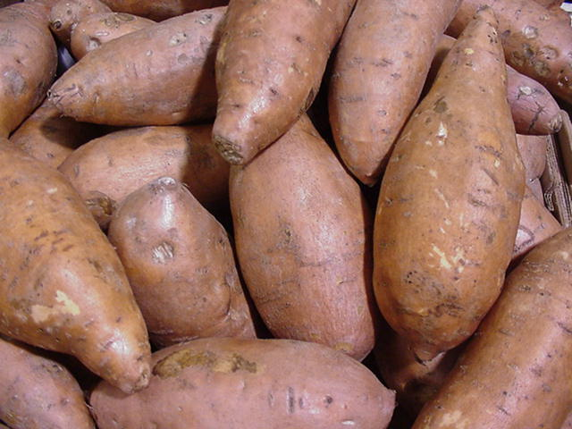
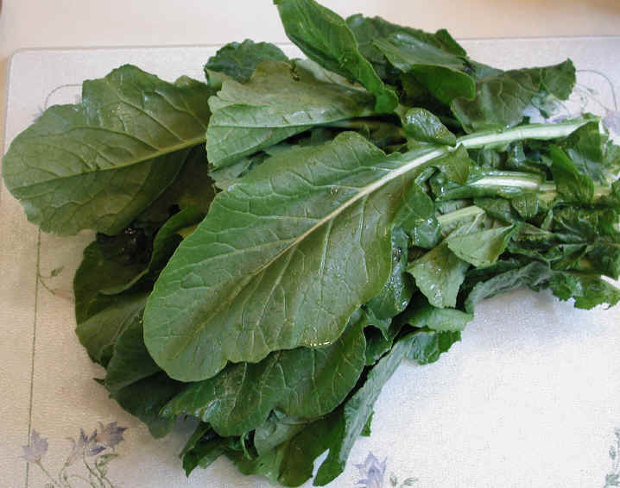

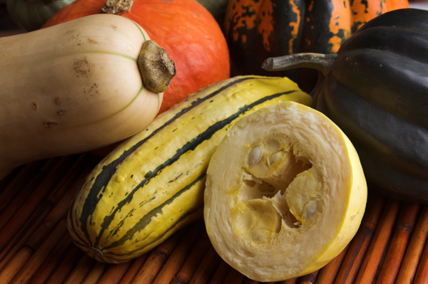
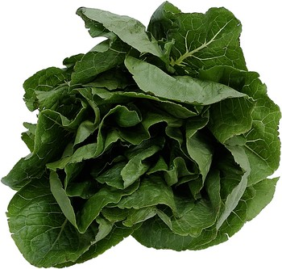
Some Sources of Beta Carotene
https://www.all-creatures.org
https://wwwcoolrain44.files.wordpress.com
https://www.westofpersia.files.wordpress.com
https://www.cdn.sheknows.com
Clockwise from the upper left—sweet potatoes, turnip greens, winter squash, carrots, and spinach. Other sources of beta carotene include kale, cilantro, and fresh thyme.
https://www.eating-in.com

Slide 56
Carotene (continued)
An excessive amount of carotene can be deposited in the skin with the overconsumption of carotene-rich foods.
The skin can take on an orange hue—the remedy, if the appearance is undesirable, would be to reduce the amount of carotene intake.
Page 149
Page 160
Page 154

Slide 57
Albinism
In a condition known as albinism, melanin is absent from the skin, hair, and irises of the eyes.
The condition results from an inherited inability to produce melanin because the melanocytes are unable to synthesize the enzyme, tyro-sinase.
Page 149
Page 160
Page 154

Slide 58
Vitiligo
In vitiligo, a partial or complete loss of melanocytes produces white patches on the skin.
The loss can be the result of an immune system disorder in which antibodies attack the melanocytes.
Michael Jackson was said to have this condition, which progressed over time.
Page 149
Page 160
Page 154

Slide 59
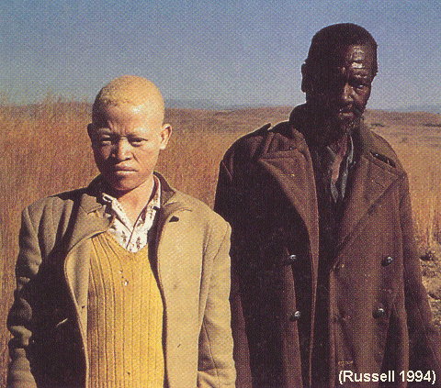
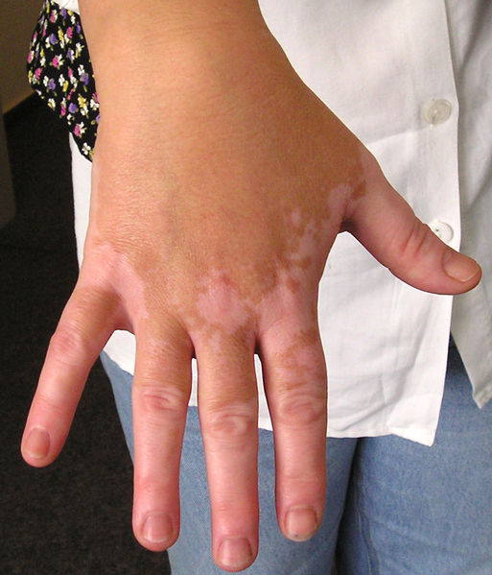
Albinism and Vitiligo
Vitiligo
https://www.cnb.uam.es
Albinism
https://www.effguide.com

Slide 60
Accessory Structures of the Skin

Slide 61
Accessory Structures
Accessory structures include hair, sebaceous and sudoriferous glands, and nails.
The structures develop from the epidermis during the embryonic stage.
The structures have important functions, including hair and nails to protect the skin, and sweat glands to help regulate body temperature.
Page 150
Page 161
Page 155

Slide 62
Hair
Hair is present on most skin surfaces except for the palms, palmar surfaces of the fingers, and plantar surfaces of the feet.
In adults, hair is most heavily distributed on the scalp and eyebrows, in the armpits (axillae), and in the area around the external genitalia.
Genetics and hormones determine the patterns and thickness of hair distribution.
Palmar surface = the palm or grasping side of the hand.
Plantar surface = sole of the foot.
Page 150
Page 161
Page 155

Slide 63
Functions
Scalp hair provides some protection from sunlight and injury and it also decreases heat loss.
Eyelashes, and hair in the nostrils and auditory canals, help protect against entry of foreign particles such as dust.
Hair root plexuses, a type of touch receptor, are activated when a hair is touched even slightly—try lightly brushing the back of your neck with a fingertip.
Hair can help individuals to establish their unique personal identities.
Page 150
Page 161
Page 155

Slide 64
Hair Composition
Hair consists of dead, keratinized epidermal cells bonded together by extracellular proteins.
The anatomy of hair is described in the textbook.
Page 150
Page 161
Page 155
Figure 5.4

Slide 65
Arrector Pili
Each hair has a bundle of smooth muscle cells known as arrector pili.
The arrector pili extend from the superficial dermis to the dermal root sheath around the sides of the hair follicle.
Hair, in its normal position, emerges from the skin at an oblique angle.
Oblique = neither parallel nor at a right angle.
Page 152
Page 163
Page 155
Figure 5.4

Slide 66
Arrector Pili (continued)
Nerve fibers of the sympathetic division stimulate the arrector pili to contract to pull the hair shafts perpendicular (~ 90 degree angle) to the skin surface.
The process produces goose bumps since the skin surrounding hair shafts forms slight elevations.
Page 152
Page 163
Page 155
Figure 5.4

Slide 67
Hair Growth
Each hair follicle passes through a cycle of growth, regression, and resting stages—the details are described in the textbook.
About 85 percent of scalp hairs are in the growth phase at any given time.
Visible hair is dead—until a hair is pushed out of its follicle by a new hair, portions of its root are alive.
Page 152
Page 163
Page 155

Slide 68
Hair Loss
Normal hair loss from the adult scalp is about 70 to 100 hairs per day.
The hair replacement cycle can be altered by illness, chemotherapy, radiation therapy, autoimmune responses, genetics, age, gender, and emotional stress.
Rapid weight-loss diets that severely restrict calorie or protein intake can increase hair loss.
The rate of hair loss in women can increase during the three to four months after childbirth.
Page 152
Page 163
Page 157

Slide 69
Alopecia
Alopecia can result from genetic factors, autoimmune responses, endocrine disorders, other diseases, and chemotherapy or radiation therapy.
The condition—including its most complete form known as alopecia universalis—can affect males and females with an onset in adulthood or childhood.
Alopecia affects about three percent of the population.
Alopecia = hair loss from heredity, hormonal imbalances, immune system responses, or other factors.
Alopecia universalis = total loss of hair on all parts of the body.
Page 152
Page 163
Page 157

Slide 70
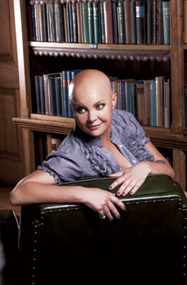

Alopecia Universalis
Gail Porter is a television personality in the United Kingdom and spokesperson for alopecia awareness.
https://www.images.mirror.co.uk
https://www.listal.com/list/famous-faces-childrens-tv

Slide 71
Lanugo
Hair follicles begin to develop during the 12th week of the embryonic period.
By the fifth month, hair follicles produce non-pigmented, downy hairs that cover the fetus.
The hairs are known as lanugo.
Page 152
Page 163
Page 157

Slide 72
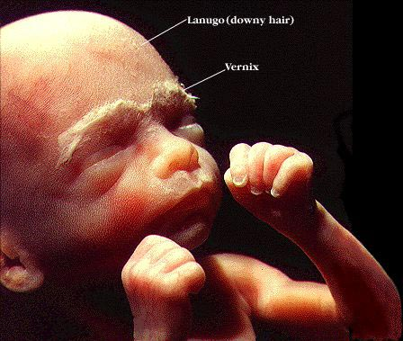
Lanugo (continued)
Week 24 after conception
http://www.i-am-pregnant.com
Vernix = (or vernix caseosa) is a white cheesy substance that covers and protects the skin of the fetus and is still all over the skin of a baby at birth. Vernix is composed of sebum (oil of the skin) and cells that sloughed off the fetus’s skin. (http://www.medterms.com)

Slide 73
Terminal and Vellus Hairs
Prior to birth, the lanugo of the eyebrows, eyelashes, and the scalp are replaced by long, coarse, and heavily-pigmented terminal hairs.
The lanugo covering the rest of the body is replaced by short, fine, and pale vellus hairs (peach fuzz) that are barely visible in casual observa-tion.
Vellus hairs cover most of the body except for the eyebrows, eyelashes, and scalp prior to puberty.
Page 152
Page 163
Page 157

Slide 74
Distribution of Hair Types
In response to androgens secreted at puberty, terminal hairs replace vellus hairs in the axillary (armpits) and pubic regions in boys and girls.
The sources of androgens are the testes in boys and adrenal cortex in boys and girls.
Terminal hairs also replace vellus hairs on the face, limbs, and chests of pubertal boys.
Page 152
Page 163
Page 157

Slide 75
Distribution of Hair Types (continued)
About 95 percent of body hair on adult males is terminal hair, and five percent is vellus hair.
About 35 percent of body hair on adult females is terminal hair, and 65 percent is vellus hair.
Page 152
Page 164
Page 157

Slide 76
Hair Color
Natural hair color is primarily due to the type and amount of melanin in the keratinized cells of hair.
Melanin is synthesized by melanocytes in the matrix of the bulb and passes into cells of the cortex and medulla of the hair.
Hair, of course, can be colored—the basic principles are described in the textbook.
Page 153
Page 164
Page 157
Figure 5.4

Slide 77
Gray and White Hair
Gray hair is the result of a progressive decline in melanin production.
White hair results from a complete lack of melanin and an accumula-tion of air bubbles in the hair shafts
Page 153
Page 164
Page 157

Slide 78
Skin Glands
Three types of exocrine glands are found in the skin:
  Sebaceous (oil) glands
  Sudoriferous (sweat) glands
  Ceruminous glands
Mammary glands are specialized sudoriferous glands in the breasts that secrete a mother’s milk.
Exocrine gland = a gland that secretes externally through a duct.
Page 153
Page 164
Page 157

Slide 79
Sebaceous Glands
Sebaceous (oil) glands are simple, branched acinar glands attached to hair follicles.
The secreting portion, located in the dermis, usually opens into the neck of a hair follicle.
The glands open directly on the surface of the skin on the lips, glans penis, labia minora, and eyelids.
Acinar gland = a gland having a saclike secretory unit and a lumen.
(https://www.medical-dictionary.thefreedictionary.com)
Page 153
Page 164
Page 158
Figure 5.1
Figure 5.4

Slide 80
Sebaceous Glands (continued)
Sebaceous glands are absent in the palms and soles, and are small in most areas of the body trunk and limbs.
They are much larger in the skin of the breasts, superior (upper) area of the chest, and neck and face.
Page 153
Page 164
Page 158

Slide 81
Secretions
Sebaceous glands secrete an oily substance known as sebum.
Sebum is composed of triglycerides, cholesterol, proteins, and inorganic salts.
It coats the surface of hairs and helps keep them from drying and becoming brittle.
Sebum helps prevent excessive evaporation of water from the skin, helps keeps the skin soft, and inhibits the growth of some types of bacteria.
Page 153
Page 164
Page 158

Slide 82
Sudoriferous Glands
The body has three to four million sudoriferous (sweat) glands.
They release sweat (perspiration) into the hair follicles or onto the surface of the skin through pores.
The two types of sweat glands—eccrine and apocrine—are defined by their structure, location, and type of secretion.
Page 153
Page 164
Page 158
Figure 5.1
Figure 5.4

Slide 83
Eccrine Sweat Glands
Eccrine sweat glands—which are simple, coiled tubular glands—are more common than apocrine sweat glands.
They are distributed in the skin of most body regions, and in higher den-sities in the skin of the forehead, palms, and soles.
These glands are not present in the margins of the lips, nail beds of the fingers and toes, glans penis, glans clitoris, labia minora, and eardrums.
Page 153
Page 164
Page 158
Figure 5.1
Figure 5.4

Slide 84
Eccrine Sweat Glands (continued)
The secretory portion of an eccrine sweat gland is usually located in the deeper dermis, although sometimes they are found in the upper part of the subcutaneous layer.
Its excretory portion projects through the dermis and epidermis and terminates as a pore on the surface of the skin.
Excretory = concerned with excretion.
Page 153
Page 164
Page 158
Figure 5.1
Figure 5.4

Slide 85
Eccrine Sweat
Eccrine glands collectively produce about 600 mL of sweat per day.
The sweat is composed of water, ions (primarily Na⁺ and Cl⁻), urea, uric acid, ammonia, amino acids, glucose, and lactic acid.
A major function of eccrine glands is to regulate body temperature through evaporative cooling.
As sweat evaporates, heat is removed from the surface of the body, which promotes cooling.
Page 153
Page 164
Page 158

Slide 86
Thermoregulatory Sweating
The homeostatic regulation of body temperature is known as thermo-regulation.
The role of eccrine glands in thermoregulation is called thermoregula-tory sweating.
Page 153
Page 165
Page 158

Slide 87
Eccrine Sweat Formation
Eccrine sweat forms first on the forehead and scalp before on the rest of the body.
Sweat forms last on the palms and soles.
Sweat that evaporates from the skin before it is perceived as moisture is known as insensible perspiration.
Sweat excreted in large amounts and experienced as moisture on the skin is called sensible perspiration.
Insensible = not perceptible by the senses.
Sensible = perceptible by the senses.
Page 153
Page 165
Page 158

Slide 88
Waste Elimination
The excretion of sweat by eccrine sweat glands has a small role in eliminating wastes—such as urea, uric acid, and ammonia—from the body.
The kidneys have a larger role in excreting these and other waste products.
Kidney function is described in the lecture module on renal physiology.
Page 153
Page 165
Page 158

Slide 89
Apocrine Sweat Glands
Apocrine sweat glands consist of simple, coiled tubular glands.
They are found in the skin of the axillae, areolae of the breasts, and bearded regions of the face in adult males.
These sweat glands were once thought to release secretions in an apocrine manner (that is, pinching-off of a portion of the cell).
Although it is now known that secretions are through exocytosis, the word “apocrine” is still used to describe these sweat glands.
Page 154
Page 165
Page 158
Figure 5.1
Figure 5.4

Slide 90
Apocrine Sweat Glands (continued)
The secretory part of an apocrine sweat gland is usually found in the subcutaneous layer.
The gland’s excretory duct opens into a hair follicle.
Page 154
Page 165
Page 158
Figure 5.1
Figure 5.4

Slide 91
Apocrine Sweat
Apocrine sweat is slightly viscous, and it has a milky or yellowish appearance.
Apocrine sweat has the same substances as eccrine sweat, but it also contains lipids and proteins.
Although apocrine sweat is odorless, a musky body odor can result from bacteria that metabolize its components.
While eccrine sweat glands function soon after birth, apocrine sweat glands begin to function at puberty in response to hormonal changes.
Viscous = having a thick, sticky consistency somewhere between a solid and a liquid.
Page 154
Page 165
Page 158

Slide 92
Apocrine Sweat Gland Functions
Apocrine sweat glands, like eccrine sweat glands, are active during emotional sweating involving sympathetic activation of the autonomic nervous system.
Apocrine sweat is also secreted during intense sexual arousal due to sympathetic activity.
Apocrine sweat glands, however, are not involved in thermoregulatory sweating to cool the body unlike eccrine sweat glands.
Page 154
Page 165
Page 158

Slide 93
Ceruminous Glands
Ceruminous glands, which are modified sweat glands in the external ear, produce a waxy, lubricating secretion.
The secretory portion of a ceruminous gland is located in the subcu-taneous layer of the external auditory canal.
Its excretory duct opens directly into the auditory canal or into the duct of a sebaceous gland.
Page 154
Page 165
Page 159

Slide 94
Ceruminous Glands (continued)
The combined secretions of the ceruminous and sebaceous glands into the external auditory canal form a yellowish material known as cerumen (or earwax).
Cerumen and hair provide a sticky barrier that impedes the entrance of foreign bodies and insects into the auditory canal.
Cerumen also waterproofs the auditory canal to help prevent bacter-ial and fungi from entering its cells.
Page 154
Page 165
Page 159

Slide 95
Nails
Nails are plates of hard, tightly-packed, dead keratinized epidermal cells.
They form a clear, solid covering of the superior surfaces of the dis-tal ends of the digits (fingertips and toe tips).
Nails help in grasping and manipulating small objects, provide pro-tection against trauma to the digit tips, and enable us to scratch an itch.
The structure of nails and their tissues is described in the textbook.
Page 155
Page 167
Page 159
Figure 5.5

Slide 96
Functions of the Integumentary System

Slide 97
Functions
The integumentary system has many functions including:
  Thermoregulation
  Blood reservoir
  Protection
  Cutaneous sensations
  Excretion and absorption
  Synthesis of vitamin D
Page 156
Page 167
Page 160

Slide 98
Thermoregulation
The skin contributes to thermoregulation (temperature control of the body) by adjusting the flow of blood in the dermis and sweating.
Sweat production in eccrine sweat glands increases in response to ambient heat and the generation of body heat in physical exercise.
The evaporation of eccrine sweat from the surface of the skin helps lower body temperature, which must be maintained within a limited range for the proper functioning of organ systems.
Eccrine sweating decreases in cold environments to conserve body heat.
Page 156
Page 168
Page 160

Slide 99
Thermoregulation (continued)
Blood vessels in the dermis dilate to increase blood flow and radiative heat loss in hot environments.
They constrict to reduce blood flow and minimize heat loss in cold envi-ronments.
Radiative heat loss = the process by which temperature decreases due to an excess of emitted radiation over absorbed radiation.
Page 156
Page 168
Page 161

Slide 100
Blood Reservoir
The dermis has an extensive network of blood vessels to serve as a blood reservoir.
The vessels contain eight to ten percent of the total blood volume of the adult body.
Some of the blood is shunted to skeletal muscle and other critical organs during intense sympathetic responses such as the fight or flight response.
Page 157
Page 168
Page 161

Slide 101
Protection
Keratin protects underlying tissues from microbes, abrasion, heat, and chemicals.
The closely interlocked keratinocytes in the dermis resist the entrance of microbes.
Lipids released by the lamellar granules inhibit the evaporation of water from the skin to help minimize dehydration.
Page 157
Page 168
Page 161

Slide 102
Protection (continued)
Lipids help prevent entry of water through the skin such as during showering and swimming.
Sebum secreted by the sebaceous glands keeps the skin and hair from drying-out.
Sebum contains bactericidal chemicals to kill bacteria on the surface of the skin.
Bactericide = a substance that kills bacteria.
Page 157
Page 168
Page 161

Slide 103
Protection (continued)
The acidity of perspiration retards (slows) the proliferation of some microbes.
The pigment melanin helps shield the skin from the damaging effects of UV radiation in sunlight.
Langerhans cells in the epidermis signal the presence of potentially-harmful microbes to the immune system.
Macrophages in the dermis can phagocytize bacteria and viruses that entered the skin.
Proliferation = growth by rapid multiplication.
Phagocytosis = the process by which a cell incorporates a particle by extending pseudo-podia and drawing the particle into a vacuole of its cytoplasm for its destruction.
(https://www.wiktionary.org)
Page 157
Page 168
Page 161

Slide 104
Cutaneous Sensations
Cutaneous (or tactile) sensations include touch, pressure, vibration, tickling, temperature, and pain.
A variety of nerve endings and sensory receptors (exteroreceptors) are distributed in the skin.
They include free nerve endings, tactile discs of the epidermis, cor-puscles in the dermis, and hair root plexuses.
Cutaneous sensations are covered in the lecture module on the so-matic senses.
Page 157
Page 168
Page 161

Slide 105
Excretion and Evaporation
Excretion is the elimination of substances from the body—for the skin, it involves evaporation.
About 400 mL of water evaporates through the skin each day, although it can be much more for a physically-active person, or in a hot environ-ment.
Sweat removes water and heat from the body, and small amounts of salts, carbon dioxide, ammonia, and urea (ammonia and urea are by-products of protein catabolism).
Catabolism = breakdown in living organisms of more complex sub-stances into simpler ones along with release of energy.
Page 157
Page 168
Page 161

Slide 106
Absorption
Absorption is the passage of substances from the external environment into the body.
Although the absorption of water-soluble substances through the skin is negligible, some lipid-soluble substances can pass.
They include vitamins A, D, E, and K, and some drugs, oxygen, and car-bon dioxide.
Page 157
Page 168
Page 161

Slide 107
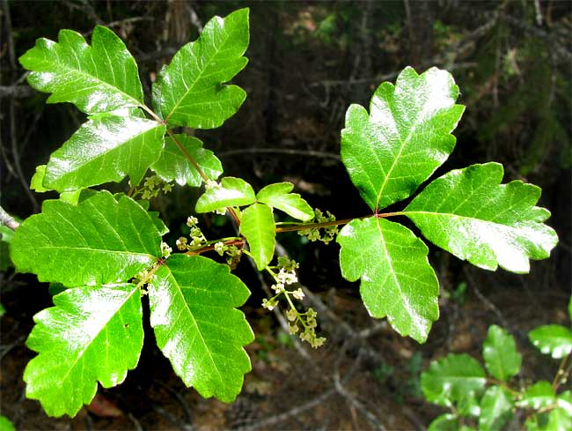
Absorption (continued)
Toxic substances that can be absorbed through the skin include:
  Acetone
  Carbon tetrachloride (dry cleaning fluid)
  Salts of heavy metals such as lead, mercury, and arsenic
  Active ingredients in poison oak, poison ivy, and poison sumac
Poison oak
https://www.backyardnature.net
Page 157
Page 168
Page 161

Slide 108
Absorption (continued)
Topical steroids, which are lipid-soluble, are readily absorbed into the papillary region of the dermis.
They exert anti-inflammatory effects by inhibiting histamine synthesis by mast cells.
Topical = pertaining to the surface of a body part; a substance applied to the skin.
Mast cells = mast cells are of the immune system and can be found throughout the body. Inside a mast cell are tiny granules containing different chemicals that cause inflammation. Probably the most important mast cell chemical affecting the skin is histamine. Various triggers will cause the mast cell to degranulate, or release its granules, causing inflammation in the surrounding tissue.
(https://www.dermatology.about.com)
Page 157
Page 168
Page 161

Slide 109
Vitamin D Synthesis
The synthesis of vitamin D requires the activation of a precursor mole-cule in the skin by UV radiation in sunlight.
Enzymes in the liver and kidneys then modify the activated molecule to produce calcitriol, the active form of vitamin D.
Calcitriol is a hormone that promotes the absorption of calcium from the small intestine into the blood.
Page 157
Page 168
Page 161

Slide 110

Vitamin D Synthesis (continued)
About 15 to 20 minutes of exposure to UV light at least twice a week is usually sufficient for an adequate amount of time for vitamin D synthesis to occur.
People living at higher latitudes during the winter months may need to take supplemental vitamin D due to short days, long nights, and many overcast days.
https://www.bhmpics.com
Page 157
Page 168
Page 161

Slide 111
Healing of Skin Wounds

Slide 112
Skin Wound Healing
Skin damage triggers a series of physiological events to repair the skin to its normal or near-normal structure and function.
Epidermal wound healing involves the epidermis, while deep wound healing also involves the dermis.
Page 158
Page 169
Page 162

Slide 113
Epidermal Wound Healing
The most common types of epidermal wounds are abrasions and minor burns.
In response to an epidermal wound, the basal cells of the epidermis surrounding the wound break contact with the basement membrane.
The basal cells enlarge and migrate as sheets across the site of the wound.
Page 158
Page 169
Page 162
Figure 5.6

Slide 114
Epidermal Wound Healing (continued)
During migration, epidermal growth factor (a local hormone) stimulates the basal cells to divide through mitosis and replace the basal cells that moved into the wounded area.
Once the epidermal basal cells meet from opposite edges of the wound, they stop migrating due to contact inhibition, a cellular response.
The epidermal basal cells continue to divide to build the strata and thick-en the new epidermis.
Page 159
Page 169
Page 162
Figure 5.6

Slide 115
Deep Wound Healing
Deep wound healing occurs in response to tissue injury to the epider-mis, dermis, and even the subcutaneous layer.
The healing is more complex than for epidermal wounds since deeper layers must also be repaired.
The healed tissue loses some of its normal functions since scar tissue is formed in the healing process.
Page 159
Page 169
Page 162
Figure 5.6

Slide 116
Healing Phases
Deep wound healing has four phases:
  Inflammatory
  Migratory
  Proliferative
  Maturation
Page 159
Page 169
Page 162
Figure 5.6

Slide 117
Inflammatory Phase
In the inflammatory phase, a blood clot forms in the wound to loosely unite its edges.
Inflammation involves vascular and cellular responses that eliminate microbes, foreign material, and dead and dying tissue to allow tissue repair to begin.
Vascular = of or pertaining to the blood vessels.
Page 159
Page 169
Page 162
Figure 5.6

Slide 118
Inflammatory Phase (continued)
The migration of some types of cells to the wound site is enhanced by the vasodilation of the arterioles and increased permeability of the cap-illaries.
The cells include:
  Neutrophils (phagocytotic white blood cells) to respond to infection.
  Monocytes, a type of WBC that develops into macrophages to pha-gocytize microbes.
  Mesenchymal cells that develop into fibroblasts.
Page 159
Page 169
Page 162
Figure 5.6

Slide 119
Migratory Phase
In the migratory phase, the blood clot forms a scab, and epithelial cells migrate beneath it to bridge the wound.
Fibroblasts migrate along fibrin threads to synthesize scar tissue from collagen fibers and glycoproteins.
The damaged blood vessels begin to regrow.
During the migratory phase, the tissue in the healing wound is known as granulation tissue.
Page 159
Page 170
Page 162
Figure 5.6

Slide 120
Proliferative Phase
The proliferative phase of deep wound healing is characterized by:
  Extensive growth of epithelial cells beneath the scab.
  Formation of collagen fibers by fibroblasts to form random patterns.
  Continued regrowth of blood vessels to supply the healing wound.
Page 159
Page 170
Page 162
Figure 5.6

Slide 121
Maturation Phase
In the maturation phase, the scab sloughs-off when the epidermis has returned to its normal thickness.
The collagen fibers become more organized, the number of fibroblasts decreases, and blood vessels are returned to a normal or near-normal state.
Page 159
Page 170
Page 162
Figure 5.6

Slide 122
Fibrosis
The process of scar tissue formation in a healing wound is known as fibrosis.
A raised scar is the result of substantial scar tissue in deep wound healing.
A hypertrophic scar is confined within the boundaries of a healed wound.
A keloid scar extends beyond these boundaries into the surrounding tissues.
Page 159
Page 170
Page 162

Slide 123
Scar Tissue Characteristics
Scar tissue differs substantially from undamaged skin because it has:
  More densely-arranged collagen fibers
  Decreased elasticity
  Fewer blood vessels
  Fewer hairs, exocrine glands, and cutaneous receptors
Scar tissue is usually lighter in color than undamaged skin due to the dense arrangement of collagen fibers and fewer blood vessels.
Page 159
Page 170
Page 162

Slide 124
Aging

Slide 125
Aging Effects
The effects of aging skin typically do not become noticeable until people reach their late-40s.
Many age-related changes occur in the proteins in the dermis because the collagen fibers decrease in number, stiffen, and break apart to form a shapeless tangle.
Elastic fibers lose some of their elasticity, form clumps, and fray—these changes are accelerated in people who smoke tobacco.
Fibroblasts, which produce collagen and elastic fibers, decrease in num-ber, enabling the formation of furrows and crevices known as wrinkles.
Page 161
Page 172
Page 164

Slide 126
Aging Effects (continued)
Langerhans cells decrease in number, and macrophages become less-efficient at phagocytosis.
These changes decrease the immune responsiveness of the skin.
A reduction in the size of the sebaceous glands results in dry and broken skin that is more susceptible to infection.
Sweat production decreases, which contributes to a greater likeli-hood of heat stroke in seniors.
Heatstroke = the most severe form of heat illness, which is a life-threatening emergency. It is typically the result of long, extreme (direct or indirect) exposure to the sun, in which a person does not sweat enough to lower body temperature.
(Adapted from https://www.medicalcenter.osu.edu)
Page 161
Page 172
Page 164

Slide 127
Aging Effects (continued)
A reduced number of functioning melanocytes results in gray hair and atypical skin pigmentation.
Hair loss increases with aging as hair follicles stop producing hair.
About 25 percent of males begin to show signs of hair loss by age 30, and about two-thirds have obvious hair loss by age 60.
Both men and women can develop pattern baldness as they age.
Atypical = not the norm.
Pattern baldness = a gradual loss of hair common in humans and associated with androgens.
Page 161
Page 172
Page 164

Slide 128
Aging Effects (continued)
The increased size of the melanocytes produces pigment blotching known as age spots.
The walls of the blood vessels in the dermis become thicker and less permeable, which reduces the delivery of oxygen and nutrients to skin tissues.
Subcutaneous adipose tissue diminishes as a person ages, which can result in a gaunter (thin, drawn, or pinched) physical appearance.
Page 161
Page 172
Page 164

Slide 129
Aging Effects (continued)
Aged skin, especially in the dermis, thins because the migration of cells from the basal layer to the epidermis diminishes.
With continued aging, skin heals more slowly, and is more suscepti-ble to conditions such as pressure sores from being bedridden and skin cancer.
Page 161
Page 172
Page 164

Slide 130
Aging Effects (continued)
Rosacea is a skin condition that affects mostly light-skin people between the ages of 30 and 60.
The condition is characterized by redness, tiny pimples, and noticeable blood vessels, especially in the central part of the face.
With aging, the growth of nails slows—they can become thin and brittle due to dehydration or the frequent use of nail polish or cuticle remover.
“Getting old is not for the faint of heart.”
—Various sources
Page 161
Page 172
Page 164

