Slide 1
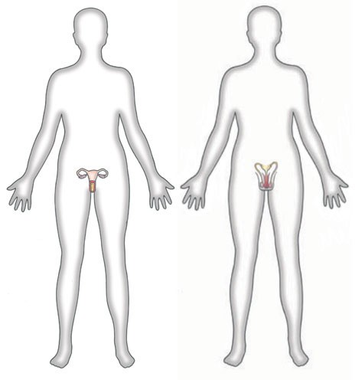
Female Reproductive System
https://www.dorlingkindersley-uk.co.uk

Slide 2
Note
Much of the text material is from, “Principles of Anatomy and Physiology” by Gerald J. Tortora and Bryan Derrickson (2009, 2011, and 2014). I don’t claim authorship. Other sources are noted when they are used.
The lecture slides are mapped to the three editions of the textbook based on the color-coded key below.
14th edition
13th edition
12th edition
Same figure or table reference in all three editions

Slide 3
Outline
Reproductive organs
Oogenesis and follicular development
Fertilization
Supporting reproductive structures
Hormonal control
Reproductive cycle

Slide 4
Reproductive Organs

Slide 5
Female Reproductive Organs
The organs and tissues of the female reproductive system include the:
  Ovaries, the female gonads
  Fallopian or uterine tubes, also known as oviducts
  Uterus
  Vagina
  External structures known as the vulva or pudendum
The mammary glands are considered part of the reproductive system and the integumentary system.
Integumentary = the skin and its supporting structures.
Page 1054
Page 1143
Page 1095
Figure 28.11

Slide 6
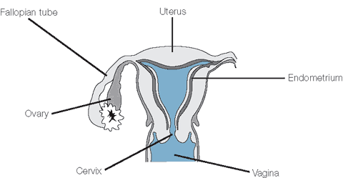
Female Reproductive Organs (continued)
Fallopian tube
Uterus
Endometrium
Ovary
Cervix
Vagina
https://www.sydneyivf.com

Slide 7
Ovaries
Each of the two ovaries is about the shape and size of an unshelled almond.
The ovaries are homologous to the testes since they have the same origin in embryonic tissues.
The ovaries produce gametes—secondary oocytes that develop into mature ova after fertilization.
They also produce four hormones—progesterone, estrogens, inhibin, and relaxin.
Homologous = differentiated from the same embryonic tissue.
Gamete = a reproductive cell having a haploid number (n) of chromosomes.
Page 1054
Page 1143
Page 1097

Slide 8
Ovaries (continued)
The ovarian follicles in the ovarian cortex contain oocytes (eggs) in different stages of development.
The cells of the follicle nourish the oocyte and secrete estrogens as the follicle continues to mature.
The mature follicle is a large, fluid-filled structure that ruptures and expels its oocyte (known as a secondary oocyte) during ovulation.
Oocyte = the immature female reproductive cell prior to fertilization.
Page 1055
Page 1143
Page 1097
Figure 28.13

Slide 9
Ovaries (continued)
The remnants of the mature follicle after ovulation become the corpus luteum.
The corpus luteum also produces hormones—progesterone, estrogens, inhibin, and relaxin.
Eventually it degenerates into scar tissue known as the corpus albicans (white body).
Page 1057
Page 1144
Page 1097
Figure 28.13

Slide 10
Oogenesis and Follicular Development

Slide 11
Oogenesis
The process of the formation of gametes in the ovaries is known as oogenesis.
In comparison to spermatogenesis (sperm production), which starts at puberty in males, oogenesis begins but does not end before birth in females.
Oogenesis, however, occurs in much the same manner as sperma-togenesis.
In females and males, the processes involve meiosis and a period of gamete maturation.
Gametes = eggs and sperm.
Page 1057
Page 1146
Page 1099
Figure 28.15

Slide 12
Germ Cells and Oogonia
Primordial germ cells migrate from the yolk sac to the ovaries dur-ing early fetal development.
The germ cells differentiate in the ovaries into what are known as oogonia.
Primordial = existing first; in this instance, egg cells in the ovaries.
Yolk sac = a membrane outside the embryo that is connected by a tube called the yolk stalk though the umbilical opening to the embryo's mid-gut. The yolk sac serves as an early site for the formation of blood and, in time, is incorporated into the primitive gut of the embryo.
(https://www.medterms.com)
Page 1057
Page 1146
Page 1099
Figure 28.15

Slide 13
Germ Cells and Oogonia (continued)
Oogonia are diploid (2n) stem cells that divide through mitosis to produce millions of haploid (n) germ cells.
Before birth, most of the germ cells degenerate through atresia.
Germ cells = developmental precursors of eggs and sperm.
Atresia = degeneration and resorption of one or more ovarian follicles before a state of maturity has been reached.
Page 1057
Page 1146
Page 1099
Figure 28.15

Slide 14
Primary Oocytes
The remaining germ cells develop into primary oocytes (egg cells).
Primary oocytes begin prophase of meiosis I during fetal develop-ment, but they do not complete meiosis I until they are ovulated at some later point in life.
During this arrested stage, each primary oocyte is surrounded by a single layer of follicular cells that will eventually develop into several layers of granulosa cells.
The structure, including the primary follicle, is known as a primordial follicle.
Arrested stage = a temporary or permanent cessation of development.
Granulosa cell = a cell lining the ovarian follicle that becomes a luteal cell after ovulation.
Page 1057
Page 1147
Page 1099
Figure 28.14
Figure 28.15

Slide 15
Primary Oocytes (continued)
About 200,000 to 2,000,000 primary oocytes remain in each ovary at birth.
By puberty, about 40,000 primary oocytes remain, and about 400 mature and undergo ovulation during a woman’s reproductive life-time.
The remaining primary oocytes eventually undergo the process of atresia.
Page 1057
Page 1147
Page 1099

Slide 16
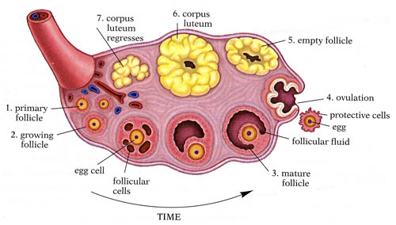
Ovarian Events
https://www.biog1105-1106.org
Mature follicle = also known as a Graafian follicle.

Slide 17
Primordial and Primary Follicles
FSH and LH secreted by the anterior pituitary stimulate the devel-opment of several primordial follicles each month.
The primordial follicles then develop into primary follicles.
The primary follicle has a primary oocyte surrounded by granulosa cells.
Each month, one primary follicle typically reaches this level of ma-turity for ovulation.
On occasion, more than one primary follicle will mature and be ovulated, and if both are fertilized, can result in dizygotic (fraternal) twins.
Fraternal (non-identical) twins may not have the same sex or physical appearance. They share half their genomes, just like any other siblings.
(https://www.genome.gov)
Page 1057
Page 1147
Page 1099
Figure 28.14

Slide 18
Secondary Follicle
With further maturation, the primary follicle develops into a second-ary follicle.
Prior to ovulation, while in the secondary follicle, the primary oocyte (2n) completes meiosis I to produce two haploid (n) cells of unequal size.
The smaller cell, known as the first polar body, consists of discarded nuclear material.
Nuclear material = DNA in the cell nucleus.
Page 1059
Page 1148
Page 1101
Figure 28.14

Slide 19
Secondary Oocyte
The larger of the two cells, the secondary oocyte, receives most of the cytoplasm of the primary oocyte.
The secondary oocyte begins meiosis II, but it stops in metaphase II (see the lecture module on cell division).
The surrounding secondary follicle becomes larger and develops into a mature follicle.
The mature follicle ruptures and releases the secondary oocyte in a process known as ovulation.
Page 1059
Page 1149
Page 1101
Figure 28.15

Slide 20
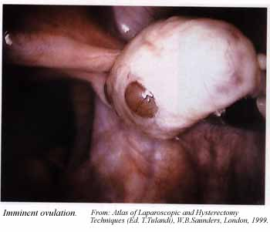
Ovulation (continued)
At ovulation, the secondary oocyte is expelled into the pelvic cavity and swept into the fallopian tube along with the first polar body and other material.
The secondary oocyte degenerates if fertilization by a sperm does not occur.
See Table 28.1 for a summary of the concurrent processes of oogen-esis and follicular development in
the ovaries.
Beginning of ovulation
(https://www.sprojects.mmi.mcgill.ca)
Page 1059
Page 1149
Page 1101
Table 28.1

Slide 21
Fertilization

Slide 22
Sperm Penetration and Fusion
The process of meiosis II resumes if a sperm penetrates the secon-dary oocyte.
With sperm penetration, the secondary oocyte splits into two haploid (n) cells of unequal size.
The larger cell is the ovum, and the smaller is the second polar body, which is discarded.
The DNA in the nuclei of ovum and sperm fuse within several hours, forming a diploid (2n) zygote.
Zygote = the diploid cell resulting from the union of a haploid ovum (egg) and a haploid spermatozoon (sperm).
Page 1059
Page 1149
Page 1101

Slide 23
Zygote
The diploid zygote has one haploid set of chromosomes from each parent.
The zygote begins mitotic cell division while it is propelled down the fallopian tube by fluid currents generated by the cilia.
The zygote (now called a blastocyst) arrives in the uterus six to seven days after fertilization.
Implantation of the blastocyst in the uterine wall will be covered when we discuss the reproductive cycle later in this lecture.
Cilia = very small hair-like organelles, similar in structure to flagella, that line the surfaces of some cells and move in rhythmic waves.
(https://www.dictionary.reference.com)
Page 1059
Page 1150
Page 1101

Slide 24
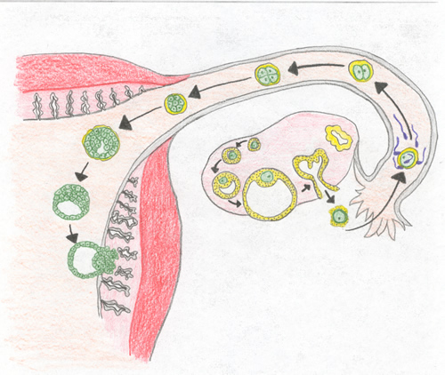
Fertilization and Implantation
https://www.missinglink.ucsf.edu

Slide 25
Supporting Reproductive Structures

Slide 26
Fallopian Tubes
The fallopian tubes (also known as the uterine tubes) extend laterally from the uterus.
The secondary oocyte is often fertilized by a sperm in the ampulla of the fallopian tube.
The fallopian tubes are a pathway for sperm to reach the secondary oocyte, and a pathway for the blastocyst to reach the uterus for implan-tation in the uterine wall.
Page 1061
Page 1149
Page 1102
Figure 28.16

Slide 27
Fimbriae
The distal ends of the fallopian tubes have finger-like projections known as fimbriae.
One fimbria is attached to the ovary as an anchor point, while the other fimbriae sweep across the surface of the ovary.
Fluid currents generated by their movement sweep the secondary oocyte into the fallopian tube.
Fimbriae = plural form of fimbria.
Page 1061
Page 1149
Page 1102
Figure 28.16

Slide 28
Ectopic Pregnancy
Implantation of a fertilized egg in the pelvic cavity can happen, which results in an ectopic pregnancy.
The more commonly-occurring ectopic pregnancy is when a fertilized egg implants itself in the fallopian tube.
The embryo cannot survive—medical and even surgical intervention is required for the health of the mother.

Slide 29
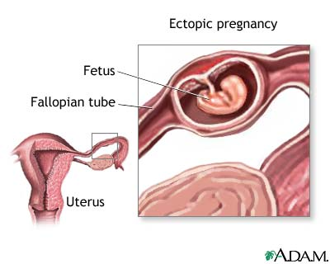
Ectopic Pregnancy (continued)
https://www.clarian.org

Slide 30
Uterus
The uterus is the pathway for sperm to reach the fallopian tubes.
The uterus is the site for the implantation of a blastocyst and embryonic and fetal development.
The uterine tissue is the source of menstrual flow in reproductive cycles when the implantation of a blastocyst does not occur, as will be covered in this lecture module.
Page 1062
Page 1151
Page 1104
Figure 28.16

Slide 31
Uterus (continued)
The uterus is about 7.5 cm long, 5 cm wide, and 2.5 cm thick in women who have not ever been pregnant.
The uterus can be enlarged after a recent pregnancy but is smaller due to atrophy when estrogen levels are low after menopause.
Page 1062
Page 1151
Page 1104
Figure 28.16

Slide 32
Tissue Layers
The uterus has three tissue layers—perimetrium, myometrium, and endometrium.
The perimetrium, the outermost layer, consists of squamous cells and areolar connective tissue.
Squamous = thin, flat epithelial cells.
Areolar tissue = loose connective tissue that consists of a meshwork of collagen, elastic tissue, and reticular fibers.
Page 1063
Page 1152
Page 1105
Figure 28.18

Slide 33
Myometrium
The myometrium has three layers of smooth muscle that are thickest in the fundus (superior portion) and thinnest at the cervix.
The smooth muscle fibers in the middle layer are circular in arrange-ment.
The smooth muscle fibers in the inner and outer layers are longitudi-nal in arrangement.
Strong, coordinated contractions of the muscle fibers in response to oxytocin secreted by the posterior pituitary help to expel the child from the uterus.
Page 1063
Page 1152
Page 1106
Figure 28.18

Slide 34
Endometrium
The endometrium, the inner layer of the uterus, is highly-vascularized.
The stratum functionalis (functional layer) of the endometrium sloughs off during menstruation.
The stratum basalis (base layer) is permanent and gives rise to a new stratum functionalis after each menstruation in response to estrogens.
Vascularized = the formation of blood vessels and capillaries in tissue.
Slough = shed or cast off.
Page 1064
Page 1152
Page 1106
Figure 28.18

Slide 35
Blood Supply
The extensive blood supply of the uterus supports the growth of the stratum functionalis after menstruation, implantation of a blastocyst, and development of the placenta.
Anatomical details of the vascular system in the uterus are found in the textbook.
Page 1064
Page 1153
Page 1108
Figure 28.19

Slide 36
Cervix and Cervical Mucus
The inferior, narrow portion of the uterus is known as the cervix—its channel is called the cervical canal.
Secretory cells in the cervical tissue produce a mucus for the cervical canal consisting of water, glycoproteins, lipids, enzymes, and inorganic salts.
Page 1064
Page 1154
Page 1106

Slide 37
Cervical Mucus (continued)
The cervical mucus is most hospitable to sperm at or near the time of ovulation because it becomes less viscous and more alkaline (pH 8.5).
The mucus supplements the energy needs of sperm and protects them from phagocytes and the acidity of the vagina and uterus.
The mucus filaments align in parallel to enable sperm to pass from the vagina to the uterus.
The mucus is more viscous and forms a cervical plug to impede sperm transit at other times in the reproductive cycle.
Phagocyte = a cell that engulfs and digests cellular debris and invading microorganisms.
(https://www.wordnetweb.princeton.edu)
Page 1064
Page 1154
Page 1106

Slide 38
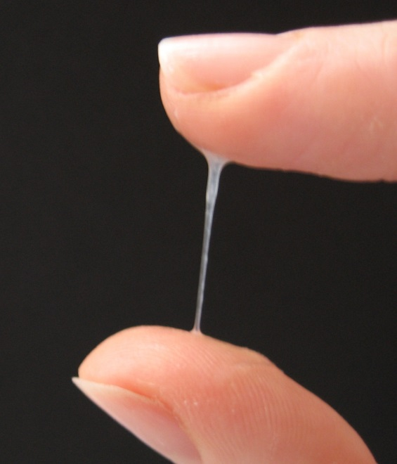
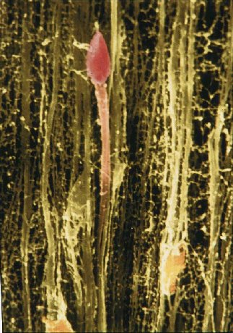
Cervical Mucus (continued)
A sperm passing through the cervical mucus.
https://www.wikimedia.org
https://www.woomb.org

Slide 39
Capacitation
The cervical mucus facilitates biochemical changes in sperm, known as capacitation, that enable a sperm to penetrate a secondary oocyte.
Capacitation also enables the sperm to move more vigorously as they travel through the uterus and along the fallopian tubes.
Page 1064
Page 1154
Page 1106

Slide 40
Vagina
The vagina is an elongated, canal of muscular fibers extending from the exterior of the body to the cervix.
The tubular-shaped structure is about 10 cm long.
The vagina serves as the receptacle for a penis during sexual inter-course, outlet for menstrual flow, and passageway for natural child-birth.
Page 1065
Page 1155
Page 1107
Figure 28.11
Figure 28.16

Slide 41
Vaginal Mucosa
The vaginal mucosa, which is continuous with the uterine mucosa, contains large stores of glycogen.
Chemical decomposition of the glycogen produces inorganic acids.
While the acidic environment inhibits microbial growth in the vagina, it is harmful to sperm.
The alkalinity of semen in a male’s ejaculate increases the pH of the vagina to help maintain the viability of the sperm.
Viability = in this context, the sperm are alive and functioning properly.
Page 1057
Page 1155
Page 1107

Slide 42
Vaginal Muscularis
The vaginal muscularis has circular and longitudinal layers of smooth muscle fibers.
The muscles can stretch considerably to accommodate a penis and childbirth.
Exterior to the muscularis is the vaginal adventitia, which is areolar connective tissue that anchors the vagina to adjacent tissues in the pelvic region.
Page 1065
Page 1155
Page 1107

Slide 43
Hymen
The hymen is a thin, vascularized membrane that partially closes the vaginal opening.
While the hymen can rupture with first sexual intercourse, it may do so earlier.
On occasion, the hymen may completely cover the vaginal opening, which can require surgery to permit the discharge of menstrual flow.
Vascularized = supplied by blood vessels.
Page 1065
Page 1155
Page 1107
Figure 28.20

Slide 44
Vulva and Mons Pubis
The vulva (or pudendum) are the external genitalia of the female—they include the:
  Mons pubis
  Labia majora and labia minora
  Clitoris
  Vestibule and bulb of the vestibule
The mons pubis is adipose tissue covered by skin and pubic hair to cushion the pubic symphysis.
Pubic symphysis = the joint between the pubic bones.
(https://www.medterms.com)
Page 1065
Page 1157
Page 1107
Figure 28.20

Slide 45
Labia Majora
The labia majora are two longitudinal folds of skin covered with pubic hair.
They contain adipose tissue, sebaceous (oil) glands, and sudoriferous (sweat) glands.
The labia majora are homologous to the scrotum in the male since they originate from the same embryonic tissue.
Page 1065
Page 1157
Page 1107
Figure 28.20

Slide 46
Labia Minora
The labia minora are two smaller folds of skin located medial to the labia majora.
They are devoid of pubic hair and have many sebaceous glands but few sudoriferous glands.
The labia minora are homologous to the penile urethra in the male.
Page 1065
Page 1157
Page 1107
Figure 28.20

Slide 47
Clitoris
The clitoris is a small cylindrical mass composed of two small erectile bodies, called the corpora cavernosa, and many blood vessels and sensory nerve endings.
The clitoris can engorge with blood and enlarge with tactile stimulation and produce sexual arousal.
The clitoris is homologous to the glans penis in the male.
Glans penis = the conical mass of erectile tissue that forms the head of the penis.
Page 1065
Page 1157
Page 1107
Figure 28.20

Slide 48
Vestibule
The vestibule is the region located between the pair of labia minora.
The hymen, vaginal orifice, external urethral orifice, and duct open-ings for several exocrine glands are within the hymen.
Page 1065
Page 1157
Page 1109
Figure 28.20

Slide 49
Bulb of the Vestibule
The bulb of the vestibule has two elongated masses of erectile tissue.
The tissue becomes engorged with blood during sexual arousal and narrows the vaginal orifice to place mechanical pressure on the penis.
The bulb of the vestibule is homologous to the corpus spongiosum and bulb of the penis in the male.
See Table 28.2 in the textbook for a summary of homologous structures in the female and male reproductive systems.
Page 1067
Page 1158
Page 1109
Figure 28.21
Table 28.2

Slide 50
Perineum
The perineum is the diamond-shaped area between the thighs and buttocks in females and males.
It contains the external genitalia and anus.
Page 1068
Page 1158
Page 1110
Figure 28.21

Slide 51
Breasts
Each breast has a pigmented projection, known as the nipple, that has lactiferous ducts for milk ejection.
The pigmented area surrounding the nipple is called the areola—it appears rough because it contains modified sebaceous (oil) glands.
Suspensory (Cooper’s) ligaments provide structural support for each breast.
The suspensory ligaments can loosen with age or excessive physi-cal strain.
Page 1068
Page 1158
Page 1110
Figure 28.22

Slide 52
Mammary Glands
Each breast has a mammary gland, which are modified sudoriferous (sweat) exocrine glands that produce milk.
Each mammary gland has 15 to 20 lobes, and each lobe has several lobules.
The lobules are grape-like clusters of milk-secreting exocrine glands known as alveoli.
The lactiferous ducts carry milk from each of the lobes to the nipples.
Page 1068
Page 1158
Page 1110
Figure 28.22

Slide 53
Functions
The mammary glands synthesize, secrete, and eject milk in lactation.
Milk production is stimulated by prolactin, and the synergistic actions of:
  LH and FSH secreted by the anterior pituitary.
  Progesterone and estrogens secreted by the ovaries.
  Other hormones.
Ejection of milk is controlled by oxytocin from the posterior pituitary in response to mechanical stimulation of the nipples by a suckling infant.
Page 1069
Page 1159
Page 1111

Slide 54
Hormonal Control

Slide 55
Reproductive Cycle
The reproductive cycle is a complex set of physiological process consisting of the:
  Ovarian and uterine cycles.
  Hormones that regulate these concurrent cycles.
  Related cyclical changes in the breasts and cervix.
Page 1069
Page 1160
Page 1112

Slide 56
Cyclical Changes
Nonpregnant females typically have cyclical changes in the ovaries and uterus during their reproductive years.
The cycles take about one month and involve oogenesis and prep-aration of the uterus to receive one or more blastocysts after fertili-zation.
Page 1069
Page 1160
Page 1112

Slide 57
Cyclical Changes (continued)
The ovarian cycle is a series of events that occur during and after maturation of an oocyte.
The uterine cycle is a concurrent series of changes in the endome-trium of the uterus to prepare for arrival of a blastocyst.
The changes are controlled by hormones secreted by the ovaries.
If fertilization does not occur, the release of hormones decreases, which causes the stratum functionalis of the endometrium to slough-off during menstruation.
Page 1069
Page 1160
Page 1112

Slide 58
Hormonal Regulation
Gonadotropin-releasing hormone (GnRH) secreted by the hypothalamus controls the ovarian and uterine cycles.
GnRH stimulates the secretion of FSH and LH from the anterior pituitary.
FSH initiates follicular growth, and LH stimulates continued development of the ovarian follicles.
FSH and LH together stimulate the ovarian follicles to secrete estrogens.
Page 1069
Page 1160
Page 1112
Figure 28.23

Slide 59
Hormonal Regulation (continued)
LH also stimulates the ovarian follicles to synthesize androgens— under the influence of FSH they are converted into estrogens.
At mid-cycle, LH triggers ovulation and the formation of the corpus luteum.
The corpus luteum secretes estrogens, progesterone, relaxin, and inhibin.
Page 1069
Page 1160
Page 1112
Figure 28.23

Slide 60
Estrogens (Estrone, Estradiol, and Estriol)
Estrogens have several physiological effects, including that they:
  Promote development and maintenance of female reproductive structures, breasts, and other secondary sex characteristics.
  Increase protein anabolism and also the building of bones in con-junction with human growth hormone (hGH).
  Lower blood cholesterol level—estrogens can reduce the risk of coronary artery disease in women younger than about 50 years.
  Inhibit release of GnRH by the hypothalamus, and LH and FSH release by the anterior pituitary through negative feedback path-ways.
Anabolism = synthesis in living organisms of more complex substances from simpler ones, such as polypeptides (that form proteins) from amino acids.
Page 1070
Page 1161
Page 1112
Figure 28.23

Slide 61
Progesterone
Progesterone is secreted by the corpus luteum after ovulation.
The hormone works synergistically with estrogens to:
  Prepare and maintain the endometrium for the arrival of a blastocyst.
  Prepare the mammary glands for milk secretion.
High blood levels of progesterone inhibit the further secretion of GnRH and LH via negative feedback pathways to the hypothalamus and pitui-tary gland.
Page 1070
Page 1161
Page 1112
Figure 28.23

Slide 62
Relaxin
Relaxin secreted by the corpus luteum during each monthly cycle relaxes the uterus by inhibiting smooth muscle contractions in the myometrium.
The action helps prepare the uterus for the possible implantation of a blastocyst.
The placenta secretes relaxin during pregnancy to relax the smooth muscles of the uterus to help maintain a hospitable environment for the developing embryo and then fetus.
At the end of pregnancy, relaxin increases the flexibility of the pubic symphysis, and helps dilate the cervical cannel to enable passage of a baby through the birth canal.
Page 1070
Page 1161
Page 1112
Figure 28.23

Slide 63
Inhibin
Inhibin is secreted by the maturing follicles and by the corpus luteum after ovulation.
It inhibits the secretion of FSH, and to a lesser extent LH, via a neg-ative feedback pathway to the anterior pituitary.
Page 1070
Page 1161
Page 1112
Figure 28.23

Slide 64
Reproductive Cycle

Slide 65
Reproductive Cycle
The female reproductive cycle ranges between 24 and 35 days, with an average of 28 days.
The reproductive cycle consists of the ovarian cycle and uterine cycle.
The ovarian cycle is a series of events occurring in the ovaries during and after maturation of an oocyte.
The uterine cycle is a concurrent series of changes in the endo-metrium of the uterus to prepare for the arrival of a blastocyst.
Page 1070
Page 1161
Page 1112
Figure 28.24

Slide 66
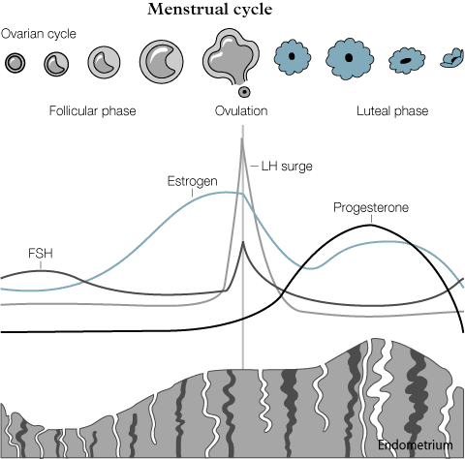
Reproductive Cycle (continued)
Ovarian
cycle
Hormonal
changes
Uterine
cycle
http://www.sydneyivf.com

Slide 67
Reproductive Cycle Phases
The four phases of the reproductive cycle are the:
  Menstrual phase
  Preovulatory phase
  Ovulation
  Postovulatory phase
The next slides assume a reproductive cycle of 28 days.
Page 1070
Page 1161
Page 1112
Figure 28.24

Slide 68
Menstrual Phase—Ovaries
The menstrual phase, also known as menstruation or menses, lasts for approximately the first five days (days 1 through 5) of a reproduc-tive cycle.
Several primordial follicles develop into primary follicles and then into secondary follicles under the influence of FSH secreted by the anterior pituitary.
A follicle that begins to develop at the beginning of one menstrual cycle may not reach maturity and ovulate until several reproductive cycles later.
Page 1071
Page 1161
Page 1113
Figure 28.24

Slide 69
Menstrual Phase—Uterus
Low levels of progesterone and estrogens stimulate the release of prostaglandins cause the arterioles of the uterine wall to constrict and reduce blood flow.
The cells that they supply are deprived of oxygen and die, and the stratum functionalis sloughs off and the endometrium becomes very thin.
Menstrual flow consists of 50 to 150 mL of blood, tissue fluid, mucus, and epithelial cells that were shed from the stratum functionalis.
The menstrual flow passes from the uterine cavity and through the cer-vical canal and vagina.
Page 1071
Page 1161
Page 1113
Figure 28.24

Slide 70
Preovulatory Phase
The preovulatory phase is the time period between the end of mens-truation and the next ovulation.
Its duration is much more variable than for the other phases, which accounts for much of the differences in the length of the reproductive cycle among women.
The preovulatory phases lasts from days 6 to 13 in a 28-day reproduc-tive cycle.
Page 1071
Page 1161
Page 1113
Figure 28.24

Slide 71
Preovulatory Phase—Ovaries
Some of the secondary follicles begin to secrete estrogens and inhibin during the preovulatory phase.
By about day 6, a single secondary follicle in one of the two ovaries has typically outgrown the others and becomes the dominant follicle.
Estrogens and inhibin secreted by the dominant follicle cause the other less-developed follicles to undergo atresia.
Dizygotic (fraternal or non-identical) twins can result when two or more secondary follicles become co-dominant and each is fertilized by sperm.
Page 1071
Page 1161
Page 1113
Figure 28.24

Slide 72
Preovulatory Phase—Ovaries (continued)
Within a few days, the dominant secondary follicle develops into a mature (Graafian) follicle.
The mature follicle continues to enlarge in an ovary until it is about 20 mm in diameter and ready for ovulation (expulsion).
A mature follicle forms a blister-like bulge on the surface of the ov-ary as it enlarges.
Page 1072
Page 1161
Page 1115
Figure 28.13

Slide 73
Preovulatory Phase—Ovaries (continued)
During the final stage of its maturation, the mature follicle increases its synthesis of estrogens.
The menstrual and preovulatory phases together are known as the follicular phase since some ovarian follicles are growing and matur-ing during this time period.
Page 1072
Page 1161
Page 1115
Figure 28.24

Slide 74
Preovulatory Phase—Uterus
The estrogens secreted into the blood by the growing ovarian follicles stimulate the repair and regrowth of the endometrium.
Cells of the stratum basalis (base layer) of the endometrium undergo mitosis and produce a new stratum functionalis.
As the endometrium thickens, endometrial glands develop and arteri-oles coil and lengthen.
The thickness of the endometrium increases to about 4 mm to 10 mm.
Page 1072
Page 1161
Page 1115
Figure 28.24

Slide 75
Ovulation
High estrogen levels during the final days of the preovulatory phase exert a positive feedback effect on the secretion of more GnRH and LH.
This instance is one of the few positive feedback pathways in human physiology.
The surge in LH secreted by the anterior pituitary causes the rupture of the mature follicle.
The rupture of the mature follicle and the release of its secondary oocyte into the pelvic cavity often occurs on day 14 in a 28-day cycle.
Page 1072
Page 1163
Page 1115
Figure 28.24
Figure 28.25

Slide 76
Ovulation (continued)
https://www.sprojects.mmi.mcgill.ca

Slide 77
Ovulation (continued)
The secondary oocyte is expelled from the mature follicle about nine hours after the peak of the LH surge.
Over-the-counter tests that detect LH level in the blood can be used to predict ovulation about one day in advance of the event.
Page 1073
Page 1163
Page 1115
Figure 28.24
Figure 28.25

Slide 78
Mittelschmerz
On occasion, a secondary oocyte is lost into the pelvic cavity where it disintegrates.
The small amount of blood from the ruptured follicle can cause a brief, lower abdominal pain, known as mittelschmerz (German for middle pain).
Page 1073
Page 1163
Page 1115

Slide 79
Postovulatory Phase
The postovulatory or luteal phase is the time duration between ovu-lation and the onset of the menstrual phase.
In a 28-day cycle, the postovulatory phase lasts from days 15 to 28— it is the most time constant phase of the entire reproductive cycle.
Page 1073
Page 1163
Page 1115
Figure 28.24

Slide 80
Postovulatory Phase—Ovaries
After ovulation, the mature follicle collapses and a blood clot forms in from a minor amount of bleeding.
The follicle becomes the corpus hemorrhagicum—the theca and gran-ulosa cells mix and are transformed into the corpus luteum under the influence of LH.
Stimulated by LH, the corpus luteum secretes progesterone, estrogens, relaxin, and inhibin.
Page 1073
Page 1163
Page 1115
Figure 28.13
Figure 28.24

Slide 81
Postovulatory Phase—Ovaries (continued)
The corpus luteum has a lifespan of about two weeks if the secondary oocyte is not fertilized by a sperm.
The corpus luteum degenerates into a corpus albicans once its secre-tory activity declines.
With the decreased levels of progesterone, estrogens and inhibin, the secretion of GnRH, FSH, and LH increases.
Follicular growth resumes and a new ovarian cycle begins under con-trol of the hormones secreted by the hypothalamus (GnRH) and pitui-tary gland (LH and FSH).
Page 1073
Page 1163
Page 1115
Figure 28.13
Figure 28.24

Slide 82
Postovulatory Phase—Ovaries (continued)
The corpus luteum will continue beyond its two-week lifespan if the secondary oocyte is fertilized.
The corpus luteum persists due to human chorionic gonadotropin (hCG) secreted by the chorion of the embryo about eight days after fertilization.
The presence of hCG in blood or urine is an indicator of pregnancy, and is the hormone detected by home pregnancy tests.
Chorion = the most superficial fetal membrane that becomes the principal embryonic portion of the placenta; serves in protective and nutritive functions.
Page 1073
Page 1163
Page 1115
Figure 28.24

Slide 83
Postovulatory Phase—Uterus
Progesterone and estrogens synthesized and secreted by the corpus luteum result in continued:
  Growth and coiling of the endometrial glands,
  Blood vessel growth (vascularization) of the endometrium, and
  Thickening of the endometrium to 12 to 18 mm.
The endometrial glands begin to secrete glycogen, a source of energy for regrowth of the endometrium.
These changes peak about one week after ovulation at about the time a blastocyst would arrive in the uterus.
Page 1073
Page 1163
Page 1116
Figure 28.24

Slide 84
Postovulatory Phase—Uterus (continued)
If fertilization does not occur, the levels of progesterone and estro-gens decline due to the degeneration of the corpus luteum into the corpus albicans.
The sharp decline in these hormones results in menstruation, which begins a new reproductive cycle.
Page 1073
Page 1163
Page 1116
Figure 28.24

Slide 85
Summary
The hormonal interactions and cyclical changes in the ovaries and uterus are described in the textbook.
A deeper understanding of the female reproductive cycle can be developed by studying the information in Figures 28.24 and 28.26.
Page 1074
Page 1163
Page 1116
Figure 28.24
Figure 28.26

