Slide 1
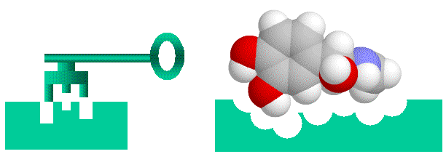
Endocrine System
General Mechanisms
https://www.home.mira.net

Slide 2
Note
Much of the text material is from, “Principles of Anatomy and Physiology” by Gerald J. Tortora and Bryan Derrickson (2009, 2011, and 2014). I don’t claim authorship. Other sources are noted when they are used.
The lecture slides are mapped to the three editions of the textbook based on the color-coded key below.
14th edition
13th edition
12th edition
Same figure or table reference in all three editions

Slide 3
Outline
Overview
Feedback concepts
Mechanisms of hormone action

Slide 4
Overview

Slide 5
Regulation
The nervous system and endocrine system regulate many functions of the body.
The nervous system acts via graded potentials, action potentials, and neurotransmitters.
The endocrine system regulates body activities by releasing chemical mediators known as hormones.
The nervous system controls many aspects of the endocrine system.
Endocrinology = structure and function of the endocrine glands; the medical specialty for the diagnosis and treatment of disorders of the endocrine system.
Page 616
Page 681
Page 643

Slide 6
What Is a Hormone?
A hormone is a molecule secreted from cells to regulate the activi-ties (usually) of other cells.
Hormones, as with neurotransmitters, exert their effects by binding to receptors either on the plasma membrane or within target cells.
A few types of molecules, such as norepinephrine, are both neuro-transmitters and hormones.
Page 616
Page 681
Page 643

Slide 7
Endocrine versus Nervous System Responses
The responses of the endocrine system are usually slower than those of the nervous system.
Some hormones act within seconds, but most take several minutes or longer to elicit (trigger) responses.
The response times of the nervous system are usually briefer than for the endocrine system.
The nervous system acts on muscles and glands, while the endocrine system, depending on the hormone, can regulate many different cells of the body.
Page 616
Page 681
Page 643
Table 18.1

Slide 8
Exocrine Glands
The body has two types of glands—exocrine glands and endocrine glands.
Exocrine glands release their products into ducts that carry them into body cavities, such as the digestive tract, or directly outside the body.
They include digestive, mucous, sudoriferous (sweat), and sebaceous glands.
Page 616
Page 681
Page 643

Slide 9
Endocrine Glands
Endocrine glands secrete hormones into the interstitial fluid surround-ing their secretory cells.
Most hormones diffuse into blood capillaries where they can be carried to target cells throughout the body.
The circulating levels of hormones are usually very low since most are needed in small amounts to exert their physiological actions.
Interstitial fluid = the extracellular fluid that fills the microscopic spaces between cells.
Page 616
Page 681
Page 643

Slide 10
Organs and Tissues of the Endocrine System
The endocrine system includes the anterior and posterior pituitary, thyroid, parathyroid, adrenal, and pineal glands.
Some tissues are not classified as endocrine glands, although they have cells that secrete hormones.
They include the hypothalamus, thymus, pancreas, ovaries, testes, kidneys, stomach, liver, small intestine, skin, heart, adipose tissue, and placenta.
Endocrine glands and other hormone-secreting cells are collectively known as the endocrine system.
Page 616
Page 681
Page 643
Figure 18.1

Slide 11
Feedback Concepts

Slide 12
Negative Feedback Pathway
Controller
-
Effector
Controller = room thermostat
Effector = room heater
Negative feedback pathways are very common in the biological sciences including in the control of the endocrine system.

Slide 13
An Example—Thyroid Hormones (T₃ and T₄)
Hypothalamus
Hypophyseal
portal system
TRH
-
Anterior
pituitary
T₃ and T₄
General
blood circulation
TSH
TRH = thyroid releasing hormone
TSH = thyroid stimulating hormone
T₃ and T₄ = thyroid hormones
Thyroid gland
There is no need to learn the details of this feedback loop at this time since it will be covered in the next lecture module.
13
Notes:
13

Slide 14
Positive Feedback Pathway
Controller
+
Effector
Positive feedback pathways are unusual in the biological and physical sciences.
However, the production of antibody clones by the immune system in response to an antigen (such as a virus or bacterium) is a notable example of a positive feedback system.

Slide 15
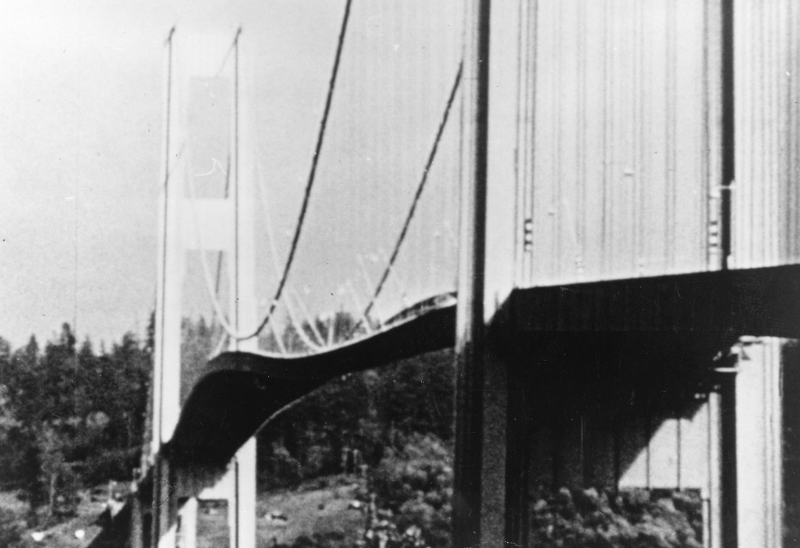
Galloping Gertie
An example of positive feedback known as oscillatory amplification—the Tacoma Narrows Bridge in Puget Sound, Washington just prior to its collapse on November 7, 1940.
Perhaps you have seen the film of the bridge collapse on the History Channel or the Discovery Channel.

Slide 16
Mechanisms of Hormone Action

Slide 17
Hormone Receptors
Although many hormones circulate in the blood, they only affect specific target cells.
A hormone exerts its actions by binding to hormone receptors of protein molecules that recognize it molecular shape (think about the “lock and key” analogy).
Thyroid-stimulating hormone (TSH) secreted by the anterior pitui-tary binds to TSH receptors on certain types of cells in the thyroid gland.
TSH does not bind to cells in the ovaries (among other tissues) because they do not have TSH receptors that would recognize the hormone.
Target cell = a cell that binds to and responds to a specific hormone.
Page 617
Page 683
Page 645

Slide 18
Hormone Receptors (continued)
A target cell typically contains 2,000 to 10,000 receptors for a specific hormone.
These receptors, like other cellular proteins, are continually being syn-thesized and broken-down in cells.
Page 618
Page 683
Page 645

Slide 19
Receptor Down-Regulation and Up-Regulation
If a hormone is present in an excessive amount, the number of hor-mone receptors can decrease in target cells—the response is called down-regulation.
Down-regulation decreases the sensitivity of the target cells to the hormone.
If a hormone is present in an insufficient amount, the number of receptors can increase in target cells—the response is called up- regulation.
Up-regulation increases the sensitivity of target cells to the hormone.
Page 618
Page 683
Page 645

Slide 20
Circulating and Local Hormones
Most hormones are in blood circulation—they diffuse from secretory cells of endocrine glands and tissues into the interstitial fluid and then into the blood through the capillary walls.
In comparison, local hormones act on neighboring cells, or on the same cell that secreted them, without entering the blood circulation.
Local hormones that act on neighboring cells are called paracrines, and those that act on the same cell that secreted them are known as autocrines.
Page 618
Page 683
Page 645
Figure 18.2

Slide 21
Nitric Oxide
Nitric oxide (NO) is a local hormone released by endothelial cells that line blood vessels—most notably, the arterioles that supply capillary networks (to be covered in the lecture module on blood vessels).
NO produces relaxation of smooth muscle fibers in the blood vessel walls, which results in vasodilation (enlargement of the lumen) that can lower blood pressure.
NO also dilates the blood vessels in the penis for blood engorgement and erection during sexual arousal.
Lumen = the cavity within a tubular structure (such as a blood vessel).
Page 618
Page 683
Page 645

Slide 22
Hormone Inactivation
Local hormones are usually quickly inactivated, while circulating hormones may exert their effects for a few minutes up to a few hours.
Circulating hormones are eventually inactivated by the liver and excreted by the kidneys.
With either liver or kidney failure, hormone levels can increase to excessive levels.
The high hormone levels are detectable in a urinalysis (to be dis-cussed in the lecture module on renal physiology).
Page 618
Page 683
Page 645

Slide 23
Chemical Classes of Hormones
Hormones are divided into two biochemical classes: 1) water-soluble and 2) lipid-soluble.
The hormones in these two classes exert their effects differently, as we will discuss.
Page 619
Page 684
Page 646

Slide 24
Water-Soluble Hormones
Amine hormones are synthesized by removing a CO₂ molecule from certain amino acids (along with other biochemical modifications).
They include the catecholamines—epinephrine, norepinephrine, and dopamine—along with histamine, serotonin, and melatonin.
Peptide hormones consist of short chains of three to 49 amino acids.
They include antidiuretic hormone (ADH) and oxytocin secreted by the posterior pituitary.
All are water-soluble and can be transported in blood plasma that is mostly water.
Page 619
Page 684
Page 646

Slide 25
Water-Soluble Hormones (continued)
Protein hormones are longer chains of about 50 to 100 amino acids.
They include human growth hormone (hGH) and insulin.
Eicosanoid hormones are derived from a 20-carbon fatty acid (called arachidonic acid).
They include prostaglandins and leukotrienes that have local effects.
These are also water-soluble and can be transported in blood plasma of mostly water.
Page 619
Page 684
Page 646

Slide 26
Lipid-Soluble Hormones
Steroid hormones are derived from cholesterol—the different chemical groups attached to their four-ring structure allow for different actions of different steroids.
Steroids included androgens, estrogens, glucocorticoids, and mineral-corticoids—all are lipid soluble.
The thyroid hormones T₃ and T₄ are also lipid-soluble.
Nitric oxide is also a lipid-soluble local hormone (and a neurotransmitter).
Page 619
Page 684
Page 646

Slide 27
Transport of Lipid-Soluble Hormones
Water-soluble hormones circulate in blood plasma in free form (not attached to other molecules).
Lipid-soluble hormones, due to their low solubility in water since they are hydrophobic, must bind to transport proteins synthesized in the liver.
The functions of transport proteins are to:
  Increase the solubility of lipid-soluble hormones in blood plasma.
  Provide a reserve of the hormone in blood circulation.
  Reduce the passage of small molecule hormones (such as ste-roids) through the filtration mechanism of the kidneys to slow their rate of loss from the body.
Page 619
Page 684
Page 646

Slide 28
Free Fraction
About 0.1 to 10 percent of a lipid-soluble hormone is not bound to a transport protein.
The free fraction passively diffuses out of the capillaries, binds to receptors inside cells, and triggers cellular actions.
The transport proteins release more of the lipid-soluble hormone to replenish the free fraction.
Page 619
Page 684
Page 646

Slide 29
Physiological Responses of Hormones
The physiological responses of a hormone depend on the hormone and target cells.
Different target cells can respond differently to the same hormone.
Insulin stimulates synthesis of glycogen in liver cells (this is how the body stores glucose), but the synthesis of triglycerides (a type of fat molecule) in adipose cells.
Page 619
Page 684
Page 646

Slide 30
Physiological Responses of Hormones (continued)
A target cell’s response to a hormone can involve the synthesis of new molecules by the cell’s organelles.
Other effects of hormones can include:
  Changing the permeability characteristics of the plasma mem-brane of target cells.
  Stimulating active transport into or out of target cells.
  Altering the rate of metabolic reactions in target cells.
  Affecting the contractions of cardiac and smooth muscle.
The effects vary because a hormone can elicit different physiological responses in different target cells.
Elicit = trigger a response.
Page 619
Page 684
Page 646

Slide 31
Receptor Locations
A hormone must bind to cellular receptors to exert its physiological actions.
Receptors for lipid-soluble hormones are located inside target cells.
Receptors for water-soluble hormones are found on the plasma mem-brane of target cells.
Page 620
Page 685
Page 647

Slide 32
Physiological Actions of Lipid-Soluble Hormones
Lipid-soluble hormones passively diffuse across the walls of capillaries, into the interstitial fluid, and then through the phospholipid bilayer of the plasma membrane of a cell.
The hormone binds to and activates receptors within the cytoplasm or nucleus of a target cell.
The activated hormone-receptor complex turns on-or-off certain genes in the cell nucleus for gene expression—that is, genotype to phenotype.
Page 620
Page 686
Page 648
Figure 18.3

Slide 33
Physiological Actions of Lipid-Soluble Hormones (continued)
In the transcription process for gene expression, mRNA is formed using a strand of DNA as the template.
The mRNA exits the cell nucleus.
In the translation process, mRNA provides directions for the synthesis of a new protein on the ribosomes (the new proteins are often enzymes for metabolic actions of the cell).
Page 621
Page 686
Page 648
Figure 18.3

Slide 34
Physiological Actions of Water-Soluble Hormones
Water-soluble hormones cannot diffuse across the phospholipid bi-layer of a plasma membrane due to the plasma membrane’s hydro-phobic properties.
The hormone binds to protein receptors on the plasma membrane of a target cell.
A water-soluble hormone serves as the first messenger when it binds to the receptors.
Page 621
Page 686
Page 648
Figure 18.4

Slide 35
Physiological Actions of Water-Soluble Hormones (continued)
The first messenger stimulates production of a second messenger inside the cell, most often a molecule known as cyclic AMP (cAMP).
Biochemical reactions occur in the cell to produce phosphorylated (energized) molecules that elicit the physiological responses of the hormone.
The enzyme phosphodiesterase inactivates cAMP after a brief pe-riod of time.
Inactivation turns-off the cellular response unless the water-soluble hormone continues to bind to receptors on the plasma membrane.
Page 621
Page 686
Page 648
Figure 18.4

Slide 36
Cascading Reactions
Water-soluble hormones can elicit effects at low concentrations because they initiate a series of cascading biochemical reactions in the cell.
Each step in the cascade amplifies the physiological effects of the hormone.
For example, ther binding of just one molecule of epinephrine to a receptor on the plasma membrane results in the hydrolysis of many millions of glycogen molecules into glucose molecules (single sug-ars).
Hydrolysis = the chemical breakdown of a compound due to its reaction with water.
Page 622
Page 687
Page 649

Slide 37
Hormone Responses and Influences
The response of a target cell to a specific hormone depends on three factors:
  Concentration of the hormone.
  Abundance of target cell receptors.
  Influences exerted by other hormones.
Influences exerted by other hormones can be permissive, syner-gistic, or antagonistic.
Page 622
Page 687
Page 649

Slide 38
Permissive Effects
The actions of some hormones require a simultaneous or recent exposure to a second hormone.
The second hormone is said to exert a permissive effect on the first hormone.
For example, epinephrine alone weakly stimulates the breakdown of triglycerides but when thyroid hormones (T₃ and T₄) are present, it stimulates the breakdown much more strongly.
The breakdown of chemical (covalent) bonds in triglycerides is called lipolysis.
Page 622
Page 687
Page 649

Slide 39
Permissive Effects (continued)
Permissive hormones increase the number of cell receptors available for binding the primary hormone (which is the case for epinephrine and T₃ and T₄).
Permissive hormones also promote synthesis of enzymes in target cells to help elicit (trigger) the primary hormone’s effects.
Page 622
Page 687
Page 649

Slide 40
Synergistic Effects
Two hormones have a synergistic effect when their effects acting together are greater than when either of the hormones acts alone.
For example, development of eggs (oocytes) in the ovaries requires follicle-stimulating hormone (FSH) from the anterior pituitary and es-trogens from the ovaries.
None of there hormones alone is sufficient to produce the intended physiological actions of egg development.
Page 622
Page 687
Page 649

Slide 41
Antagonistic Effects
Two hormones have antagonistic effects when one hormone opposes the action of the other hormone.
For example, insulin and glucagon synthesized in the pancreas are antagonistic in their effects on blood glucose level.
Glycogen is a complex molecule made-up of many glucose molecules (glycogen is how the body stores glucose, which is used for ATP pro-duction).
Insulin promotes the synthesis of glycogen in the liver, lowering blood glucose level.
Glucagon stimulates the breakdown of glycogen in the liver, increasing blood glucose level.
Page 622
Page 687
Page 649

Slide 42
Secretory Control of Hormones
Secretion of most hormones occurs in short bursts, with little or no release occurring during the time in-between bursts.
When stimulated, an endocrine gland secretes its hormone in more frequent bursts.
This form of secretory control normally prevents excessive release of hormones.
Page 622
Page 688
Page 650

Slide 43
Secretory Control of Hormones (continued)
Hormone secretions are regulated or controlled by the nervous sys-tem, other hormones, and chemical changes.
As examples:
  The sympathetic division of the autonomic nervous system stimulates the adrenal medulla to secrete epinephrine and norepinephrine.
  Adrenocorticotropic hormone (ACTH) from the anterior pituitary stimulates the secretion of cortisol, a steroid, from the adrenal cortex.
  Blood calcium (Ca²⁺) level regulates the secretion of parathyroid hormone (PTH) from the parathyroid glands.
Page 623
Page 688
Page 650

