Slide 1
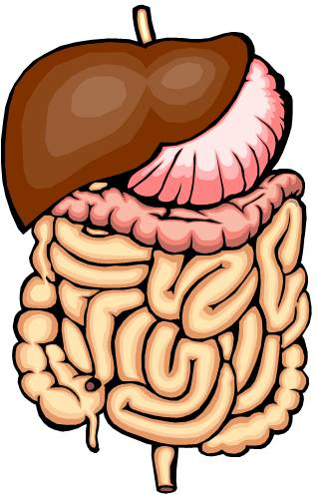
Digestive System
https://www.madras.com

Slide 2
Note
Much of the text material is from, “Principles of Anatomy and Physiology” by Gerald J. Tortora and Bryan Derrickson (2009, 2011, and 2014). I don’t claim authorship. Other sources are noted when they are used.
The lecture slides are mapped to the three editions of the textbook based on the color-coded key below.
14th edition
13th edition
12th edition
Same figure or table reference in all three editions

Slide 3
Outline
Introduction
Overview
Tissue layers
Nervous system control
Upper gastrointestinal tract
Lower gastrointestinal tract
Phases of digestion
Aging

Slide 4
Introduction

Slide 5
Food and Digestion
Food supplies nutrients for metabolism, tissue growth, and repair of damaged tissues.
Food is the only source of chemical energy that can be used by our bodies.
Most of the food we eat consists of molecules—such as proteins, lipids, and complex sugars—that are too large to be used by cells.
Most foods is broken-down into smaller molecules by digestive pro-cesses so that it can be absorbed.
Page 886
Page 967
Page 921

Slide 6
Food and Digestion (continued)
The organs involved in the digestion and absorption of food are known as the digestive system.
The digestive system is a tubular structure that extends from the mouth to the anus.
Its close working relationship with the cardiovascular system assures the availability of chemical energy to meet the body’s metabolic needs.
Page 886
Page 967
Page 921

Slide 7
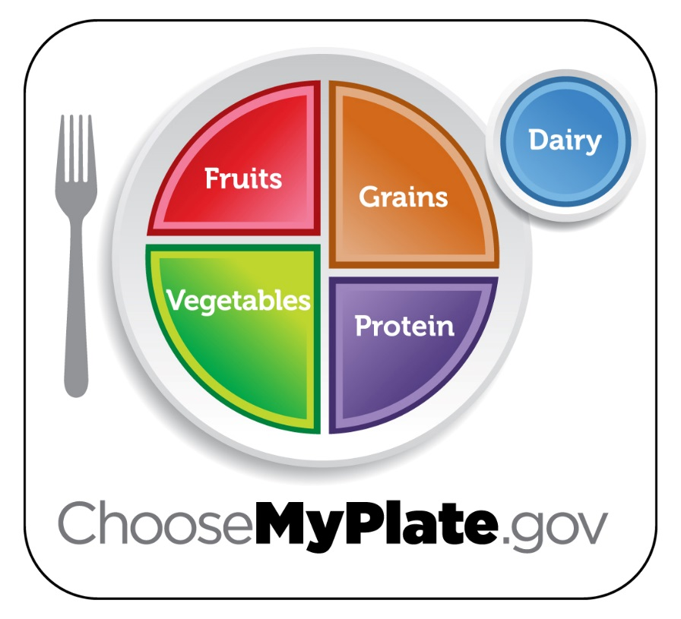
Dietary Guidelines
See the U.S. Department of Agriculture website, https://www.choosemyplate.gov.
Tap of click here for the Nutrition Source website, Harvard University School of Public Health.

Slide 8
Definitions
The medical specialty for the diagnosis and treatment of diseases of the esophagus, stomach, and intestines is known as gastroen-terology.
The medical specialty for the rectum and anus is called proctology.
Page 886
Page 967
Page 921

Slide 9
Overview

Slide 10
Gastrointestinal Tract
The digestive system consists of the gastrointestinal (GI) tract and accessory digestive organs.
The GI tract is also known as the alimentary canal, a term we won’t use in this lecture module.
It includes the mouth, most of the pharynx (throat), esophagus, stom-ach, small intestine, and large intestine.
The end-to-end length of the GI tract is about five to seven meters in a living person.
Page 887
Page 968
Page 922
Figure 24.1

Slide 11
Accessory Digestive Organs
The accessory organs include teeth, tongue, salivary glands, liver, gall bladder, and pancreas.
Teeth support the mechanical breakdown of food by chewing, while the tongue assists in chewing and swallowing.
None of the other accessory organs come into direct contact with food.
The liver, gall bladder, and pancreas produce or store secretions to enable the chemical breakdown of food.
Page 887
Page 968
Page 922
Figure 24.1

Slide 12
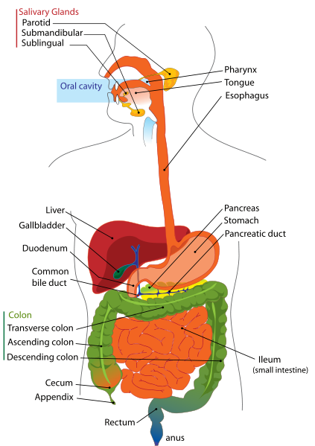
Digestive System
https://www.pediatricfeeding.org

Slide 13
Roles of Muscles
Smooth muscle contractions in the wall of the GI tract mechanically breakdown food by churning and propelling it along its hollow struc-ture (lumen).
The muscle contractions also help dissolve foods by mixing them with fluids secreted into the GI tract that chemically breakdown food molecules.
The contractions consist of segmentations and peristalsis, which we will discuss later in this lecture module.
Page 887
Page 968
Page 922

Slide 14
Basic Functions
The six basic functions of the digestive system are:
  Ingestion
  Secretion
  Mixing and propulsion
  Mechanical and chemical digestion
  Absorption
  Defecation
Page 887
Page 968
Page 923

Slide 15
Basic Functions (continued)
Ingestion involves eating and drinking to take foods and liquids into the mouth.
Secretion involves the release of water, acids, buffers, and enzymes into the lumen of the GI tract.
Mixing and propulsion of food in the GI tract is accomplished by the alternating contraction and relaxation of smooth muscle in the walls of the GI tract.
Page 887
Page 968
Page 923

Slide 16
Basic Functions (continued)
Mechanical and chemical digestion break food into smaller molecules to aid in their absorption.
Absorption involves the passage of small molecules into the epithelial cells lining portions of the GI tract, and especially in the small intestine.
  The molecules pass into blood or lymph and circulate to the liver and cells throughout the body.
  A few substances can be absorbed without chemical digestion— these include some vitamins, ions, cholesterol, and water.
Page 888
Page 968
Page 923

Slide 17
Basic Functions (continued)
Defecation is the elimination of materials from the digestive tract by the anus.
  The materials include waste products, indigestible substances, undigested food, bacteria, and cells from the inner lining of the GI tract.
  The eliminated materials are known as feces.
Page 887
Page 969
Page 923

Slide 18
Tissue Layers

Slide 19
Tissue Layers
The wall of the GI tract, from the esophagus to the anal canal, has four layers of tissues.
Starting with the lumen to the outer surface of the GI tract, the tissues are the mucosa, submucosa, muscularis, and serosa.
Lumen = the central cavity of a tubular or other hollow structure.
Page 888
Page 969
Page 924
Figure 24.2

Slide 20
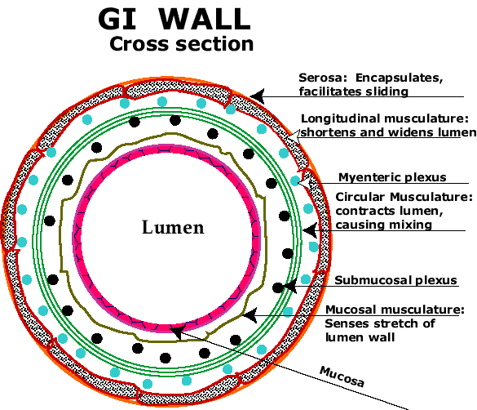
Tissue Layers (continued)
https://www.med.howard.edu

Slide 21
Skeletal Muscle
The muscularis of the mouth, pharynx, and upper parts of the eso-phagus consists of skeletal muscle to enable voluntary swallowing.
Skeletal muscle also forms the external anal sphincter for voluntary control of defecation.
Page 889
Page 970
Page 925

Slide 22
Smooth Muscle
The muscularis is made up of smooth muscle in the other parts of the GI tract.
Smooth muscle is typically organized into two layers: 1) an inner layer of circular fibers and 2) an outer layer of longitudinal fibers.
Involuntary contractions of the smooth muscle mechanically break-down food, mix it with digestive secretions, and propel it along the GI tract.
Between the two muscle layers is an intricate network of neurons known as the myenteric plexus, which is part of the enteric nervous system.
Page 889
Page 970
Page 925

Slide 23
Nervous System Control

Slide 24
Neural Innervation
The digestive system is controlled by the enteric nervous system (ENS) and the autonomic nervous system (ANS).
The ENS has about 100 million neurons extending from the esoph-agus to the anus.
While the neurons of the ENS can function independently, they are also regulated by the parasympathetic and sympathetic divisions of the ANS.
Page 889
Page 971
Page 925

Slide 25
Enteric Nervous System
The ENS consists of the myenteric plexus and submucosal plexus.
Plexuses are complex networks of sensory neurons, interneurons, and motor neurons.
The myenteric plexus regulates the motility of the GI tract by the control of circular and longitudinal smooth muscles in the walls of the tract.
Motility = motion or movement.
Page 889
Page 971
Page 925
Figure 24.3

Slide 26
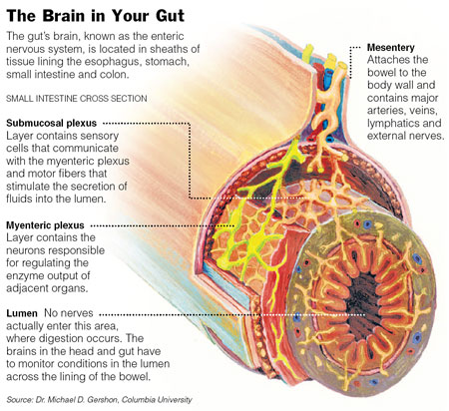
Enteric Nervous System (continued)
https://www.nutrition.mattters.com

Slide 27
Enteric Nervous System (continued)
The submucosal plexus controls the accessory organs of the GI tract to regulate their secretions.
Interneurons within the ENS interconnect the two plexuses to enable coordinated control of their functions.
Sensory neurons are located in the mucosal epithelium (inner lining) of the GI tract.
Page 889
Page 971
Page 925
Figure 24.3

Slide 28
Parasympathetic Influence
The vagus nerve (X) supplies parasympathetic fibers to much of the GI tract.
The lower half of the large intestine, however, is innervated by para-sympathetic fibers originating in the sacral section of the spinal cord.
Parasympathetic activity increases gastric motility and secretions by increasing the activity of neurons in the myenteric and submuscosal plexuses.
Page 890
Page 971
Page 925

Slide 29
Sympathetic Influence
Sympathetic fibers act on the ENS through the thoracic and lumbar segments of the spinal cord.
Sympathetic activity decreases gastric motility and secretions by inhibiting the activity of the two plexuses.
Physical activity and emotions such as anger, fear, and anxiety can slow the digestive process.
Page 890
Page 971
Page 925
Figure 24.3

Slide 30
Upper Gastrointestinal Tract

Slide 31
Mouth
The mouth is also called the oral cavity or buccal cavity (we will use mouth).
Structural details, including of the teeth and tongue, can be found in the textbook.
The teeth aid in mechanical digestion or mastication, and the tongue in swallowing or deglutition.
In this section, we focus primarily on the role of the salivary glands of the mouth.
Page 893
Page 974
Page 928
Figure 24.5

Slide 32
Salivary Glands
The mucous membrane of the mouth and tongue has salivary glands that open directly or indirectly via short ducts into the mouth.
Salivary glands secrete a fluid known as saliva.
A sufficient amount of saliva is usually secreted to keep the mucous membranes of the mouth and pharynx (throat) moist and to cleanse the mouth and teeth.
Salivary secretions increase just before or as food enters the mouth to lubricate, dissolve, and begin its chemical breakdown by the diges-tive system.
Page 894
Page 974
Page 929
Figure 24.6

Slide 33
Saliva
Saliva consists of about 99.5 percent water and 0.5 percent solutes.
The solutes—in ionic form—include sodium, potassium, chloride, bicar-bonate, and phosphate.
Mucus, urea and uric acid, immunoglobulin A, bacterial enzymes, and salivary amylase are usually found in saliva.
Not all salivary glands secrete the same composition and percentages of solutes.
Salivary amylase = an enzyme that breaks-down starch molecules.
Page 894
Page 975
Page 930

Slide 34
Saliva (continued)
The water in saliva provides a medium for dissolving foods so that:
  Food can be tasted via gustatory receptors in the tongue.
  Chemical digestion can begin.
The solutes in saliva, especially bicarbonate and phosphate ions, serve as a buffer for acidic foods.
Salivary amylase, an enzyme, is activated by the chloride ions in saliva.
Gustatory receptors = taste receptors in taste buds that interact with chemicals in food to produce action potentials that are transmitted to the brain.
Page 894
Page 975
Page 930

Slide 35
Saliva (continued)
Immunoglobulin A in saliva helps keep microbes in the external environ-ment from penetrating the mucous membrane.
Lysozyme, an enzyme in saliva, kills but does not completely eliminate bacteria in the mouth—in fact, about 100 species of bacteria live in our mouths.
Mucus in saliva lubricates food so it can be moved more easily, formed into a ball, and swallowed.
Page 894
Page 975
Page 930

Slide 36
Salivation
About 1.0 to 1.5 L of saliva is secreted each day, although the amount can vary depending on environmental and physiological conditions.
Saliva moistens the mouth, and when swallowed, helps moisten the esophagus.
Much of the saliva is eventually reabsorbed to reduce excessive fluid loss from the body.
When a person is dehydrated, the secretion of saliva slows or ceases, contributing to a conscious sensation of thirst.
Page 894
Page 976
Page 931

Slide 37
Neural Control
Salivation—the secretion of saliva—is controlled by the autonomic nervous system.
Parasympathetic activity produces a continuous secretion of mod-erate amounts of saliva.
Sympathetic activity decreases salivary secretion to produce a dry mouth, such as in fear or anxiety.
Page 894
Page 976
Page 931

Slide 38
Sensory and Cognitive Stimulation
The feel and taste of food stimulates salivary gland secretions by activating the gustatory receptors of the tongue.
Sensory nerve impulses are conveyed to the salivary nuclei in the brainstem.
Parasympathetic control is via cranial nerves VII and IX to stimu-late the secretion of saliva.
Even the smell, sight, or thought of food can also lead to its secre-tion.
Cranial nerve VII = facial
Cranial nerve IX = glossopharyngeal
Page 894
Page 976
Page 931

Slide 39
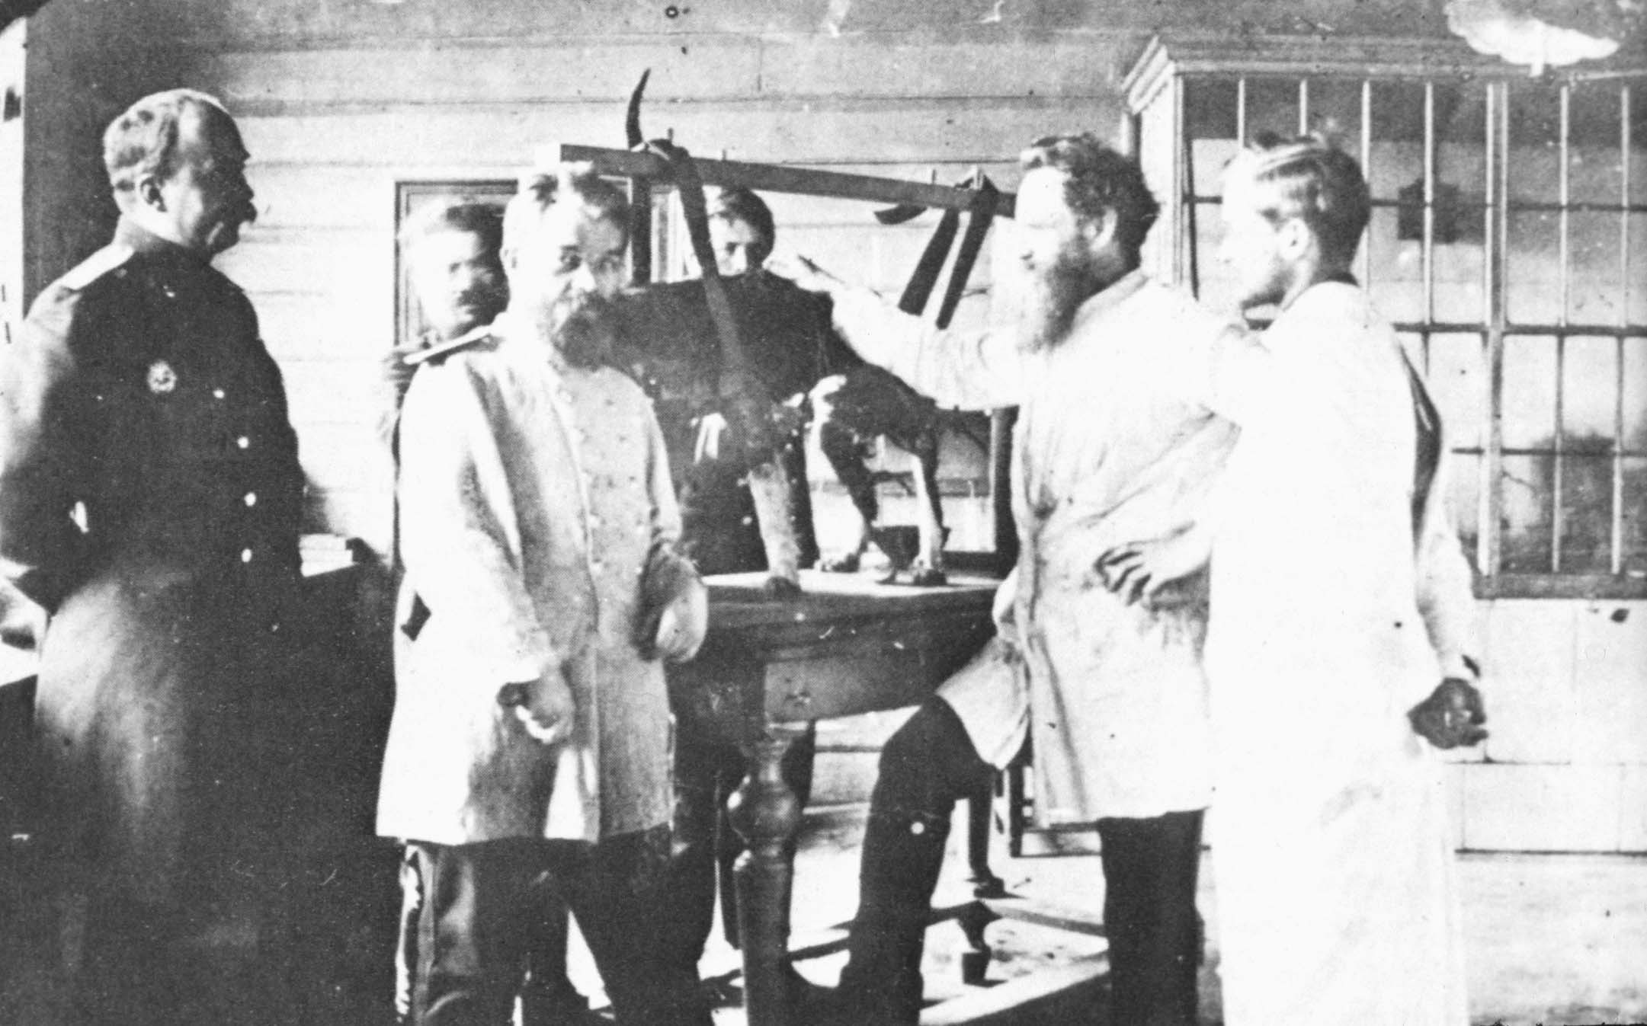
Ivan Pavlov and His Dogs
https://www.nournours.files.wordpress.com
Classical conditioning of the salivary response:
Unconditioned stimulus produces an unconditioned response.
Conditioned stimulus produces a conditioned response.

Slide 40
Digestion—Mouth
Mechanical digestion in the mouth involves chewing (mastication) in which the food is manipulated by the tongue, ground by the teeth, and mixed with saliva.
The food is reduced to a soft and flexible mass called a bolus.
Some foods (especially carbohydrates) begin to dissolve in the saliva due to the salivary enzymes.
Page 898
Page 978
Page 932
Table 24.1

Slide 41
Digestion—Mouth (continued)
The enzyme salivary amylase is secreted by certain exocrine glands in the mucosa of the mouth.
While most carbohydrates we eat are starches, only monosaccharides (single sugar molecules) can be absorbed into blood circulation through the wall of the small intestine
Salivary amylase starts the chemical digestion of starches into smaller molecules in the mouth.
The digestive process continues in the stomach and small intestine to form monosaccharides (in particular, fructose, glucose, galactose, and maltose).
Page 898
Page 978
Page 933
Table 24.1

Slide 42
Digestion—Mouth (continued)
Lingual lipase, an enzyme secreted by the lingual glands in the tongue, is activated in the acidic environment of the stomach.
The enzyme starts the process of the chemical digestion of triglycerides into diglycerides and fatty acids.
Triglyceride = three fatty acid chains covalently bonded to a glycerol molecule.
Diglyceride = two fatty acid chains covalently bonded to a glycerol molecule.
Fatty acid = an organic compound composed of a carbon chain with hydrogen atoms attached and an acid group at each end.
Page 898
Page 978
Page 933
Table 24.1

Slide 43
Pharynx
When food is swallowed, it passes from the mouth into the pharynx (throat).
The pharynx is lined by mucous membrane; it also contains skeletal muscle in its muscularis.
Muscle contractions of the pharynx propel the bolus of food into the esophagus.
Page 898
Page 980
Page 934
Table 24.2

Slide 44
Esophagus
The esophagus is a tube about 25 cm long located posterior to the trachea.
The esophagus:
  Begins at the inferior end of the laryngopharynx,
  Pierces the diaphragm through the esophageal hiatus, and
  Empties into the superior portion of the stomach.
The muscularis of the superior third is composed of skeletal muscle; the intermediate third of skeletal and smooth muscle; and the inferior third of smooth muscle.
Page 899
Page 980
Page 934
Figure 24.1

Slide 45
Esophagus (continued)
The esophagus secretes mucus to lubricate the bolus of food as it is propelled into the stomach.
It does not secrete digestive enzymes or have any absorption func-tions.
The upper esophageal sphincter, composed of skeletal muscle, reg-ulates movement of the bolus from the pharynx into the esophagus.
The lower esophageal sphincter, composed of smooth muscle, reg-ulates movement of the bolus from the esophagus into the stomach.
Page 899
Page 980
Page 934
Figure 24.1

Slide 46
Swallowing—Deglutition
The movement of a bolus into the stomach is initiated by swallowing (deglutition).
Swallowing is assisted by saliva and mucus and involves the mouth, pharynx, and upper esophageal sphincter.
Page 899
Page 981
Page 935
Figure 24.10

Slide 47
Swallowing (continued)
Swallowing has three phases:
  Voluntary phase in which the bolus is moved from the mouth to the pharynx,
  Pharyngeal phase, the involuntary passage of the bolus through the pharynx and into the esophagus, and
  Esophageal phase, the involuntary passage of the bolus through the esophagus into the stomach.
Page 900
Page 981
Page 935
Figure 24.10

Slide 48
Swallowing (continued)
The voluntary stage occurs when a bolus is forced to the back of the mouth and into the oropharynx by movements of the tongue against the palate.
In the pharyngeal stage, the bolus involuntarily passes from the pharynx into the esophagus.
The pharyngeal stage is controlled by the swallowing (deglutition) center in the medulla oblongata.
Oropharynx = the part of the throat that is at the back of the mouth, in contrast to the nasopharynx, the part of the throat that is behind the nose.
(https://www.medicinenet.com)
Page 900
Page 981
Page 936
Figure 24.10

Slide 49
Esophageal Phase
During the esophageal phase, persitaltic contractions involving the circular and longitudinal fibers of the smooth muscles push the bolus toward the stomach.
As the bolus approaches the inferior end of the esophagus, the lower esophageal sphincter relaxes, and the bolus enters the stomach.
The passage of solid or semi-solid food from the mouth to stomach takes four to five seconds, while soft foods and liquids take about one second.
Peristalsis = a series of wave-like muscle contractions that moves food to different processing stations in the digestive tract.
(https://www.medlineplus.gov)
Page 900
Page 981
Page 936
Figure 24.10

Slide 50
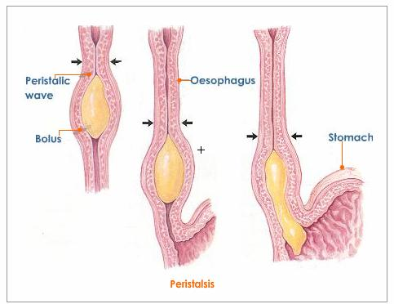
Peristalsis
https://www.tutorvista.com
Oesophagus = British spelling of esophagus.

Slide 51
Lower Gastrointestinal Tract

Slide 52
Stomach
The stomach is a J-shaped enlargement of the GI tract that connects the esophagus to the duodenum (first section of the small intestine).
The stomach is a storage reservoir and mixing area for the boluses of food.
Its role as a storage reservoir is important since food can be ingested much faster than it can be absorbed by the small intestine.
Page 901
Page 982
Page 937
Figure 24.11

Slide 53
Stomach (continued)
The position and size of the stomach changes continuously since the diaphragm pushes and pulls on the stomach with each inhalation and exhalation of air.
Although an empty stomach is about the size of a large sausage, it is distensible (stretches) so that it can accommodate a large quantity of food.
In the stomach:
  The semisolid bolus is converted to liquid.
  Digestion of starches continues that started in the mouth.
  Digestion of proteins and triglycerides begins.
  Some substances are absorbed.
Page 901
Page 982
Page 937

Slide 54
Structure
The stomach consists of the cardia, fundus, body, and pylorus.
  The cardia surrounds the superior opening of the stomach.
  The dome portion superior and to the left of the cardia is the fundus.
  Inferior to the fundus is the large central portion known as the body.
  The region that connects to the duodenum of the small intes-tine is the pylorus.
The pylorus is connected to the duodenum via the pyloric sphincter of smooth muscle.
Page 901
Page 982
Page 937
Figure 24.11

Slide 55
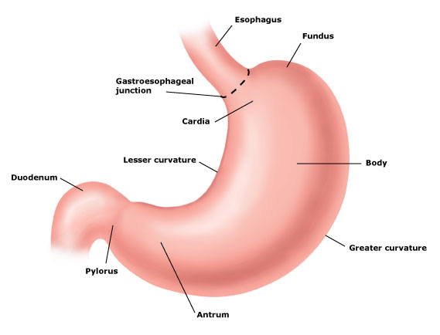
Structure (continued)
https://www.aboutcancer.com

Slide 56
Stomach Tissue
The stomach wall has the same basic tissue layers as the other parts of the GI tract, although it has three (instead of two layers) of smooth muscle fibers.
Gastric glands are embedded in the stomach wall—several open into a narrow channel known as a gastric pit.
Secretions from gastric glands flow into the gastric pits, and then into the lumen of the stomach.
Page 903
Page 984
Page 937
Figure 24.12

Slide 57
Gastric Glands
The gastric glands consist of three types of exocrine gland cells:
  Mucous cells that secrete mucus.
  Parietal cells that secrete H⁺ and Cl⁻, and intrinsic factor for the absorption of vitamin B₁₂.
  Chief cells that secrete pepsinogen and gastric lipase.
Their combined secretions produce 2.0 to 3.0 L of gastric juice per day.
Gastric glands in the pyloric antrum secrete the hormone, gastrin, into the blood—the hormone stimulates aspects of gastric activity.
Page 903
Page 984
Page 937
Figure 24.12

Slide 58
Mechanical Digestion
Mixing waves pass over the stomach every 15 to 25 seconds for several minutes after a bolus enters the stomach through the low-er esophageal sphincter.
The waves macerate the bolus, mix it with secretions from the gastric glands, and reduce it to a soupy liquid known as chyme.
The vigorous waves in the stomach body intensify as they reach the pylorus.
Few mixing waves occur in the fundus, which is the storage area for the boluses of food entering from the esophagus.
Macerate = to make soft by soaking or steeping in a liquid.
Page 904
Page 986
Page 939

Slide 59
Mechanical Digestion (continued)
The pyloric sphincter to the duodenum usually remains almost com-pletely closed.
When chyme reaches the pylorus, each mixing wave forces about 3.0 mL of the liquid through the pyloric sphincter—this process is called gastric emptying.
Most, but not all of the chyme is forced back into the stomach where the mixing actions continue.
Page 904
Page 986
Page 939

Slide 60
Mechanical Digestion (continued)
The next wave pushes the chyme forward again and forces a little bit more of the liquid into the duodenum.
The back-and-forth movement of chyme through the pyloric sphinc-ter helps to assure that it is thorough mixed in the stomach.
Page 904
Page 986
Page 939

Slide 61
Chemical Digestion
A bolus can remain in the fundus for as long as one hour before it is mixed with gastric juice.
Chemical digestion of carbohydrates by salivary amylase continues during this time.
The mechanical churning action eventually mixes the bolus with gas-tric juice of high acidity.
Page 905
Page 986
Page 941

Slide 62
Chemical Digestion (continued)
The exposure of the bolus to the stomach’s acidity inactivates sali-vary amylase and activates lingual lipase—recall both are secreted by exocrine glands in the mouth.
Activation of lingual lipase starts the chemical digestion of triglycer-ides into diglycerides and fatty acids in the stomach.
Page 905
Page 986
Page 941
62
Notes:
62

Slide 63
Hydrochloric Acid
Parietal cells secrete hydrogen (H⁺) ions, via proton pumps, and chloride (CL⁻) ions, via passive diffusion, into the stomach’s lumen.
Hydrochloric acid (HCl) is formed from ionic bonding of these secre-tions—if HCl were to be secreted directly, it would destroy the tissues of the stomach wall.
Proton pump = an integral membrane protein that is capable of moving protons (such as H⁺ ions) across a cell membrane, mitochondrion, or other organelle.
(https://www.wikipedia.org)
Page 905
Page 986
Page 941
Figure 24.13

Slide 64
Hydrochloric Acid (continued)
HCl production is stimulated by acetylcholine from parasympathetic neurons, gastrin from G cells, and histamine from the lamina propia tissue layer of the stomach.
HCl denatures proteins and stimulates the flow of bile and pancreatic juices.
The acidic environment due to HCl also kills many (but not all) of the microbes in the stomach.
Lamina propia = a layer or connective tissue residing under the epithelium of a mucous membrane.
Denature = unfolding; a process pertaining to a change in structure of a protein from a regular to an irregular arrangement of the polypeptide chains.
Page 905
Page 986
Page 941

Slide 65
Pepsin
Pepsinogen is secreted by the chief cells in the wall of the stomach.
Pepsinogen is converted into an active form, pepsin, when it comes in contact with HCl in the lumen of the stomach.
This proteolytic enzyme severs the peptide bonds between amino acids to break-down protein chains into many smaller peptide frag-ments.
Pepsin is most effective in the highly-acidic environment of the stom-ach (pH ~ 2.0), and it becomes less active and then inactive at higher pH values.
Proteolytic = protein-digesting.
Page 905
Page 987
Page 941

Slide 66
Pepsin (continued)
Pepsin does not digest the proteins in the stomach tissue because it is secreted from the chief cells in an inactive form called pepsin-ogen.
Pepsinogen is converted to pepsin when it comes in contact with the acidic HCl in the lumen of the stomach.
A one to three mm thick layer of alkaline mucus lining the stomach wall secreted by mucus cells protects the stomach tissue from gas-tric juices including HCl and pepsin.
Page 905
Page 987
Page 941

Slide 67
Gastric Lipase
Gastric lipase is an enzyme that splits short-chained triglycerides (which are found in dairy products) into monoglycerides and fatty acids.
A monoglyceride is a single fatty acid chain covalently bonded to a glycerol molecule.
This enzyme, which has a limited role in the stomachs of adults, is most effective at a pH of 5.0 to 6.0.
Table 24.3 gives a summary of the digestive activities of the stomach.
Page 906
Page 987
Page 941
Table 24.3

Slide 68
Absorption
Very few nutrients are absorbed through the stomach wall since its epithelial cells are impermeable to most substances.
Mucous cells, however, can absorb small amounts of water, ions, short-chain fatty acids, some drugs (such as aspirin), and alcohol.
Alcohol can rapidly enter blood circulation and affect brain functions.
Page 906
Page 987
Page 941

Slide 69
Emptying Time
The contents of the stomach completely empty into the duodenum and small intestine within two to three hours of eating.
Carbohydrates are quickest to exit the stomach, followed by proteins and then triglycerides.
Page 906
Page 987
Page 941

Slide 70
Pancreas
Chemical digestion in the small intestine involves secretions from the pancreas, liver, and gall bladder.
The pancreas is a retroperitoneal organ located posterior to the great curvature of the stomach.
It consists of a head located near the curve of the duodenum, a body, and a tapering tail.
Retroperitoneal = external to or posterior to the peritoneum.
Peritoneum = the serous membrane lining of the abdominal and pelvic walls.
Page 906
Page 988
Page 942
Figure 24.15
Figure 24.14
Figure 24.14

Slide 71
Pancreas (continued)
Pancreatic juices are secreted by the pancreas into ducts.
The ducts form two large channels called the pancreatic duct and accessory duct that allow pancreatic secretions to be released into the duodenum and small intestine.
The pancreatic duct joins the common bile duct from the liver and gallbladder to form the hepatopancreatic ampulla that empties into the duodenum.
Ampulla = a dilated (enlarged) portion of a canal or duct.
Hepato- = pertaining to the liver.
Page 906
Page 988
Page 942
Figure 24.15
Figure 24.14
Figure 24.14

Slide 72
Pancreas (continued)
The accessory duct leads from the pancreas and empties into the duodenum.
The passage of pancreatic juice and bile into the duodenum and small intestine is regulated by smooth muscle called the sphincter of the hepatopancreatic ampulla.
Page 907
Page 988
Page 942
Figure 24.15
Figure 24.14
Figure 24.14

Slide 73
Pancreatic Cells
The pancreas has many small clusters of glandular epithelial cells known as acini.
About 99 percent of the acini are the exocrine part of the pancreas—they release a mixture of fluid and digestive enzymes known as pan-creatic juice.
The remaining one percent of clusters, the pancreatic islets, are the endocrine portion of the pancreas.
These cells secrete the hormones glucagon, insulin, somatostatin, and pancreatic polypeptide, as was discussed in the lecture on the endocrine system.
Page 907
Page 988
Page 944

Slide 74
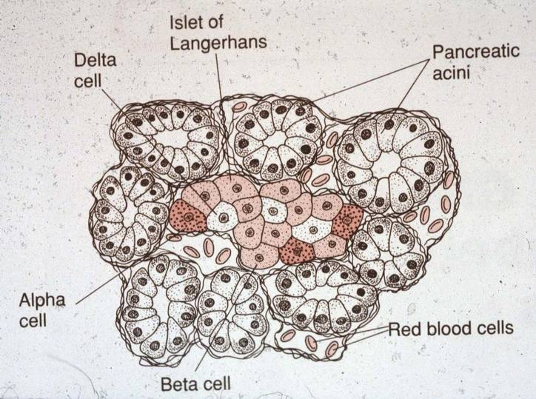
Pancreatic Cells (continued)
https://www.mc.vanderbilt.edu

Slide 75
Pancreatic Juice
The pancreas secretes 1.0 to 1.5 L of pancreatic juice per day into the duodenum.
The clear, colorless liquid consists of water and salts, sodium bicar-bonate, and several enzymes.
Sodium bicarbonate makes the pancreatic juice slightly alkaline (pH 7.1 to 8.2) to buffer the gastric acid juice in chyme.
The alkalinity inhibits the action of pepsin and creates the proper pH for pancreatic and other digestive juices in the small intestine to exert their chemical actions.
Buffer = ionic compound that resists changes in its pH.
Page 907
Page 988
Page 944

Slide 76
Pancreatic Juice (continued)
The enzymes in pancreatic juice include:
  Pancreatic amylase, a starch-digesting enzyme.
  Trypsin and other protein-digesting enzymes.
  Pancreatic lipase, a triglyceride-digesting enzyme in adults.
  Ribonuclease and deoxyribonuclease to digest nucleic acids.
Protein-digesting enzymes are synthesized and secreted in inac-tive forms so that they cannot digest the cells of the pancreas.
These enzymes of the pancreas are activated by other enzymes in the lumen of the small intestine.
Page 907
Page 988
Page 944

Slide 77
Liver and Gallbladder
The liver weighs about 1.4 kg in an average-sized adult.
The liver is located inferior to the diaphragm in the abdominal pelvic cavity.
The gall bladder is a pear-shaped sac located in a depression on the posterior surface of the liver.
Page 909
Page 990
Page 945
Figure 24.15
Figure 24.15
Figure 24.14

Slide 78
Hepatocytes
The liver has hepatocytes, hepatic sinusoids, and hepatic ducts.
Hepatocytes are cells that have a wide range of metabolic, sec-retory, and endocrine functions.
These cells represent about 80 percent of the mass of the liver.
The many functions of hepatocytes will be covered in later slides.
Hepato- = refers to the liver.
Page 909
Page 991
Page 945
Figure 24.16
Figure 24.16
Figure 24.15

Slide 79
Hepatic Sinusoids
Hepatic sinusoids are highly-permeable capillaries found among the hepatocytes.
They receive oxygenated blood from branches of the hepatic artery.
They also receive nutrient-rich, deoxygenated blood from branches of the hepatic portal vein.
Page 909
Page 991
Page 945
Figure 24.16
Figure 24.16
Figure 24.15

Slide 80
Blood Supply
Branches of the hepatic artery and hepatic portal vein carry blood into the hepatic sinusoids.
Oxygen, nutrients, and some toxic substances are taken-up by the hepatocytes.
The products synthesized by the hepatocytes, which are needed by other tissues, are secreted into the blood.
The blood drains into the central vein and then into the hepatic vein.
Page 912
Page 993
Page 948
Figure 24.17
Figure 24.7
Figure 24.16

Slide 81
Fixed Phagocytes
Fixed phagocytes in the hepatic sinusoids, called satellite reticulo-endothelial cells, engulf and destroy:
  Damaged and worn-out red blood cells and white blood cells.
  Bacteria.
  Other foreign matter in the venous blood draining from the GI tract.
Page 909
Page 991
Page 945

Slide 82
Ducts
The bile canaliculi are small ducts found among the hepatocytes to collect bile.
Bile passes into bile ductules and then into the bile ducts, which merge to form the left and right hepatic ducts.
The left and right hepatic ducts converge and exit the liver as the common hepatic duct
This duct joins the cystic duct from the gallbladder to form the com-mon bile duct.
Bile enters the small intestine from the common bile duct for chemi-cal digestion.
Page 909
Page 993
Page 945

Slide 83
Bile
Hepatocytes secrete about 0.9 to 1.0 L of bile per day.
Bile consists of water, cholesterol (lipid), lecithin (phospholipid), bile salts, and ions.
Bile is slightly alkaline (pH 7.6 to 8.6) to further neutralize the acidity of gastric juice in the small intestine.
The major bile pigment is bilirubin, resulting from phagocytosis of red blood cells in the liver.
Iron and globin from the destruction of RBCs is recycled and bilirubin from the RBCs is secreted into the small intestine for elimination from the body.
Page 912
Page 994
Page 948

Slide 84
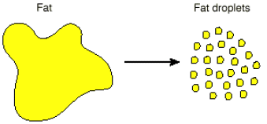
Bile (continued)
Through the process of emulsification, bile salts break-down large lipid globules into smaller lipid molecules in the small intestine.
Small lipid molecules collectively have a larger surface area that a globule that enables pancreatic lipase to more rapidly and complete-ly chemically digest the triglycerides.
The bile salts—consisting of sodium salts and potassium salts—aid in the absorption of lipids by the small intestine after chemical diges-tion.
Page 912
Page 994
Page 948

Slide 85
Liver Functions
The liver has a number of functions, which are summarized in the next slides:
  Carbohydrate metabolism
  Lipid metabolism
  Protein metabolism
  Processing of drugs and hormones
  Excretion of bilirubin
  Synthesis of bile salts
  Storage
  Phagocytosis
  Activation of vitamin D
Page 912
Page 994
Page 949

Slide 86
Carbohydrate Metabolism
The liver helps maintain a normal blood glucose level.
When blood glucose level is low, the liver breaks-down glycogen to liberate glucose into blood circulation as a source of chemical energy.
The liver can convert lactic acid and some amino acids into glucose for cellular energy production.
It can also convert monosaccharides—including fructose and galac-tose—into glucose.
When blood glucose level is high, such as immediately after eating, the liver converts glucose to glycogen and trigylcerides for storage by the body.
Page 913
Page 994
Page 949

Slide 87
Lipid Metabolism
The roles of the hepatocytes in lipid metabolism include:
  Storage of triglycerides.
  Break-down of fatty acids to produce ATP for cellular work.
  Synthesis of cholesterol from sterol precursors.
  Use of cholesterol in the synthesis of bile salts.
  Synthesis of lipoproteins that transport triglycerides, fatty acids, and cholesterol (LDL and HDL).
Sterol = a group of solid cyclic unsaturated alcohols found in animal and plant tissues.
LDL = low-density lipoprotein, a transport molecule for cholesterol.
HDL = high-density lipoprotein, a transport molecule for cholesterol.
Page 913
Page 995
Page 949

Slide 88
Protein Metabolism
Hepatocytes deaminate amino acids by removing the NH₂ group so that the amino acids can be used in ATP production or converted to carbohydrates and lipids.
The byproduct, ammonia (NH₃), is converted into urea, a less toxic compound excreted in urine.
Hepatocytes synthesize most of the blood plasma proteins including globulins, albumin, prothrombin, and fibrinogen.
Page 913
Page 995
Page 949

Slide 89
Processing of Chemicals and Hormones
The smooth endoplasmic reticulum (ER) in hepatocytes detoxifies substances in blood circulation including alcohol and some drugs.
The liver excretes some exogeneous substances (drugs) such as penicillin, erythromycin, and sulfonamides in bile.
The thyroid hormones (T₃ and T₄) and steroid hormones—including the androgens, estrogens, and aldosterone—can be chemically mod-ified in the liver.
Page 913
Page 995
Page 949

Slide 90
Other Liver Functions
Stellate reticuloendothelial cells of the liver phagocytize red blood cells, white blood cells, bacteria, and some foreign substances to remove them from blood circulation.
Bilirubin, from the breakdown of red blood cells in the liver, is metabolized in the small intestine by bacteria.
The metabolites are eliminated in feces.
The bile salts in the small intestine emulsify lipids and aid in their absorption by the small intestine.
Page 913
Page 995
Page 949

Slide 91
Other Liver Functions (continued)
Glycogen is stored in the liver as a reserve for chemical energy.
The liver stores lipid-soluble vitamins (A, D, E, and K) and some minerals, including iron and copper.
The liver, skin, and kidneys are involved in synthesis of the active form of vitamin D known as calcitriol.
Page 913
Page 995
Page 949

Slide 92
Small Intestine
The small intestine begins at the pyloric sphincter and ends at the large intestine.
Most chemical digestion and absorption of food molecules occurs in the small intestine.
The length of the small intestine, about three meters, provides a large surface area for digestion and absorption.
The surface area for absorption through the small intestine wall is greatly increased by circular folds, villi, and microvilli.
Page 913
Page 995
Page 949

Slide 93
Structure
The small intestine has three sections—duodenum, jejunum, and ileum.
The duodenum, about 25 cm in length, extends from the pyloric sphincter to the jejunum.
The jejunum is about one meter long and extends to the ileum.
The ileum is about two meters long and extends to the large intes-tine.
Page 913
Page 995
Page 949
Figure 24.18
Figure 24.18
Figure 24.17

Slide 94
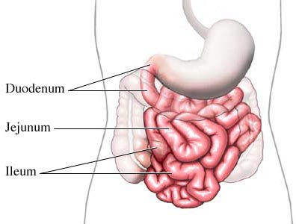
Structure (continued)
https://www.integris-health.com

Slide 95
Intestinal Wall
The wall of the small intestine has the same four tissue layers of other parts of the GI tract—mucosa, submucosa, muscularis, and serosa.
Absorptive cells in the mucosa chemically digest and absorb the nu-trients in chyme.
Goblet cells in the mucosa secrete mucus to promote the passage of chyme.
The cells lining the crevices of the mucosa form intestinal glands that secrete intestinal juice.
Page 914
Page 995
Page 950
Figure 24.19
Figure 24.19
Figure 24.18

Slide 96
Intestinal Wall (continued)
The intestinal glands consist of paneth cells and enteroendocrine cells.
Paneth cells secrete lysozyme, an enzyme that breaks-down and destroys some bacteria.
The three types of enteroendocrine cells—S cells, CCK cells, and K cells—secrete hormones.
Duodenal glands in the submucosa secrete an alkaline mucus to help neutralize the gastric acid in chyme.
CCK = cholecystokinin, a peptide hormone in the digestive system responsible for stim-ulating the chemical digestion of fats and proteins.
Page 914
Page 995
Page 950
Figure 24.19
Figure 24.19
Figure 24.18

Slide 97
Other Features of the Small Intestine
The muscularis of the small intestine has two layers of smooth muscle—an outer, thinner layer of longitudinal fibers, and an inner, thicker layer of circular fibers.
Circular folds of the mucosa and submucosa increase the surface area for absorption of food molecules.
The arrangement of folds causes chyme to spiral rather than travel in a straight line as it moves down the lumen.
Spiraling increases the length of time that the chyme is in the lumen of the small intestine to maximize absorption through the wall of the small intestine.
Page 916
Page 996
Page 950
Figure 24.19
Figure 24.19
Figure 24.18

Slide 98
Intestinal Juice
About one to two liters of intestinal juice are secreted each day; the juice consists of water and mucus and is slightly alkaline (pH 7.6).
Pancreatic juice and intestinal juice provide a liquid medium to aid in the absorption of nutrients from the chyme in the small intestine.
Page 918
Page 998
Page 953

Slide 99
Villi
Villi are fingerlike projections from the mucosa of the circular folds of the small intestine.
They are about 0.5 to 1 mm long, and they increase the surface area for digestion and absorption.
Nutrients in the chyme absorbed by epithelial cells in the villi pass through the wall of a capillary or lacteal in a villus to enter either blood or lymph.
Villus = singular form of villi.
Lacteal = intestinal lymphatic vessels that transport chyle, a milky fluid of fat droplets and lymph.
Page 916
Page 996
Page 950
Figure 24.19
Figure 24.19
Figure 24.18

Slide 100
Microvilli
Microvilli are tiny projections on the epithelial cells in the villi that are about one micron (μm) long.
Each microvillus consists of a bundle of 20 to 30 actin fibers.
The small intestine has about 200 million microvilli per square milli-meter of its inner surface.
Under a light microscope, microvilli have the visual appearance of a faint, fuzzy line known as the brush-border.
Under an electron microscope, their detailed structure becomes evi-dent.
Page 916
Page 998
Page 953
Figure 24.19
Figure 24.19
Figure 24.18

Slide 101
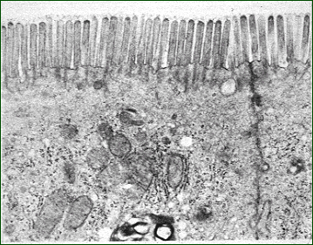
Brush-Border
https://www.cals.ncsu.edu
A transmission electron micrograph showing the microvilli of the small intestine.

Slide 102
Microvilli (continued)
Microvilli increase the surface area for the absorption of nutrients in the small intestine.
The brush-border has enzymes (called brush-border enzymes) for the chemical digestion of food molecules in chyme that come in con-tact with it.
Page 916
Page 998
Page 953
Figure 24.19
Figure 24.19
Figure 24.18

Slide 103
Brush-Border Enzymes
Absorptive cells in the villi synthesize the brush-border enzymes and insert them into the plasma membrane of the microvilli.
The brush-border enzymes consist of:
  Four carbohydrate-digesting enzymes
  Two protein-digesting enzymes
  Two nucleotide-digesting enzymes
Cells of the brush border that slough-off into the lumen of the small intestine break apart and release their enzymes to aid in chemical digestion.
Page 918
Page 998
Page 953

Slide 104
Mechanical Digestion—Segmentations
The myenteric plexus controls two types of motion:
  Segmentations
  Migrating motility complex (a type of peristalsis)
Segmentations are local mixing contractions that occur in the small intestine when it is distended (stretched) by the chyme in its lumen.
The contractions mix chyme with digestive juices and bring chyme in contact with the villi and microvilli for the absorption of food molecules.
Page 918
Page 998
Page 953

Slide 105
Segmentations (continued)
Segmentations result from the contraction of the circular smooth muscles in the intestinal wall.
These motions do not propel chyme along the lumen of the small intestine—their role is to thoroughly mix the chyme with the diges-tive juices.
Page 918
Page 998
Page 953

Slide 106
Peristalsis
Segmentations end and peristalsis begins once most of the food molecules in chyme meal have been absorbed.
This type of peristalsis is called migrating motility complex (MMC), but we will refer to it simply as peristalsis.
Peristalsis results from the coordinated contractions of the circular and longitudinal smooth muscles in the wall of the small intestine.
Peristalsis = a sequence of muscle contractions that pro-gressively squeeze one small section of the digestive tract and then the next to push food along the tract, something like pushing toothpaste out of its tube.
(https://www.medical-dictionary.thefreedictionary.com)
Page 918
Page 1000
Page 953

Slide 107
Peristalsis (continued)
Peristalsis begins in the lower portion of the stomach and pushes chyme along a short stretch of small intestine before the wave dis-sipates.
A series of peristaltic waves move along the small intestine before reaching the end of the ileum—the process usually takes 90 to 120 minutes.
Chyme, however, can remain in the small intestine for three to five hours.
Page 918
Page 1000
Page 953

Slide 108
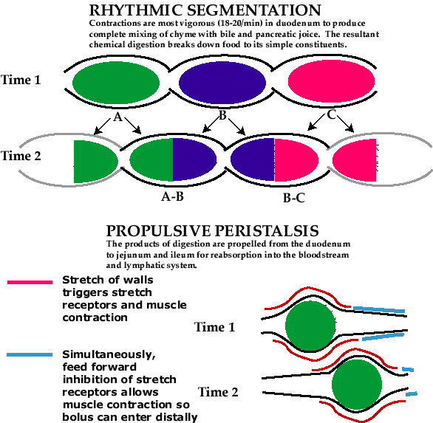
Segmentations versus Peristalsis
Segmentations
Peristalsis
http://www.med.howard.edu

Slide 109
Chemical Digestion
Chyme—when it enters into the small intestine—contains partially-digested carbohydrates, proteins, and lipids due to the mechanical and chemical digestion that occurred in the stomach.
The further chemical digestion in the small intestine is facilitated by the contributions of enzymes in pancreatic juice, bile, and intestinal juice.
Page 918
Page 1000
Page 954

Slide 110
Carbohydrates
Not all carbohydrates are broken-down when chyme enters the duo-denum from the stomach.
Many of the remaining carbohydrates are broken-down by an enzyme, pancreatic amylase, in the small intestine.
Although pancreatic amylase breaks (hydrolyzes) the covalent bonds in starches and glycogen, it cannot breakdown cellulose that passes through the GI tract as water-soluble fiber or insoluble fiber.
These fibers are also known as roughage that absorb cholesterol and keep us regular.
Page 919
Page 1000
Page 954

Slide 111
Carbohydrates (continued)
Brush-border enzymes split disaccharides into monosaccharides.
These enzymes are:
  Sucrase, which breaks-down sucrose to form glucose and fructose.
  Lactase, which breaks-down lactose to form glucose and galactose.
  Maltase, which breaks-down maltose to form glucose and glucose.
Page 919
Page 1000
Page 954

Slide 112
Proteins
Protein digestion begins in the stomach with the release of pepsin from the gastric glands in the stomach wall.
The enzymes in pancreatic juice continue to break-down proteins into smaller polypeptides in the small intestine.
Protein digestion is completed by two peptidases (enzymes) in the brush-border of the small intestine.
Page 919
Page 1001
Page 954

Slide 113
Lipids
Some digestion of lipids occurs in the stomach through the actions of two enzymes, lingual lipase and gastric lipase.
Most of the chemical digestion occurs in the small intestine through the action of the enzyme, pancreatic lipase.
Page 919
Page 1001
Page 954

Slide 114
Emulsification
Large lipid globules must be emulsified into smaller globules before they can be digested in the small intestine
Emulsification is produced by the sodium and potassium bile salts from the pancreas.
As we discussed, the smaller lipid globules collectively have a larger surface area than larger globules.
An increased surface area enables pancreatic lipase (an enzyme) in the small intestine to function more effectively in the chemical diges-tion of lipids.
Page 919
Page 1001
Page 954

Slide 115
Nucleic Acids
Pancreatic juice contains two nucleases (enzymes) to digest strands of RNA and DNA into their individual nucleotides.
The nucleotides are further digested by two brush-border enzymes.
Page 919
Page 1001
Page 955

Slide 116
Absorption
The passage of digested nutrients from the GI tract into the blood via capillary or lacteal is known as absorption.
Absorption, depending on the food molecule, is mediated by pas-sive diffusion, facilitated diffusion, osmosis, or active transport.
About 90 percent of absorption occurs in the small intestine, and the remaining ten percent occurs in the stomach and large intestine.
The undigested or unabsorbed material in the small intestine after absorption is pushed into the large intestine by peristaltic waves.
Facilitated diffusion = a process by which substances are transported across cell membranes by means of protein carrier molecules; also called facilitated transport.
(https://www.dictionary.reference.com)
Page 919
Page 1001
Page 956

Slide 117
Absorption (continued)
The textbook describes the processes of absorption of food and other molecules in the small intestine:
  Monosaccharides—facilitated diffusion or active transport
  Amino acids and short peptide chains—active transport
  Lipids—passive diffusion
  Electrolytes—passive diffusion or active transport
  Lipid-soluble vitamins—passive diffusion
  Water-soluble vitamins—active transport
  Water—osmosis
Page 920
Page 1001
Page 956

Slide 118
Large Intestine
The large intestine is the terminal (end) portion of the intestinal tract.
Its functions are the completion of absorption, production of some vitamins, formation of feces, and elimination of the feces from the body.
Page 924
Page 1006
Page 959

Slide 119
Structure
The large intestine, about 1.5 meters long and 6.5 cm in diameter, extends from the ileum to the anus.
It is attached to the posterior abdominal wall by the mesocolon, a double layer of peritoneum.
The four major sections of the large intestine are the cecum, colon, rectum, and anal canal.
Page 924
Page 1006
Page 959
Figure 24.23
Figure 24.23
Figure 24.22

Slide 120
Ileum and Cecum
The opening from the ileum of the small intestine into the large intestine is protected by a fold of membrane called the ileocecal sphincter.
Located inferior to the ileocecal valve is the cecum, a pouch about 6.0 cm long.
Attached to the cecum is a twisted, coiled tube called the appendix.
Appendix = a lymphatic organ described in the lecture modules on the immune system.
Page 925
Page 1006
Page 959
Figure 24.23
Figure 24.23
Figure 24.22

Slide 121
Cecum
The open end of the cecum merges with a long tube known as the colon.
The colon is divided into the ascending, transverse, descending, and sigmoid segments.
Page 925
Page 1006
Page 959
Figure 24.23
Figure 24.23
Figure 24.22

Slide 122
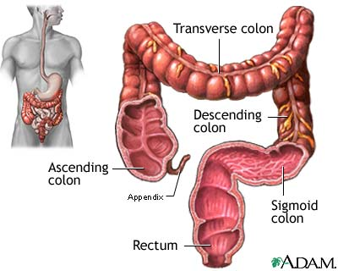
Colon
https://www.nlm.nih.gov

Slide 123
Rectum and Anal Canal
The rectum is the last 20 cm of the GI tract—its terminal 2.0 to 3.0 cm section is known as the anal canal.
The opening of the anal canal to the exterior of the body is called the anus.
The internal anal sphincter consists of smooth muscle while the external anal sphincter consists of skeletal muscle.
Only the external sphincter is under voluntary control.
Both anal sphincters are normally closed except during defecation.
Page 926
Page 1006
Page 959
Figure 24.23
Figure 24.23
Figure 24.22

Slide 124
Tissue Layers
The large intestine has the typical four layers found in the other sec-tions of the GI tract.
The primary function of the absorptive cells in the large intestine is absorption of water from the lumen.
Goblet cells secrete mucus that lubricates the passage of the colonic contents.
Circular folds and villi are not found in the large intestine, but microvilli are present to handle the small amount of absorption that takes place.
Page 926
Page 1006
Page 961
Figure 24.24
Figure 24.24
Figure 24.23

Slide 125
Mechanical Digestion
The passage of chyme from the ileum of the small intestine into the cecum of the large intestine is regulated by the ileocecal sphincter.
The sphincter is usually partially closed to slow the entry of chyme from the small intestine.
The gastroileal reflex intensifies peristalsis in the ileum of the small intestine and forces the chyme into the cecum immediately after a meal.
A peptide hormone, gastrin, secreted into the pyloric antrum helps to relax the ileocecal sphincter.
Gastroileal reflex = increase in motility in the ileum and opening of the ileocecal sphincter when food enters the empty stomach.
(https://www.medical-dictionary.thefreedictionary.com)
Page 927
Page 1009
Page 962

Slide 126
Mechanical Digestion (continued)
Movements of the colon begin when chyme passes through the ileo-cecal sphincter, fills the cecum, and accumulates in the ascending colon.
Churning motions, called haustral churning, and peristalsis occur in the large intestine.
Mass peristalsis begins in the transverse colon and rapidly pushes the contents of the colon into the rectum about three to four times per day.
Page 928
Page 1009
Page 963

Slide 127
Chemical Digestion
Mucus (but no enzymes) is secreted by cells in the wall of the large intestine.
The final stage of digestion occurs due to bacteria in the lumen of the colon.
Chyme is prepared for elimination from the body by the activity of the bacteria that ferment the remaining carbohydrates that entered from the small intestine.
The product of fermentation is a mixture of oxygen, carbon dioxide, and methane gases that produces flatulence, commonly known as “passing gas.”
Page 928
Page 1009
Page 963

Slide 128
Chemical Digestion (continued)
Bacteria convert any remaining proteins or polypeptides into amino acids.
They also break-down amino acids into simpler molecules including indole, skatole, and hydrogen sulfide.
Some of the indole and skatole molecules are eliminated in feces that contributes to their odor.
The remainder of these two molecules is absorbed and transported to the liver and converted to less toxic compounds and eliminated in the urine.
Page 928
Page 1009
Page 963

Slide 129
Chemical Digestion (continued)
Other byproducts are absorbed and transported to the liver where they are converted to less toxic substances, and then excreted in the urine.
Bacterial products absorbed in the large intestine include vitamin K and some B vitamins, which are needed for cellular metabolism.
Bacteria decompose bilirubin resulting from the breakdown of red blood cells into stercobilin to give feces their characteristic brown color.
Page 928
Page 1009
Page 963

Slide 130
Absorption
About 90 percent of water absorption occurs in the small intestine.
The large intestine absorbs enough water to help maintain water balance.
Of the 0.5 to 1.0 liter of water that enters the large intestine each day, normally all but 100 to 200 mL is reabsorbed via osmosis.
Ions, including Na⁺ and Cl⁻, and some vitamins are reabsorbed by the large intestine.
Page 928
Page 1010
Page 963

Slide 131
Feces Formation
Chyme becomes a solid or semisolid material due to water reab-sorption once it has been in the large intestine for about three to ten hours.
This mass of waste material is known as feces.
Feces consist of water, inorganic salts, epithelial cells, bacteria, bacterial products, unabsorbed digested materials, and soluble and insoluble fiber.
Page 928
Page 1010
Page 963

Slide 132
Defecation Reflex
Mass peristalsis pushes the fecal material from the sigmoid colon into the rectum.
The distension (stretching) of the rectal wall stimulates stretch sensory receptors that initiate the defecation reflex to empty the rectum.
The reflex involves the parasympathetic division and internal anal sphincter (smooth muscle).
The external anal sphincter, which is a skeletal muscle, enables the voluntary control of defecation.
Page 928
Page 1010
Page 963

Slide 133
Bowel Movements
The frequency of bowel movements depends on a number of fac-tors including diet, health, and stress.
The typical range of bowel movements varies from two to three per day to three to four per week.
Page 929
Page 1010
Page 963

Slide 134
Diarrhea
Diarrhea is characterized by increased frequency, volume, and fluid content of the feces.
Insufficient time is available for absorption if chyme passes too quickly through the small intestine and large intestine due to excessive motility such as from a bacterial or parasitic infection.
Frequent bouts of diarrhea can result in dehydration and electro-lyte imbalances.
Excessive motility can be caused by lactose intolerance, stress, and microbes that irritate the mucosa of the small and large intes-tines.
Motility = in this context, bowel motions.
Page 929
Page 1010
Page 963

Slide 135
Constipation
Constipation involves either infrequent or difficult defecation due to decreased motility of the intestines.
Excessive water reabsorption occurs when the feces remain in the colon for a prolonged period of time.
The feces become dry and hard and can be difficult to eliminate from the body.
Page 929
Page 1010
Page 963

Slide 136
Constipation (continued)
Constipation can be caused by delaying defecation, spasms of the colon, not enough dietary fiber, inadequate fluid intake, lack of exer-cise, emotional stress, and some drugs.
One treatment involves giving a mild laxative; however, this practice can be habit-forming.
Other approaches include adding dietary fiber, using a stool softener, increasing fluid intake, or physical exercise.
Page 929
Page 1010
Page 964

Slide 137
Phases of Digestion

Slide 138
Cephalic Phase
Digestion involves three overlapping phases—cephalic, gastric, and intestinal.
In the cephalic phase, the smell, sight, initial taste, or even thought of food activates centers in the cerebral cortex, hypothalamus, and brainstem.
The cephalic phase prepares the mouth and stomach for food that is about to be eaten.
Cephalic = relating to the head; in this instance, the brain.
Page 930
Page 1011
Page 965

Slide 139
Gastric and Intestinal Phases
The gastric phase of digestion begins once the bolus of food enters the stomach.
Neural and hormonal activity increases gastric secretions and gas-tric motility.
The intestinal phase begins once chyme enters the small intestine.
Neural and hormonal activity regulates the exit of chyme from the stomach and promote the digestion and absorption of food in the small intestine.
Page 930
Page 1012
Page 965
Figure 24.25
Figure 24.25
Figure 24.24

Slide 140
Aging

Slide 141
Aging Effects
Changes in the digestive system associated with aging include:
  Decreased secretions from exocrine glands into the stomach and small intestine.
  Decreased strength, tone, and motility of muscle tissues in the wall of the GI tract.
  Changes in sensory feedback that help regulate enzyme and hormone release.
  Diminished responses to internal sensations including pain in the GI tract.
Page 932
Page 1014
Page 967

Slide 142
Aging Effects (continued)
Changes in the upper GI tract with aging can include:
  Reduced sensitivity to irritations and sores in the mouth
  Loss of taste
  Periodontal (gum) disease
  Difficulty in swallowing
  Hiatal hernia
  Gastritis
  Peptic ulcer disease
Hiatal hernia = occurs when the upper part of your stomach bulges through the large muscle (diaphragm) separating the abdomen and chest.
Gastritis = inflammation of the lining of the stomach.
(Both definitions are from https://www.mayoclinic.org)
Page 932
Page 1014
Page 967

Slide 143
Aging Effects (continued)
Changes in the small intestine can include duodenal ulcers, maldi-gestion, and malabsorption.
Changes in the large intestine can include constipation, hemorrhoids, and diverticular disease.
Bowel obstructions, impactions, and colon cancer are more common in older persons.
Other disorders more likely to occur with aging include appendicitis, gall bladder problems, jaundice, cirrhosis, and acute pancreatitis.
Diverticular disease = an infection in the tiny pouches that some people get in their colon. The pouches are called diverticula. These pouches bulge out through weak spots in your colon. The pouches can become inflamed (red, swollen) or infected.
(https://www.hopkinsmedicine.org)
Page 932
Page 1014
Page 967

