Slide 1
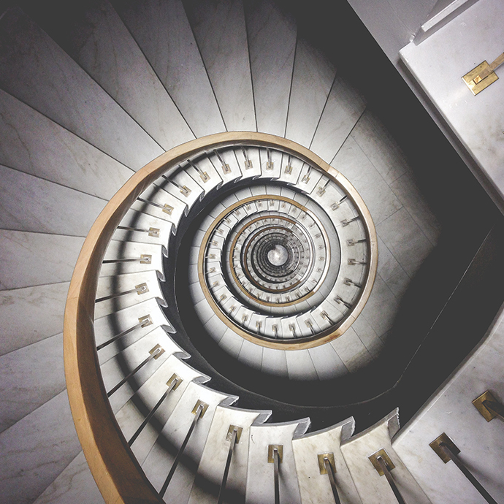
Depth Perception
Binocular vision
Convergence
Perspective
Superimposition
Relative size
Relative movement
Color and texture
https://www.zennioptical.com

