Slide 1
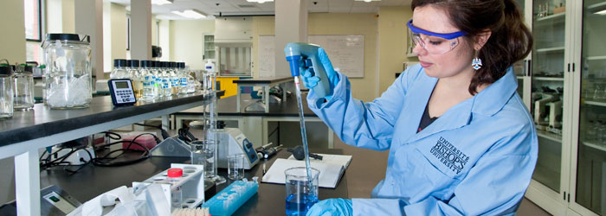
Chemical Foundations
https://www.ubishops.ca

Slide 2
Note
Much of the text material is from, “Essential Biology with Physiology” by Neil A. Campbell, Jane B. Reece, and Eric J. Simon (2004 and 2008). I don’t claim authorship. Other sources are noted when they are used.
2
Notes:
2

Slide 3
Foundations of Physiology
Chemistry
Biology
Anatomy
3
Notes:
3

Slide 4
Outline
Some basic principles
Organic chemistry and biochemistry

Slide 5
Some Basic Principles
C
Mg
N
K
Cl
H
I
F
Cu
Zn
P
Se
Si
Co
Cr
Na
Fe
O
Mo
Mn
B
Sn
S
Ca
V

Slide 6
Chemical Elements
Chemical elements are the fundamental basis of all matter since they cannot be broken-down into smaller unique elements.
92 naturally occurring chemical elements have been identified along with other chemical elements formed in laboratories.
A chemical element is designated by a one- or two-letter symbol; for example, hydrogen (H), oxygen (O), carbon (C), and sodium (Na).
The symbols are typically derived from the Greek, Latin, or English names.
All chemical elements are organized in the periodic table of elements.

Slide 7
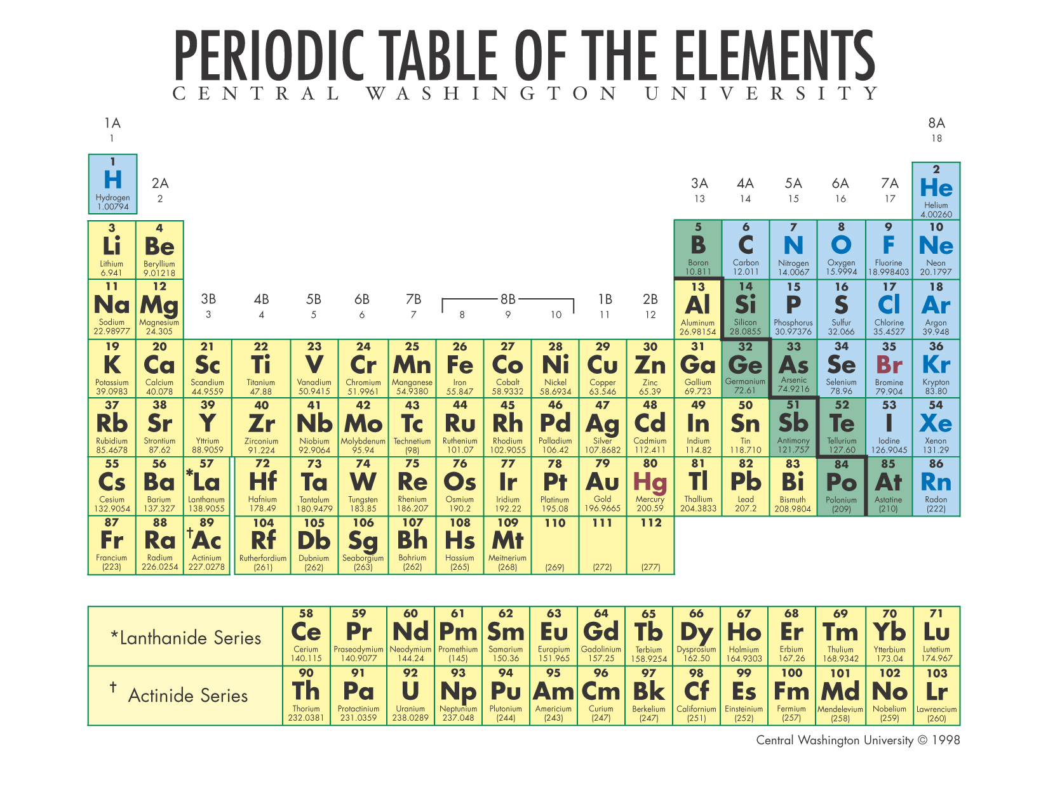
Periodic Table
https://www.cwu.edu

Slide 8
Life-Essential Chemical Elements
Twenty-five of the 92 naturally occurring chemical elements are essential for life.
  Oxygen, carbon, hydrogen, and nitrogen make-up about 96 percent of the mass of the human body.
  Almost the remaining four percent consists of seven elements.
  Less than 0.01 percent of the human body are trace elements.

Slide 9
Life-Essential Chemical Elements
Elements
Oxygen (O)—65.0%
Carbon (C)—18.5%
Hydrogen (H)—9.5%
Nitrogen (N)—3.3%
Calcium (Ca)—1.5%
Phosphorous (P)—1.0%
Potassium (K)—0.4%
Sulfur (S)—0.3%
Sodium (Na)—0.2%
Chlorine (Cl)—0.2%
Magnesium (Mg)—0.1%
Trace elements—0.01%
Trace Elements
Boron (B)
Chromium (Cr)
Cobalt (Co)
Copper (Cu)
Fluorine (F)
Iodine (I)
Iron (Fe)
Manganese (Mn)
Molybdenum (Mo)
Selenium (Se)
Silicon (Si)
Tin (Sn)
Vanadium (V)
Zinc (Zn)
The percentages are by body weight.

Slide 10
Teeth and Plaque
Our teeth are part of the living, dynamic system that makes-up the oral cavity (mouth).
Bacteria reside in plaque, which consists of food, saliva, and dead cells.
Bacteria release acids, especially when a person eats sugars and refined carbohydrates, that remove minerals from tooth surfaces.
Cavities, pain, and tooth loss can occur.

Slide 11
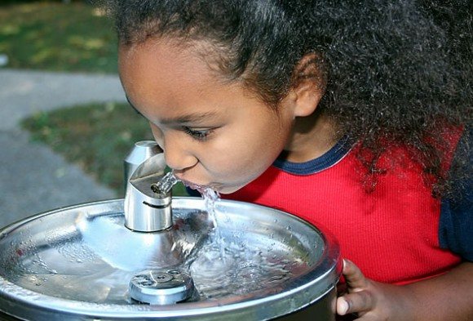
Fluoride
Fluoride (F⁻), an ionic form of the chemical element fluorine, is found in the earth’s crust.
Fluoride dissolves in water when water percolates through ground and into the aquifer (ground water).
The earth’s crust and aquifer in parts of North America do not have this trace element.
https://www.toonaripost.com

Slide 12
Fluoride (continued)
Fluoride can help maintain healthy teeth if in sufficient concentration in drinking water.
According to the U.S. Centers for Disease Control and Prevention (CDC), water fluoridation reduces tooth decay by about 25 percent over a person's lifetime.
Fluoride helps to re-mineralize tooth surfaces to help prevent cavities from forming.
Fluoride can be added to drinking water as part of the water treatment process.

Slide 13
Chemical Compounds
Chemical elements can be combined to form chemical compounds of two or more chemical elements in fixed ratios.
Chemical compounds are much more common than pure chemical elements— examples include:
  Water or H₂O
  Sodium chloride or NaCl (table salt)
  Methane or CH₄
  Glucose and fructose isomers of C₆H₁₂O₆ (cane and beet sugar)

Slide 14
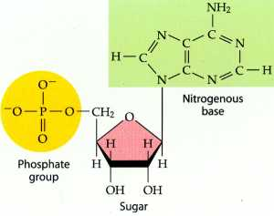
Chemical Compounds (continued)
Most chemical compounds in living organisms are formed from several chemical elements.
For example, the nucleotides (individual units) of DNA and RNA consist of carbon, nitrogen, oxygen, and phosphorous.
Nucleotide
https://biochemicalminds.files.wordpress.com

Slide 15
Atoms
A chemical element is an atom that is distinctly different from the atoms of other chemical elements.
Atom is from the Greek word for indivisible; it is the smallest unit of matter that retains the unique properties of a chemical element.
For example, a carbon atom is the smallest amount of the chemical element, carbon.
Carbon plays key roles in life as we will discuss.
Atoms are very small; about one million carbon atoms would stretch across a period in a textbook.

Slide 16
Structure of Atoms
Atoms are composed of subatomic particles called protons, electrons, and neutrons.
  A proton has a single unit of positive charge (+).
  An electron has a single unit of negative charge (-).
  A neutron is electrically neutral—it has no electrical charge.
The nucleus of an atom has protons and neutrons, while electrons are in the surrounding electron cloud.

Slide 17
Structure of Atoms (continued)
An atom with equal number of protons and electrons is electrically neutral.
For example, a helium atom (He) has two protons, two electrons, and two neutrons.
Electrons surround the nucleus in what is described as a cloud or probability density function.

Slide 18
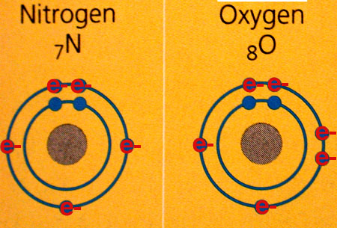
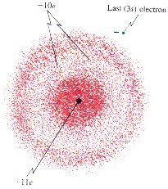
Electron Shells
To provide scale: if the electron cloud (below) were 100 meters in diameter, the nucleus would be the size of a housefly.
https://www.academic.brooklyn.cuny.edu
The inner shells are shown in blue and outer shells in red.
https://www.members.tripod.com/craigjm

Slide 19
Atomic and Mass Numbers
The number of protons in an atom, its atomic number, determines the chemical element.
For example, the atomic number of oxygen is 8 because it has eight protons.
The mass number is the total number of protons and neutrons in the nucleus.
Oxygen has a mass number of 16, and carbon has a mass number of 12 (six protons and six neutrons).

Slide 20
Mass
Mass is a measure of the amount of matter in an object determined by its atoms.
Protons and neutrons have nearly identical masses, while electrons have about 1/2000 the mass of protons and neutrons.
Even smaller subatomic particles exist, which are known as quarks.
Quarks are not particularly relevant to our discussion of chemical ele-ments.

Slide 21
Isotopes
Isotopes of a chemical element have the same number of protons and electrons but different numbers of neutrons—therefore, their mass numbers vary.
Measure | Isotope
 | Carbon-12 | Carbon-13 | Carbon-14
Number of protons | 6 | 6 | 6
Number of neutrons | 6 | 7 | 8
Atomic number | 6 | 6 | 6
Mass number | 12 | 13 | 14
Percentage of all carbon | ~ 99% | ~ 1% | << 1%
Stable? | Yes | No | No

Slide 22
Isotopes (continued)
Carbon-14 (¹⁴C) is a naturally-occurring, unstable isotope—its nucleus decays and emits particles and releases energy.
The degree of instability of ¹⁴C is measured by its half-life (5,730 years).

Slide 23
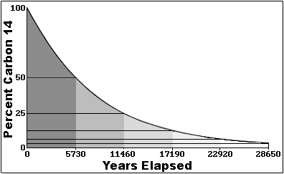

Carbon-14 Half-Life
Bristlecone pines in the
White Mountains, California. Dead trees can be dated using the carbon-14 decay curve while living trees can be dated using tree ring counting.
Carbon-14 decay curve
https://www.earthsci.org

Slide 24
Radioactive Isotopes
A radioactive isotope emits particles and energy when its nucleus decays.
They have many uses in biological research and medicine since living cells do not distinguish among isotopes of the same chemical element.
An organism takes-up and uses radioactive isotopes in its usual bio-logical ways.
With uptake by cells, the location and concentration is measured by the radiation they emit.

Slide 25
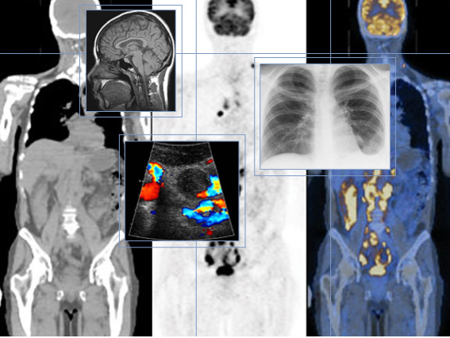
Radioactive Isotopes (continued)
Radioisotopes can be used as tracers to monitor the uptake and use of atoms and chemical compounds in living organisms.
With imaging instruments—such as PET scanners—radioisotopes are used to monitor chemical processes in the body for diagnostic and research purposes.
https://www.examiner.com

Slide 26
Electron Arrangement
Electrons determine how an atom will behave when it encounters one or more other atoms.
An atom has one or more electron shells—electrons in the outer shell have the highest energy levels.
The inner shell can accommodate up to two electrons and the second and third shells can each have up to eight electrons.

Slide 27
Electron Shells
https://www.academic.brooklyn.cuny.edu
The inner shell for each atom is shown in blue and its outer shells are shown in red.
27

Slide 28
Electron Arrangement (continued)
The number of electrons in the outer shell determines the chemical properties of an atom.
Atoms with outer shells that are not completely full can interact with atoms whose outer shells are also not full.

Slide 29
Chemical Elements—Comparisons
Chemical element | Atomic number (number of protons) | Electrons in inner shell (maximum = 2) | Electrons in outer shell (maximum = 8) | Additional electrons that can be added | Chemically reactive?
Hydrogen (H) | 1 | 1 | -- | 1 | Yes
Helium (He) | 2 | 2 | -- | 0 | No
Carbon (C) | 6 | 2 | 4 | 4 | Yes
Nitrogen (N) | 7 | 2 | 5 | 3 | Yes
Oxygen (O) | 8 | 2 | 6 | 2 | Yes
Hydrogen, carbon, nitrogen, and oxygen are biologically important chemical elements, in part because they can covalently bond with other atoms (that is, they are chemically reactive).

Slide 30
Covalent Bonds
Two atoms that share one or more pairs of outer shell electrons form a covalent bond.
The number of covalent bonds that can form is equal to the number of additional electrons needed to fill the outer shells.
For example, the single covalent bond in an H₂ molecule (gaseous hydrogen) completes the single shell of electrons for both hydrogen atoms.

Slide 31
Covalent Bonds (continued)
In H₂O, two hydrogen atoms share their electrons with an oxygen atom.
In CH₄ (methane), four hydrogen atoms share electrons with a car-bon atom.
In O₂ (gaseous oxygen), two atoms share two pairs of electrons to form a double covalent bond.

Slide 32
Ionic Bonds
NaCl, composed of sodium and chloride (an ionic form of chlorine), is formed through an ionic bond.
Chemical Element | Atomic number | Electrons in inner shell (maximum = 2) | Electrons in second shell (maximum = 8) | Electrons in third shell (maximum = 8) | Ionic bond
Sodium (Na) | 11 | 2 | 8 | 1 | Na donates an electron to Cl and becomes Na+
Chlorine (Cl) | 17 | 2 | 8 | 7 | Cl accepts the electron from Na and becomes Cl- (chloride)
Before the electron transfer, sodium and chloride are electrically neutral; after the electron transfer, the atoms are ions—that is, they are electrically charged.
The Na⁺ and Cl⁻ ions are held together by an ionic bond, the attraction between ions with opposite charges, to form NaCl (sodium chloride).

Slide 33
Molecular Representations
Several methods can be used to represent molecules consisting of one or more atoms.
Representation | Visual depiction | Used in this course?
Conventional naming | Text | Yes
Molecular formula | Text | Yes
Electron configuration | Graphic | No
Structural configuration | Text or 2-D graphic | Yes
Ball-and-stick model | 3-D model | Sometimes
Space-filling model | 3-D model | Sometimes

Slide 34
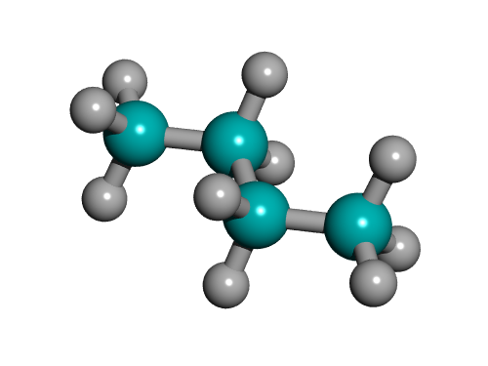
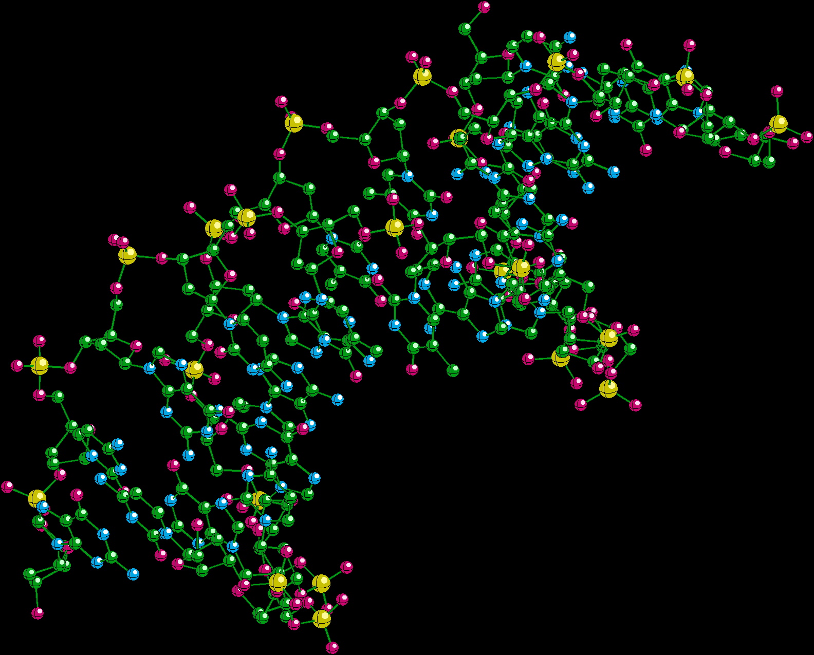
Ball-and-Stick Models
DNA
https://www.wikimedia.org
N-butane
C₄H₁₀
or
CH₃-CH₂-CH₂-CH₃
https://www.orc.uni-linz.ac

Slide 35
Chemical Reactions
The chemistry of life is dynamic—chemical reactions in cells rearrange molecules by breaking chemical bonds and forming new bonds for meta-bolic and other cellular functions.
For example, oxygen and hydrogen gases can react to form water and produce energy.
2H₂ + O₂ = 2H₂O + energy
H₂ and O₂ are the reactants and H₂O is the product.
Matter is neither created nor destroyed—the same number of hydrogen and oxygen atoms are found in the reactants and products, although they are arranged differently.

Slide 36
Water and Life
Life originated in the seas as single-cell organisms about 3.7 billion years ago and evolved in water for about 3 billion years before arriv-ing on land.
Life remains tied to water; terrestrial (land) species developed water retention and regulation mechanisms suited to their physical environ-ments.
Cells are surrounded by a fluid consisting mostly of water and they have 70 to 90 percent water content.
The abundance of water is a key reason that life can exist and flour-ish on Earth.
36

Slide 37
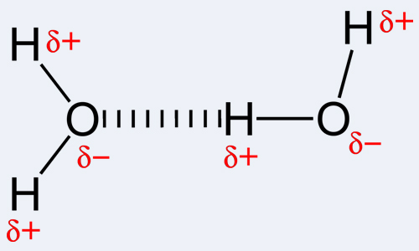
Hydrogen Bonds
A water molecule consists of two hydrogen atoms joined to an oxygen atom by two covalent bonds.
H₂O is a polar molecule because of two features:
  Oxygen, because of its much greater mass, attracts the electrons in the covalent bonds more strongly than does hydrogen.
  The V-shape of the molecule (slightly less than 145 degrees).
The polarity results in weak attraction, known as hydrogen bonding, between the hydrogen and oxygen atoms in adjacent water molecules.

Slide 38
Hydrogen Bonds (continued)
A hydrogen bond is short-lived—it persists for only a few trillionths of a second.
Although only 15 percent of H₂O molecules are bonded to four adjacent H₂O molecules at any given instant in time, water is more cohesive than most other liquids due to hydrogen bonding.
Cohesion = intermolecular force that holds molecules together in a solid or liquid.

Slide 39
Can you name and describe three types of molecular bonds?

Slide 40
Solutions, Solvents, and Solutes
A solution is a liquid that contains one or more substances (such as sugar).
A substance that is dissolved is the solute and the dissolving agent is the solvent.
Water is the solvent in an aqueous solution.
Water can dissolve many substances necessary for the sustainment of life.

Slide 41
Water—The Solvent of Life
H₂O can dissolve ionic salts by orienting its charged regions toward the oppositely charged regions of these molecules.
In sodium chloride (NaCl), the Na⁺ ions attract electrically negative ox-gen atoms, and the Cl⁻ ions attract positively charged hydrogen atoms in water molecules.
Polar attractions facilitate the dissolving of many types of salt crystals in water.
Other polar molecules, including sugars, also readily dissolve in water.

Slide 42
Acids and Bases
Water molecules can dissociate (break apart) into hydrogen (H⁺) and hydroxide (OH⁻) ions.
A base, or alkali, is a compound that accepts H⁺ ions and removes them from the solution.
A chemical compound that donates H⁺ ions to a solution is known as an acid.
Hydrochloric acid (HCl) in the lumen of the stomach is a strong acid formed from H⁺ and Cl⁻ secreted by specialized cells in the stomach wall.

Slide 43
pH Scale
The pH (potential hydrogen) scale ranges from 0 to 14—that is, from very acidic to very basic.
Biological fluids have buffers that resist changes in pH to maintain the organism’s homeostasis (internal equilibrium) for proper functioning of metabolic processes.
Buffer = resists changes in pH by accepting H⁺ ions when they are in excess and donate H⁺ ions when they are depleted.

Slide 44
pH Scale (continued)
Basic
solution
pH > 7.0
14
13
Oven cleaner
Household bleach
The pH scale is logarithmic. Each whole unit represents a ten-fold change in hydrogen concentration.
For example, lemon juice (pH 2) has about ten times more H⁺ ions than an equivalent amount of grapefruit juice (pH 3).
12
Household ammonia
H⁺ < OH⁻
Increasingly basic
11
Milk of magnesia
10
9
8
Seawater
Neutral
solution
pH = 7.0
Human blood
7
Pure water
H⁺ = OH⁻
6
Urine
5
4
Tomato juice
Increasingly acidic
Grapefruit juice
H⁺ > OH⁻
3
2
Lemon juice, gastric juice
Acidic
solution
pH = < 7.0
1
0

Slide 45
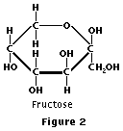
Organic and Biochemistry
https://www.library.thinkquest.org

Slide 46



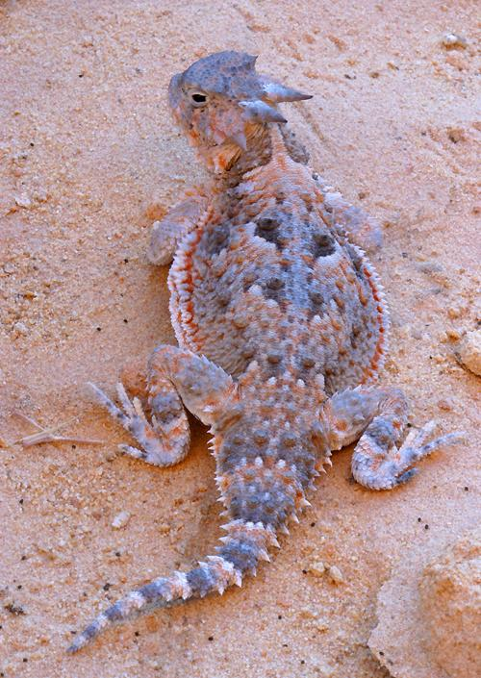
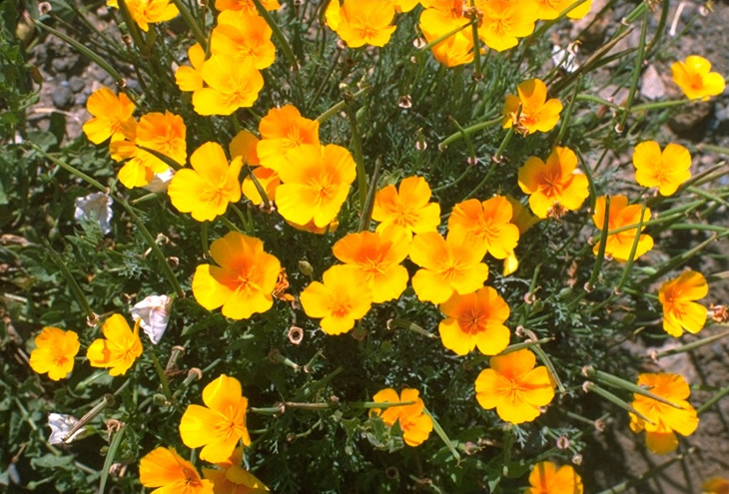
Organic Chemistry—All Life is Carbon-Based
Lichen (combination of fungus and a symbiotic photosynthetic partner)
https://3611farm1.static.flickr.com
https://www.rspb.org.uk
https://media.wiley.com
https://www.richardseaman.com
https://www.fs.fed.us

Slide 47
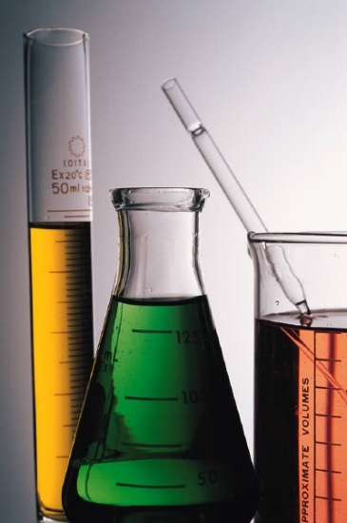
Organic Chemistry
Cells contain mostly water—the remainder is primarily carbon-based molecules.
Carbon can form large, complex, and diverse molecular structures.
The study of carbon-based compounds is known as organic chemistry.
https://www.organicglassware.com

Slide 48
Organic Chemistry—Characteristics of Carbon
The versatility of carbon in organic molecules is due to four physical features:
  Has four electrons in an outer shell that can accommodate eight electrons.
  Can complete its outer shell by forming covalent bonds with many other chemical elements including hydrogen, oxygen, and nitro-gen.
  Serves as a molecular intersection that can branch in four direc-tions.
  Can bond to other carbon atoms to form intricate and vast molec-ular structures.

Slide 49
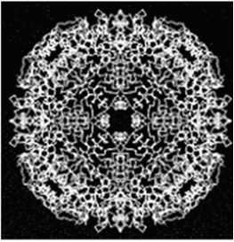
Organic Chemistry—Carbon Backbones
Carbon backbones (or skeletons) can vary in length from very short to very long, and are:
  Unbranched or branched
  Have single or double covalent bonds
  Arranged in single-ring or multi-ring structures
Carbon backbone of a protein molecule
(x-ray diffraction image).
https://www.scielo.com

Slide 50
Hydrocarbons
The simplest organic compounds are the hydrocarbons, which consist of carbon and hydrogen atoms.
The simplest hydrocarbon is methane (CH₄), a carbon atom with cova-lent bonds to four hydrogen atoms.
Methane is:
  One of the most abundant hydrocarbons found in natural gas that may heat our homes.
  Produced by prokaryotic bacteria in the digestive tracts of grazing animals including cattle and sheep.
  Produced by prokaryotic cells in swamps of decaying vegetation, especially in the southeastern region of the United States.

Slide 51
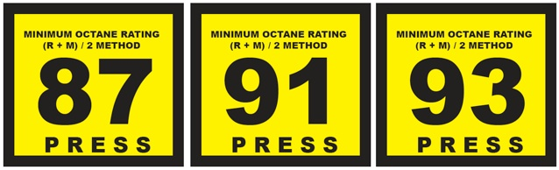
Hydrocarbons (continued)
Octane, with its eight carbon molecules, is in the fossil fuels (gasoline and diesel oil) used by internal combustion engines.
The energy-rich components (fatty acids) of fat molecules have hydro-carbon structures.
https://www.pedrosgarage.com
At the gas pump.

Slide 52
Organic Molecule Shapes
Each organic molecule has a unique three-dimensional shape, which is primarily due to carbon’s ability to form four bonds.
Large organic molecules can have elaborate shapes such as branched and multi-ring structures.

Slide 53
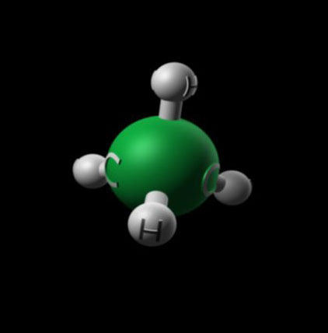
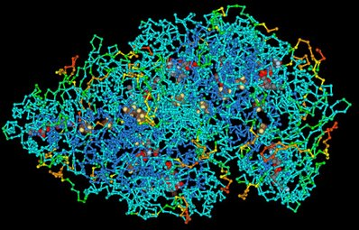
Molecular Comparisons
Organic molecules range from simple to very complex structures.
Protein molecule
https://www.nai.nasa.gov
Methane molecule (CH₄)
https://www.fixedreference.com

Slide 54
Are there other atoms that could take the place of carbon as the basis for life?
The short answer: no.

Slide 55
Functional Groups
The properties of an organic compound depend on carbon and other atoms attached to the carbon skeleton.
Atoms that participate in chemical reactions are known as functional groups.

Slide 56
Functional Groups (continued)
Four functional groups that are important in the chemistry of life con-sist of:
  Hydroxyl group (O-H) found in alcohols and sugars
  Carbonyl group (C=O) found in sugars
  Amino group (H-N-H) found in amino acids
  Carboxyl group (O=C-O-H) found in amino acids, fatty acids, and some vitamins
Many biological molecules, including amino acids and nucleic acids, have two or more functional groups.

Slide 57
Macromolecules
Biological molecules that are very large on a molecular scale are called macromolecules.
Macromolecules include:
  Polysaccharides (complex sugars)
  Triglycerides (a type of fat molecule)
  Polypeptide chains and proteins
  Nucleic acids (DNA and RNA)
The polymer structures of some macromolecules are synthesized from repeating units of smaller molecules known as monomers.
A polymer is (sort of) like a beaded necklace consisting of many in-dividual beads.

Slide 58
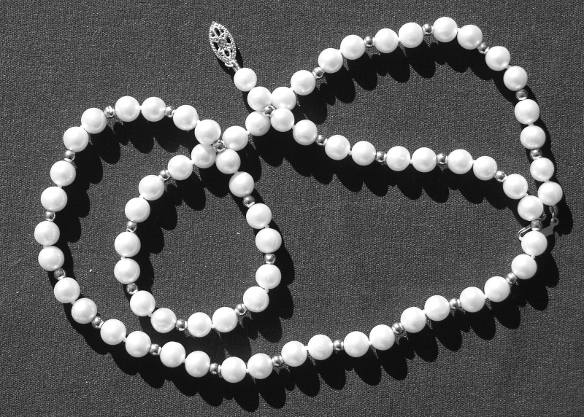
String of Pearls
https://www.k43.pbase.com
The string of pearls is somewhat analogous to identical monomers (simple sugars) bonded together to form starch or different monomers (amino acids) bonded together to form polypeptides that form proteins.

Slide 59
Polymer Formation
Polymers are formed from monomers through the process of dehydra-tion synthesis.
For each monomer added to a polymer chain, a water (H₂O) molecule is formed with the release of one oxygen and two hydrogen atoms.
The monomers replace lost covalent bonds by forming covalent bonds to each other.

Slide 60
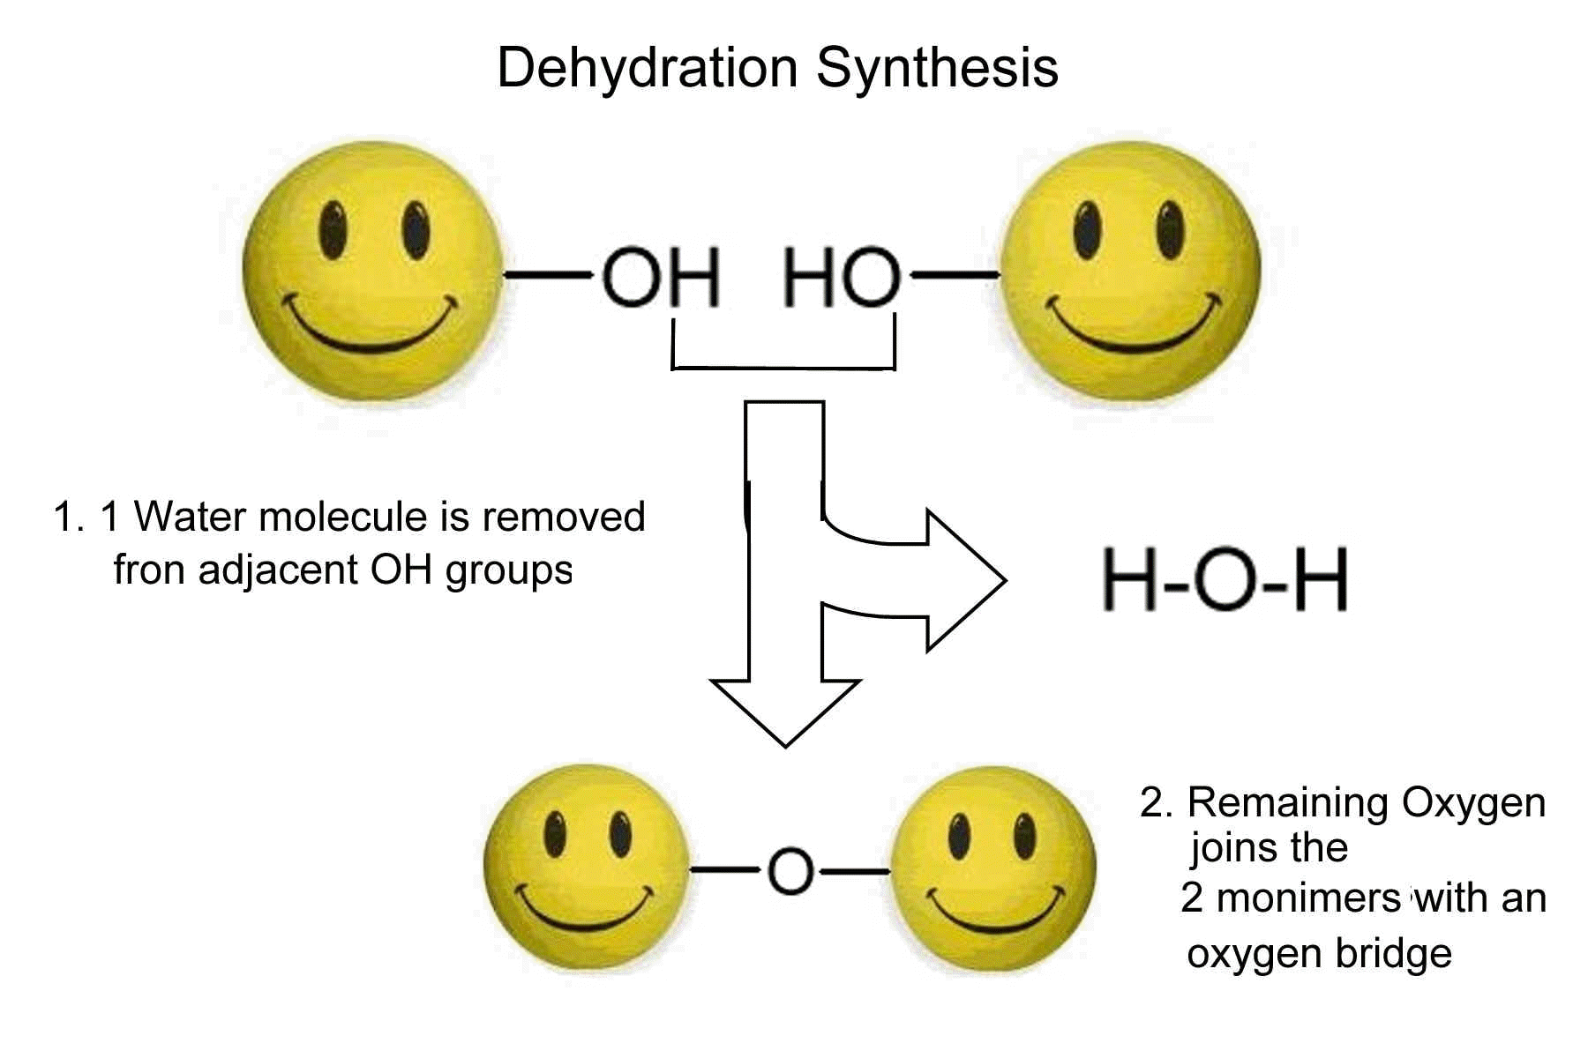
Dehydration Synthesis
(H₂O)
https://www.chsweb.lr.k12.nj.us
Monomers (such as glucose but not happy faces) are joined through the process of dehydration synthesis.

Slide 61
Breakdown of Polymers
Organisms (including humans) can breakdown certain molecules into smaller molecules or atoms.
The starches and proteins in the food we eat consist of long chains of polymers.
The polymers must be broken-down (digested) for absorption by the small intestine to make the monomers available for cell metabolism.
Cell metabolism = the chemical processes occurring within a living cell or organism that are necessary for the maintenance of life. In metabolism, some substances are broken down to yield energy for vital processes while other substances, necessary for life, are synthesized.
(https://www.thefreedictionary.com)

Slide 62
Breakdown of Polymers (continued)
The process of hydrolysis is the reverse of the process of dehydra-tion synthesis.
The covalent bonds between monomers are broken by adding H₂O along with an enzyme to facilitate the chemical reaction.

Slide 63
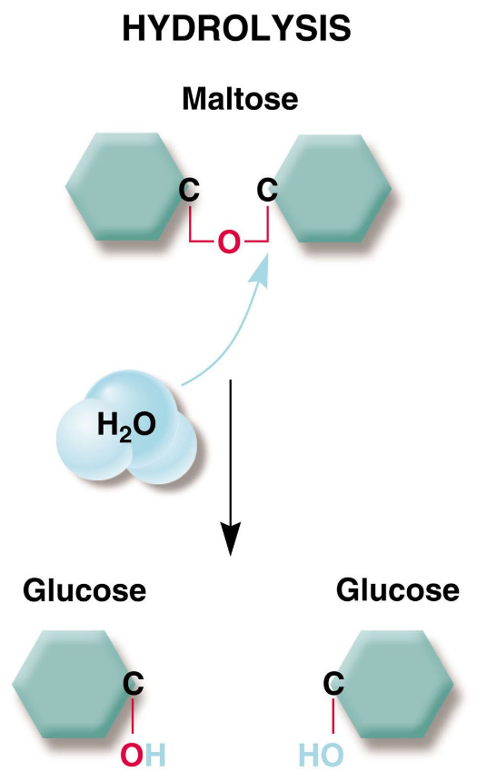
Hydrolysis
Maltose (double sugar)
+ Maltase (enzyme)
Glucose
Glucose (single sugars)
https://www.northonline.sccd.ctc.edu
In hydrolysis, the covalent bond between the two glucose molecules is broken-down through hydrolysis.

Slide 64
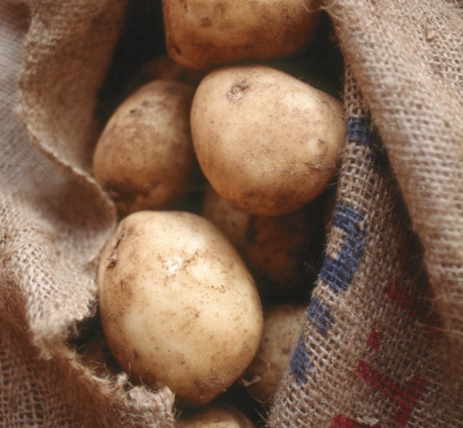
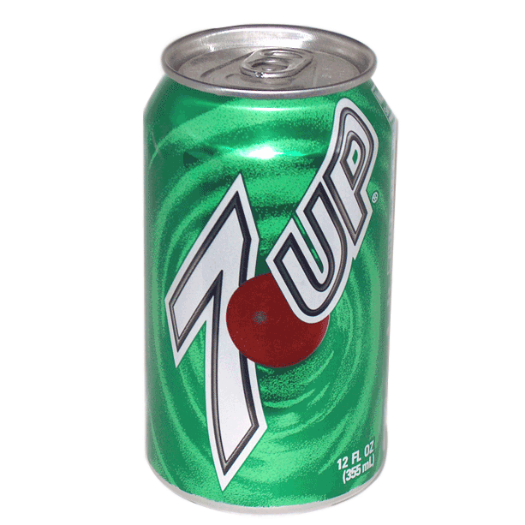
Carbohydrates
https://www.blackgoldpotatoes.com
https://www.dormgear.com
Carbohydrates range from single- and double-sugar molecules in soft drinks and candy, to long-chained starch molecules in pasta and potatoes.

Slide 65
Monosaccharides
Simple sugars (or monosaccharides) include:
  Glucose in sports drinks and corn syrup
  Fructose in fruit
  Fructose and glucose in high fructose corn syrup (HFCS)
Glucose and fructose are isomers that have the same molecular for-mula (C₆H₁₂O₆).
These two isomers differ in the position of a double covalent bond of an oxygen atom.
Many monosaccharides form ring-like structures in aqueous solutions.

Slide 66
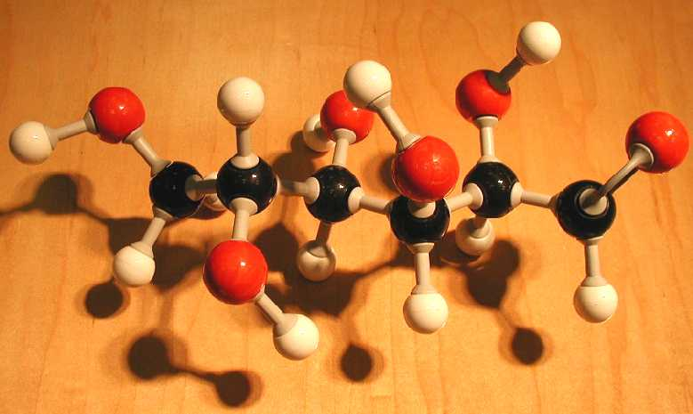
Glucose
https://www.biology.clc.uc.edu
Molecular formula: C₆H₁₂O₆
For glucose, the double bond for an oxygen atom is at the first carbon position. For fructose, an isomer of glucose (same molecular formula), the oxygen double bond is at the second carbon position.

Slide 67
Monosaccharides (continued)
We experience fructose as being much sweeter than glucose because our taste receptors for sweetness better fit the shape of fructose mole-cules.
Glucose is a primary source of chemical energy for performing cellu-lar work.
It is the only energy source used by the brain and other nervous sys-tem tissues.
Fructose is converted to glucose by the liver so that it can be used as an energy source by cells.

Slide 68
Disaccharides
A disaccharide is a double sugar formed from two monosaccharides through dehydration synthesis.
Disaccharides and their monosaccharides include:
  Sucrose = glucose + fructose (sugar cane and beet sugar)
  Maltose = glucose + glucose (beer, malted milk shakes, and malted milk balls)
  Lactose = glucose + galactose (dairy products)

Slide 69

Dairy-Producing Areas
https://www.nass.usda.gov
Dairies represent a substantial portion of the farming and agricultural economy in the United States.
69
Notes:
69

Slide 70

National Advertising Campaign
https://www.alondra2005.com
70
Notes:
70

Slide 71
Lactose Intolerance
Lactose is the sugar found in cow’s milk and other dairy products.
For some people, lactose can cause bloating, gas, and other un-comfortable symptoms.
They suffer from lactose intolerance, which is the inability to digest lactose.
The small intestine produces an enzyme, lactase, that breaks-down lactose into glucose and galactose so it can be absorbed.
Lactase is either not produced or produced in insufficient quantities in people who are lactose intolerant.
-ose — a sugar
-ase — an enzyme
71
Notes:
71

Slide 72
Signs, Symptoms, and Treatment
The water balance in the small intestine is disturbed, causing uncom-fortable symptoms.
Lactose intolerance cannot be reversed, but the signs and symptoms can be controlled by:
  Avoiding dairy products and other foods with lactose.
  Consuming milk and cheese substitutes made from soy.
  Consuming dairy products pretreated with lactase.
  Ingesting pills that contain lactase, such as Lactaid©.
Lactose intolerance illustrates the importance of biological molecules for health.
72
Notes:
72

Slide 73
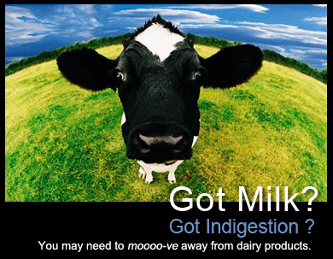
Public Information Campaign
https://www.publicaffairs.uth.tmc.edu
Developed by the University of Texas.
73
Notes:
73

Slide 74
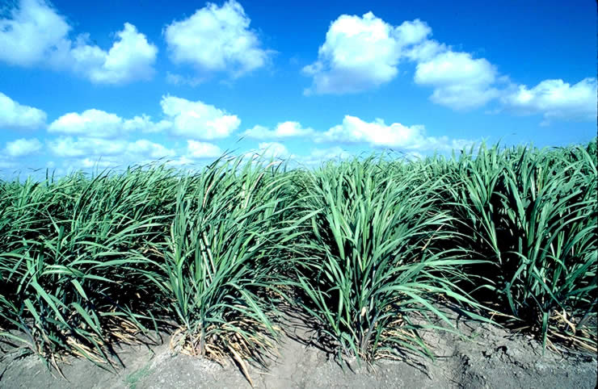
Sugar Cane
https://www.texasbeyondhistory.net
Sugar cane and sugar beets contain sucrose—glucose and fructose form this disaccharide.
74
Notes:
74

Slide 75
Commonly-Consumed Sugars
Sources | Sugar molecule |  | Comments
 | Fructose (percent) | Glucose (percent)
Sucrose | 50 | 50 | Used in many calorically sweetened beverage and food products outside of the U.S. and Canada.
High fructose corn syrup (HFCS-55) | 55 | 42 | Derived from corn syrup. Used in soft drinks and some juices as a caloric sweetener.
High fructose corn syrup (HFCS-42) | 42 | 53 | Derived from corn syrup. Used in baked goods, jams, and yogurt, including as a caloric sweetener, browning agent, and shelf-life extender.
Fruit | 100 | 0 | Caloric density is generally much less than other sugar sources listed in this table.
Honey | 50 | 50 | Nectar contains sucrose that honeybees hydrolyze into the monosaccharides, glucose and fructose.

Slide 76
Polysaccharides—Cellulose
The simplest polysaccharides are long chains of single types of sugar molecules—recall photo of the pearls of a necklace.
Starch, from roots and other plant organs, has many glucose mono-mers covalently bonded together.
Plant cells store starch as a source of chemical energy and materials for synthesizing other molecules.

Slide 77
Polysaccharides—Cellulose (continued)
Starch in human diets is from potatoes and grains such as wheat, corn, and rice.
Starches are digested in the digestive tract in the hydrolysis of chemical bonds between glucose molecules.

Slide 78
Polysaccharides—Cellulose (continued)
Cellulose is the most abundant organic compound on Earth—it forms cable-like fibers in the cell walls of plant cells.
Glucose monomers in cellulose are linked in more complex structures than in starches.
Cellulose cannot be digested by most animals (although ruminants are an exception), and it passes through the digestive tract as fiber (rough-age).
Fiber, which is an important dietary component, is found in fruits, vege-tables, whole grains, bran, and beans.
Fiber can absorb excess cholesterol in the small intestine and can help regulate bowel movements.

Slide 79
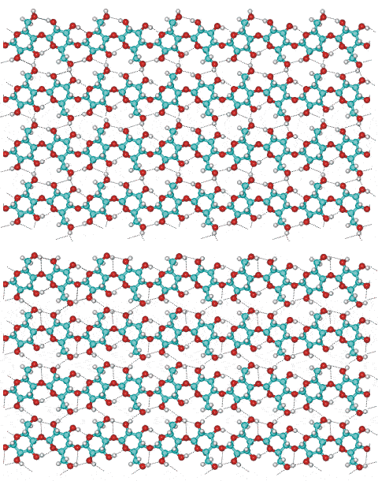
Cellulose—Molecular Structure
https://www.lsbu.ac.uk
Cellulose is a complex array of glucose molecules.
Grazing animals (ruminants), including cattle, and wood-eating termites have bacteria in their digestive systems that have enzymes that break the covalent bonds between glucose molecules in cellulose to enable it to be digested.

Slide 80
How many different carbohydrates do you consume in your diet?

Slide 81
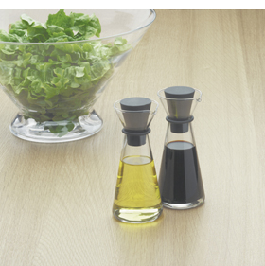
Lipids
Lipids are a broad and diverse set of biological molecules that include fats, cholesterol, and steroids.
All are hydrophobic—that is, they do not mix well with water because of their chemical properties.
For example, in oil and vinegar salad dressing, the oil (a lipid) will sep-arate from the vinegar consisting mostly of water.
https://www.tivolihome.com

Slide 82
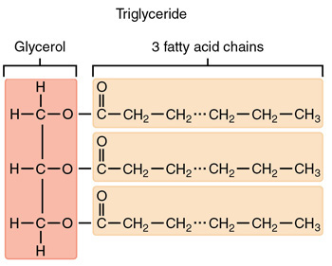
Fats
Triglycerides (a dietary fat) have a glycerol molecule covalently bonded to three chains of fatty acid molecules through dehydration synthesis.
Fatty acids consist of long hydrocarbon chains that store substantial amounts of energy—a pound of fat contains over twice the potential energy of a pound of starch.
Adipose cells swell and shrink with the deposit and withdrawal of fatty acids.
82

Slide 83
Fats (continued)
Due to its energy efficiency, fat is difficult to burn-off for losing weight.
A reasonable amount of body fat is normal and healthy and serves as a reserve for chemical energy.

Slide 84
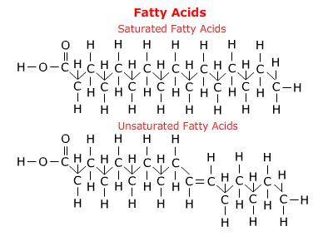
Saturated and Unsaturated Fatty Acids
A fatty acid is saturated when it has only single bonds and the maxi-mum number of hydrogen atoms.
A fatty acid is unsaturated when it has a double bond and less than the maximum number of hydrogen atoms.
An unsaturated fatty acid bends at the double covalent bond in its carbon backbone.
Saturated
Unsaturated
https://www.telstar.ote.cmu.edu

Slide 85
Nutritional Fats
A saturated fat has no double bonds in any of its three fatty acid chains.
A monounsaturated fat has a double bond in one of its three fatty acid chains.
A polyunsaturated fat has double bonds in two or three of its three fatty acid chains.

Slide 86
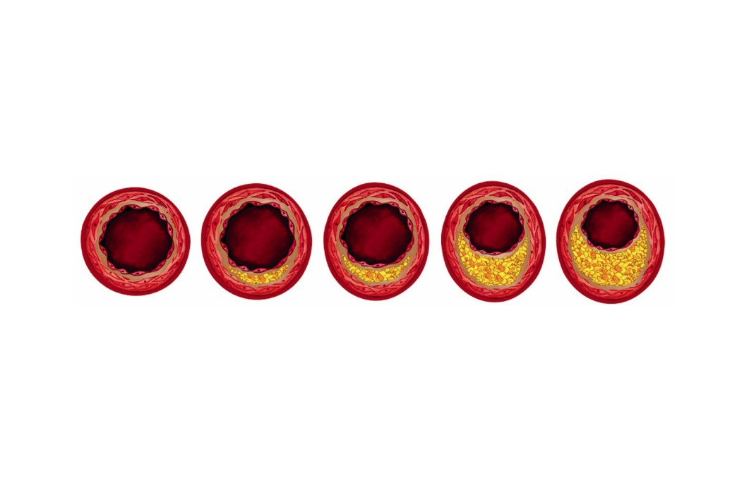
Nutritional Fats—Unhealthy Effects
Many animal fats—including red meat, lard, and butter—are high in saturated fats.
The linear shape of the hydrocarbon chains in saturated fatty acids allows them to stack easily, making saturated fats solid at room temperature.
Diets rich in saturated fats can contribute to cardiovascular disease in a condition known as atherosclerosis.
Lipid-containing deposits (called plaque) build-up in the walls of the coronary arteries and other arteries that reduces the blood flow and increases the risk of heart attacks and strokes.
Healthy artery (left)
Arteries progressively occluded with plaque (right)
https://www.multivu.com

Slide 87
Nutritional Fats—Healthier Alternatives
The fats in plant and fish are tend to be high in unsaturated fats.
Unsaturated fats include corn oil, canola oil, and cod liver oil—all can be part of a healthy diet.
Tropical plants oils, such as cocoa butter, contain both unsaturated and saturated fats.
87
Notes:
87

Slide 88
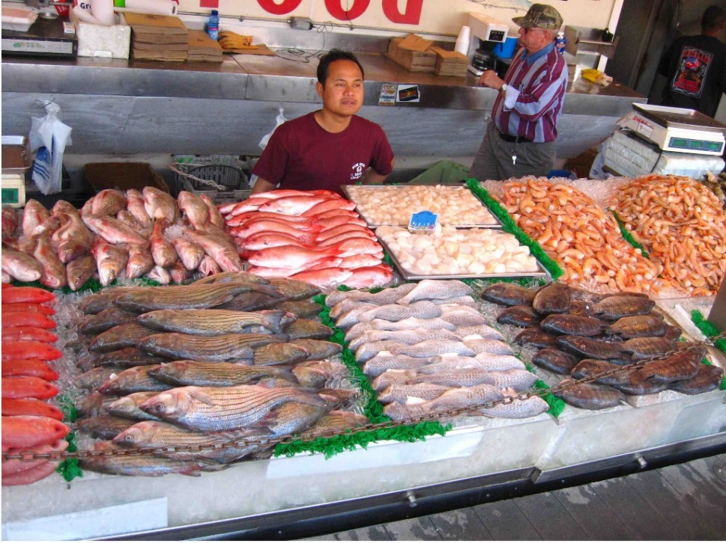
Nutritional Fats—Fish Market
https://www.thedctraveler.com
Many fish are an excellent source of unsaturated fats.
88
Notes:
88

Slide 89
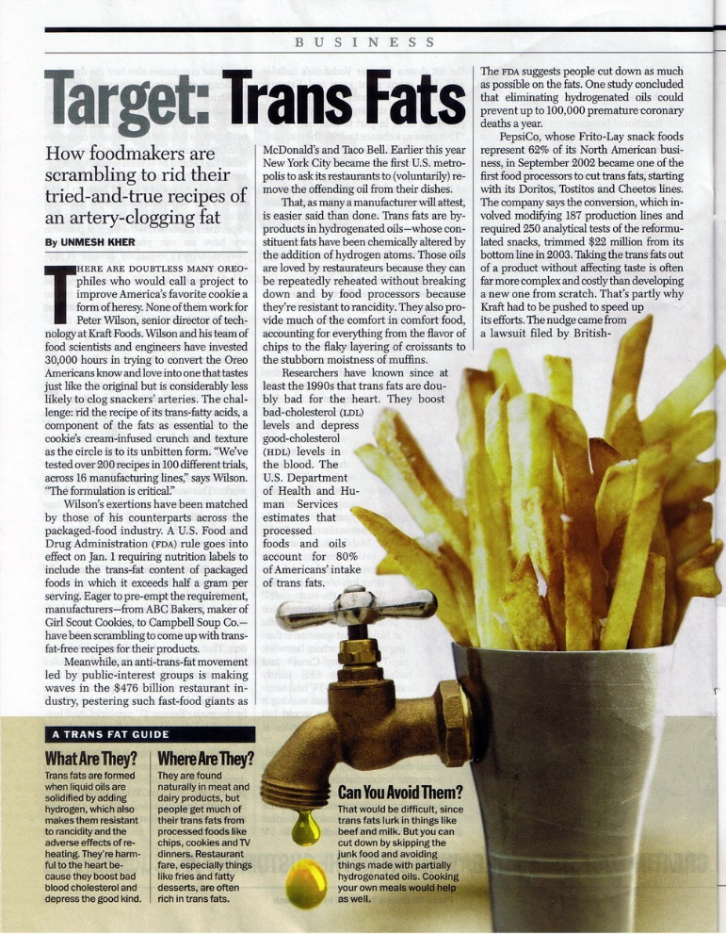
Trans Fats
https://www.olifera.com
89
Notes:
89

Slide 90
Trans Fats (continued)
Trans fats have received much scrutiny because they are implicated in cardiovascular disease.
Vegetable oils are hydrogenated to form a solid mass at room temp-erature—the process of adding hydrogen under high pressure elimi-nates the double bonds.
In the 1950s and 1960s, margarine was made from trans fats—not a healthy food despite the advertising at the time.
New York City and California, among other jurisdictions, have banned trans fats in restaurant chains.
The Federal government followed suit and expanded these restrictions to include packaged goods.
90
Notes:
90

Slide 91
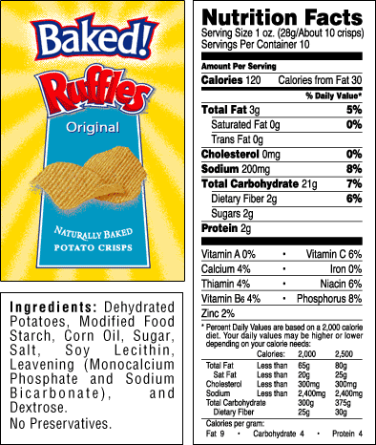
Nutrition Label
https://www.labelchoices.com
Nutrition labels are required by federal law on all packaged food items.
91
Notes:
91

Slide 92
At the grocery store, could you pick-out saturated and unsaturated fats?

Slide 93
Steroids
Steroids are lipids since they are hydrophobic—however, they differ from fats in their molecular structure and functions.
The carbon skeleton of a steroid has four rings (called A, B, C, and D).

Slide 94
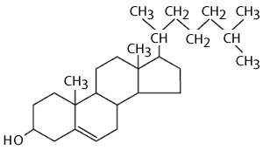
Steroids—Molecular Structure
C
D
A
B
https://www.abc.net.au
Cholesterol, shown above, is a precursor to other steroid molecules. They all share the same A-B-C-D ring structure.

Slide 95
Cholesterol
Cholesterol, a sterol molecule, is a precursor for testosterone, estro-gens, and corticosteroids, among other steroids.
We will discuss steroids in more detail when will cover endocrinology and sexual reproduction.
Cholesterol is needed by the body to synthesize cell membranes and to synthesize other molecules.
High levels of cholesterol (in particular, LDL) are linked to cardiovas-cular disease.
LDL = low density lipoprotein, a transport molecule since cholesterol is insoluble in blood plasma, which is mostly water.

Slide 96

Cholesterol Testing
https://www.myhealthtestreminder.com
Cholesterol testing is a preventative step in helping to maintain cardiovascular health.
96
Notes:
96

Slide 97
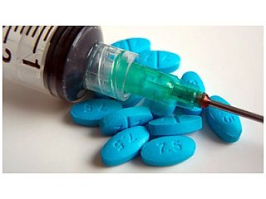
Anabolic Steroids
Anabolic steroids are synthetic (human-made) variants of testosterone, the male sex hormone.
In males at puberty, testosterone stimulates increased muscle and bone mass, promotes facial and body hair growth, and promotes other mascu-line traits.
Anabolic steroids mimic these effects due to a similar molecular structure.
Some professional and amateur athletes use anabolic steroids to enhance their performance because the margin between winning and losing can be miniscule.
https://www.californiaaddictionnetwork.com

Slide 98
Anabolic Steroids—Medical and Societal Issues
The health effects of anabolic steroids include violent mood swings, depression, liver damage, high cholesterol levels, reduced sex drive, and infertility.
The use of anabolic steroids raises medical, moral, ethical, and legal issues of unfair competitive advantage.
It also raises questions about athletes who are using anabolic steroids and other performance-enhancing drugs serving as role models for chil-dren and adolescents.

Slide 99
Anabolic Steroids—Mitigation
Major League Baseball (MLB), professional cycling, and professional wrestling have been the focus of recent controversies involving ana-bolic steroids.
Many athletic organizations including MLB no longer are oblivious to the use of anabolic steroids, and regularly test for anabolic steroids, blood doping, and banned drugs.

Slide 100
Proteins
Proteins are formed from one or more polypeptide chains that are synthesized from monomers known as amino acids.
The human body has tens of thousands of different proteins—each has a unique molecular shape.
The functions of proteins include:
  Structural
  Storage
  Contractile
  Enzymes
  Signal
  Transport
  Defensive

Slide 101
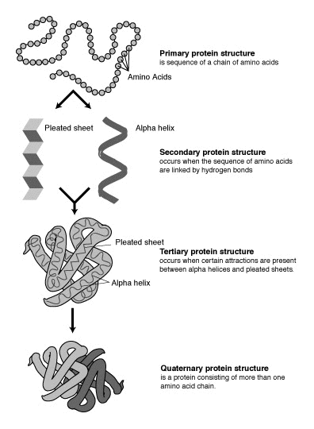
Levels of Protein Structure
Primary = amino acid sequence.
Secondary = alpha helix or pleated sheet.
Tertiary = polypeptide, three-dimensional shape.
Quaternary = protein, three-dimensional shape.
A protein molecule consists of one or more polypeptide chains joined by hydrogen bonds.
https://www.wikimedia.org

Slide 102
Amino Acids
All proteins in our bodies are synthesized from a common set of 20 amino acids.
Each amino acid has a carbon atom covalently bonded to four partners.
  Carboxyl group (—COOH)
  Amino group (—NH₂)
  Hydrogen atom (—H)
  Side group that is unique to each amino acid.
The side group gives an amino acid its specific properties.
The peptide (covalent) bonds that join amino acids are formed through dehydration synthesis.

Slide 103
Amino Acids—Structure
H
Amino
Group
(NH₂)
Carboxyl
Group
(COOH)
C
Side
Group
Side
Group
Side
Group
Side
Group
or…
A schematic diagram of a carbon atom and its four covalent partners in an amino acid.

Slide 104
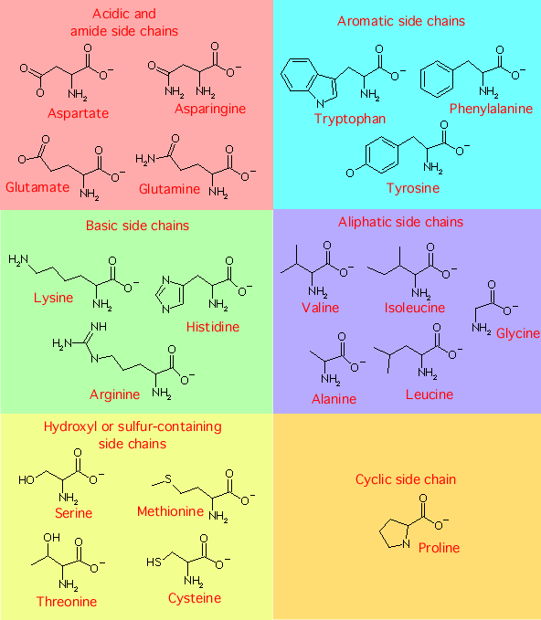
Amino Acids—Side Groups
Acidic or
amide
(n = 4)
Aromatic
(3)
Basic
(3)
Aliphatic
(5)
Hydroxyl or
sulfur-containing
(4)
Cyclic
(1)
https://www.bact.wisc.edu
Total = 20

Slide 105
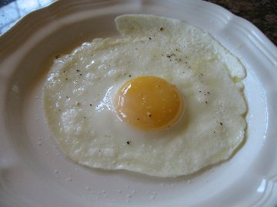
Proteins—Denaturation
The configuration (shape) of a protein is sensitive to its environment including pH and temperature.
Denaturation occurs when hydrogen bonds break and the protein un-ravels and loses its shape.
The shape usually cannot be restored when the environment returns to optimum conditions—the protein can no longer perform its function.
Denaturation can be observed
in the proteins of egg white when it turns from clear to opaque in a heated frying pan.
https://www.whatscookingamerica.com
105
Notes:
105

Slide 106
Nucleic Acids
The names of DNA (deoxyribonucleic acid) and RNA (ribonucleic acid) are derived from their origins in the cell nucleus.
Nucleic acids consist of long chains of four monomers known as nucle-otides.
The genes in DNA contain the instructions for synthesizing amino acid sequences to form polypeptides and proteins.
Transcription (DNA to mRNA) and translation (RNA to proteins) will be covered later in the biology review.

Slide 107
Nucleic Acids (continued)
Each nucleotide has three components: 1) sugar, 2) phosphate group, and 3) nitrogenous base.
The five-carbon sugar is ribose in RNA and deoxyribose in DNA (thus, their names).
The nitrogenous base is what gives each nucleotide its uniqueness.

Slide 108
Nucleotide Structure
Nitrogenous bases:
Thymine (T) and cytosine (C) have single-ring structures (known as pyrimidines).
Adenine (A) and guanine (G)
have double-ring structures (known as purines).
CH₂
Phosphate
group
Sugar
(deoxyribose)
Deoxyribose + phosphate group = sugar-phosphate backbone.
DNA base pairing rules = A with T and G with C in a double helix arrangement.

Slide 109
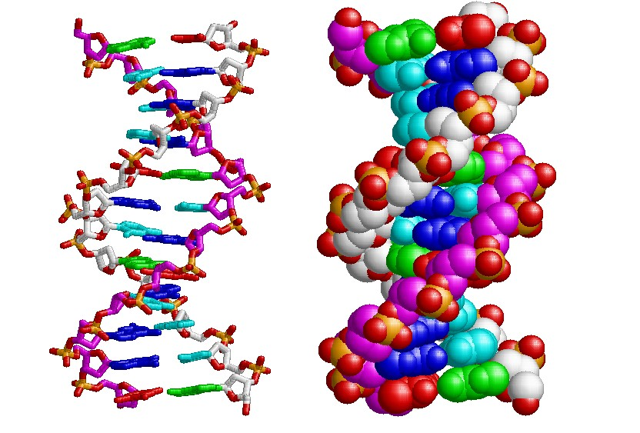
DNA Double Helix
Nitrogenous bases pair-off in the two strands of DNA to form a double helix structure.
The two strands are held together by hydrogen bonds.
https://www.csulb.edu
Two modeling techniques are shown—modified ball-and-stick model and space-filling model.

Slide 110
Can you name and provide a brief description of the
molecules of life?

