Slide 1
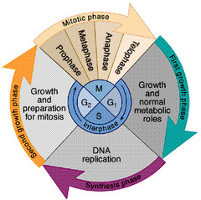
Cell Division
https://www.o.quizlet.com

Slide 2
Note
Much of the text material is from, “Essential Biology with Physiology” by Neil A. Campbell, Jane B. Reece, and Eric J. Simon (2004 and 2008). I don’t claim authorship. Other sources are noted when they are used.
2
Notes:
2

Slide 3
Outline
Mitosis
Cancer
Meiosis
Chromosomal disorders
Polyploid organisms

Slide 4
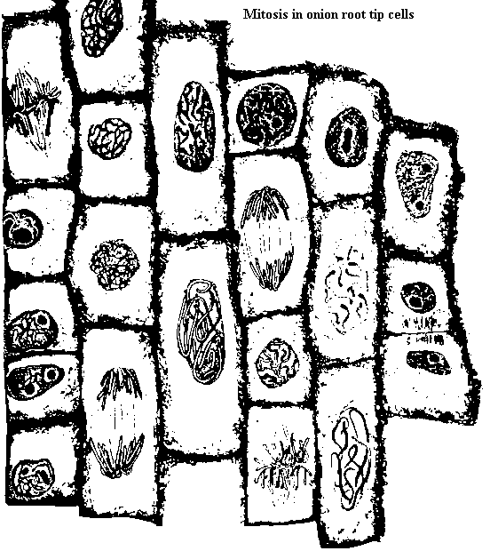
Mitosis
https://www.uq.edu.au

Slide 5
Reproduction
Reproduction is often associated with the origins of new offspring.
However, also occurs in many but not all types of cells for tissue growth and repair.

Slide 6
Skin
Our skin has an outer layer of dead epithelial cells—underneath are layers of living epithelial cells that are continually dividing and under-going chemical reactions.
New epithelial cells move to the skin’s surface to replace worn and cast-off dead cells.
New cells are also formed in our tissues to help heal wounds when we are injured.
This form of cell reproduction, known as mitosis, is a lifelong process for tissue growth and repair.

Slide 7
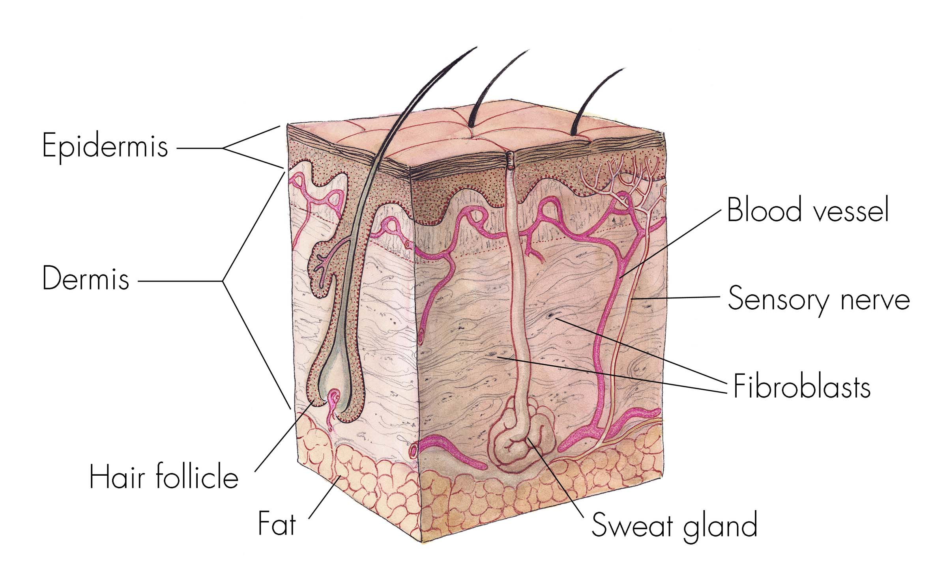
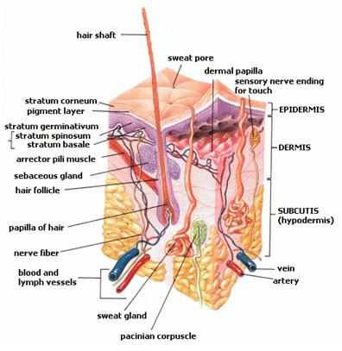
Skin (continued)
https://www.publications.nigms.nih.gov
Skin is a complex organ. Another lecture module is devoted to it.
https://www.web-books.com

Slide 8
Genetic Transmission
The two daughter cells are genetically identical to each other when a parent cell divides through mitosis.
In this context, daughter, the term used by biological scientists, does not imply gender.
The parent cell duplicates its set of chromosomes before it divides into two daughter cells.
In mitotic cell division, identical sets of genetic material are distributed to the daughter cells.

Slide 9
Asexual Reproduction
Single-cell organisms, such as amoeba, reproduce through simple cell division.
The offspring are genetically identical to the one parent.
The process is called asexual reproduction because it does not involve fertilization of an egg by a sperm.

Slide 10
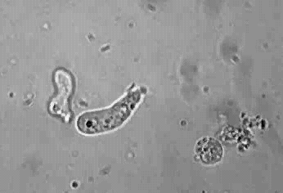
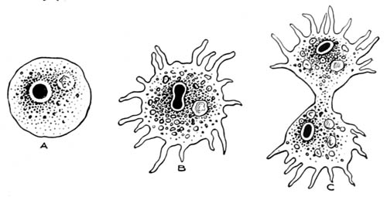
Amoeba
Amoeba reproduce asexually—cell division is underway.
https://www.biophysik.uni-bremen.de
Light micrograph
https://www.gutenburg.org

Slide 11
Asexual Reproduction (continued)
In asexual reproduction, the one parent and offspring have identical genetic material.
The process that enables cell division and asexual reproduction is mitosis.
For bacteria, the process is known as replication, which is different from mitosis.

Slide 12
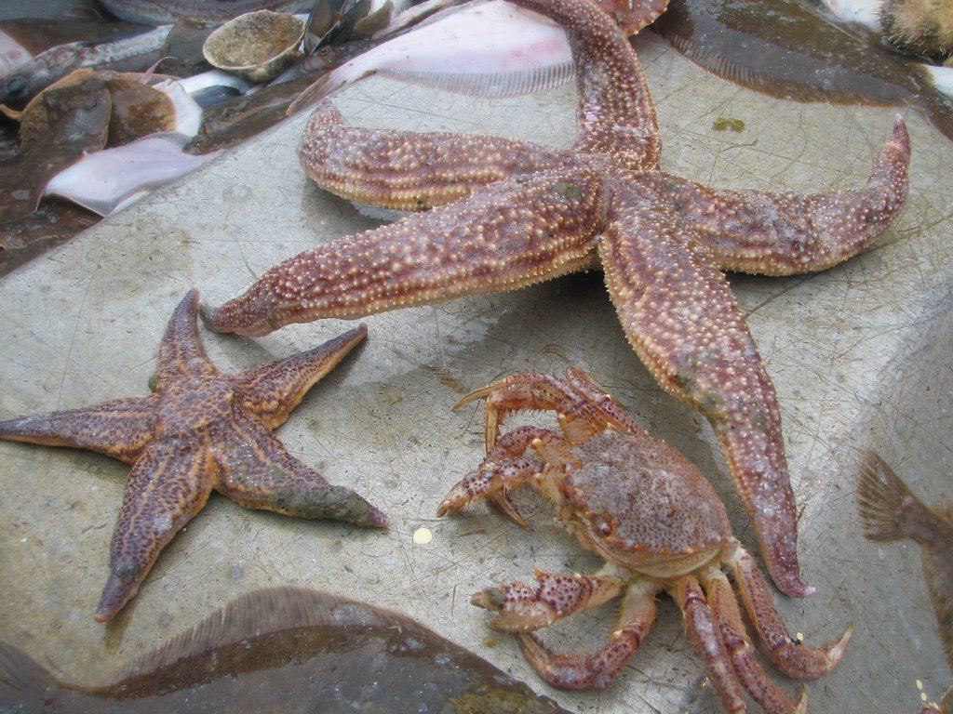
Sea Stars
https://www.jacobtanenbaum.com
Two sea stars and a crab—sea stars can replace their appendages by the cell division process of mitosis.

Slide 13
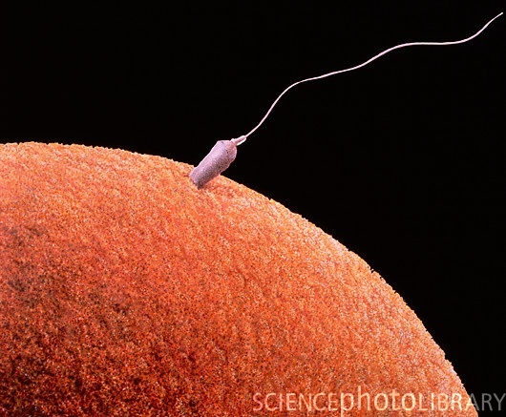
Sexual Reproduction
Sexual reproduction involves the fertilization of an egg by a sperm to produce genetically-unique offspring.
The production of egg cells and sperm cells involves a form of cell division known as meiosis.
Both types of cell division, meiosis and mitosis, are part of the lives of all sexually-reproducing organisms.
Egg and sperm,
computer-generated image
https://www.neurophilosophy.files.wordpress.com

Slide 14
Genome
A genome is a complete set of an organism’s genes—about 20,000 to 25,000 in humans.
Most of the genome is found in the chromosomes in the cell nucleus, which is derived from both parental lineages.
A small number of genes are found in the mitochondria, which is de-rived from the maternal lineage.
The genes are formed from the nucleotide pairings in the cell’s DNA.
Genes provide instructions for the synthesis (production) of proteins in the ribosomes through the transcription and translation processes.
DNA nucleotide pairings:
Adenine (A) with thymine (T)
Cytosine (C) with guanine (G)

Slide 15
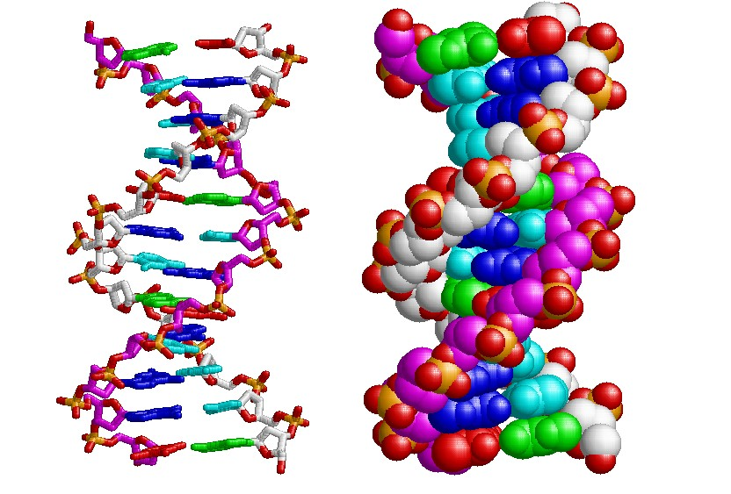
DNA (Cell Nucleus)
https://www.csulb.edu
Two molecular representations of a small segment of DNA and its two strands of nucleotides. Modified ball-and-stick and space-filling models are shown.

Slide 16
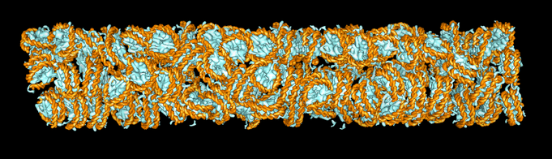
Chromosomes
The number of chromosomes varies by species—human somatic (body) cells usually have 46, dog cells have 78, and mouse cells have 40.
Chromosomes are made up of DNA tightly packed in protein molecules to form chromatin.
These proteins help condense and organize the chromosomes and con-trol gene activity.
Chromatin (computer-generated image)
https://www.cgl.ucsf.edu

Slide 17
DNA Packing
The DNA in each chromosome is packed into a multi-level system of coils and folds.
  At the first level, the DNA has the appearance of beads on a string.
  Each bead is called a nucleosome, made-up of DNA wound around eight histone molecules.
  At the second level, the beaded chain is wrapped into a tight helix-like fiber.
  At the third level, the helical fibers are arranged into a much thicker coil.
The coils and folds enable large amounts of DNA to be packed into a microscopic (very tiny) cell nucleus.

Slide 18
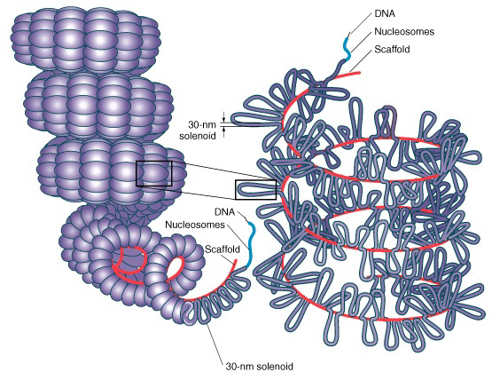
DNA Packing
https://www.mun.ca

Slide 19
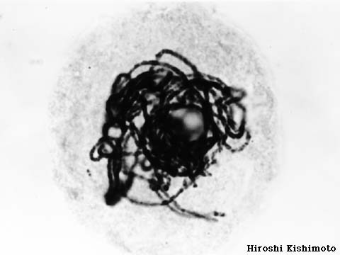
Chromosomes Prior to Mitosis
For much of a cell’s lifecycle, the chromosomes are a mass of fibers that are much longer than the diameter of a cell nucleus if they were to be stretched-out to their full length.
When a cell is not preparing to divide, the chromosomes are too thin to be visible under a light microscope.
When a cell prepares to divide, the chromatin fibers coil up and form compact chromosomes.
The chromosomes are visible with
a light microscope as shown here.
Nucleus of a chrysanthemum (plant) cell
https://www.z.about.com

Slide 20
Sister Chromatids
A parent cell preparing to divide duplicates its 46 chromosomes through DNA replication before mitosis begins.
Each of the original 46 chromosomes now has two genetically-identical copies called sister chromatids (the term does not imply gender or sex).
The sister chromatids are joined at their waists by a junction known as the centromere.
Sister chromatids separate in mitosis so that the daughter chromosomes are distributed to the two daughter cells.
The two daughter cells will each have 46 single chromosomes to form 23 pairs.

Slide 21
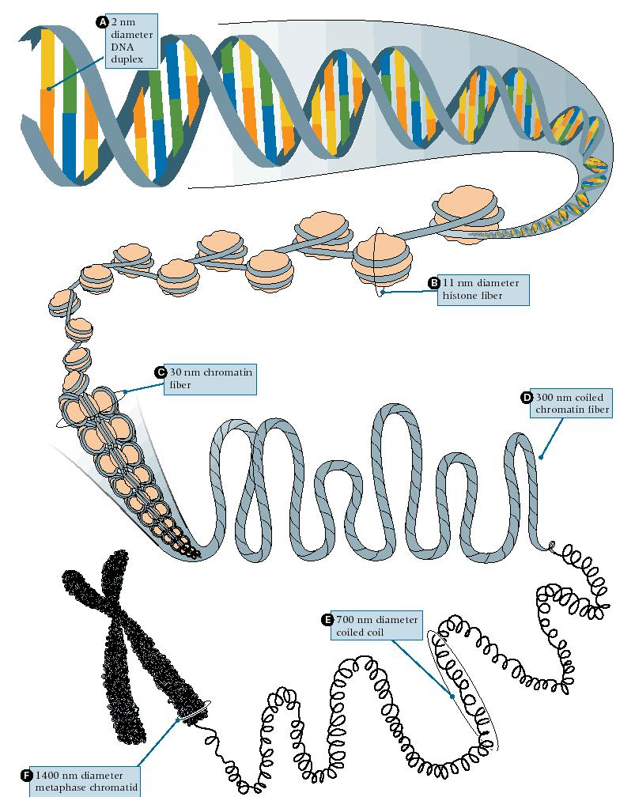
Sister Chromatids (continued)
A sister chromatid
joined at its waist or centromere. Each of the two genetically-identical strands in the sister chromatid is a daughter chromosome.
https://www.cbs.dtu.dk

Slide 22
Cell Cycle
The rate at which cells divide depends on their roles within an organism.
Some cells can divide as often once a day, others less often, and others including skeletal muscle fibers, cardiac muscle fibers, and neurons in humans and other mammals don’t divide.
The cell cycle is a sequence of events from the time a new cell is formed by the process of mitosis until it divides and forms two daughter cells.

Slide 23
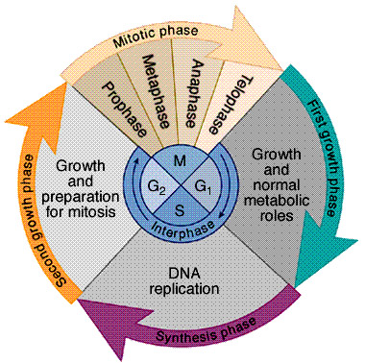
Cell Cycle—Interphase
https://www.bhs.smuhsd.org
Interphase consists of:
1. Growth and normal metabolic roles
2. DNA replication
3. Growth and preparation for mitosis

Slide 24
Interphase
A cell spends much of its lifespan in interphase, mostly in its growth and normal metabolic roles.
Prior to mitosis the cell duplicates its DNA and many of its organelles in preparation for cell division.
Interphase = the interval in the cell cycle between two cell divisions when the individual chromo-somes cannot be distinguished. Interphase was once thought to be a resting phase, but it is far from a time of rest for the cell. It is the time when DNA is replicated in the cell nucleus.
(https://www.medterms.com)

Slide 25
Cell Cycle—Mitotic Phase
https://www.bhs.smuhsd.org

Slide 26
Mitosis and Cytokinesis
The segment of the cell cycle when the cell divides is called the mitotic phase.
The mitotic phase has two overlapping components: mitosis and cyto-kinesis.
In mitosis, duplicated daughter chromosomes known as sister chroma-tids are equally distributed to the two daughter cells..

Slide 27
Mitosis and Cytokinesis (continued)
At the end of the mitotic phase, the still-connected daughter cells each have their own nucleus and organelles.
In cytokinesis, the cytoplasm is divided in two individual compartments to produce two physically-separated daughter cells.
Mitosis and cytokinesis produce two genetically-identical daughter cells.

Slide 28
Accuracy
Mitosis is an accurate mechanism for allocating genetic material to two daughter cells to assure genetic consistency from generation to generation.
In yeast, a type of eukaryotic cell, chromosomal errors occur about once in every 100,000 cell divisions, which is an extremely low error rate.

Slide 29
What could happen if mitosis were not a highly-accurate process?

Slide 30
Stages of Mitosis
Although mitosis is a continuum of cell division activity, four stages have been identified:
  Prophase
  Metaphase
  Anaphase
  Telophase

Slide 31
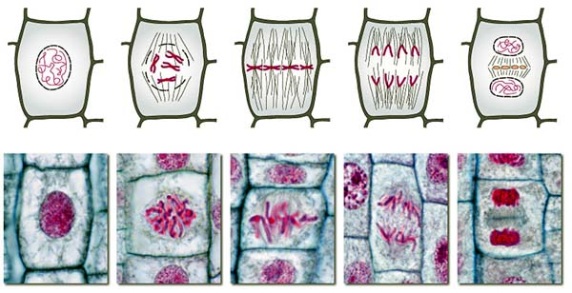
Mitosis in Onion Root Cells
https://www.sep.alquds.edu
Interphase (G₂)
Prophase
Metaphase
Anaphase
Telophase
Mitosis involves stages 2 through 5.
The process of mitosis, except for cytokinesis, is the same in plant and animal cells.

Slide 32
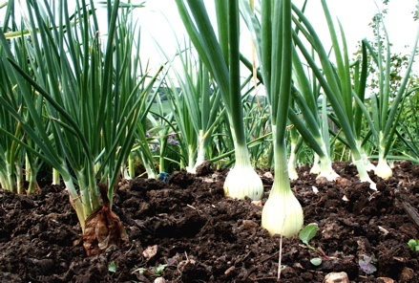
Why Examine Onion Root Cells?
Onion root cells are often used in demonstrating mitosis because they have large chromosomes that take a chemical stain well to en-hance their visual appearance.
Mitosis in onion root cells can be observed using a light microscope.
The process of mitosis (but not cytokinesis) is identical in plants, ani-mals, and other eukaryotic cells
https://www.mytinyplot.co.uk

Slide 33
Cell Cycle—Mitotic Phase
https://www.bhs.smuhsd.org

Slide 34
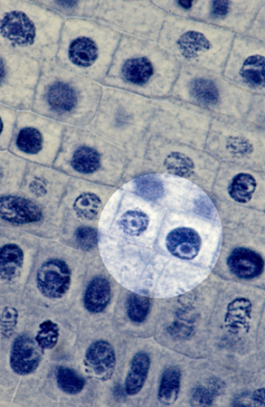
Interphase
https://www.sep.alquds.edu
https://www.microscopy-uk.org.uk

Slide 35
Interphase
Late interphase is the period when the parent cell synthesizes new molecules and organelles in preparation for cell division so that each daughter cell has a complete set.
The chromosomes are duplicated, although they cannot be visually distinguished since they are still loosely packed in the chromatin.
The nucleolus in the nucleus is visible, and it is producing ribosomes for protein synthesis needed for cell division.
In very late interphase (G₂), the cell has two centrosomes at each of its two poles that produce microtubules.

Slide 36
Prophase
https://www.sep.alquds.edu
https://www.microscopy-uk.org.uk

Slide 37
Early Prophase
In early prophase, changes are visually apparent in the nucleus and cytoplasm of the parent cell.
The chromatin fibers coil and become thick enough (condense) to be viewed using a light microscope.
Each individual chromosome is duplicated as two genetically-identical sister chromosomes that are joined at their waist (centromere) to form sister chromatids.
A mitotic spindle of microtubules extends from the two centrosomes at the opposite poles of the parent cell.
The microtubules consist of specialized motor protein molecules for movement of the sister chromatids and their daughter chromosomes.

Slide 38
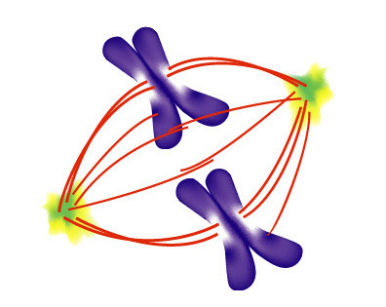
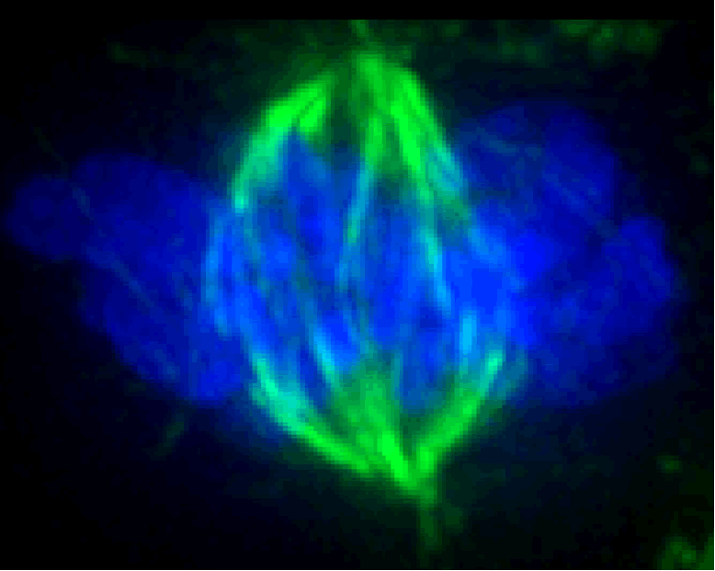
Mitotic Spindle
Centrosomes are shown in yellow and green at the opposite poles of the parent cell. Two sister chromatids of the 46 total are shown for simplicity. The mitotic spindle is shown in red.
https://www.mcb.berkeley.edu
Centrosome = an organelle that serves as the main microtubule organizing center of the animal cell as well as a regulator of cell cycle progression.
(https://www.wikipedia.org)
https://www.ornl.gov

Slide 39
Late Prophase
In late prophase, the plasma membrane of the nucleus (known as the nuclear envelope) breaks-up so the microtubules of the mitotic spindle can reach the sister chromatids.
Some of the microtubules attach to the sister chromatids and place them into a complex, rocking motion.
Other microtubules make contact with microtubules from the opposite pole to position the sister chromatids along the equator of the parent cell.
Cell equator = midway between the two opposite poles of the cell.

Slide 40
Metaphase
https://www.sep.alquds.edu
https://www.microscopy-uk.org.uk

Slide 41
Metaphase
In metaphase, the mitotic spindle is fully formed, and all of the 46 sister chromatids are positioned along the equator of the parent cell.
Other microtubules attach to each of the sister chromatids to try to pull the two daughter chromosomes that make up each sister chromatid to the opposite poles of the parent cell.
A tug of war between the microtubules keeps the sister chromatids posi-tioned along the equator and about midway between the two poles of the parent cell.

Slide 42
Anaphase
https://www.sep.alquds.edu
https://www.microscopy-uk.org.uk

Slide 43
Anaphase
In anaphase, the two daughter chromosomes in each sister chromatid suddenly separate.
Motor proteins of the microtubules move the daughter chromosomes to the opposite poles of the parent cell.
The microtubules shorten to bring the daughter chromosomes closer to each pole.
Other microtubules that are not attached to the daughter chromosomes push the poles farther apart to elongate (stretch) the parent cell in prep-aration for cytokinesis.

Slide 44
Telophase
https://www.sep.alquds.edu
https://www.microscopy-uk.org.uk

Slide 45
Telophase
Telophase begins when the daughter chromosomes reach the opposite poles of the elongated parent cell.
Two nuclear envelopes form, the chromosomes uncoil, and the mitotic spindle disappears.
Mitosis is now complete.
Cytokinesis—the physical separation of the parent cell into two individual daughter cells—occurs at the end of telophase.

Slide 46
Cytokinesis in Animal Cells
In cytokinesis, a ring of microfilaments consisting of the motor protein actin produces a cleavage furrow in the elongated parent cell.
This furrow encircles the equator of the cell midway between the two poles.
The ring constricts like the pulling of a drawstring, which deepens the furrow and divides the parent cell into two genetically identical daugh-ter cells.

Slide 47
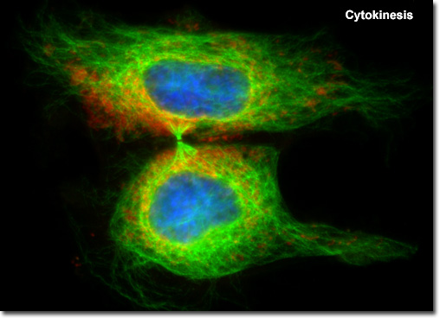
Cytokinesis in Animal Cells
https://www.molecularexpressions.com
Actin molecules in the process of pinching off the elongated parent cell to form two genetically-identical daughter cells.

Slide 48
Cytokinesis in Plant Cells
Vesicles containing material for cell walls collect at the equator of the elongated parent cell.
The vesicles fuse to form a cell plate.
The cell plate fuses with the plasma membrane to produce two sep-arate daughter cells.

Slide 49
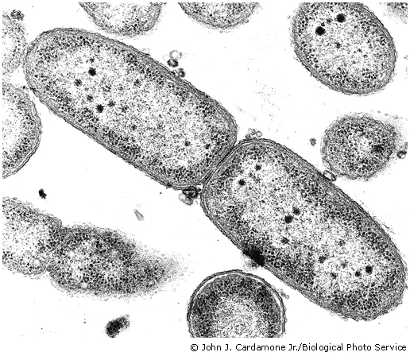
Cytokinesis in Plant Cells
https://www.trc.ucdavis.edu
The formation of cell walls and plasma membranes are visible in this electron micrograph.

Slide 50
Cell Control Cycle
The timing of mitosis is precisely controlled by genes in eukaryotic cells to grow and maintain tissues.
The events of the cell cycle are directed by a cell cycle control system of specialized proteins within the cell.
The proteins integrate information from the cell environment and send start and stop signals via signal transduction pathways at key points in the cell cycle.
Signal transduction pathway = the process by which a chemical or physical signal is transmitted through a cell as a series of molecular events.

Slide 51
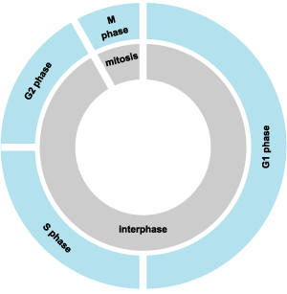
Cell Control Cycle (continued)
The cell cycle normally halts at the G₁ (growth and normal metabolic roles) stage of interphase unless it receives a signal to proceed.
If a signal does not arrive, the cell cycle will switch to a permanent off state, such as in mature muscle cells and neurons that do not divide in humans.
These cells are said to remain in G₀, which is the permanent off-state.
Mitotic phase
G₂ phase
Cell control cycle
G₁ phase
S phase
https://www.answers.com

Slide 52
Cell Control Cycle (continued)
For cells that do divide (such as epithelial cells), they will continue into the S phase and then into the G₂ phase.
Once the organelles and chromosomes are duplicated, the cell enters the mitotic phase to divide into two daughter cells.
Mitotic phase
G₂ phase
Cell control cycle
G₁ phase
S phase
https://www.answers.com

Slide 53
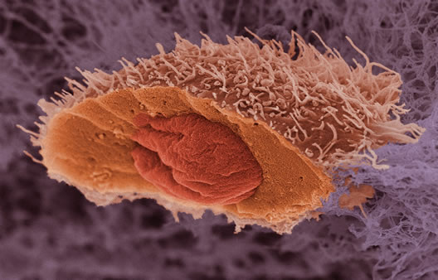
Cancer
A cancerous squamous cell with a cross-sectional cut
https://www.wellcome.ac.uk

Slide 54
When Things Go Wrong
Cells can reproduce at the wrong time and too often if the cell cycle control system malfunctions.
The result may be a tumor—an abnormal mass of cells that can be benign or malignant.

Slide 55
Benign Tumors
A benign tumor remains at its original site where it displaces normal tissue.
Although benign tumors are usually not dangerous, they should be medically examined.
Benign tumors of the brain can be dangerous since the cranial cavity is an enclosed chamber.
Tumor growth can increase the intracranial pressure and deform the delicate brain tissues.

Slide 56
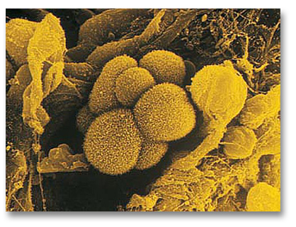
Malignant Tumors
A growth resulting from reproduction of cancer cells is called a malig-nant tumor.
Like benign tumors, malignant tumors displace normal tissue as they grow larger.
Lung cancer cells
https://www.oralcancerfoundation.org

Slide 57
Malignant Tumors (continued)
Malignant cancer cells can often spread to nearby tissues and other parts of the body.
The spread, known as metastasis, occurs through the blood vessels and lymphatic vessels.
Malignant cells show many unusual and abnormal behaviors.
Malignant cells may continue to multiply and metastasize until the or-ganism dies.

Slide 58
Malignant Tumors (continued)
Cancer is a collection of diseases in which cells are no longer effec-tively controlled by the processes that normally limit division during mitosis.
Cells divide excessively as if there were no stop signals in the cell control cycle.
The malfunctioning cell control cycle is due to mutations in certain genes and how they control protein synthesis in the ribosomes to regulate the cycle.

Slide 59
Oncogenes and Proto-Oncogenes
A gene that causes a cell to be cancerous is known as an oncogene (or tumor gene).
A normal gene that has the potential through mutations to become an oncogene is known as a proto-oncogene.

Slide 60
Genes and Growth Factors
Many of the genes involved in cancer normally code for growth factors—proteins that stimulate cell division in the cell control cycle.
These proteins normally keep the rate of mitotic cell division at the right level.
Uncontrolled cell growth can occur when the synthesis of these proteins goes awry.
Mitotic phase
G₂ phase
Cell control cycle
G₁ phase
S phase
https://www.answers.com

Slide 61
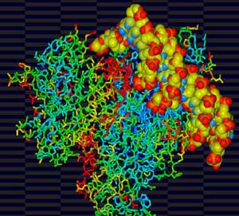
Tumor Suppressor Genes
Other genes can inhibit uncontrolled cell division by suppressing the division and growth of cancerous cells.
These tumor suppressor genes are a promising focus of research for cancer treatments.
A protein produced by a tumor-suppressor gene shown surrounding a segment of DNA of a proto-oncogene.
Computer-generated image
https://www.cosmosmagazine.com

Slide 62
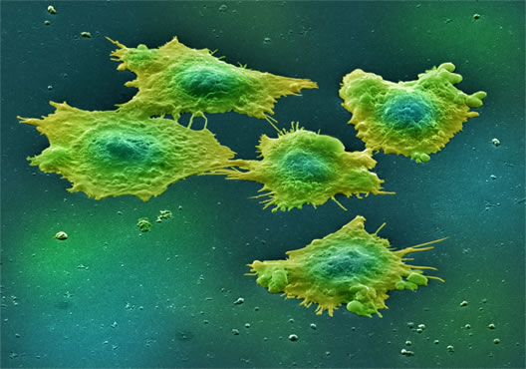
Colorectal Cancer
About 150,000 people in the United States are diagnosed with colon or rectal cancer each year.
Colorectal cancer, a well-understood human cancer, illustrates a key principle of how cancer develops:
More than one mutation is usually required for the appearance of cancer cells.
Colon cancer cells,
false-color, scanning electron micrograph
https://www.wellcome.ac.uk

Slide 63
Progressive Mutations
Colorectal cancer begins as unusually-frequent mitotic division of normal appearing cells in the lining of the colon wall.
DNA mutations occur at this initial stage and at later stages too.
The number of progressive mutations before colorectal cancer is evident (at least four) helps to explain why this cancer can take a long time to de-velop.
The cancerous cells are grossly altered in their physical appearance by the fourth mutation.
A substantial risk factor for colorectal cancer are high fat diets that are common in many western industrialized countries.

Slide 64
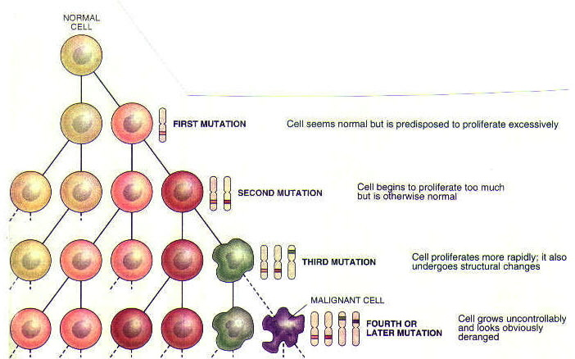
Progressive Mutations (continued)
Normal cell
Malignant cell
https://www.science.kennesaw.edu

Slide 65
Role of Heredity
Although cancer is a genetic disease, it is usually not inherited, since it results from mutations in the DNA of somatic cells but not gametes (eggs and sperm).
Genetic mutations are not passed from the parents to the child if they do not affect the gametes.
In a small number of families, the mutations in one or more genes can be passed to their children and may increase their risk of certain types of cancer.
The cancer usually does not develop unless the person acquires addi-tional mutations.
Somatic cells = all cells of the body except for gametes (eggs and sperm).

Slide 66
Breast Cancer
One out of every ten women in the United States will be diagnosed with breast cancer in their lifetimes.
Breast cancer can have different causes and therefore different treat-ments.
The large majority of cases of breast cancer have nothing to do with inherited mutations.

Slide 67
BRCA1 and BRCA2 Genes
A relatively small number of breast cancer cases are related to muta-tions of the BRCA1 or BRCA2 genes.
Research suggests that the proteins encoded by the normal BRCA1 and BRCA2 genes serve as tumor suppressors.
Clinical tests are available for detecting the presence of mutations in the BRCA1 and BRCA2 genes.
About 70 percent of women with the mutated gene will develop this form of breast cancer since penetrance is 0.70.
Few good options currently exist if a BRCA1 or BRCA2 test result is positive.
67

Slide 68
Cancer Risk
Cancer is a leading cause of death in industrialized countries including the United States.
Death rates for some types of cancer have declined, but the overall rate is on the rise.
Cancer-causing agents, called carcinogens, lead to DNA changes and cellular mutations.
In some instances, the mutations may require years of exposure to the carcinogen.
Lifestyle factors have a role in at least 50 percent of all cases of cancer.
Mutagenic = an agent capable of causing a gene change. Among the known mutagens are radiation, certain chemicals, and some viruses.
(https://www.medterms.com)

Slide 69
Lifestyle Factors
Some of the chemicals in the tar of first- and second-hand tobacco smoke are potent carcinogens.
Excessive exposure to the UVB radiation in sunlight can cause skin cancer.
Consumption of too much animal fat is associated with colorectal cancer— a reduction in fat consumption is a good idea for a number of health reasons.
Consuming about 20 to 30 grams of plant fiber each day, about twice the U.S. average, can reduce the risk of colorectal cancer.
Fruits and vegetables are good sources of soluble and insoluble fiber.

Slide 70
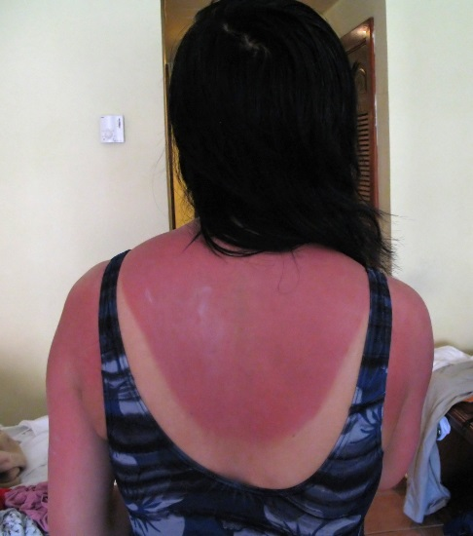
Ultraviolet Radiation
Increasing energy
10⁻⁵ nm
10⁻³ nm
1 nm
10³ nm
10⁶ nm
1 m
10³ m
Wavelength
Electromagnetic
radiation
Gamma
rays
X-rays
Ultra-
violet
Infrared
Microwaves
Radio waves
Visible light (380 to 750 nm)
Sunlight is about 45 percent visible light,
46 percent infrared, and 9 percent ultraviolet.
Beyond limiting excessive exposure to sunlight, the best protection from UV(B) radiation is wearing sunglasses and protective clothing, and using a proven, high-SPF sunscreen.
https://www.content.answers.com
70
Notes:
70

Slide 71
Lifestyle Factors (continued)
Vitamins including C, E, and A may offer some protection against some cancers—however, some recent research suggests that this may be questionable.
The role of diet in increasing the risk of some cancers is a focus of medical and public health research.

Slide 72


Glamorous?
https://www.blog.beliefnet.com
Two past cultural icons,
Lauren Bacall and James Dean
https://www.uberoriginal.blogspot.com

Slide 73
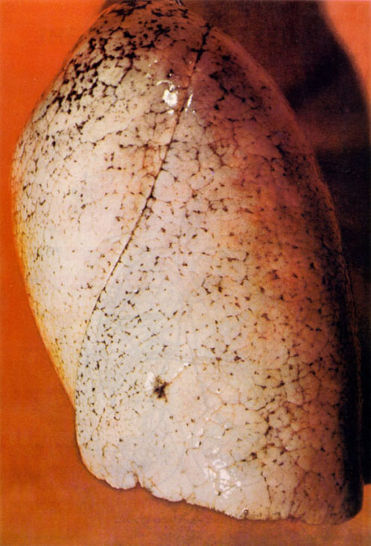
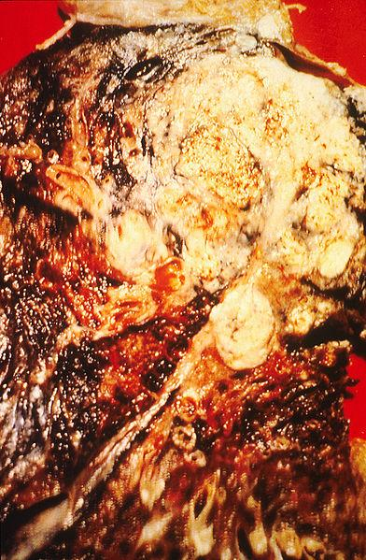
Lung Cancer
https://www.home-air-purifier-expert.com
https://www.esubulletin.com
Healthy and cancerous lung tissues.

Slide 74
Tobacco Smoke Can Also Cause:
Coronary artery disease and heart attacks (myocardial infarctions)
Chronic obstructive pulmonary disease (COPD)
Asthma
Strokes
Reduced fertility in women
Ectopic pregnancy (a fertilized egg implants in the fallopian tube)
Premature, low-birth weight babies
Type 2 diabetes
Cataracts and age-related macular degeneration
Colon, cervix, liver, stomach, and pancreatic cancer, among others.
American Lung Association
(https://www.lung.org)

Slide 75

Really?
75
Notes:
75

Slide 76
Cancer Types
A cancer is named based on where the malignant cells originated in the body.
Liver cancer, originates in the liver—it may remain there or metastasize to other tissues.
Cancers are grouped into four broad categories based on origination:
  Carcinomas—external or internal coverings of the body including the skin or intestines.
  Sarcomas—tissues that provide structure and movement for the body including bone and skeletal muscle.
  Leukemias—blood-forming tissues including the red bone marrow.
  Lymphomas—lymph nodes.

Slide 77
Surgery and Radiation Therapy
The major types of cancer treatment are surgery, radiation therapy, and chemotherapy.
The treatments can be used individually or in combination.
Surgery is often a first step—less invasive surgical techniques are being introduced.
Radiation therapy can often destroy malignant cells with their high rate of mitotic cell division, while leaving many healthy cells with their lower rates of division intact.
The side effects of radiation treatment can include hair loss and nausea.

Slide 78
Chemotherapy
Chemotherapy is intended to disrupt the high rate of mitotic division in cancer cells.
Some anti-mitotic drugs disrupt the formation of the mitotic spindle prior to cell division.
Other anti-mitotic drugs freeze the mitotic spindle so that mitotic cell division cannot continue.
Some of these drugs are produced from plants found in tropical and temperate rain forests.
Many of these forests are endangered due to either over-harvesting, clear-cutting, or fire.

Slide 79
Immunotherapy
Some cancers might be treated by harnessing lymphocytes (a type of white blood cell) of the body’s immune system.
The treatments are promising, in particular for one type of childhood leukemia, and presently very expensive.
Expect to hear much more about immunotherapy in the coming years.

Slide 80
Early Detection and Intervention
Some cancers are often treatable if they are detected in their early stages.
Regular visits to a physician or health clinic can help identify tumors at their earliest stages for timely treatment.
Websites and literature are available from health organizations that discuss the risks and what can be done.

Slide 81
Do you think if enough money were devoted to cancer research, that an overall cure will be found?

Slide 82
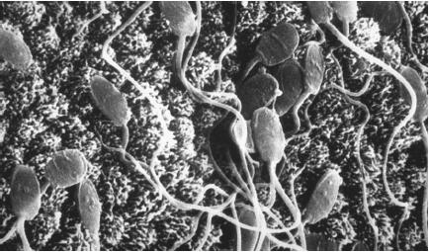
Meiosis
Electron micrograph of sperm
https://www.scienceclarified.com

Slide 83
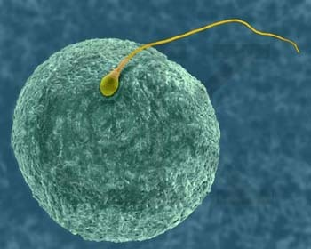
Sexual Reproduction
https://www.about.biology.com
Sexual reproduction involves the fusion of the genetic material (chromosomes) of an egg and a sperm.

Slide 84
Homologous Chromosomes
All chromosomes, except X and Y on the 23rd pair in males, have a twin that is matched in size, shape, and bands.
Each pair is said to be homologous since each chromosome carries the same sequence of genes for controlling inherited characteristics.
For example, the multiple genes for eye color are found at identical locations on the homologous pairs.
The instructions are dominant or recessive, with one inherited from each parent.

Slide 85
Karyotype
A typical body cell in humans, known as a somatic cell, usually (but not always) has 46 chromosomes.
We will cover some exceptions when will discuss chromosomal disorders.
A light micrograph of the chromosomes can be made if the cell nucleus is opened.
The individual chromosomes can be arranged in an ordered array known as a karyotype.

Slide 86
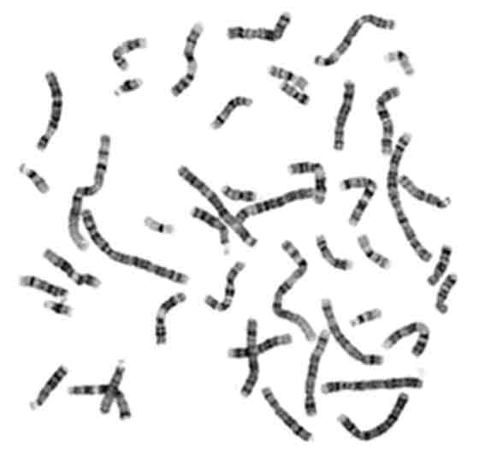
Unordered Chromosomes
https://www.biotechnologyonline.gov
Light micrograph of chromosomes.

Slide 87
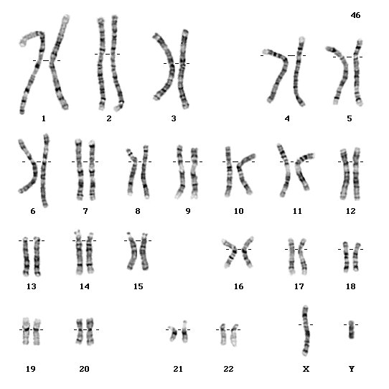
Karyotype
https://www.ucl.ac.uk
A karyotype is an ordered array of chromosomes based on their sizes, shapes, and bands.

Slide 88
Sex Chromosomes
The 23rd set of chromosomes specifies the genetic sex of a human.
An egg has a X chromosome.
A sperm has a X or Y chromosome to determine the genetic sex of the embryo.
Embryo = an early stage in the development of a multi-cellular organism. In humans, it covers about week three through week eight after fertilization.

Slide 89
Sex Chromosomes (continued)
Genetic females usually have two X chromosomes—but sometimes it can be XO or XXX—XO signifies there is only one X chromosome.
Genetic males usually have one X chromosome and one Y chromo-some—but sometimes it can be XXY or XYY.
The 23rd set is known as the sex chromosomes.
The remaining 22 sets, in both females and males, are called auto-somes.
The XO, XXY, and XXY chromosomal patterns are covered in the lecture module on sexual differentiation.

Slide 90
Diploid Number
Humans and most animals are diploid organisms because all so-matic (body) cells contain paired sets of homologous chromosomes.
The number of pairs is represented by n (in humans, n = 23).
The number of individual chromosomes (46) is the diploid number, 2n.
Di- = two

Slide 91
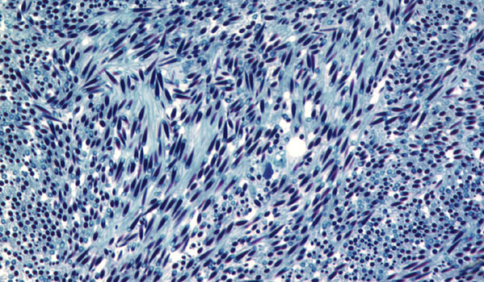
Haploid Number
Gametes (eggs and sperm) formed through meiosis in the ovaries and testes contain one member of each homologous chromosome pair.
Gametes are haploid since they contain one-half the number of chromosomes found in body cells.
The number of chromosomes in human gametes (23) is known as the haploid number, n.
Spermatozoa (sperm)
https://www.zoology.unh.edu

Slide 92
Fertilization
A sperm cell (spermatozoon) fuses with an egg cell (ovum) in the process of fertilization.
Each of the two gametes is haploid (23 chromosomes) and the fertilized egg (zygote) is diploid (23 pairs of chromosomes) once fusion of the genetic material occurs.
One member of each pair of homologous chromosomes is contri-buted by each parent.
Spermatozoa = plural
Spermatozoon = single

Slide 93
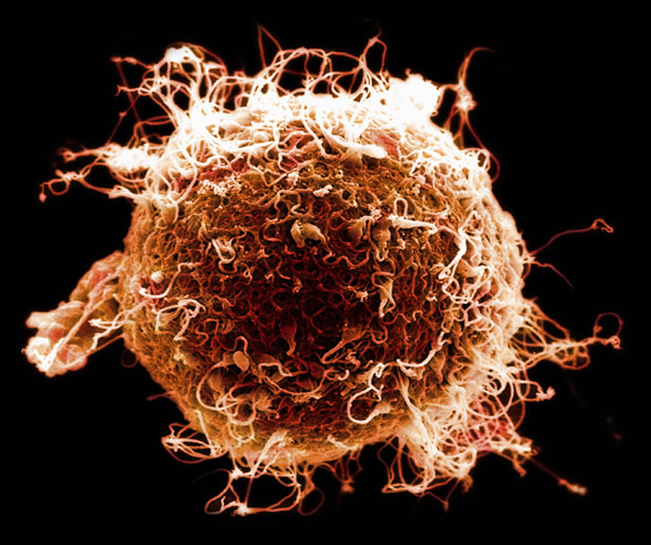
Sperm and Egg
https://www.nmhm.washingtondc.museum
Although many sperm are present, only one can fertilize the egg due to rapid biochemical changes in the plasma membrane of the egg once one sperm penetrates it. This prevents the chromosomes of multiple sperm fusing with the chromosomes of a single egg.

Slide 94
Mitotic Cell Division
Mitotic cell division begins within a day or so after fertilization of an egg by a sperm.
Each one of the approximately 70 trillion cells (70,000,000,000,000) in the human body can be traced to a single fertilized egg (called a zygote).

Slide 95
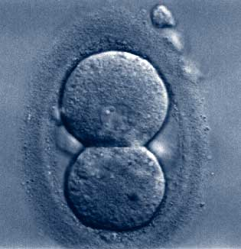
Two Cell Stage
https://www.midwesttiv.com
The first day after fertilization—mitotic cell division has begun.

Slide 96
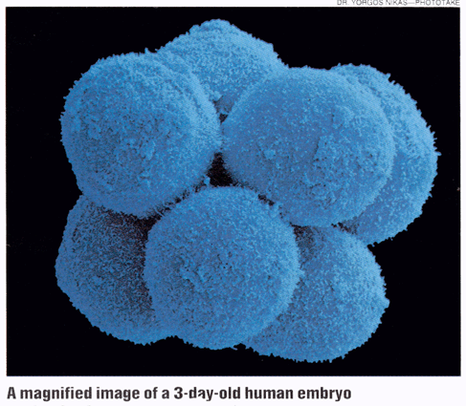
Eight Cell Stage
https://www.fig.cox.miami.edu
Three days after fertilization.

Slide 97
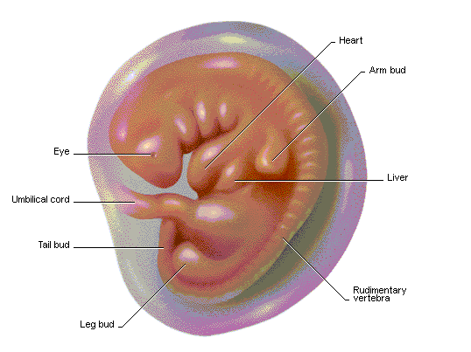
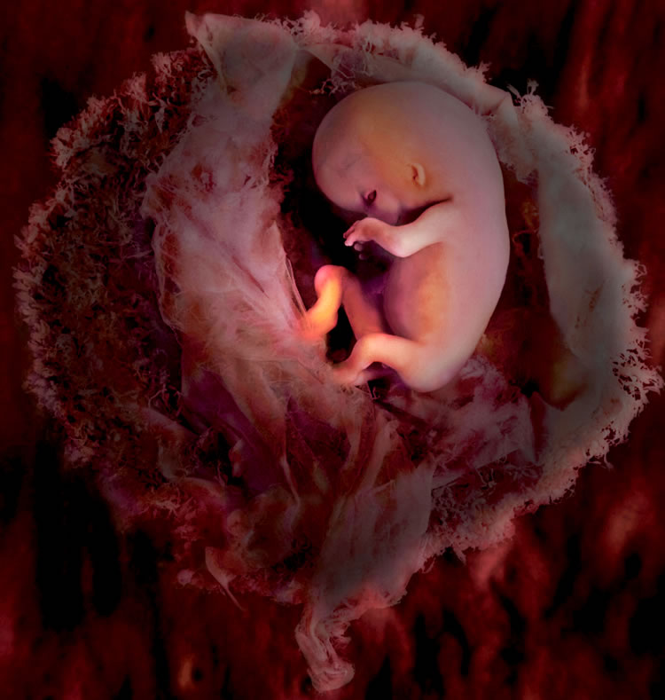
Continued Growth
Eight-week-old human embryo
https://www.library.thinkquest.org
Five-week-old human embryo
https://www.nmhm.washingtondc.museum

Slide 98
In Vitro Fertilization
In vitro fertilization (IVF) is a medical technique for fertilizing an egg outside of the woman’s reproductive tract.
IVF can be used when a couple cannot conceive for various reasons through sexual intercourse.

Slide 99
IVF Procedures
IVF involves stimulating the ovaries with hormones to release ova, harvesting them, and fertilizing them with sperm in a fluid medium.
The embryo is transferred to the mother once the uterus has been readied hormonally.
Precision techniques are sometimes used to insert the sperm into the ovum.
Ova = plural for ovum (egg).

Slide 100
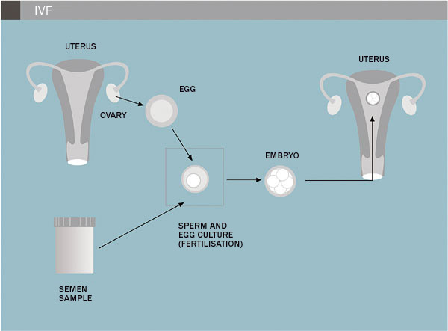
IVF Procedure
https://www.ivi.es
The traditional in-vitro fertilization (IVF) method is shown.

Slide 101
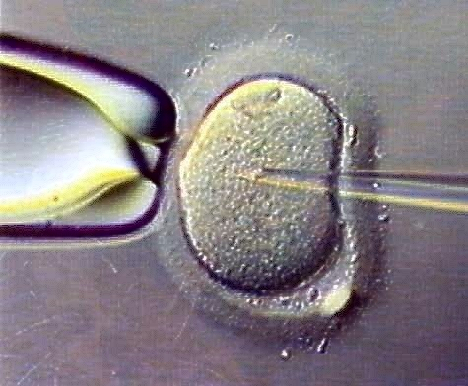
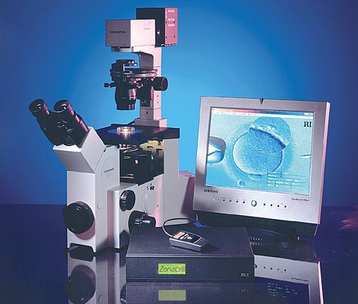
IVF Microtechnique
This microtechnique is a more recent, precision approach to IVF.
https://www.tylermedicalclinic.com
A sperm cell is inserted into an egg cell using a glass micropipette with a very thin, hollow tip.
https://www.stoeltingco.com

Slide 102
Success Rates
The success rate of IVF is about 33 percent, although it can be lower for older women.
Multiple eggs, to improve the likelihood of pregnancy, may result in more than one embryo.
A woman may provide her own eggs or rely on a donor if one is avail-able.

Slide 103
Meiosis
Meiosis, the basis of sexual reproduction, resembles mitosis, but it has two additional aspects:
  Crossing over (exchange) of genetic material between the homologous pairs of chromosomes.
  Halving of the number of chromosomes (2n is reduced to n).
The gametes undergo two consecutive divisions in meiosis I and II.
Four daughter cells result, each with one-half as many chromosomes (n) as the starting cell (2n).
Meiosis takes place in the ovaries and testes; mitosis occurs in somatic (body) cells.

Slide 104
Meiosis (continued)
Meiosis is the basis of sexual reproduction in multicellular eukaryotic organisms (including humans).
It occurs in the ovaries or testes, and their equivalents in plants and fungi.
Each offspring inherits a unique combination of genes from the two parents.
Unlike in mitosis, where the daughter cells are genetically-identical, the offspring resulting from meiosis will have substantial genetic vari-ation.

Slide 105
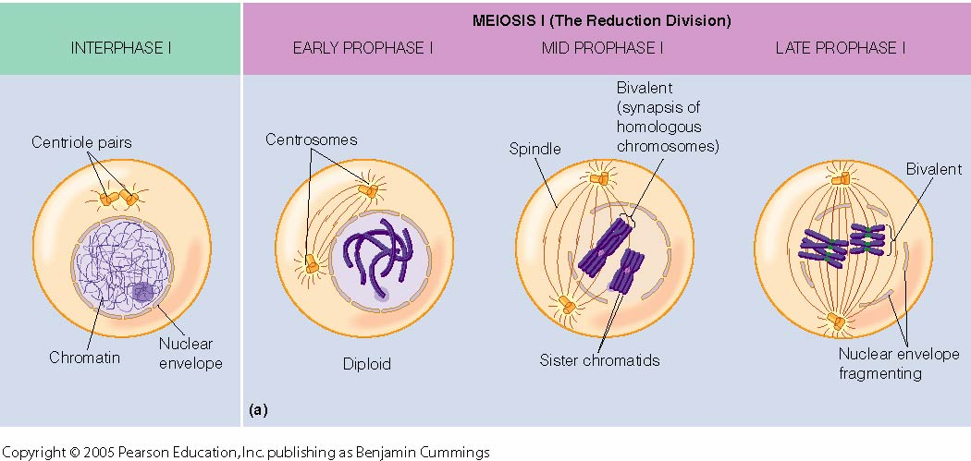
Interphase and Meiosis I
Interphase
Meiosis I
https://www.mun.ca

Slide 106
Interphase
In the interphase, before meiosis I begins, each chromosome of a homologous pair replicates to form two pairs of sister chromatids.
The two pairs of sister chromatids stay together as a tetrad until the end of meiosis.

Slide 107
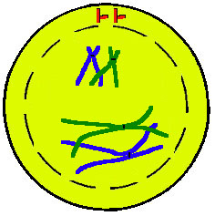
Prophase I
In prophase I, specialized proteins hold the tetrads together as the chromatin condenses.
The chromatids of the homologous pairs in the tetrads exchange DNA segments (genetic information) in a process known as crossing-over.
https://www.uic.edu

Slide 108
Prophase I (continued)
Crossing-over assures genetic variation from generation to generation and between siblings.
The process rearranges the genetic information from the two parents, as we will discuss.
Spindles of microtubules form, and the tetrads are moved toward the parent cell’s equator.
https://www.uic.edu

Slide 109
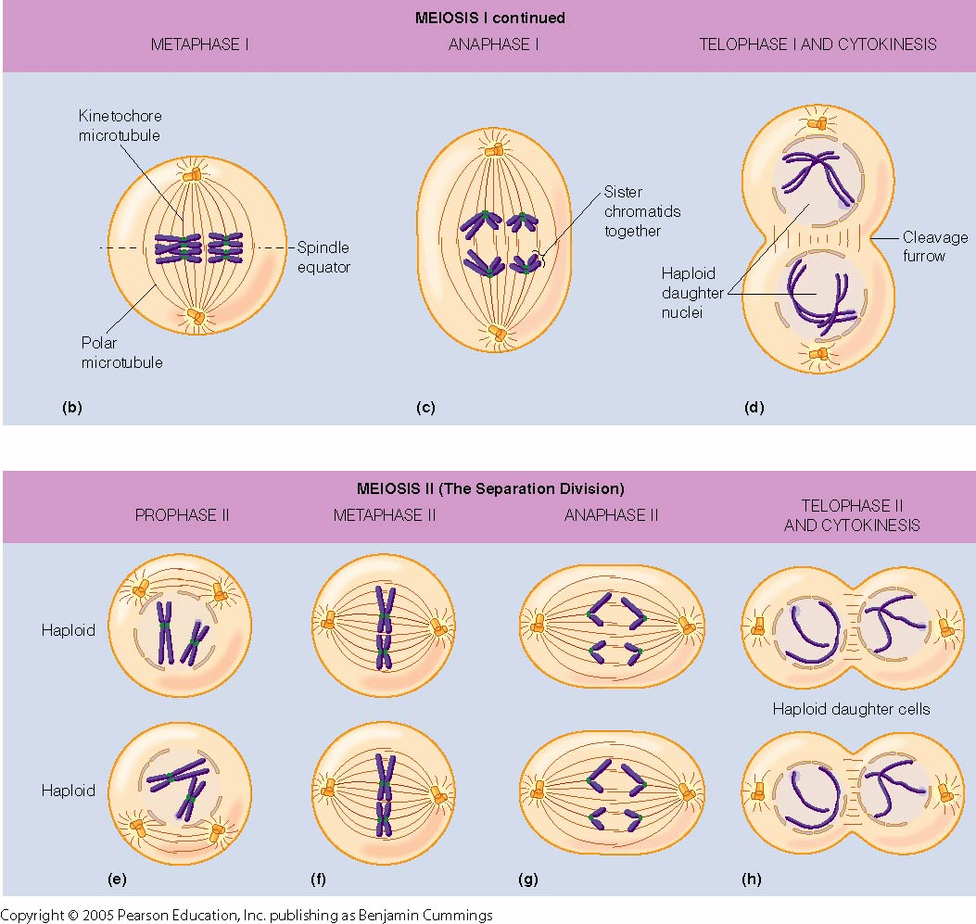
Metaphase I, Anaphase I, and Telophase I
https://www.mun.ca

Slide 110
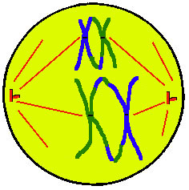
Metaphase I
In metaphase I, the sister chromatids in the tetrad remain attached at their centromeres (waists).
The tetrads are aligned on the equator by the spindles anchored to the opposite poles of the cell.
The spindle is arranged so that the homologous chromosomes of each tetrad can move to the opposite poles.
https://www.uic.edu

Slide 111
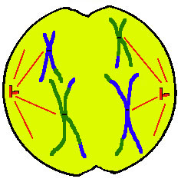
Anaphase I
In anaphase I, the microtubules in the spindles move the chromosomes toward the opposite poles of the parent cell.
Unlike in mitosis, sister chromatids migrate as pairs rather than splitting up.
The sister chromatids, each with unique genetic content, are separated from their homologous partners—this occurs after the process of cross-ing-over in prophase I.
https://www.uic.edu

Slide 112
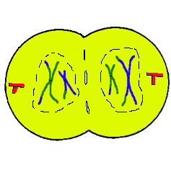
Telophase I and Cytokinesis
In telophase I, the sister chromatids reach the poles as a haploid set since the chromosomes are still in duplicate form.
Two haploid daughter cells with pairs of chromosomes are formed by cytokinesis at the end of telophase I.
No further chromosome duplication occurs in the subsequent stages of meiosis II.
https://www.uic.edu

Slide 113
Meiosis II
https://www.mun.ca

Slide 114
Meiosis II
The processes of prophase II, metaphase II, anaphase II, telophase II, and cytokinesis are very similar the processes we discussed for mitosis.
Meiosis I results in two haploid daughter cells, while meiosis II doubles the number to four haploid daughter cells.
The haploid cells serve as the progenitors for eggs and sperm produced by the gonads.
Progenitor = predecessor

Slide 115
Mitosis versus Meiosis
Mitosis enables growth, tissue repair, and asexual reproduction by the production of daughter cells that are genetically identical to the parent cell.
Meiosis only occurs in the ovaries and testes whereas mitosis occurs in somatic cells.
Meiosis enables sexual reproduction by production of genetically unique daughter cells called gametes (eggs or sperm).
In mitosis and meiosis I, the chromosomes duplicate only one time dur-ing the interphase.

Slide 116
Mitosis versus Meiosis (continued)
Mitosis involves one division of the cell nucleus and cytoplasm to produce two diploid daughter cells (2n).
Meiosis I and II involves two divisions of the cell nucleus and cyto-plasm to produce four haploid daughter cells (4n) for eggs and sperm.
All events unique to meiosis (those not occurring in mitosis), occur in meiosis I.

Slide 117
Mechanisms of Genetic Variation
Crossing over and genetic recombination
Independent assortment
Random fertilization
Because of these three mechanisms, offspring will display much genetic variation from the parents and all siblings except in instances of monozygotic (identical) twins.

Slide 118
Crossing Over
At the time of crossing over of genes during prophase I, homologous chromosomes in a tetrad are closely paired all along their lengths.
Due to this arrangement, a precise gene by gene alignment enables the exchange of genetic material.
Crossing over provides vast possibilities for genetic variation between parents and offspring.

Slide 119
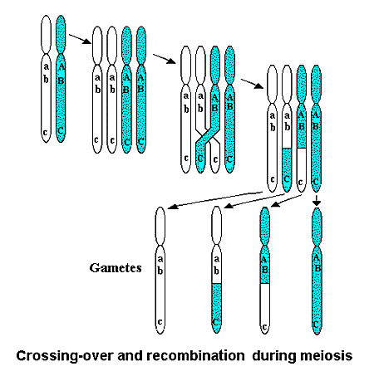
Crossing-Over (continued)
Tetrads
Homologous chromosomes are doubled to form tetrads.
Crossing-over occurs.
Genetic recombination of chromosomes.
Haploid cells
(gametes)
https://www.regentsprep.org

Slide 120
Genetic Recombination
Chromosomes resulting from the process of crossing over are known as recombinant.
The genetic recombinations are different from the parent chromosomes.
A single cross over can affect many genes because most chromosomes have thousands of genes.

Slide 121
Independent Assortment
Each pair of homologous chromosomes in the tetrad orients itself inde-pendently during metaphase I.
The orientation is a matter of chance similar to flipping a coin.
The total number of unique chromosome combinations in a gamete is 2^{n} where n is the haploid number.
Since n = 23 in humans, over 2²³ combinations of pairings are possible.
Each gamete (egg or sperm) is one of over eight million (8 x 10⁶) combi-nations.

Slide 122

Independent Assortment (continued)
https://www.3.bp.blogspot.com

Slide 123
Random Fertilization
A human egg (8 x 10⁶ combinations) when fertilized by a sperm (8 x 10⁶ combinations) will produce one of 6.4 x 10¹³ random combinations.
Thus, fertilization adds a high degree of genetic variability to the offspring beyond the variability introduced by the crossing-over process.
To put this number in perspective:
6.4 x 10¹³ = 64,000,000,000,000 = 64 trillion

Slide 124
Can you describe the sources of genetic variation that leads to substantial human biological diversity?

Slide 125

Chromosomal Disorders
https://www.cdn.sheknows.com

Slide 126
Errors During Meiosis
Errors during meiosis can result in chromosomal disorders in humans.
Chromosomal disorders often have a characteristic set of physical and mental signs.
The sum total (constellation) of these signs is known as a syndrome.
Just one or even a few characteristic signs do not necessarily make a syndrome.
A chromosomal or genetic disorder, no matter how it might appear to an observer, does not make the person abnormal and separate from other people. We are all finding our way through this life and we each face our own struggles and challenges.

Slide 127


Down Syndrome (Trisomy-21)
Trisomy-21 karyotype
https://www.atlasgeneticoncology.org
Characteristic physical features of a young child with Down syndrome.
https://www.impaedcard.com

Slide 128
Down Syndrome
Characteristic features of Down syndrome include:
  Fold of skins at the inner corner of the eye
  Round face and flattened nose bridge
  Small irregular teeth
  Short stature
  Heart defects
  Susceptibility to some diseases
  Sexual underdevelopment and sterility
  Varying degrees of intellectual impairment
Tap or click here to learn more about Down syndrome and its three types. Trisomy-21 is (by far) the most common type.
128

Slide 129


Down Syndrome (continued)
https://www.downsyndrome.com
Many people with Down syndrome are socially adept, able to hold jobs, and live fulfilling lives.
https://www.cdss.ca

Slide 130

Maternal Age
p = 1 / 46
(age 46)
Incidence (likelihood)
p = 1 / 2,300 (age 20)
p = probability (likelihood) of the event
https://www.fig.cox.miami.edu
Age of mother at conception
(20 to 47 years)
The probability of bearing a child with Down syndrome increases with the age of the mother, especially if she is in her late-30s or -40s.
Due to the potential risk, older parents may decide on prenatal genetic testing and counseling for Down syndrome and other chromosomal disorders.

Slide 131


Amniocentesis
https://www.embryology.med.unsw.edu.au
Amniocentesis can be performed from about 15 weeks to term (birth).
https://www.dkimages.com
131

Slide 132

Chorionic Villus Sampling
https://www.contentanswers.com
Chorionic villus sampling (CVS) from the chorion of the placenta can be performed earlier than amniocentesis, starting at 11 to 14 weeks.
132

Slide 133

Resources and Support
https://www.icongrouponline.com

Slide 134

Edward Syndrome (Trisomy-18)
https://www.slh.wisc.edu
The condition is also known as trisomy-18 due to the third chromosome on set 18.

Slide 135
Edward Syndrome
Edward syndrome occurs about one in 3,000 conceptions, and one in 6,000 live births—thus, the mortality rate in utero is about 50 percent.
Characteristics features include:
  Low birth weight
  Small head and other characteristic facial features
  Structural heart defects
  Feeding and breathing difficulties
  Developmental delays
About five to ten percent of babies with Edward syndrome will survive the first year due to heart defects and severe breathing difficulties (ap-nea).
In utero = in the uterus.
135

Slide 136
Edward Syndrome (continued)
Major medical interventions are often withheld for Edward syndrome because the long-term prognosis is not good.
Trisomy-18 is the result of a nondisjunction occurring during meiosis I.
Other trisomies can occur, but the embryo or fetus usually fails to sur-vive to term (birth).

Slide 137
Nondisjunctions
The production of gametes (eggs and sperm) is the result of meiosis in the ovaries and testes.
The spindle of microtubules almost always distributes chromosomes to the four daughter cells without error in meiosis I.
On rare occasions, chromosomes may not separate completely in the ovaries.
The result is an abnormal number of chromosomes such as trisomy-21 (Down syndrome), trisomy-18 (Edward syndrome), and some sex chromosome disorders.

Slide 138

Nondisjunctions (continued)
https://www.uic.edu
Nondisjunctions occasionally occur during meiosis I—they are the chromosomal mechanism for Down syndrome, Edward syndrome, and other trisomies.

Slide 139
Why Do Nondisjunctions Happen?
Egg cells are arrested midstream in the meiosis process for as long as 40 or more years since meiosis I begins in the ovaries prior to a woman’s birth.
The mechanism for nondisjunctions is well understood, although the reasons why they happen are not.

Slide 140
Would you know where to find more information on chromosomal disorders?

Slide 141

Polyploid Organisms
https://www.federalcompress.com
Cotton is a polyploid plant. Humans and other animals are diploid—not polyploid.

Slide 142

Polyploid Organisms (continued)
Errors in meiosis do not always lead to problems and may actually be instrumental in the continued evolution of many plant species.
Some plant species, especially flowering types, are the result of errors in cell division that resulted in extra sets of chromosomes.
The new species is said to be polyploid—it has more than two homol-ogous chromosomes.
https://www.botit.botany.wisc.edu

Slide 143
Polyploid Organisms
Cotton and wheat are polyploid plants that contribute substantially to agricultural production.
Polyploidy in animals is not common—when it does occur, it is mostly in fish and amphibians.

