Slide 1
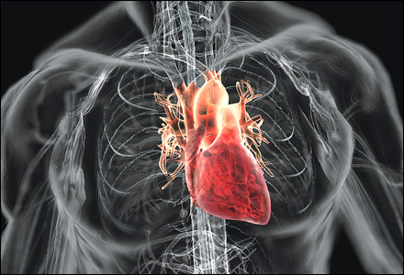
Cardiovascular System
Heart
https://www.away.com

Slide 2
Note
Much of the text material is from, “Principles of Anatomy and Physiology” by Gerald J. Tortora and Bryan Derrickson (2009, 2011, and 2014). I don’t claim authorship. Other sources are noted when they are used.
The lecture slides are mapped to the three editions of the textbook based on the color-coded key below.
14th edition
13th edition
12th edition
Same figure or table reference in all three editions

Slide 3
Outline
Structure
Blood circulation
Cardiac muscle tissue
Electrocardiography
Cardiac cycle
Cardiac output
Physical exercise and the heart

Slide 4
A Few Statistics
The heart beats about 100,000 times each day, and about 2.5 billion times in a lifetime.
It pumps about 5 liters of blood per minute, or about ten million liters in one year.
An even greater volume of blood is pumped to meet tissue demands during physical activity.
Page 688
Page 757
Page 717

Slide 5
Cardiology
The scientific study of the normal heart and its diseases is known as cardiology.
It is becoming an increasingly needed specialty as a substantial seg-ment of the population ages.
Page 688
Page 757
Page 717

Slide 6
Structure

Slide 7
Circulatory System
Postnatally, the heart pumps blood into two closed circuits known as systemic circulation and pulmonary circulation.
The circuits are arranged in series so the output of blood of one circuit serves as the input of the blood to the other circuit (and on and on).
More will be said about systemic circulation and pulmonary circu-lation in this lecture module and the next module.
Postnatal = after birth.
Page 698
Page 768
Page 728
Figure 20.7

Slide 8
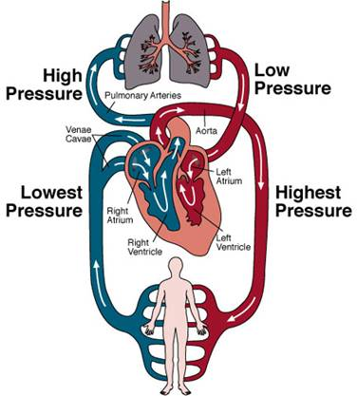
Circulatory System (continued)
Pulmonary circulation
(lungs)
Systemic circulation
(all organs and tissues including the lungs)
https://www.agingresearch.buffalo.edu

Slide 9
Heart Size
The heart is about the size, but not the shape, of a closed, adult fist.
It has a mass of about 250 grams in adult females and about 300 grams in adult males related to average differences in body mass.
Page 689
Page 758
Page 718
Figure 20.1

Slide 10
Location
The heart rests on the diaphragm near the midline of the thoracic cavity, with about two-thirds of its tissue usually to the left of the body’s midline.
The heart is located in the mediastinum, the region extending from the sternum to the vertebral column, from the first rib to the diaphragm, and between the lungs.
A very small number of people have their hearts positioned slightly to the right of midline, most notably in “mirror image” identical (monozygotic) twins.
Page 689
Page 758
Page 718
Figure 20.1

Slide 11
Pericardium
The pericardium is the membrane that surrounds and provides protec-tion for the heart.
The membrane is a fibrous tissue that prevents overstretching of the heart.
The membrane confines the heart to the mediastinum, while allowing space for movement during rapid and forceful cardiac contractions such as during physical activity.
Page 690
Page 758
Page 719
Figure 20.2

Slide 12
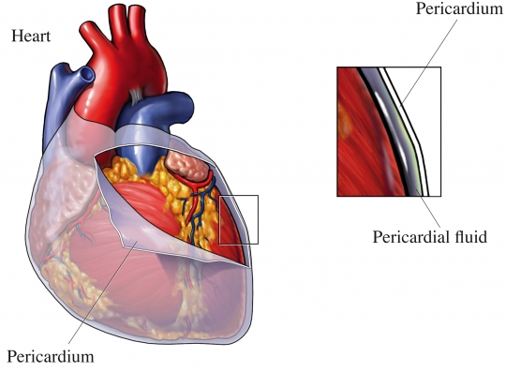
Pericardium

Slide 13
Pericardial Fluid
The pericardial cavity between the pericardium and heart tissue has a small amount of pericardial fluid.
The fluid reduces the friction between the two tissues during contraction of the heart.
Tap or click here to read about the medical condition, cardiac tamponade.
Page 690
Page 758
Page 719
Figure 20.2
13
Notes:
13

Slide 14
Tissue Layers
The heart wall has three tissue layers: epicardium, myocardium, and endocardium.
The epicardium is a thin, transparent outer layer.
The myocardium is cardiac muscle tissue and is about 90 percent of the mass of the heart.
Much more will be said about the myocardium and its functions in this lecture module.
Page 690
Page 760
Page 720
Figure 20.2

Slide 15
Tissue Layers (continued)
The endocardium, the inner layer, provides a smooth lining for the heart chambers and valves.
The layer is continuous with the endothelial lining of the large blood ves-sels to minimize surface friction and turbulent blood flow.
The surface of the heart has grooves, or sulci, that contain the coronary arteries along with some fatty tissue.
The coronary arteries, as will be discussed, supply the heart with oxygen and nutrients.
Page 691
Page 761
Page 720
Figure 20.2

Slide 16
Chambers
The heart has four chambers:
  The atria are the two superior receiving chambers for blood.
  The ventricles are the two inferior pumping chambers for blood.
Each atrium has a pouch-like structure on its anterior surface that slightly increases its volume.
Superior and inferior refer to their anatomical locations of the chambers of the heart and are not a value judgements of their roles.
Page 692
Page 761
Page 720
Figure 20.3

Slide 17
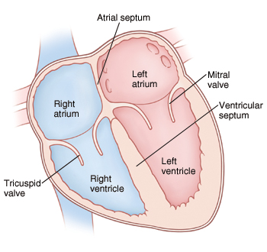
Heart Chambers (continued)
Superior
Inferior
https://www.mountnittany.org

Slide 18
Right Chambers
The right atrium receives deoxygenated blood from three major veins— superior vena cava, inferior vena cava, and coronary sinus—for systemic circulation.
Blood is pumped from the right atrium into the right ventricle through the tricuspid valve.
Blood is then ejected from the right ventricle through the pulmonary valve into pulmonary circulation.
Deoxygenated = oxygen-poor.
Systemic circulation = circulation of blood throughout the body through the arteries, capillaries, and veins, which carry oxygenated blood from the left ventricle to various tissues and return venous blood to the right atrium.
(https://www.yourdictionary.com)
Page 692
Page 763
Page 722
Figure 20.4

Slide 19
Left Chambers
The left atrium receives oxygenated blood from pulmonary circulation via the pulmonary veins.
Blood is pumped from the left atrium into the left ventricle through the bicuspid (or mitral) valve.
Blood is ejected from the left ventricle through the aortic valve into sys-temic circulation.
Pulmonary circulation = the circulation of blood through the lungs for the purpose of oxygenation and the release of carbon dioxide.
(https://www.answers.com)
Page 695
Page 765
Page 722
Figure 20.4

Slide 20
Left Chambers (continued)
A small amount of aortic blood is diverted into the coronary arteries to meet the metabolic needs of the heart.
Most aortic blood, however, is distributed to the other organs and tissues of the body.
Page 695
Page 765
Page 724

Slide 21
Fetal Circulation
During the fetal period (prior to birth), a temporary blood vessel known as the ductus arteriosus directly shunts blood from the pulmonary trunk into the aorta.
Very little blood enters into the non-functioning fetal lungs since oxygen is supplied by the pregnant woman to the fetus through the placenta and umbilical cord.
Page 695
Page 765
Page 724
Figure 21.30

Slide 22
Pressure Demands
The right and left ventricles eject equal volumes of blood with each heartbeat.
The right ventricle pumps blood to the lungs at relatively low pres-sure since the flow resistance in pulmonary circulation is relatively low.
The left ventricle pumps blood to all other parts of the body at higher pressure since flow resistance in systemic circulation is much higher than in pulmonary circulation.
The mechanisms for flow resistance are described in the lecture module on blood vessels
Page 696
Page 765
Page 724

Slide 23
Myocardial Thickness
The two atria have the thinnest walls because they have the lowest pressure demands.
The left ventricle has the thickest wall because it has the highest pressure demand.
https://www.mountnittany.org
23
Notes:
23

Slide 24
Myocardial Thickness (continued)
The thickness of the myocardium of each heart chamber is related to pressure demands.
The thin-walled right and left atria deliver blood under low pressure to the ventricles.
The walls of the ventricles are thicker since they pump blood at higher pressures into systemic and pulmonary circulations.
Of the two ventricles, the left ventricle has a thicker wall (10 to 15 mm) for the high pressure of systemic circulation compared to the lower pres-sure of pulmonary circulation.
Page 696
Page 765
Page 724
Figure 20.4

Slide 25
Fibrous Skeleton
The heart wall has a dense connective tissue that forms a fibrous skel-eton.
The fibrous skeleton has four rings of connective tissue that surround the heart valves and merge with the ventricular septum.
The rings provide a structural framework for the heart valves to prevent their overstretching when blood is forced through them.
The fibrous skeleton also serves as an electrical insulator between the atria and ventricles, as will be discussed.
Page 696
Page 765
Page 725
Figure 20.5

Slide 26
Valve Operation
The heart valves open and close in response to pressure changes when the atria and ventricles contract and then relax.
They ensure the one-way flow of blood by opening to enable blood to flow through them, and then closing to prevent backflow (in a healthy heart without valve problems).
Page 696
Page 766
Page 725

Slide 27
Bicuspid and Tricuspid Valves
The bicuspid (mitral) valve and tricuspid valve are on the left and right sides of the heart, respectively.
The valves are positioned between the atria and ventricles and so they are also known as the atrioventricular (AV) valves.
Page 696
Page 767
Page 725
Figure 20.6

Slide 28
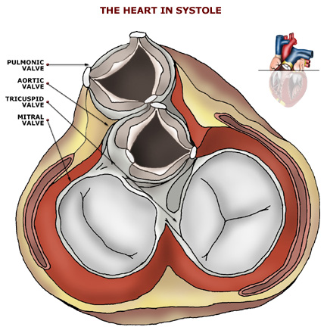
Bicuspid and Tricuspid Valves (continued)
Cross-sectional cut
Tricuspid valve
(three cusps)
Bicuspid or mitral valve
(two cusps)
https://www.prenhall.com
The bicuspid valve is also called the mitral valve because early anatomists thought it looked like the mitral crowns worn by bishops.

Slide 29
Bicuspid and Tricuspid Valves (continued)
The rounded cusps of the mitral and tricuspid valves extend into the ventricles when they are open to permit blood flow into the chamber.
When the ventricles contract, the increased blood pressure in these chambers closes the cusps to prevent the back flow of blood into the atria (in hearts without valve damage).
The papillary muscles and chordae tendineae of the bicuspid and tri-cuspid valves assure they do not open into the atria under high ven-tricular pressure.
Page 696
Page 767
Page 725
Figure 20.6

Slide 30
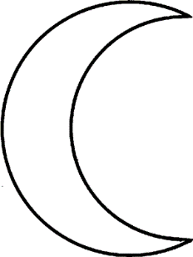
Aortic and Pulmonary Valves
The aortic and pulmonary valves are also known as the semilunar valves due to their crescent shapes.
The aortic and pulmonary valves allow the ejection of blood into the aorta and pulmonary trunk, respectively, while preventing backflow into the left and right ventricles.
The two valves open when ventricular pressure exceeds the pressures in the aorta and pulmonary trunk.
A crescent shape
(like a waxing or waning moon; hence the word, semilunar).
https://www.learnersdictionary.com
Page 697
Page 767
Page 727
Figure 20.6

Slide 31
Aortic and Pulmonary Valves (continued)
Pulmonary valve
Cross-sectional cut
Aortic valve
https://www.prenhall.com

Slide 32
Aortic and Pulmonary Valves (continued)
Some of the blood ejected into the aorta and pulmonary trunk will flow back toward the heart when the ventricles relax.
Blood fills the cusps of the aortic and pulmonary valves and closes them to prevent backflow into the ventricles (in hearts without valve damage).
Page 697
Page 768
Page 727
Figure 20.6

Slide 33
Entry Points
There are no valves between the vena cavae and the right atrium, and the pulmonary veins and the left atrium.
When the two atria contract, a small amount of blood flows from the atrial chambers into these veins.
The entry points collapse to minimize backflow of blood into the veins.
Page 698
Page 768
Page 727

Slide 34
Blood Circulation

Slide 35
Systemic and Pulmonary Circulation
The left side of the heart serves as the pump for systemic circulation— it receives oxygenated blood from the lungs.
The right side of the heart serves as the pump for pulmonary circula-tion—it receives deoxygenated blood from organs and other body tis-sues.
As had been covered, the systems are arranged in series so that the outflow of blood from one system serves as inflow of blood to the other system.
Deoxygenated blood is not devoid of oxygen. Depending on the metabolic needs of organs and tissues (such as during exercise or at rest), it generally has 50 to 75 percent of the oxygen content of oxygenated blood.
Page 698
Page 768
Page 728
Figure 20.7

Slide 36
Circulatory System (continued)
Pulmonary circulation
(lungs)
Systemic circulation
(all organs and tissues including the lungs)
https://www.agingresearch.buffalo.edu

Slide 37
Systemic Circulation
The left ventricle pumps oxygenated blood into the aorta and systemic circulation to meet the metabolic needs of the organs and other tissues of the body.
Blood passes through smaller and smaller arteries as it flows to organs and other tissues of the body.
The smallest arteries branch into even smaller-diameter arterioles that supply capillary beds in organs and other tissues where substance ex-change occurs.
Page 698
Page 768
Page 728
Figure 20.7

Slide 38
Systemic Circulation (continued)
Capillary blood fulfills the metabolic needs of cells and enables waste removal.
The exchange of gases (O₂ and CO₂), nutrients, hormones, and waste products occurs across the thin and porous walls of systemic capillar-ies.
The blood exiting the capillaries flows into venules (the smallest veins), and then into larger and larger veins on its return path to the right side of the heart.
Page 700
Page 768
Page 728
Figure 20.7

Slide 39
Pulmonary Circulation
The right atrium receives deoxygenated blood from the veins of the systemic circulation, and the right ventricle pumps it into pulmonary circulation.
Blood pumped from the right ventricle flows into the pulmonary trunk, which branches into two pulmonary arteries.
The left and right pulmonary arteries carry blood to the left lung and right lung.
Page 700
Page 768
Page 728
Figure 20.7

Slide 40
Pulmonary Circulation (continued)
Progressively smaller-diameter arteries branch into beds of capillaries in the lungs.
The capillaries exchange O₂ and CO₂ with the alveoli in the lungs (to be covered in the lecture module on the respiratory system).
The freshly-oxygenated blood flows into the pulmonary veins and then into the left atrium.
Page 700
Page 768
Page 728
Figure 20.7

Slide 41
Coronary Arteries
Oxygen and nutrients cannot diffuse from the blood in the heart cham-bers to supply the metabolic needs of the heart’s tissues.
The myocardium has a network of blood vessels called the coronary arteries.
The coronary arteries branch from the ascending aorta to form a crown-like shape around the surface of the heart.
Page 700
Page 768
Page 728
Figure 20.8

Slide 42
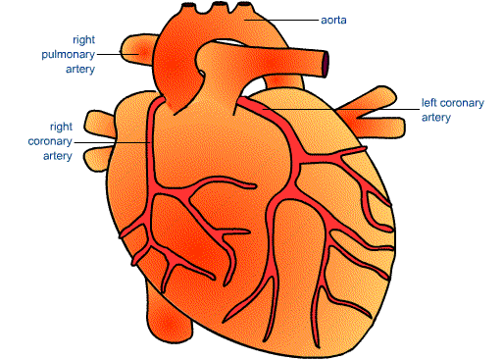
Coronary Arteries
Right pulmonary
artery
Ascending aorta
Left coronary
artery
Right coronary
artery
https://www.hcc.uce.ac.uk
The heart, whose mass is about 90 percent cardiac muscle fibers, receives oxygen and nutrients from the coronary arteries and not from the blood being pumped through its chambers (atria and ventricles). The coronary arteries can become occluded (blocked) over time by plaque from LDL cholesterol and saturated fats.
42
Notes:
42

Slide 43
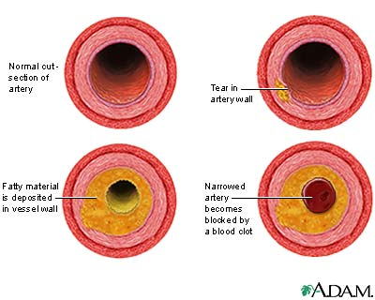
Atherosclerosis
https://www.nlm.nih.gov
“The development of arterial atherosclerosis may occur when deposits of cholesterol and plaque accumulate at a tear in the inner lining of an artery. As the deposits harden and occlude the arterial lumen, blood flow to distant tissues decreases and a clot may become lodged, completely blocking the artery” (and possibly causing a heart attack).
(https://www.nlm.nih.gov)
43
Notes:
43

Slide 44
Risk Factors for Heart Attacks
Hypercholesterolemia (high LDL cholesterol), a genetic condition
Diet high in saturated fats, cholesterol, and/or salt
Uncontrolled diabetes (types 1 and 2)
Sedentary lifestyle (little or no physical activity)
Smoking
Hypertension (high blood pressure)
Overweight (BMI > 30)
Emotional response patterns to life’s stressors
Age (> 45 years for men and >55 years for women)
Family history (genetics and/or learned behavior patterns)
Heart attack (myocardial infarction) = an occlusion or blockage of a coronary artery resulting in injury or necrosis (death) of the heart muscle.
44
Notes:
44

Slide 45
Possible Signs and Symptoms
Referred pain—such as jaw, upper arm, or between shoulder blades
Shortness of breath
Nausea
Sweating
Feeling of indigestion
Unexplained fatigue
Sometimes there are no signs or symptoms (known as asymptomatic)
Sign = objective evidence of a disease that can be observed by others (such as blood pressure, heart rate, and body temperature).
Symptom = apparent only to the patient (such as fatigue and pain).
(Both definitions are from https://www.nature.com)
45
Notes:
45

Slide 46
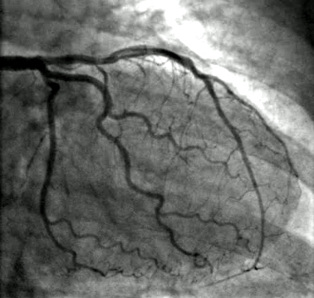
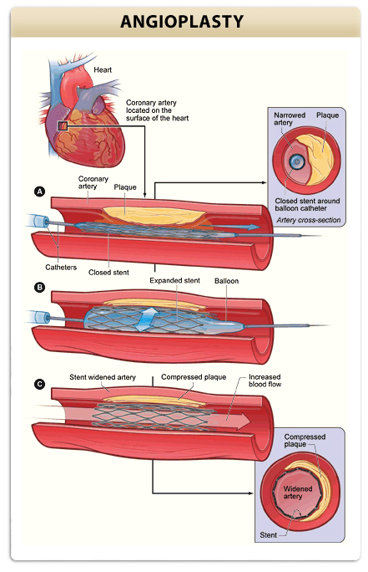
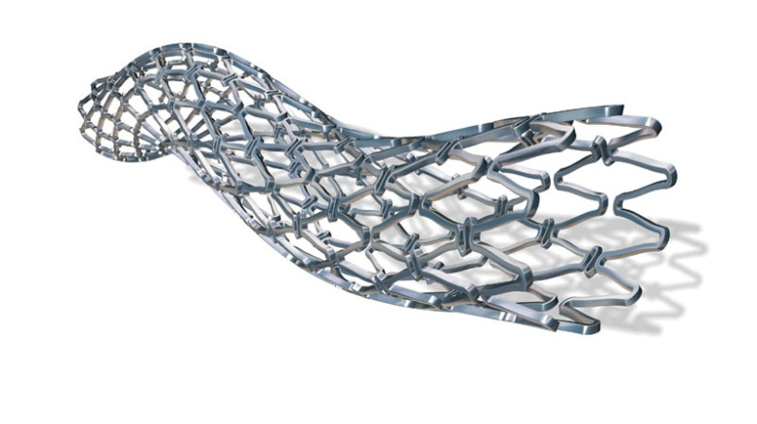
Angiogram, Angioplasty, and Stent Placement
https://www.heart-valve-surgery.com
https://www.professionalradiology.com
https://www.keepyourhearthealthy.files.wordpress.com
We will discuss these interventional procedures in class.
46
Notes:
46

Slide 47
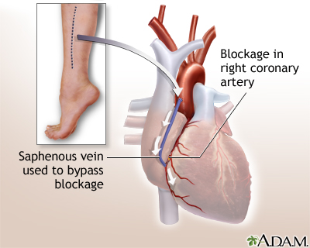
Coronary Bypass Surgery
https://www.medlineplus.gov
We will discuss this surgical procedure in class.
47
Notes:
47

Slide 48
Heart Disease Classifications
Coronary arteries (by far, the most common of all heart diseases)
Heart valves
Electrical conduction system
Cardiac tissue (myopathy)

Slide 49
Cardiac Muscle Tissue

Slide 50
Cardiac Muscle Tissue
Cardiac muscle fibers are shorter in length and less circular in cross-section than skeletal muscle fibers.
A typical muscle fiber is 50 to 100 μm long with a diameter of about 14 μm.
Cardiac muscle fibers have extensive branching that give them a stair-step appearance.
Usually only one centrally-located nucleus is found in a cardiac muscle fiber, unlike skeletal muscle fibers which have many nuclei at their peri-phery.
Page 702
Page 772
Page 731
Figure 20.9
Table 4.9

Slide 51
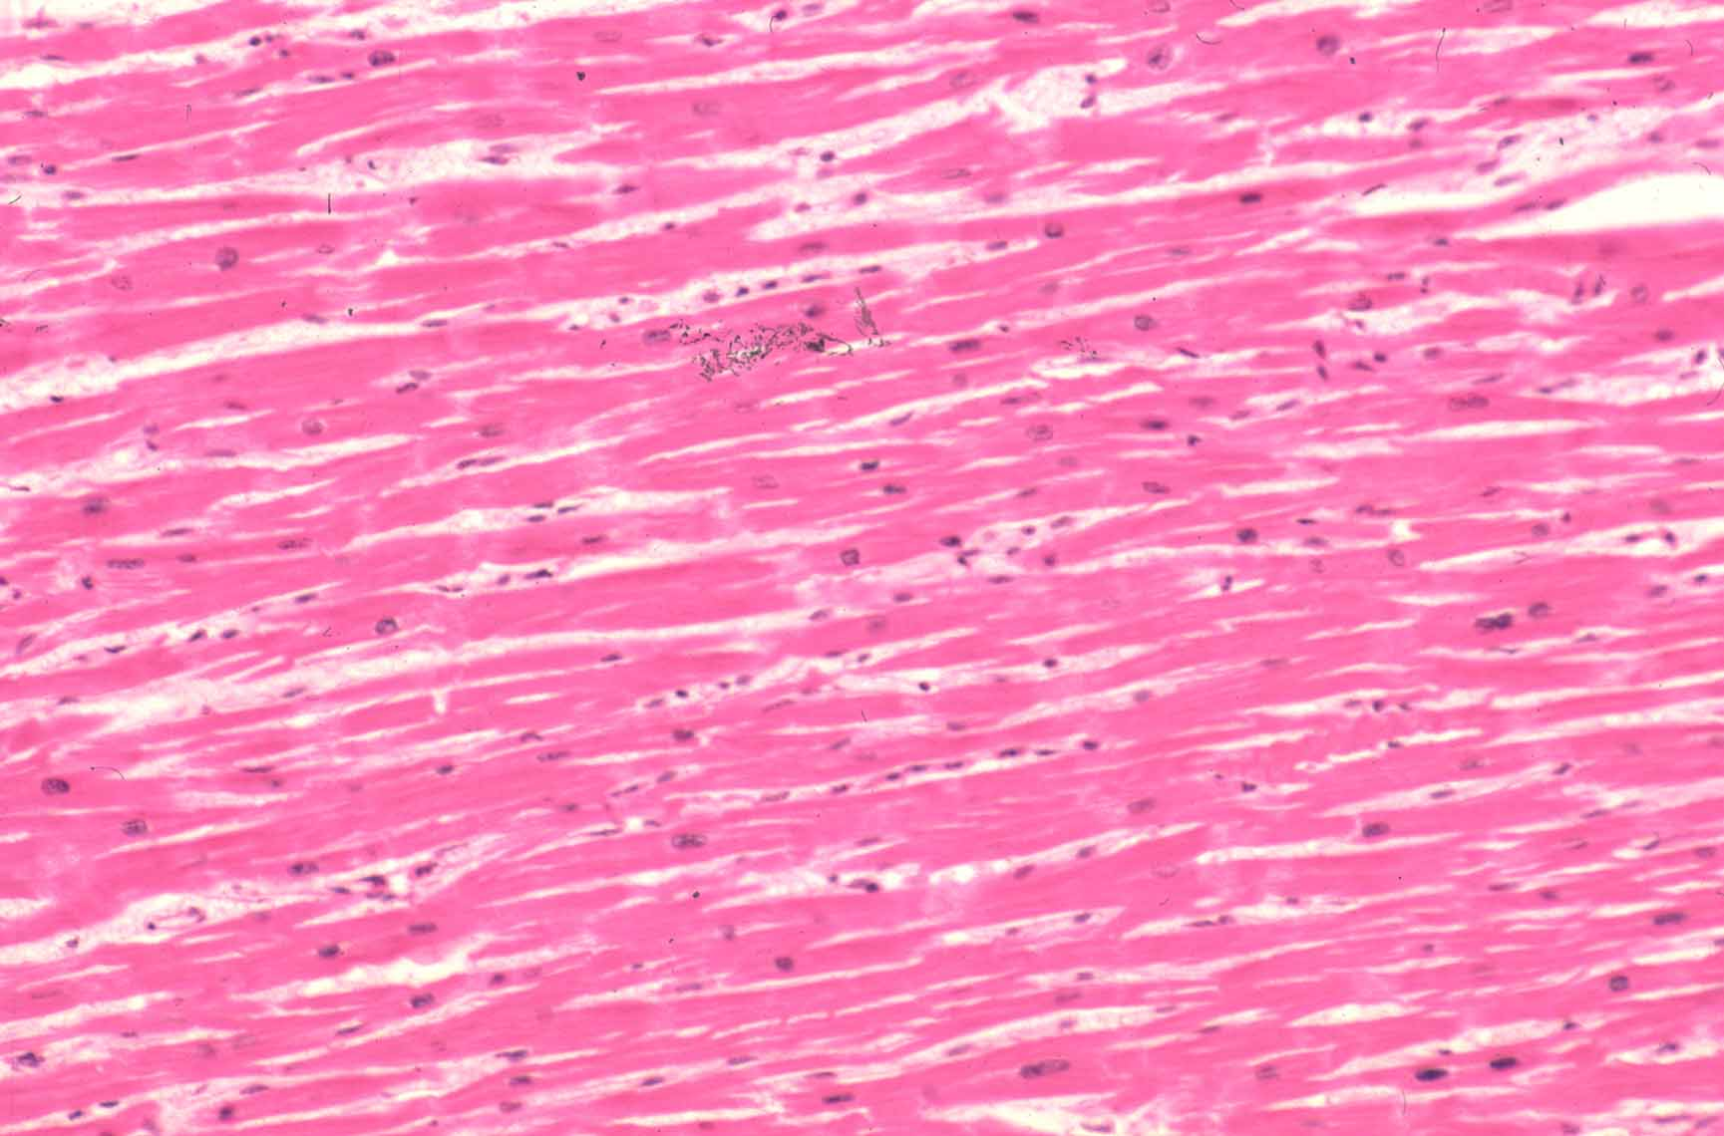
Myocardium
https://www.path.cam.ac.uk

Slide 52
Cardiac Muscle Tissue (continued)
Each end of a cardiac muscle fiber has thickenings of the sarcolemma known as intercalated discs.
The discs have desmosomes that hold the fibers together to form gap junctions.
Action potentials rapidly propagate (travel) from muscle fiber to muscle fiber via these gap junctions.
The gap junctions enable the myocardium of each chamber to contract as a single, coordinated unit.
Desmosome = a structure that forms the site of adhesion between two cells.
Page 702
Page 772
Page 732
Figure 20.9

Slide 53
Fiber Comparisons
Mitochondria are larger and more numerous in cardiac muscle fibers than in skeletal muscle fibers—about 25 percent versus two percent of the sarcoplasm.
The implication is that cardiac muscle fibers rely almost completely on aerobic respiration and require a constant supply of oxygen to function.
Cardiac muscle fibers have the same arrangement of actin and myo-sin, and same bands, zones, and Z discs as found in skeletal muscle fibers.
Page 702
Page 772
Page 732

Slide 54
Fiber Comparisons (continued)
The transverse tubules are wider in cardiac muscle fibers, although they are less abundant than in skeletal muscle fibers.
The sarcoplasmic reticulum is less extensive than in skeletal muscle.
This suggests that cardiac muscle has a smaller intracellular reserve of calcium ions (Ca²⁺) for triggering the chain of events for the contrac-tion cycle.
Page 702
Page 772
Page 732

Slide 55
Autorhythmic Fibers
Cardiac contractions result from spontaneous electrical activity gen-erated in heart tissue.
A specialized network of cardiac muscle fibers, known as autorhyth-mic fibers, is self-excitable and the source of this electrical activity in the heart.
The autorhythmic fibers generate action potentials that trigger cardiac muscle contractions.
The autorhythmic fibers can continue to stimulate the heartbeat after the heart is removed from the body, which happens in heart transplant surgery.
Page 704
Page 772
Page 732

Slide 56
Autorhythmic Fibers (continued)
About one percent of the cardiac muscle fibers become autorhythmic during embryonic development.
The autorhythmic fibers serve as the pacemaker in establishing the rhythm of electrical excitation (action potentials) for cardiac contrac-tion.
They also form the conduction system so that action potentials can propagate from the atria to the ventricles.
The conduction system enables the atria and ventricles to contract in sequence and in a coordinated manner.
Propagate = to travel along or spread.
Page 704
Page 772
Page 732

Slide 57
Conduction Pathway
Cardiac excitation in a healthy heart begins in the autorhythmic fibers in the sinoatrial (SA) node in the wall of the right atrium.
The autorhythmic fibers spontaneously depolarize, due to ion channel activity, and produce a pacemaker (graded) potential that triggers the generation of action potentials.
The action potential rapidly propagates through the right and left atria via gap junctions of the cardiac muscle fibers.
The atria contract in unison and force blood through the bicuspid (mi-tral) and tricuspid valves into the ventricles that are in a relaxed state.
Page 704
Page 772
Page 732
Figure 20.10

Slide 58
Conduction Pathway (continued)
The action potential reaches the atrioventricular (AV) node in the inter-atrial septum of the heart.
It enters the atrioventricular bundle (axons) for propagation into the left and right ventricles.
The action potential enters the right and left AV bundles (axons) of the ventricles.
The atrioventricular bundle is also called the bundle of His.
Interatrial septum = tissue that separates the right atrium and left atrium.
Page 704
Page 774
Page 732
Figure 20.10

Slide 59
Conduction Pathway (continued)
Large-diameter Purkinje fibers (axons) in the right and left AV bundles rapidly conduct the action potential to the myocardium of the ventricles.
The ventricles contract, and blood is ejected from the heart through the aortic and pulmonary valves into the aorta and pulmonary trunk.
Page 704
Page 774
Page 732
Figure 20.10

Slide 60
Fundamental Rhythm
The autorhythmic fibers in the SA node in the right atrium trigger ac-tion potentials at a rate of about 100 per minute—this is the heart’s fundamental rhythm.
The autonomic nervous system and hormones (including epinephrine and norepinephrine from the adrenal medulla) can change the timing and strength of each heartbeat.
However, neither catecholamine nor other hormones (such as T₃ and T₄) are responsible for the fundamental heart rhythm—that’s the role of the SA node.
Page 704
Page 775
Page 733

Slide 61
Contractile Fibers
Action potentials generated in the contractile fibers have three phases: depolarization, plateau, and repolarization.
The sequence of the three phases is shown in Figure 20.11—there are similarities and differences with the action potentials in skeletal muscle fibers.
We will discuss similarities and differences in class.
Page 704
Page 775
Page 734
Figure 20.11

Slide 62
Contraction Process
The mechanism of contraction is the same in both cardiac muscle and skeletal muscle.
Action potentials stimulates the release of Ca²⁺ from the sarcoplasmic reticulum in cardiac muscle fibers.
Ca²⁺ binds to the regulatory protein, troponin, to act on tropomyosin to uncover the myosin blinding sites on the actin molecules of the thin filaments.
Crossbridges are formed, the power stroke occurs, and the thin and thick filaments slide past one another to develop muscle tension in the myocardium.
Page 706
Page 776
Page 735

Slide 63
Contraction Process (continued)
Substances that alter the flow of Ca²⁺ through the calcium channels can affect the strength of heart contractions.
Epinephrine increases force of contraction by enhancing Ca²⁺ flow.
Calcium channel blockers decrease force of cardiac contraction— these drugs can be used to treat high blood pressure (hypertension).
Other medication are also used to treat hypertension including beta blockers (see the lecture module on the autonomic nervous system).
Page 706
Page 776
Page 735

Slide 64
Refractory Period
The refractory period is the time interval when a second action potential cannot be triggered.
The refractory period (about 300 msec) of a cardiac muscle is due to the lengthy plateau period.
Therefore, another contraction cannot occur until relaxation is underway.
The refractory period establishes an upper limit on how rapidly the heart can beat.
This enables the heart to relax and contract so that it can adequately fill and then pump blood into systemic circulation and pulmonary circulation.
Page 706
Page 776
Page 735
Figure 20.11

Slide 65
Refractory Period (continued)
Tetanus, the sustained contraction in skeletal muscle, does not occur in cardiac muscle due to the long refractory period.
If the heart muscle could undergo tetanus, the blood flow would cease since the heart’s pumping action depends on repeated contractions and relaxations.
Not to be confused with the bacteria disease known as tetanus.
Page 707
Page 776
Page 735

Slide 66
ATP Production
Unlike skeletal muscle, cardiac muscle produces very little ATP for the contraction cycle through anaerobic respiration (glycolysis).
Cardiac muscle relies almost exclusively on aerobic cellular respiration (Krebs cycle) in its many mitochondria.
Oxygen needed for ATP production diffuses from the blood in the cor-onary capillaries to bind to myoglobin molecules in the cardiac muscle fibers.
Page 707
Page 776
Page 735

Slide 67
Creatine Kinase
Cardiac muscle, like skeletal muscle, produces some ATP from creatine phosphate.
Creatine kinase (CK) is an enzyme that catalyzes the transfer of a phos-phate group from creatine phosphate to ADP to form ATP, just like what occurs in skeletal muscle (see the lecture module on how muscle tissue contracts.)
One sign that a heart attack (myocardial infarction) has occurred is the presence of creatine kinase in the blood.
Page 707
Page 776
Page 735

Slide 68
Creatine Kinase and Troponin
Creatine kinase and the regulatory molecule troponin are normally con-fined within the sarcoplasm of cardiac muscle fibers.
They are released into blood circulation from damaged or dead muscle fibers when the sarcolemmas of cardiac muscle fibers breakdown in a heart attack.
Page 707
Page 776
Page 735

Slide 69
Electrocardiography

Slide 70
Electrocardiogram
The electrical voltages of action potentials that propagate through car-diac tissue can be detected on the surface of the body.
The electrocardiogram (ECG), or electrokardiogram (EKG) as named by its German discoverers, is a recording of the electrical activity of the heart
Two limb leads and six chest leads are attached in standard locations for ECG recording—standardization assures that traces can be com-pared.
An electrocardiograph, an electronic device, amplifies the electrical signals, and displays 12 traces from the various combinations of chest and limb leads.
Page 707
Page 776
Page 735

Slide 71
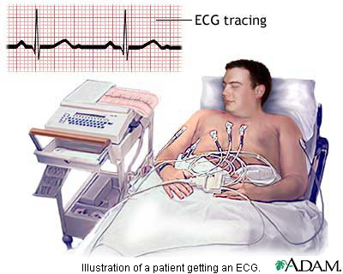
Electrocardiogram (continued)
https://www.aculty.ksu.edu.sa

Slide 72
Diagnostic Value
By comparing ECG traces with standard traces, it is possible to deter-mine, for example, if the:
  Heart is enlarged.
  Conducting pathway is abnormal.
  Regions of the heart are damaged.
Page 707
Page 776
Page 735

Slide 73
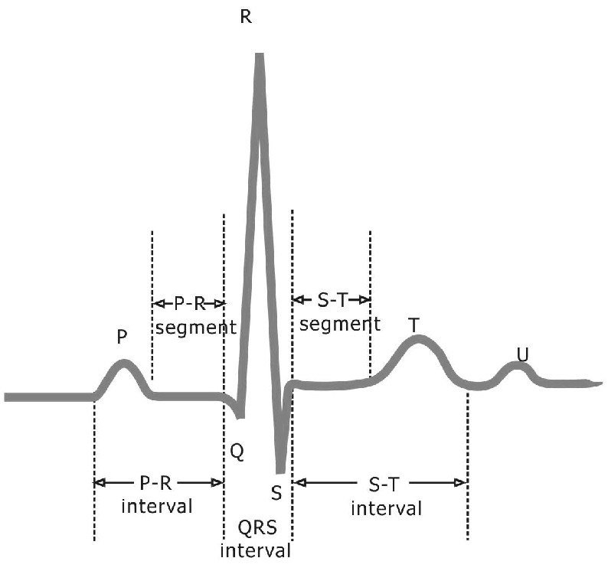
ECG Trace—Waveforms
Amplitude (voltage)
https://www.zone.ni.com
Time (milliseconds)

Slide 74
P Wave
Three obvious waveforms appear in an ECG trace with each heart-beat.
The first component, the P wave, is a small upward deflection in the trace.
The P wave represents atrial depolarization of action potentials propagating from the SA node through the cardiac muscle fibers of the right and left atria.
Page 707
Page 776
Page 735
Figure 20.12

Slide 75
QRS Complex
The second waveform, the QRS complex, begins as a downward de-flection.
It continues as a large, upward, triangular wave, and ends as a second downward deflection.
The QRS complex represents ventricular depolarization as the action potentials propagate through the cardiac muscle fibers of the right and left ventricles.
Atrial repolarization also occurs during the QRS complex but its wave-form is obscured by the electrical activity of ventricular depolarization.
Page 707
Page 776
Page 736
Figure 20.12

Slide 76
T Wave
The third component, the T wave, is a dome-shaped upward deflec-tion.
The T wave represents ventricular repolarization when the ventricles start to relax.
The T wave is of smaller amplitude but wider than the QRS complex, in part because repolarization lasts longer than depolarization.
Prior to the T wave and after the QRS complex, the ECG is flat due to a steady period of ventricular depolarization.
Page 707
Page 776
Page 736
Figure 20.12

Slide 77
ECG Indicators
The amplitudes of the waveforms can be examined to diagnose some types of cardiac abnormalities.
Examples include:
  Large P waves—possible enlargement of one or both atria.
  Large Q waves—possible myocardial infarction.
  Large R waves—possible ventricular enlargement.
  Flatter-than-normal T waves—possible insufficient oxygen supply to the heart.
  Larger-than-normal T waves—possible high blood level of potas-sium (known as hyperkalemia).
Page 707
Page 776
Page 736
Figure 20.12

Slide 78
ECG Trace—Intervals and Segments
https://www.zone.ni.com
Time (milliseconds)

Slide 79
P-Q Interval
Analysis of ECG records also involves measuring the time spans be-tween waves—these are known as intervals or segments.
The P-Q interval represents the conduction time from the beginning of atrial excitation to the beginning of ventricular excitation.
The P-Q interval can lengthen if action potentials must detour around scar tissue from disorders such as coronary artery disease and rheu-matic fever.
Rheumatic fever = an inflammatory disease that can develop as a complication of untreated or poorly treated strep throat. Strep throat is caused by infection with group A streptococcus bacteria. Rheumatic fever can cause permanent damage to the heart that may result in serious harm to the heart valves and heart failure.
(https://www.mayoclinic.com)
Page 708
Page 777
Page 736
Figure 20.12

Slide 80
S-T Segment
The S-T segment is the time period when the ventricular muscle fibers are depolarized during the plateau phase of the action potential.
The S-T segment is elevated above baseline in a myocardial infarction.
It can be depressed below baseline when the heart receives insufficient oxygen.
Page 708
Page 777
Page 736
Figure 20.12

Slide 81
Q-T Interval
The Q-T interval is the time period from the beginning of ventricular depolarization to the end of ventricular repolarization.
The interval can lengthen due to myocardial damage, ischemia, or conduction abnormalities.
Ischemia = decreased blood flow to an organ or tissue, in this case, cardiac tissue.
Page 708
Page 777
Page 736
Figure 20.12

Slide 82
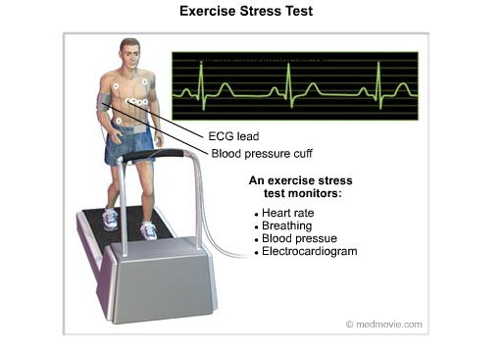
Stress Testing
Stress testing involves evaluating cardiac activity during physical exer-cise, such as on an inclined treadmill, or by chemically simulating phys-ical activity.
Narrowed coronary arteries may carry a sufficient amount of blood and oxygen when a person is at rest but might not meet the heart’s oxygen needs during physical activity.
The ECG and stress testing,
sometimes in conjunction with nuclear isotopes, can be used to detect some types of cardiac problems.
https://www.cardiachealth.org
Page 708
Page 777
Page 736

Slide 83
Transient Events
Abnormal heart rhythms and inadequate coronary blood supply can be transient.
Ambulatory electrocardiograms are sometimes used to detect such problems.
A portable, battery-powered heart monitor is worn to record the ECG continuously for 24 hours.
The ECG record can be telemetered or downloaded for evaluation by medical personnel locally or almost anywhere (for example, a cardiac specialist in Rome).
Transient = not lasting, enduring, or permanent.
Ambulatory = literally, while walking around.
Page 708
Page 777
Page 736

Slide 84
Cardiac Cycle

Slide 85
Cardiac Cycle
A single cardiac cycle includes all of the cardiac events associated with one heartbeat.
The atria and ventricles alternately contract and relax in a cardiac cycle.
The cardiac cycle is 0.8 seconds for a heart rate of 75 beats per minute (bpm).
The calculation:
60 seconds per minute divided by 75 beats per minute = 0.8 seconds per beat
Page 710
Page 779
Page 738
Figure 20.14

Slide 86
Systole and Diastole
The atria and ventricles depolarize and contract at different times to enable effective pumping.
Systole refers to the period of contraction, and diastole refers to the period of relaxation.
An ECG can measure the timings of atrial and ventricular systole and diastole.
The details of the timings of each cardiac event are described in the textbook.
Page 708
Page 777
Page 736
Figure 20.13

Slide 87
Cardiac Cycle (continued)
Isovolumetric relaxation (all four chambers)
Atrial diastole
Atrial systole
Ventricular diastole
Ventricular systole
Isovolumetric = relating to or characterized by the same or an unchanging volume.
Page 710
Page 779
Page 738

Slide 88
Pressure Differentials
When a chamber of the heart contracts, the hydrostatic pressure in the chamber increases.
Cardiac contraction forces blood from an area of relatively high pressure to an area of lower pressure, either through the atrioventricular valves or the semilunar valves.
Hydrostatic pressure = the pressure exerted by a fluid (a somewhat simplified definition that doesn’t account for the role of gravity).
Page 710
Page 779
Page 738

Slide 89
Pressure and Volume Changes
The relationships between the ECG and changes in the heart during a single cardiac cycle are shown in Figure 20.14.
The changes include:
  Atrial pressure
  Ventricular pressure
  Aortic pressure
  Ventricular volume
Page 710
Page 779
Page 738
Figure 20.14

Slide 90
Pressure and Volume Changes (continued)
The pressures shown in Figure 20.14 in the textbook are for the left side of the heart for systemic circulation.
The pressures are much lower on the right side for pulmonary circula-tion due to less resistance of the pulmonary vessels.
However, the left and right ventricles pump an equal volume of blood during one heartbeat regardless of the pressure differences between the left and right sides.
This also holds true for the volume of blood returned to the right and left atria.
Page 710
Page 779
Page 738
Figure 20.14

Slide 91
Isovolumetric Relaxation
During isovolumetric relaxation, all four chambers (both atria and both ventricles) are relaxed.
The atria begin to refill with blood returning from the vena cava and pulmonary veins.
The isovolumetric relaxation period shortens when the heart beats faster—atrial systole and ventricular systole, however, shorten only slightly.
Page 710
Page 781
Page 738
Figure 20.14

Slide 92
Atrial Diastole
The atria are still relaxed during atrial diastole.
Deoxygenated blood flows into the right atrium from the venae cavae in systemic circulation.
Oxygenated blood flows into the left atrium from pulmonary vein in pul-monary circulation.
Page 710
Page 779
Page 738
Figure 20.14

Slide 93
Atrial Systole
During atrial systole, the atria contract while the ventricles are relaxed.
When the atria contract, the increased pressure forces blood through the AV valves (bicuspid and tricuspid) into the ventricles.
At the end of atrial systole (which is also the end of ventricular diastole), the ventricles each contain ~ 130 ml of blood (known as end-diastolic volume).
The ECG, pressure, and volumes for atrial systole are shown in Figure 20.14.
mmHg = millimeters of mercury
Page 710
Page 779
Page 738
Figure 20.14

Slide 94
Ventricular Systole
During ventricular systole, the ventricles contract while the atria are relaxed.
Contraction causes the hydrostatic pressure to rise steeply in the left and right ventricles.
The atrioventricular (bicuspid and tricuspid) valves are forced closed by the increased hydrostatic pressure in the ventricles to prevent backflow into the atria.
The semilunar (SL) valve of the left ventricle opens when ventricular pressure exceeds the aortic pressure (about 80 mmHg).
The SL valve for the right ventricle opens when ventricular pressure exceeds the pressure in the pulmonary trunk (about 20 mmHg).
Page 710
Page 779
Page 738
Figure 20.14

Slide 95
Ventricular Systole (continued)
Each ventricle ejects about 70 mL of blood—about 60 mL of the 130 mL of the end-diastolic volume remains in each ventricle.
The blood volume that remains is known as the end-systolic volume.
The blood that is ejected is known as stroke volume.
Therefore, end-diastolic volume minus end-systolic volume equals stroke volume.
The calculation is: 130 mL - 60 mL = 70 mL for a person typically at rest.
Page 710
Page 779
Page 738
Figure 20.14

Slide 96
Ejection Fraction (Mayo Clinic)
Ejection fraction is the percentage of blood pumped from the left ventricle in one heartbeat.
“The left ventricle is the heart's main pumping chamber that pumps oxygenated blood through the ascending (upward) aorta to the rest of the body, so ejection fraction is usually measured only in the left ventricle (LV). An LV ejection fraction of 55 percent or higher is considered normal. An LV ejection fraction of 50 percent or lower is considered reduced. Experts vary in their opinions about an ejection fraction between 50 and 55 percent, and some would consider this a borderline range.
Keep in mind that ejection fraction is just one measure of heart function. Even with a normal ejection fraction, overall heart function may not be normal. Talk with your doctor if you have concerns about your heart.”
(https://www.mayoclinic.org)
96
Notes:
96

Slide 97
Ventricular Diastole
During ventricular diastole, blood flows back toward the heart from the aorta (systemic circulation) and pulmonary trunk (pulmonary circulation).
The semilunar valves (SL) close due to the backflow and prevent blood from reentering the ventricles—the aortic SL valve closes at a pressure of about 100 mmHg.
Ventricular pressure decreases rapidly as the ventricles continue to relax.
Page 710
Page 781
Page 740
Figure 20.14

Slide 98
Ventricular Diastole (continued)
The ventricles are almost three-quarters full at the end of the ven-tricular diastole.
The P wave (atrial depolarization) appears in the ECG, and a new cardiac cycle begins.
Page 710
Page 781
Page 740
Figure 20.14

Slide 99
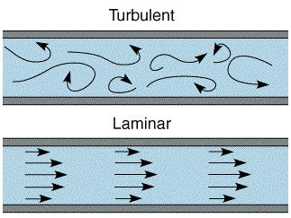
Heart Sounds
Detecting sounds in the body is performed using a stethoscope.
This act of listening to the sounds is known as auscultation.
Heart sounds that can be detected result from the turbulent flow of blood due to closing of the heart valves.
Page 712
Page 781
Page 740
Figure 20.15

Slide 100
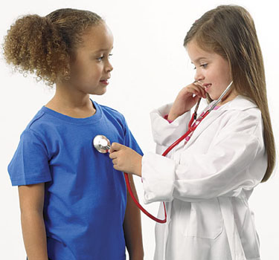
Stethoscope
https://www.pakmed.net

Slide 101
Heart Sounds (continued)
Smooth-flowing blood, or laminar flow, is silent and is not detected with a stethoscope.
Although there are four heart sounds, only S1 and S2 are loud enough to be heard from a healthy heart (the other sounds are known as S3 and S4).
Page 712
Page 781
Page 740

Slide 102
Heart Sounds (continued)
The first heart sound (S1) is due to the closure of the AV (bicuspid and tricuspid) valves soon after ventricular systole begins.
S1 is described as a “lup,” and is louder and slightly longer in duration than the second sound (S2).
S2 is due to closure of the SL (aortic and pulmonary) valves at the start of ventricular diastole.
S2 is described as a “dup.”
Page 712
Page 781
Page 740

Slide 103
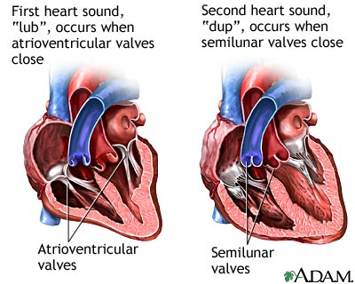
Heart Sounds (continued)
https://www.nlm.nih.gov

Slide 104
Heart Sounds (continued)
S1 and S2 are best heard in chest locations slightly downstream of the valves because sound waves are carried by blood flow through the arteries.
S3 and S4 are usually not loud enough to be heard from a healthy heart.
S3 is due to blood turbulence during ventricular diastole when the ventricles are filling with blood, and S4 is due to blood turbulence during atrial systole.
Page 712
Page 781
Page 740

Slide 105
Cardiac Output

Slide 106
Cardiac Output
Cardiac output (CO) represents the volume of blood ejected by the left ventricle into the aorta each minute.
CO equals stroke volume (SV) in milliliters (mL) times the heart rate (HR):
CO = SV x HR
In a resting adult male, SV is about 70 mL and heart rate is about 75 beats per minute.
By applying the formula, cardiac output is 5,250 mL or 5.25 liters per minute.
Page 712
Page 782
Page 741

Slide 107
Cardiac Output (continued)
The cardiac output (CO) at rest is very close to the total blood volume of about five liters in an adult male (total blood volume for adult females is slightly less, on average, for the reason discussed in the lecture module on blood).
The total blood volume flows through both systemic and pulmonary sys-tems about once every minute.
Factors including physical activity increase CO by increasing stroke vol-ume and heart rate to meet the higher metabolic needs of skeletal mus-cles and other tissues.
For example, if SV increases to 100 mL/beat and HR to 100 beats/min, CO increases to 10 liters per minute (from 5.25 liters for the example on the previous page).
Page 713
Page 782
Page 741

Slide 108
Cardiac Reserve
Cardiac reserve is the difference between a person’s maximum car-diac output and her or his cardiac output at rest.
People with healthy hearts have average cardiac reserves of four to five times the resting value.
Well-conditioned, endurance athletes can have cardiac reserves as high as seven to eight times the resting value.
People with cardiac disease may have little or no cardiac reserve, which can limit their ability to perform even the simplest, routine, every-day household tasks.
Page 713
Page 782
Page 741

Slide 109
Stroke Volume
A healthy heart will pump the amount of blood that was delivered to it during the previous diastole.
The more blood that is delivered to the ventricles during diastole, the more blood can be ejected (stroke volume) during the next systole.
At rest, the stroke volume is 50 to 60 percent of end-diastolic volume.
This is because 40 to 50 percent of the blood remains in the ventricles after each contraction.
Page 713
Page 782
Page 741

Slide 110
Regulation of Stroke Volume
Three factors regulate stroke volume and ensure that the right and left ventricles pump equal volumes of blood.
They are:
  Preload—the degree of stretch of the heart before it contracts.
  Contractility—the forcefulness of contraction of individual ventri-cular muscle fibers.
  Afterload—the pressure that must be exceeded before ejection of blood from the ventricles can occur.
Detailed descriptions of the factors can be found in Chapter 20 of the textbook.
Page 713
Page 782
Page 741

Slide 111
Regulation of Heart Rate
Heart rate is one of the two factors for determining cardiac output—the other is stroke volume.
During physical activity, cardiac output increases to supply the working organs and other tissues with oxygen and nutrients and remove waste products.
The autonomic nervous system and several hormones regulate heart rate, and therefore cardiac output.
Page 714
Page 783
Page 742

Slide 112
Autonomic Control
Autonomic nervous system regulation of heart rate originates in the cardiovascular (CV) center in the medulla oblongata of the brainstem.
The CV center receives input from hypothalamus, limbic system, and cerebral hemispheres.
The CV center modifies heart rate through the sympathetic and para-sympathetic divisions.
Sympathetic activity increases and parasympathetic activity decreases heart rate as covered in the lecture module on the autonomic nervous system)
Page 714
Page 783
Page 742
Figure 20.16

Slide 113
Neural Control (continued)
The cardiac accelerator nerves of the sympathetic division innervate the SA and AV nodes, and most of the myocardium.
Action potentials trigger the release of norepinephrine from the post-ganglionic neurons, which stimulate β₁ adrenergic receptors in cardiac muscle.
The stimulation results in increased pacemaker firing in the SA node, which increases heart rate.
Norepinephrine also helps promotes entry of Ca²⁺ into cardiac muscle from the sarcoplasmic reticulum to increase the force of cardiac con-traction.
Page 714
Page 783
Page 742
Figure 20.16

Slide 114
Neural Control (continued)
Parasympathetic nerve impulses reach the heart via the left and right branches of the vagus (X) cranial nerve.
The vagal fibers (axons) innervate the SA and AV nodes and most of the myocardium.
The postganglionic neurons release acetylcholine from their synaptic vesicles.
Acetylcholine decreases heart rate by slowing the rate of spontaneous depolarization in the pacemaker fibers of the SA node and other auto-rhythmic fibers.
Page 714
Page 784
Page 742
Figure 20.16

Slide 115
Neural Control (continued)
A continually shifting balance (autonomic tone) exists for sympa-thetic and parasympathetic control of the heart.
The sympathetic division dominates during physical exercise and emotional arousal.
The parasympathetic division dominates when the body is at rest.
Page 714
Page 784
Page 743

Slide 116
Other Factors
Hypoxia (low oxygen level), acidosis (low pH), and alkalosis (high pH) decrease or depress cardiac activity.
Several hormones and cations (ions with positive charge) can have major cardiac effects.
Page 714
Page 784
Page 743
Figure 20.17

Slide 117
Epinephrine and Norepinephrine
Epinephrine and norepinephrine secreted by the adrenal medulla increase cardiac output by increasing heart rate and cardiac contract-ility.
These hormones affect cardiac muscle fibers in much the same way as does norepinephrine released by the cardiac accelerator nerves of the sympathetic division.
Physical exercise, stress, and emotional excitement, through the ANS, stimulate the adrenal medulla to increase its secretion of the catechol-amines.
Page 714
Page 784
Page 743
Figure 20.17

Slide 118
Thyroid Hormones
Thyroid hormones (T₃ and T₄) also increase heart rate and cardiac contractility to increase cardiac output.
A sign of hyperthyroidism (excessive secretion of T₃ and T₄ from the thyroid) is tachycardia, an elevated heart rate.
Compare tachycardia with bradycardia (depressed) heart rate.
Page 714
Page 784
Page 743
Figure 20.17

Slide 119
Cations
The generation of action potentials in cardiac muscle is dependent upon the intracellular and extracellular concentrations of cations, in particular Na⁺ and K⁺.
Ionic imbalances can compromise the heart’s pumping effectiveness.
Elevated levels of Na⁺ or K⁺ can decrease heart rate and contractility.
A moderate increase in Ca²⁺ can increase the heart rate and force of cardiac contraction.
Page 715
Page 784
Page 743
Figure 20.17

Slide 120
Additional Factors
Additional factors that can affect the regulation of resting heart rate include age, gender, physical fitness, and body temperature.
Some of the details for these factors are described in Chapter 20 of the textbook.
Page 715
Page 786
Page 743
Figure 20.17

Slide 121

Physical Exercise
https://www.fit-and-fab.com

Slide 122
Physical Fitness
With at least a modest level of health, a person’s level of physical fitness can be improved at almost any age with regular physical exercise.
Aerobics, a physical activity that works the large skeletal muscles for at least 20 minutes, elevates cardiac output and increases the metabolic rate of the body.
Three to five aerobic sessions per week can improve the health of the cardiovascular system.
Aerobic activities include brisk walking, jogging, running, bicycling, fast dancing, and swimming.
Aerobics is not the same as aerobic cellular respiration.
Page 716
Page 786
Page 745

Slide 123
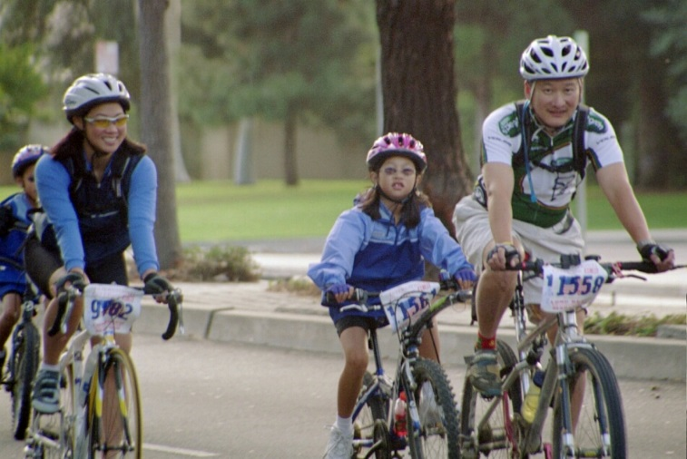
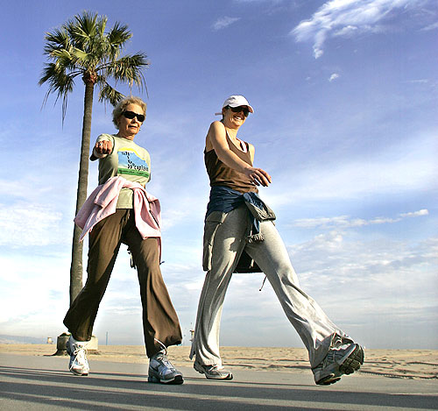
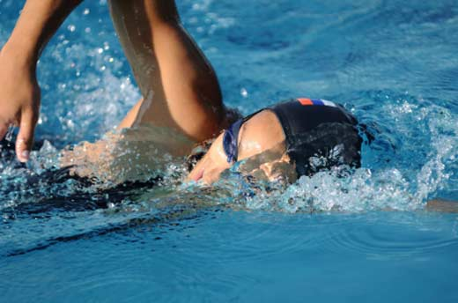
Some Aerobic Activities (Among Many)
https://www.dianesabba.com
https://www.reginanuzzo.com
https://www.media.readersdigest.com.au

Slide 124
Physiological Effects
Exercise increases the oxygen demands of the cardiac and skeletal muscles.
O₂ delivery increases to skeletal muscles as more capillary beds are formed.
In a healthy person, the rate of oxygen delivery to the body’s tissues can continue to increase even after several weeks of vigorous physical training.
Before embarking on an aerobics program, it’s best to visit your health-care provider first.
Page 716
Page 786
Page 745

Slide 125
Benefits
A well-trained athlete can achieve a cardiac output over twice that of a person who lives a sedentary life, in large part due to hypertrophy of the heart.
The resting cardiac output is about the same as in a healthy, untrained person because stroke volume increased while heart rate decreased— think back to the formula for cardiac output.
Regular physical exercise in most people can have other physical and mental benefits too.
Sedentary = characterized by or requiring much sitting; accustomed to sitting or to taking little exercise.
(https://www.answers.com)
Hypertrophy = the enlargement of existing muscle fibers (it does not involve the addition of new muscle fibers, which is hyperplasia).
Page 716
Page 786
Page 745

