Slide 1
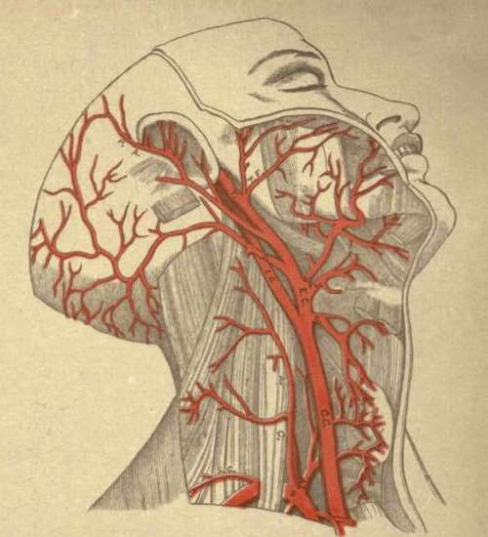
Cardiovascular System
Blood Vessels and Hemodynamics
https://www.chestofbooks.com

Slide 2
Note
Much of the text material is from, “Principles of Anatomy and Physiology” by Gerald J. Tortora and Bryan Derrickson (2009, 2011, and 2014). I don’t claim authorship. Other sources are noted when they are used.
The lecture slides are mapped to the three editions of the textbook based on the color-coded key below.
14th edition
13th edition
12th edition
Same figure or table reference in all three editions

Slide 3
Outline
Overview
Structure and function
Capillary exchange
Hemodynamics
Blood pressure and blood flow
Checking circulation
Shock and homeostasis
Circulation
Aging
The focus of this lecture module is on systemic circulation. Pulmonary circulation will be covered in the lecture module on the respiratory system.

Slide 4
Hemodynamics
Hemodynamics is the study of physical principles and forces involved in the circulation of blood.
“Hemo” refers to blood.
We will cover hemodynamics after the discussion of the different types of blood vessels.
Page 729
Page 803
Page 760

Slide 5
Overview

Slide 6
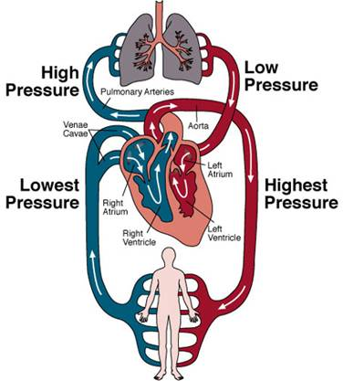
Circulatory System
Pulmonary circulation
(lungs)
Systemic circulation
(all organs and tissues including the lungs)
https://www.agingresearch.buffalo.edu
This lecture module.

Slide 7
Types of Blood Vessels
Arteries
Arterioles
Capillaries
Venules
Veins
Page 730
Page 803
Page 761

Slide 8
Arteries and Arterioles
Arteries carry blood from the heart to organs and other tissues of the body to meet their metabolic needs.
The large, elastic arteries divide into medium-size muscular arteries, and they divide into small arteries.
The small arteries divide into even smaller arteries called arterioles.
Page 730
Page 803
Page 761

Slide 9
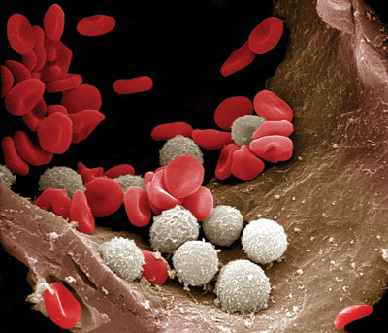
Arteriole
Red blood cells and white blood cells in an arteriole (electron micrograph with false color enhancement).
(From Nature, December 20, 2007)

Slide 10
Capillaries
Arterioles branch into tiny vessels known as capillaries within tis-sues.
The thin and porous walls of the capillaries enable the exchange of substances between the blood and tissues.
Substances include O₂, nutrients, hormones, and CO₂ and other waste products of cell metabolism.
Page 730
Page 803
Page 761

Slide 11
Venules and Veins
The capillaries in a tissue merge to form the smallest veins called ven-ules.
Venules then merge to form progressively larger blood vessels known as veins.
Veins in systemic circulation convey blood from organs and tissues to the right atrium of the heart.
Page 730
Page 803
Page 761

Slide 12
Structure and Function

Slide 13
Tissue Layers
The wall of a blood vessel usually has three tissue layers—each one is known as a tunica:
  The inner lining of endothelial cells is the tunica intima or (tunica interna).
  The middle layer of smooth muscle and elastic connective tissue is the tunica media.
  The outer covering of connective tissue is the tunica externa or tunica adventitia.
Blood vessels (except for capillaries) have this arrangement of three tissue layers.
Page 730
Page 803
Page 761
Figure 21.1

Slide 14
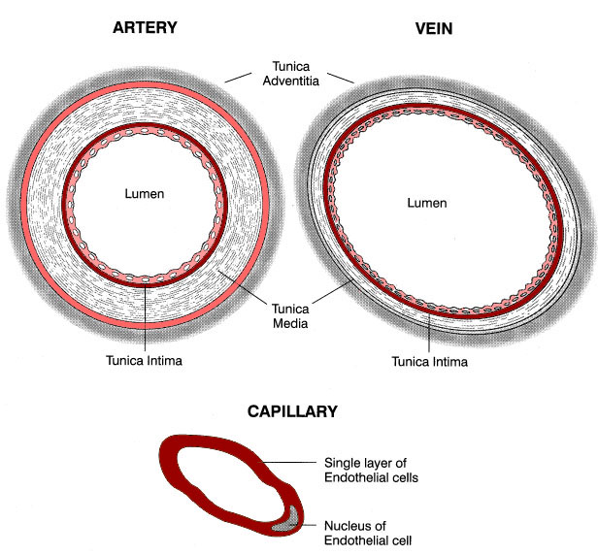
Tissue Layers (continued)
Artery
Vein
Capillary
https://www.nurse-prescriber.co.uk

Slide 15
Tunica Interna
The tunica interna is in contact with blood flowing through the lumen of the blood vessel.
It has a layer of flattened endothelial cells, known as the endothelium, which is continuous with the endocardial lining of the heart to maintain a smooth (or laminar) flow of blood.
At one time, the tunica interna was thought to serve as little more than a passive barrier between the blood and the rest of the blood vessel wall.
Lumen = the inner open space or cavity of a tubular organ such as a blood vessel.
Page 730
Page 803
Page 761
Figure 21.1

Slide 16
Tunica Interna (continued)
We know know that endothelium cells of the tunica interna secrete locally-acting chemical mediators such as nitric oxide that:
  Affect the activity of smooth muscle in the vessel walls.
  Alter capillary permeability to enable diffusion of substances across capillary walls.
The basement membrane of the tunica interna provides structural support for the endothelium.
Page 730
Page 803
Page 761
Figure 21.1

Slide 17
Tunica Media
The percentages of smooth muscle and elastic tissue of the tunica media vary among the different types of arteries and veins.
The smooth muscles are in a circular arrangement to regulate the diameter of the vessel lumen.
Blood pressure and the blood flow through organs and other tissues is regulated by the smooth muscle in the smaller arteries and arter-ioles.
Page 730
Page 803
Page 761
Figure 21.1

Slide 18
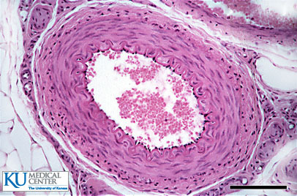
Tunica Media (continued)
https://www.kumc.edu
Tunica media
(in this blood vessel, it is mostly smooth muscle)

Slide 19
Tunica Media (continued)
The tunica media has elastic fibers to enable elastic arteries (such as the aorta) to stretch and recoil with the pressure pulses of blood ejected from the heart.
The structural differences in the tunica media account for the varia-tions in functions of the different types of blood vessels (especially elastic arteries and muscular arteries that will be discussed in this module).
Page 730
Page 803
Page 763
Figure 21.1

Slide 20
Sympathetic Stimulation
Sympathetic fibers innervate smooth muscles in the tunica media in the muscular arteries and arterioles.
Sympathetic activity causes the circular smooth muscles to contract, which constricts (narrows) the lumen of an artery.
The decrease in lumen diameter is known as vasoconstriction, where “vaso” refers to blood vessel.
Vasoconstriction reduces blood flow to a tissue.
Muscular arteries have mostly smooth muscle fibers in the tunica media while elastic arteries only have elastic fibers.
Page 730
Page 803
Page 763

Slide 21
Sympathetic Stimulation (continued)
Decreased sympathetic stimulation causes the smooth muscle in an arterial wall to relax, which dilates (widens) the lumen.
The increase in lumen diameter is known as vasodilation.
Vasodilation increases blood flow to an organ or other tissue to help meet its metabolic needs such as during exercise or a fight or flight reaction.
Some ions and chemicals including as H⁺, nitric oxide, and lactic acid also relax the smooth muscle in arterial walls.
Page 732
Page 805
Page 763

Slide 22
Vascular Spasm
When an artery or arteriole is damaged, its smooth muscle contracts, resulting in vascular spasm.
Spasms cause turbulence and therefore slow blood flow through the vessel (especially in the arterioles with their small lumens) to reduce blood loss.
Page 732
Page 805
Page 763

Slide 23
Tunica Externa
The tunica externa has collagen and other fibers to provide structural support for arteries and (to an extent) veins.
The layer also contains sympathetic nerves.
In large arteries, the tunica externa has small blood vessels to meet the metabolic needs of the vessel walls.
These vessels are known as the vasa vasorum, the Latin term mean-ing “vessels to the vessel.”
The tunica externa also anchors blood vessels to the surrounding tis-sues in the body.
Page 732
Page 805
Page 763
Figure 21.1

Slide 24
Arteries
Arterial walls contain all three tissue layers of a typical blood vessel.
Most have a tunica media of elastic fibers or smooth muscle fibers.
Compliance = the degree of suppleness of a form.
Suppleness = yielding or changing readily; flexible.
Page 732
Page 805
Page 763
Figure 21.1

Slide 25
Elastic Arteries
The elastic arteries are the largest arteries of the body, and are of two sizes:
  Diameter of a garden hose for the aorta and pulmonary trunk.
  Finger-sized branches that extend from the aorta.
The walls of the elastic arteries are thin in relationship to their out-side diameters.
The tunica media consists mostly of elastic fibers instead of muscle fibers.
Elastic arteries have high compliance due to the elasticity—their walls can stretch in response to blood pressure pulses without tearing.
Page 732
Page 805
Page 763

Slide 26
Elastic Arteries (continued)
The elastic arteries stretch in response to pressure pulses of blood pumped from the left ventricle.
As the arterial walls stretch, they accumulate potential energy that is released as mechanical energy when the arteries recoil.
The mechanical energy propels the blood through the larger arteries and into smaller and smaller arteries.
Page 732
Page 805
Page 763
Figure 21.2

Slide 27
Muscular Arteries
Medium-sized arteries are known as muscular arteries since their tunica media has substantial amounts of smooth muscle (and much less elastic tissue).
The muscular arteries vasoconstrict and vasodilate to regulate blood flow to organs and other tissues.
In the largest muscular arteries, the tunica media has as many as 40 layers of smooth muscle fibers arranged in a circular pattern to allow for vasoconstriction and vasodilation.
The smallest muscular arteries have as few as three layers of smooth muscle fibers, which are also arranged in a circular pattern.
Page 733
Page 806
Page 764

Slide 28
Muscular Arteries (continued)
The diameters of the muscular arteries range from the thickness of a pencil (5 mm) to that of a piece of string (0.5 mm).
They are sometimes referred to as branching arteries because they diverge (or divide) to distribute blood to organs and other tissues of the body.
Unlike the elastic arteries, muscular arteries cannot recoil and propel blood forward because they have very little elastic tissue in the tunica media.
Page 733
Page 806
Page 764

Slide 29
Muscular Arteries (continued)
Muscular arteries can constrict and dilate due to the smooth muscle in their tunica media, which is under sympathetic control.
These arteries normally maintain a partial state of contraction called vascular tone.
Vascular tone stiffens the arterial wall and helps maintain blood pres-sure and efficient blood flow.
Page 733
Page 806
Page 764

Slide 30
Anastomoses
Most tissues of the body receive blood from more than one artery.
The arrangement gives redundant routes for blood; for example, when body movements compress an artery and reduce its blood supply to a tissue.
The joining (union) of the branches of two or more arteries is called an anastomosis.
Anastomoses (-is) = plural and singular forms.
Page 733
Page 806
Page 764

Slide 31
Anastomoses and End Vessels
Anastomoses are also found between veins, and between arterioles and venules to serve as shunts (or channels) to bypass the capillary beds.
Arteries that do not have anastomoses are known as end vessels— in these instances, a vessel obstruction can result in the necrosis of a tissue.
Necrosis = localized death of cells such as from an infection or interruption of blood supply.
Page 733
Page 806
Page 764

Slide 32
Arterioles
Arterioles are microscopic vessels that regulate the flow of blood into the capillary beds of organs and other tissues.
The ~400 million arterioles have diameters ranging from 300 μm to 15 μm.
The wall thickness is typically about one-half the outside diameter of the arteriole.
The tunica media has one or two layers of smooth muscle fibers in a circular arrangement.
The smooth muscle regulates resistance (that is, opposition) to blood flow.
Page 733
Page 806
Page 764
Figure 21.3

Slide 33
Arterioles (continued)
The terminal (or distal) end of an arteriole is known as a metarteriole.
Smooth muscle cells of the metarteriole form a precapillary sphincter at its junction with a capillary bed.
The opening and closing of a precapillary sphincter controls the flow of blood into a capillary bed.
Sphincter = a ring of muscle that contracts to close an opening.
Page 733
Page 806
Page 764
Figure 21.3

Slide 34
Arterioles (continued)
Arterioles are also known as resistance vessels because they reg-ulate flow resistance.
This resistance is primarily due to friction between the blood and tunica interna of the blood vessel.
Friction is higher when the diameter of the lumen of a blood vessel is small because there is relatively more surface area compared to larger blood vessels.
As a result, there is more resistance to blood flow when an arteriole constricts.
Page 733
Page 806
Page 764

Slide 35
Arterioles (continued)
The contraction of smooth muscle in an arteriole wall causes vasocon-striction, which increases flow resistance.
The relaxation of smooth muscle causes vasodilation, which decreases flow resistance.
Changes in the lumen diameters of the many millions of arterioles can have a substantial effect on blood pressure:
  When their collective lumen diameters decrease (constrict), blood pressure increases.
  And when their collective lumen diameters increase (dilate), blood pressure decreases.
Page 733
Page 806
Page 764

Slide 36
Capillaries
Capillaries are the smallest blood vessels.
Their inner diameter measures about 5 μm—much smaller than the outer diameter of red blood cells (8 μm).
These vessels are short, branched, and interconnected found in al-most all tissues.
Systemic circulation has about 20 billion capillaries that collectively have a very large surface area although though a single capillary has a very small surface area.
This vast surface area is needed for the exchange of oxygen, water, nutrients, hormones, ions, and carbon dioxide and other waste prod-ucts.
Page 733
Page 806
Page 764
Figure 21.3

Slide 37
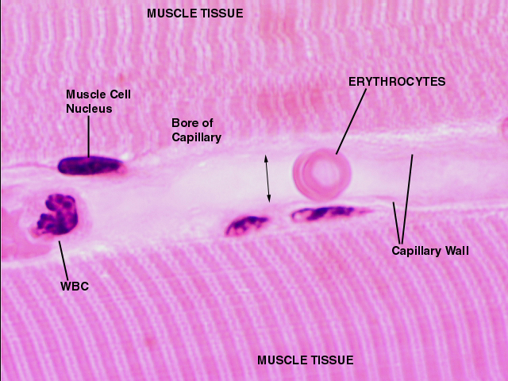
Capillary and Red Blood Cell
https://www.education.vetmed.vt.edu
Red blood cells (or erythrocytes) because they have a diameter of about 8 μm, must squeeze through the narrow lumens (5 μm) of capillaries. The micrograph is of striated muscle tissue.

Slide 38
Capillaries (continued)
Capillaries are sometimes called exchange vessels because they enable the exchange of substances between the blood and intersti-tial fluid.
The blood flow from arterioles through capillaries and into venules is called microcirculation.
Interstitial fluid = the fluid found in the extracellular space around cells.
Page 734
Page 806
Page 764

Slide 39
Capillaries (continued)
Capillaries are located adjacent to almost every cell in the human body.
However, capillaries are not present in a few body tissues includ-ing cartilage and the cornea and lens of the eye.
Page 734
Page 807
Page 765

Slide 40
Capillaries (continued)
The numbers of capillaries vary with the metabolic needs of the tissues they supply.
Tissues with high metabolic requirements have substantial num-bers of capillaries—they include the brain, skeletal muscle, liver, and kidneys.
Tissues with lower metabolic needs have fewer capillaries—they include tendons and ligaments.
Page 734
Page 807
Page 765

Slide 41
Substance Exchange
Capillaries have a tunica interna, but not a tunica media or tunica externa.
Substances in the blood pass through the one layer of endothelial cells and basement membrane of the tunica interna to enter inter-stitial fluid (and vice versa).
Most substance exchange occurs in the capillaries and to a limited extent at the beginning of the venules that also have only a tunica interna.
Substance exchange does not occur in the arteries, arterioles, and veins because they have all three tissue layers in their vessel walls that serves as a barrier to exchange.
Page 734
Page 807
Page 765
Figure 21.1

Slide 42
Capillary Beds
From ten to 100 capillaries diverge from a metarteriole (distal end of an arteriole) to form a capillary bed.
The precapillary sphincters of metarterioles regulate blood flow into these beds.
When the metabolic needs of a tissue are low, blood may flow only through a portion of a capillary bed.
When metabolic needs are high, such as in contracting muscle, blood flows through the entire capillary bed.
Page 734
Page 807
Page 765
Figure 21.3

Slide 43
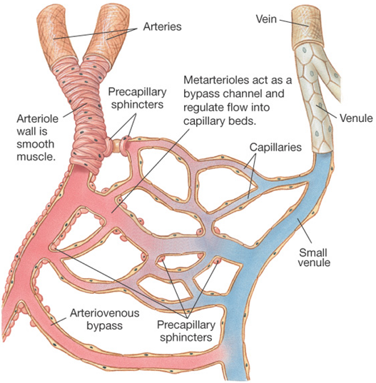
Capillary Bed
Direction of arterial blood flow
Direction of venous blood flow
https://www.faculty.pasadena.edu
Capillary bed

Slide 44
Vasomotion and Capillary Blood Flow
Blood usually flows intermittently through capillaries due to smooth muscle contractions in the metarterioles and precapillary sphincters.
The contractions, called vasomotion, occur about five to ten times per minute.
Vasomotion controls the moment-by-moment blood flow through the capillary beds.
Intermittent = not continuous.
Page 734
Page 807
Page 765
Figure 21.3

Slide 45
Continuous Capillaries
The three types of capillaries are: 1) continuous, 2) fenestrated, and 3) sinusoids.
In the human body, most are continuous capillaries, where the mem-brane of endothelial cells forms a continuous tube interrupted only by intercellular clefts (gaps between cells).
They are found in the brain, lungs, skeletal and smooth muscles, and connective tissues.
Page 735
Page 808
Page 766
Figure 21.3

Slide 46
Fenestrated Capillaries
Endothelial cells in fenestrated capillaries have small pores known as fenestrations.
The fenestrations range from 70 to 100 nm in diameter to allow some substances to pass.
Fenestrated capillaries are found in the kidneys, villi of the small intes-tine, choroid plexuses of the brain’s ventricles, ciliary process in the eye, and endocrine glands.
Page 735
Page 808
Page 766
Figure 21.4

Slide 47
Sinusoids
Sinusoids are wider and more winding than the other two types of capillaries.
They have large fenestrations and a basement membrane that is incomplete or absent.
Large intercellular clefts allow proteins and, in some cases, blood cells to pass from tissues into the blood.
Sinusoids are found in the red bone marrow, anterior pituitary, liver, spleen, and parathyroid gland.
Page 735
Page 808
Page 766
Figure 21.4

Slide 48
Portal Systems
When blood is pumped from the ventricles of the heart, it passes in sequence through arteries, arterioles, capillaries, venules, and veins.
In a portal system, blood passes from one capillary bed into another capillary bed through a portal vein.
They include the:
  Hypophyseal portal system of the hypothalamus and anterior pituitary—discussed in the second lecture module on endocrin-ology lecture module.
  Hepatic portal system (liver).
Page 735
Page 808
Page 766

Slide 49
Venules
Venules drain the blood from capillaries to begin its return to the right atrium of the heart.
They have thin walls that cannot maintain their shape, unlike the thick walls of arterioles and arteries.
The postcapillary venules, the smallest of the venules, measure about 10 μm to 50 μm in diameter.
Page 735
Page 808
Page 766
Figure 21.3

Slide 50
Venules (continued)
Postcapillary venules have loosely-organized endothelial junctions.
Their porosity enables some nutrient and waste exchange, and white blood cell emigration (pass from the blood to interstitial fluid surround-ing cells).
The postcapillary venules converge to form larger venules that have one or two layers of smooth muscle.
The thicker walls of the larger venules prevent the exchange of nutri-ents and waste products.
Porous = having small spaces through which some small molecules can pass.
Page 735
Page 808
Page 766
Figure 21.3

Slide 51
Veins
Veins generally have much thinner walls than arteries and arterioles.
They have the same three tissue layers as arteries, but the relative thicknesses are different.
Their diameters range from 0.5 mm to 3 cm (for the largest veins that return blood to the right atrium of the heart).
1.0 inches equals about 2.54 cm.
Page 736
Page 809
Page 767
Figure 21.1

Slide 52
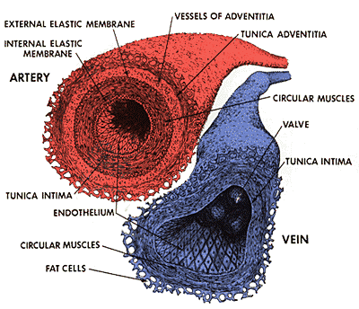
Artery and Vein Compared
Artery
Vein
https://www.mybioworld.blogspot.com

Slide 53
Veins (continued)
The tunica interna is thinner and the tunica media is much thinner in veins than in arteries.
The tunica externa composed of collagen and elastic fibers is the thickest layer.
Veins are distensible to adjust to the volume and pressure of blood passing through them.
They cannot, however, withstand the high pressures encountered in arteries.
Blood pressure in the veins is much lower than in the arteries; the difference is apparent when a vein versus an artery is cut (arteries will bleed profusely).
Distensible = capable of being stretched or expanded.
Page 736
Page 809
Page 767
Figure 21.1

Slide 54
Low Venous Pressure and Backflow
The low blood pressure in veins allows blood returning to the right atrium to slow and even back up.
Veins, especially those in legs, have one-way valves to minimize backflow—more about this later.
The contraction of skeletal muscles in the legs also helps to return blood to the heart—also to be discussed.
Page 736
Page 809
Page 767
Figure 21.5

Slide 55
Venous Sinuses
A venous or vascular sinus is a vein with a thin endothelial wall, but with no smooth muscle to alter its diameter.
The surrounding tissues help provide structural support for the sinus.
Venous sinuses of the dura mater allow the return of blood from the brain to the heart.
Page 736
Page 809
Page 767

Slide 56
Pairing of Veins
Veins are usually paired and accompany medium to small arteries in skeletal muscle.
The parallel veins interconnect in ladder-like rungs known as anas-tomotic veins.
The largest numbers of paired veins are found in the limbs and the subcutaneous layer of the skin.
Page 736
Page 809
Page 767
Figure 21.25

Slide 57
Superficial Veins
Superficial veins form anastomoses with deep veins in skeletal mus-cles.
The anastomoses enable blood flow between superficial and deep veins.
In the upper limbs, the superficial veins are much larger in diameter than the deep veins.
They serve as the major pathway for blood returning to the right atrium.
In the lower limbs, the deep veins serve as the major return pathway to the right atrium.
Page 736
Page 809
Page 767
Figure 21.25

Slide 58
Blood Distribution
Much of the blood volume (about 64 percent) is in systemic veins and venules in a person at rest.
The distribution of blood volume in the circulatory system is shown in Figure 21.6 of the textbook.
Page 736
Page 811
Page 769
Figure 21.6

Slide 59
Blood Distribution (continued)
Veins and venules are a reservoir from which blood can be quickly diverted to organs and tissues of the body when the need arises.
The primary reservoirs are the veins of the abdominal region and skin.
With physical exercise, the sympathetic division of the autonomic nervous system constricts these veins.
Vasoconstriction reduces the reservoir volume and enables more blood to be pumped to the skeletal muscles, liver, and brain with their increased metabolic requirements.
Page 736
Page 811
Page 769

Slide 60
Capillary Exchange

Slide 61
Mechanisms of Capillary Exchange
The primary role of the cardiovascular system is to deliver blood to the capillaries.
Capillaries enable the exchange of substances between the blood and the interstitial fluid that surrounds cells.
The seven percent of total blood volume that is in the systemic cap-illaries, at any given instant, exchanges substances with the intersti-tial fluid.
Substances cross the capillary walls by three processes: 1) passive diffusion, 2) transcytosis, and 3) bulk flow.
We covered passive diffusion and transcytosis in the lecture module on cell metabolism.
Page 738
Page 811
Page 769

Slide 62
Passive Diffusion
Much of capillary exchange is via passive diffusion, where substances flow along their concentration gradients (from a high concentration to a low concentration).
Oxygen, carbon dioxide, glucose, amino acids, and hormones are ex-changed in this manner.
Because O₂ and nutrients are normally in higher concentrations in the blood, they diffuse into interstitial fluid, and then into cells to meet their metabolic needs.
CO₂ and waste products of cellular metabolism are present in higher concentrations in the interstitial fluid after release from cells, and they diffuse into the blood.
Page 738
Page 811
Page 769

Slide 63
Passive Diffusion (continued)
Lipid-soluble substances, including O₂, CO₂ and steroids, diffuse through the plasma membranes of endothelial cells lining the cap-illaries.
Water-soluble substances, including glucose and amino acids, diffuse across capillary walls through intercellular clefts (or gaps).
Red blood cells and most plasma proteins cannot pass since they are too large to fit through the intercellular clefts of most capillaries (except sinusoids in the red bone marrow and liver).
Intercellular cleft = physical separation between two cells (for capillaries, these are endothelial cells).
Page 739
Page 811
Page 769

Slide 64
Passive Diffusion (continued)
The intracellular clefts in sinusoids are large enough to allow RBCs and proteins to pass.
In red bone marrow, reticulocytes (immature RBCs) diffuse into the blood through sinusoids.
Plasma proteins synthesized by hepatocytes (liver cells) also diffuse into the blood through sinusoids.
Sinusoid = tiny endothelium-lined passages for blood in the tissue of an organ; a type of capillary.
Page 739
Page 812
Page 770
Figure 21.4

Slide 65
Passive Diffusion (continued)
Capillaries in the brain permit only a few substances to move across their walls.
Endothelial cells of the capillary walls have tight junctions that form the blood-brain barrier.
The permeability characteristics of these tight junctions are aided by chemical secretions from astrocytes, a type of neuroglia (or glial cell).
The hypothalamus, pituitary gland, and pineal gland do not have this barrier, and can freely engage in the capillary exchange of hormones.
Page 739
Page 812
Page 770

Slide 66
Transcytosis
Some large, water-soluble molecules can cross the capillary walls by transcytosis.
Substances in blood plasma are engulfed within invaginations in the plasma membranes of the endothelial cells that then form vesicles.
The vesicles enter endothelial cells of the capillaries via endocytosis, pass through the cell’s plasma membrane, and exit on the inner side via exocytosis (endocytosis and exocytosis in tandem are transcyto-sis).
Invagination = folded inward.
Page 739
Page 812
Page 770

Slide 67
Transcytosis (continued)
Insulin, a protein molecule, enters the blood from the beta cells of the pancreas by transcytosis.
Some antibodies and proteins can pass from maternal blood circu-lation to fetal blood circulation in the placenta by this process.
Page 739
Page 812
Page 770

Slide 68
Bulk Flow
Bulk flow is a passive process in which large numbers of ions and molecules in a solution all move together in the same direction.
The substances move at higher rates than could be explained by passive diffusion alone.
Bulk flow is from an area of higher pressure to an area of lower pressure.
The flow will typically continue as long as the pressure difference exists.
Page 739
Page 812
Page 770

Slide 69
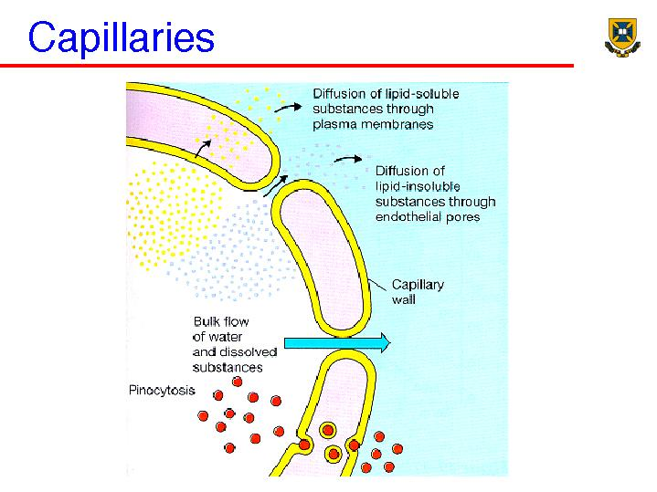
Capillary Exchange—Summary
https://www.people.eku.edu

Slide 70
Hemodynamics

Slide 71
Blood Flow and Cardiac Output
Blood flow is the volume of blood that passes through a tissue in a one-minute period of time.
Total blood flow of the human body is a function of cardiac output (CO), the volume of blood that circulates though systemic circula-tion in one minute.
Cardiac output is determined by stroke volume and heart rate as was discussed in the lecture on the heart:
Cardiac output (CO) = stroke volume (SV) x heart rate (HR)
Page 741
Page 814
Page 772

Slide 72
Distribution of Cardiac Output
The distribution of cardiac output to organs and other tissues depends on:
  Pressure differences that drive blood flow through the tissues.
  Resistance to blood flow in the blood vessels (known as vascular resistance).
Blood flows from regions of higher pressure to regions of lower pres-sure—the greater the pressure difference, usually the higher the blood flow.
And, the lower the vascular resistance, usually the higher the blood flow.
Page 741
Page 814
Page 772

Slide 73
Blood Pressure
The contraction of the heart’s left ventricle generates systolic blood pressure (BP).
Systolic BP is related to three factors: 1) cardiac output, 2) blood volume, and 3) vascular resistance.
Systolic BP is highest in the aorta and large systemic arteries since they are close proximity to the left ventricle.
BP is about 110 mmHg during systole and 70 mmHg during diastole in a healthy, young adult at rest.
Systole and diastole in blood pressure measurement represent left ventricular contraction and relaxation, respectively.
Page 741
Page 814
Page 772
Figure 21.8

Slide 74
Blood Pressure (continued)
Blood pressure progressively decreases once blood leaves the aorta and flows through many branchings of the arteries in systemic circula-tion.
Compared to aortic pressure (about 80 mmHg), BP drops to about 35 mmHg as blood passes from the arterioles to the systemic capillaries.
The pressure fluctuations in the arteries due to ventricular contractions disappear in the capillaries.
Page 741
Page 814
Page 772
Figure 21.8

Slide 75
Blood Pressure (continued)
Blood pressure is about 16 mmHg as blood exits the systemic capil-laries.
BP continues to drop in the venules and veins and drops to 0 mmHg at the right atrium.
Thus, blood flows “downhill” in the circulatory system from higher pres-sure regions to lower pressure regions.
Page 741
Page 814
Page 772
Figure 21.8

Slide 76
Mean Arterial Pressure
Mean arterial pressure (MAP) is the average blood pressure in the arteries—it is one-third of the difference between diastolic and sys-tolic BP:
MAP = diastolic BP + 1/3 (systolic BP - diastolic BP)
MAP for a blood pressure of 110/70 mmHg (systolic/diastolic) is 83 mmHg.
Page 741
Page 815
Page 773

Slide 77
Mean Arterial Pressure (continued)
When cardiac output increases due to increased stroke volume or heart rate, MAP will rise if resistance in the arteries and arterioles remains constant.
Decreased cardiac output reduces mean arterial pressure if vascu-lar resistance remains constant.
Page 741
Page 815
Page 773

Slide 78
Blood Volume and Blood Pressure
Blood pressure also depends on the total volume of blood in circu-lation.
A reduction in blood volume, such as from hemorrhage, decreases the amount of blood in circulation, which can decrease blood pres-sure.
Small reductions in blood volume can often be compensated by homeostatic mechanisms that maintain blood pressure—see the textbook, chapter 20.
Hemorrhage = loss of blood from ruptured blood vessels.
Page 741
Page 815
Page 773

Slide 79
Blood Volume and Pressure (continued)
Blood pressure will drop if the loss in blood volume is more than about 10 percent.
An increase in blood volume, such as from water retention, tends to increase blood pressure.
Page 741
Page 815
Page 773

Slide 80
Vascular Resistance
Vascular resistance is the opposition to blood flow due to the friction between blood and tunica interna in the walls of blood vessels.
Three factors determine this resistance: 1) lumen diameter, 2) blood viscosity, and 3) blood vessel length.
Page 742
Page 815
Page 773

Slide 81
Lumen Diameter
The smaller the diameter of the lumen, the greater the resistance to blood flow.
This is because there is a relatively larger surface area that comes in contact with blood, which produces more friction.
Vasoconstriction narrows the lumen of a blood vessel, and vasodila-tion widens it.
With vasoconstriction, vascular resistance increases and blood pres-sure increases.
Page 742
Page 815
Page 773

Slide 82
Lumen Diameter (continued)
With vasodilation, vascular resistance decreases and blood pressure decreases.
Moment to moment fluctuations in blood flow through a tissue are due to rapid vasoconstriction and vasodilation of arterioles supplying the capillary beds.
Page 742
Page 815
Page 773

Slide 83
Blood Viscosity
The viscosity of blood depends on the concentration of RBCs and to a lesser extent on the concentration of proteins in blood plasma.
Resistance to blood flow increases when blood viscosity increases.
Conditions that increase blood viscosity—including polycythemia and dehydration—tend to increase blood pressure.
A depletion of RBCs or plasma proteins, such as in anemia or hem-orrhage, can decrease blood pressure since the blood’s viscosity is reduced.
Viscosity = the property of a fluid that resists the force tending to cause a fluid to flow.
Page 742
Page 815
Page 773

Slide 84
Blood Vessel Length
Resistance to blood flow is directly proportional to the total length of blood vessels.
That is, the longer a blood vessel, the greater the flow resistance.
Overweight people often have hypertension due to the additional blood vessels in adipose tissue.
A kilogram (2.2 pounds) of adipose tissue adds an estimated 650 kilometers (about 406 miles) of blood vessels to systemic circula-tion.
Hypertension = high blood pressure; a commonly occurring disorder in which blood pressure remains abnormally high.
Page 742
Page 815
Page 773

Slide 85
Systemic Vascular Resistance
Systemic vascular resistance (SVR) is the sum total of the vascular resistances of all blood vessels in systemic circulation.
The arterioles, capillaries, and venules contribute the most vascular resistance due to their small-diameter lumens.
A major function of the arterioles is to control SVR, and therefore the blood pressure and blood flow to tissues, by vasodilation and vasocon-striction.
Page 742
Page 815
Page 773

Slide 86
Systemic Vascular Resistance (continued)
Arterioles, due their very large numbers (400 million), need to vaso-dilate or vasoconstrict only slightly to have large effect on systemic vascular resistance.
The regulatory center for SVR is the vasomotor nuclei in the medulla oblongata.
The arterioles vasoconstrict in response to sympathetic stimulation controlled by this center.
Page 742
Page 815
Page 773

Slide 87
Venous Return
The pressure difference from the venules (16 mmHg) to the right ventricle (0 mmHg) is normally sufficient to enable blood return to the right atrium of the heart.
If pressure were to increase in the right atrium, venous return will decrease because of the reduced pressure differential (difference).
This condition can result from a leaky bicuspid (mitral) valve that allows blood to flow back into the right atrium from the right ventri-cle during ventricular contraction.
Blood volume will build-up on the venous side of systemic circula-tion.
Page 742
Page 815
Page 773

Slide 88
Venous Return (continued)
When a person stands-up, the pressure difference forcing the blood through the veins to the heart is just sufficient to overcome the force of gravity (G).
Two mechanisms help propel blood from the lower body to the heart:
  Skeletal muscle valves and pump
  Respiratory valves and pump
Page 742
Page 815
Page 773

Slide 89
Skeletal Muscle Valves and Pump
The veins in the legs have pairs of one-way valves, distal and prox-imal, to enable blood flow to the right atrium.
Skeletal muscles in the legs squeeze the veins when they contract to propel blood forward.
The valves open and close to enable blood flow to the right atrium and prevent backflow into the extremities—especially into the legs.
Page 742
Page 815
Page 773
Figure 21.9

Slide 90
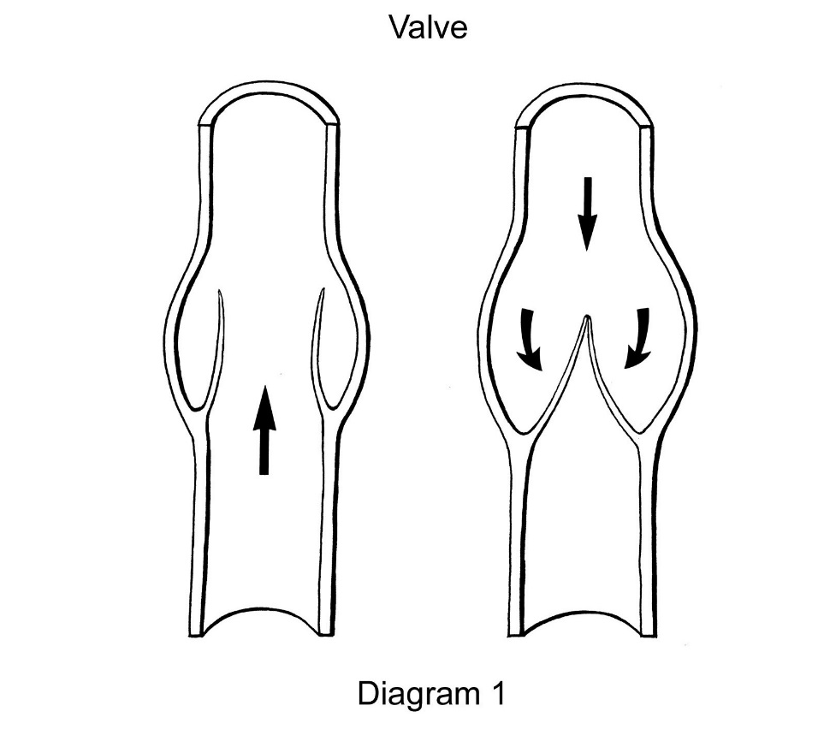
A Single Venous Valve
The force of gravity (G) causes the blood to flow down hill, which forces the valve closed so that it cannot pool in the lower limbs.
Blood must flow in this direction to reach the right atrium.
https://www.wsiat.on.ca

Slide 91
Skeletal Muscle Valves Pump (continued)
People who are bedridden or immobilized due to injury or disease may not have sufficient contractions of the leg muscles to squeeze the veins.
The venous return of blood to the right atrium is slower and circula-tory problems can develop.
Page 743
Page 816
Page 774

Slide 92
Respiratory Valves and Pump
The respiratory pump enables the alternating compression and decom-pression of veins.
With inhalation, the diaphragm moves downward to increase pressure in the abdominal cavity and decrease the pressure in the thoracic cav-ity where the heart is located.
Diaphragm = the skeletal muscle that separates the thoracic cavity from the abdomen. The diaphragm is the main skeletal muscle of respiration.
(https://www.medterms.com)
Page 743
Page 816
Page 774

Slide 93
Respiratory Valves and Pump (continued)
As a result, the abdominal veins are compressed so that blood is propelled into the decompressed thoracic veins and into the right atrium.
When the pressure differential is reversed on exhalation, the one-way valves in the thoracic veins prevent the backflow of blood into the abdominal veins.
Blood therefore enters the right atrium.
Page 743
Page 816
Page 774

Slide 94
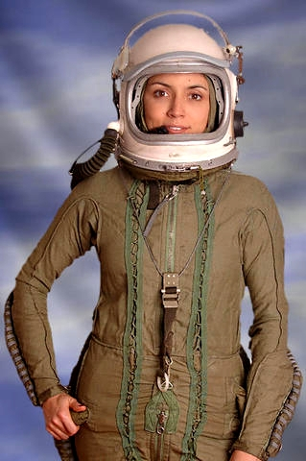
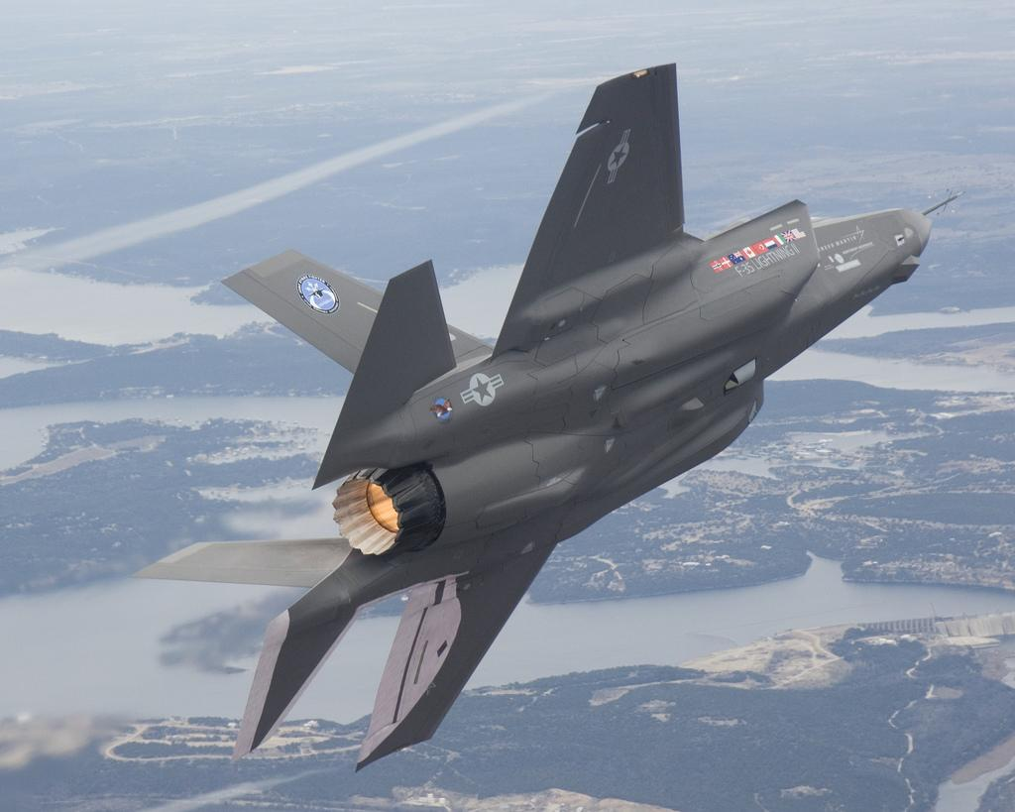
High-G Environment
At several times the force of gravity (G) in a fighter plane in a tight turn, venous blood can pool in the extremities (especially the legs and feet) and can cause black-outs and unconsciousness.
A G-suit can be used to help force blood into the right atrium by applying external pressure to the extremities (arms and legs) and their blood vessels.
https://www.armybase.us

Slide 95
Blood Flow Velocity
Blood flow velocity is inversely proportional to the cross-sectional area of a blood vessel.
When an artery branches, the total cross-sectional area increases and blood flow velocity decreases.
When venules merge to form veins, the total cross-sectional area decreases and blood flow velocity increases.
Inversely proportional = the value of one variable increases while the value of the other variable decreases.
Page 743
Page 816
Page 774
Figure 21.11

Slide 96
Blood Flow Velocity (continued)
The 20 billion capillaries in systemic circulation have a large combined cross-sectional area, and therefore blood flow velocity slows consider-ably in the capillary beds.
The slow velocity gives adequate time for the exchange of substances between the blood and interstitial fluid, and interstitial fluid and blood.
Page 744
Page 816
Page 774
Figure 21.11

Slide 97
Circulation Time
Circulation time is the time duration required for a drop of blood to:
  Pass from the right atrium and into the right ventricle,
  Through pulmonary circulation,
  Return to the left atrium and into the left ventricle,
  Through systemic circulation to the most distal point (feet), and
  Return to the right atrium.
The circulation time in a resting person is typically about one minute.
Page 744
Page 816
Page 774

Slide 98
Blood Pressure and Blood Flow

Slide 99
Negative Feedback Systems
Negative feedback systems control blood pressure by regulating:
  Heart rate
  Stroke volume
  Systemic vascular resistance
  Blood volume
Some of the systems respond with rapid adjustments to cope with sudden changes—such as in standing-up from a prone or sitting position.
Other systems act more slowly in the long-term regulation of blood pressure.
Prone position = lying with the front of the body or face downward.
Page 744
Page 817
Page 775
Figure 21.14

Slide 100
Cardiovascular Center
The cardiovascular (CV) center in the medulla oblongata regulates heart rate and stroke volume.
The CV center controls neural and hormonal feedback systems that regulate blood flow and blood pressure to organs and other tissues.
The CV center receives input from other brain regions including the hypothalamus, limbic system (our “emotional brain”), and cerebral cortex.
Thus, overall arousal and emotional states can affect cardiac activity.
Page 744
Page 817
Page 776
Figure 21.12

Slide 101
Sensory Receptors
The cardiovascular system has two types of sensory receptors (which are interoreceptors).
Baroreceptors in blood vessel walls sense blood pressure and degree of stretch in blood vessels.
Chemoreceptors, including in the hypothalamus, respond to concentra-tions of certain chemicals in blood circulation.
Interoreceptor = a sensory receptor of an internal organ.
Page 745
Page 818
Page 776
Figure 21.12

Slide 102
Neural Output
Output from the CV center is via the sympathetic and parasympa-thetic divisions of the ANS.
Action potentials of the sympathetic division reach the heart via the cardiac accelerator nerves.
Increased sympathetic stimulation increases the heart rate and force of cardiac contraction to increase cardiac output (CO).
Sympathetic stimulation also produces vasoconstriction to help divert blood from venous reservoirs to other body tissues including skeletal muscle, liver, and brain.
Vasoconstriction tends to increase blood pressure.
Page 746
Page 818
Page 776
Figure 21.12

Slide 103
Neural Output (continued)
Action potentials of the parasympathetic division are conveyed via the vagus (X) cranial nerve.
Parasympathetic stimulation decreases heart rate and force of car-diac contractility.
Page 746
Page 818
Page 776
Figure 21.12

Slide 104
Hormonal Regulation
Hormones are involved in regulating blood pressure and blood flow.
They include:
  Hormones of the renin-angiotensin-aldosterone system
  Epinephrine and norepinephrine
  Antidiuretic hormone (ADH)
  Atrial natriuretic hormone (ANP)
The hormones can either alter cardiac output, change vascular resistance in the systemic circulatory system, or adjust the total blood volume.
A summary of the hormonal effects is contained in Table 21.2 of the textbook.
Page 747
Page 820
Page 778
Table 21.2

Slide 105
Autoregulation
The ability of a tissue to self-regulate blood flow to meet its metabolic demands is known as autoregulation.
Vasodilators cause a local dilation of arterioles and relaxation of pre-capillary sphincters to increase blood flow to capillary beds.
Vasoconstrictors have the opposite effect in decreasing blood flow to capillary beds.
Page 747
Page 821
Page 779

Slide 106
Autoregulation (continued)
Autoregulation involves a complex set of physiological mechanisms.
These mechanisms contribute substantially to increased blood flow in cardiac muscle and skeletal muscle.
They provide more oxygen and nutrients to muscles as the physical demands increase and enable waste products to be removed more rapidly.
Autoregulation controls regional blood flow in the brain in response to specific mental activities—for example, an auditory task versus a visual task activating areas in the temporal lobe or occipital lobe, re-spectively.
Page 747
Page 821
Page 779

Slide 107
Chemicals Involved in Autoregulation
White blood cells, macrophages, platelets, endothelial cells, and smooth muscle fibers release chemicals that can change the di-ameter of blood vessels.
Vasodilator chemicals include ions (K⁺ and H⁺), lactic acid, adeno-sine, nitric oxide, kinins, and histamine.
Vasoconstrictor chemicals include thromboxane A2, superoxide radicals, serotonin released by platelets, and endothelins released by endothelial cells.
Page 748
Page 821
Page 779

Slide 108
Checking Circulation

Slide 109
Pulse
The alternating expansion and recoil of elastic arteries with each ventricular contraction produces a pressure wave known as the pulse.
Pulse is strongest near the heart, weaker in arterioles, and non-existent in capillaries and veins.
It can be detected in an artery that lies close to the surface of the body that can be compressed against bone or other firm structure.
The most commonly-used pulse points for checking circulation are listed in Table 21.3.
Page 748
Page 822
Page 780
Table 21.3

Slide 110
Pulse Rate
Pulse rate typically ranges between about 70 to 80 beats per minute (bpm) at rest.
Tachycardia is a resting pulse rate over 100 bpm.
Bradycardia is a resting pulse rate below 50 bpm.
Endurance athletes often have bradycardia at rest, which is partially a result of their physical training, although genetics may have a role too.
Page 748
Page 822
Page 780

Slide 111
Blood Pressure Measurement
Blood pressure represents the hydrostatic pressure in arteries:
  Generated by the left ventricle during systole
  Relaxation of the left ventricle during diastole.
Blood pressure is usually measured in the brachial artery of the left or right arm.
A sphygmomanometer and stethoscope are used in measuring blood pressure.
Korotkoff sounds are heard when taking blood pressure measure-ments.
Korotkoff sounds originate from turbulent blood flow and oscillations of the arterial walls.
Page 748
Page 822
Page 780
Figure 21.15

Slide 112
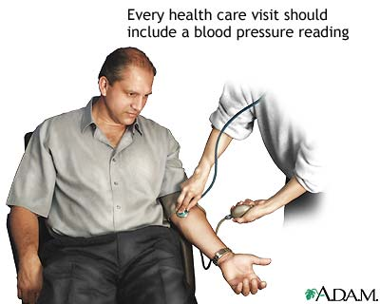
Blood Pressure Measurement
https://www.pennmedicine.org

Slide 113
Normal Blood Pressure
For healthy, young adult males, blood pressure is typically less than 120 mmHg systolic and less than 80 mmHg diastolic (< 120 / 80 mmHg).
For healthy, young adult females, the systolic and diastolic pressures are typically 8 to 10 mmHg lower.
People who exercise regularly, eat healthy, and remain in good health can often maintain low blood pressure well into their adult years—hypertension doesn’t necessarily need to be an inevitable outcome of aging.
Page 749
Page 823
Page 781

Slide 114
Pulse Pressure
The difference between systolic pressure and diastolic pressure is pulse pressure.
The normal ratio of systolic pressure to diastolic pressure to pulse pressure is 3:2:1—for example, 120 mmHg, 80 mmHg, 40 mmHg.
Pulse pressure, normally about 40 mmHg, can provide useful infor-mation about the cardiovascular system.
Medical conditions (such as atherosclerosis) that cause stiffening of the arterial walls can increase pulse pressure.
Atherosclerosis was discussed in the lecture module on the heart.
Page 749
Page 823
Page 781

Slide 115
Shock

Slide 116
Shock
Shock is a failure of the cardiovascular system to deliver sufficient oxygen and nutrients to meet the metabolic needs of organs and other tissues.
The causes of shock are many and varied, but all are characterized by inadequate blood flow to tissues.
Without an adequate supply of oxygen, cells switch from aerobic to anaerobic production of ATP, which results in lactic acid accumula-tion in body fluids.
If shock persists without immediate medical treatment, the cells in organs and other tissues can be damaged and may die due to lack of oxygen.
Page 750
Page 823
Page 781
Figure 21.16

Slide 117
Shock (continued)
Shock is an important topic for the health sciences— I encourage you to read the section in the textbook.
Areas to focus on are types of shock, the signs and symptoms, and homeostatic responses.
Page 750
Page 823
Page 781

Slide 118
Circulation

Slide 119
Circulatory Routes
Blood vessels are arranged in circulatory routes to carry blood to organs and other tissues.
The two main systems, as we discussed, are systemic circulation and pulmonary circulation.
Coronary circulation, hepatic portal circulation, and fetal circulation are considered to be specialized subsystems of the circulatory sys-tem.
Page 752
Page 824
Page 783
Figure 21.17

Slide 120
Circulatory System
Pulmonary circulation
(lungs)
Systemic circulation
(all organs and tissues including the lungs)
https://www.agingresearch.buffalo.edu

Slide 121
Systemic Circulation
Systemic circulation includes the arteries and arterioles that carry oxygenated blood from the left ventricle into systemic capillaries.
It also includes venules and veins that carry deoxygenated blood to the right atrium of the heart.
The bronchial arteries, which carry oxygen and nutrients to the lung tissue and remove waste products, are also part of systemic circul-ation.
Anatomical details of systemic circulation are found in the textbook, chapter 21.
Page 752
Page 826
Page 783
Figure 21.17

Slide 122
Pulmonary Circulation
Pulmonary circulation carries deoxygenated blood from the right ventricle to the ~300 million alveoli of the lungs.
It then returns the oxygenated blood to the left atrium of the heart.
The pulmonary trunk emerges from the right ventricle and divides into left and right pulmonary arteries to the left and right lungs.
Upon entering the lungs, the pulmonary arteries divide and further subdivide until they form capillaries that surround the alveoli in the lungs.
Pulmonary circulation is discussed in more detail in the lecture module on the respiratory system.
Page 788
Page 862
Page 819
Figure 21.29

Slide 123
Pulmonary Circulation (continued)
Oxygen diffuses from the air in the alveoli across a thin membrane, known as the respiratory membrane, and into the blood of the pul-monary capillaries.
Carbon dioxide diffuses from the blood and into the alveoli for exha-lation from the body.
The pulmonary capillaries merge to form venules, which merge to form pulmonary veins to carry reoxygenated blood to the left atrium of the heart.
Anatomical details of pulmonary circulation can be found in the text-book, chapter 21.
Page 788
Page 862
Page 819
Figure 21.29

Slide 124
Circulatory System Differences
Blood in pulmonary circulation is not pumped nearly as far as blood in systemic circulation due to close proximity of the heart and lungs.
Resistance to pulmonary blood flow is therefore low and less pres-sure is needed to move blood through pulmonary circulation.
Pulmonary arteries have larger lumens, thinner walls, and less elas-tic tissue compared to systemic arteries due to the reduced pressure demands.
The peak systolic pressure in the right ventricle is about 20 percent of peak systolic pressure in the left ventricle—another words, about 22 to 24 mmHg.
Page 752
Page 826
Page 783
Figure 21.17

Slide 125
Hepatic Portal Circulation
Hepatic portal circulation carries blood from organs of the digestive tract and spleen to the liver.
A vein that carries blood from one capillary network to another cap-ilary network is called a portal vein.
After a meal, the hepatic portal blood is rich with nutrients absorbed into blood circulation from the digestive tract.
Hepatic = refers to the liver and its functions.
Page 787
Page 861
Page 818
Figure 21.28

Slide 126
Liver
The liver stores some nutrients and modifies others before they pass into general circulation.
The liver converts glucose to glycogen for the storage of carbo-hydrates.
This process reduces blood glucose level, especially after a meal.
The liver detoxifies some substances such as alcohol, which is absorbed through the walls of the stomach and small intestine.
The liver has many other functions too.
Page 787
Page 861
Page 818
Figure 21.28

Slide 127
Fetal Circulation
Fetal circulation includes specialized structures to enable the fetus to exchange substances with its mother.
It differs from postnatal circulation because the lungs, kidneys, and gastrointestinal system do not begin to function until birth.
The fetus obtains oxygen and nutrients from the maternal blood and eliminates carbon dioxide and other wastes into the maternal blood.
The exchange mechanism between fetal blood and maternal blood is the placenta.
Postnatal = after birth.
Page 788
Page 862
Page 819
Figure 21.30

Slide 128
Fetal Circulation (continued)
The placenta forms inside the uterus and attaches to the umbilicus (navel) of the fetus via the umbilical cord.
The umbilical cord has blood vessels that branch into capillaries in the placenta.
The placenta communicates with maternal circulation through many small blood vessels in the wall of the uterus.
Page 788
Page 862
Page 819
Figure 21.30

Slide 129
Fetal Circulation (continued)
Waste products in fetal blood diffuse into capillaries of the placen-ta, and into the intervillous spaces that contain maternal blood in the placenta, and then into the mother’s uterine veins.
Nutrients travel in the opposite direction from maternal to fetal cir-culation.
Page 788
Page 862
Page 819
Figure 21.30

Slide 130
Fetal Circulation (continued)
Most fetal blood is not pumped from the right ventricle into the lungs of the fetus, because O₂ replenishment and CO₂ removal is through the mother.
An opening in the heart’s septum—the foramen ovale—is a direct path for blood between the right atrium and left atrium to meet the metabolic needs of the fetus.
Page 789
Page 862
Page 820
Figure 21.30

Slide 131
Fetal Circulation (continued)
Only very small amounts of blood reach the non-functioning fetal lungs.
The blood that does reach the fetal lungs is transported via the ductus arteriosus, a vessel connecting the pulmonary trunk with the aorta.
Blood is then carried via systemic circulation to fetal tissues to meet its metabolic needs.
Page 789
Page 862
Page 820
Figure 21.30

Slide 132
Aging

Slide 133
Aging Effects
Cardiovascular changes that can occur as we age into our senior years can include:
  Decreased compliance (distensibility) of the aorta.
  Reduction in the size of cardiac muscle fibers and thus a progres-sive loss of cardiac muscular strength.
  Reduced cardiac output.
  Diminished maximum heart rate.
  Increased systolic pressure.
Page 792
Page 866
Page 823

Slide 134
Aging Effects (continued)
Blood levels of low-density lipoproteins (LDL, AKA bad cholesterol) tend to increase with age.
The high-density lipoproteins (HDL, the good cholesterol) tend to decrease with age.
The likelihood of atherosclerosis increases, which is a major cause of coronary artery disease in older people.
Congestive heart failure, a collection of symptoms associated with impaired pumping of the heart, is also more likely to occur in older people.
Page 792
Page 866
Page 823

Slide 135
Aging Effects (continued)
Changes in blood vessels that supply the brain, including from atherosclerosis, reduce nourishment to the brain cells, which can result in mental impairment.
By 80 years of age, cerebral blood flow is 20 percent less, and renal (kidney) blood flow is 50 percent less than at 30 years of age.
Page 792
Page 866
Page 823

