Slide 1
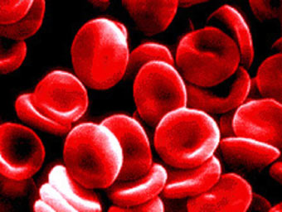
Cardiovascular System
Blood
https://www.blog.lib.umn.edu

Slide 2
Note
Much of the text material is from, “Principles of Anatomy and Physiology” by Gerald J. Tortora and Bryan Derrickson (2009, 2011, and 2014). I don’t claim authorship. Other sources are noted when they are used.
The lecture slides are mapped to the three editions of the textbook based on the color-coded key below.
14th edition
13th edition
12th edition
Same figure or table reference in all three editions

Slide 3
Outline
Overview
Functional properties
Formation of blood cells
Red blood cells
White blood cells
Platelets
Bone marrow transplants
Hemostasis
Blood groups

Slide 4
Overview

Slide 5
Cardiovascular System
The cardiovascular system has three major components—they are: blood, heart, and blood vessels.
This material is about blood, and the next two lecture modules will cover the heart and blood vessels.
Page 661
Page 728
Page 689

Slide 6
Blood
Blood transports various substances, helps regulate life processes, and provides protection against some diseases.
For all its similarities, blood is as unique from one person to another as her or his skin, bone structure, and hair.
Page 661
Page 728
Page 689

Slide 7
Diagnostics and Transfusions
Blood chemistry is used for diagnostic purposes in the health sciences.
Healthcare professionals analyze blood when diagnosing some types of diseases.
The study of blood, blood-forming tissues, and their disorders and dis-eases is known as hematology.
Transfusion of whole blood and its products is a common medical prac-tice.
Major hospitals often have a department of transfusion medicine to meet the needs of the community.
Page 661
Page 728
Page 689

Slide 8
Functional Properties

Slide 9
Blood and Interstitial Fluid
Cells in multicellular organisms require a means to obtain oxygen and nutrients and eliminate carbon dioxide and other waste prod-ucts.
The cellular needs are met by two fluids: interstitial fluid and blood.
Interstitial fluid is liquid that surrounds and bathes body cells, and it is constantly replenished by the fluid (blood plasma) in blood circula-tion.
Page 662
Page 729
Page 690

Slide 10
Blood Plasma
Blood is a connective tissue of a liquid extracellular matrix known as blood plasma.
The blood plasma suspends specialized cells (red blood cells and white blood cells) and cell fragments (platelets).
The plasma also suspends or dissolves a number of chemical sub-stances.
Page 662
Page 729
Page 690

Slide 11
Major Functions
The functions of blood include:
  Transporting oxygen, nutrients, carbon dioxide, waste products, and hormones.
  Regulating body temperature and pH.
  Providing protection through phagocytosis (bacteria) and antibody production (viruses and some bacteria).
Phagocytosis = the process by which cells known as phagocytes ingest and destroy bacteria, cell debris, and other matter.
Page 662
Page 729
Page 690

Slide 12
Transport
Blood transports oxygen from the lungs, to the left side of the heart, and then to cells of the body.
It also transports carbon dioxide from the cells, to the right side of the heart, and then to the lungs for elimination of CO₂ and replenishment of oxygen.
Blood transports nutrients from the digestive tract and hormones from endocrine glands and tissues to cells.
Blood transports waste products and heat from organs for elimination from the body.
Page 662
Page 729
Page 690

Slide 13
Regulation
Blood helps regulate pH through buffer compounds (such as bicarbon-ate) in its plasma.
Blood helps adjust body temperature through the heat-absorbing and coolant properties of water in its plasma and by heat loss through the skin.
The osmotic pressure of blood helps regulate the water content of cells.
Buffer = a solution that minimizes changes in hydrogen ion concentration.
Osmotic pressure = the pressure exerted by the flow of water through a semipermeable membrane separating two solutions with different concentrations.
Page 662
Page 729
Page 690

Slide 14
Protection
Blood normally can clot, which can protect against excessive blood loss from some types of injuries.
White blood cells (WBCs) protect against certain diseases, especially bacterial and viral infections, by phagocytosis (bacteria) and immune system responses (bacteria and viruses).
Page 662
Page 729
Page 690

Slide 15
Physical Characteristics
Blood is denser and more viscous than water, and it feels slightly sticky.
Blood temperature is 38°C, or about 1°C higher than oral or rectal body temperature.
Blood is slightly alkaline (pH 7.35 to 7.45).
Blood with high oxygen content is bright red, and blood with low O₂ con-tent is a darker red.
Viscous = syrupy; having a relatively high resistance to flow.
Page 662
Page 729
Page 690

Slide 16
Blood Volume
Blood makes-up about 20 percent of all extracellular fluid, or about eight percent of total body mass.
Blood volume is:
  5 to 6 liters (up to 1.5 gallons) in an average-size adult male
  4 to 5 liters (up to 1.2 gallons) in an average-size adult female
The average difference in volumes between males and females is due to average differences in body sizes.
Extracellular fluid = all body fluid outside the cells of a multicellular organism (including humans).
Page 662
Page 729
Page 690

Slide 17
Components of Blood
Blood plasma—a watery liquid that contains dissolved substances (55 percent of blood volume).
Formed elements—specialized cells and cell fragments (45 per-cent of blood volume).
  About 99 percent of the formed elements are red blood cells (RBCs).
  White blood cells (WBCs) and platelets make-up the remaining one percent.
Page 662
Page 729
Page 690
Figure 19.1

Slide 18
Centrifuged Blood
When whole blood is spun in a high-speed centrifuge:
  The denser RBCs settle to the bottom,
  With a buffy coat layer of WBCs and platelets on top of the RBCs, and
  Followed by the top-most layer of less-dense blood plasma.
Blood centrifuge = an apparatus that uses centrifugal force to separate cells or particles from the liquid suspension (blood plasma).
Centrifugal force = moving or tending to move away from a center.
Page 662
Page 729
Page 690
Figure 19.1

Slide 19
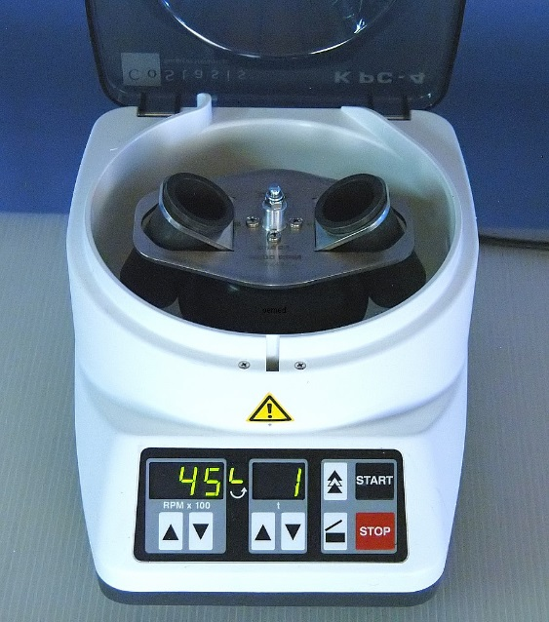
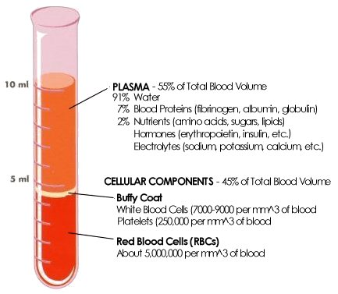
Centrifuged Blood (continued)
https://www.pemed.com
https://www.nsbri.org

Slide 20
Blood Plasma
Blood plasma is what remains when formed elements are removed from whole blood.
Blood plasma is about 91.5 percent water and 8.5 percent solutes, most of which are proteins.
Protein molecules found only in blood are known as plasma proteins.
Some of the proteins help maintain proper osmotic pressure, which is a key factor in the exchange of fluids via osmosis across the capillary walls in the tissues of the body.
Page 662
Page 729
Page 690
Figure 19.1

Slide 21
Plasma Proteins
Hepatocytes synthesize plasma proteins including albumins, globulins, and fibrinogen.
Albumins serve as transport proteins for lipid-soluble, steroid hormones and fatty acids (54 percent of all plasma proteins).
Gamma globulins respond to viruses and bacteria (about 38 percent of all plasma proteins).
Fibrinogen has an essential role in blood clotting (7 percent of all plasma proteins).
Hepatocytes = types of liver cells that perform many different functions.
Page 664
Page 731
Page 692
Figure 19.1

Slide 22
Gamma Globulins
Gamma globulins, also known as antibodies or immunoglobulins, are produced during some types of immune responses.
Foreign substances known as antigens, including viruses and bacteria, stimulate the production of specific antibodies.
An antibody binds to the antigen that stimulated its production—its role is to disable the antigen.
Details can be found in the textbook and lecture module on the immune system.
Page 664
Page 731
Page 692

Slide 23
Other Solutes
Other solutes in the blood plasma proteins include:
  Electrolytes
  Nutrients
  Enzymes
  Hormones
  Gases including oxygen (O₂), carbon dioxide (CO₂), and nitrogen (N₂)
  Waste products including urea, uric acid, creatinine, ammonia, and bilirubin
Page 664
Page 731
Page 692
Table 19.1

Slide 24
Formed Elements
The formed elements in blood are the RBCs, WBCs, and platelets.
RBCs and WBCs are whole cells, and platelets are cell fragments.
RBCs and platelets each have only a few functions, but WBCs have many as will be discussed.
Page 664
Page 731
Page 692
Figure 19.2

Slide 25
Hematocrit
Hematocrit is the total percentage of blood volume occupied by RBCs.
A hematocrit of 40 indicates that 40 percent of the blood volume is made-up of RBCs.
The normal range of hematocrit for adult females is 38 to 46 percent (average = 42), and for adult males it is 40 to 54 percent (average = 47).
Page 664
Page 731
Page 692

Slide 26
Hematocrit (continued)
Testosterone secreted by the testes promotes the synthesis of erythropoietin (EPO) in the kidneys.
EPO is a hormone secreted into general blood circulation that stimulates production of RBCs in red bone marrow.
Thus, testosterone contributes to the higher hematocrit values in males than in females.
Lower hematocrit values for women in their reproductive years are also due to blood loss during menstruation.
Page 665
Page 732
Page 692

Slide 27
Anemia
A substantial drop in hematocrit indicates anemia, a lower than nor-mal number of RBCs.
Anemia impairs oxygen delivery to meet the metabolic needs of tissues, which results in a wide range of physiological effects, as will be discussed.
Page 665
Page 732
Page 692

Slide 28
Polycythemia
In polycythemia, RBC concentration is abnormally high—hematocrit can be 65 or higher.
Polycythemia raises the viscosity of the blood, which increases resis-tance to blood flow and makes the blood more difficult for the heart to pump.
The condition can contribute to high blood pressure and increased risk of stroke.
Stroke = a sudden loss of consciousness resulting when the rupture or occlusion of a blood vessel leads to an oxygen deficit in the brain.
Page 665
Page 732
Page 693

Slide 29
Polycythemia (continued)
Polycythemia can result from:
  Abnormal increases in RBC production in red bone marrow.
  Hypoxia including at high altitudes where the air is less dense.
  Blood doping with erythropoietin (EPO) or storage and reuse of one’s own RBCs.
Hypoxia = diminished oxygen supply to tissues.
Blood doping = the practice of boosting the number of red blood cells in the bloodstream in order to enhance athletic performance (the practice is now banned in most organized sports).
Page 665
Page 732
Page 693

Slide 30
Hemoglobin Level
Hemoglobin level is typically measured as part of a routine blood test.
Hemoglobin level measures the oxygen-carrying capacity of blood, which is expressed in grams per deciliter (100 ml) of whole blood.
An automated machine uses a blood sample that has been chem-ically treated to release hemoglobin from RBCs.
The hemoglobin is bound to cyanide that forms a compound that absorbs light, which can be measured with a light-sensing device.
30
Notes:
30

Slide 31
Hemoglobin Level (continued)
Normal ranges vary by age and beginning in adolescence by gender.
  Newborns: 17 to 22 gm/dl
  One week of age: 15 to 20 gm/dl
  One month of age: 11 to 15 gm/dl
  Children: 11 to 13 mg/dl
  Adult males: 14 to 18 gm/dl
  Adult women: 12 to 16 gm/dl
  Men after middle age: 12.4 to 14.9 gm/dl
  Women after middle age: 11.7 to 13.8 gm/dl
(Source: https://www.medicinenet.com)
31
Notes:
31

Slide 32
Glycated Hemoglobin
Glucose in blood circulation binds to the hemoglobin molecules in RBCs to form glycated hemoglobin (HbA1c).
The HbA1c test measures the average level of blood glucose level during the past 2 to 3 months.
The test is used to diagnose diabetes and is also used by people who have diabetes to determine if their glucose levels are staying within range.
For people who do not have diabetes, the normal range for HbA1c level is between 4 and 5.6 percent (or 6 percent depending on the literature source).
Hb = hemoglobin
(Source: https://www.webmd.com)
32
Notes:
32

Slide 33
Formation of Blood Cells

Slide 34
Lifespans
Many formed elements have lifespans of hours, days, or weeks, and so they must be continuously replaced.
Some types of lymphocytes, in comparison, can have lifespans meas-ured in years.
Lymphocytes = types of white blood cells (B cells, T cells, and NK cells) involved in immune responses.
Page 665
Page 732
Page 693

Slide 35
Abundances
Negative feedback systems regulate the numbers of RBCs and platelets in the blood circulation so that their numbers remain relatively constant.
In comparison, the types and numbers of WBCs vary in response to the types of pathogens and other foreign antigens that are present.
Pathogen = a disease-causing agent (such as a virus or some bacteria).
Antigen = a substance that prompts the generation of antibodies and can cause an immune response. Antigen means “antibody generator.”
Page 665
Page 732
Page 693

Slide 36
Hemopoiesis
Hemopoiesis is the process by which the formed elements (red blood cells, white blood cells, and platelets) are produced.
The process occurs in the yolk sac of the embryo, and then in the liver, spleen, thymus, and lymph nodes of the fetus.
The red bone marrow become the primary site of hemopoiesis during the last three months of the fetal period prior to birth.
Red bone marrow continues as the source of blood cells after birth and throughout a person’s lifetime.
Page 665
Page 732
Page 693

Slide 37
Red Bone Marrow
Red bone marrow is a highly-vascularized, connective tissue found in the microscopic spaces of spongy bone tissue.
About 0.05 to 0.10 percent of the red bone marrow cells are pluripotent stem cells.
Stem cells have the capacity to develop into different types of cells in-cluding RBCs, WBCs, and platelets.
Pluripotent stem cells = immature stem cells in red bone marrow that gives rise to precursors of all the different mature blood cells.
Page 665
Page 732
Page 693

Slide 38
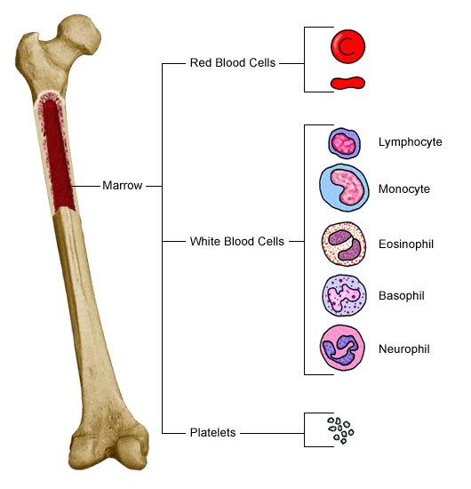
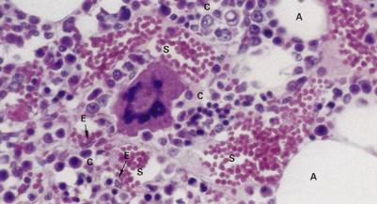
Red Bone Marrow (continued)
https://www.chxa.com
https://www.mc.vanderbilt.edu

Slide 39
Yellow Bone Marrow
In newborns, all bone marrow is red, and actively involved in blood cell production.
Some of the red bone marrow is then replaced by yellow bone mar-row composed of adipose cells.
As a result, the rate of blood cell formation decreases as a person ages.
In some instances, such as prolonged bleeding, red bone marrow can expand into yellow bone marrow to increase the rate of forma-tion of blood cells.
Page 666
Page 733
Page 693

Slide 40
Hemopoietic Growth Factors
Erythropoietin (EPO) increases the number of red blood cell precursors called reticulocytes.
EPO is produced primarily in the kidneys—with kidney (renal) failure, RBC production is inadequate, and the person will be severely anemic since there are fewer RBCs to carry oxygen to the tissues of the body..
Thrombopoietin (TPO), produced in the liver and kidneys, stimulates the formation of platelets, or thrombocytes.
Page 667
Page 734
Page 695

Slide 41
Entry into Blood Circulation
Blood cells formed in the red bone marrow enter blood circulation through sinusoids.
Sinusoids are leaky capillaries within the red bone marrow and its fibers.
Formed elements, with the exception of lymphocytes, do not divide once they leave the red bone marrow.
Page 667
Page 734
Page 695

Slide 42
Red Blood Cells

Slide 43
Red Blood Cells
Red blood cells (also called erythrocytes) contain an oxygen-carrying protein known as hemoglobin.
A healthy adult male has about 5.4 million RBCs per μL of blood, while a healthy adult female has about 4.8 million per μL.
To put these RBC counts in perspective, one drop of blood is about 50 μL.
RBCs enter blood circulation at a rate of about two million per second to balance the rate of RBC destruction as they wear out.
μL = microliter = 10⁻⁶ liter.
Page 668
Page 735
Page 695

Slide 44
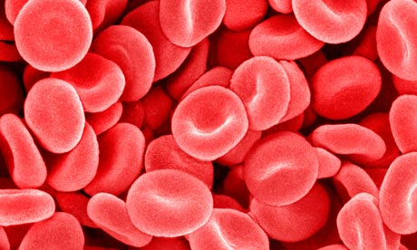
RBC Structure
RBCs are shaped like biconcave discs (like two Frisbees placed back-to-back), and measure 7 to 8 μm in diameter.
The plasma membrane is strong and flexible to enable RBCs to deform without rupturing when they squeeze through the narrow capillaries in body tissues.
Antigens on the plasma membrane define the blood groups including ABO, Rh, and other blood classification systems (more about his later).
https://www.static.guim.co.uk
Page 668
Page 735
Page 695
Figure 19.4

Slide 45
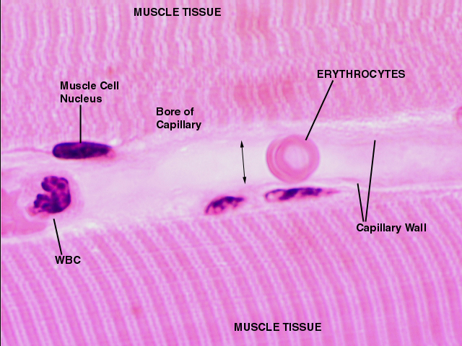
A Tight Fit
https://www.education.vetmed.vt.edu
A red blood cell, also known as an erythrocyte, is shown squeezing through a capillary in striated muscle (skeletal muscle or cardiac muscle).

Slide 46
RBC Structure (continued)
RBCs lack a nucleus and other organelles, and so they cannot repro-duce or perform much metabolic activity.
Their cytosol contains hemoglobin molecules, which are about 33 per-cent of the total weight of an RBC.
Hemoglobin molecules are synthesized during RBC production in red bone marrow.
Page 668
Page 735
Page 696

Slide 47
RBC Physiology
RBCs transport oxygen, and to a much lesser extent, carbon dioxide.
Because they have no nucleus, much of the internal cellular space is available for O₂ transport.
RBCs do not consume oxygen because they lack mitochondria—they generate ATP anaerobically through glycolysis that takes place in their cytosol.
The biconcave shape provides a larger surface area for the diffusion of gas molecules.
Page 668
Page 735
Page 696

Slide 48
Hemoglobin
A single RBC contains about 280 million hemoglobin molecules.
Hemoglobin contains a globin molecule consisting of four polypeptide chains.
Each chain is bonded to a ring-like, non-protein pigment known as a heme.
Each heme contains one iron ion (Fe²⁺) that can bind to one oxygen molecule.
Thus, one hemoglobin molecule can bind up to four oxygen molecules.
Page 668
Page 735
Page 696
Figure 19.4

Slide 49
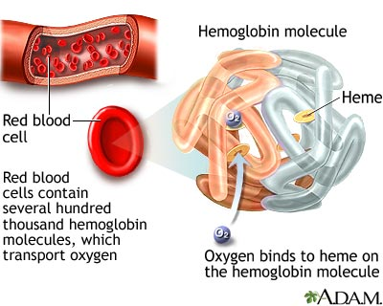
Hemoglobin (continued)
https://www.clarian.org

Slide 50
Oxygen Transport
O₂ binds to Fe²⁺ (iron) in hemoglobin molecules in the pulmonary capillaries of the lungs.
The iron-oxygen reaction reverses itself when blood flows through the capillaries in body tissues to release O₂ and meet their meta-bolic needs.
Factors affecting the binding and release of O₂ by hemoglobin will be discussed when we cover the respiratory system.
Page 668
Page 735
Page 696

Slide 51
Carbon Dioxide Transport
Carbon dioxide is a waste product of the aerobic cellular respiration.
Hemoglobin transports about 23 percent of carbon dioxide by binding CO₂ to the amino acids in globin of hemoglobin molecules.
The remaining fraction of CO₂ (~77 percent) is transported in solution in the blood plasma.
In the lungs, CO₂ passively diffuses across the respiratory membrane for exhalation from the body (more about this in the lecture module on the respiratory system.
Aerobic = requires oxygen.
Alveoli = “air sacs” in the lungs through which oxygen and carbon dioxide are exchanged with pulmonary blood.
Page 669
Page 736
Page 696

Slide 52
RBC Lifecycle
RBCs, due to accumulated damage to their plasma membranes from squeezing through capillaries, have average lifespans of about 120 days.
They cannot synthesize new cell components since they lack a nucleus and other organelles.
With aging, the plasma membranes of RBCs are more likely to rupture, especially as they squeeze through the even narrower capillaries of the spleen.
Page 669
Page 736
Page 696
Figure 19.5

Slide 53
RBC Lifecycle (continued)
Macrophages in the spleen and liver breakdown worn-out, damaged RBCs by phagocytosis.
Many of the breakdown products are recycled—however, some, such as bilirubin, are eliminated from the body.
Macrophages = types of white blood cells that perform phagocytosis—more about this process later in the lecture module.
Page 669
Page 736
Page 696
Figure 19.5

Slide 54
Erythropoiesis
The production of RBCs, known as erythropoiesis, begins in the red bone marrow with a precursor cell known as a proerythroblast.
This precursor cell divides several times by the simple form of cell division (mitosis) to produce cells that synthesize hemoglobin.
A cell nearing the end of its development ejects its nucleus and becomes a reticulocyte.
The loss of the cell nucleus causes the plasma membrane to indent on both surfaces, resulting in the characteristic biconcave shape of RBCs.
Reticulocytes = immature red blood cells that enter blood circulation from the red bone marrow.
Page 670
Page 737
Page 698
Figure 19.6

Slide 55
Erythropoiesis (continued)
Reticulocytes have a limited number of mitochondria, ribosomes, and endoplasmic reticulum.
They pass from red bone marrow into blood circulation by squeezing between gaps in the endothelial cells of the capillary walls.
Reticulocytes mature into RBCs within 1 to 2 days of release from red bone marrow.
The RBCs can now transport oxygen.
Page 670
Page 737
Page 698
Figure 19.6

Slide 56
Erythropoiesis (continued)
Erythropoiesis (RBC production) and RBC destruction usually proceed at similar rates to maintain a constant level of RBCs in blood circula-tion.
Erythropoiesis increases when the oxygen-carrying capacity of blood drops due to a loss of RBCs.
Page 670
Page 737
Page 698
Figure 19.6

Slide 57
Hypoxia
Inadequate amounts of oxygen transported to body tissues result in a condition known as tissue hypoxia.
Hypoxia can result from external and internal conditions including:
  High altitude.
  Lack of dietary iron, certain amino acids, and vitamin B₁₂.
  Circulatory problems.
  Certain diseases such as sickle cell anemia.
Hypoxia increases the release of EPO from the kidneys to stimulate the production of more RBCs to increase oxygen delivery to the tis-sues of the body.
Page 670
Page 737
Page 698
Figure 19.6

Slide 58
White Blood Cells

Slide 59
White Blood Cells
White blood cells (WBCs), also called leukocytes, have a nucleus but no hemoglobin.
WBCs are agranular or granular, depending on whether they have granules (vesicles) in their cytoplasm.
The granules, when stained, are visible using a light microscope.
Agranular WBCs include lymphocytes and monocytes.
Granular WBCs include basophils, neutrophils, and eosinophils.
The suffix a- = without.
Page 671
Page 738
Page 699
Figure 19.7

Slide 60
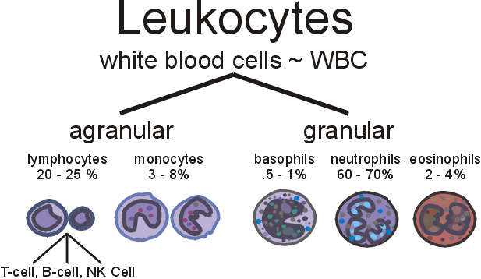
WBC Distribution
https://www.lymphomation.org

Slide 61
Major Histocompatibility Antigens
WBCs and all other nucleated cells in the body have proteins called major histocompatibility (MHC) antigens.
The antigens protrude from the plasma membrane of WBCs (and all other nucleated cells too).
These cell identity markers are unique to each person except in the case of monozygotic (identical) twins.
RBCs have blood group antigens, as we will discuss, but they lack MHC antigens.
Nucleated cell = has a nucleus containing DNA. (Red blood cells are not nucleated.)
Page 672
Page 739
Page 700

Slide 62
WBC Lifespans
While some WBCs (especially lymphocytes) in a healthy person can live for several months or years, most survive for only a few days.
Phagocytotic WBCs may survive for only a few hours during a viral or bacterial infection.
WBCs (5,000 to 10,000 per μL) are vastly outnumbered by RBCs by a ratio of about 700 to 1.
Phagocytotic = refers to phagocytosis.
Page 673
Page 739
Page 700

Slide 63
WBC Functions
Our skin and mucous membranes are continually exposed to bacteria and their exotoxins and endotoxins.
Some bacteria, if the opportunities are available, will invade deep body tissues.
Bacteria that enter the body are combated by WBCs through phagocy-tosis and immune responses.
WBCs exit the bloodstream and gather at the site of invasion or inflam-mation.
Page 673
Page 740
Page 700

Slide 64
WBC Functions (continued)
Monocytes (agranular) and granular white blood cells do not return to the blood once they exit blood circulation to respond to an infection or injury.
Lymphocytes, however, can recirculate from blood to tissue, to lymphatic fluid, and back to blood.
About 2 percent of the total lymphocyte population is in blood circulation at any time.
The other 98 percent of lymphocytes are found in the lymphatic fluid and in body organs and tissues.
Page 673
Page 740
Page 700

Slide 65
Emigration
WBCs exit the bloodstream through a process known as emigration.
They roll along the endothelium (inner lining) of a blood vessel, stick to it, and then squeeze between the endothelial cells and enter the inter-stitial fluid that surrounds cells.
The biochemical signals that stimulate emigration vary for the different types of WBCs.
Emigration = in this context, the act of leaving blood circulation.
Page 673
Page 740
Page 700
Figure 19.8

Slide 66
Phagocytosis
Macrophages and neutrophils ingest bacteria and dead matter by phago-cytosis.
Some of the chemicals released by microbes and inflamed tissue attract phagocytes by chemotaxis.
Chemical stimuli include kinins and colony-stimulating factors released at the site of an injury or infection.
Phagocytosis = the ingestion of a smaller cell or cell fragment, a microorganism, or foreign particles by means of the local enfolding of a cell's membrane and the protrusion of its cytoplasm around the fold until the material has been surrounded and engulfed by closure of the membrane and formation of a vacuole.
(https://www.dictionary.reference.com)
Page 673
Page 740
Page 700

Slide 67
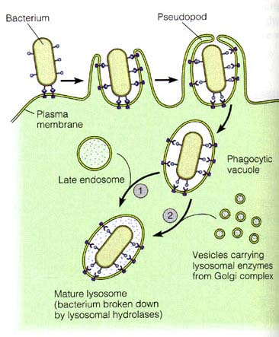
Phagocytosis (continued)

Slide 68
Types of White Blood Cells
Neutrophils
Monocytes
Basophils
Eosinophils
Lymphocytes

Slide 69
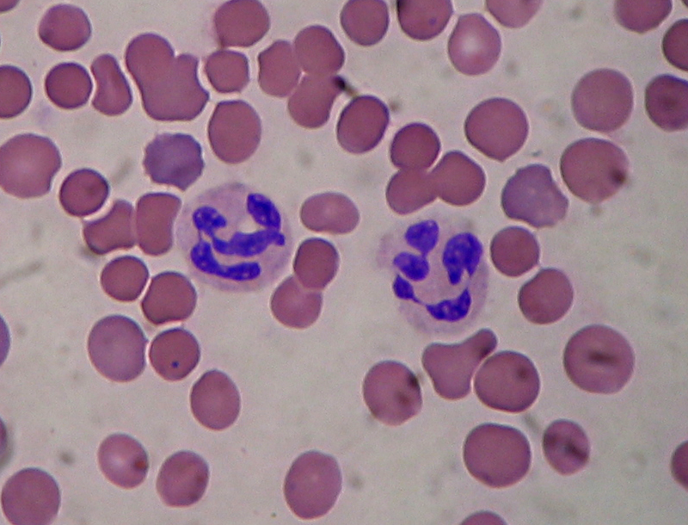
Neutrophils
https://www.wikimedia.org
The quality of the light micrographs of WBCs, starting on this page, varies considerably depending on which internet sources that I could find for the images.

Slide 70
Neutrophils (continued)
Neutrophils, a type of granular white blood cell, respond to tissue destruction caused by pathogenic bacteria.
After engulfing the bacterium through phagocytosis, a neutrophil releases enzymes and oxidants to destroy it.
Neutrophils also release defensins, a protein molecule that pokes holes in the bacterial membrane and kills the bacterium by leakage and loss of its cellular contents.
Pathogenic = disease-causing.
Bacterium = singular form of bacteria.
Oxidant = oxidizing agent.
Page 672
Page 739
Page 700
Figure 19.7

Slide 71
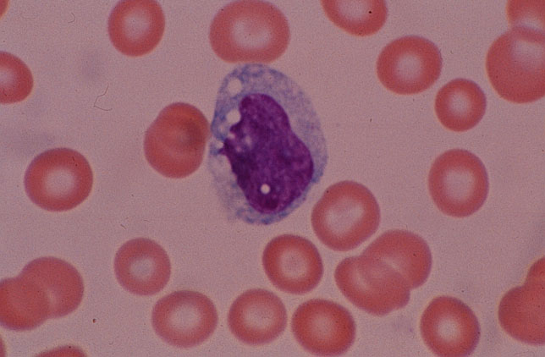
Monocytes
https://www.som.tulane.edu

Slide 72
Monocytes (continued)
Monocytes, a type of agranular white blood cell, take longer than neutrophils to reach the site of infection, but when they do, they arrive in larger numbers.
Monocytes enlarge and differentiate into wandering macrophages that engulf and destroy microbes and cellular debris (phagocytosis).
Other monocytes become fixed macrophages that remain in tissues including the liver, lungs, and spleen.
Page 672
Page 739
Page 701
Figure 19.7

Slide 73
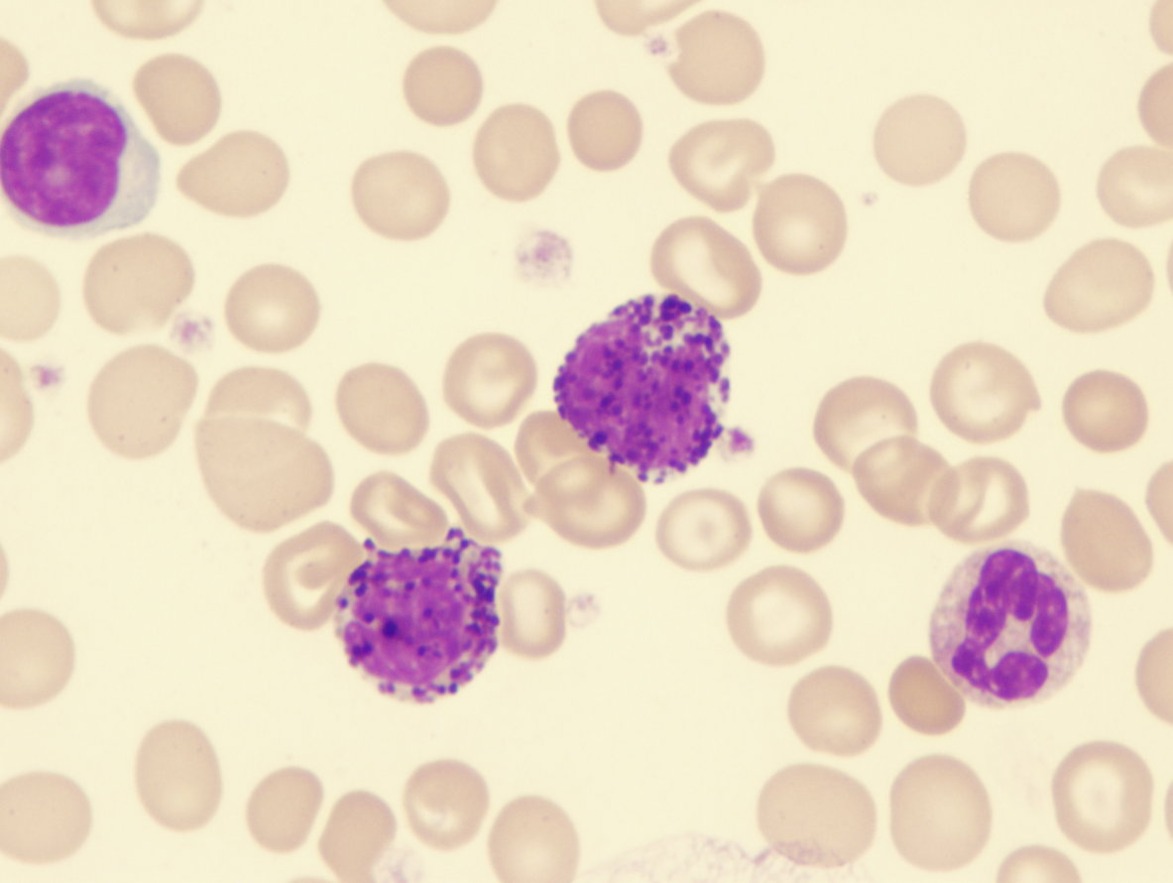
Basophils
https://www.healthsystem.virginia.edu

Slide 74
Basophils (continued)
Basophils, a type of granular white blood cell, exit the capillaries at the site of the inflammation and release heparin, histamine, and serotonin.
The chemical substances intensify inflammatory reactions—they are also involved in hypersensitivity reactions (commonly known as aller-gic reactions).
Page 672
Page 739
Page 701
Figure 19.7

Slide 75
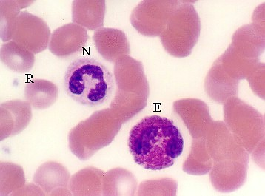
Eosinophils
https://www.uic.edu
E = eosinophil, N = neutrophil, and R = red blood cell.

Slide 76
Eosinophils (continued)
Eosinophils, a type of granular white blood cell, exit the capillaries and enter the interstitial fluid.
They release enzymes that combat the effects of histamine and other substances involved in inflammation that occurs in allergic reactions.
Eosinophils break-down antigen-antibody complexes and respond to some species of parasitic worms.
A high eosinophil count can indicate an allergic reaction or possibly a parasitic infection.
Parasite = an organism that lives in or on and takes its nourishment from another organism since it cannot live independently.
(https://www.webterms.com)
Page 672
Page 739
Page 701
Figure 19.7

Slide 77
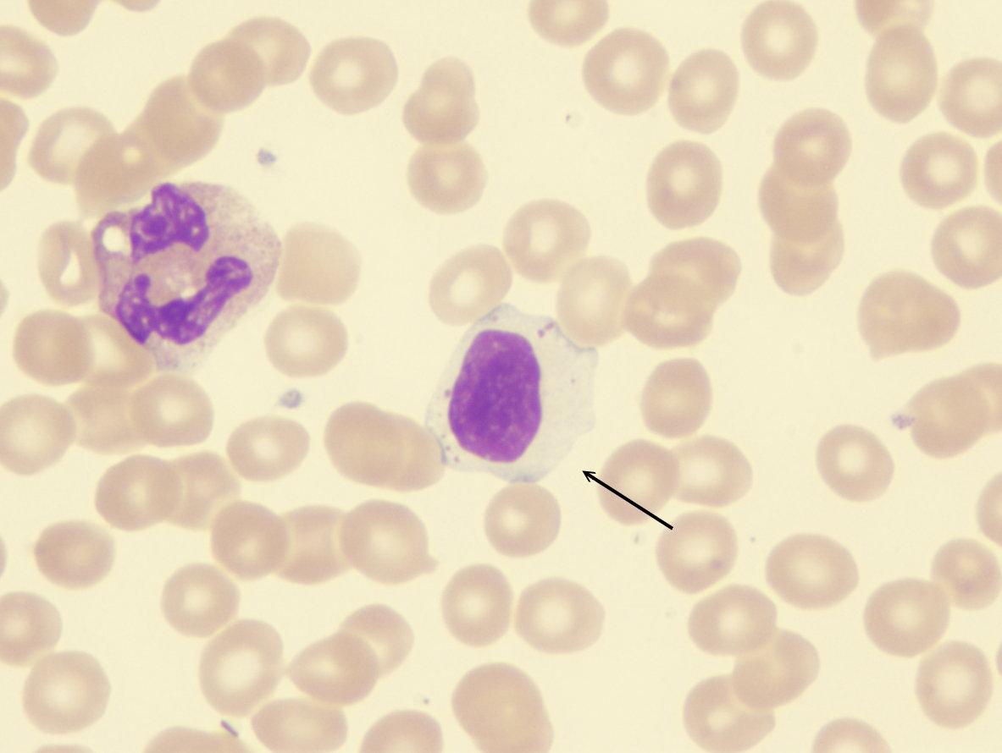
Lymphocytes
https://www.healthsystem.virginia.edu

Slide 78
Lymphocytes (continued)
Lymphocytes, a type of agranular white blood cell, are a key aspect of immune system responses to invading pathogens.
Most lymphocytes continually move among the lymphoid tissues, lymph, and blood.
They can enter the blood, but they remain there for a only few hours at a time.
The three types of lymphocytes are:
  B cells
  T cells
  Natural killer (NK) cells
Page 672
Page 739
Page 701
Figure 19.7

Slide 79
Types of Lymphocytes
B cells release antibodies to tag antigens (viruses and bacteria) for de-struction.
T cells attack viruses, fungi, transplanted cells, cancer cells, and some bacteria.
T cells are responsible for allergies, transfusion reactions, and rejection of transplanted organs.
The immune responses of B and T cells combat infections and provide can protection from viral and bacterial diseases.
NK cells attack a wide variety of infectious microbes and some develop-ing tumor cells.
Page 672
Page 741
Page 701

Slide 80
WBC Counts
WBC counts can be used to:
  Detect an infection or inflammation.
  Diagnose poisoning by some drugs and chemicals.
  Monitor blood disorders such as leukemia.
  Monitor the effects of chemotherapy.
  Detect allergic reactions.
  Detect parasitic infections.
Since each type of WBC has a different role, the percentages of each type can help in diagnosing a condition—see Table 19.2 in the textbook.
Page 673
Page 741
Page 701
Table 19.2

Slide 81
Platelets

Slide 82
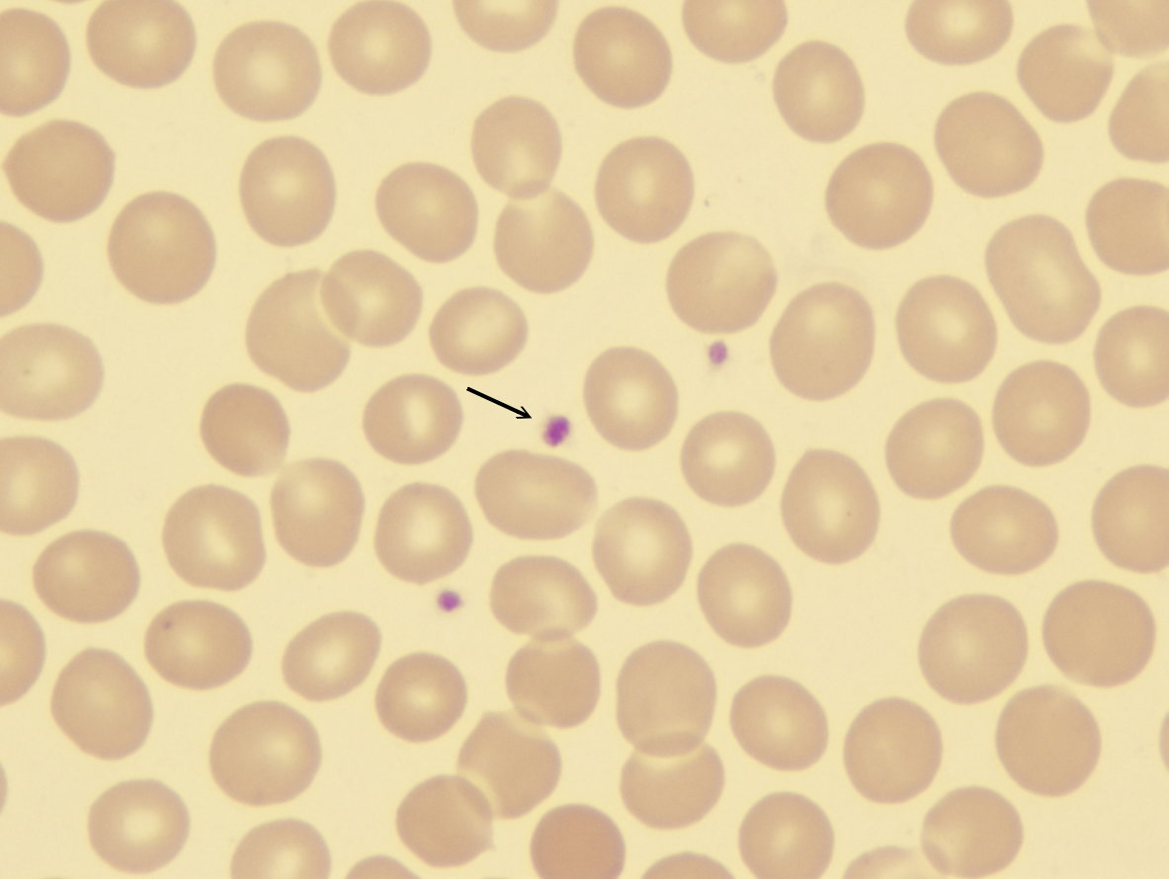
Platelets
https://www.healthsystem.virginia.edu

Slide 83
Platelet Formation
Hemopoietic stem cells, in addition to producing RBC and WBCs, differentiate into cells that produce platelets, which are also known as thrombocytes.
Under the influence of thrombopoietin secreted by the kidneys, myeloid stem cells in the red bone marrow develop into precursor cells known as megakaryoblasts.
Megakaryoblasts in turn develop into megakaryocytes, which are very large cells.
Megakaryocytes then splinter into 2,000 to 3,000 individual fragments.
Hemopoietic = involved in the formation of blood cells.
Mega- = very large or huge.
Page 674
Page 741
Page 701

Slide 84
Platelet Formation (continued)
Each fragment of the splintered megakaryocyte forms a platelet that has no nucleus but has its own plasma membrane.
A platelet measures about 2 to 4 μm in diameter.
The platelets exit the red bone marrow and enter blood circulation.
About 150,000 to 400,000 platelets are present in one μL of blood.
Page 674
Page 741
Page 701

Slide 85
Platelet Functions
Platelets help stop blood loss from damaged blood vessels by form-ing plugs.
The vesicles in platelets contain chemicals known as clotting factors that promote blood clotting.
The lifespan of platelets is about five to nine days—aged and dead platelets are removed by fixed macrophages in the spleen.
A patient undergoing chemotherapy may need frequent transfusions to replace the platelets when the red bone marrow is not producing sufficient numbers.
See Table 19.3 for a summary of the formed elements in blood.
Page 674
Page 741
Page 702
Table 19.3

Slide 86
Stem Cell Transplants from Bone Marrow and Cord Blood

Slide 87
Bone Marrow Transplants
A bone marrow transplant involves the replacement of cancerous or otherwise abnormal red bone marrow with healthy red bone marrow.
The abnormal bone marrow is destroyed by high dosages of chemo-therapy or radiation prior to the transplant procedure.
This treatment kills abnormal cells and disables the immune system to decrease the likelihood of rejection of the bone marrow transplant from a donor.
Page 675
Page 743
Page 703

Slide 88
Donor and Recipient
Healthy bone marrow may be given by a donor, or sometimes by the patient (autodonation) if the disease is in remission.
Red bone marrow is removed from the hip bone of the donor using a syringe for injection into a vein in the recipient.
The injected marrow migrates to the recipient’s red bone marrow so the donor’s stem cells can multiply.
Newer techniques for harvesting hemopoietic stem cells from a donor are far less invasive and possibly painful.
Remission = disappearance of the signs and symptoms of cancer or other disease. A remission can be temporary or permanent.
Page 676
Page 743
Page 703

Slide 89
Potential Risks
The patient is temporarily vulnerable to infections once her or his red bone marrow has been destroyed by chemotherapy and radiation.
The transplanted bone marrow begins to produce sufficient numbers of WBCs in about 2 to 3 weeks to end the window of vulnerability for infections.
Transplanted red bone marrow cells may produce T cells that attack the recipient’s tissues, which is known as graft versus host disease.
T cells in a recipient that survived chemotherapy and radiation treat-ment can also attack the bone marrow transplanted from the donor.
Page 676
Page 743
Page 703

Slide 90
Immunosuppressive Drugs
Bone marrow recipients require immunosuppressive drugs for the rest of their lives to minimize rejection.
The drugs reduce the level of immune system activity, which increases the risk of infection.
Recipients may have side effects including fever, headache, muscle aches, fatigue, depression, high blood pressure, and kidney and liver damage.
Immunosuppressive drug = a drug that lowers the body's normal immune system response.
Page 676
Page 743
Page 703

Slide 91
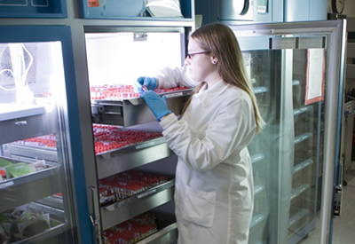
Cord Blood Transplant
Partially-developed stem cells can be harvested from the umbilical cord blood shortly after a child’s birth.
The stem cells are removed with a syringe and can be frozen indefinitely and stored in a public or private cord blood bank.
The risk of rejection is much less compared to bone marrow transplants since the HLA (human leukocyte antigen) match doesn’t need to be as precise.
https://www.stemcellumbilicalcordblood.com
Page 676
Page 743
Page 703

Slide 92
Cord Blood Transplant (continued)
Advantages of obtaining stem cells from the umbilical cord include:
  They are more abundant than stem cells collected from red bone marrow.
  They are less likely to result in graft versus host disease, so the donor and recipient do not need to be as closely matched.
Cord blood transplants will also be discussed in the video, “Banking on the Future.”
Page 676
Page 743
Page 703

Slide 93
Hemostasis

Slide 94
Hemostasis
Hemostasis—not to be confused with homeostasis—is a sequence of cardiovascular responses to stop bleeding and therefore loss of blood volume.
The responses in hemostasis must be rapid, localized to the region of damage, and precisely controlled.
Three mechanisms help in reducing blood loss: 1) platelet plug for-mation, 2) blood clotting, also known as coagulation, and 3) vascular spasm.
Homeostasis = the tendency of an organism or a cell to regulate its internal conditions, usually by a system of feedback controls, so as to stabilize health and functioning, regardless of the outside changing conditions.
(https://www.biology-online.org/dictionary)
Page 676
Page 743
Page 703

Slide 95
Hemostasis (continued)
Hemostasis, when it is successful, prevents hemorrhage, the loss of a large amount of blood from vessels.
Hemostatic mechanisms can prevent hemorrhage from smaller ves-sels.
Hemorrhage of larger vessels usually requires immediate medical intervention.
The textbook provides detail on the roles of hemostatic mechanisms in reducing blood loss.
Hemorrhage = may be external and visible on the outside of the body or internal, where there is no sign of bleeding outside the body. Bleeding from a cut on the face is an external hemorrhage. Bleeding into the spleen or liver are examples of internal hemorrhage. (https://www.medicinenet.com)
Page 676
Page 743
Page 703

Slide 96
Blood Groups

Slide 97
Blood Groups
RBCs have genetically-determined antigens on their plasma membranes.
The antigens (or agglutinogens) consist of carbohydrate molecules known as glycolipids and glycoproteins.
Blood groups are based on the presence or absence of specific antigens.
Over 100 different antigens have been detected on the surface of RBCs.
These various antigens form the basis of at least 24 different blood group classification systems worldwide.
Page 680
Page 748
Page 708

Slide 98
Blood Groups (continued)
We will cover two commonly-used blood group classification sys-tems used in the United States and other countries: ABO and Rh.
The prevalence of the ABO and Rh blood groups varies among different population groups, as shown in Table 19.5 of the textbook.
Other blood group classifications include the Lewis, Kell, Kidd, and Duffy systems.
Page 680
Page 748
Page 708
Table 19.5

Slide 99
Blood Type Distribution (United States)
Blood type
O+ | A+ | B+ | AB+ | O- | A- | B- | AB-
37.4% | 35.7% | 8.5% | 3.4% | 6.6% | 6.3% | 1.5% | 0.6%
The numbers represent population percentages.
The distributions of blood types can vary somewhat in different geographical regions of the United States.

Slide 100
Co-Dominance
As covered in the genetics lecture module, both alleles are expressed in co-dominance, such as in the AB blood type.
Co-dominance is different from incomplete dominance, the expression of an intermediate trait.

Slide 101
Three Alleles
Four blood types result from combinations of three alleles, I^{A}, I^{B}, and i.
I^{A} produces carbohydrate A, I^{B} produces carbohydrate B, and i pro-duces neither.
One of each of the three possible alleles is inherited from each parent.
Alleles = alternate gene forms on homologous chromosomes—an allele can be either dominant or recessive.

Slide 102
Combinations of Alleles
I^{A} and I^{B} alleles are dominant to the i allele.
The six possible combinations are:
  I^{A} * I^{A} and I^{A} * i result in type A blood.
  I^{B} * I^{B} and I^{B} * i result in type B blood.
  I^{A} * I^{B} result in type AB blood where both alleles are expressed.
  i * i result in type O blood, where neither the A nor the B carbo-hydrate is present.

Slide 103
Antibodies
Blood plasma has antibodies (also known as agglutinins) that react with A or B antigens.
Anti-A antibody reacts with antigen A, and anti-B antibody reacts with antigen B.
A person does not have antibodies that react with the antigens of her or his own RBCs.
Page 681
Page 748
Page 708
Figure 19.12

Slide 104
Antibodies (continued)
A, B, and AB blood types are defined by the antigens present on the plasma membrane of red blood cells. Neither antigen A nor antigen B is found on RBCs in type O blood.
A person does not have the anti-A or anti-B antibody that reacts with her or his blood antigens.
Type A blood (antigen A) = anti-B antibody is present.
Type B blood (antigen B) = anti-A antibody is present.
Type AB blood (antigens A and B) = neither antibody is present.
Type O blood (neither antigen) = both antibodies are present.
Page 681
Page 748
Page 708
Figure 19.12

Slide 105
Antibodies (continued)
The anti-A and anti-B antibodies are large IgM-type types that cannot cross the placenta.
Thus, blood type incompatibility is rarely a problem between a mother and fetus.
IgM antibody = a class of antibodies found in circulating body fluids. They are the first antibodies to appear in response to an initial exposure to an antigen.
(https://www.dermatology.about.com)
Placenta = an organ that develops in the uterus during pregnancy. The structure provides oxygen and nutrients to a fetus. It also removes waste products from the blood of the fetus. The placenta attaches to the wall of the uterus, and the umbilical cord of the fetus arises from it.
(Adapted from https://www.mayoclinic.org)
Page 681
Page 748
Page 708

Slide 106
Transfusions
Blood is the most easily shared of human tissues and it saves many lives each year.
Transfusions involve the transfer of whole blood or its components (such as RBCs or platelets) from a donor to a recipient.
Transfusions, among other purposes, are most often given to:
  Alleviate anemia.
  Increase blood volume after hemorrhage (blood loss).
  Improve immunity in individuals with immune system diseases.
Page 681
Page 749
Page 708

Slide 107
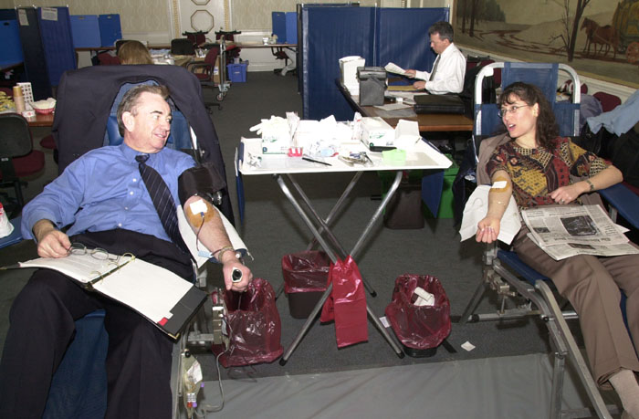
Blood Donor Programs
https://www.hhs.gov
Whole blood
Plasma
Platelets
National Marrow Donor Program (http://www.marrow.org)

Slide 108
Blood Type Incompatibility
An antigen-antibody response can occur in the recipient if the blood types of the recipient and donor are incompatible.
In an incompatible blood transfusion, the antibodies in the recipient’s blood plasma bind to the antigens on the donated RBCs.
This binding causes agglutination (clumping) of RBCs in the recipient.
Page 681
Page 749
Page 708

Slide 109
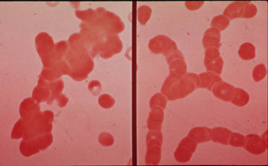
Agglutination
https://www.transfusionmedicine.stanford.edu

Slide 110
Antigen-Antibody Complexes
Antigen-antibody complexes that form in agglutination activate plas-ma proteins of the complement family, as described in Chapter 22 of the textbook.
The complement molecules make the plasma membranes of RBCs leaky.
RBCs rupture (known as hemolysis) and release their hemoglobin into the blood plasma.
Hemoglobin molecules damage the kidneys by clogging the filtration membranes of the nephrons.
Nephrons = functional units of the kidneys involved in blood filtration (among other functions).
Page 681
Page 749
Page 708

Slide 111
Rh Blood Group
The Rh blood group was named for an antigen first discovered on the RBCs in rhesus monkeys.
People whose RBCs have the Rh(D) antigen are Rh⁺, and people who lack the Rh(D) antigen are Rh⁻.
The seven Rh(x) antigens are A, a, B, b, C, c, and D for a total of 61 combinations.
The people that lack all seven Rh antigens (Rh null) are said to have “golden blood.”
The ~40 people worldwide who are Rh null can donate to all other Rh blood types, but they cannot accept blood from other Rh blood types.
Tap of click here to learn more about the golden blood type.
Page 682
Page 749
Page 709

Slide 112
Universal Recipients
Table 19.6 in the textbook summarizes the compatibilities of the four blood types in the ABO system.
People with type AB blood do not have anti-A or anti-B antibodies in their blood plasma.
They are called universal recipients because they can receive blood from all four blood types (A, B, AB, and O) if the Rh factor is compat-ible.
Page 681
Page 749
Page 709
Table 19.6

Slide 113
Universal Donors
People with type O- blood have neither the A nor B antigens nor the rhesus factor.
They are called universal donors because they can donate blood to all four ABO blood types.
Page 682
Page 749
Page 709
Table 19.6

Slide 114
RBC Compatibility
Recipient’s blood type | Donor’s blood type
 | O- | O+ | A- | A+ | B- | B+ | AB- | AB+
O- | x
O+ | x | x
A- | x |  | x
A+ | x | x | x | x
B- | x |  |  |  | x
B+ | x | x |  |  | x | x
AB- | x |  | x |  | x |  | x
AB+ | x | x | x | x | x | x | x | x

Slide 115
Blood Type Interactions
In actual practice, labeling of people as universal recipients or donors can be misleading and possibly dangerous.
RBCs also contain other antigens (about 100) and blood plasma also contains other antibodies that can potentially lead to transfusion prob-lems.
To prevent such problems, blood must be cross-matched or screened before transfusion to a recipient takes place.
Page 682
Page 749
Page 709

Slide 116
Blood Typing
To prevent mismatches, a blood sample from the intended recipient is exposed to anti-A serum and anti-B serum and compared to the blood sample of a potential donor.
The process of ABO blood typing with two antisera is shown in Figure 19.14.
Another antiserum is used to determine the presence or absence of the Rh factor.
Serum = the clear yellowish fluid obtained upon separating whole blood into its solid and liquid components after it has been allowed to clot. It is also called blood serum.
Antiserum = human or animal serum containing antibodies that are specific for one or more antigens.
(Both definitions are from https://www.thefreedictionary.com)
Page 682
Page 749
Page 710
Figure 19.14

Slide 117
Rh Incompatibility
Blood plasma does not contain anti-Rh antibodies if a person’s blood has not ever been transfused.
If a Rh⁻ person receives a Rh⁺ blood transfusion, the immune system produces anti-Rh antibodies that remain in the blood.
The person will not experience an adverse reaction to the first blood transfusion.
However, a second Rh⁺ transfusion can result in agglutination and hemolysis of RBCs.
Page 683
Page 749
Page 709

Slide 118
Blood Cross-Matching
Donor blood of the same ABO type and Rh type is selected once the recipient’s blood type is known.
RBCs from the potential donor are mixed with the recipient’s blood serum to determine whether or not agglutination occurs.
If agglutination does not occur, the donor’s blood and the recipient’s blood are considered compatible, and a transfusion can be performed.
A recipient’s blood can also be screened against a test panel of RBCs that have antigens known to cause blood transfusion problems.
Page 681
Page 750
Page 711

Slide 119
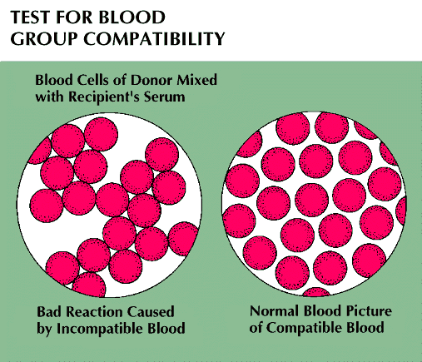
Blood Cross-Matching (continued)
https://www.cache.eb.com
Agglutination

Slide 120


