Slide 1
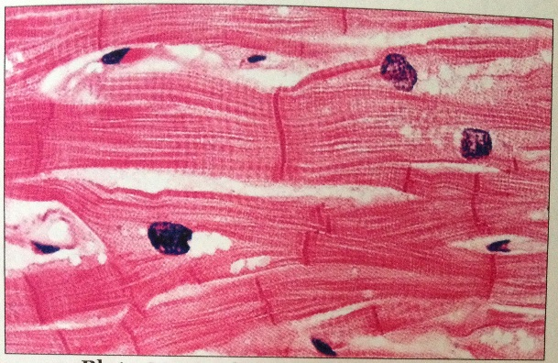
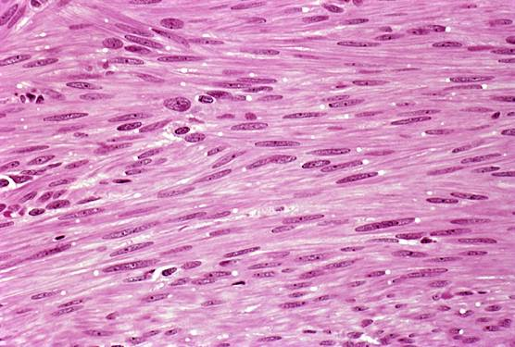
Cardiac Muscle and Smooth Muscle
Cardiac muscle
https://www.classconnection.s3.amazonaws.com
Smooth muscle
https://www.learningtosavetheearth.com

Slide 2
Note
Much of the text material is from, “Principles of Anatomy and Physiology” by Gerald J. Tortora and Bryan Derrickson (2009, 2011, and 2014). I don’t claim authorship. Other sources are noted when they are used.
The lecture slides are mapped to the three editions of the textbook based on the color-coded key below.
14th edition
13th edition
12th edition
Same figure or table reference in all three editions

Slide 3
Outline
Cardiac muscle
Smooth muscle

Slide 4
Cardiac Muscle

Slide 5
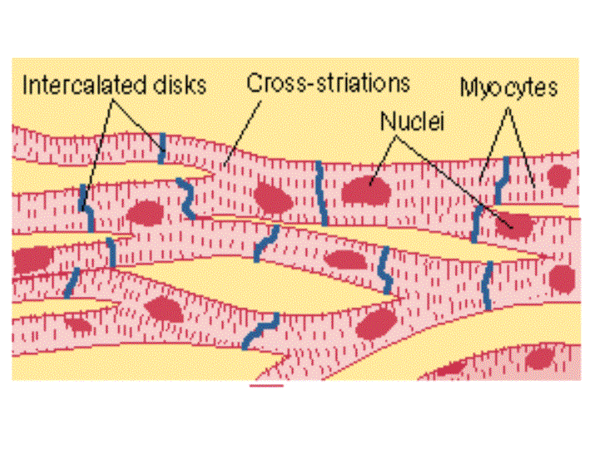
Cardiac Muscle Fibers
https://www.ucl.ac.uk

Slide 6
Structure
The walls of the heart are composed mostly of cardiac muscle.
Between the layers of cardiac muscle fibers is connective tissue that contain blood vessels, nerves, and an electrical conduction system.
Cardiac muscle fibers have the same arrangement of thin and thick elements, and the same bands, zones, and Z discs found in skeletal muscle.
Page 317
Page 354
Page 327
Figure 20.9

Slide 7
Structure (continued)
Cardiac muscle fibers are attached by transverse thickenings of the plasma membrane known as intercalated discs.
The discs have desmosomes to hold the muscle fibers together dur-ing contractions.
The fibers have gap junctions to enable the rapid conduction of action potentials to enable the atria and then the ventricles to contract in uni-son.
Desmosome = a cell structure specialized for cell-to-cell adhesion.
Gap junction = directly connects the cytoplasm of two cells, which allows various molecules and ions to pass freely between the cells.
(Both definitions from https://www.wikipedia.org)
Page 318
Page 354
Page 327
Figure 4.2

Slide 8
Cardiac Muscle Response
Cardiac muscle contractions are much longer in duration (about 300 msec) than skeletal muscle contractions.
The longer time results from the prolonged delivery of Ca²⁺ from the sarcoplasmic reticulum to the sarcoplasm.
Page 318
Page 354
Page 327

Slide 9
Cardiac Muscle Stimulation
Skeletal muscle contracts when stimulated by ACh triggered by neu-ronal action potentials from spinal motor neurons.
In comparison, cardiac muscle tissue contracts when stimulated by autorhythmic muscle fibers in the heart—generally about 100 times per minute.
The autonomic nervous system regulates changes in heart rate and other aspects of cardiac activity in response to stress, physical exer-cise, and other conditions.
Page 318
Page 354
Page 327

Slide 10
ATP Production
The mitochondria in cardiac muscle fibers are larger and more numer-ous than in skeletal muscle.
Aerobic cellular respiration is the principal source of ATP in cardiac muscle—heart muscle requires more oxygen than most other tissues.
Cardiac muscle can also use the lactic acid from contractions of skeletal muscle to produce ATP.
Page 318
Page 354
Page 327

Slide 11
Smooth Muscle

Slide 12
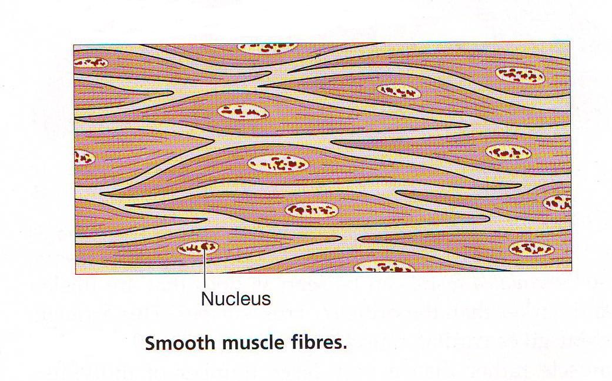
Smooth Muscle Fibers
https://www.faculty.ksu.edu.sa

Slide 13
Single-Unit Tissue
One type of smooth muscle is single-unit or visceral smooth muscle tissue.
The muscle fibers form a tubular arrangement in the walls of small arteries and veins.
They also form the walls of hollow organs including for the digestive tract, urinary tract, and uterus.
Gap junctions enable muscle action potentials to spread rapidly to al-low the muscle fibers to contract in unison.
Page 318
Page 354
Page 327
Figure 10.16
Figure 10.16
Figure 10.17

Slide 14
Multi-Unit Tissue
Multi-unit tissue consists of individual smooth muscle fibers, each with its own motor neuron terminals and few (if any) gap junctions.
Stimulation of a multi-unit causes contraction of only that one unit.
Multi-unit smooth muscle tissues are found in:
  Walls of the large arteries.
  Respiratory bronchioles to the alveoli in the lungs.
  Muscles of the iris of the eye for constriction and dilation of the pupils.
Page 318
Page 354
Page 327
Figure 10.16
Figure 10.16
Figure 10.17

Slide 15
Smooth Muscle Stimulation
Smooth muscle contracts in response to the release of neurotrans-mitters (acetylcholine or norepinephrine) from motor neurons of the autonomic nervous system.
Some smooth muscles also contract in response to:
  Stretching
  Hormones
  Ion concentrations
  pH changes
  Body temperature
  Oxygen and carbon dioxide levels in the blood
Page 318
Page 354
Page 328

Slide 16
Smooth Muscle Response
The contractions of smooth muscle start more slowly and last longer than in skeletal muscle.
Because there are fewer transverse tubules in smooth muscle, Ca²⁺ takes longer to reach the central region of the muscle fiber to trigger the contraction process.
Ca²⁺ exits the sarcoplasm and replenishes the sarcoplasmic reticu-lum more slowly, which delays the relaxation of smooth muscles.
Page 318
Page 356
Page 328

Slide 17
Smooth Muscle Response (continued)
Smooth muscle fibers can shorten and stretch to a greater extent than skeletal muscle fibers and cardiac muscle fibers.
Smooth muscle fibers, unlike skeletal muscle fibers, can be stretched considerably and still maintain their contractility.
An example is a very full stomach after a large meal—the stomach wall has substantial smooth muscle.
Page 318
Page 356
Page 328

