Slide 1
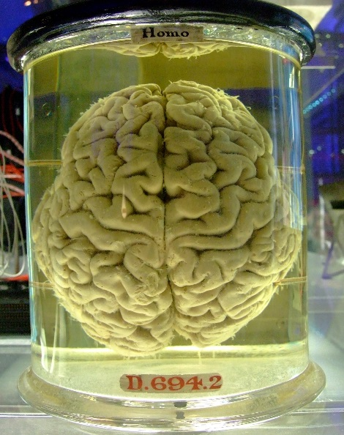
Brain and Cranial Nerves
https://www.wikimedia.org

Slide 2
Note
Much of the text material is from, “Principles of Anatomy and Physiology” by Gerald J. Tortora and Bryan Derrickson (2009, 2011, and 2014). I don’t claim authorship. Other sources are noted when they are used.
The lecture slides are mapped to the three editions of the textbook based on the color-coded key below.
14th edition
13th edition
12th edition
Same figure or table reference in all three editions

Slide 3
Outline
Introduction
Brain organization
Protection and blood supply
Brainstem
Cerebellum
Diencephalon
Telencephalon
Functional organization of the cerebral cortex
Cranial nerves
Aging

Slide 4
Introduction

Slide 5
Brain Overview
The human brain has an estimated 100 billion (10¹¹) neurons.
It also has as many as 50 trillion neuroglia—cells that provide sup-port to neurons.
A single neuron may have more than 1,000 (10³) synaptic connec-tions with other neurons.
Thus, our brains may have more than a thousand trillion (10¹⁴) syn-apses.
The human brain is the most intricate and complex single physical entity known to humans.
Page 473
Page 527
Page 495

Slide 6
Brain Overview (continued)
The brain is responsible for sensation, perception, memory, intelli-gence, decision-making, emotions, motivations, and motor control, among other functions.
The brain is also the so-called executive center for the control of many body functions.
Because the nervous system is exceedingly complex, the textbook devotes several chapters to it.
We can only explore one of life’s greatest mysteries in a somewhat cursory manner.
Page 473
Page 527
Page 495

Slide 7
Homeostasis
The nervous system and endocrine system maintain homeostasis of the body.
The nervous system regulates body activities by electrical activity known as graded potentials and action potentials and the release of neurotransmitters at synapses.
The endocrine system responds more slowly through the release of hormones.
Homeostasis = the condition in which the body’s internal environment remains relatively constant within physiological limits.
Page 399
Page 447
Page 415

Slide 8
Brain Organization

Slide 9
Embryonic Development
Forebrain (prosencephalon) → telencephalon, diencephalon
Midbrain (mesencephalon) → mesencephalon
Hindbrain (rhombencephalon) → metencephalon, myelencephalon
Developmental changes from a 3- and 4-week embryo to a 5-week embryo.
Page 474
Page 528
Page 496
Table 14.1

Slide 10
Embryonic Development (continued)
Myelencephalon → medulla oblongata, lower part of fourth ventricle.
Metencephalon → pons, cerebellum, upper part of fourth ventricle.
Mesencephalon → midbrain, aqueduct of the midbrain.
Diencephalon → thalamus, hypothalamus, epithalamus, third ventricle.
Telencephalon → cerebral hemispheres, subcortical structures, lateral ventricles.
Progression from a 5-week embryo to full development.
Page 474
Page 528
Page 496

Slide 11
Major Parts of the Brain
The brainstem consists of the medulla oblongata, pons, and midbrain.
The cerebellum is located posterior to the brainstem.
The diencephalon includes the thalamus, hypothalamus, posterior pitui-tary, and epithalamus.
The telencephalon, the largest part of the human brain, consists of the cerebral hemispheres, basal ganglia, limbic system, and hippocampus.
Page 474
Page 528
Page 496

Slide 12
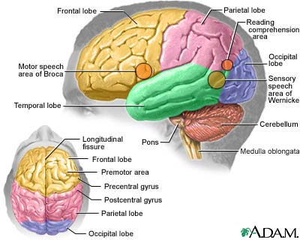
Cerebral Hemispheres
https://www.howstuffworks.com

Slide 13
Anatomical Positions
Superior—toward the upper part of the body or body structure.
Inferior—toward the lower part of the body or structure.
Anterior—nearer to or at the front of the body or structure.
Posterior—nearer to or at the back of the body or structure.

Slide 14
Anatomical Positions (continued)
Midline—vertical plane that divides a bilaterally-symmetrical body or structure into its left and right halves.
Lateral—away from the midline of a body or structure.
Proximal—nearer to the point of origin or attachment.
Distal—farther from the point of origin or attachment.
Bilateral symmetry = the right half of the body or body structure is a mirror image of its left half.

Slide 15
Anatomical Planes
Sagittal plane: vertical cut from the top to bottom of the body or structure that divides it into left and right portions.
Mid-sagittal plane: a sagittal cut along the midline of the body or structure.
Coronal plane: vertical cut that divides the body or structure into anterior and posterior portions.
Transverse plane: horizontal cut that divides the body or structure into cranial and caudal (head and tail) portions.
The definitions were adapted from Wikipedia, https://www.wikipedia.org

Slide 16
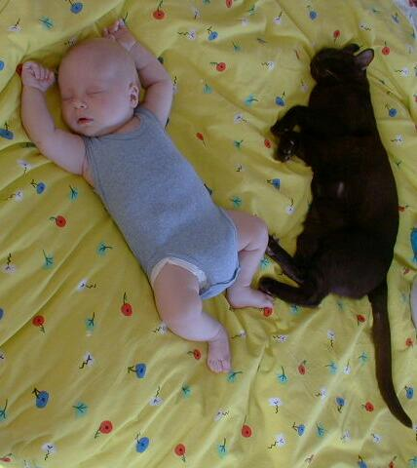
Biped and Quadruped
https://www.cwi.nl

Slide 17
Protection and Blood Supply

Slide 18
Protective Coverings
The cranium and cranial meninges encase (surround) and protect the brain.
The cranial meninges consist of the outer dura mater, middle arach-noid mater, and inner pia mater.
The cranial meninges are continuous with the spinal meninges—both have the same basic structure.
Arachnoid = spider-like.
Page 476
Page 528
Page 496
Figure 14.2

Slide 19
Protective Coverings (continued)
Blood is supplied to the brain via the carotid and vertebral arteries.
Arteries pass along the surface of the brain and then penetrate in-ward sheathed in pia mater.
Between the layers of the dura mater are venous sinuses that drain the blood and deliver if to the jugular veins for its return to the right atrium of the heart.
Page 477
Page 531
Page 496
Figure 14.2

Slide 20
Blood Flow
Although the adult brain is about two percent of total body weight, it consumes about 20 percent of oxygen and glucose supplied to the body.
Neurons consume glucose in metabolic reactions that require oxy-gen for aerobic respiration.
Blood flow increases to the active areas to meet the increased local demands for glucose and oxygen.
Page 477
Page 531
Page 498

Slide 21
Blood Flow (continued)
Oxygen and glucose must be continuously supplied to neurons since neither is stored in the brain.
A brief slowing of blood flow to the brain can result in unconscious-ness.
One to two minutes of disrupted blood flow can impair mental func-tions.
Deprivation of oxygen, such as in a stroke, for as little as four minutes can cause permanent brain damage.
Stroke = disruption of blood supply to the brain. The condition can be caused by a blocked artery (ischemic stroke) or leaking or bursting of a blood vessel (hemorrhagic stroke). (https://www.mayoclinic.org).
Page 477
Page 531
Page 498

Slide 22
Blood-Brain Barrier
The blood-brain barrier (BBB) protects that brain from harmful sub-stances and pathogens by preventing their passage from the blood vessels into brain tissue.
Tight junctions in the endothelial cells lining the walls of the brain’s capillaries form the BBB.
Processes from the astrocytes, a type of neuroglial cell, embrace the capillaries and secrete chemicals that help maintain the permeability characteristics of the capillaries.
Pathogen = a disease-producing agent, especially a virus or a bacterium.
(https://www.wordnetweb.princeton.edu)
Page 477
Page 531
Page 499

Slide 23
Blood-Brain Barrier (continued)
A few water-soluble compounds, including glucose, cross the blood-brain barrier via active transport (requires energy in the form of ATP or other high energy molecule).
Lipid-soluble compounds, including oxygen, carbon dioxide, alcohol, and most anesthetics, passively diffuse across the BBB.
Creatine, urea, and most ions pass through the BBB very slowly, and antibiotics and proteins do not pass at all.
Brain trauma, some toxins, and inflammation can cause a breakdown of the BBB, which can enable pathogens and harmful substances to reach neurons.
Page 477
Page 531
Page 499

Slide 24
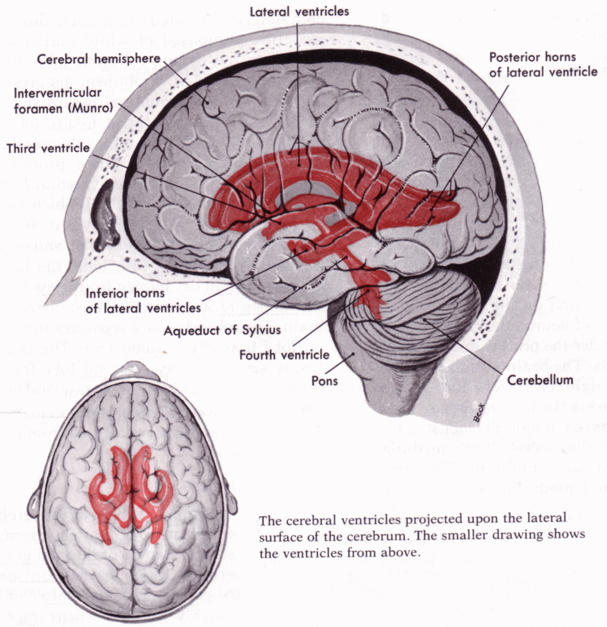
Ventricles
https://www.arthursclipart.org

Slide 25
Cerebrospinal Fluid
Cerebrospinal fluid (CSF) is a clear, colorless liquid that helps protect the brain and spinal cord from chemical and physical trauma and other injuries.
It circulates through the cavities of the brain and spinal cord and in the subarachnoid space between the arachnoid mater and pia mater.
The total volume of CSF in an adult is 80 to 150 mL.
CSF contains glucose, proteins, lactic acid, urea, anions, and cations.
Anion = ion that has a negative (-) charge.
Cation = ion that has a positive (+) charge.
Page 477
Page 531
Page 499
Figure 14.4

Slide 26
Cerebrospinal Fluid (continued)
CSF is produced in the choroid plexuses, a network of capillaries in walls of the ventricles.
The blood-cerebrospinal barrier regulates substances that can enter the CSF to protect the brain and spinal cord from potentially harmful materials.
The rates of formation and reabsorption of CSF are normally equal, resulting in a constant CSF volume in the cavities of the brain and spinal cord.
Page 477
Page 531
Page 500

Slide 27
CSF Functions
CSF is a shock-absorbing medium to protect delicate tissues of the brain and spinal cord.
It provides an optimal chemical environment for neuronal activity— slight changes in ion concentrations can disrupt the generation of electrical activity in neurons.
CSF also enables exchange of nutrients and waste products between the blood and nervous tissue.
Action potentials = what are sometimes referred to as nerve impulses.
Page 477
Page 532
Page 500

Slide 28
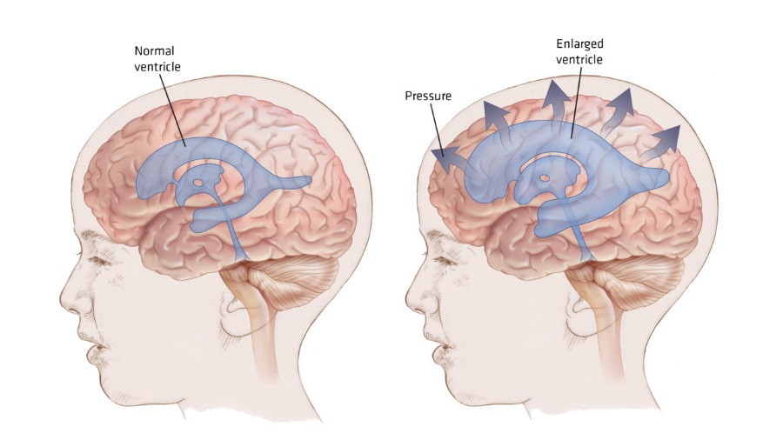
Hydrocephalus
Tumors, tissue inflammation, and developmental malformations can hinder drainage of CSF from the third ventricle into the subarachnoid space.
Intracranial pressure increases with excessive accumulation of CSF in the ventricles.
In young children, the cranium can enlarge because the sutures of the skull are not yet fused.
Page 479
Page 533
Page 502

Slide 29
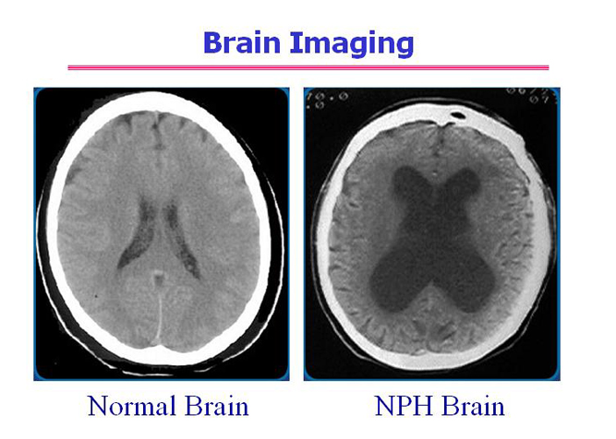
Hydrocephalus (continued)
Fluid buildup compresses and damages the delicate nervous tissues if the condition persists.
The condition can be relieved through surgical procedures to drain ex-cess CSF.
Normal pressure hydrocephalus (NPH) = excessive CSF accumulates in the ventricles causing thinking and reasoning problems, difficulty in walking, and loss of bladder control.
Page 479
Page 533
Page 502

Slide 30
Brainstem

Slide 31
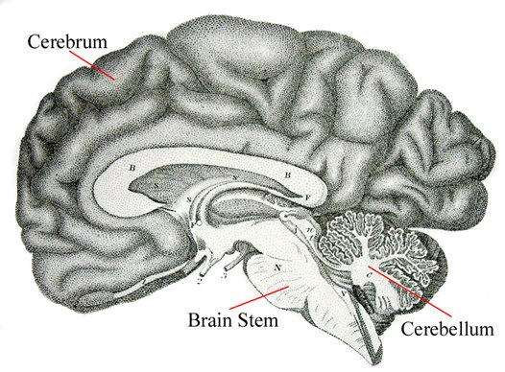
Brainstem
https://www.australianmuseum.net.au

Slide 32
Medulla Oblongata
The medulla oblongata is located superior to the cervical segments of the spinal cord.
All sensory and motor fiber tracts between the brain and spinal cord pass through the medulla oblongata.
About 90 percent of the motor fiber tracts crossover for contralateral control of skeletal muscles.
The other ten percent of the tracts allow for ipsilateral or bilateral con-troll.
Contralateral = opposite side of the body.
Ipsilateral = same side of the body.
Bilateral = both sides of the body.
Page 482
Page 536
Page 503
Figure 14.6

Slide 33
Medullary Functions
The cardiovascular (CV) center, a collection of cell bodies of neurons called a nucleus, regulates heart rate.
The CV center also regulates the internal diameter of blood vessels, especially the arterioles that supply capillary beds where substance exchange occurs in organs and tissues.
The respiratory rhythmicity center regulates breathing patterns con-trolled by the diaphragm and external intercostal muscles (both con-sist of skeletal muscles).
The vomiting center initiates the forceful expulsion of the contents of the stomach.
Page 482
Page 537
Page 503
33

Slide 34
Medullary Functions (continued)
Nuclei in the medulla oblongata control sneezing, coughing, and hiccupping.
Other nuclei influence neuronal activity in the cerebellum including the learning of new motor skills.
The medulla oblongata has nuclei and sensory tracts for body sen-sations, hearing, taste, and balance.
Nuclei = the plural form of nucleus.
Page 483
Page 537
Page 503

Slide 35
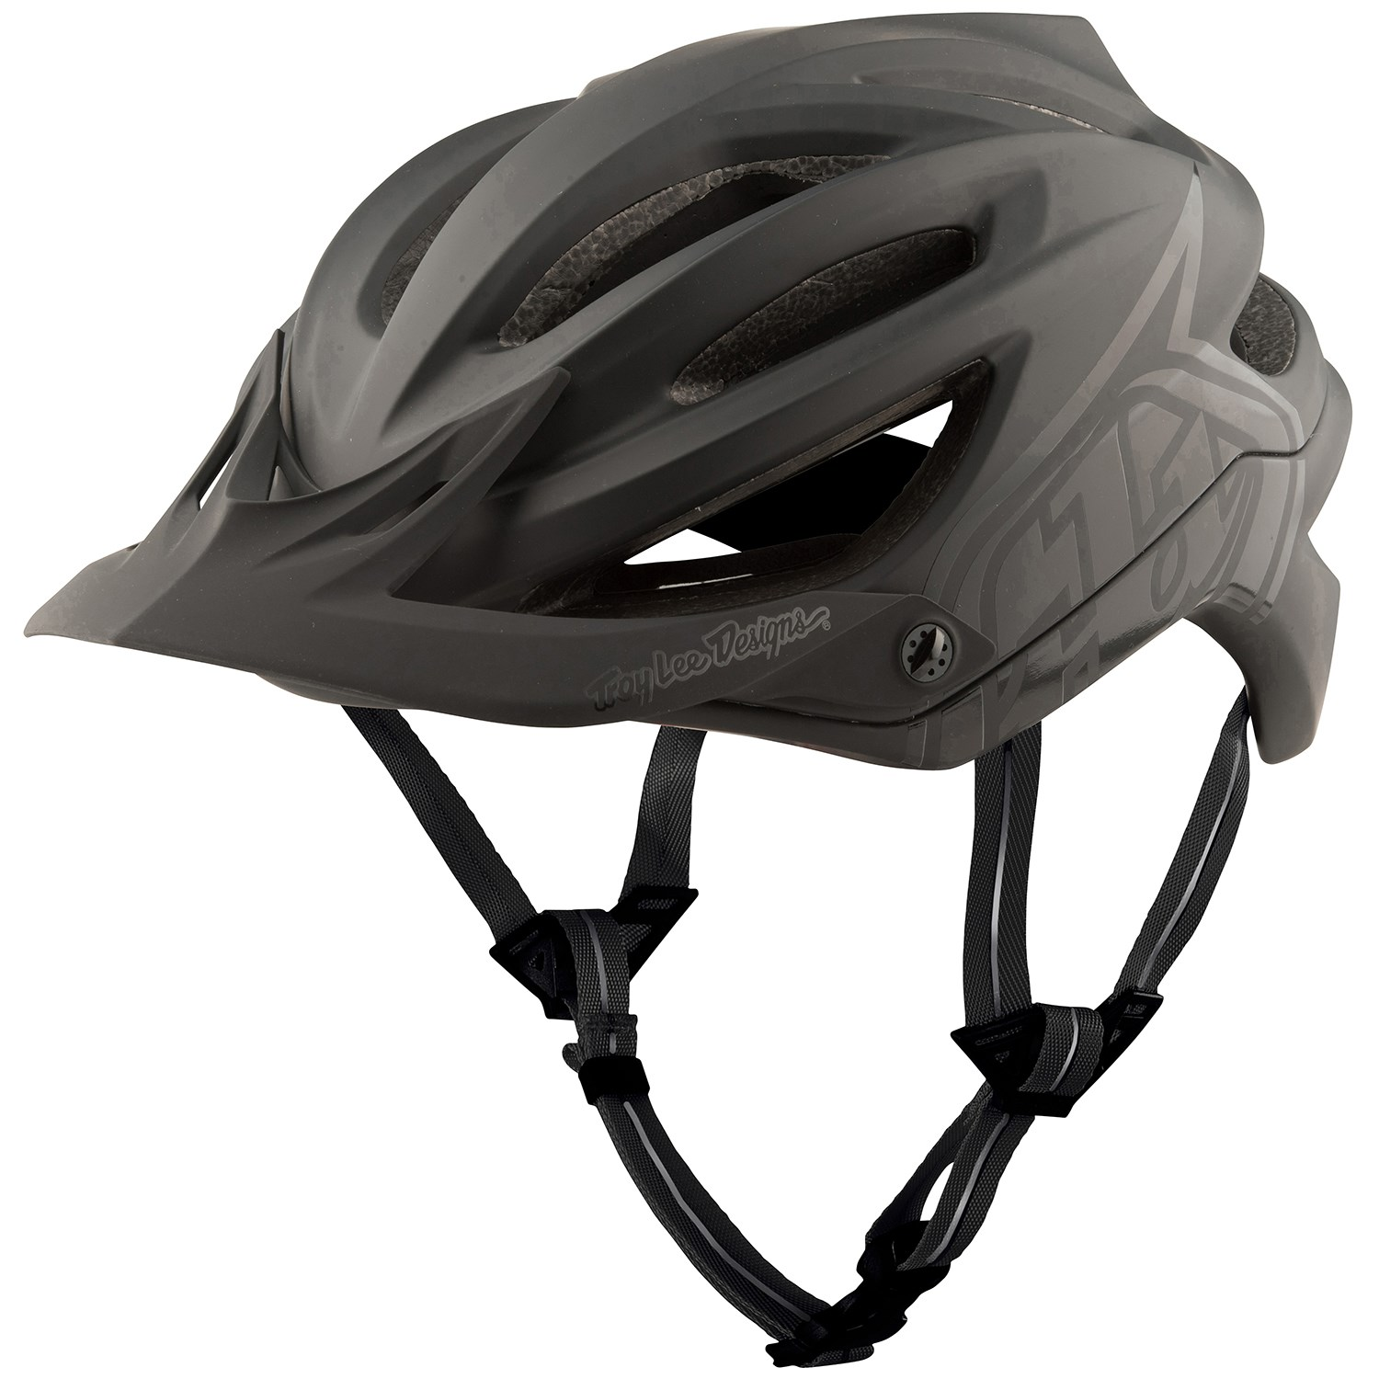
Medullary Damage
Damage to the medulla oblongata from a hard blow to the back of the head or upper neck can be fatal.
Damage to the rhythmicity center can be especially injurious and lead to rapid death.
Bicycle helmet
Wear your bicycle/motorcycle/skateboard/rollerblade/skating/ski helmet.
Page 484
Page 538
Page 505

Slide 36
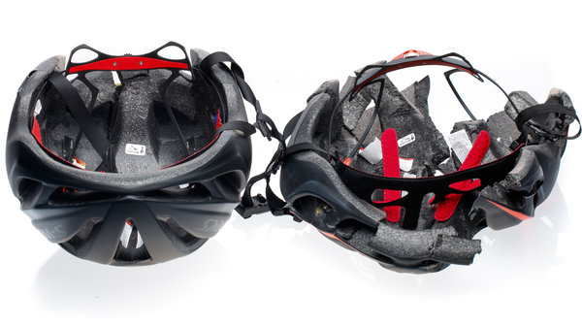
Bicycle Helmet vs. Counterfeit Helmet
https://www.npr.org
Both bicycle helmets were subjected to the same impact loads in a safety evaluation. The helmet that broke apart on impact will provide no head protection. Which one is the counterfeit helmet?
36
Notes:
36

Slide 37
Medullary Damage (continued)
Symptoms of nonfatal injuries to the medulla oblongata include:
  Irregular breathing and heart rhythm.
  Paralysis and loss of sensation on the opposite (contralateral) side of the body.
  Cranial nerve malfunctions on the same (ipsilateral) side of the body.
  Unlike motor tracts, the cranial nerves (except partially for the optic nerve) do not cross over to the opposite side of the body.
Page 484
Page 538
Page 505

Slide 38
Medullary Suppression
Opiates can fatally suppress critical medullary functions, especially at higher dosages as a user’s tolerance threshold to the drug increases over time.
Opiate and alcohol overdoses can suppress the rhythmicity center and result in death.
Page 484
Page 538
Page 505
38
Notes:
38

Slide 39
Pons and Pontine Functions
The pons is the bridge that connects superior and inferior parts of the brainstem and the brainstem with the cerebellum.
Like the medulla oblongata, the pons has nuclei, sensory tracts, and motor tracts.
Motor and sensory fiber tracts do no cross-over in the pons (only in the medulla oblongata).
Page 484
Page 538
Page 505
Figure 14.5

Slide 40
Pons and Pontine Functions (continued)
Action potentials for voluntary movements from the motor areas of the cerebral cortex are relayed through nuclei in the pons to the cerebellum.
The pneumotaxic and apneustic centers in the pons work with the rhythmicity center in the medulla oblongata to control our breathing patterns.
Page 484
Page 538
Page 505
Figure 14.5
40
Notes:
40

Slide 41
Midbrain
Like the medulla oblongata and pons, the midbrain contains nuclei, sensory tracts, and motor tracts.
The motor and sensory tracts do not cross-over in the midbrain.
The cerebral peduncles contain the corticospinal (cerebral cortex to the spinal cord), corticopontine (to the pons), and corticobulbar (to the medulla) motor tracts.
The superior colliculi and inferior colliculi, which mediate visual and auditory reflexes and orientating behavior, are located in the posterior part of the midbrain.
Page 484
Page 538
Page 505
Figure 14.7

Slide 42
Superior Colliculi
The superior colliculi are reflex centers involved in certain visual ac-tivities such as tracking moving images and scanning fixed images.
They help control movements of the head, eyes, and body trunk in response to visual stimuli.
The superior colliculi are part of an evolutionarily-older visual system that mammals, including humans, share with reptiles.
Extensive damage to the visual cortex can result in blindsight involv-ing the older visual system.
Blindsight = ability of people who are cortically blind due to lesions in their striate cortex, also known as primary visual cortex or V1, to respond to visual stimuli that they do not consciously see.
(https://www.wikipedia.org)
Page 484
Page 538
Page 507
Figure 14.7

Slide 43
Inferior Colliculi
The inferior colliculi are part of the auditory pathway and relay action potentials from the inner ear to other nuclei and centers in the brain.
They also mediate the startle reflex that involves sudden movements of the head, eyes, and body trunk when a person is startled by a loud sound.
Page 484
Page 538
Page 507
Figure 14.7

Slide 44
Other Midbrain Nuclei
The substantia nigra (black substance) is part of the extrapyramidal motor system.
It involves dopamine as a neurotransmitter for subconscious control of skeletal muscles.
The red nuclei have nerve fiber connections with the cerebellum and cerebral cortex to regulate some voluntary movements of the limbs.
Extrapyramidal nervous system = the name used to describe a number of centers and their associated tracts whose primary function is to coordinate and process motor commands performed at a subconscious level.
(https://www.sciencedirect.com)
Nerve fibers = groups or bundles of axons in the central nervous system (CNS).
Page 485
Page 538
Page 507
Figure 14.7

Slide 45
Reticular Formation
White matter and gray matter form a net-like arrangement known as the reticular formation.
The structure is visible under a light microscope in properly-stained brain tissue.
The reticular formation extends from the medulla oblongata and into the diencephalon (in particular, the thalamus).
The neurons of the reticular formation have afferent (sensory) and efferent (motor) functions.
The efferent fibers assist in regulating body posture and muscle tone.
White matter = myelinated axons of neurons.
Gray matter = cell bodies and dendrites of neurons.
Page 485
Page 540
Page 507
Figure 14.7

Slide 46
Reticular Activating System
The afferent fibers of the reticular formation make up the reticular activating system (RAS).
The RAS is a complex network of sensory fibers that project to the cerebral cortex through the thalamus.
The RAS maintains our consciousness and is also active when a person awakens from sleep.
Page 485
Page 541
Page 507

Slide 47
Sleep
We spend about one-third of our lives sleeping—about eight hours each day.
The biological reasons of why we sleep are not fully understood despite much research over the past century.
Yet, sleep is as essential to survival as consuming food and water.
Many areas are involved in sleep including the midbrain, reticular activating system, thalamus, and cerebral cortex.
The midbrain contains nuclei that regulate our sleep patterns and cycles.
Sleep has two distinct patterns: slow wave sleep (SWS) and rapid eye movement (REM) sleep.
Tap or click here to learn more about sleep.

Slide 48
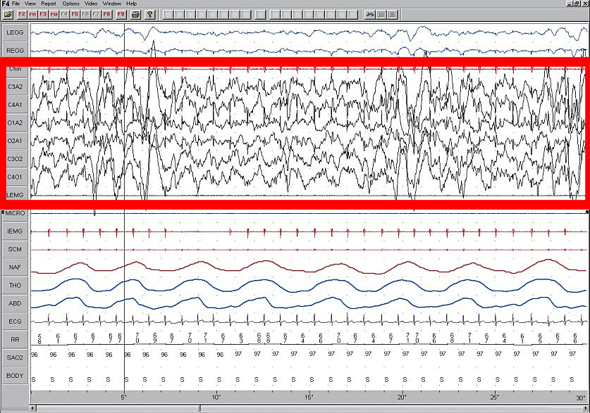
Slow Wave Sleep
Once we fall asleep, we progress through four stages of slow wave sleep as characterized by the EEG (brain wave) patterns—these are known as SWS stages 1, 2, 3, and 4.
Each stage represents a progressive deepening of slow wave sleep.
Some hormones, including human growth hormone, are secreted in greater amounts from the anterior pituitary, which is under control of the hypothalamus.
Slow wave sleep is also
referred to as restorative sleep since it is associated with physical recovery from the previous day’s activities.
EEG pattern, SWS-4
(https://www.wikipedia.org)

Slide 49
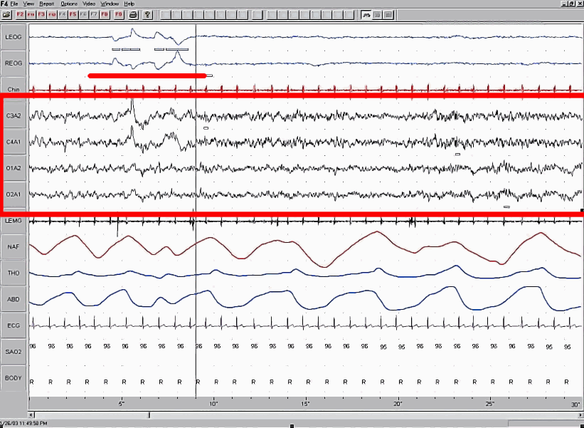
Rapid Eye Movement (REM) Sleep
After about 75 to 90 minutes of slow wave sleep, we enter rapid eye movement (REM) sleep.
The eyes flick back and forth—while all other skeletal muscles except those for breathing are inactivated—REM lasts for about ten minutes.
The EEG appears like that of one who is fully awake, but the person is still asleep—hence, REM is also referred to as paradoxical sleep.
If awakened, the person
would probably report having been dreaming.
Prolonged REM sleep deprivation can result in disturbances in emo-tional health.
EEG pattern, REM sleep
(https://www.wikipedia.org)

Slide 50
Sleep Cycles
As the sleep session progresses, we repeatedly alternate between slow wave sleep and REM sleep.
The SWS periods decrease in duration and the REM sleep periods increase in duration—we do most of our dreaming late in the sleep cycle before we wake up.
Jet lag and shift work can disrupt normal sleep patterns.
Alcohol consumption and some sleep medications can disrupt REM sleep, which paradoxically can lead to an undesired positive feed-back loop and a greater dependence on sleep-inducing substances.

Slide 51
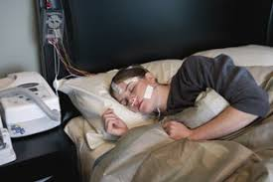
The Most Common Types of Sleep Disorders
Chronic insomnia
Sleep apnea
Narcolepsy
Restless leg syndrome
Sleep disorders clinic
(https://www.texasneurology.com)

Slide 52
Cerebellum

Slide 53
Cerebellum
https://www.australianmuseum.net.au

Slide 54
Cerebellum (continued)
The cerebellum is second in mass to the cerebral hemispheres.
It has a highly-folded cortex of gray matter, like the cerebral hemi-spheres.
The folding enables a large number of neurons to be packed into a limited area.
The cerebellum has ~50 percent of all neurons in the brain, although it is only one-tenth of its total mass.
Page 487
Page 541
Page 507
Figure 14.8

Slide 55
Cerebellar Functions
A primary function of the cerebellum is to evaluate how well move-ments initiated by the motor areas in the cerebral hemispheres are carried-out.
The cerebellum sends feedback signals to the motor areas via nuclei in the thalamus.
The feedback helps correct errors, smooth movements, and coordi-nate complex sequences of skeletal muscle contractions.
The cerebellum is also the primary region for regulating body posture and balance.
Page 487
Page 541
Page 509

Slide 56
Ataxia
Ataxia can result from damage to the cerebellum from physical trauma or disease.
Blindfolded people with ataxia often cannot touch the tip of their noses because they are unable to coordinate their movements with the sense of body location.
Ataxia can alter speech patterns due to uncoordinated control of skeletal muscles in the larynx (voice box).
Trauma = a wound or shock produced by sudden physical injury, as from violence or accident.
(https://www.dictionary.reference.com)
Page 488
Page 543
Page 510

Slide 57
Ataxia (continued)
Ataxia can result in a staggering gait and other abnormal walking movements.
Similar behavioral signs can result from consuming too much alcohol, which suppresses cerebellar activity.
Some of the most obvious signs of alcohol intoxication include slurred speech and staggering.
Page 488
Page 543
Page 510

Slide 58
Diencephalon

Slide 59
Diencephalon
https://www.australianmuseum.net.au

Slide 60
Thalamus
The diencephalon consists of the thalamus, hypothalamus, posterior pituitary, epithalamus, pineal gland, and circumventricular organs (CVOs).
The thalamus is about 80 percent of the mass of the diencephalon.
It is the major relay station for most sensory information that reaches the sensory projection areas of the cerebral cortex.
The thalamus also contributes to motor functions by transmitting infor-mation from the cerebellum and basal ganglia to the primary motor area of the cerebral cortex.
Page 489
Page 543
Page 510
Figure 14.9

Slide 61
Thalamus (continued)
The thalamus also relays action potentials among the different areas of each cerebral hemisphere.
It has roles in the maintenance of consciousness and awareness as part of the reticular activating system.
The thalamus contains seven major groups of nuclei named accord-ing to their positions and functions.
For example, the lateral geniculate body relays sensory information to the primary visual area of the cerebral cortex.
The medial geniculate body relays sensory information to the primary auditory area.
Discuss sensory synesthesia during the class session.
Page 490
Page 543
Page 510

Slide 62
Hypothalamus
The hypothalamus is a small area of the diencephalon located inferior to the thalamus.
It controls many body functions and is one of the primary regulators of homeostasis.
The hypothalamus receives input from somatic and visceral sensory receptors, and sensory information for vision, taste, and smell.
Receptors in the hypothalamus monitor osmotic pressure, blood glu-cose level, some hormone concentrations, and blood temperature.
Osmotic pressure = the pressure exerted by the flow of water through a semipermeable mem-brane separating two solutions with different concentrations of a solute.
(https://www.thefreedictionary.com)
Page 490
Page 540
Page 512
Figure 14.10

Slide 63
Hypothalamic Functions
Control of the autonomic nervous system—examples include regula-tion of heart rate, movement of food through the digestive tract, and contraction of the urinary bladder.
Production of hormones—synthesizes releasing and inhibiting hor-mones that control the release of hormones from the anterior pitui-tary.
The hypothalamus also synthesizes the hormones released by the posterior pituitary.
Regulation of emotional responses—along with the limbic system, the hypothalamus is involved in rage, aggression, pain, pleasure, and sexual arousal.
Page 490
Page 545
Page 512

Slide 64
Hypothalamic Functions (continued)
Regulation of eating and drinking—contains feeding, satiety (fullness), and thirst centers.
Control of body temperature—promotes heat production and retention, and heat loss via the autonomic nervous system.
Regulation of circadian rhythms—serves as a key component of the body’s biological clock for physiological processes that are on about a 24-hour cycle.
Page 491
Page 546
Page 512

Slide 65
Pituitary Gland
The pituitary gland, located inferior to the hypothalamus, is under its control.
It is known as the master gland of the body since it controls a number of endocrine glands.
The pituitary gland consists of an anterior lobe (adenohypophysis) and a posterior lobe (neurohypophysis).
The two lobes are controlled by the hypothalamus but in very different ways.
We will discuss the pituitary gland in much more detail when we study the endocrine system.
Page 491
Page 546
Page 513
Figure 14.10

Slide 66
Epithalamus and Pineal Gland
The epithalamus, a small area superior and posterior to the thalamus, includes the pineal gland and habenular nuclei.
The pineal gland is about the size of a garden pea.
The pineal gland is involved in the annual migratory patterns of some bird species.
The pineal gland secretes the hormone, melatonin, which in humans is involved in the control of sleep patterns.
The habenular nuclei are involved in olfaction and especially emotional responses to odors.
Page 492
Page 546
Page 513

Slide 67
Circumventricular Organs
The circumventricular organs (CVOs) are located in the wall of the third ventricle.
CVOs monitor changes in blood chemistry as part of maintaining the body’s homeostasis.
CVOs are an entry site for HIV into the brain, which can lead to irreversible mental deterioration as AIDS progresses without treat-ment.
HIV = Human immunodeficiency virus, the retrovirus that causes acquired immunodeficiency syndrome (AIDS).
Page 492
Page 546
Page 513

Slide 68
Telencephalon

Slide 69
Cerebral Hemispheres
https://www.australianmuseum.net.au

Slide 70
Tissues of the Cerebral Hemispheres
The cerebral hemispheres (or cerebrum) is where higher-level men-tal and other functions take place.
The cerebral hemispheres consist of:
  A thin, outer region known as the cerebral cortex (gray matter).
  An inner region of projection, association, and commissural fibers (white matter).
  A deeper region consisting of the basal ganglia, limbic system, and hippocampus (gray matter).
Higher-level mental functions include thinking, judgment, long-term memory, sensory processing, perception, and control of skeletal muscles.
Page 492
Page 546
Page 514
Figure 14.11

Slide 71
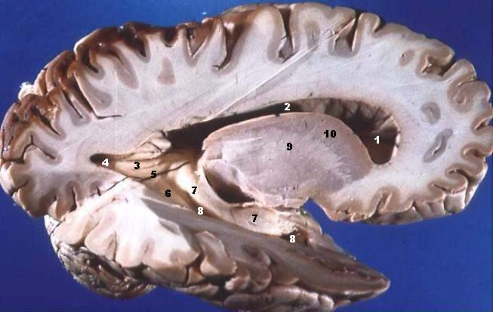
Gray and White Matter
https://www.wikimedia.org
Human brain—mid-sagittal section, right-lateral view.

Slide 72
Definitions
Nucleus is a cluster of cell bodies of neurons in the central ner-vous system (CNS)—not to be confused with nucleus of a cell.
Ganglion is a cluster of cell bodies of neurons usually in the peri-pheral nervous system (PNS).
Fiber tract is a bundle of axons connecting neurons in the brain or spinal cord (CNS).
Nerve is a bundle of axons in the PNS.
Nucleus = singular for nuclei.
Ganglion = singular for ganglia.
Page 410
Page 457
Page 424
72
Notes:
72

Slide 73
Cerebral Cortex
The cerebral cortex—also known as the neocortex—is the region of gray matter that forms the outer layers of the cerebral hemispheres.
It contains many billions of neurons, although it is only about 2 to 4 mm thick.
A piece of cerebral cortex the size of a grain of beach sand can con-tain up to 100,000 neurons and between one hundred million (10⁸) and one billion (10⁹) synaptic connections.
Neocortex = the evolutionary most recent part of the brain; hence the word, neocortex in which “neo” means “new.”
Page 492
Page 546
Page 514
Figure 14.11

Slide 74
Cerebral Cortex (continued)
During embryonic development, the cerebral cortex folds upon itself to provide greater surface area to enable the cell bodies of neurons to be packed in a much greater density.
The folds are called gyri.
The deepest grooves are called fissures and the shallower grooves are known as sulci.
Gyrus = singular form of gyri.
Sulcus = singular form of sulci.
Page 492
Page 547
Page 513
Figure 14.11

Slide 75
Lobes and Major Fissures
Each cerebral hemisphere has visible four lobes—frontal, parietal, temporal, and occipital.
A fifth lobe, the medial, is located within the lateral fissure.
The lateral fissure separates the frontal lobe from the temporal lobe.
The central fissure separates the frontal lobe from the parietal lobe.
The left and right hemispheres are separated by the longitudinal fissure.
Page 492
Page 547
Page 514
Figure 14.11

Slide 76
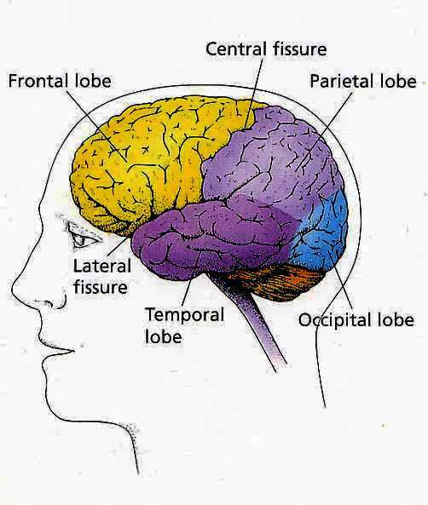
Lobes and Major Fissures (continued)
https://www.rhsmpsychology.com
Left-lateral view.

Slide 77
Lobes and Major Fissures (continued)
The precentral gyrus immediately anterior to the central fissure is the primary motor area.
The postcentral gyrus immediately posterior to the central fissure is the primary somatosensory area.
Somatosensory = pertaining to sensations received in the skin and deep tissues.
(https://www.medical-dictionary.thefreedictionary.com)
Page 492
Page 549
Page 516
Figure 14.11

Slide 78
Cerebral White Matter
Cerebral white matter consists of myelinated axons in three types of tracts.
Association tracts are fibers connecting the gyri (folds) in the same hemisphere (intrahemispheric communication).
Commissural tracts are fibers connecting the gyri in the opposite hemispheres (interhemispheric communication).
Projection tracts consist of afferent (sensory) and efferent (motor) fibers.
Afferent fibers relay action potentials from the body to the brain, and efferent fibers relay action potentials from the brain to the body.
Page 494
Page 549
Page 516
Figure 14.12

Slide 79
Commissural Fibers
Each cerebral hemisphere is connected via commissural fibers.
The largest band of commissural fibers, the corpus callosum, has about 300 million axons of neurons.
Other commissural fibers are the anterior commissure and posterior commissure.
Commissural fibers enable communication between the cerebral hemi-spheres.
Page 494
Page 549
Page 516
Figure 14.12

Slide 80
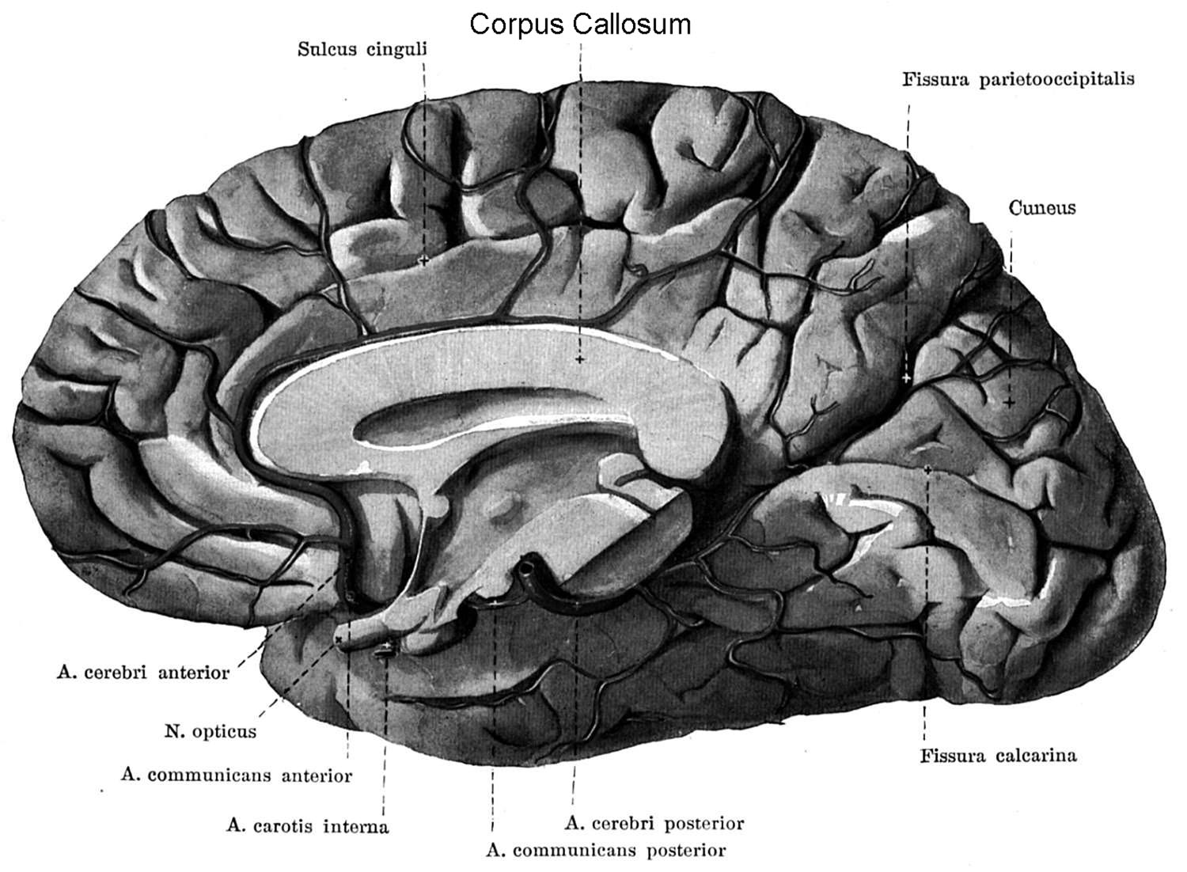
Corpus Callosum
Anterior
Posterior
https://www.psywww.com

Slide 81
Basal Ganglia
The basal ganglia are located deep within the cerebral hemispheres.
This is the one instance where a collection of nuclei in the CNS are called ganglia.
Ganglia is typically reserved for collections of nuclei (cell bodies of neurons) in the peripheral nervous system.
The basal ganglia consist of the globus pallidus, putamen, and lenti-form nucleus—the last two together are known as the corpus striatum.
Page 494
Page 549
Page 517
Figure 14.13

Slide 82
Basal Ganglia (continued)
A major function of the basal ganglia is to assist in initiating and ter-minating skeletal muscle movements of the body.
The basal ganglia has fiber connections with the primary motor area and the cerebellum (through the thalamus).
The basal ganglia suppress unwanted body movements and regulate muscle tone.
Parkinson’s disease is associated with problems in the basal ganglia at the neurochemical level (that is, with the neurotransmitter, known as dopamine).
Parkinson’s disease = a group of neurological disorders characterized by hypokinesia, tremor, and muscular rigidity.
Hypokinesia = partial or complete loss of muscle movement.
Page 494
Page 549
Page 517

Slide 83
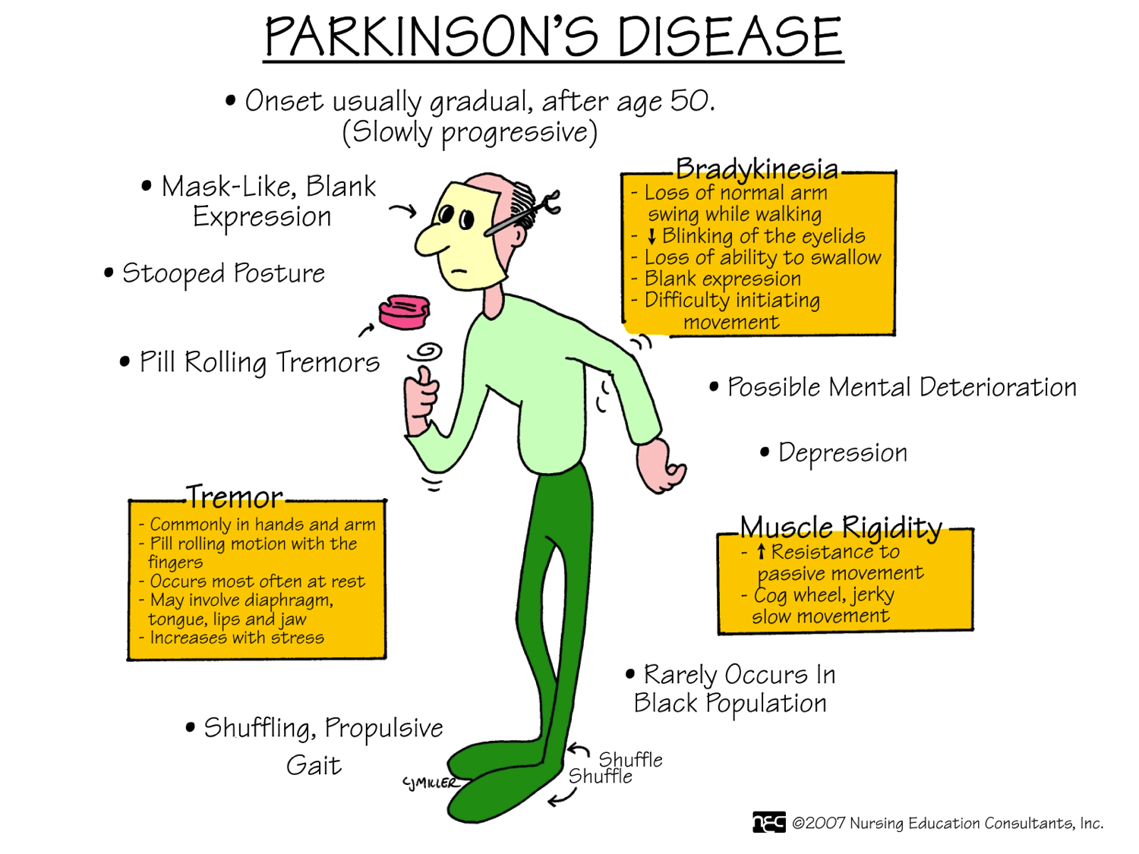
Signs and Symptoms

Slide 84
Limbic System
The limbic system consists of structures located deep in the cerebral hemispheres including the amygdala, fornix, septal area, hippocampus, and olfactory bulbs.
The limbic system forms a border (limbus in Latin) around deeper brain structures.
The limbic system is sometimes called the emotional brain since it helps mediate emotions including pleasure, affection, pain, fear, and anger.
Some psychotropic drugs that affect a person’s mood act upon synapses in the limbic system.
Page 495
Page 549
Page 517
Figure 14.14

Slide 85
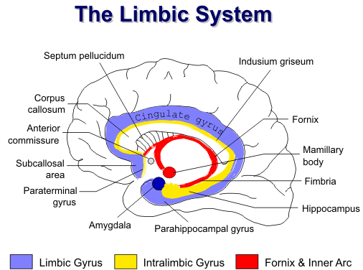
Limbic System (continued)
Limbic System (continued)
https://www.spinwarp.ucsd.edu

Slide 86
Limbic System (continued)
Olfactory receptors (for smell) are directly connected to structures in the limbic system.
This anatomical arrangement may be why certain smells can elicit strong emotional responses.
Page 495
Page 549
Page 517
Figure 14.14

Slide 87
Hippocampus
The hippocampus is involved in consolidation of short-term memory traces into long-term memory in the cerebral cortex.
One theory is that transient electrical events for short-term memory are converted to more permanent structural changes for long-term memory.
Persistent or long-term disruption of REM sleep can hinder hippo-campal activity and affect long-term memory and emotional health.
Bilateral hippocampal damage can result in the inability to establish new long-term memory traces.
Transient = brief; lasting for a short time.
Page 495
Page 551
Page 518
Figure 14.14

Slide 88

At the Movies
https://www.sonypictures.com
To be discussed in class.

Slide 89
Functional Organization of the Cerebral Cortex

Slide 90
Functional Organization
Sensory and motor information is processed in the cerebral cortex.
The primary motor area initiates the voluntary movements of skeletal muscles.
The sensory projection areas process sensory information for each sensory modality (such as vision, audition, and touch).
Association areas are involved in perception; that is, the conscious awareness and interpretation to give meaning to sensations for each sensory modality.
Association areas are also involved in the integration of complex func-tions including intelligence, memory, judgment, emotions, and motiva-tion.
Page 497
Page 552
Page 518
Figure 14.15

Slide 91
Sensory Projection Areas
Sensory information is relayed primarily to the posterior areas of the cerebral cortex.
Sensory projection areas receive sensory information from the sensory receptors through the thalamus (except for olfaction).
More will be said about sensory projection areas on the upcoming slides.
Olfaction = smell
Page 497
Page 552
Page 519
Figure 14.15

Slide 92
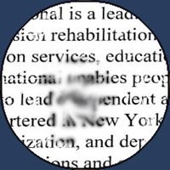
Sensory Projection Areas (continued)
Damage to the primary visual projection area can result in cortical blindness, or in the event of less extensive damage, a scotoma.
https://www.humaneyeproject
Scotoma = an area of lost vision surrounded by an area of normal vision.
Page 497
Page 552
Page 519
Figure 14.15

Slide 93
Sensory Association Areas
The sensory association areas integrate information from the sensory projection areas and other areas of the brain including those involved in long-term memory.
Sensory experiences are combined to form meaningful patterns that enable awareness and recognition.
Page 497
Page 552
Page 519
Figure 14.15

Slide 94
Sensory Association Areas (continued)
For example, a person with damage to the visual projection area, would be at least partially blind, depending on the extent of the damage.
A person with damage to the visual association areas could see but may not be able to recognize and name objects—the visual scene might look somewhat like an abstract painting.
About 30 areas of the cerebral cortex are involved in interpreting visual information, each with its own specialty such as facial recog-nition.
Page 497
Page 554
Page 519
Figure 14.15

Slide 95
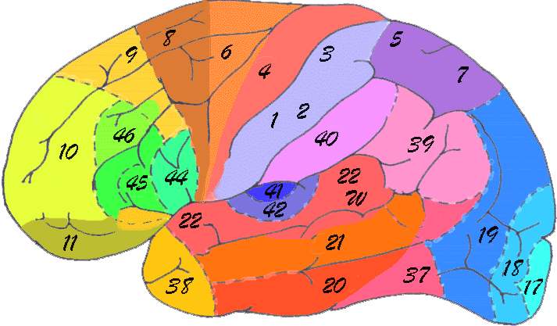
Brodmann’s Numbering System
https://nwww.euro.psyc.memphis.edu
Korbinian Brodmann (1868-1918) identified 52 different regions of the cerebral cortex based on their histological (cytoarchitectonic) differences.
Histology = the study of the microscopic structure of tissues.

Slide 96
Sensory Projection Areas
The primary visual projection area (17) is the most posterior portion of the occipital lobes.
The primary somatosensory projection areas (1, 2, and 3) are pos-terior to the central fissure.
The primary auditory projection area (42) are in the superior part of the temporal lobes.
The primary gustatory projection area (43) for taste is in the parietal lobes.
The primary olfactory projection area
(28) is along the medial aspect of the temporal lobes (and therefore is not visible in the cortical map to the right).
Page 497
Page 553
Page 519
Figure 14.15

Slide 97
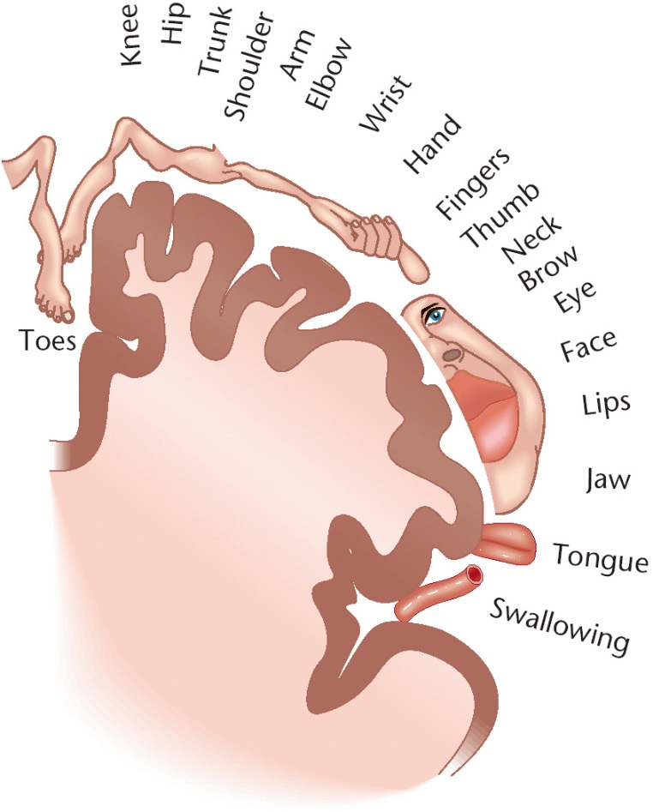
Homunculus—Somatosensory Map
Homunculus (today in the neurosciences) = a representation of the human body based on a neurological map of the areas and proportions of the human brain dedicated to processing motor or sensory functions for different parts of the body.
Homunculus (early times and into the 19th century) = a supposed microscopic but fully-formed human being in a sperm cell from which a fetus was believed to develop.
https://www.spinacare.files.wordpress.com

Slide 98
Association Areas
The association areas cover large expanses of the occipital, parietal, temporal, and frontal lobes.
They include the:
  Visual association areas (18 and 19)
  Somatosensory association areas (5 and 7)
  Facial recognition areas (20, 21, and 37)
  Auditory association area (22)
  Prefrontal and orbitofrontal areas (9, 10, 11, and 12)
Page 498
Page 553
Page 520
Figure 14.15

Slide 99
Association Areas (continued)
Other association areas of the cerebral cortex include:
  Wernicke’s auditory association areas (22, 39, and 40)
  Common integrative areas (5, 7, 39, and 40)
  Premotor area (6)
  Frontal eye field area (8)
Page 498
Page 553
Page 520
Figure 14.15

Slide 100
Primary Motor Area
The primary motor area (4) controls the voluntary contractions of the motor units in skeletal muscles (to be covered in the lecture modules on muscle physiology).
Electrical stimulation at a precise location in the primary motor area will produce contraction of a specific skeletal muscle on the opposite (contralateral) side of the body.
Page 498
Page 553
Page 520
Figure 14.15

Slide 101
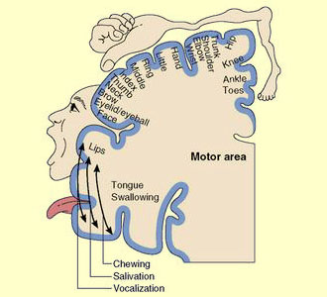
Homunculus—Motor Map
https://www.thebrain.mcgill.ca

Slide 102
Primary Motor Area (continued)
Just as for somatic representation in the somatosensory area, differ-ent skeletal muscles are represented unequally in the primary motor area.
Much of the primary motor cortex is devoted to skeletal muscles with small motor units that are involved in skilled, complex, and precise movements (such as our hands).
Motor unit = a single motor neuron and all the skeletal muscle fibers to which it connects.
Page 498
Page 553
Page 520
Figure 14.15

Slide 103
Broca’s Areas
Broca’s areas (44 and 45) are located in the frontal lobe, just superior to the lateral fissure.
These areas are involved in speech articulation.
For right-handed individuals, Broca’s area is almost always found in the left hemisphere.
For left-handed individuals, Broca’s area is located in either the right hemisphere or both hemispheres.
Articulation = the act of vocal expression.
Page 498
Page 553
Page 520
Figure 14.15

Slide 104
Broca’s Area (continued)
Broca’s area has fiber (axonal) connections with the motor areas that control the skeletal muscles of the pharynx (throat) and larynx (voice box).
People who have damage to Broca’s area can think clearly, but they are unable to articulate words, which is a motor function.
This medical condition is known as non-fluent aphasia.
Page 498
Page 553
Page 520
Figure 14.15

Slide 105
Non-Fluent Aphasia
In general, aphasia is an inability to use or comprehend words—it can occur from brain injury.
Non-fluent aphasia involving Broca’s area is the inability to properly form or articulate words.
People with non-fluent aphasia know what they want to say but they cannot articulate it properly.
Needless to say, it can be a very frustrating experience for the afflicted individuals.
However, they can still express themselves in words using a keyboard or sign language since these actions involve other areas of the cerebral cortex.
Page 499
Page 554
Page 520

Slide 106
Wernicke’s Areas
Damage to Wernicke’s areas (22, 39, and 40), which pertain to audi-tory association, results in fluent aphasia.
A person can speak but may produce strings of words that have no meaning (known as word salad).
The underlying deficit results from word deafness or word blindness.
Page 499
Page 554
Page 520

Slide 107
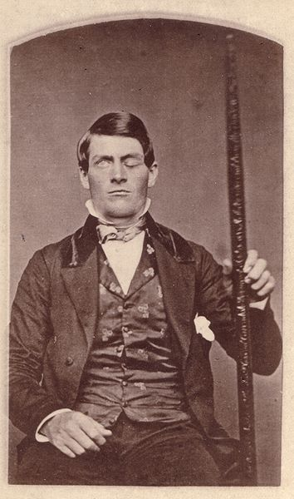
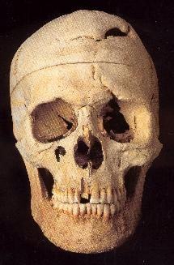
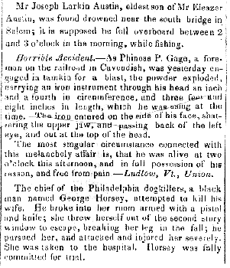
Phineas Gage
https://www.hanenwurger.org
Newspaper article, 1848 (soon after the accident)
https://www.deakin.edu.au
Warren Anatomical Museum, Harvard Medical School's Countway Library of Medicine, Boston, MA
https://www..wikimedia.org
Born 1823, died 1860
Discuss the life of Phineas Gage during the lecture session.

Slide 108
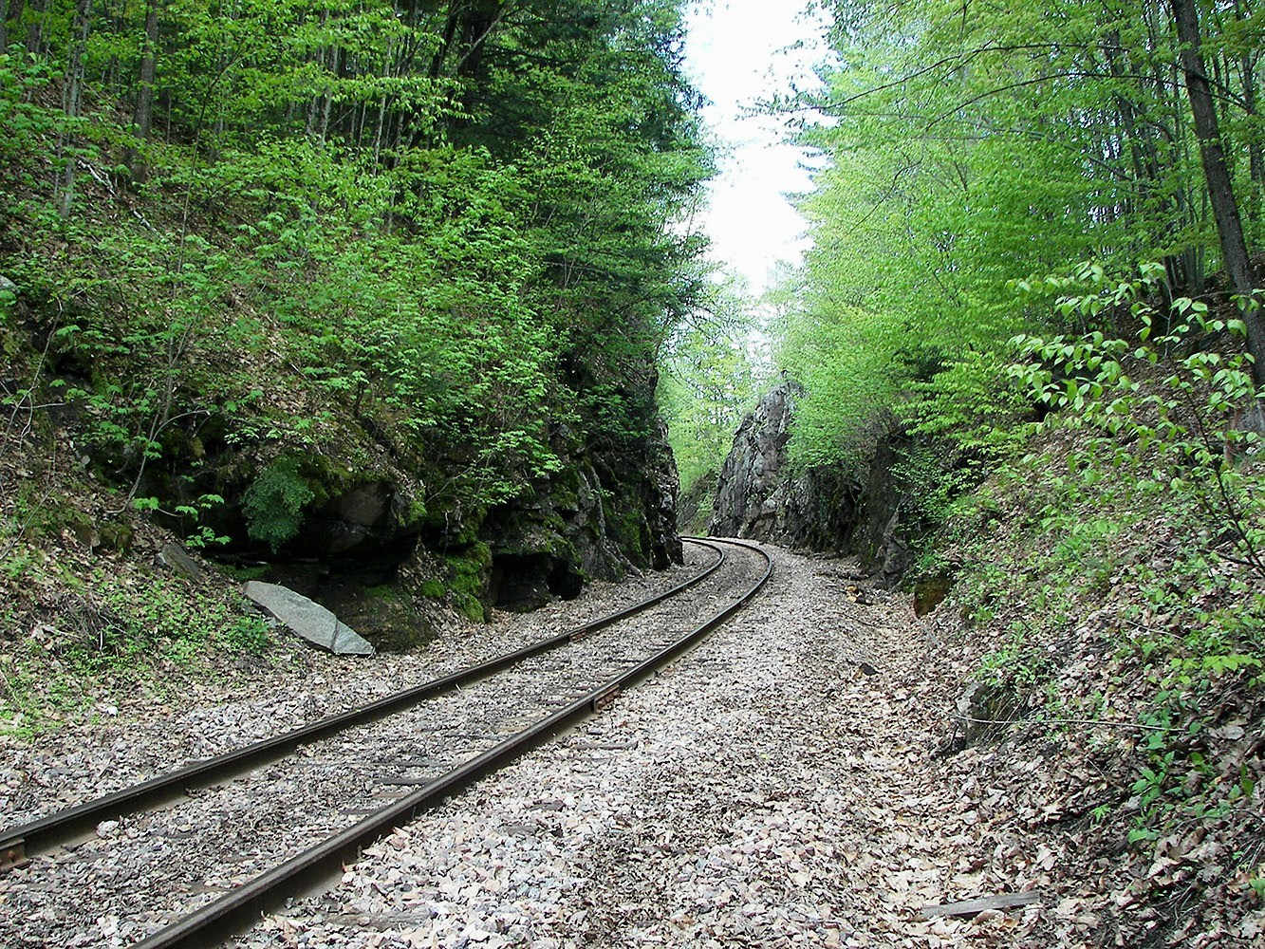
Phineas Gage (continued)
Burlington and Rutland Railroad
The presumed accident site, Cavenish, Vermont
https://www.wikimedia.org

Slide 109
Prefrontal Areas
Damage to the prefrontal areas (9, 10, and 11) of the front lobes can result in a wide variety of behavioral deficits.
Deficits can affect language, problem solving, spontaneity, memory, initiative, judgment, impulse control, and social and sexual behavior.
Prefrontal lobotomies, involving severing association fibers with the thalamus, were once done (in the mid-1900s) in attempts to alleviate certain psychiatric disturbances.
The surgical procedure, which is
rare now, was often performed with out informed consent and respect for patients and their families.
109
Notes:
109

Slide 110
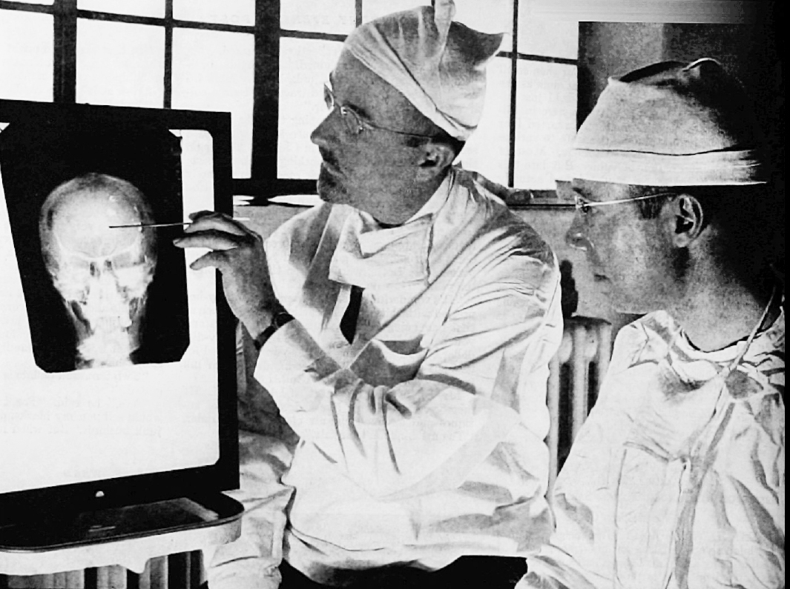
Walter Jackson Freeman II
American neurologist (born 1895, died 1972)
https://www.wikimedia.org
Discuss the life of Walter Freeman during the lecture session.

Slide 111
Hemispheric Specialization
Subtle anatomical differences are found between the two cerebral hemi-spheres.
For right-handers, Wernicke’s and other temporal lobe areas are about 50 percent larger in the left hemisphere than in the right hemisphere.
This asymmetry begins to appear in a human fetus about 30 weeks after conception.
An implication is that each hemisphere specializes in performing certain mental functions.
This asymmetry is the basis of what is known as hemispheric specializa-tion.
Page 499
Page 556
Page 521

Slide 112
Hemispheric Specialization (continued)
The left hemisphere in right-handed people is specialized for reasoning, numerical skills, spoken and written language, and sign language.
The right hemisphere is more specialized for spatial and pattern recog-nition tasks, and musical and artistic awareness.
The right hemisphere may also be involved in interpreting the emotional content of a stimulus including for sight, sound, touch, taste, or smell.
While reasons that are unknown, hemispheric specialization is usually not as obvious in left-handed people compared to right-handed people.
Page 499
Page 556
Page 521

Slide 113
Hemispheric Specialization (continued)
A considerable amount of variation in hemispheric specialization can be found among people.
Left-handed and right-handed people typically show the most obvious differences.
Hemispheric specialization appears to be less evident in females than in males.
Page 499
Page 556
Page 521

Slide 114
Electroencephalography
Millions of cortical neurons generate electrical activity at any instant in time.
Brain waves represent the sum total of electrical activity generated primarily in the gray matter of the cerebral cortex.
The waveforms can be detected by electrodes attached to the scalp which are electronically amplified and recorded as an electroenceph-alogram (EEG).
EEG can be used for studying normal brain functions and diagnosing brain disorders.
EEG traces can also used in determining if brain death has occurred.
Page 501
Page 556
Page 522
Figure 14.16

Slide 115
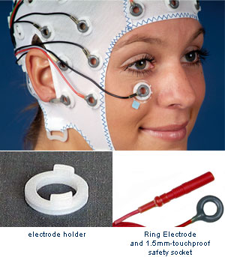
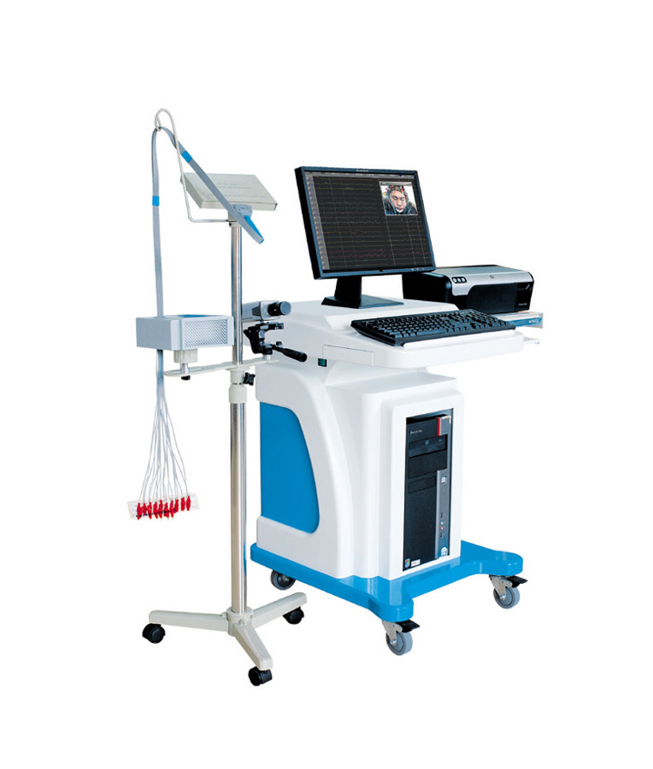
EEG Recording
https://www.brainproducts.com

Slide 116
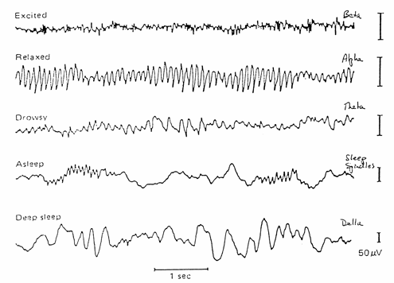
Major EEG Waveforms
https://www.neurodevelopmentcenter.com

Slide 117
Major EEG Waveforms (continued)
Beta waves—14 to 30 Hz, recorded during periods of sensory input and other mental activity.
Alpha waves—8 to 13 Hz, may be present during relaxation states and lack of sensory processing.
Delta waves—1 to 5 Hz, recorded during deep sleep in adults and in awake infants.
A high-frequency wave similar to a beta pattern is found during REM sleep (the sleep state when dreaming occurs).
Epileptic seizures are characterized by random and chaotic wave pat-terns.
Page 501
Page 556
Page 522
Figure 14.16

Slide 118
Stroke
A stroke results when the blood supply to part of the brain is reduced or interrupted.
Brain tissue is deprived of oxygen and nutrients and so neurons can begin to die within minutes.
Neurons are not replaceable since they do not divide by mitotic cell division.
Prompt treatment of this medical emergency is critical to help reduce brain damage and other complications.
Fewer people are dying of stroke than in the past due to education and more effective medical treatments.
118
Notes:
118

Slide 119
Ischemic Stroke
Ischemic stroke is the most common type.
The blood vessels become narrowed or blocked to reduce blood flow (known as ischemia).
Ischemia is caused by atherosclerosis by the build-up of plaque or by blood clots that can form during atrial fibrillation (along with other causes).
Risk factors for ischemic strokes include:
  High saturated fat / high cholesterol diet
  Physical inactivity
  Tobacco smoking or secondhand smoke exposure
  Heavy or binge drinking
  Use of cocaine and methamphetamine
  Family history of ischemic strokes
119

Slide 120
Hemorrhagic Stroke
Hemorrhagic strokes, which are less common than ischemic strokes, occur when blood vessels in the brain leak or rupture.
Risk factors related to this type of stroke include:
  Aneurysms—bulges at weak spots in arterial walls of the brain
  Uncontrolled high blood pressure (hypertension).
  Overtreatment with anticoagulants (blood thinners)
  Head trauma such as from an automobile accident
  Protein deposits that can cause weaknesses in arterial walls
120

Slide 121
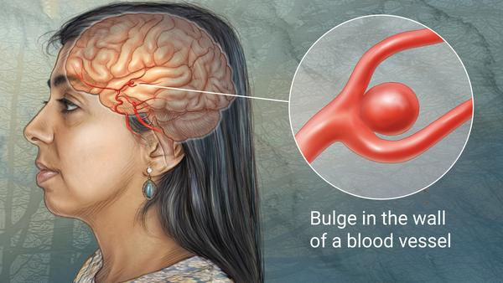
Intracranial Aneurysm
“Most intracranial aneurysms occur between the underside of the brain and the base of the skull. The aneurysm can leak or rupture, causing life-threatening bleeding. An unruptured aneurysm usually causes no symptoms. A key symptom of a ruptured aneurysm is a sudden, severe headache. Treatments for an unruptured aneurysm include medications to control blood pressure and procedures to prevent a future rupture. Emergency medical care is needed for a ruptured aneurysm.”
(Source: Mayo Clinic)
121

Slide 122
Signs and Symptoms
Trouble speaking and understanding what other people are saying.
Paralysis or numbness on one side of the body—contralateral side for spinal nerves and ipsilateral side for cranial nerves.
Trouble walking that may include loss of balance and coordination, and dizziness.
Problems seeing in one or both eyes such as blurred, blackened, or double vision.
A sudden and severe headache that may be accompanied by vomit-ing, dizziness, or altered consciousness.
The person may say that the headache is the most painful that he or she has ever experienced.
American Stroke Association
(https://www.stroke.org)
122
Notes:
122

Slide 123
BE-FAST
Seek medical attention if any of the signs or symptoms of a stroke are apparent even if they come and go or disappear completely.
Think BE-FAST and do the following:
  Balance: Does the person have a sudden loss of balance?
  Eyes: Does the person have a sudden loss in vision?
  Face: Ask the person to smile—does one side of the face droop?
  Arms: Ask the person to raise both arms—does one arm drift downward or is one arm unable to rise?
  Speech: Ask the person to repeat a simple phrase—is the speech slurred or strange?
  Time: If you observe any of these signs, call 911 immediately.
American Stroke Association
(https://www.stroke.org)
123
Notes:
123

Slide 124
Transient Ischemic Attack
A transient ischemic attack (TIA) is sometimes called a ministroke.
The temporary signs and symptoms are similar to those of a stroke.
TIAs are caused by a temporary decrease in blood supply to part of the brain.
Like an ischemic stroke, a TIA occurs when a blood clot or debris reduces or blocks the blood supply to a part of the brain, although it resolves on its own.
Having a TIA increases the risk of an ischemic stroke at a later date.
124

Slide 125
Cranial Nerves

Slide 126
Cranial Nerves
The cranial nerves (except for the optic nerve) are considered to be part of the peripheral nervous system, as are the 31 pairs of spinal nerves that exit the spinal cord.
The 12 pairs of cranial nerves of the brain pass through foramina in the bones of the cranium.
Each cranial nerve is labeled with a Roman numeral, I through XII, starting from the most anterior location.
The name of each cranial nerve designates either its function or dis-tribution.
Foramen (plural, foramina) = passage or opening.
Page 502
Page 557
Page 522

Slide 127
Cranial Nerves (continued)
Olfactory (I)
Optic (II)
Oculomotor (III)
Trochlear (IV)
Trigeminal (V)
Abducens (VI)
Facial (VII)
Vestibulocochlear (VIII)
Glossopharyngeal (IX)
Vagus (X)
Accessory (XI)
Hypoglossal (XII)
A revised mnemonic:
“On old Olympus’s towering top a Finn and German vend snowy hops”

Slide 128
Types of Cranial Nerves
Sensory—olfactory, optic, and vestibulocochlear.
Motor—oculomotor, trochlear, abducens, accessory, and hypoglossal.
Mixed (sensory and motor)—trigeminal, facial, glossopharyngeal, and vagus.
Page 502
Page 557
Page 523

Slide 129
Cranial Nerves (I, II, and III)
Olfactory (I)—conveys sensory information (smell) from the olfactory bulb.
Optic (II)—conveys sensory information (vision) from the retina.
Oculomotor (III)—controls some eye muscles and smooth muscles of the iris.
Page 503
Page 558
Page 523

Slide 130
Cranial Nerves (IV, V, and VI)
Trochlear (IV)—controls other eye muscles and conveys proprioceptive information from these muscles.
Trigeminal (V)—conveys sensory information (touch, pain, and thermal) from the face and adjacent areas and controls certain muscles include-ing for chewing.
Abducens (VI)—controls some eye muscles including for lateral rotation of the eyeball.
Proprioceptor = a receptor located in skeletal muscles, tendons, joints, or the internal ear that provides information about body position and movements.
Page 505
Page 560
Page 526

Slide 131
Cranial Nerves (VII and VIII)
Facial (VII)—conveys sensory information (taste) from the anterior two-thirds of the tongue and proprioceptive information from facial muscles and ear canal.
Cranial nerve VII also controls facial, scalp, and neck muscles and tear- and saliva-producing glands.
Vestibulocochlear (VIII)—the vestibular branch conveys information for balance and equilibrium and the cochlear branch carries information for hearing.
Page 507
Page 564
Page 527

Slide 132
Cranial Nerves (IX and X)
Glossopharyngeal (IX)—conveys sensory information (taste) from the posterior one-third of the tongue, proprioceptive information from the muscles for swallowing, and stretch and chemical receptor information from the carotid sinus and carotid artery.
Cranial nerve IX also controls portions of the pharynx (throat) and larynx (voice box).
Vagus (X)—has a wide distribution of functions in the thorax and abdo-men in serving as a major pathway for the autonomic nervous system (parasympathetic division).
Page 510
Page 566
Page 528

Slide 133
Cranial Nerves (XI and XII)
Accessory (XI)—controls muscles for head movement and provides proprioceptive information from these muscles.
Hypoglossal (XII)—controls muscles for speech and swallowing and provides proprioceptive information from the tongue.
Page 512
Page 568
Page 531

Slide 134
Aging

Slide 135
Early Years
The human brain develops and matures rapidly during the first few years of life.
Growth is primarily due to:
  Proliferation of neuroglia (glial cells)
  Myelination of axons
  Development of elaborate dendritic branching
  Formation of additional synapses among neurons
New neurons do not develop (with possibly very limited exceptions).
Page 517
Page 573
Page 539

Slide 136
Adulthood
The brain loses mass starting in early adulthood—by age 80, its mass has decreased by about seven percent.
The processing of information diminishes—action potential conduction velocities decrease, voluntary muscle movements slow down, and reflex times increase.
Page 517
Page 573
Page 539

