Slide 1
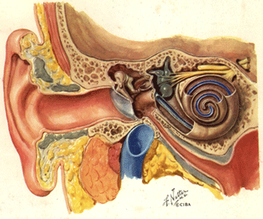
Auditory and Vestibular System
https://www.hearingcarecenter.com

Slide 2
Note
Much of the text material is from, “Principles of Anatomy and Physiology” by Gerald J. Tortora and Bryan Derrickson (2009, 2011, and 2014). I don’t claim authorship. Other sources are noted when they are used.
The lecture slides are mapped to the three editions of the textbook based on the color-coded key below.
14th edition
13th edition
12th edition
Same figure or table reference in all three editions

Slide 3
Outline
Introduction
Basic structure and functions
Nature of sound waves
Physiology of hearing
Physiology of equilibrium

Slide 4
Introduction

Slide 5
Overview
The ear contains sensory receptors sensitive to sound vibrations of extremely small amplitudes (as little as 0.2 nm).
These receptors can respond 1,000 times faster than photoreceptors respond to light.
The ear also has vestibular receptors to maintain the body’s equilibri-um and balance.
Vestibular = relating to the perception of body position and movement.
(https://www.merriam-webster.com)
Equilibrium = a state of bodily balance, maintained primarily by special receptors in the inner ear.
(https://www.thefreedictionary.com)
Page 595
Page 656
Page 620

Slide 6



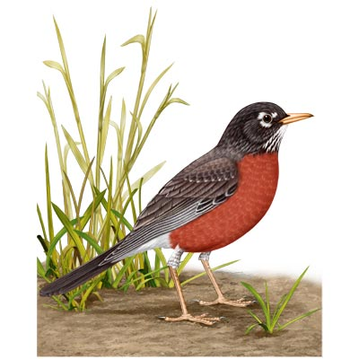
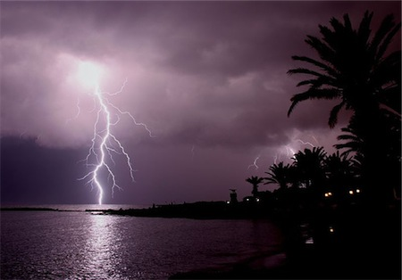
Sounds Surround Us
https://www.potential2success.com
https://www.panoramio.com
https://wwwavrackradio.webs.com
https://www.ascienceportal.com
https://www.whatbird.wbu.com

Slide 7
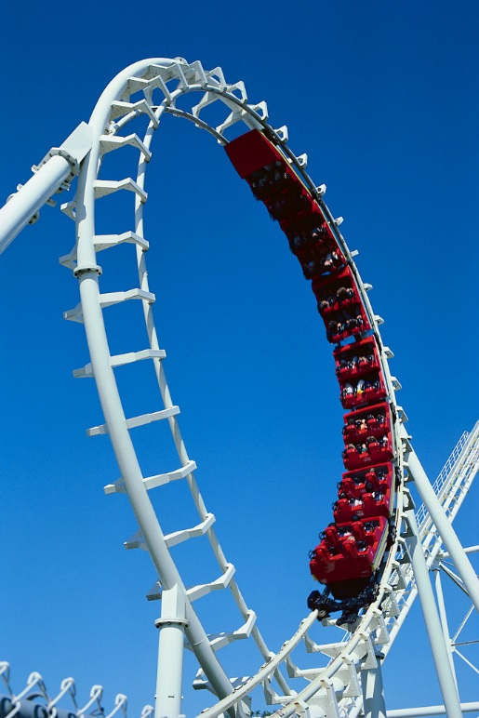

Vestibular Sensations Can Challenge Us
https://wwwsciencefair.math.iit.edu
https://www.phinn.funformentals.com

Slide 8
Basic Structure and Functions

Slide 9
Major Components of the Ear
The ear has three major components:
  The external or outer ear collects sound waves and channels them inward into the auditory canal.
  The middle ear conveys sound waves to a structure known as the oval window.
  The internal ear has sensory receptors for hearing, equilibrium, and balance.
Page 595
Page 658
Page 620
Figure 17.18

Slide 10
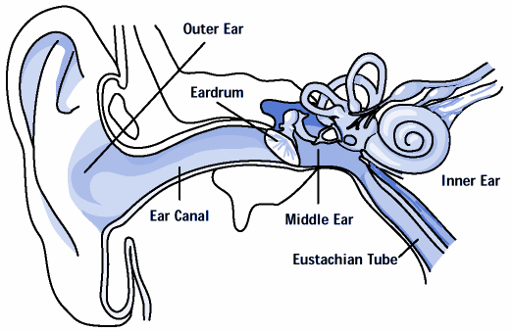
Cross-Section of the Ear
https://www.health.state.ny.us

Slide 11
External Ear
The external ear consists of the auricle, external auditory canal, and tympanic membrane or eardrum.
The auricle is a flap of elastic cartilage, shaped like the flared end of a trumpet and covered by skin.
The external auditory canal is a curved tube about 2.5 cm in length that lies in the temporal bone and leads to the tympanic membrane.
The tympanic membrane (eardrum) is a thin, semi-transparent partition located between the external auditory canal and middle ear.
Page 595
Page 658
Page 620
Figure 17.18

Slide 12
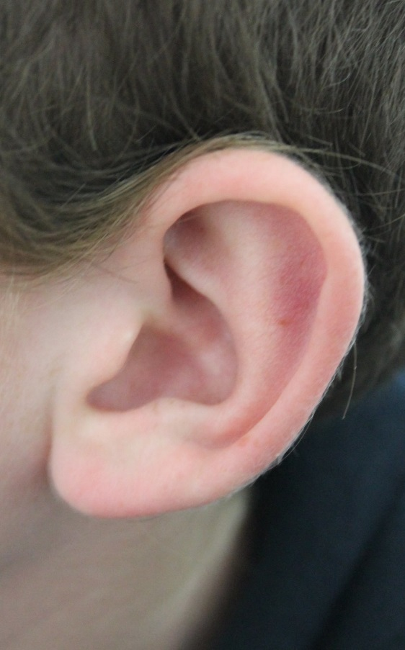
Auricle
https://www.wikimedia.org

Slide 13
Tympanic Membrane Damage
A tear in the tympanic membrane is known as a perforated eardrum.
The damage can result from a foreign object, trauma, or middle ear infection.
The old adage applies, “never put anything in your ear smaller than your elbow.”
Fortunately, a perforated eardrum will typically heal in about a month.
Page 595
Page 658
Page 620

Slide 14
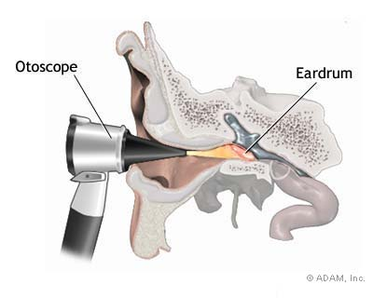
Otoscope
An otoscope—a viewing instrument for illumination and magnification— is used to observe the external auditory canal and tympanic membrane.
https://www.graphics8.nytimes.com
Page 595
Page 658
Page 620

Slide 15
Cerumen
Ceruminous glands are specialized sweat glands that secrete ceru-men (earwax).
The combination of cerumen and hair in the external auditory canal helps prevent dust and foreign objects from entering the ear.
Cerumen also helps prevent damage to the skin of the external audi-tory canal by water and insects.
Page 596
Page 658
Page 620

Slide 16
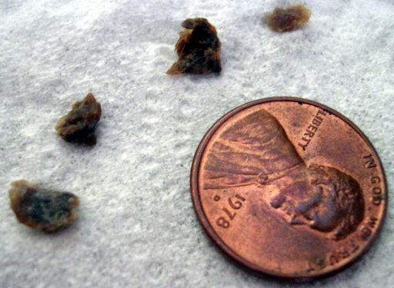
Cerumen (continued)
While cerumen usually dries-up and falls out, some people produce large amounts of earwax that become impacted and muffle sounds.
Treatment by medical personnel involves irrigation of the external auditory canal, or removal of the build-up with a blunt instrument.
Cerumen
https://www.ukweli.files.wordpress.com
Page 596
Page 658
Page 620

Slide 17
Middle Ear
The middle ear is a small, air-filled cavity lined by epithelial cells in the temporal bone.
It is separated from the external ear by the tympanic membrane and the inner ear by the oval window and round window.
Page 596
Page 659
Page 620
Figure 17.19

Slide 18
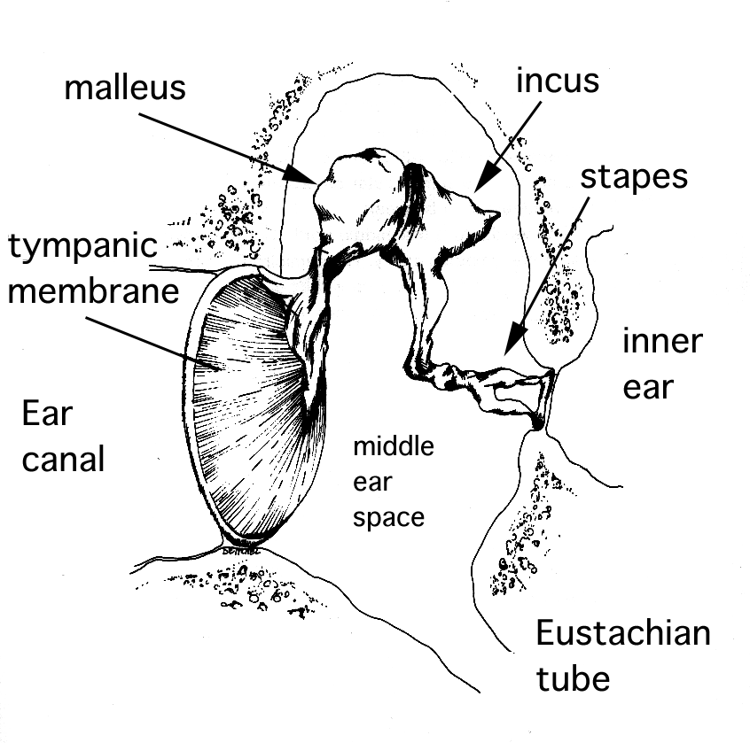
Middle Ear (continued)
https://www.phon.ox.ac.uk

Slide 19
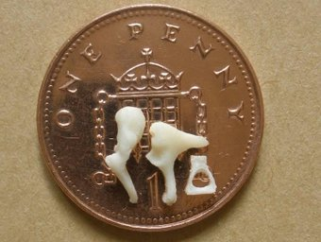
Auditory Ossicles
The three smallest bones in the body, called the auditory ossicles, are the major parts of the middle ear, and are attached by ligaments.
The bones, which have Latin names for their shapes, are the malleus, incus, and stapes.
The bones are also known as the hammer, anvil, and stirrup, respec-tively.
The stapes and its footplate
fit into the oval window of the inner ear.
Page 596
Page 659
Page 620
Figure 17.19

Slide 20
Tensor Tympani Muscles
Two very tiny skeletal muscles, the tensor tympani muscle and the stapedius muscle, are attached to the auditory ossicles.
The tensor tympani muscles, supplied by the trigeminal (V) cranial nerve, limit movement and increase tension on the tympanic mem-brane to help prevent damage to the inner ear from loud sounds.
Page 596
Page 659
Page 621
Figure 17.19

Slide 21
Stapedius Muscle
The stapedius muscle, supplied by the facial (VII) cranial nerve, dampens large vibrations of the stapes to protect the oval window.
Damping by the stapedius muscle protects the oval window and reduces hearing sensitivity for loud sounds.
Damping = the capacity built into a device to prevent excessive correction and the resulting instability or oscillatory conditions.
(https://www.answers.com)
Page 596
Page 659
Page 621
Figure 17.19

Slide 22
Muscle Responses
The tensor tympani and stapedius muscles require only a fraction of a second to contract.
The muscles help protect the inner ear from some loud noises, but not from very brief sounds such as gunshots.
Hearing protection in high-noise environments can help protect hear-ing.
Paralysis of the stapedius muscle can result in hyperacusis, which is abnormally-sensitive hearing.
Page 596
Page 659
Page 621

Slide 23
Auditory Tube
The middle ear has an opening that leads to the auditory tube (also called the eustachian tube).
The tube, composed of bone and cartilage, leads to the nasopharynx, the superior portion of the throat.
The auditory tube is normally closed at the pharyngeal (or throat) end.
It opens during swallowing and yawning, enabling air to enter or exit the middle ear until the pressure in the middle ear equals atmospheric pressure.
This process is called equilibration—it is usually most apparent when a person ascends or descends rapidly.
Page 597
Page 659
Page 621
Figure 17.19

Slide 24
Auditory Tube (continued)
When pressures are equalized, the tympanic membrane can vibrate freely as sound waves strike it.
Intense pain, hearing impairment, ringing sensations, and vertigo can develop if pressures in the middle ear and atmosphere are not equal-ized.
The auditory tube can serve as a pathway for pathogens from the nose and throat to the middle ear that cause ear infections.
Vertigo = aside from being the name of a classic 1958 Alfred Hitchcock film (with Jimmy Stewart and Kim Novak), vertigo is a feeling that you are dizzily turning around or that things are dizzily turning about you. Vertigo is usually due to a problem with the inner ear. Vertigo can also be caused by vision problems.
(https://www.medterms.com)
Page 597
Page 660
Page 621

Slide 25
Inner Ear
The internal or inner ear, also known as the labyrinth, has an outer bony structure that encloses an inner membranous labyrinth.
This bony structure—known as the bony labyrinth—has cavities in the temporal bone that are divided into three areas:
  Vestibule with receptors for static equilibrium
  Semicircular canals with receptors for dynamic equilibrium
  Cochlea with sensory receptors for hearing
Membranous = relating to or made of a membrane.
Page 597
Page 660
Page 622
Figure 17.20

Slide 26
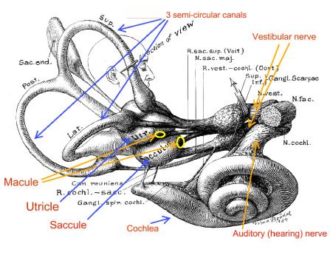
Inner Ear (continued)
https://www.rivercitymalone.com

Slide 27
Vestibule
The vestibule is the oval central portion of the bony labyrinth between the semicircular canals and the cochlea.
It contains two sacs, called the utricle and saccule, that form the mem-branous labyrinth.
Three semicircular canals project from the vestibule at approximate right angles to each other.
Page 597
Page 660
Page 622
Figure 17.20

Slide 28
Semicircular Canals
The three canals are called the anterior, posterior, and lateral semi-circular canals.
The first two canals have a vertical orientation, and the third canal has a horizontal orientation.
The enlargement at one end of each semicircular canal is known as the ampulla.
The membranous labyrinth in the semicircular canals is known as the semicircular ducts—they connect with the utricle.
Page 597
Page 660
Page 622
Figure 17.20

Slide 29
Vestibular Innervation
The vestibular branch of the vestibulocochlear (VIII) cranial nerve has first-order sensory neurons and motor neurons.
First-order sensory neurons transmit sensory information via action potentials from the vestibular receptors to the brain.
Motor neurons carry feedback signals via action potentials from the brain to the vestibular receptors to modify their sensitivity to linear and rotational acceleration.
Innervation = supply an organ or body part with nerves.
Page 598
Page 661
Page 622

Slide 30
Cochlea
The cochlea is a spiral canal anterior to the vestibule—the canal resembles a snail’s shell and makes almost three turns around its bony core.
The cochlea has three components—cochlear duct, scala vestibuli, and scala tympani.
Page 598
Page 661
Page 623
Figure 17.21

Slide 31
Cochlea (continued)
The vestibular membrane separates the cochlear duct and the scala vestibuli.
The basilar membrane separates the cochlear duct and the scala tym-pani.
The cochlear duct is filled with endolymph, and the scala vestibuli and scala tympani are filled with perilymph.
Endolymph = the fluid that fills the membranous labyrinth of the inner ear.
Perilymph = the fluid that surrounds the membranous labyrinth of the inner ear.
Page 598
Page 661
Page 623
Figure 17.21

Slide 32
Cochlea (continued)
The spiral organ, or organ of Corti, rests on the basilar membrane of the inner ear.
It has a coiled sheet of epithelial cells along with about 16,000 hair cells that serve as the receptors for hearing.
The inner hair cells are arranged in a single row, and the outer hair cells are arranged in three rows.
Page 598
Page 661
Page 623
Figure 17.21

Slide 33
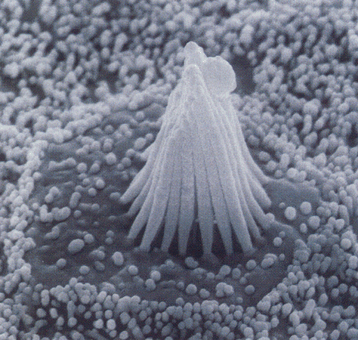
Stereocilia
About 40 to 80 stereocilia at the tip of each hair cell extend into the endolymph of the cochlear duct.
The tectorial membrane, a flexible gelatinous (gelatin-like) tissue, covers the hair cells of the spiral organ.
Electron micrograph of stereocilia in the cochlear duct of a frog
(http://www.unmc.edu)
Page 598
Page 661
Page 623

Slide 34
Cochlear Innervation
The inner and outer hair cells synapse with first-order sensory neurons and motor neurons in the cochlear branch of the vestibulocochlear (VIII) cranial nerve.
The outer hair cells outnumber the inner hair cells by a factor of three to one.
The inner hair cells synapse with 90 to 95 percent of the first-order sen-sory neurons that relay auditory information to the brain.
About 90 percent of the motor neurons synapse with the outer hair cells.
Page 598
Page 661
Page 623
Figure 17.21

Slide 35
Nature of Sound Waves

Slide 36
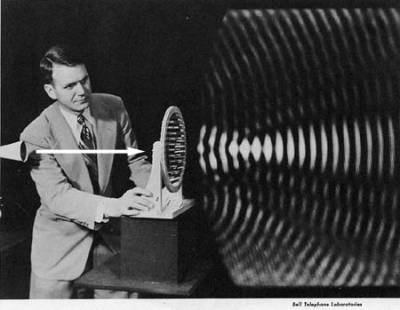
Sound Waves
Sound waves are alternating higher- and lower-pressure regions that travel through a medium such as air or water.
They travel from a vibrating object in much the same way that ripples travel over the smooth surface of a lake when a stone is tossed into it.
https://www.zgeek.com
Page 598
Page 661
Page 626

Slide 37
Sound Frequencies
The frequency of a sound wave is its pitch—the higher its frequency, the higher the pitch.
The entire audible range for young adults typically extends from 20 to 20,000 Hz.
Humans typically have their greatest auditory sensitivity between 50 and 5,000 Hz.
Speech sounds are usually in the range between 100 and 3,000 Hz.
The audible range diminishes as a person progresses into middle age and older.
Hertz (Hz) = number of complete cycles per second.
Page 598
Page 661
Page 626

Slide 38
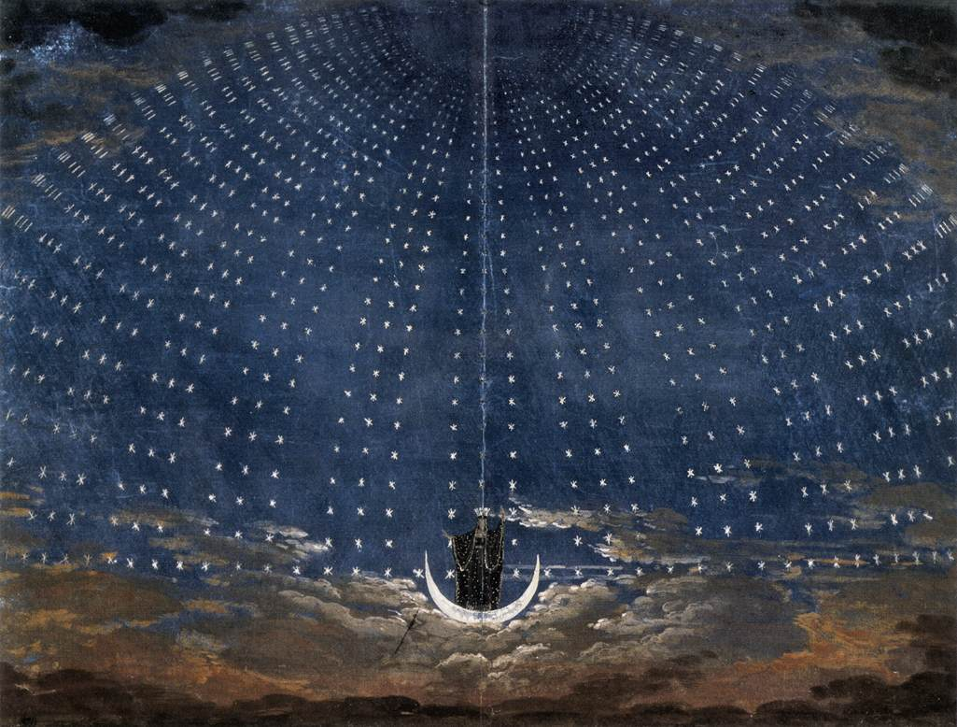
Some Reference Frequencies
Middle C4 = 261.6 Hz, and a high C6 sung by a soprano = 1046.5 Hz.
Tuning of modern musical instruments, A above middle C = 440Hz.
Queen of the Night Mozart’s The Magic Flute
(https://www.wga.hu)
Page 598
Page 661
Page 626

Slide 39
Sound Intensity
Intensity is the amplitude of a vibration—we perceive it as the loudness of a sound.
Sound intensity is measured in decibels (dB), which are measured on a base-10 logarithmic scale.
An increase of one dB represents a ten-fold increase in sound intensity.
Page 598
Page 661
Page 626

Slide 40
Decibel Comparisons (continued)
Some typical dB levels are:
  Gently rustling leaves, 15 dB
  Whispered speech, 30 dB
  Normal conversation, 60 dB
  Vacuum cleaner, 75 dB
  Shouting, 80 dB
  Nearby loud motorcycle, 90 dB
For healthy ears, sounds become uncomfortable at 120 dB, and painful above 140 dB.
Page 598
Page 661
Page 626

Slide 41
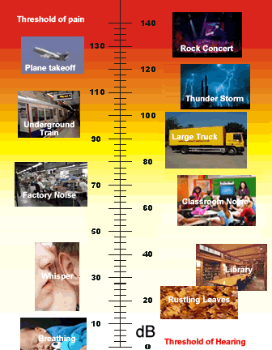
Decibel Comparisons (continued)
https://www.cyberphysics.co.uk

Slide 42
Physiology of Hearing

Slide 43
Sequence of Events
The auricle directs sound (pressure) waves into the external auditory canal.
The sound waves strike the tympanic membrane causing it to move back and forth—the eardrum vibrates slower for low frequency than for high frequency sounds.
The vibration is transmitted from the malleus (connected to the central area of the tympanic membrane), to the incus, and then to the stapes.
Page 601
Page 664
Page 626
Figure 17.22

Slide 44
Sequence of Events (continued)
As the stapes moves back and forth, it pushes the membrane of the oval window in and out—it vibrates more intensely than the tympanic membrane due to its smaller size.
Movement of the oval window creates pressure waves in the perilymph of the scala vestibuli in the cochlea.
The pressure waves are transmitted from the scala vestibuli to the scala tympani, and then to the round window.
Page 601
Page 664
Page 626
Figure 17.22

Slide 45
Sequence of Events (continued)
The pressure waves that deform the walls of the scala vestibuli and scala tympani push the vestibular membrane back and forth, which produces pressure waves in the endolymph inside the cochlear duct.
The pressure waves in the endolymph cause the basilar membrane to vibrate, moving the hair cells of the spiral organ against the basilar membrane.
The movements result in bending of the stereocilia, producing graded receptor potentials that lead to the generation of action potentials.
The action potentials propagate along the cochlear branch of the vesti-bulocochlear (VIII) cranial nerve to the brain, as will be covered in sub-sequent slides.
Page 601
Page 664
Page 626
Figure 17.22

Slide 46
Frequency Tuning
Sound waves of differing frequencies (pitch) cause different segments of the basilar membrane to vibrate more effectively than other segments.
Each segment of the basilar membrane is tuned for a specific frequency.
The basilar membrane is narrower and stiffer at the base of the cochlea, and therefore high-frequencies cause maximal vibrations in this region.
The basilar membrane is wider and more flexible toward the apex (tip) of the cochlea, and therefore low-frequencies cause maximal vibrations in this region.
Page 602
Page 664
Page 626

Slide 47
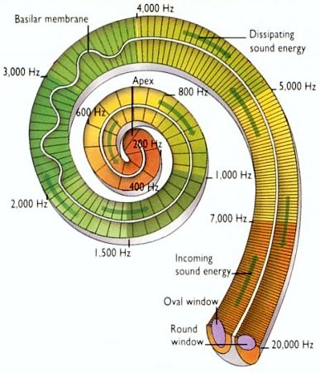
Cochlear Organization
Apex
Base
https://www.physics.uwo.ca

Slide 48
Sensitivity to Sound Intensities
The loudness we perceive is determined in large part by the intensity or amplitude of the sound waves.
High-intensity (loud) sounds result in larger vibrations in the basilar membrane, resulting in a higher frequency of action potentials in the cochlear branch of the vestibulocochlear nerve.
Loud sounds also stimulate a larger number of hair cells in the cochlea.
Page 602
Page 665
Page 626

Slide 49
Transduction
The hair cells in the basilar membrane transduce mechanical vibrations into electrical signals.
As the basilar membrane vibrates, the stereocilia at the apex of the hair cell bend back and forth, and slide against one another.
The bending of the stereocilia produces graded, receptor potentials via a tip link protein that connects the tip of each stereocilium with a mechani-cally-gated ion channel.
Depolarization results from the inflow of K⁺ from the endolymph, produc-ing an inflow of Ca²⁺ that triggers synaptic vesicles to release glutamate, a neurotransmitter.
Transduce = to convert energy from one form to another.
Page 602
Page 665
Page 626

Slide 50
Transduction (continued)
With greater Ca²⁺ inflow, the frequency of action potentials increases in the first-order sensory neurons that synapse with the base of the hair cell.
Bending of the stereocilia in the opposite direction generates hyper-polarizations, which decreases the frequency of the action potentials in the first-order sensory neurons.
Page 602
Page 665
Page 627

Slide 51
Otoacoustic Emissions
The cochlea can produce sounds on its own although they are usually inaudible.
These otoacoustic emissions are recorded by placing a special micro-phone next to the tympanic membrane.
The emissions are produced by the vibrations of the outer hair cells in response to signals from motor neurons that innervate the cochlea.
The motor activity enhances the movement of the basilar membrane, which serves to amplify the response of the inner hair cells to sound waves.
Page 602
Page 665
Page 627

Slide 52
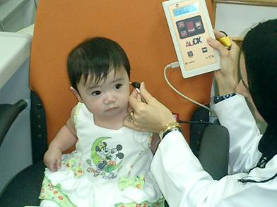
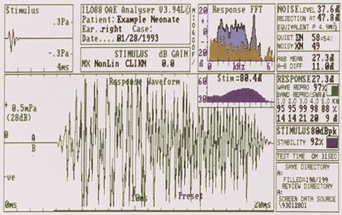
Otoacoustic Testing
The recording of otoacoustic emissions is used in screening newborn for hearing loss since the emissions are absent or diminished when a child is deaf.
https://www.jish.com
https://www.med.umich.edu
Page 602
Page 665
Page 627

Slide 53
Auditory Pathways
The action potentials resulting from the bending of the stereocilia propa-gate along the axons of sensory neurons.
The axons form the cochlear (hearing) branch of the vestibulocochlear (VIII) cranial nerve.
They synapse with neurons on the ipsilateral (same side) in the cochlear nucleus of the medulla oblongata.
Some of the axons from the cochlear nuclei terminate in the inferior colli-culus on the contralateral (opposite) side of the midbrain.
The inferior colliculi control auditory reflexes; for example, turning of the head toward the source of a loud, unexpected sound.
Page 602
Page 665
Page 627
Figure 17.23

Slide 54
Auditory Pathways (continued)
Other axons from the cochlear nuclei terminate in the superior olivary nucleus in the pons.
Slight differences in the timing of the action potentials arriving in the superior olivary nucleus from the two ears help the person to locate the source of the sound.
Axons from the superior olivary nuclei terminate in the inferior colliculi.
Page 602
Page 665
Page 628
Figure 17.23

Slide 55
Auditory Pathways (continued)
From the inferior colliculi, action potentials propagate to the medial geniculate body of the thalamus.
Action potentials then propagate to the primary auditory area in the temporal lobe of the cerebral cortex.
Some auditory axons cross-over in the medulla and others remain on the same side.
This incomplete decussation enables the primary auditory areas in the left and right cerebral hemispheres to receive auditory informa-tion from both ears.
Decussation = crossing over of nerve fibers (axons).
Page 602
Page 665
Page 628
Figure 17.23

Slide 56
Cortical Processing
Auditory processing occurs in the temporal lobes to give meaning to what we hear.
The auditory projection and association areas are located inferior to the lateral fissure.
The areas are closely associated with the language areas, as covered in the lecture module on the brain.

Slide 57
Physiology of Equilibrium

Slide 58
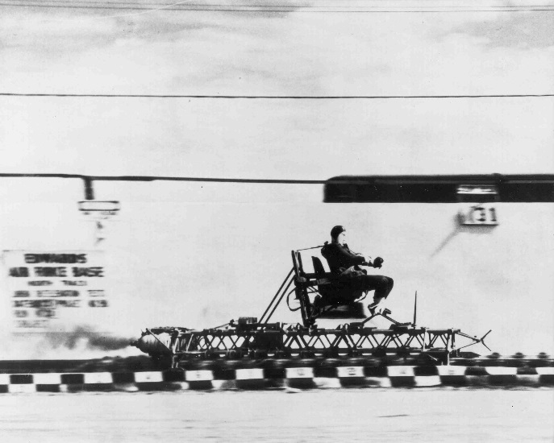
Equilibrium
Static equilibrium is the maintenance of position of the body and head relative to the force of gravity (G).
Motions that stimulate receptors for static equilibrium include titling the head, and linear acceleration or deceleration such as with the speeding up or slowing down of an automobile.
Rocket sled, Edwards Air Force Base, California
(http://wikivisual.com)
Page 602
Page 665
Page 628

Slide 59
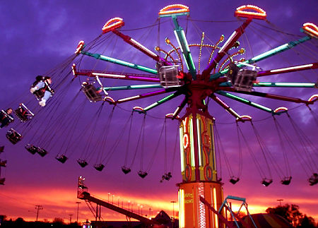
Equilibrium (continued)
Dynamic equilibrium involves maintaining the position of the body and head in response to rotational acceleration or deceleration, such as on some carnival rides.
https://www.boston.com
Page 602
Page 665
Page 629

Slide 60
Otolithic Organs
The otolithic organs are the saccule and utricle—each contains a small, thickened region known as a macula.
The maculae of the saccule and utricle are positioned perpendicular (90 degrees) to each other and serve as the receptors for static equilibrium.
The maculae:
  Provide sensory information on head position in three-dimensional space.
  Are essential for maintaining the body’s balance and posture.
  Detect linear acceleration and deceleration (such as on the rocket sled).
Maculae = plural of macula.
Page 603
Page 666
Page 629
Figure 17.24

Slide 61
Otolithic Organs (continued)
The maculae have hair cells (sensory receptors) and supporting cells.
Each hair cell has 40 to 80 stereocilia of graduated height, and a kino-cilium extending beyond the longest stereocilium.
Stereocilia are connected via tip links to mechanically-gated ion chan-nels, just like in the cochlea.
The stereocilia and kinocilium together form what is called a hair bundle.
Graduated = change gradually or by degrees.
Stereocilium = singular form of stereocilia.
Page 603
Page 666
Page 630
Figure 17.24

Slide 62
Otolithic Organs (continued)
Among the hair cells are columnar supporting cells that secrete a thick, gelatinous glycoprotein layer that forms the otolithic membrane.
The otolithic membrane rests on top of the hair bundles.
A layer of dense, calcium carbonate crystals, known as otoliths, covers the surface of the otolithic membrane.
Page 603
Page 666
Page 630
Figure 17.24

Slide 63
Otolithic Organs (continued)
When the head is tilted, the otolithic membrane and otoliths are pulled by gravity—they slide downhill in the direction of the tilt, which bends the hair bundles.
Bending of the hair bundles in one direction stretches the tip links to produce depolarizing (excitatory) receptor potentials.
Bending in the opposite direction produces hyperpolarizing (inhibitory) receptor potentials.
Page 603
Page 666
Page 630
Figure 17.24

Slide 64
Neural Pathway
As hair cells depolarize and repolarize, they release the neurotrans-mitter glutamate at a faster or slower rate.
The hair cells have synapses with first-order sensory neurons in the vestibular branch of the vestibulocochlear (VIII) cranial nerve.
First-order neurons generate action potentials at firing rates that are proportional to the amount of neurotransmitter released by the hair cells.
Motor neurons synapse with hair cells and first-order sensory neurons to regulate their sensitivity to vestibular stimuli.
Page 603
Page 666
Page 630

Slide 65
Semicircular Ducts
The three semicircular ducts—anterior, posterior and lateral—are at about right angles to one another in three planes.
This arrangement enables the detection of rotational acceleration and deceleration, which is known as dynamic equilibrium.
The dilated portion of each semicircular duct, called an ampulla, has a small elevation known as the crista.
Each crista has a group of hair cells and supporting cells covered by a gelatinous material known as cupula.
Page 605
Page 669
Page 630
Figure 17.20
Figure 17.25

Slide 66
Semicircular Ducts (continued)
When a person moves her or his head, the semicircular ducts and hair cells move with it.
Endolymph within the ampulla lags behind during movement of the head, and the hair bundles bend as they drag along the endolymph.
Page 605
Page 669
Page 631
Figure 17.20
Figure 17.25

Slide 67
Neural Pathway
The bending of the hair cells in the utricle, saccule, and semicircular ducts results in the release of the neurotransmitter glutamate.
Glutamate generates action potentials in first-order sensory neurons that synapse with the hair cells.
Action potentials propagate along the vestibular branch of the vestibu-locochlear (VIII) cranial nerve to the brain.
Page 606
Page 669
Page 631
Figure 17.26

Slide 68
Brain Involvement
Many axons synapse with the vestibular nuclei, which are the major integrating centers for equilibrium in the midbrain and pons.
Vestibular nuclei receive sensory input from the eyes and somatic receptors, and proprioceptors in the neck muscles for positioning of the head.
Other axons enter the cerebellum for control of balance— bidirect-ional fiber pathways connect the vestibular nuclei and cerebellum.
Proprioreceptors = sensory nerve receptors situated in the muscles, tendons, and joints that furnish information to the central nervous system concerning the movements and positions of the limbs, trunk, head, and neck.
(https://www.medical-dictionary.thefreedictionary.com)
Bidirectional = moving or operating in two opposite directions.
Page 606
Page 670
Page 631
Figure 17.26

Slide 69
Brain Involvement (continued)
Vestibular nuclei in the midbrain and pons integrate information from the vestibular, visual, and somatic systems, and relay signals to:
  Nuclei of the oculomotor (III), trochlear (IV), and abducens VI) cranial nerves to control the movements of the eyes and head.
  Nuclei of the accessory (XI) cranial nerve to control head and neck movements to assist in maintaining equilibrium.
  Vestibulospinal tracts to help maintain skeletal muscle tone for equilibrium.
  The ventral posterior nucleus in the thalamus, and then to the vestibular area in the parietal lobe of the cerebral cortex for conscious awareness of the position and movements of the head.
Page 606
Page 670
Page 631
Figure 17.26

Slide 70

https://www.artinthefog.files.wordpress.com

