Slide 1
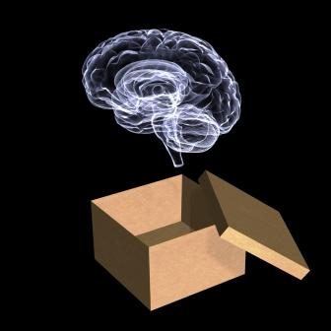
Accounts of Neurological Case Studies
https://www.psychologytoday.com

Slide 2
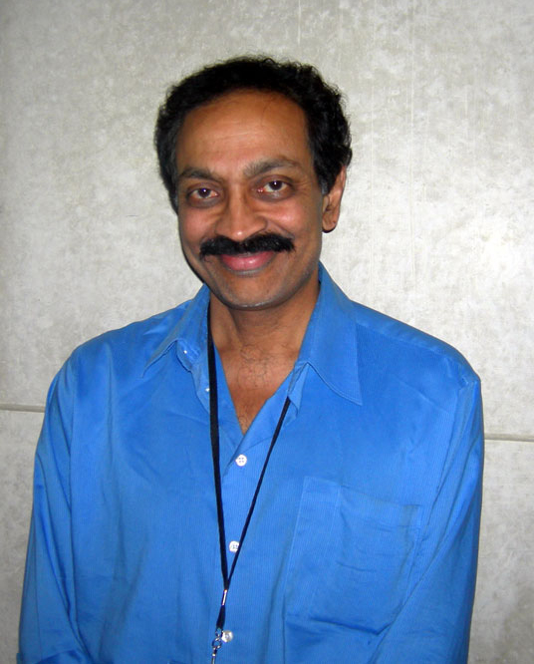
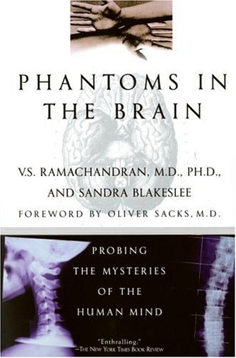
V.S. Ramachandran
https://www.networkedblogs.com/ blog/neurologycoffeecup
https://www.courses.cit.cornell.edu

Slide 3
Books by V.S. Ramachandran
Phantoms in the Brain (with Sandra Blakeslee),1998
The Emerging Mind, 2003
A Brief Tour of Human Consciousness, 2004
The Tell-Tale Brain, 2011

Slide 4
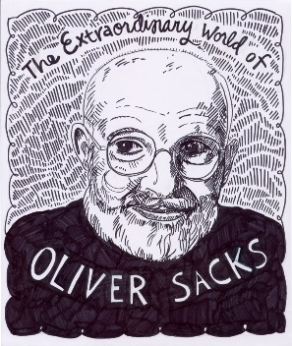
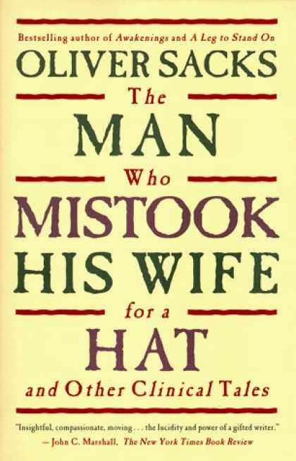

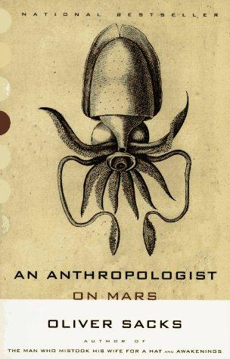
Oliver Sacks (1933-2015)
https://courses.cit.cornell.edu
https://www.oliversacks.com
https://www.womensbookshop.co.nz
Portrait from
https://www.ultimaspaginas.files.wordpress.com

Slide 5
Books by Oliver Sacks
Migraine, 1970
Awakenings, 1973
A Leg to Stand On, 1984
The Man Who Mistook His Wife for a Hat, 1985
Seeing Voices: A Journey into the World of the Deaf, 1990
An Anthropologist on Mars, 1995
The Island of the Colorblind, 1996
Musicophilia: Tales of Music and the Brain, 2007
The Mind’s Eye, 2010

Slide 6
Karinthy Frigyes (1887-1938)
A Journey Around My Skull, New York: New York Review Classics Books, 2008.
“The first patient’s-eye-view account of a brain operation in medical history…remarkable.”– Time Magazine
“Here is a book of surpassing interest and power…Written with utmost clarity and candor, Karinthy’s account of his illness and operation is a compelling, unique achievement which needs no artifice…the patient’s narrative holds the reader in a spell.” – Los Angeles Times

Slide 7

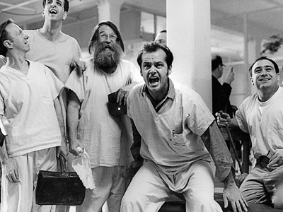
One Flew Over the Cuckoo’s Nest
A fictional work—the book and movie include compelling accounts of electroconvulsive shock treatment and prefrontal lobotomy.
https://www.52books.tumblr.com
https:// www.trappedintheattic.wordpress.com

