Slide 1

A Few Sensory Concepts

Slide 2
Note
Much of the text material is from, “Principles of Anatomy and Physiology” by Gerald J. Tortora and Bryan Derrickson (2009, 2011, and 2014). I don’t claim authorship. Other sources are noted when they are used.
The lecture slides are mapped to the three editions of the textbook based on the color-coded key below.
14th edition
13th edition
12th edition
Same figure or table reference in all three editions

Slide 3
Outline
Sensation and perception
Some basic principles
Types of sensory receptors

Slide 4
Sensation and Perception

Slide 5
Sensation
Sensation is a conscious or subconscious awareness of changes in the external or internal environment.
The nature of the sensation and the reaction it can elicit is based on the destination of the action potentials (sensory signals) in the CNS.
Sensory signals to the cortical auditory areas are experienced as sound, and sensory signals to the cortical visual areas are experi-enced as sight.
Page 547
Page 607
Page 570

Slide 6
Sensation (continued)
Sensory signals that reach the level of spinal cord can elicit spinal reflexes.
Sensory signals that reach the brainstem can elicit more complex reflexes including those involving the cardiovascular and respiratory systems.
Sensory signals that reach the cerebral cortex can result in conscious awareness including for vision, hearing, taste, smell, touch, and pain.
Page 547
Page 607
Page 570

Slide 7
Perception
Perception is the conscious or unconscious interpretation of sen-sations based on many factors including our past experiences and even our emotional states.
Sensory association areas and other areas of the cerebral cortex are involved in perception.
For example, about 30 areas of the cerebral cortex are involved in interpreting visual information.
Visual illusions have been used to illustrate how sensation and per-ception differ.
A course in biological or physiological psychology would cover sen-sation and perception in much more detail.
Page 547
Page 607
Page 570

Slide 8
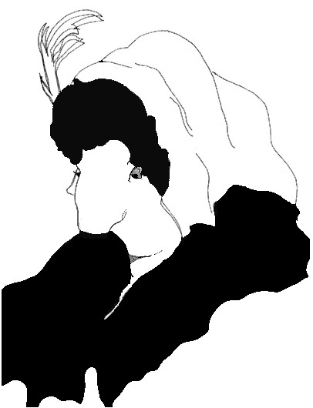

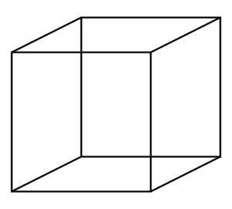
Visual Illusions
When sensation and perception collide—the visual stimuli are unchanging, but what do you see in each of the images?
https://www.owlminerva.files.wordpress.com
https://www.nature.com
https://www.wellsphere.com

Slide 9
Some Basic Principles

Slide 10
Sensory Modalities
Each type of sensation—such as vision, touch, and pain—has its own sensory modality.
A sensory neuron carries information for only one sensory modality, and no other.
For example, sensory neurons that relay action potentials for touch to the primary somatosensory area of the cerebral cortex do not transmit signals for pain.
Page 547
Page 607
Page 570

Slide 11
General Senses
The general senses consist of somatic, visceral, and proprioceptive sensations.
The somatic senses include the tactile sensations of touch, pressure, and vibration.
The somatic senses also include thermal (temperature) and pain sen-sations.
Page 547
Page 607
Page 570

Slide 12
General Senses (continued)
The visceral senses provide information about conditions within internal organs.
Proprioceptive sensations include the static positions and movements of the limbs and head.
Static = lacking movement, action, or change.
Visceral senses will be discussed when we cover other organ systems.
Page 547
Page 607
Page 570

Slide 13
Special Senses
The special senses consist of vision, hearing, equilibrium, smell, and taste.
Lecture modules are posted on the course website for the visual sys-tem, and the auditory and vestibular system for hearing and equilib-rium.
Smell = olfaction
Taste = gustation
Page 547
Page 607
Page 570

Slide 14
Transduction
A stimulus must occur in the sensory receptor’s receptive field for the receptor to be activated.
The sensory receptor transduces the energy in the stimulus, such as a mechanical vibration, into a graded potential.
Stimulus = an external or internal event that evokes a specific reaction in an organ or tissue.
Receptive field = a region of space in which the presence of a stimulus will alter the firing of the sensory receptor or neuron.
Transduce = convert a physical quantity into another physical quantity such as mechanical vibration to an electrical signal.
Page 547
Page 607
Page 570

Slide 15
Transduction (continued)
The amplitude of the graded potential depends on the intensity of the stimulus.
Graded potentials that reach the threshold value for the sensory neuron trigger action potentials that propagate (travel) via afferent fibers to the CNS.
The CNS processes and integrates the sensory action potentials to pro-duce a sensation.
Page 547
Page 607
Page 570

Slide 16
Types of Sensory Receptors
Sensory receptors are classified at the microscopic level as one of three basic types:
  Free nerve endings of first-order neurons
  Encapsulated nerve endings of first-order neurons
  Separate receptors that synapse with first-order neurons
First-order neuron = a sensory neuron that directly conducts action potentials from the peripheral nervous system into the CNS.
Page 547
Page 607
Page 570
Figure 16.1

Slide 17
Receptor Features
Free nerve endings are bare dendrites that mediate pain, thermal, tickle, itch, and some touch sensations.
Encapsulated nerve endings are dendrites enclosed in a capsule of connective tissue that enhances the sensitivity of the sensory recep-tors.
These receptors mediate pressure, vibration, and some touch sen-sations.
Free nerve endings and encapsulated nerve endings are first-order neurons that generate action potentials for propagation into the CNS.
Page 547
Page 608
Page 570
Figure 16.1

Slide 18
Receptor Features (continued)
The receptors for the special senses are separate cells that synapse with first-order neurons that generate action potentials.
They include photoreceptors (rods and cones) in the retina of the eye, hair cells for hearing and equilibrium in the inner ear, and receptors in the taste buds of the tongue.
Page 548
Page 608
Page 571

Slide 19
Generator Potentials
Sensory receptors produce one of two different kinds of graded poten-tials, either generator potentials or receptor potentials, in response to stimuli.
Generator potentials are produced by dendrites of free nerve endings, encapsulated nerve endings, and olfactory receptors (that is, first-order neurons).
A generator potential that reaches the activation threshold of the first- order neuron triggers an action potential that propagates along its axon into the CNS.
Page 548
Page 608
Page 571

Slide 20
Receptor Potentials
Sensory receptors are separate cells that produce receptor potentials that trigger the release of a neurotransmitter at their synapses with first-order neurons.
Receptor potentials are a type of graded potential, as discussed when we covered the electrical activity of neurons.
The neurotransmitter diffuses across the synaptic cleft to produce post-synaptic potentials in the first-order neuron.
Action potentials generated by the first-order neuron propagate along its axon into the CNS.
Page 547
Page 608
Page 571

Slide 21
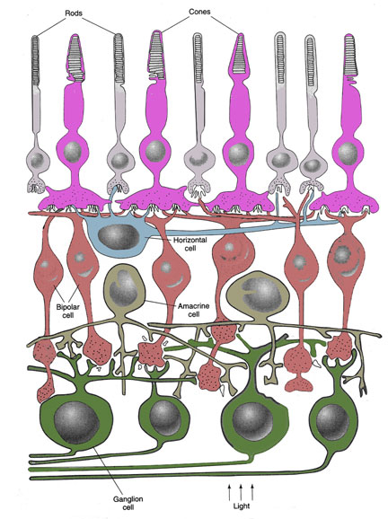
Cross Section of the Retina
Retina of the eye
Photoreceptors
(rods and cones)
Horizontal cell
Outer synaptic layer
Amacrine cells
Bipolar cells
Inner synaptic layer
Ganglion cells
https://www.skidmore.edu
Direction of light

Slide 22
Frequency Coding
The amplitude (voltage) of generator and receptor potentials varies with the intensity of the stimulus.
If the cell’s threshold value is reached, action potentials will be gen-erated based on the all or none principle.
The frequency of the action potentials will vary with the amplitude of the generator or receptor potential based on the the principles of fre-quency coding was as discussed in the lecture module on the elect-rical activity of neurons.
Page 549
Page 609
Page 572

Slide 23
Types of Sensory Receptors

Slide 24
Sensory Receptor Types
Exteroreceptors
Interoreceptors
Proprioreceptors
Page 549
Page 609
Page 572

Slide 25
Exteroreceptors
Exteroreceptors are located at or near the external surfaces of the body.
They respond to external stimuli to provide information about the external environment.
Sensory modalities that have exteroreceptors include vision, hearing, smell, taste, touch, pressure, vibration, temperature, and some types of pain.
Page 549
Page 609
Page 572

Slide 26
Interoreceptors
Interoreceptors are located in the blood vessels, visceral (body) organs, muscle tissue, and the hypothalamus.
They monitor conditions in the body’s internal environment in response to internal stimuli.
The activity does not reach the level of conscious awareness; however, strong stimuli may be experienced as pressure or pain.
For example, the passage of a kidney stone through a ureter, especially if it becomes lodged in its lumen, can result in intense, debilitating pain.
Ureters = the bilateral ducts through which urine passes from each kidney to the bladder. Interoreceptors are embedded in the smooth muscle wall of the ureter.
Page 549
Page 609
Page 572

Slide 27
Proprioreceptors
Proprioreceptors are located in the skeletal muscles, tendons, joints, and inner ear.
They provide information about muscle length and tension, and the position and movement of the synovial joints and the entire body.
Page 549
Page 609
Page 572

Slide 28
Another Classification System
Sensory receptors can also be classified according to their functions.
Mechanoreceptors respond to mechanical stimuli from touch, pressure, vibration, hearing, equilibrium, and stretching of the blood vessels and internal organs.
Thermoreceptors detect temperature changes in the external environ-ment.
Nocireceptors respond to painful stimuli resulting from tissue irritation or damage.
Noci- = noxious
Page 549
Page 609
Page 572

Slide 29
Another Classification System (continued)
Photoreceptors respond to particles of light (photons) that reach the retina.
Chemoreceptors detect chemicals involved in taste and smell, and chemicals in body fluids including the blood and cerebrospinal fluid.
Osmoreceptors detect the osmotic pressure of body fluids, especially the blood.
Osmotic pressure = pressure generated by water moving by osmosis into or out of a cell.
Page 549
Page 609
Page 572

Slide 30
Sensory Adaptation
Some sensory receptors show adaptation, where the generator or receptor potential decreases in amplitude when the stimulus is con-stant and persistent (long lasting).
The sensation may fade or disappear if a constant stimulus persists for a period of time.
For example, stepping into a very hot shower could at first be very uncomfortable, but feel comfortable after a minute or two—thermo-receptors in the skin have undergone rapid adaptation.
Page 549
Page 609
Page 572

Slide 31
Sensory Adaptation (continued)
Rapidly-adapting sensory receptors include those for pressure, touch, and smell.
Slowly-adapting receptors involve pain, body position, and the chemical composition of blood.
Page 549
Page 610
Page 572

Slide 32
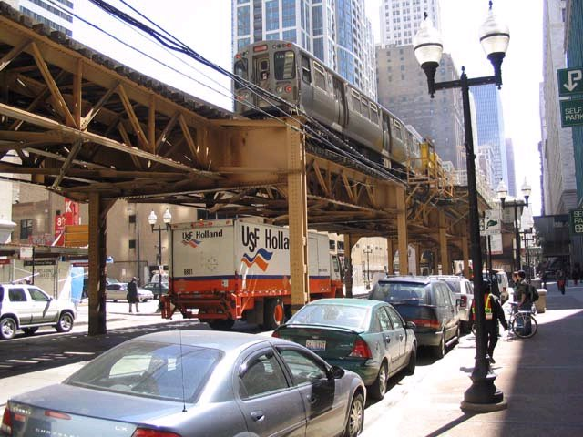
Cortical Adaptation
https://www.pics4.city-data.com
Sensory adaptation also occurs in the cerebral cortex, which is known as cortical adaptation. Gating mech-anisms can filter out periodic sounds such as the loud rumbling of the elevated train.

